Slide 1
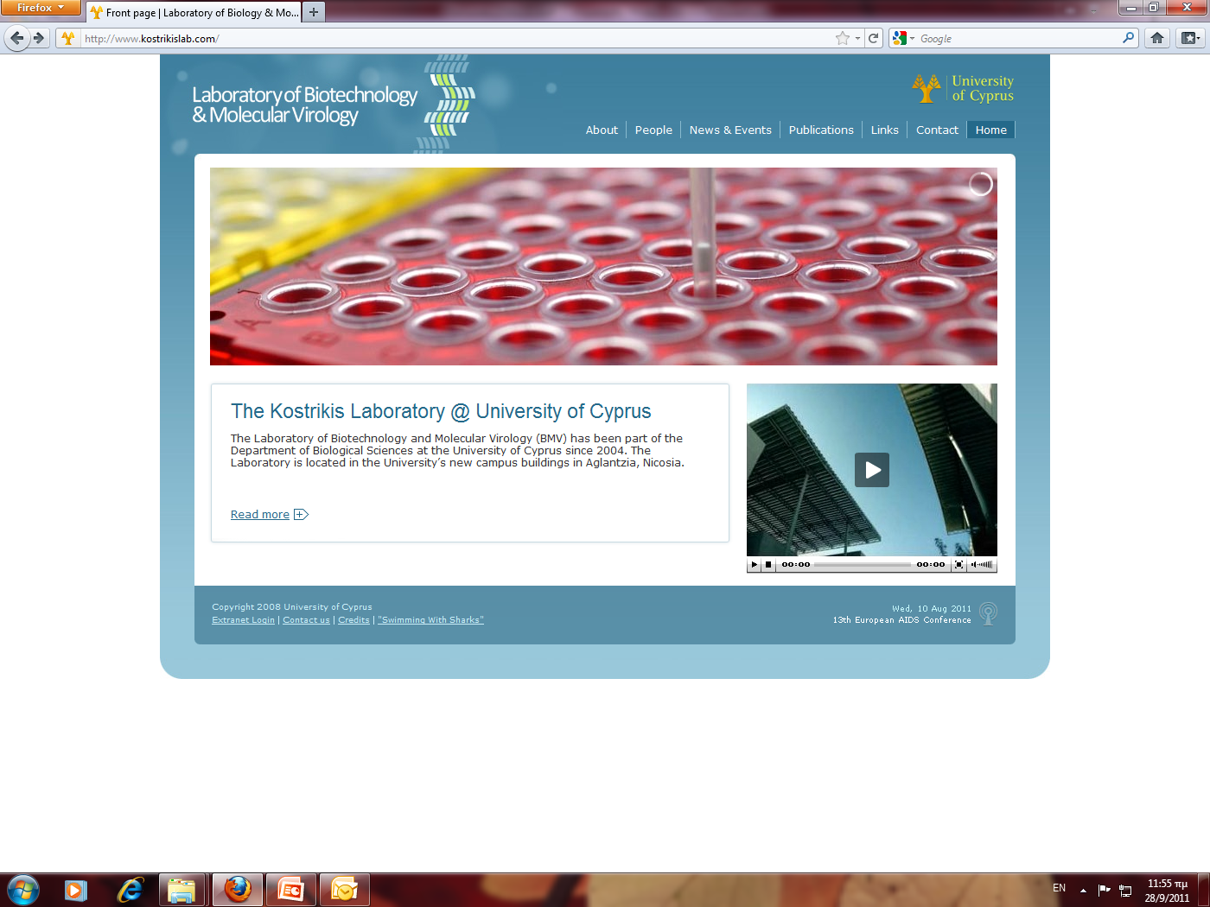
Novel Vaccines Utilizing Antigen-Displayed Inoviral Vectors
7th Middle East – Global Summit
Vaccines & Vaccination
September 28, 2015
Prof. Leondios G. Kostrikis
University of Cyprus
Department of Biological Sciences
Notes:
First, I would like to thank everybody for coming in today’s lecture especially the members of the committee who had to fly from abroad.
For the last fifteen years or so, our research has concentrated almost exclusively on the study of HIV-1.
Our laboratory uses a variety of experimental approaches to understand the molecular mechanisms of HIV-1 transmission and the pathogenesis of AIDS.
Today, I am going to be talking about the role of host and viral factors in the biology of HIV-1

Slide 2
AIDS
AIDS ranks as one of the most important infectious diseases facing humankind in the 21st century
Since its initial clinical description two decades ago, AIDS has resulted in the deaths of 16 million people
HIV-1, the most common cause of AIDS, has infected more than 50 million individuals, and the rate of infections is estimated at nearly 6 million per year

Slide 3
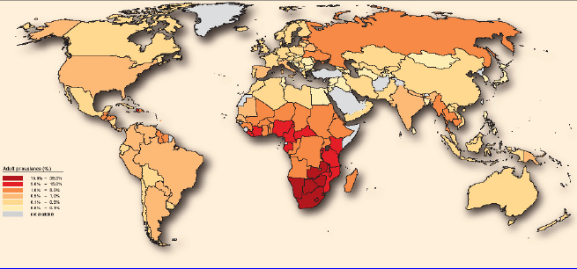
A Global View of the AIDS Pandemic
Adult Prevalence
15.0% - 39.0%
5.0% - 15.0%
1.0% - 5.0%
0.5% - 1.0%
0.1% - 0.5%
0.0% 0.1%
Not Available
Although sub-Sahara Africa remains the global epicenter, rates of infection have increased in recent times in the former Soviet Union and parts of south Asia (India and China), where literally hundreds of millions of individuals are at risk

Slide 4
Basic Biology and Natural History of HIV-1
Role of Human Genetics in HIV-1 transmission
Classical Novel Vaccination Strategies

Slide 5
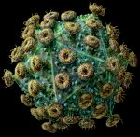
HIV-1 Architecture

Slide 6
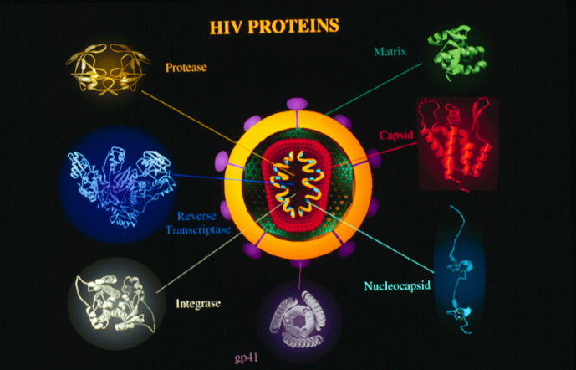

Slide 7
Allelic Variants in Chemokine and Chemokine Receptors
CD4
CCR5
HIV
CD antigen has been known to be principal cell surface receptor for HIV-1
since 1983.
In 1996, a member of the seven-transmembrane spanning family of chemokine
receptors termed CCR5 was identified by five groups (E. Burger, J. Sodroski,
N. Landau, R. Doms and R. Koup & J. Moore) as major co-receptor for most
transmitting HIV-1 strains.
Notes:
In HIV-1 entry into susceptible cells,
HIV is recognized by two major receptors. “CD antigen has been known to be the principal cell surface receptor of HIV-1 since 1983”.
“In 1996, a member of the seven-transmembrane spanning family of chemokine receptors termed CCR5 was identified by five groups (E. Burger, J. Sodroski, R. Doms and R. Koup and J. Moore)
as a major co-receptor for most transmitting HIV-1 strains”

Slide 8
Genesis of Natural Genetic Diversity of HIV-1
Reverse
transcription
ss HIV-1 RNA
ds HIV-1 DNA
RT enzyme
One mutation per HIV genome per life cycle
Recombination events
Evolutionary advantages of HIV virus
Notes:
The genesis of the natural genetic diversity of HIV-1 is due to ….

Slide 9

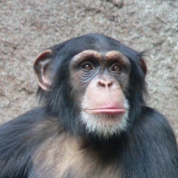
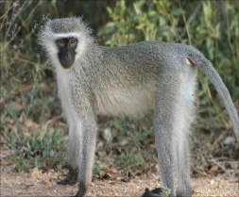

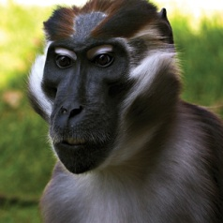
Global Genetic Variability of SIV and HIV
SIVcpz.Ant
SIVcpz.Cam
SIVcpz.US
SIV
HIV-1 N
P. t. troglodytes
African Green
Monkey
HIV-1
SIVmac/SIVsm
HIV-1/2
HIV-1 O
Humans
HIV-1 M
HIV-2
Sooty mangabey
0.1
Notes:
The HIV-1 pandemic today is mainly due to the M group ….

Slide 10
A human HIV-1 vaccine remains a central component in the quest to control the worldwide epidemic.
Despite heroic efforts, the development of a safe and effective preventative HIV-1 vaccine remains elusive.
There is no pharmacologic strategy in sight that can eradicate persistent HIV-1 to bring the goal of an AIDS-free generation within our reach.
The design of immunogens able to elicit broadly neutralizing antibodies (bNAbs) is the holy grail of HIV-1 research.
Our lab is working on a novel vaccine strategy using inoviral-associated vectors (IAV) to create stable “live” HIV-1 vaccines which are sufficiently long-lived to elicit bNAbs at mucosal sites of HIV-1 transmission.
Is an HIV-1 Vaccine Achievable?
Notes:
We move now to the third vignette which deals with the natural genetic diversity of HIV-1

Slide 11
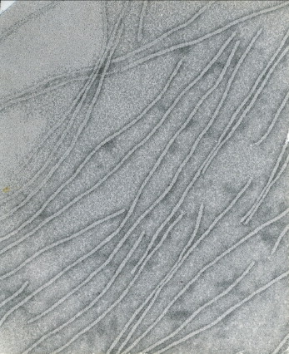
Morphology of Ff Virion Ends
A uranyl acetate negative stain electron micrograph of fd showing one complete virion and the ends of others. One end is more rounded or blunt, and the other is tapered with additional tassel-like mass sometimes perceptible extending from the tip.
(Day, L. A. 2008. Inoviruses, p. 117-124. In B. W. J. Mahy and M. H. V. V. Regenmortel (ed.), Encyclopedia of Virology (Third Edition). Academic Press, Oxford.)

Slide 12
Virion Compositions
Parameter |  | Ff |  | Xf | Pf1 | Pf3
Total Nucleotides |  | 6,408 |  | 7,420 ± 240 | 7,390 ± 180 7,352 ± 100 | 5,833
Nucleotides / subunits (n/s)
 | Total nucleotides / total subunits |  | 2.30 ± 0.11 | 2.12 ± 0.15 | - | 2.38 ± 0.14
 | STEM |  | 2.37 ± 0.05 | 2.16 ± 0.09 | 1.06 ± 0.04 | 2.57 ± 0.08
 | N/P mole ratio |  | 2.32 ± 0.05 | - | 0.97 ± 0.06 | -
 | Theoretical values |  | 2.40 | 2.00, 2.17 | 1.00, 1.07 | 2.40
Total gp8 subunits |  |  | 2,750 ± 100 | 3,500 ± 220 | 7,370 ± 150 | 2,500 ± 160
DNA % base compositions (A/T/G/C) |  |  | 25 / 34 / 21 / 20 | 21 / 19 / 33 / 28 | 19 / 20 / 33 / 28 | 20 / 35 / 24 / 21
Adapted from Day, L. A. , et al., Ann rev. Biophys. Chem. 1988. 17: 509-39

Slide 13
Architectural Characteristics from Physical Data
Parameter |  | Ff | Xf | Pf1 | Pf3
Length (Å)
 | Electron microscopy (TEM) | 8,800 ± 300 | 9,770 ± 350 | 19,150 ± 770 | 6,830 ± 300
 | STEM | 8,860 ± 190 | 10,500 ± 420 | 20,800 ± 230 | 6,860 ± 140
 | Hydrodynamics (D_{T} ,D_{R}) | 8,950 ± 200 | 9,900 ± 300 | 20,000 | 7,200 ± 250
Diameter (Å)
 | Hydrodynamics (D_{T} ,D_{R}) | 90.0 | 72.0 | - | 65.0, 84.0
 | Neutron scattering | 66.0 | - | 64.0 | -
 | STEM | ̴ 68.0 | ̴ 68.0 | ̴ 68.0 | ̴ 66.0
 | X-ray fiber diffraction | 55.0-65.0 (83.0) | 57.0-62.0 | 53.0-63.0 | 56.0-62.0
 | DNA region (STEM) | 20.0-24.0 | 20.0-24.0 | 16.0 | 20.0-24.0
Total mass (10⁶ daltons)
 | Hydrodynamics | 16.4 ± 0.6 | 17.9 ± 1.0 | - | 13.4 ± 0.8
 | STEM | 16.1 ± 0.3 | 17.6 ± 0.3 | 34.3 ± 0.8 | 12.3 ± 0.3
Mass per length (daltons Å)
 | Turbidity | 19,100 ± 600 | 19,100 ± 600 | - | 19,600 ± 900
 | Hydrodynamics | 18,300 ± 800 | 18,300 ± 1,200 | - | 18,600 ± 1,300
 | STEM | 18,200 ± 300 | 16,800 ± 200 | 16,500 ± 300 | 18,000 ± 400
 | Neutron scattering | 18,400 ± 1,400 | - | 15,700 ± 1,300 | -
X-ray fiber diffraction layer spacing (Å)
 | Repeat distance | 32.00 - 32.40 | 77.0 | 75.0 – 77.0 | 75.0 – 80.0
Subunits per X-ray repeat
 | Turbidity | 10.5 | 28.5 | - | 29.2
 | Hydrodynamics | 10.0 | 27.6 | - | 27.7
 | Neutron scattering | 10.0 | - | 24.5 | -
 | STEM | 10.0 | 25.3 | 25.8 | 26.8
 | Total subunits & TEM length | 10.1 | 27.6 | 29.3 | 29.3
Adapted from Day, L. A. , et al., Ann rev. Biophys. Chem. 1988. 17: 509-39

Slide 14
Structural Parameters for the Protein Coats
Parameter |  | Ff | Xf | Pf1 | Pf3
Symmetry of subunit helix
 | Rise per subunit (Å) | 16.0 - 16.2 | 2.85 | 2.78-3.05 | 2.78-2.96
 | Rotation per subunit | ̴ 30.0° | ̴ 66.7° | ̴ 65.9 - 66.7° | ̴ 66.7°
 | Pitch of subunit helix (Å) | 16.0 - 16.2 | 15.4 | 15.0 - 16.6 | 15.0-15.8
 | Symmetry designation | C₅S_{2.0} | C₁S_{5.4} | C₁S_{5.4} – C₁S_{5.46} | C₁S_{5.4}
 | Symmetry designation | (2 / 10; 3 / 15) | (2 / 11; 3 / 17) | (2 / 11; 3 / 17) | (2 / 11; 3 / 17)
Subunit a-helix content and orientation
 | CD amplitudes
 | [θ]₂₀₈ (cm² deg dmol⁻¹) | -18,000 | -35,000 | -31,000
 | [θ]₂₂₂ (cm² deg dmol⁻¹) | -15,000 | -32,000 | -38,000
 | % α-Helix | 40-65 | 80-100 | 80-100
 | Raman 1650 cm⁻¹ amide I band
 | Deconvolved components | 1,646 (0.71) 1,658 (0.29) | 1,652 (1.0) - | 1,645 (0.82) 1,666 (0.08)
 | % α-Helix | 71 | 100 | 82
Adapted from Day, L. A. , et al., Ann rev. Biophys. Chem. 1988. 17: 509-39

Slide 15
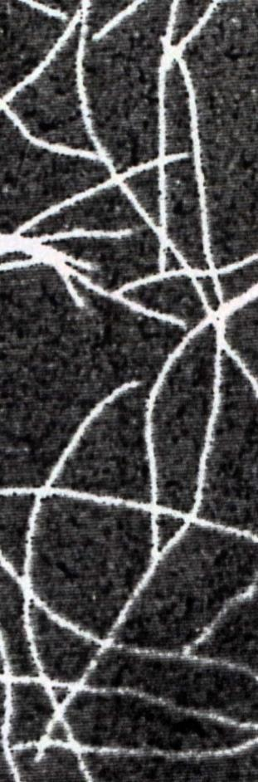
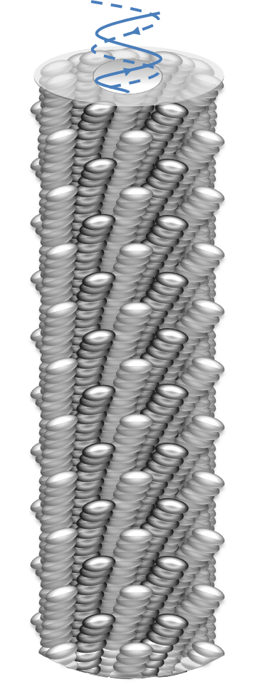
Architecture of Virus
Virion Contour
~ 8,800 Å
~ 176 Å

Slide 16
Amino Acid Sequences of Major Capsid Protein gp8
Ff (fd, f1) [M13], (ZJ/2) | - - - + - - A E G D D P A K A A F D S L Q A S A T E Y I G Y A W A M V V V I V G A T I G I K L F K K F T S K A S [N] (A)
Ike | - - - + - A E P N A A T N Y A T E A M D S L K T Q A I D L I S Q T W P V V T T V V V A G L V I R L F K K F S S K A V
If1 | - - + - - A D D A T S Q A K A A F D S L T A Q A T E M S G Y A W A L V V L V V G A T V G I K L F K K F V S R A S
+
+
+
+
+
+
+
+
K
K
K
K
+
+
+
+
+
+
+
+
R
K
K
K
+
+
+
+
+
+
+
+
K
K
K
R

Slide 17
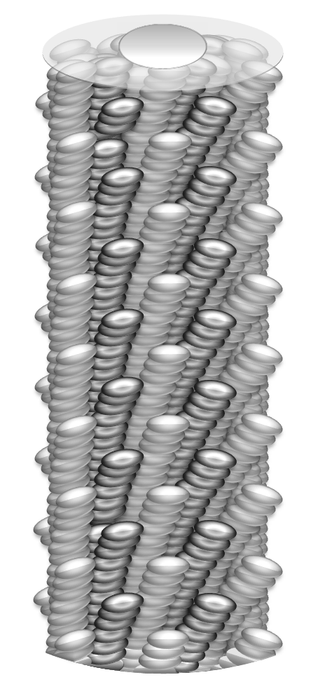
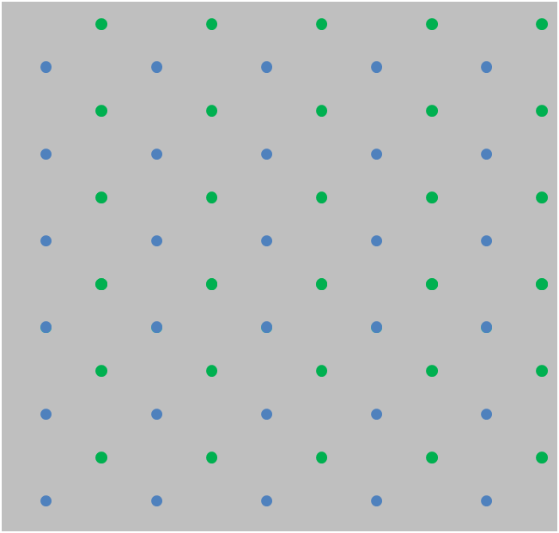

Lattice Diagram of Ff Virion
99
66
Axial Rise
33
0
Virion Perimetrical (Azimuthal) Distance
-33
-66
-83
-41,5
0
41,5
83

Slide 18
Virion Lattice Diagram
Area: ~1,370 Å²
n + 10
n + 10
33
n
n
0
Axial Rise (Å)
Virion Perimetrical (Azimuthal) Distance (Å)
n - 10
n - 10
-33
-66
-83
-41,5
0
41,5
83

Slide 19
Antigen Display on Virion
n + 10
33
n
0
n - 10
-33
27 Å
-66
Axial Rise (Å)
Virion Perimetrical (Azimuthal) Distance (Å)
-83
-41,5
0
41,5
83

Slide 20
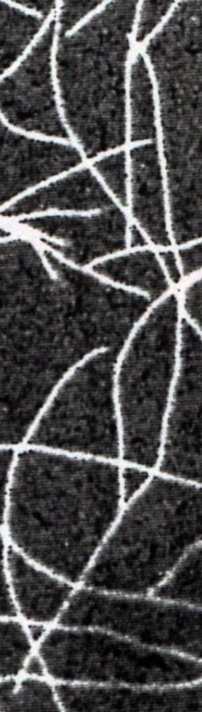
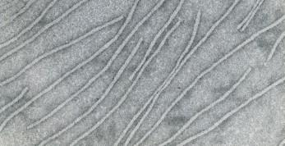
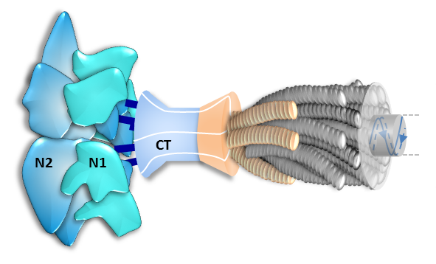
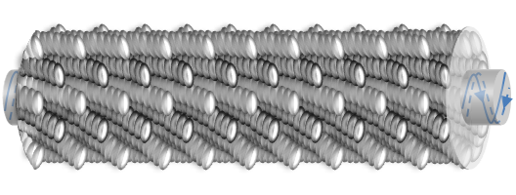
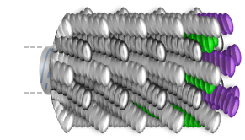
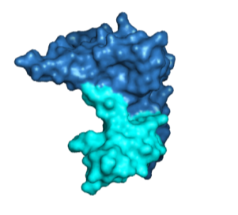
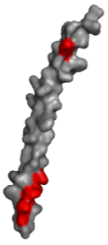
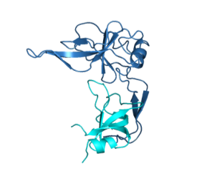
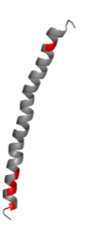
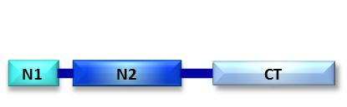
A Scale Architectural Model of an End-to-End Ff Inovirus
gp3 (5 subunits)
~ 176 Å
Virion Contour Length ~8,800 Å
gp8 subunits
gp7
gp9
gp6 (5 subunits)
cssDNA (6,408 nts)
N1
N1
N2
N2

Slide 21
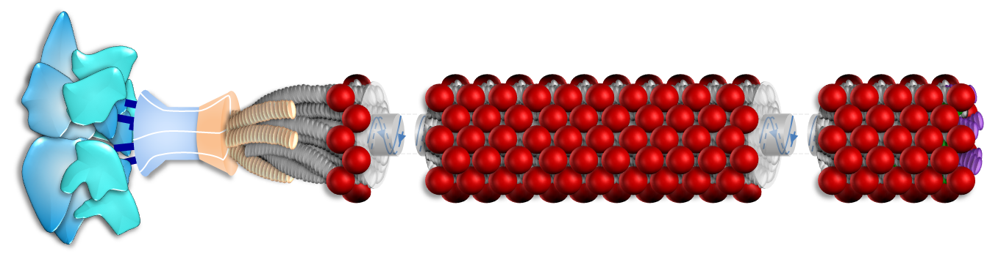
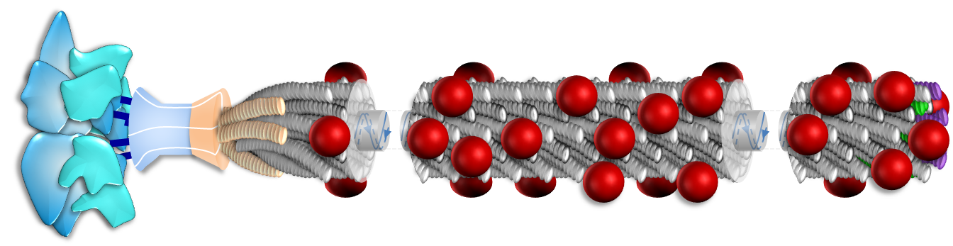
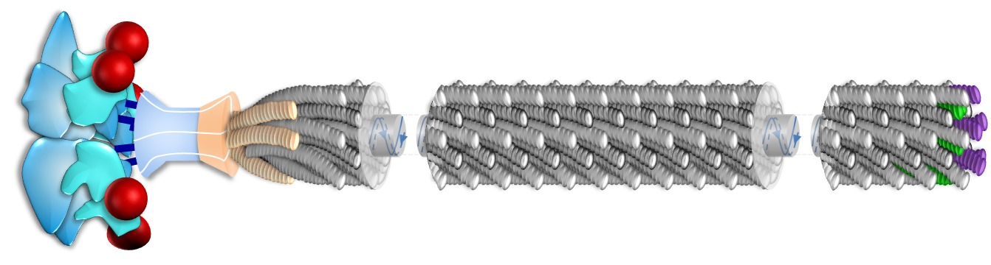
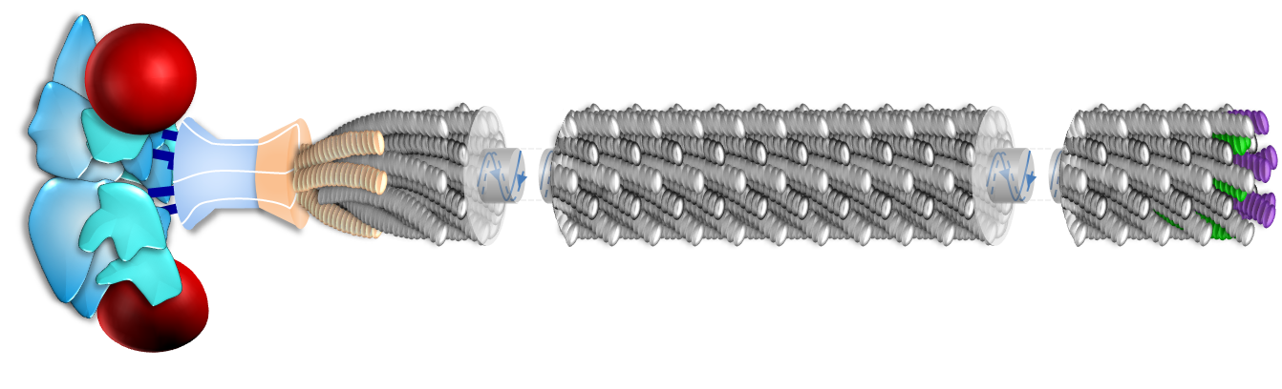
Vaccine Strategies Utilizing Displayed Inoviral Vectors
Ff.g8
Ff.g8.m
Ff.g3
Ff.g3.m

Slide 22
Inovirus-Based Vaccines Against HIV-1
Pathogens | Inoviral vector | Antigen | Study Animal Model | Type of Immune Response | Protection of Vaccinated Animals Against Challenge with the Pathogen | References
HIV-1 | Fd.g3 | gp120 | Rabbits | Specific humoral | ND | Keller et. al., 1993
HIV-1 | M13.g8.m | Unknown | Mice | Specific humoral | ND | Scala et. al., 1999
HIV-1 | Fd.g8.m | gp120 | Mice, Rabbits | Non-specific humoral | ND | Zwick et. al., 2001
HIV-1 | M13.g8.m | Unknown | Rhesus macaques | Specific humoral | Partial | Chen et. al., 2001
HIV-1 | Fd.g3 | gp120 | Mice | Specific humoral | ND | Dorgham et. al., 2005
HIV-1 | M13.g3 | gp120 | Rabbits | Specific humoral | ND | Wilkinson et. al., 2007
HIV-1 | M13.g3 | Unknown | Mice | Specific humoral | ND | Rodriguez et. al., 2007
HIV-1 | M13.g3 | Unknown | Mice | Specific humoral | ND | Humbert et. al., 2007
HIV-1 | M13.g3 | Unknown | Mice | Specific humoral | ND | Humbert et. al., 2008
HIV-1 | Fd.g8.m | Carbohydrates | Rabbits | Non-specific humoral | ND | Menendez et. al., 2008
HIV-1 | M13.g3 | gp41 | Mice, Rabbits | Specific humoral | ND | Rodriguez et. al., 2011

Slide 23
Inovirus-Based Vaccines Against Pathogens Causing Infectious Diseases
Pathogens | Inoviral vector ^{b} | Antigen | Study Animal Model | Type of Immune Response | Protection of Vaccinated Animals Against Challenge with the Pathogen | References
Viral
HBV | F1.g8.m | Hepatitis B Surface Antigen | Mice | Specific humoral | ND | Folgori et. al., 1994
HBV | M13.g8.m | Hepatitis B Surface Antigen | Mice | Specific cellular | ND | Wan et. al., 2001
HPV | Fd.g8.m | E7 | Mice | Specific humoral | ND | Lidqvist et. al., 2008
HSV-2 | Fd.g8.m | Glycoprotein G2 | Mice | Specific humoral | Significant | Grabowska et. al., 2000
Influenza A | M13.g3 | Haemagglutinin Antigen | Mice | Specific humoral | Significant | Zhong et. al., 2011
Neurotropic Murine Coronavirus | Fd.g8.m | Surface Glycoprotein | Mice | Specific humoral | Partial | Yu et. al., 2000
Rabies virus | M13.g3 | Rabies Viral Glycoprotein | Mice | Specific humoral | ND | Huimel et. al., 2009
RSV | Fd.g3 | Glycoprotein G | Mice | Specific humoral | Complete | Bastien et. al., 1997
Protozoan
Plasmodium falciparum | Fd.g3 | CSP | Mice, Rabbits | Specific humoral | ND | Stoute et. al., 1995
Plasmodium falciparum | F1.g3 | CSP | Mice, Rabbits | Specific humoral | ND | de la Cruz et. al., 1988
Plasmodium falciparum | F1.g8.m | CSP | Rabbits | Specific humoral | ND | Greenwood et. al., 1991

Slide 24
Inovirus-Based Vaccines Against Pathogens Causing Infectious Diseases
Pathogens | Inoviral vector ^{b} | Antigen | Study Animal Model | Type of Immune Response | Protection of Vaccinated Animals Against Challenge with the Pathogen | References
Fungal
Candida albicans | Fd.g8.m | Heat Shock Protein 90 | Mice | Specific humoral and cellular | Partial | Yang et. al., 2005
Candida albicans | Fd.g8.m | Heat Shock Protein 90 | Mice | Specific humoral and cellular | Partial | Wang et. al., 2006
Worm
Fasciola hepatica | M13.g3 | Cathepsin L | Sheep | Specific humoral | Partial | Villa-Mancera et. al., 2008
Schistosoma japonicum | M13.g3 | Ferritin of Sj | Mice | Specific humoral | Partial | Tang et. al., 2004
Schistosoma japonicum | M13.g3 | Epitope of mAb SSJ14 | Mice | Specific humoral and cellular | Significant | Wang et. al., 2006
Schistosoma japonicum | M13.g3 | Sj338 | Mice | Specific humoral | Partial | Wu et. al., 2006
Taenia solium | M13.g8.m, M13.g3 | GK1, KETc1, KETc7, KETc12 | Guinea Pigs | Specific cellular Non-specific humoral | Significant | Manoutcharian et. al., 2004
Trichinella spiralis | M13.g3 | Ts87 | Mice | Specific humoral | Partial | Gu et. al., 2008
Trichirella spiralis | M13.g3 | Ts Paramyosin | Mice | Specific humoral | Partial | Wei et. al., 2011

Slide 25
Inovirus-Based Vaccines Against non-Infectious Diseases
Diseases | Inoviral Vector | Antigen | Study Animal Model | Type of Immune Response | Protection of vaccinated animals against disease progression | References
Cancer
Colorectal cancer | M13.g3 | EGFR | Mice | Specific humoral | ND | Riemer et. al., 2005 A
Melanoma | Fd.g8.m | HMW-MAA | Mice | Specific humoral | ND | Riemer et. al., 2005 B
Melanoma | Fd.g3 | HMW-MAA | Mice | Specific humoral | ND | Luo et. al., 2005
Melanoma | Fd.g8.m | MAGE A1 | Mice | Specific cellular | Significant | Fang et. al., 2005
Melanoma | Fd.g8 | HMW-MAA | Rabbits | Specific humoral | ND | Wagner et. al., 2005
Melanoma | Fd.g3 | HMW-MAA | Rabbits | Specific humoral | ND | Luo et. al., 2006
Melanoma | F1.g8.m, M13.g3 | HMW-MAA | Mice, Rabbits | Specific humoral only in mice | ND | Latzka et. al., 2011
Murine mastocytoma P815 | M13.g8.m | P1A | Mice | Specific cellular | Significant | Wu et. al., 2002
Various types of cancer | M13.g3 | Epitope of mAb BAT | Mice | Specific humoral and cellular | Significant | Hardy et. al., 2005
Various types of cancer | M13.g3 | EGFR | Rabbits | Specific humoral | ND | Hartman et. al., 2010
Various types of cancer | M13.g3 | VEGF | Mice | Specific humoral | ND | Li et. al., 2013
Alzheimer’s
 | M13.g8.m, M13.g3 | EFRH | Mice | Specific humoral | Partial | Solomon et. al., 2007
 | M13.g8.m, M13.g3 | EFRH | Guinea pigs | Specific humoral | ND | Frenkel et. al., 2000

Slide 26


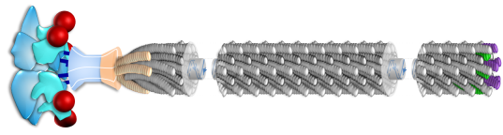
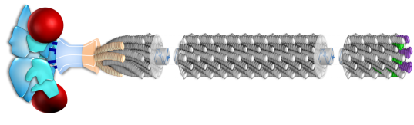
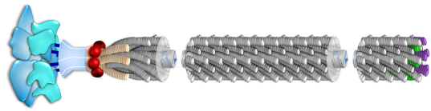
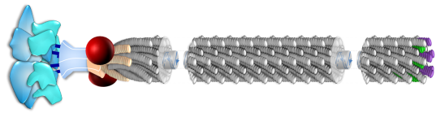
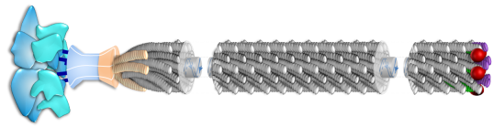
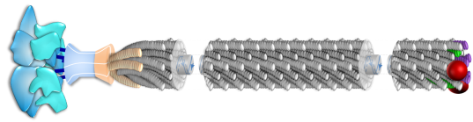
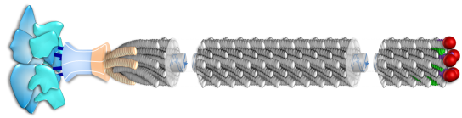
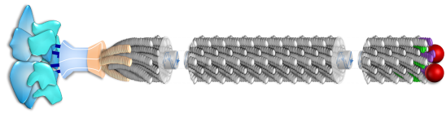
Vaccine Strategies Utilizing Displayed Inoviral Vectors
Ff.g8
Ff.g8.m
Ff.g3
Ff.g3.m
Ff.g6
Ff.g6.m
Ff.g7
Ff.g7.m
Ff.g9
Ff.g9.m

Slide 27

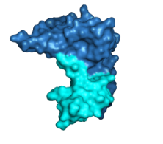
Construction of Penetrating Inoviral Vectors
AETVESCLA...
M13KE.g3
N1
N2
CT
N1
N2
(TAT) YGRKKRRQRRRGGGSAETVESCLA...
(pen) RQIKIWFQNRRMKWKKGGGSAETVESCLA...
(Tp10) AGYLLGKINLKALAALAKKILGGGSAETVESCLA...
(pVec) LLIILRRRIRKQAHAHSKGGGSAETVESCLA...
(R8) RRRRRRRRGGGSAETVESCLA...
(R10) RRRRRRRRRRGGGSAETVESCLA...
M13KE.g3CPP
N1
N2
CT
N2
N1

Slide 28
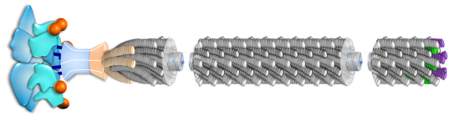

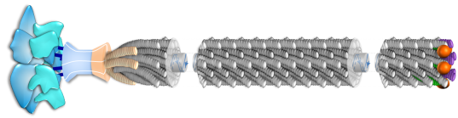
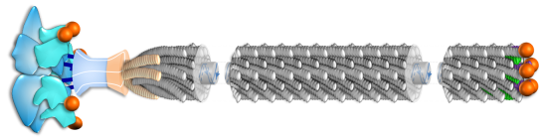
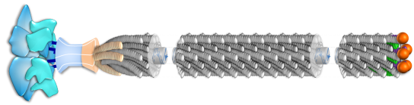
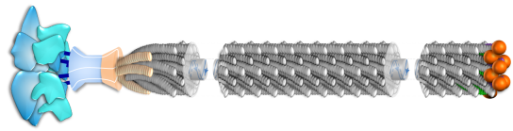

CPPs Displayed on Inoviral Vectors
Ff.g3CPP
Ff.g3g7CPP
Ff.g7CP
Ff.g3g9CPP
Ff.g9CPP
Ff.g7g9CPP
Ff.g3g7g9CPP

Slide 29
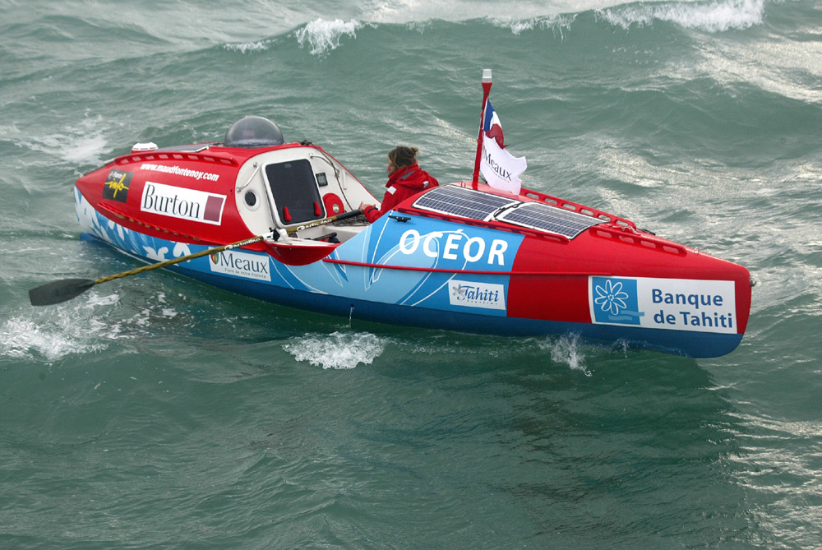
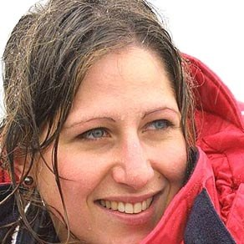
“Oser Toujours, douter parfois ne renoncer jamais”
“Always dare, doubt at times, but never quit”
Maud Fontenoy
French Solitary Navigator
Notes:
We move now to the third vignette which deals with the natural genetic diversity of HIV-1

