Slide 1
About Omics Group
OMICS Group International through its Open Access Initiative is committed to make genuine and reliable contributions to the scientific community. OMICS Group hosts over 400 leading-edge peer reviewed Open Access Journals and organize over 300 International Conferences annually all over the world. OMICS Publishing Group journals have over 3 million readers and the fame and success of the same can be attributed to the strong editorial board which contains over 30000 eminent personalities that ensure a rapid, quality and quick review process.

Slide 2
About Omics Group conferences
OMICS Group signed an agreement with more than 1000 International Societies to make healthcare information Open Access. OMICS Group Conferences make the perfect platform for global networking as it brings together renowned speakers and scientists across the globe to a most exciting and memorable scientific event filled with much enlightening interactive sessions, world class exhibitions and poster presentations
Omics group has organised 500 conferences, workshops and national symposium across the major cities including SanFrancisco,Omaha,Orlado,Rayleigh,SantaClara,Chicago,Philadelphia,Unitedkingdom,Baltimore,SanAntanio,Dubai,Hyderabad,Bangaluru and Mumbai.

Slide 3


Efficiency of Excitation Dynamics and Regulation Ability in Photosynthetic Light Harvesting
L. Valkunas
Institute of Physics, Center for Physical Sciences and Technology, Vilnius
Department of Theoretical Physics, Faculty of Physics, Vilnius University,
Lithuania
Notes:
3

Slide 4
Outline:
Photosynthesis: introduction
Sensitivity to the external conditions: NPQ
Single Molecular Spectroscopy
Coherences and oscillations in 2D electronic spectroscopy
Notes:
4

Slide 5
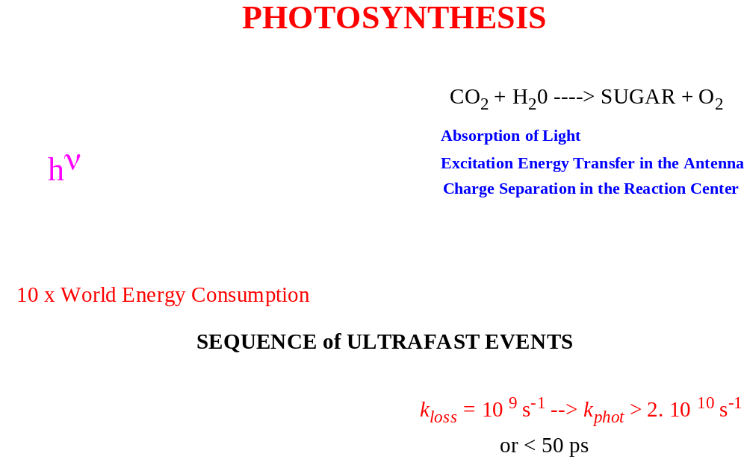
Photosynthesis

Slide 6
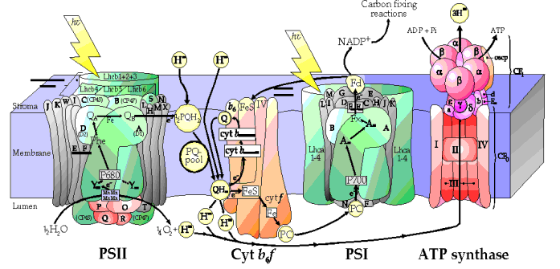
Light energy accumulation processes: time scales
10⁻¹⁵ s
10⁻¹⁰ s
10⁻¹⁰-10⁻¹ s
10⁻³-10¹ s
Photon Exciton Electron Proton
>10² s
Carbon
fixation
Notes:
Photosynthetic time scale – extending life of the light energy – accumulation issue
Photon mass 1.8×10⁻⁵⁰ kg electron mass: 10⁻³⁰ kg; proton: 10⁻²⁷ kg
mosquito Moon Saturn

Slide 7
Photosystem II
Stroma
Thylakoid membrane
Lumen
Antenna
(LHCII)
Reaction
center
Antenna chlorophylls
RC chlorophylls

Slide 8
Photosystem II
Primary electron acceptor
Stroma
to PSI
Q
Thylakoid membrane
Charge separation
e–
+
Lumen
e–
4 H⁺
2
H₂O
O₂

Slide 9
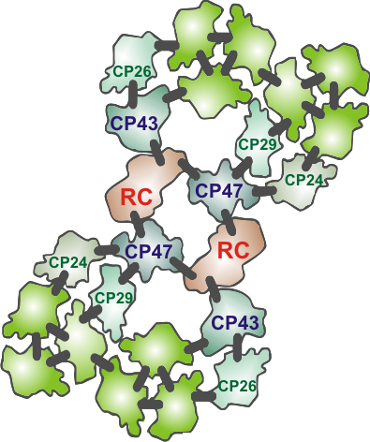
PSII
LHCII
PSII core
Light-harvesting antenna
Notes:
9

Slide 10
Theory

Slide 11
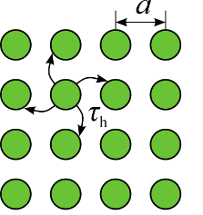
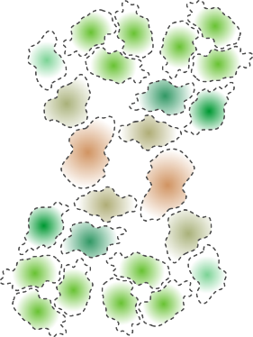
Fluctuating antenna model
Ideal 2D square lattice:
The lack of connectivity at some antenna points may be accounted by fractional dimension d:
Diffusion limit
J. Chmeliov, G. Trinkunas, H. van Amerongen, L. Valkunas, JACS 136, 8963-8972, 2014.
Diffusion limit

Slide 12
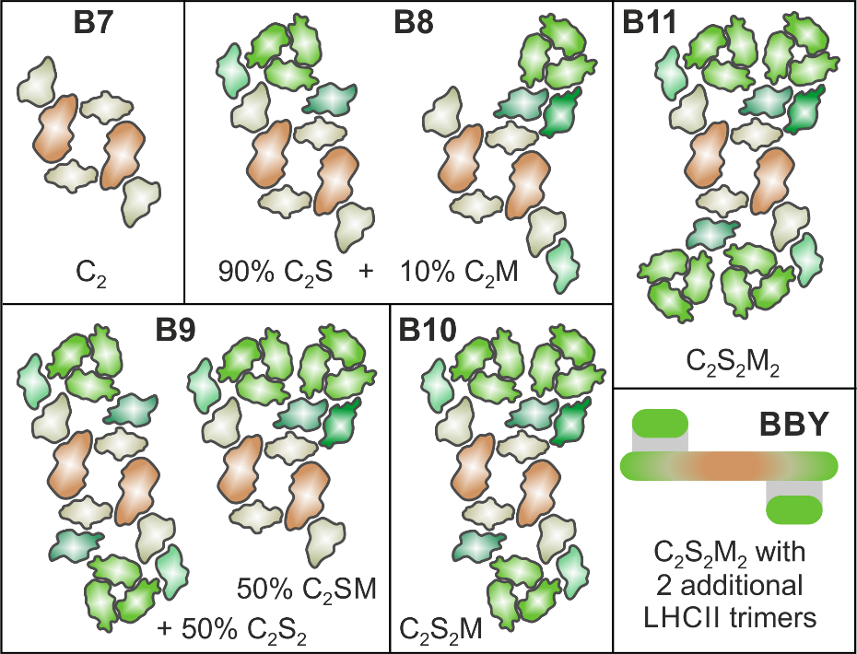
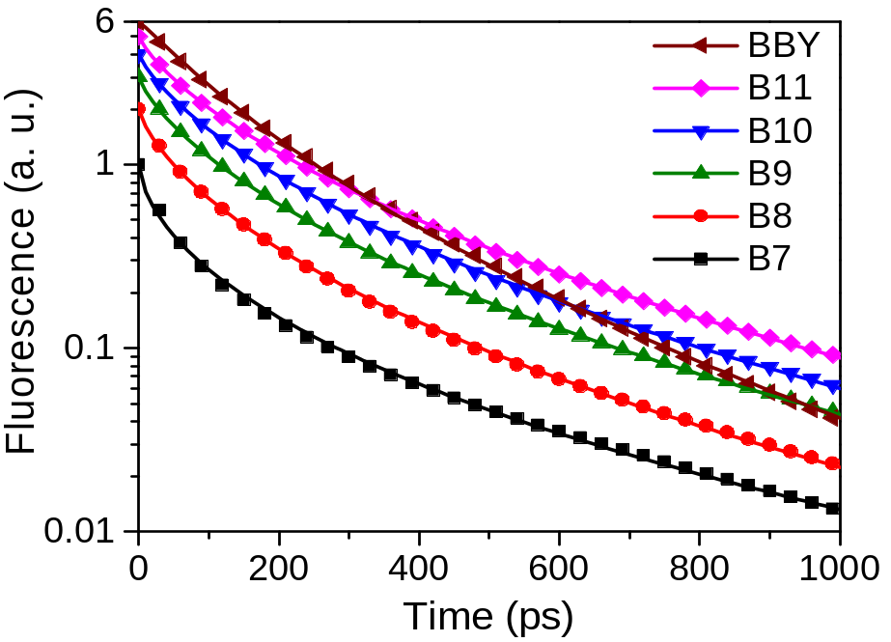
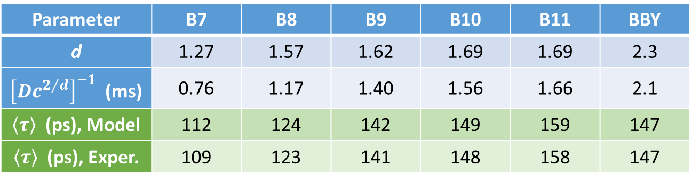
Fluorescence decay kinetics
Parameter | B7 | B8 | B9 | B10 | B11 | BBY
d | 1.27 | 1.57 | 1.62 | 1.69 | 1.69 | 2.3
${\left[Dc^{2/d}\right]}^{−1}$(ms) | 0.76 | 1.17 | 1.40 | 1.56 | 1.66 | 2.1
$\left\langle τ\right\rangle$ (ps), Model | 112 | 124 | 142 | 149 | 159 | 147
$\left\langle τ\right\rangle$ (ps),Exper. | 109 | 123 | 141 | 148 | 158 | 147
J. Chmeliov, G. Trinkunas, H. van Amerongen, L. Valkunas, JACS 136, 8963-8972, 2014.

Slide 13
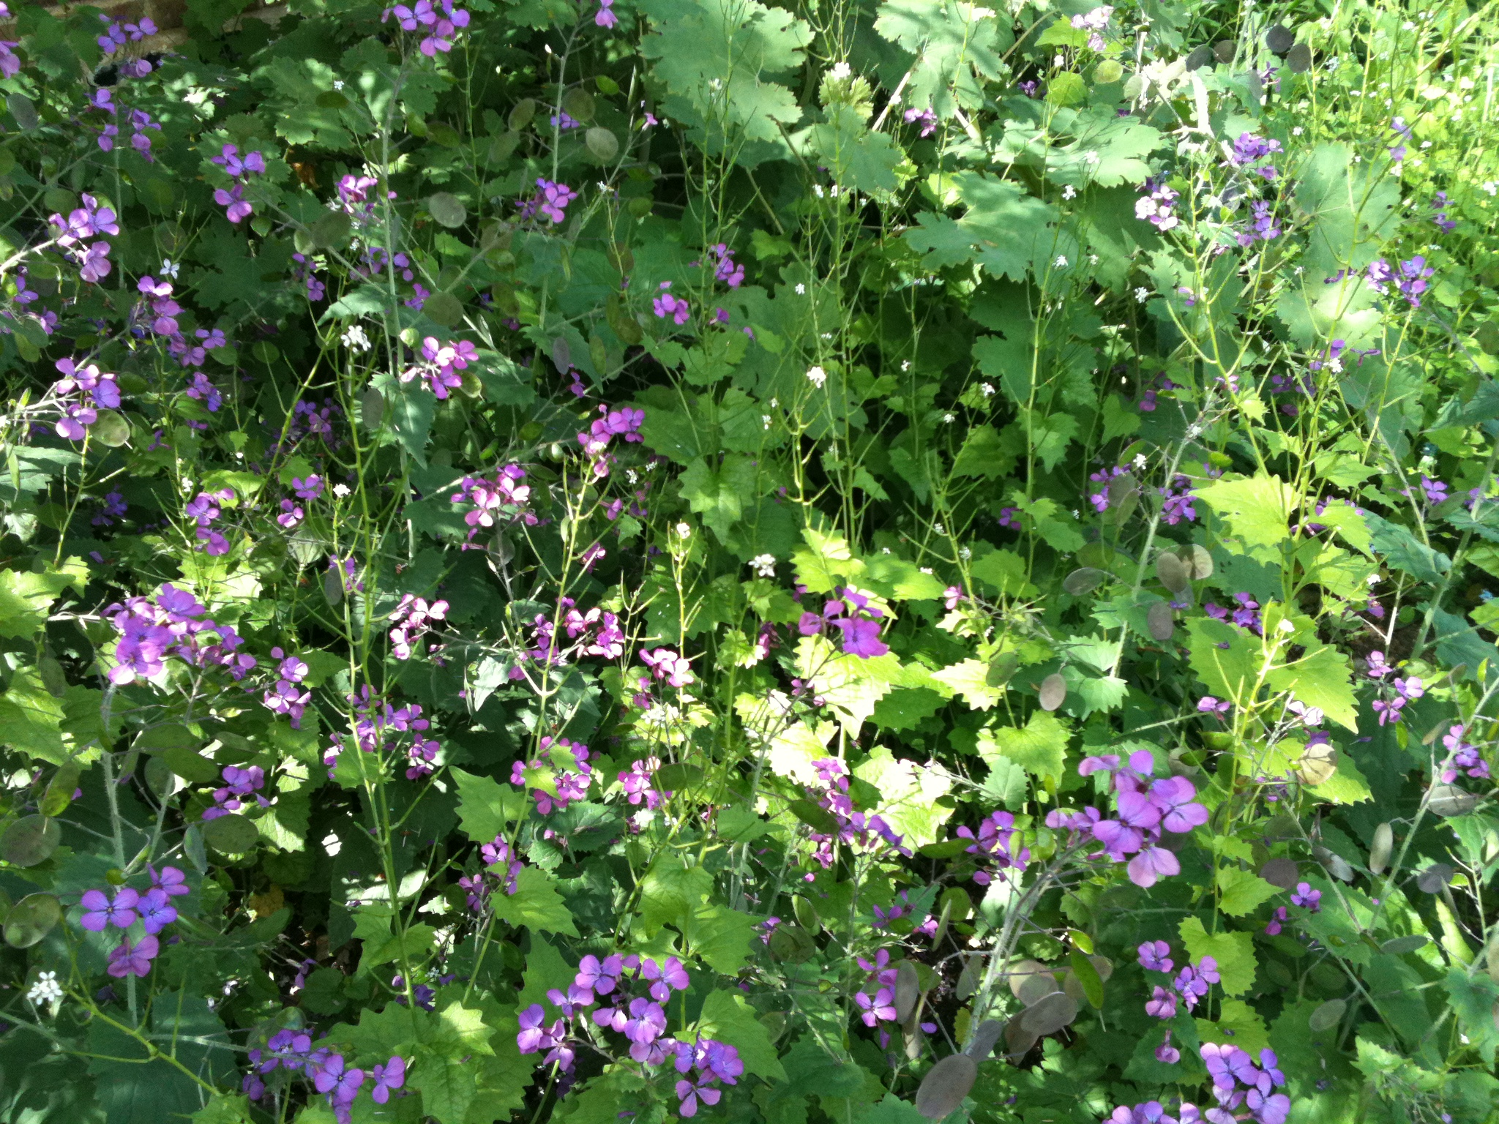
Notes:
Erysimum in Darwin’s gardens (Downe)

Slide 14
The need for photoprotection
Low light
High light
photoinhibition

Slide 15
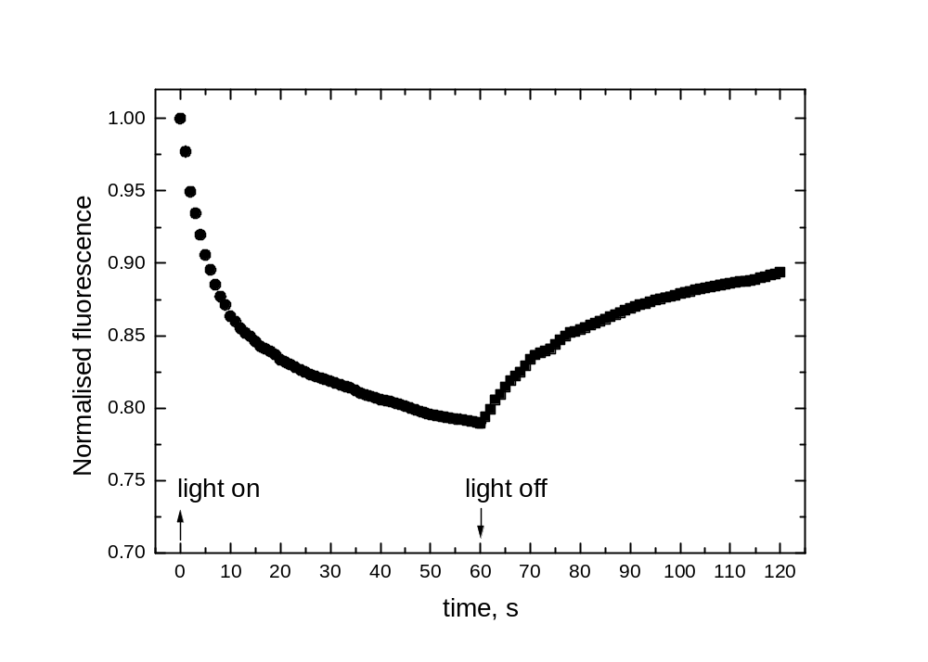
LHCII aggregates
Barzda, V. et al. Biophys. J. 2001, 80, 2409-2421.

Slide 16
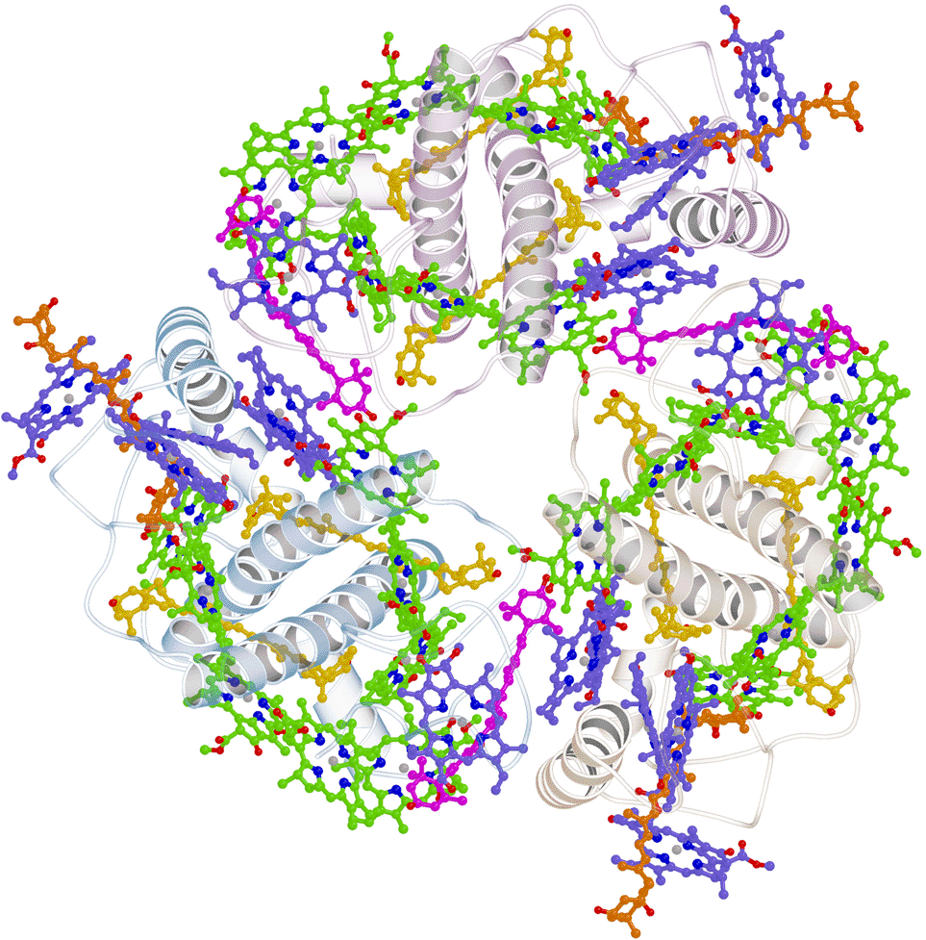
LHCII trimer

Slide 17
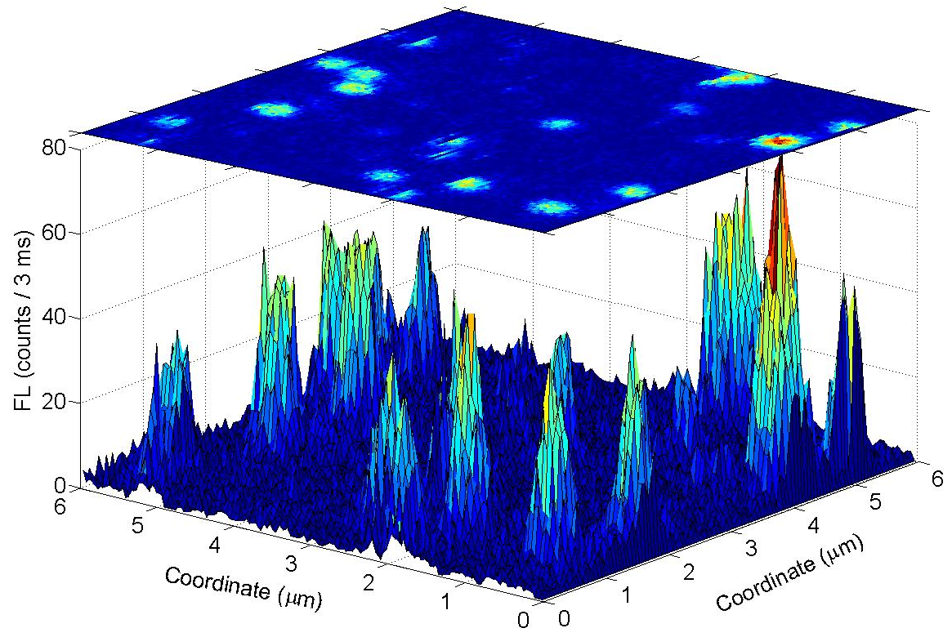
Fluorescence from single LHCII
T.P.J. Krüger, C. Ilioaia, and R. van Grondelle, Fluorescence Intermittency from the Main Plant Light-Harvesting Complex: Resolving Shifts between Intensity Levels,
J. Phys. Chem. B 115, 5071 (2011).
T.P.J. Krüger, C. Ilioaia, L. Valkunas, and R. van Grondelle, Fluorescence Intermittency from the Main Plant Light-Harvesting Complex: Sensitivity to the Local Environment, J. Phys. Chem. B 115, 5083 (2011).

Slide 18
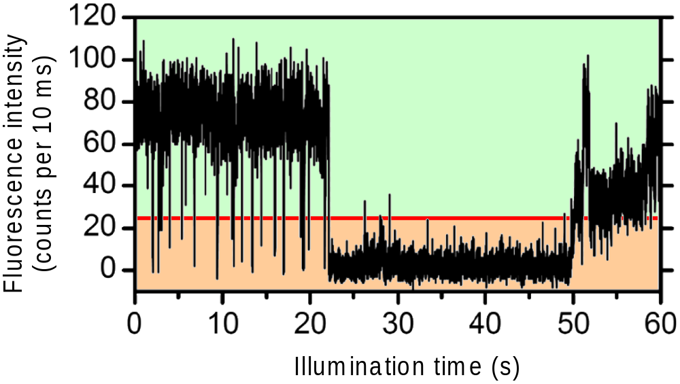
Fluorescence from single LHCII
T.P.J. Krüger, C. Ilioaia, and R. van Grondelle, Fluorescence Intermittency from the Main Plant Light-Harvesting Complex: Resolving Shifts between Intensity Levels,
J. Phys. Chem. B 115, 5071 (2011).
T.P.J. Krüger, C. Ilioaia, L. Valkunas, and R. van Grondelle, Fluorescence Intermittency from the Main Plant Light-Harvesting Complex: Sensitivity to the Local Environment, J. Phys. Chem. B 115, 5083 (2011).

Slide 19
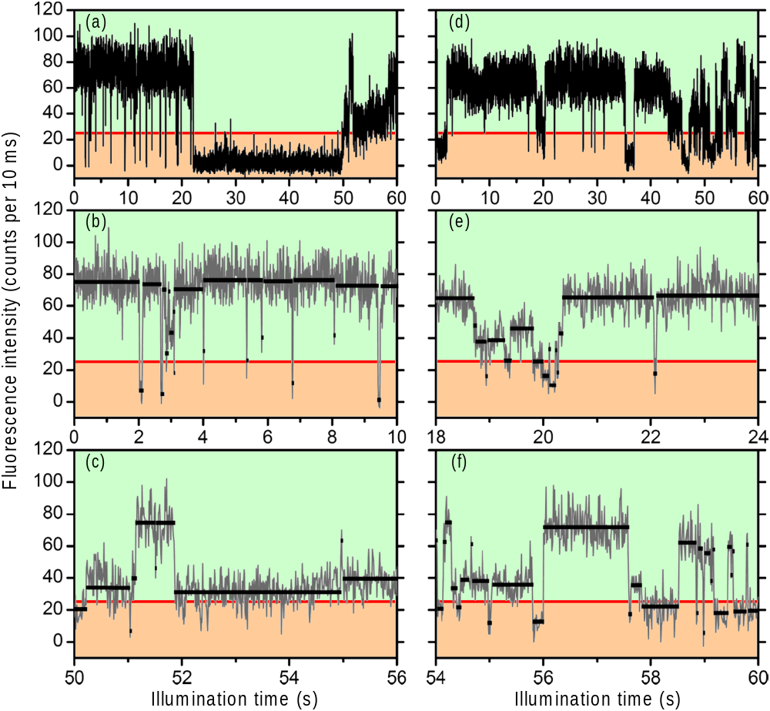
Fluorescence traces

Slide 20

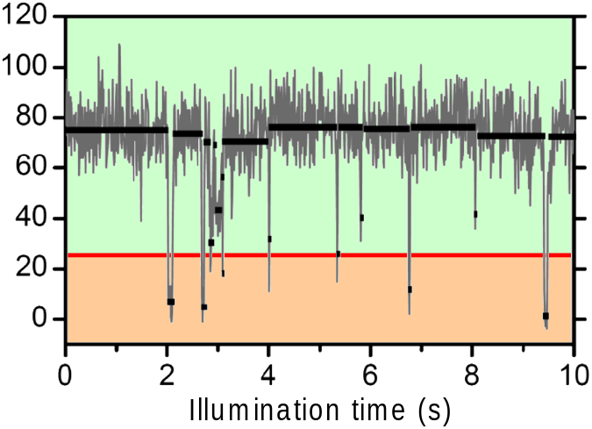
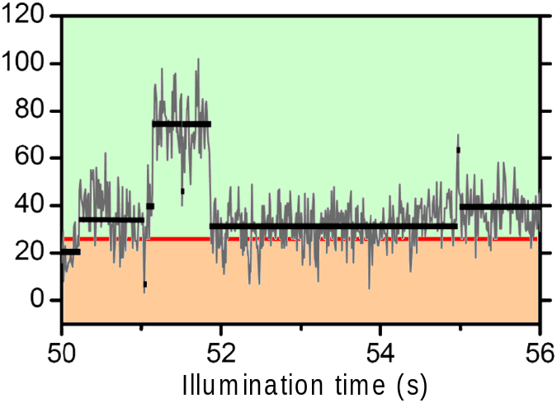
Fluorescence traces

Slide 21
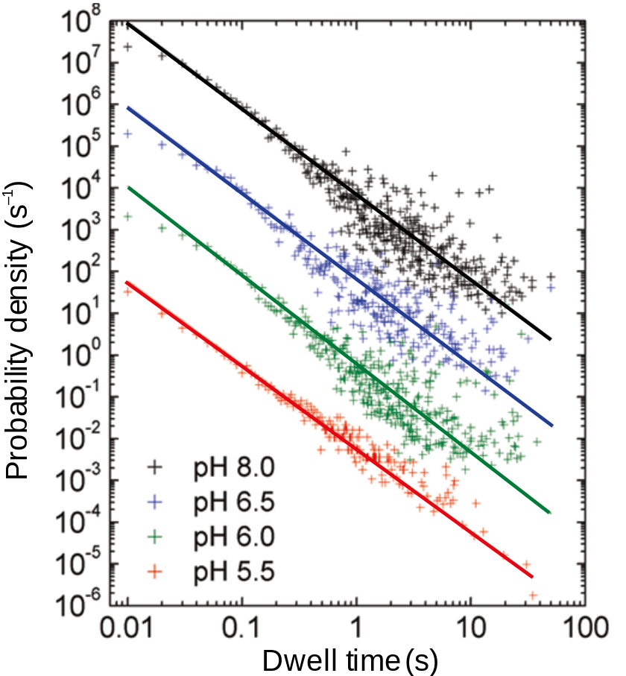
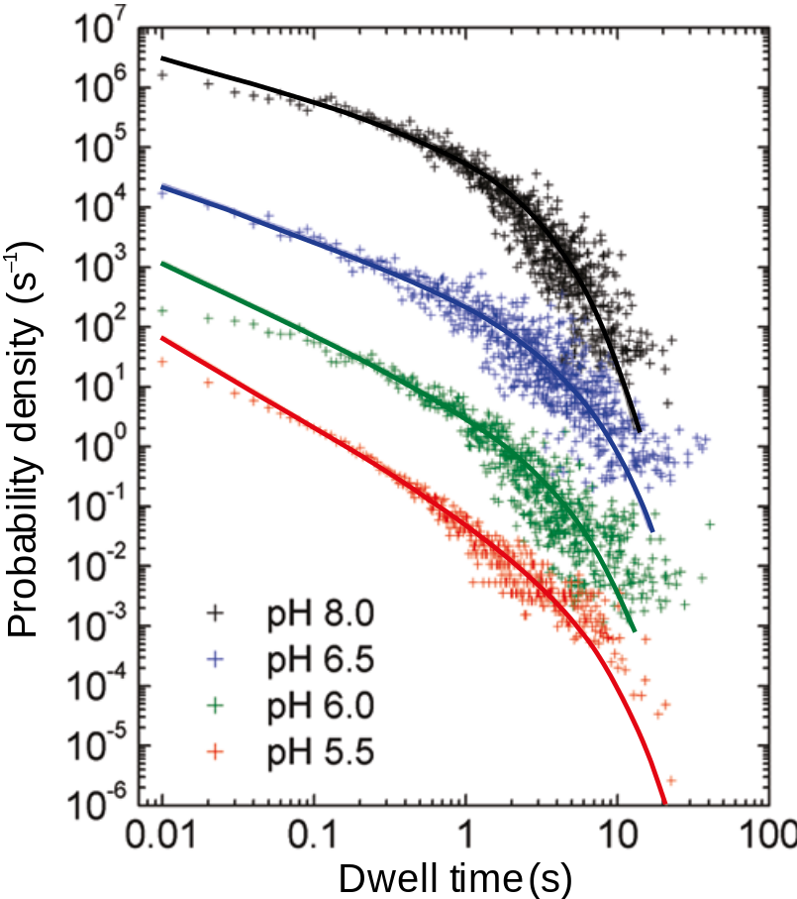
Distributions of the lifetimes
Dark state:
Bright state:

Slide 22
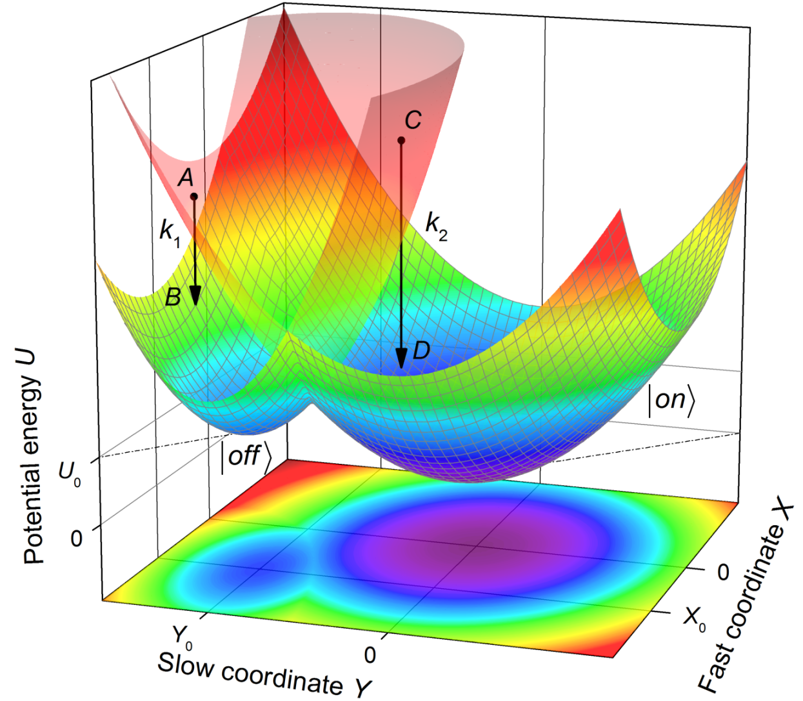
Potential surfaces
Describes fast molecular vibrations
Determines slow structural conformations of the protein

Slide 23
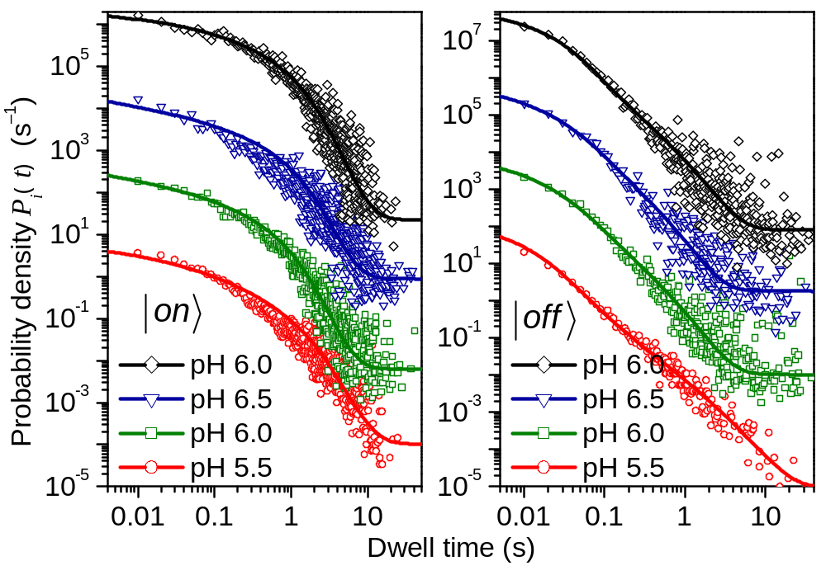
Modeling results

Slide 24
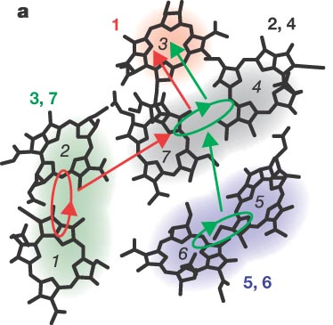
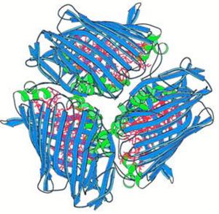
FMO

Slide 25
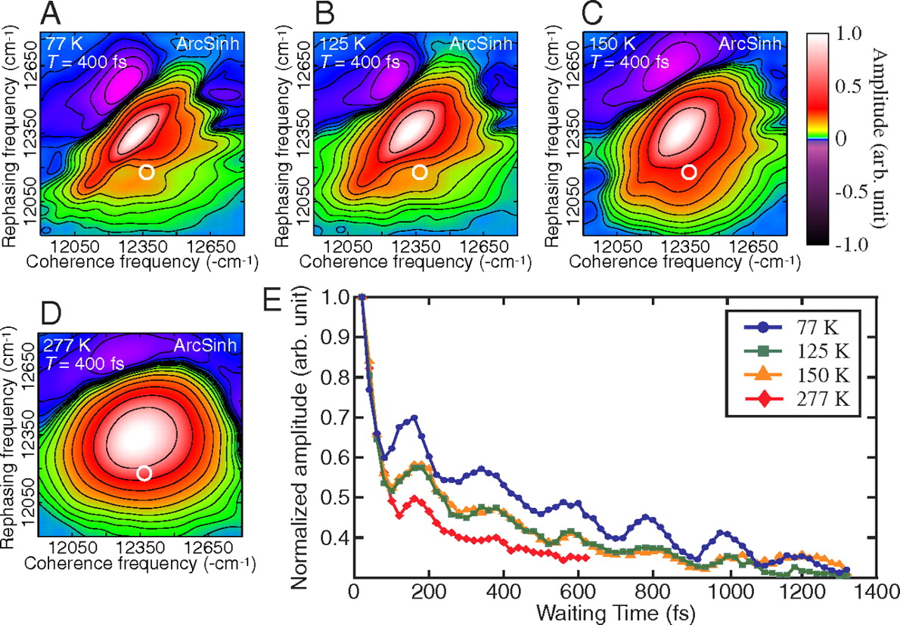
A “must have” slide
G. S. Engel et al. Nature 446, 782 (2007)
G. Panitchayangkoon et al. PNAS 107, 12766-12770 (2010)

Slide 26
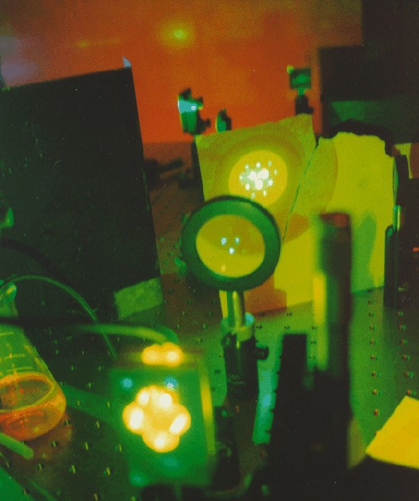
Generating and Measuring
Integrated Photon Echo Signals
Two Pulse Echoes:
2k₁ – k₂
k₁ – 2k₂
Three Pulse Echoes:
k₃ ± (k₁ – k₂)

Slide 27
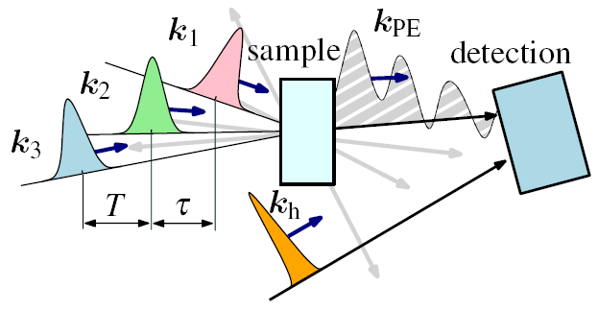
2D photon echo spectroscopy
Scheme
Notes:
As we know, 2D PE spectroscopy is a very powerful (and may be, too powerful) tool capable of resolving various quantum correlations at the femtosecond scale as long-lasting coherent oscillations observed in a number of various systems, including...

Slide 28
Perturbation expansion
Perturbations of the density matrix
make series expansion for the density matrix
calculate expectation values

Slide 29
Weakly driven quantum dynamics
Perturbations of the density matrix
Non-linear response function (optical excitation)

Slide 30
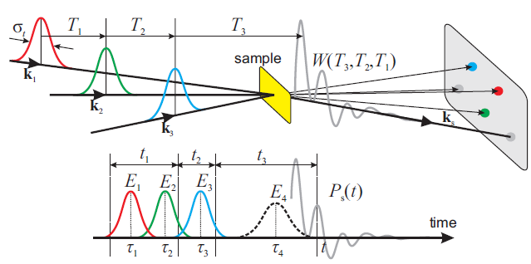
Classification of third order techniques:
Possible phase-matching directions:
Assuming that each laser pulse interacts with the system only once, we get 4 linearly independent signals
non-rephasing
rephasing
double quantum coherence
These are detected at different directions

Slide 31
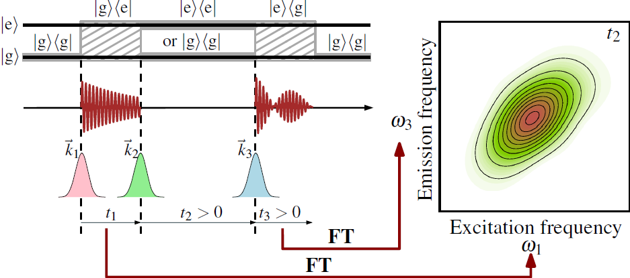
Two-level system
Inhomogeneous linewidth
Homogeneous linewidth

Slide 32
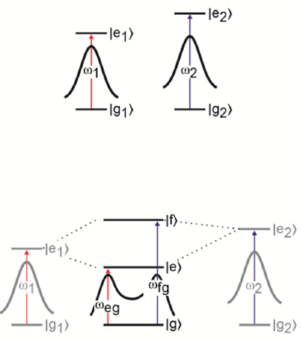
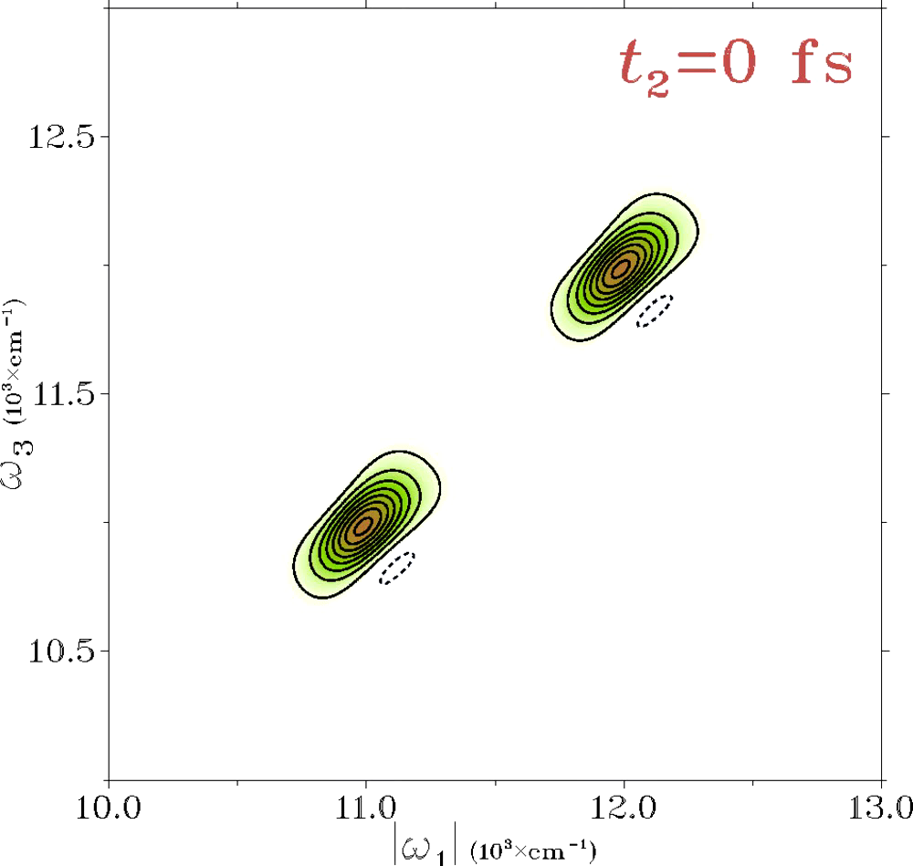
Noninteracting molecules
Two diagonal peaks present
Peaks getting round shape due to losing correlation

Slide 33
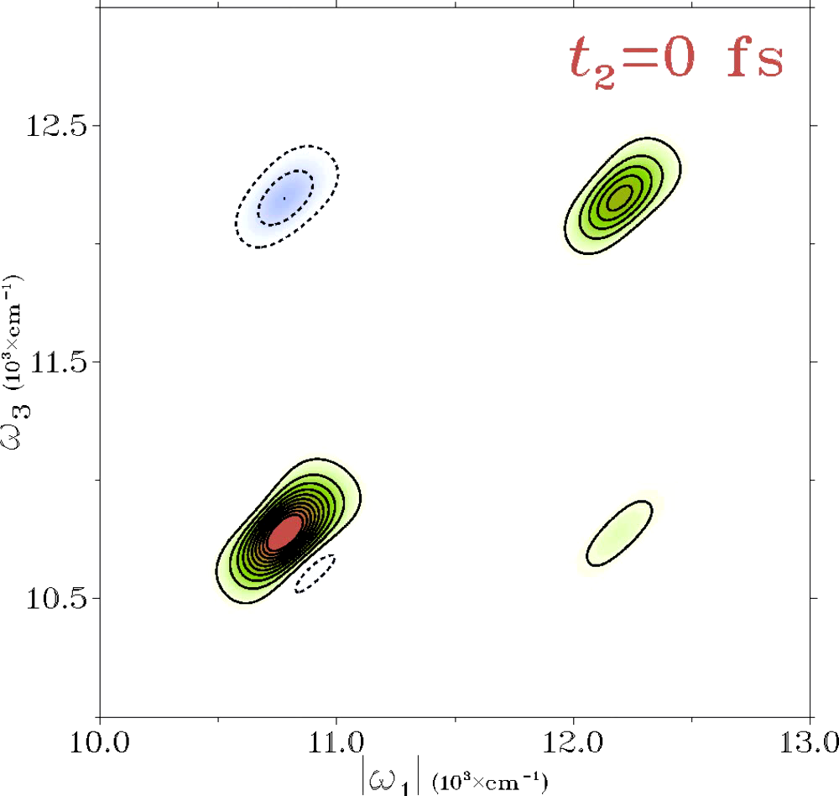
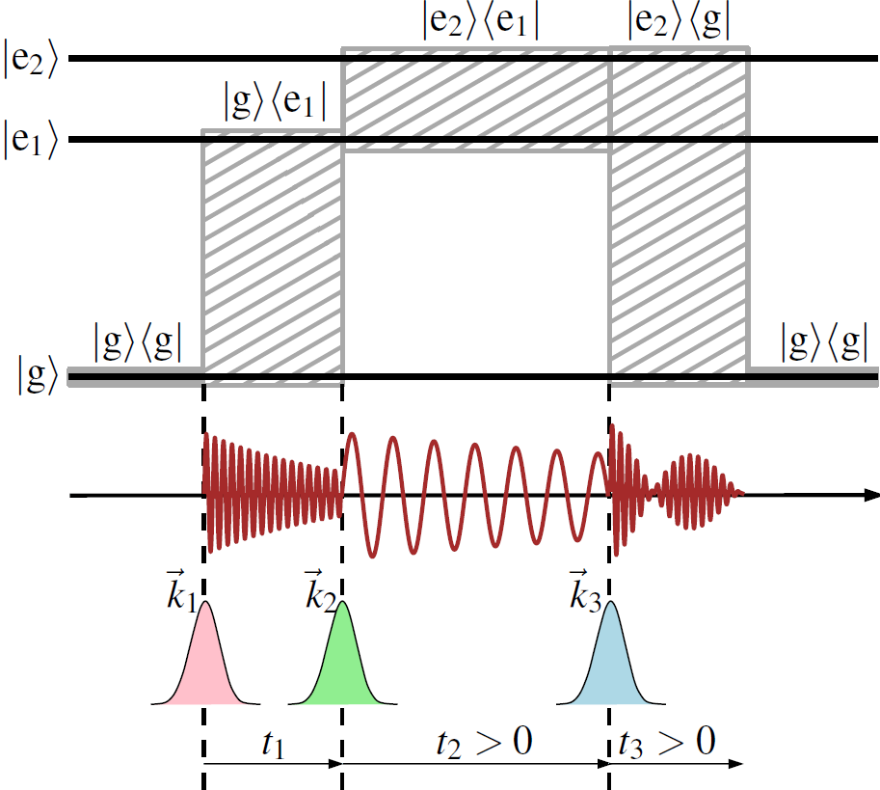
Interacting molecules (a dimer)
Excited state absorption
Excitation relaxation

Slide 34
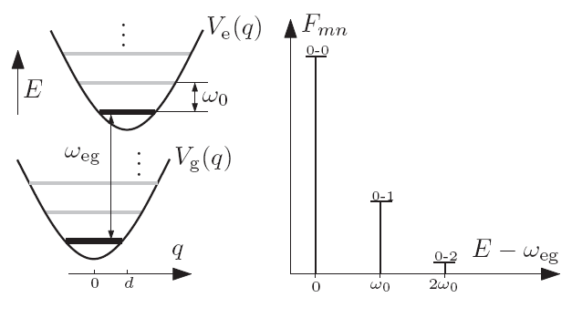
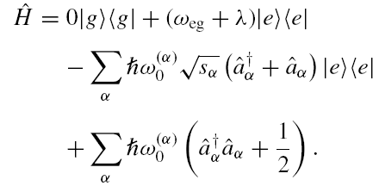
Molecule coupled to a phonon bath
Hamiltonian of a single molecule
V. Butkus et al. JCP 137, 044513 (2012)

Slide 35
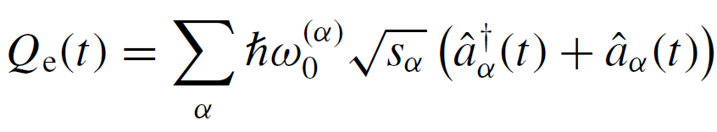

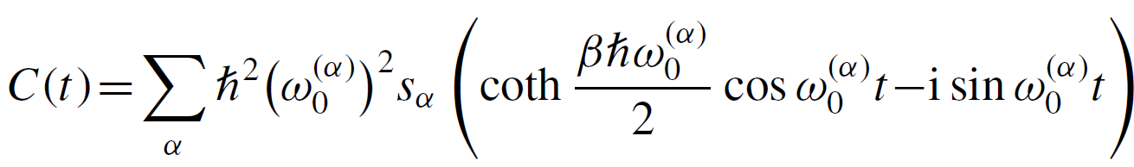
Spectral density of harmonic bath
Fluctuating collective bath coordinate
Correlation function

Slide 36
Absorption spectrum

Slide 37
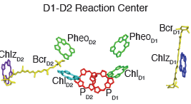
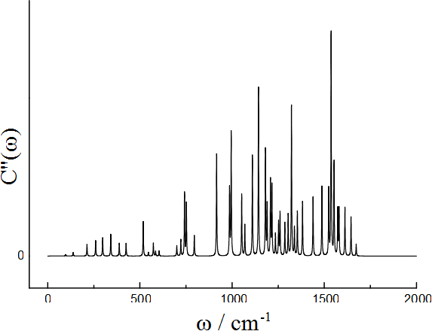
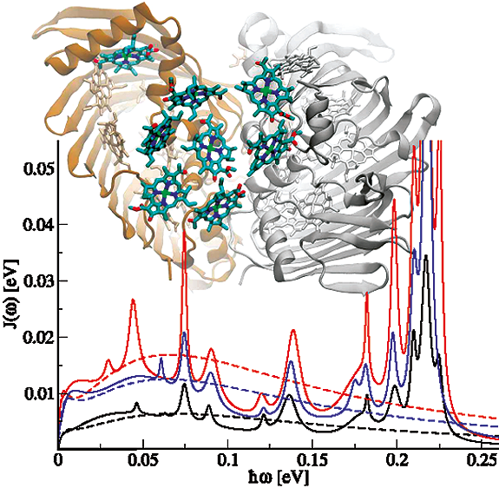
Nontrivial open quantum system
The spectral density of chlorophyll in PS-II
Novoderezhkin et al. Biophys. J. 89, 1464 2005.
C. Olbrich, et al. J. Phys. Chem. Lett., 2011
Protein environment is highly structured
This cannot be ignored

Slide 38
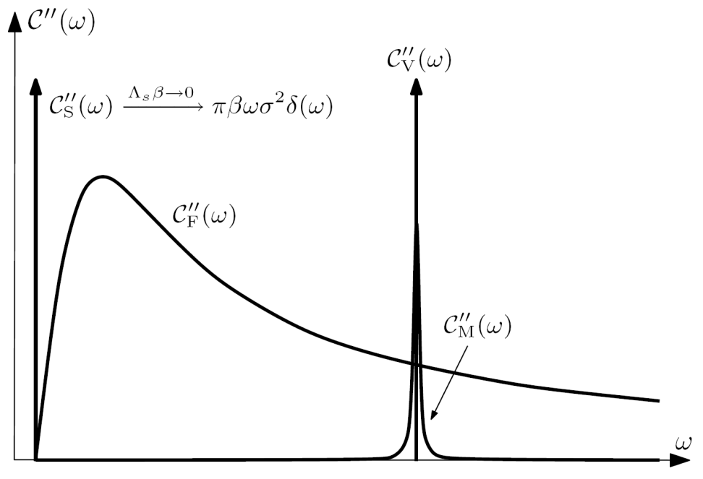
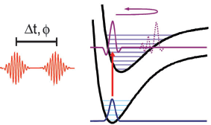
Spectral density with specific resonances
1. Static inter-molecular fluctuations
colored bath
2. Intra-molecular fast damping mode
3. Underdamped intra-molecular
vibrations

Slide 39
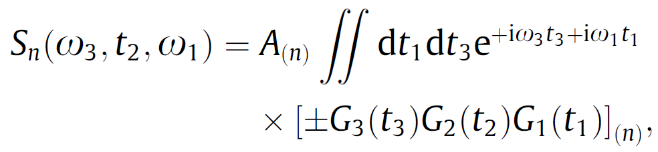
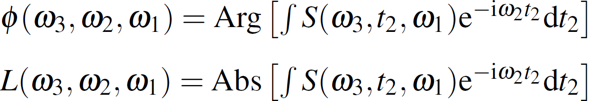
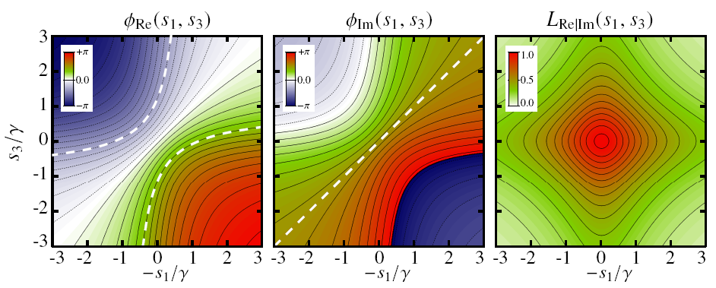
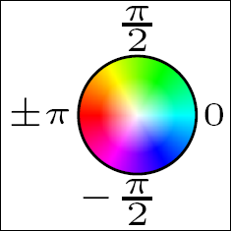
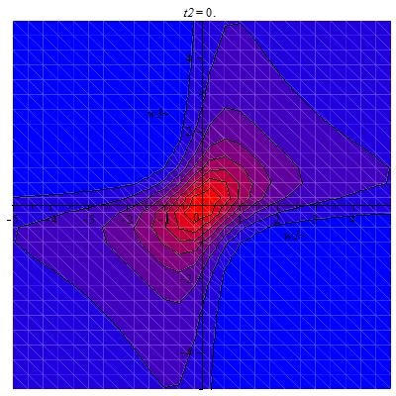
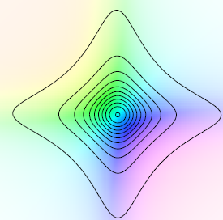
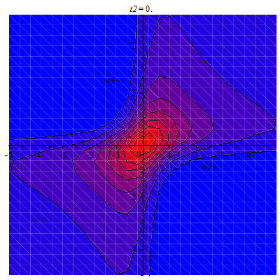
Oscillation Fourier maps
One contribution of the rephasing signal
Phase and amplitude of oscillations is obtained by Fourier transform of time-dependent spectra,
assuming no bath-induced relaxation and Green’s function
, gives
Oscillating cross-peak:

Slide 40
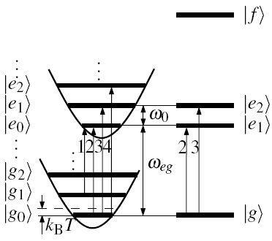
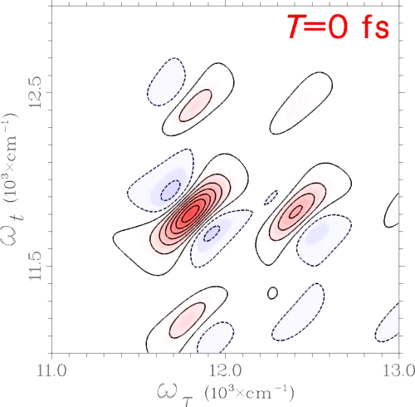
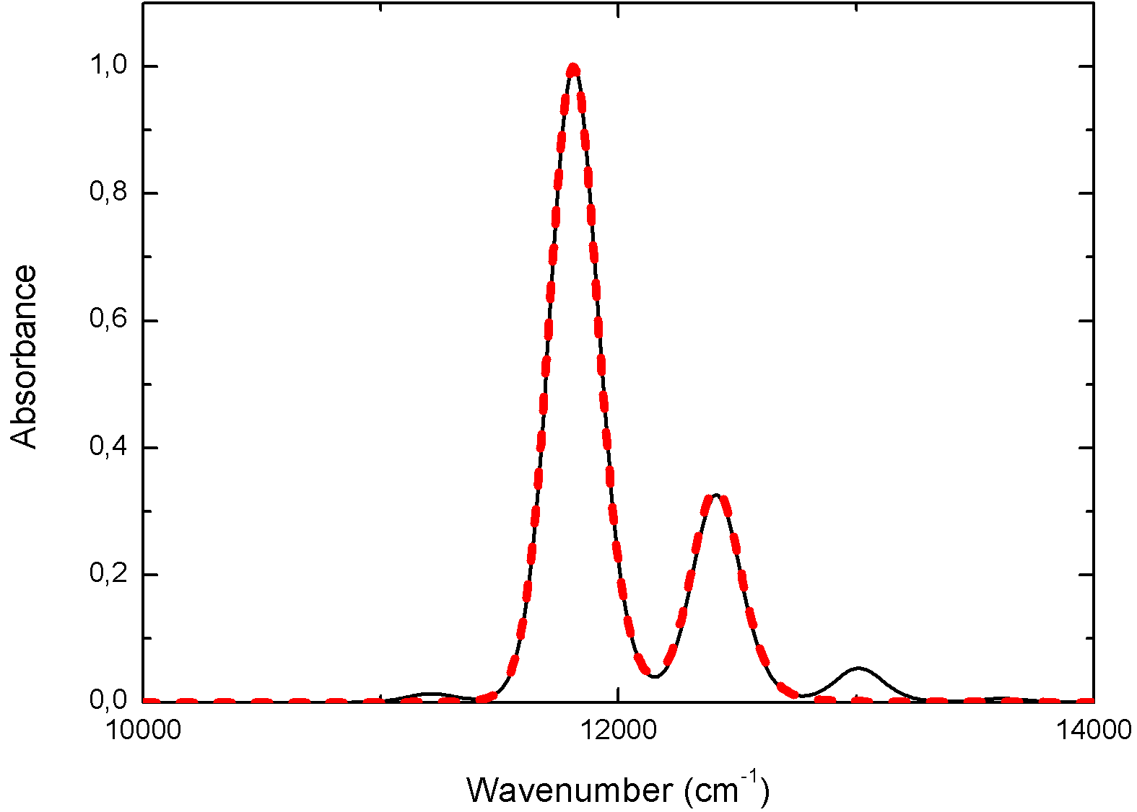

Purely electronic/vibrational systems
Vibrational monomer
V. Butkus et al. CPL 545 (2012)
Vibrational monomer
Electronic dimer
Electronic dimer

Slide 41








Oscillations in model systems
(rephasing signal only)
Cross-peak oscillations IN PHASE
Intensity
Intensity
Diagonal elements
Off-diagonal elements
Population time (fs)
Population time (fs)
Intensity
Intensyvumas
Diagonal elements
Off-diagonal
elements
Population time (fs)
Population time (fs)

Slide 42

Purely electronic/vibrational systems
Vibrational monomer
V. Tiwari et al. PNAS 110 (2013)
Electronic dimer

Slide 43

Time-resolved phenomena
Coherent beats of vibrational
degrees of freedom
(internal structure of excitons)

Slide 44

PSII RC

Slide 45

Spectral density

Slide 46

Monomer absorption

Slide 47

Absorption of PSII RC

Slide 48

PSII RC 2D at 77 K
A. Gelzinis et al. New J. Phys. 15, 075013 (2013)

Slide 49

PSII RC 2D at 77 K

Slide 50

PSII RC 2D at 77 K

Slide 51

Tight binding hamiltonian

Slide 52

CT states

Slide 53

CT pathways

Slide 54


2D spectrum of the PSII RC at 77K at a waiting time of 170 fs.
F. D. Fuller, J. Pan, A. Gelzinis, V. Butkus, S. S. Senlik, D. E. Wilcox, C. E. Yocum, L. Valkunas, D. Abramavicius, J. P. Ogilvie. Nature Chemistry 6, 706 (2014)

Slide 55



Physical origin of coherences
Experiment
Theory
Excitonic states
Experiment
Theory
Vibronic
Vibrational
F. D. Fuller, J. Pan, A. Gelzinis, V. Butkus, S. S. Senlik, D. E. Wilcox, C. E. Yocum, L. Valkunas, D. Abramavicius, J. P. Ogilvie. Nature Chemistry 6, 706 (2014)

Slide 56


Enhancement of the charge transfer
Separated charges
Population of
CT state
CT state
Ground
state
Spectral density
After the excitation, the electron appears in the initial state A. The transition along overdamped and underdamped coordinates are indicated as states B, C and D. The charge transfer may take place at any time while the most probable event happens in the state D.
Excitonic splittings
D. Abramavicius et al. Acceleration of charge separation by oscillations of the environment polarization. Chem Phys Lett 368 (2003)
F. D. Fuller, J. Pan, A. Gelzinis, V. Butkus, S. S. Senlik, D. E. Wilcox, C. E. Yocum, L. Valkunas, D. Abramavicius, J. P. Ogilvie. Nature Chemistry 6, 706 (2014)

Slide 57
Conclusions
Fluorescence intermittency in single LHCII is probably related to NPQ and can be explained by considering equilibrium between |on⟩ and |off⟩ states in a dynamic self-organisation model.
Adverse environment enforce LHCII to switch to the non-fluorescing dark state.
2D spectral oscillations come either from electronic coherencies or vibrational resonances of the bath. For this purpose the Fourier maps are useful by analyzing the 2D electronic spectra.
Inhomogeneous disorder makes different effect of on electronc/vibronic coherences.
Vibrational coherences evolving in the ground state and vibronic coherences in the excited state are equally significant.

Slide 58

Acknowledgements
Vilnius: Lund: Frankfurt:
D. Abramavicius D. Zigmantas C. Büchel
V. Butkus
A. Gelzinis Gif sur Yvette: Ann Arbor:
R. Augulis B. Robert J. P. Ogilvie
E. Songaila A. Gall F. D. Fuller
J. Chmeliov
Amsterdam:
R. van Grondelle
T. P. J. Krüger
C. Ilioaia
LSC grant no:
VP1-3.1-ŠMM-07-K-01-007.

Slide 59
Let Us Meet Again
We welcome all to our future group conferences of Omics group international
Please visit:
www.omicsgroup.com
www.Conferenceseries.com
http://optics.conferenceseries.com/

