Slide 1





Quantitative analysis of the mitochondrial proteome and phosphoproteome in the yeast Saccharomyces cerevisiae
Claire LEMAIRE
CNRS-UMR8221, CEA-IBITECS, Université Paris-Sud, I2BC, F-91191 Gif-sur-Yvette, FRANCE.
claire.lemaire@i2bc.paris-saclay.fr
July 14th 2015
International Summit on Current Trends in Mass Spectrometry 2015

Slide 2
Mitochondrial respiratory chain complexes

Slide 3
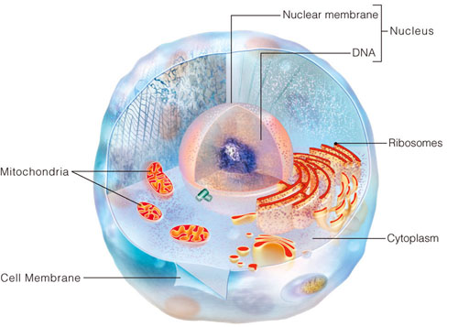
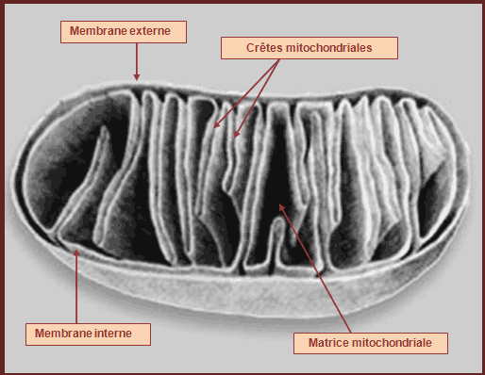
Mitochondrion: an essential organelle
Mitochondrion
External membrane
Cristae
Essential function:
energy production
Internal membrane
Matrix
http://conceptcours.fr/www/term_s/spe/energie

Slide 4
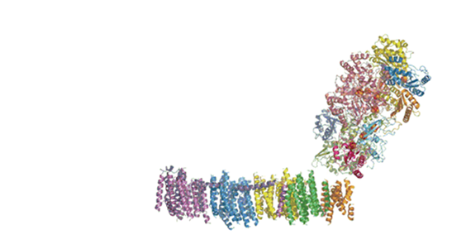


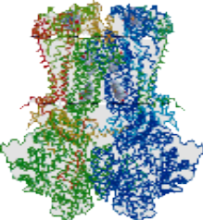

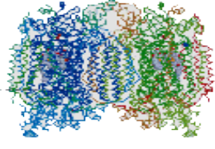

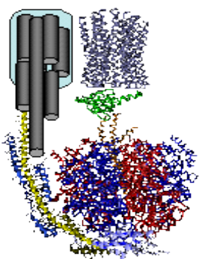

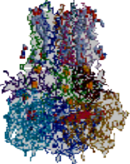

The mitochondrial respiratory chain complexes (OXPHOS)
External membrane
Cristae
Internal membrane (IM)
Matrix
OXPHOS
http://conceptcours.fr/www/term_s/spe/energie
IM
Matrix
I II III IV V
Variations among the metabolism of the cell

Slide 5
The mitochondrial respiratory chain complexes (OXPHOS)
Dysregulation
IM
Matrix
I II III IV V
Pathologies
Metabolic demand/various stresses, adjustement of the activity

Slide 6
Levels of regulation
Change in the expression level of proteins
Reversible interaction with effectors
Post-translational modifications

Slide 7
Post-Translational
Modifications

Slide 8
Post-Translational
Modifications
S-Nitrosylation
Methylation
SUMOylation
N-Acetylation
Lipidation
Glycosylation
Ubiquitination
Phosphorylation

Slide 9
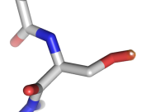
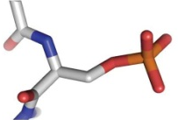
Importance of protein regulation by phosphorylation
Functional
properties
Cellular
localization
Phosphorylation
Interaction with partners

Slide 10

Link between phosphorylation and pathologies
Phosphorylation
Pathologies

Slide 11
Link between phosphorylation and pathologies
Phosphorylation
Pathologies
Abnormal phosphorylation events
Cancers and neurodegenerative diseases (Alzheimer’s, Parkinson’s or Huntington’s disease)

Slide 12
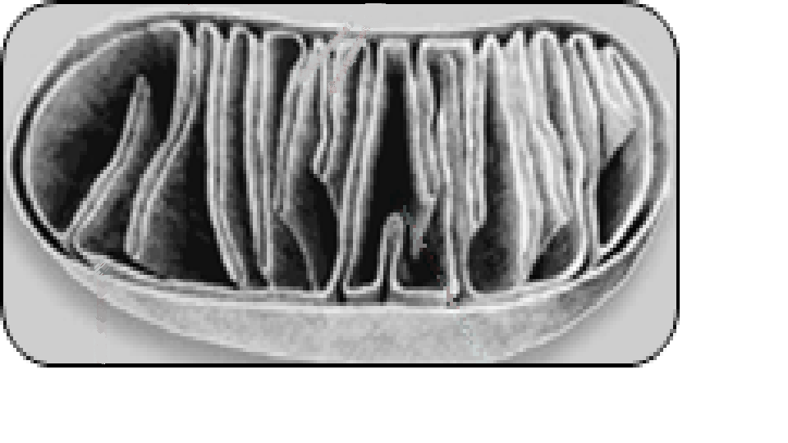
Link between mitochondria and pathologies
Pathologies
In human, dysregulation of mitochondrial functions, particularly of the respiratory chain are associated with different pathologies (neurodegenerative, neuromuscular, cardiovascular diseases for example)
Mitochondria

Slide 13
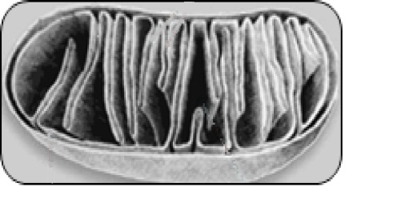
Link between mitochondria and phosphorylation?
Phosphorylation
Pathologies
Few data (cellular extracts)
Qualitative
?
Mitochondria

Slide 14
Link between mitochondria and phosphorylation?
Phosphorylation
Pathologies
?
Mitochondria
Data on phosphorylation in mitochondria:
Reproducible
Quantitative
Obtained in different physiological conditions → variations

Slide 15
I – General strategy

Slide 16
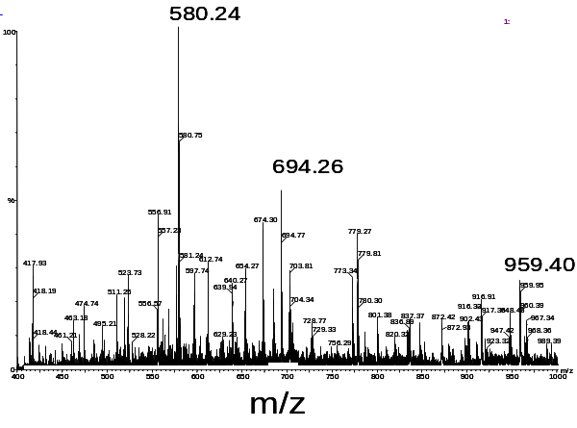
1
I
Identification and quantification of proteins accumulation and phosphorylation level in well-defined physiological states
S
T
R
A
T
E
G
Y
Mass spectrometry

Slide 17
I
Identification and quantification of proteins accumulation and phosphorylation level in well-defined physiological states
S
T
R
A
T
E
G
Y
Mass spectrometry
Ser, Thr , Tyr

Slide 18
I
Identification and quantification of proteins accumulation and phosphorylation level in well-defined physiological states
2
Site-directed mutagenesis
S
T
R
A
T
E
G
Y
Mass spectrometry
Permanent phosphorylated state
Ser, Thr , Tyr Glu, Asp

Slide 19
I
Identification and quantification of proteins accumulation and phosphorylation level in well-defined physiological states
2
S
T
R
A
T
E
G
Y
Mass spectrometry
Site-directed mutagenesis
Permanent phosphorylated state
Ser, Thr , Tyr Glu, Asp
Permanent dephosphorylated state
Ser , Thr Ala
Tyr Phe

Slide 20
Identification and quantification of proteins accumulation and phosphorylation level in well-defined physiological states
I
Mass spectrometry
Site-directed mutagenesis
S
T
R
A
T
E
G
Y
Permanent phosphorylated state
Ser, Thr , Tyr Glu, Asp
Permanent dephosphorylated state
Ser , Thr Ala
Tyr Phe
3
Structural and functional analysis of the respiratory complexes

Slide 21
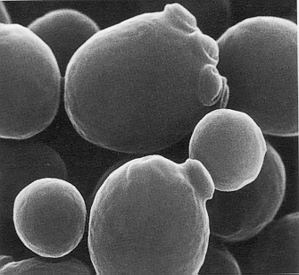
II – Biological study model : the yeast Saccharomyces cerevisiae

Slide 22

II
Saccharomyces cerevisiae
Facultative aerobe → study of various physiological states, dependent on culture conditions
WT
Respiratory mutant
S
T
U
D
Y
M
O
D
E
L
Respiratory medium
(Lactate)
Fermentescible medium
(glucose, galactose)
Molecular genetics techniques
Complete sequenced genome
Numerous homologies with the human respiratory chain

Slide 23
III – First aim

Slide 24
Quantitative variations of the mitochondrial proteome and phosphoproteome during fermentative and respiratory growth in Saccharomyces cerevisiae
Renvoisé et al. , J Proteomics (2014) 106, 140-150

Slide 25
IV -Methodology
IV
M
E
T
H
O
D
O
L
O
G
Y

Slide 26
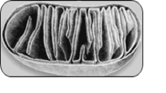

1
Growth in three conditions
IV
A
B
C
  Fermentation
  (Galactose)
  Respiration
  (Lactate)
M
E
T
H
O
D
O
L
O
G
Y
Metabolism
(Substrate)
Fermentation
(Glucose)
2
Mitochondria purification
A
B
C
4 independant biological replicates for each of the 3 growth conditions
3
Trypsin digestion
Protein quantification by LC-MS/MS
software developed by the PAPPSO Platform/ Gif-sur-Yvette/ France

Slide 27

IV
Trypsic peptides
4
Multiplex stable isotope dimethyl labeling (Boersema et al., Nat Protoc., 2009)
CH₂O CD₂O ¹³CD₂O
Labeling
Efficiency:
93-97,7%
Primary amines
Formaldehyde
Cyanoborohydride
M
E
T
H
O
D
O
L
O
G
Y
5
Mix the 3 samples in 1:1:1ratio
6
Strong Cation Exchange Chromatography (SCX)
Enrichment
in
Phospho
peptides
7
Affinity Chromatography (IMAC)
Phosphopeptides quantification by LC-MS/MS

Slide 28
V – Results

Slide 29
V-1- Proteomic results

Slide 30
Variations of mitochondrial protein abundances
V-1
544 mitochondrial proteins quantified
(only peptides quantified in at least 3 replicates/condition were kept
Only proteins quantified with at least two peptides were kept)
P
R
O
T
E
O
M
I
C
S

Slide 31
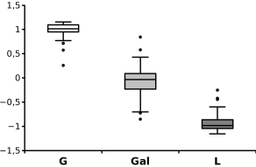
Significant changes of protein abundances according to the substrate
V-1
Classification:
2 major groups
1st group
P
R
O
T
E
O
M
I
C
S
Cluster4
26 proteins
Cluster1
68 proteins
1 2 3
Cluster3
49 proteins
Cluster2
33 proteins
1: Glucose
2: Galactose
3: Lactate

Slide 32
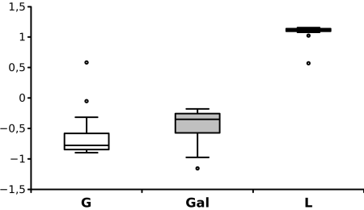
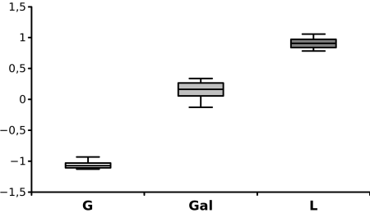
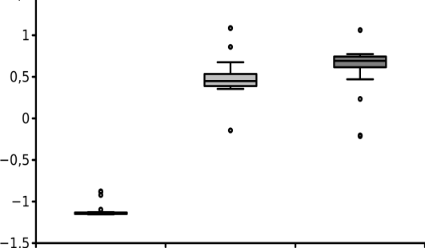
Significant changes of protein abundances according to the substrate
V-1
2nd group
P
R
O
T
E
O
M
I
C
S
Cluster4
26 proteins
1 2 3
Cluster1
68 proteins
Cluster3
49 proteins
Cluster2
33 proteins
1 2 3
1: Glucose
2: Galactose
3: Lactate
1 2 3

Slide 33
Significant changes of protein abundances according to the substrate
V-1
P
R
O
T
E
O
M
I
C
S
Cluster4
26 proteins
1 2 3
1 2 3
Cluster1
68 proteins
Cluster3
49 proteins
Cluster2
33 proteins
1 2 3
1: Glucose
Differences glucose vs galactose
2: Galactose
3: Lactate
1 2 3

Slide 34
Conclusions
V-1
This study allows ,for the first time, an overall comparison of mitochondrial protein abundances in fermentation and respiration
Differences between the two fermentative substrates (glucose and galactose) are highlighted
→ Galactose could be considered as a substrate displaying an intermediate metabolism between fermentation and respiration
→ respiro-fermentative substrate
P
R
O
T
E
O
M
I
C
S

Slide 35
V-2 Phosphoproteomic results

Slide 36
Phosphosites selection
V-2
P
H
O
S
P
H
O
R
O
T
E
O
M
I
C
S
LC-MS/MS identification
670 phosphosites

Slide 37
V-2
Phosphosites selection
P
H
O
S
P
H
O
R
O
T
E
O
M
I
C
S
LC-MS/MS identification
670 phosphosites
LC-MS/MS quantification
650
(97%)

Slide 38
Phosphosites selection
V-2
P
H
O
S
P
H
O
R
O
T
E
O
M
I
C
S
LC-MS/MS identification
670 phosphosites
LC-MS/MS quantification
650
Present in at least
3 replicates
330 (49%)

Slide 39
V-2
Phosphosites selection
P
H
O
S
P
H
O
R
O
T
E
O
M
I
C
S
LC-MS/MS identification
670 phosphosites
650
330
289
(43%)
LC-MS/MS quantification
Present in at least
3 replicates
Normalization according
to protein abundance

Slide 40
Variations of mitochondrial protein phosphorylation
V-2
P
H
O
S
P
H
O
R
O
T
E
O
M
I
C
S
289 mitochondrial phosphosites quantified, of which 214 were new

Slide 41
Variations of mitochondrial protein phosphorylation
V-2
P
H
O
S
P
H
O
R
O
T
E
O
M
I
C
S
90 mitochondrial phosphosites quantified with significative variation
1 condition
9
3 conditions
39
42
2 conditions

Slide 42

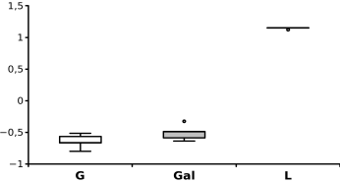
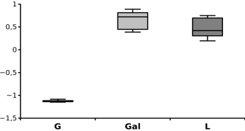
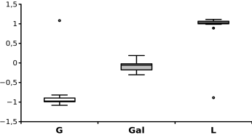
Significant changes of phosphorylation according to the substrate
V-2
P
H
O
S
P
H
O
R
O
T
E
O
M
I
C
S
39 varying phosphosites quantified in the 3 conditions
Classification
1 2 3
1 2 3
1 2 3
Clusters P1 to P4 : same pattern as clusters 1 to 4

Slide 43
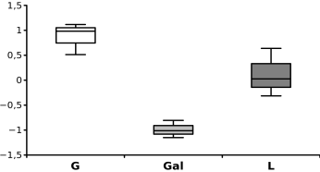
Significant changes of phosphorylation according to the substrate
V-2
P
H
O
S
P
H
O
R
O
T
E
O
M
I
C
S
1 2 3
Additional cluster P5: specific regulation in galactose

Slide 44
V-2
Conclusions
P
H
O
S
P
H
O
R
O
T
E
O
M
I
C
S
300 mitochondrial proteins were identified as phosphorylated ≈ 30% mitochondrial proteins
289 phosphorylation sites were quantified of which 214 were new → significant enlargement of the yeast mitochondrial phosphosites map
1/3 of the phosphorylation sites varies from the 3 culture conditions tested (glucose, galactose, lactate)
Specific regulation seems to occur in galactose (respiro-fermentative medium)

Slide 45
Variations of mitochondrial protein abundances and protein phosphorylation
according to their metabolic pathways
Proteins associated with metabolic pathways according to the MIPS functional classification ( http:// mips.helmholtz-muenchen.de)
Proteins
Phosphosites
Number
Conclusion: The most regulated metabolic pathway at both proteomic and phosphoproteomic levels is energy metabolism

Slide 46
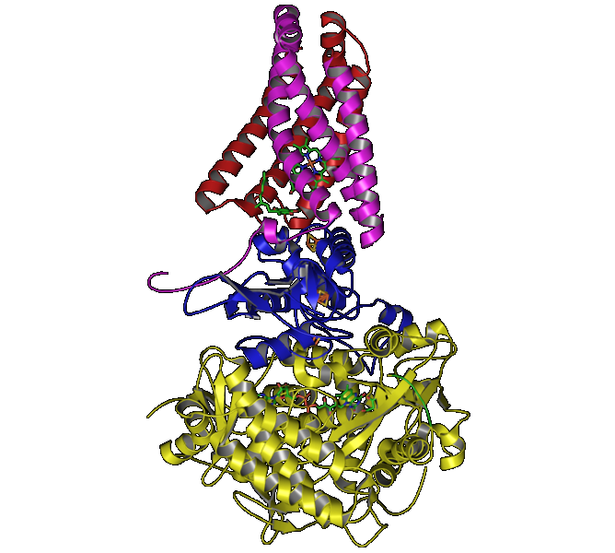
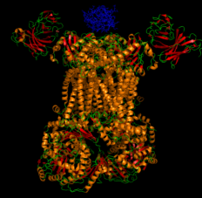
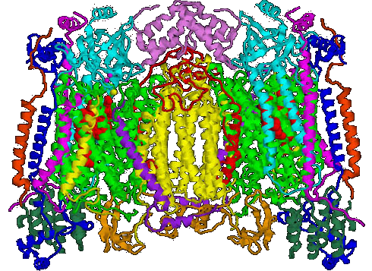
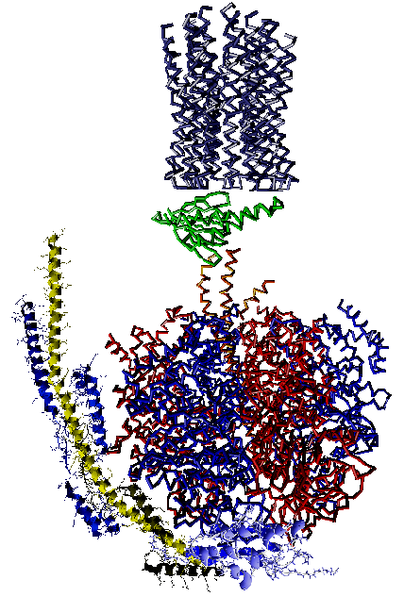
OXPHOS proteins
Intermembranary
space
Inner
membrane
NDE1
NDI1
matrix
O
X
P
H
O
S
C II
(CIII)₂
(CIV)₂
CV
31 OXPHOS proteins were reproducibly quantified in the 3 growth conditions and showed different abundances according to the condition
19 of these proteins were phosphorylated, displaying 37 phosphosites
→ important role of phosphorylation in the regulation of the respiratory chain
For most of them, proteins were more abundant and more phosphorylated in lactate medium (respiratory condition) except for 2 proteins

Slide 47
In progress
Permanent phosphorylated state
2
Ser, Thr , Tyr Glu, Asp
Site-directed mutagenesis
Permanent dephosphorylated state
Ser , Thr Ala
Tyr Phe
3
Structural and functional analysis of the respiratory complexes

Slide 48
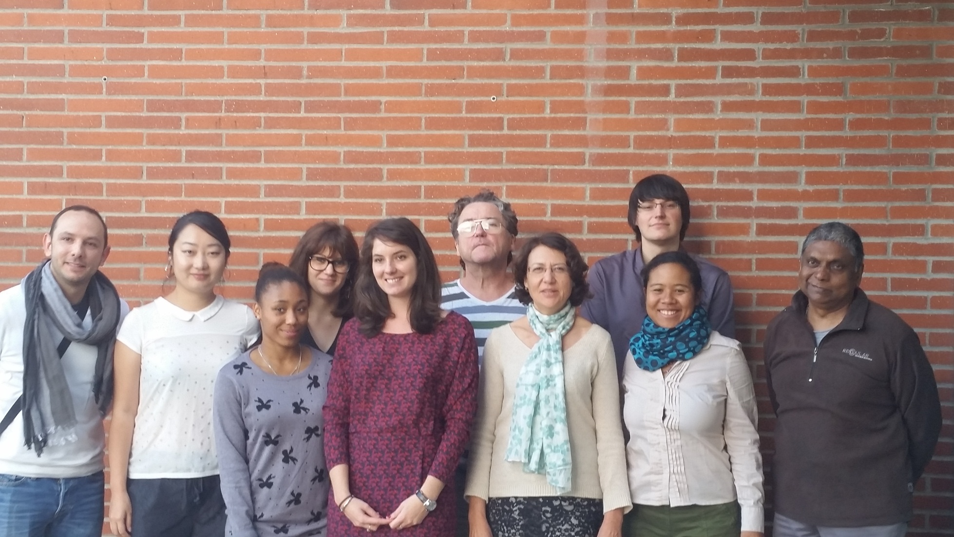
Acknowledgements
The team « Regulation of mitochondrial energy-transducing complexes »
Francis
Erwan
Elodie
Francis
Erwann
Mehdi
Qian
Margaux
Bosco
Laurélie
Claire
Deborah
Tiona

Slide 49



Acknowledgements
Collaborations
Ohio State University
Columbus, U.S.A.
I.B.G.C. ,Bordeaux
Marie-France Giraud
Daniel Brèthes
Isabelle Larrieu
Anne Devin
Michel Rigoulet
Michel Zivy
Ludovic Bonhomme
Marlène Davanture
Benoit Valot
Thierry Bailleau
Patrice Hamel
SBIGEM, Saclay
Gwenaëlle Le Roux
Christophe Carles
Financial support and encouragements: Bruno Robert, head of department B3S
Thank you for your attention

Slide 51
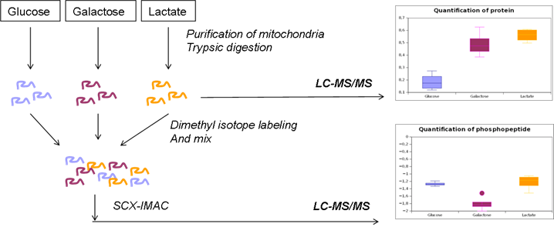

Slide 52
Cellular localization
of the 724 proteins identified

Slide 53
Maximum
.
4Q
1:
50%
Middle of 1
3Q
Median
2Q
2:
50%
.
Middle of 2
1Q
Minimum
Q : quartile

Slide 54
outlier
.
Maximum
4Q
1:
50%
Middle of 1
3Q
Median
.
2Q
2:
50%
Middle of 2
1Q
Minimum
Q : quartile

Slide 55
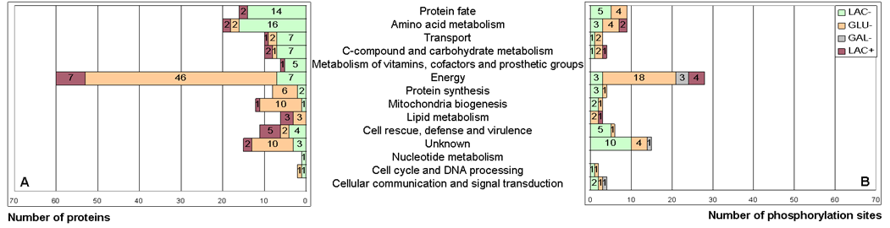
Variations of mitochondrial protein abundances and protein phosphorylation according to their metabolic pathways
Proteins associated with metabolic pathways according to the MIPS functional classification ( http:// mips.helmholtz-muenchen.de)
Conclusion: The most regulated metabolic pathway at both proteomic and phosphoproteomice levels is energy metabolism

Slide 56

Localization of phosphorylation sites on yeast OXPHOS proteins
O
X
P
H
O
S
Intermembranary
space
COR1
SDH1
SDH2
RIP1
ATP2
NDE1
Inner
membrane
NDI1
INH1
matrix
C II
(CIII)₂
(CIV)₂
CV
Globally, the level of phosphorylation varied in the same direction as protein amounts, except for 2 proteins (Rip1 and Atp2)

Slide 57
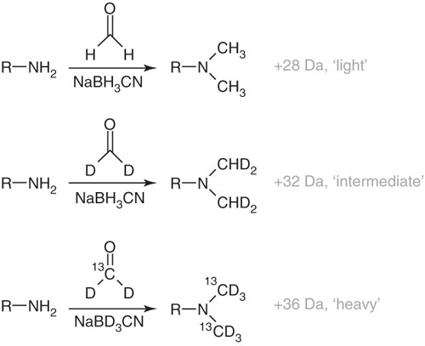
Stable Isotope Dimethyl labeling of trypsic peptides
Reaction of peptide primary amines with formaldehyde -→ base Schiff, reduced
by addition of cyanoborohydride
Regular
Formaldehyde/
cyanoborohydride
Deutered
Formaldehyde/
cyanoborohydride
Deutered and
C13-labeled
Formaldehyde/
cyanoborodeuteride

Slide 58
- SILAC: stable isotope labeling by amino acids in cell culture cells are grown in culture media lacking essential (auxotrophic) amino acid(s). These amino acids are then supplied in either their natural form or in a stable isotope form to cause in vivo incorporation of the labeled amino acid(s). The differentially labeled samples are mixed and digested with a protease (most often trypsin) to obtain samples that can be readily analyzed by the mass spectrometer.
iTRAQ : isobaric tagging for relative and absolute quantification
The ITRAQ method is based on the covalent labeling of the N-terminus and side chain amines of peptides from protein digestions with tags of varying mass. There are currently two mainly used reagents: 4-plex and 8-plex,

Slide 59
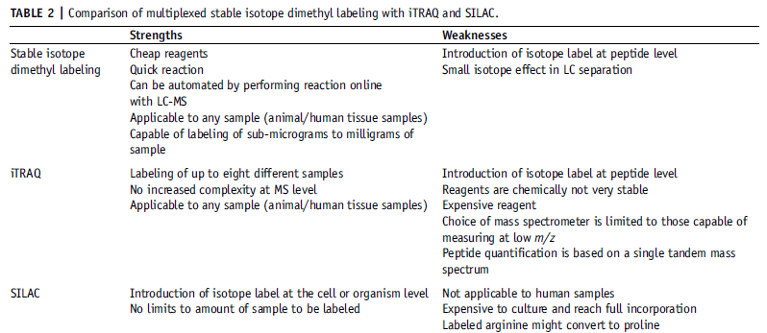

Slide 60
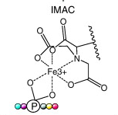

Slide 61
- Labeled peptides were dried by vacuum centrifugation and re-suspended in ACN/H2O:30/70, 0.5% formic acid, pH2
- Sample fractionation by strong cation exchange chromatography
(Bonhomme et al. , Mol Cell Proteomics, 2012, 11,957-972) using a Zorbax BioSCX-Series II column on a Ultimate LC system combined with a Famos autosampler and a Switchos II microcolumn switch system (LC packings)
Samples automatically collected to form 12 fractions
Each fraction was dried by vacuum centrifugation and re-suspended in
ACN/H2O:30/70, 250mM acetic acid
- Incubation with Phos-select affinity gel during 1H
- Washed in SigmaPrep spin column 2 fold with ACN/H2O:30/70, 250mM acetic acid
- Elution of phosphopeptides in SigmaPrep spin column with ACN/H2O:30/70, 0.4M ammonium hydroxide
Enrichment very effective :24% phosphorylated peptides
(non-enriched samples: 4 phosphopeptides)
88% of unphosphorylated peptides contained one ASP or GLU -→
limit of IMAC methodology (strong affinity for acidic peptides)

Slide 62
Phosphoproteomic analysis
The phosphopeptides were identified in 299 proteins of which :
150 displayed 1 site of phosphorylation
72 displayed 2 sites of phosphorylation
27 displayed 3 sites of phosphorylation
50 displayed 4 sites of phosphorylation or more
71% serine
16% threonine
0.6% tyrosine
12.6% not precisely localized in the peptide sequence

