Slide 1
Analysis and Application of Speciated Atmospheric Mercury
Leiming Zhang
Air Quality Research Division
Science and Technology Branch
Environment Canada

Slide 2
Outline
Background information
Overview of data applications
Selected example studies

Slide 3
Background information
Atmospheric mercury (Hg) is operationally defined as:
Gaseous elemental Hg (GEM)
typically 1.0-2.0 ng m⁻³, 0.5-2 years
Gaseous oxidized Hg (GOM) or reactive gaseous Hg (RGM)
Particulate-bound Hg (PBM)
typically 1.0-20.0 pg m⁻³ in North America, could be higher in Asian countries, hours to weeks

Slide 4
Background information
dry, wet deposition
Atmospheric mercury
collected by the surface
microbial activity
methylmercury
streams, lakes, etc.
food chain
Other animals
including human beings
accumulates in fish
e.g., ‘Minamata Disease’ in Japan, 1930-1970’s

Slide 5
Background information
Potential applications:
Identifying Hg source-receptor relationships (Lynam et al., 2006; Swartzendruber et al., 2006; Choi et al., 2008; Rutter et al., 2009; Weiss-Penzias et al., 2009; Huang et al., 2010; Sprovieri et al., 2010; Cheng et al., 2012, 2013)
Understanding Hg cycling and partitioning (Engle et al., 2008; Steffen et al., 2008; Amos et al., 2012)
Evaluating Hg transport models (Baker and Bash, 2012; Zhang et al., 2012a)
Quantifying Hg dry deposition budget (Engle et al., 2010; Lombard et al., 2011; Zhang et al., 2012b)

Slide 6
Overview of data application
- Sour-receptor studies
Objectives: Identify and quantify the contributions of sources to receptor measurements (e.g., atmospheric Hg, aerosols, ozone, VOCs concentrations in air and deposition)
Methods: Data analysis and models require receptor measurements to interpret sources and quantify their contributions
  Multivariate models (e.g., Positive Matrix Factorization, Principal Components Analysis) – input pollutant of interest, other pollutant markers, and meteorological parameters
  Back trajectory models (e.g. HYSPLIT)
  Hybrid Receptor Models (combining source contributions or pollutants data with back trajectory data) (e.g., Potential Source Contribution Function, Concentration-weighted trajectory model)
  Analysis of trends (e.g., seasonal and diurnal patterns, wind direction analysis, analysis of elevated pollution events)

Slide 7
Receptor model | Advantages | Disadvantages
Positive Matrix Factorization (Keeler et al., 2006) | Multivariate Down-weight variables based on signal to noise ratio | Requires knowledge of source profiles Chemical reactions and transformation not included
Principal Components Analysis (Huang et al., 2010) | Multivariate Available in most statistical software | Similar to PMF model
HYSPLIT back trajectories (Lyman and Gustin, 2008) | Identify potential locations of sources Models air mass transport | Uncertainties in the distance travelled Applies more to regional than local airflows
Potential Source Contribution Function (Fu et al., 2011) | Mapping of probable source areas based on trajectory residence time | Applies to concentrations above an arbitrary threshold only
Gridded Frequency Distribution (Gustin et al., 2012) | Use of multiple trajectory start heights and locations | Applies to elevated pollution events only
Concentration-weighted trajectory model (Cheng et al., 2013) | Concentration is the weighting factor for the trajectory residence time | Model evaluation requires comprehensive emissions inventory
Watson et al., 2008

Slide 8
Example major findings from source-receptor studies
Positive Matrix Factorization and UNMIX models both identified coal combustion as the dominant contributor (70%) to Hg wet deposition in eastern Ohio (Keeler et al., 2006)
Analysis of seasonal and diurnal patterns and Gridded Frequency Distribution identified local electricity power plants, long-range transport from U.S. Northeast, and vehicular emissions as potential sources contributing to Hg dry deposition in Florida (Gustin et al., 2012)
Principal Components Analysis identified 6 factors affecting speciated atmospheric Hg in Rochester, New York: snow melt, coal combustion, Hg oxidation, wet deposition, traffic, other combustion (Huang et al., 2010)
Concentration-weighted trajectory model identified industrial sources and fossil fuel power plants in southern Ontario and Quebec and eastern U.S. affecting speciated atmospheric Hg in Dartmouth, Nova Scotia (Cheng et al., 2013)

Slide 9
Overview of data application
Hg cycling and partitioning
Some studies focused on the understanding of Hg cycling and partitioning (Engle et al., 2008; Steffen et al., 2008; Rutter and Schauer, 2007)
Wang (2010), Zhang (2012) conducted studies of gas-particle partitioning at emission sources
Amos et al. (2012) developed a regression model for the partitioning coefficient
Cheng et al. (2014) further developed partitioning regression models

Slide 10
Overview of data application
- Evaluating Hg transport models
Zhang et al. (2012) first evaluated CMAQ and AURAMS using AMNet data, and identified a factor of 2-10 over prediction of surface concentrations of GOM and PBM from Hg transport models
Baker and Bash (2012) found similar conclusions using a later version of CMAQ
Two other studies evaluated GEO-CHEM
Kos et al. (2013) explored causes of the discrepancies between measured and modelled GOM and PBM

Slide 11
Overview of data application
- Estimating Hg dry deposition
Most studies only included GOM and PBM in the dry deposition budget (Engle et al., 2010; Lombard et al., 2011; Amos et al., 2012)
Zhang et al. (2012) estimated speciated dry deposition and using litterfall Hg as constrain, and identified GEM is as important as or more important than GOM+PBM over vegetated surfaces.
Sakata, M., and K. Asakura (2007), Cheng et al. (2014) estimated speciated Hg to Hg wet deposition

Slide 12
Selected example studies
Source-receptor study comparing a coastal and inland rural site
Gas-particle partitioning regression modeling
Speciated and total Hg dry deposition at AMNet

Slide 13
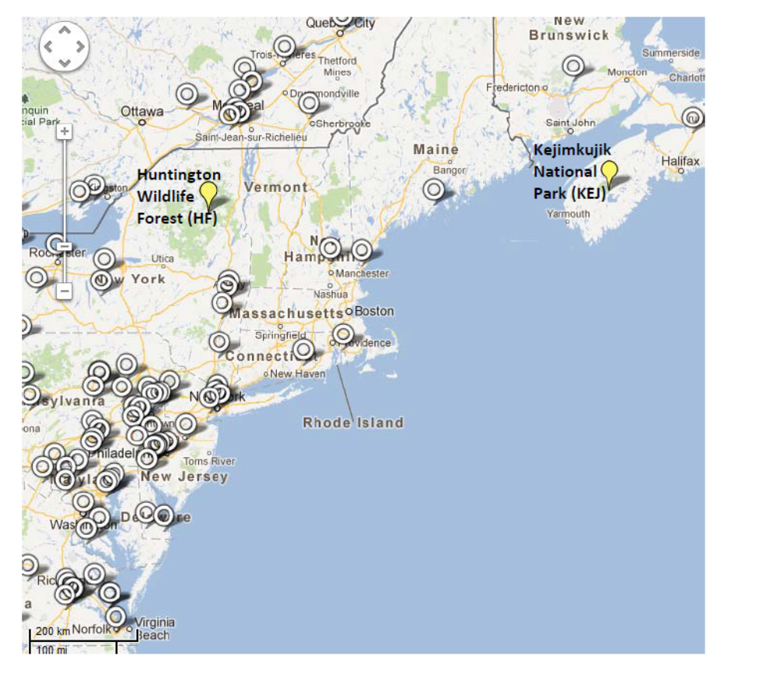
Source-receptor study comparing a coastal and inland rural site
Goal: Compare sources and atmospheric processes affecting GEM, GOM, and PBM at a coastal (Kejimkujik National Park, Nova Scotia) and inland site (Huntington Wildlife Forest, New York)
Cheng I, Zhang L., Blanchard P., Dalziel J., Tordon R., Huang J., Holsen T.M., 2013. Comparing mercury sources and atmospheric mercury processes at a coastal and inland site. JGR -Atmosheres, 118, 2434-2443

Slide 14
Motivation
  Both sites were identified as biological Hg hotspots in NE North America
  Potential difference in sources and atmospheric processes between coastal and inland sites: influence of the marine boundary layer
    Evasion of GEM from the ocean – largest source of natural and re-emitted Hg globally
    Adsorption of GOM by sea-salt aerosols
    Photochemical production of GOM from GEM-bromine reactions – the ocean is a major source of Br

Slide 15
Results – Comparing the coastal and inland site
Potential Sources or processes (from PCA factors) | Coastal site | Inland site | APCS for the coastal site
Combustion and industrial sources | ☑ | ☑ | Coastal > land airflows (Shipping port source)
Wildfires | ☑ | ☑
Hg condensation on particles in winter | ☑ | ☑ | Land and coastal > oceanic airflows
GEM evasion from ocean | ☑ |  | Oceanic > land and coastal airflows
Urban emissions |  | ☑ | N/A
Hg wet deposition |  | ☑ | N/A
Photochemical production of GOM or transport from free troposphere | ☑ | ☑ | Not statistically different between airflow patterns

Slide 16
Conclusions
Factor representing combustion and industrial source was found only in 2009 and not in 2010 for the two sites
  Possible explanation is large SO₂ and NO_{x} emission reductions from coal utilities in U.S. over the same time frame
Influence of marine airflow is the key difference in sources and processes affecting speciated atmospheric Hg concentrations at a coastal and inland site
  Evasion of GEM from ocean
  GOM production by GEM-Br reaction is potentially occurring at low O₃ concentrations (<40 ppb) – however there are still many uncertainties on the reactions that produce GOM

Slide 17
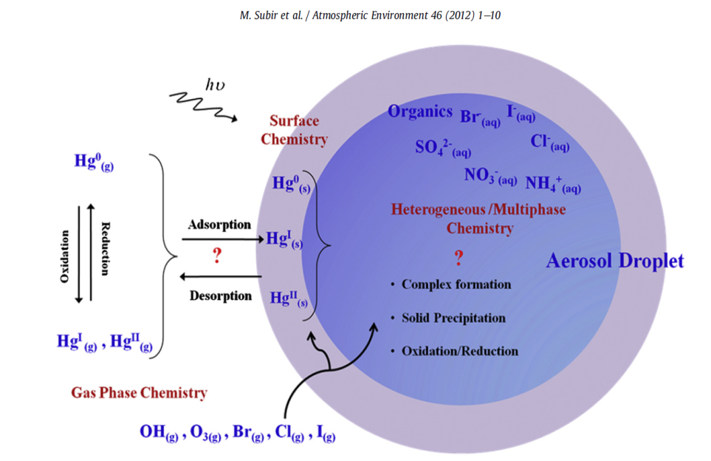
Regression modeling of GOM and PBM partitioning
Hg(II) can distribute between the gas (GOM) and particulate phases (PBM)
Theories on how Hg(II) partitions: condensation of GOM, adsorption, heterogeneous and aqueous phase chemical reactions
Potential factors affecting partitioning of semi-volatile pollutants: Air temperature, Aerosol water uptake and relative humidity, Aerosol chemical composition – also affects the 2nd factor
Subir et al., 2012, Atmos. Environ., 46
Figure illustrates the number of ways Hg(II) may interact with aerosols
Cheng I., Zhang L., and Blanchard P., 2014. Regression modeling of gas-particle partitioning of atmospheric oxidized mercury from temperature data. Journal of Geophysical Research –Atmospheres. Revised.

Slide 18
Motivation
Understanding processes affecting GOM and PBM concentrations in air
Improving mercury deposition estimates and assessing impacts to ecosystems
  Majority of chemical transport models assume Hg(II) is distributed at fixed ratios between the gas and particulate phases regardless of the location – not supported by scientific theory
  Need to develop Hg(II) gas-particle partitioning model with a stronger theoretical basis, e.g. a surface adsorption model that parameterizes gas-particle partitioning using a partition coefficient (K_{p})

Slide 19
Methodology
Hg(II) partition coefficient:
  K_{p} = f(temperature)
Hg(II) fraction in particles:
  Alternative gas-particle partitioning parameter used in literature
Apply regression analysis to develop models for K_{p} and f_{PBM} as a function of temperature
Collect ambient air data from 10 Atmospheric Mercury Network sites in U.S. and Canada:
  PBM and GOM – AMNet uses Tekran Hg speciation system
  PM_{2.5} – USEPA AirData and Environment Canada NAPS network
  Air temperature – USEPA CASTNET

Slide 20
Regression model results
Generalized K_{p}-temperature model:
  Daytime data points included, low GOM and PBM excluded in regression model – remove data with large uncertainties data
  Applied linear and nonlinear models – exponential function provided best data fit for K_{p} vs. 1/T in terms of R²
Site(s) | Regression Equation | R²
NS01 | Log(1/K_{p}) = 15.41 – 4285.73(1/T) | 0.59 | This study Strong R² at only 2/10 sites
VT99 | Log(1/K_{p}) = 11.93 – 3258.75(1/T) | 0.54
NS01 and VT99 (combined data) | Log(1/K_{p}) = 12.69 – 3485.30(1/T) | 0.55
5 sites combined | Log(1/K_{p}) = 10 – 2500(1/T) | 0.49 | Amos et al. (2012)
Urban site | Log(1/K_{p}) = 15 – 4250(1/T) | 0.77 | Rutter and Schauer (2007)
Urban site | Log(1/K_{p}) = 7 – 1710(1/T) | 0.49

Slide 21
Regression model results
Model evaluation of Log(1/K_{p}) = 12.69 – 3485.30(1/T):
  Applied the single K_{p} equation to all 10 sites
  Average predicted and observed K_{p} were more comparable than previous models at 7/10 sites
    Larger discrepancies for 3 near-source sites may be due to different % of speciated Hg emitted from nearby sources
  Model K_{p} in this study have a wider range and higher values than in previous models
  Predicted and observed K_{p} correlations: r = 0.12-0.46
Site-specific Hg(II) gas-particle partitioning models:
  Log(1/K_{pavg}) = a + b/T (exponential) and f_{PBMavg} = c + d/T (linear) developed for each of the 10 sites
  K_{pavg} and f_{PBMavg} is the average corresponding to each 2⁰C temperature interval
    2-4 hr K_{p} and f_{PBM} have large variability; averaging could reduce the variability and may improve the model R²

Slide 22
Site-specific model results
Model evaluation of site-specific models:
  Model fit of data improved: R² = 0.5-0.96 at 9/10 sites
  Good agreement with average observed K_{p} and f_{PBM}
  Good agreement with monthly average observed K_{p} and f_{PBM}
  Weak correlation between predictions and observations (2-4 hr): r = 0.11-0.43
    2-4 hr K_{p} and f_{PBM} may be influenced by other factors (source effects, wind direction changes?)
    Exact chemical composition of Hg(II) unknown – potentially affect aerosol water uptake and Hg(II) aqueous-phase reactions
Overall, results show strong temperature dependence of Hg(II) particle partitioning

Slide 23
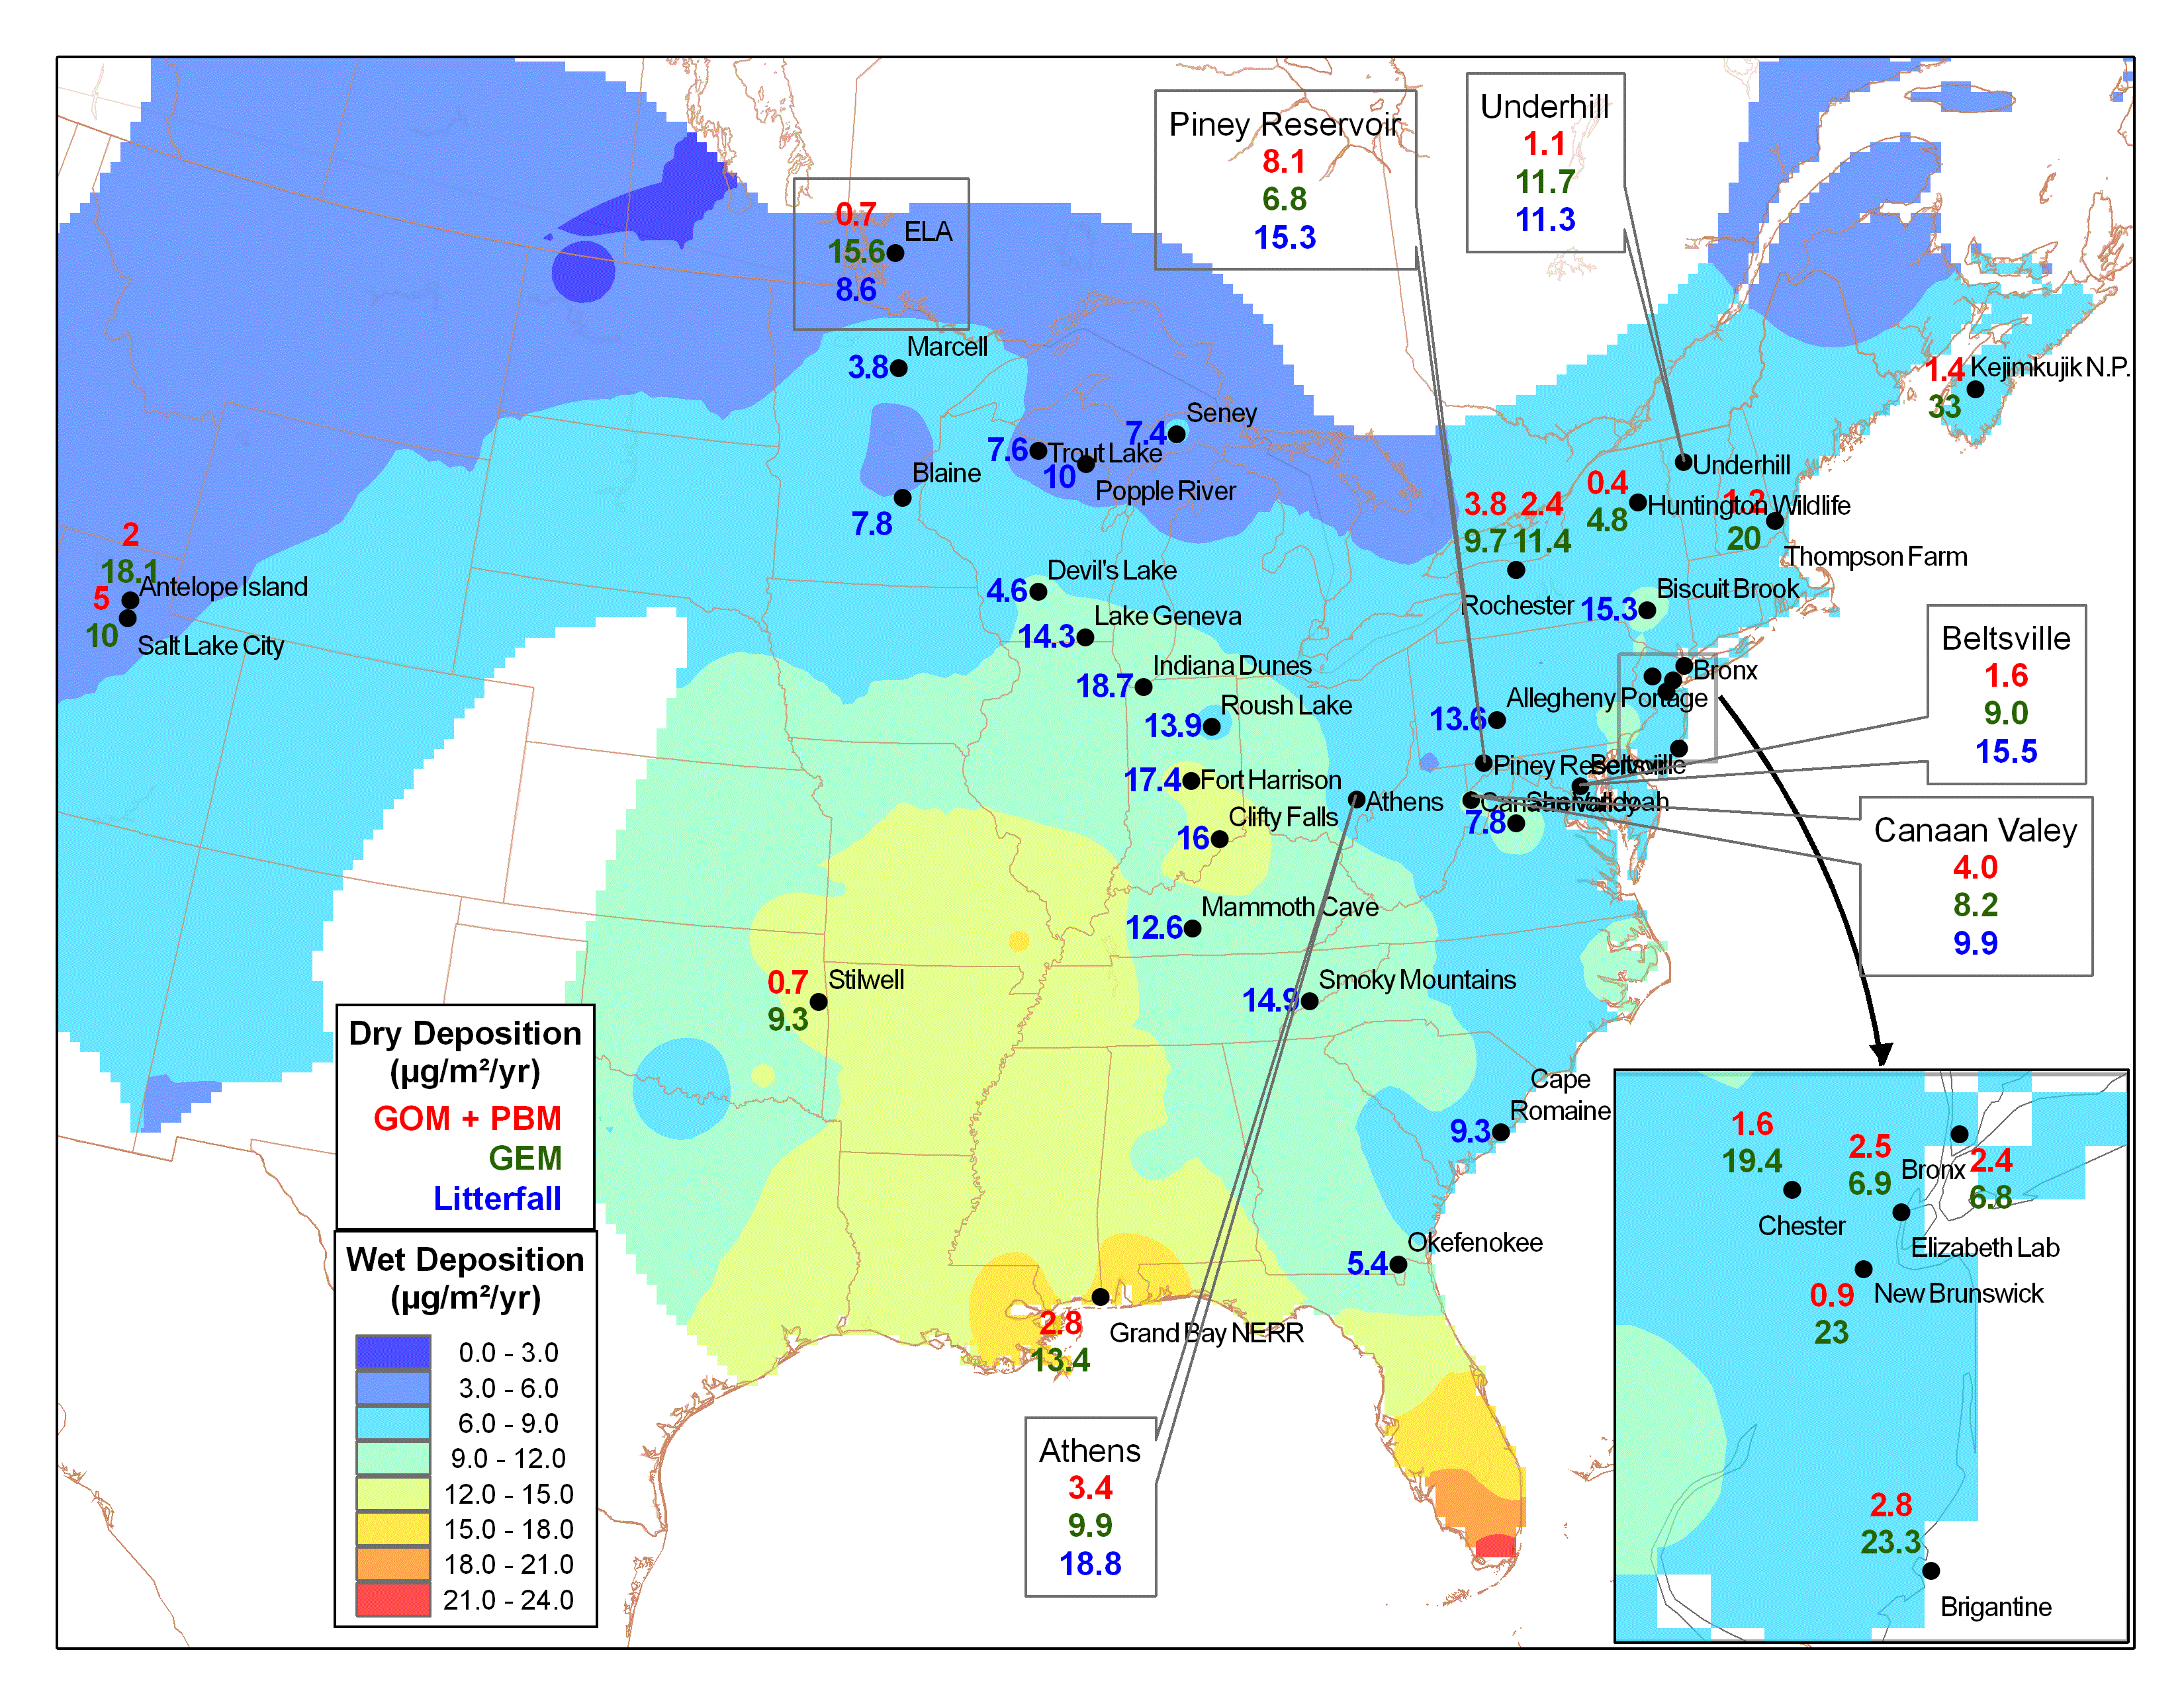
Speciated and total Hg dry deposition at AMNeT

Slide 24
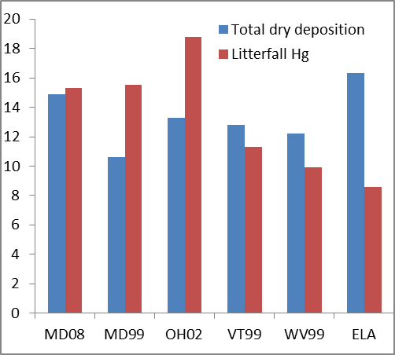
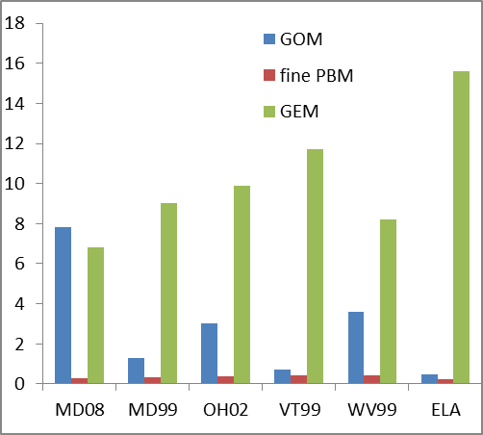
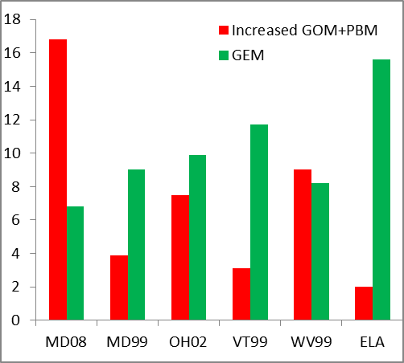
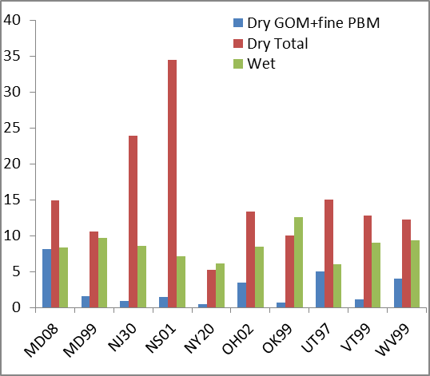

Slide 25
Conclusions
Estimated dry deposition amount is supported by litterfall measurements
GEM deposition is as important as or more important than RGM+Hgp
A large portion of litterfall is from GEM deposition
Dry deposition is in a similar magnitude to wet deposition
Significant seasonal and spatial pattern have been identified
Known uncertainties should not change the major conclusions (e.g., doubling GOM+PBM dry deposition)

