Slide 1

Health-care Cost Outcomes and Adherence to Screening Guidelines in a Health-Insured Population, South Africa
Dr. Leegail Adonis,
University of Witwatersrand, Johannesburg, South Africa

Slide 2
Overview
Background
  South African Health Insurance Climate
  Discovery Health and Discovery Vitality Programmes
  The Incentivized Screening Programme
Aim of the study
Methodology Utilized
Results
Discussion
Limitations
Conclusion

Slide 3



Background
Health Care funding in South Africa- largely through National Treasury
Approx. 14% population insured.
Discovery Health 40% market share
Voluntary Wellness Program that Incentivizes Preventive Screening

Slide 4
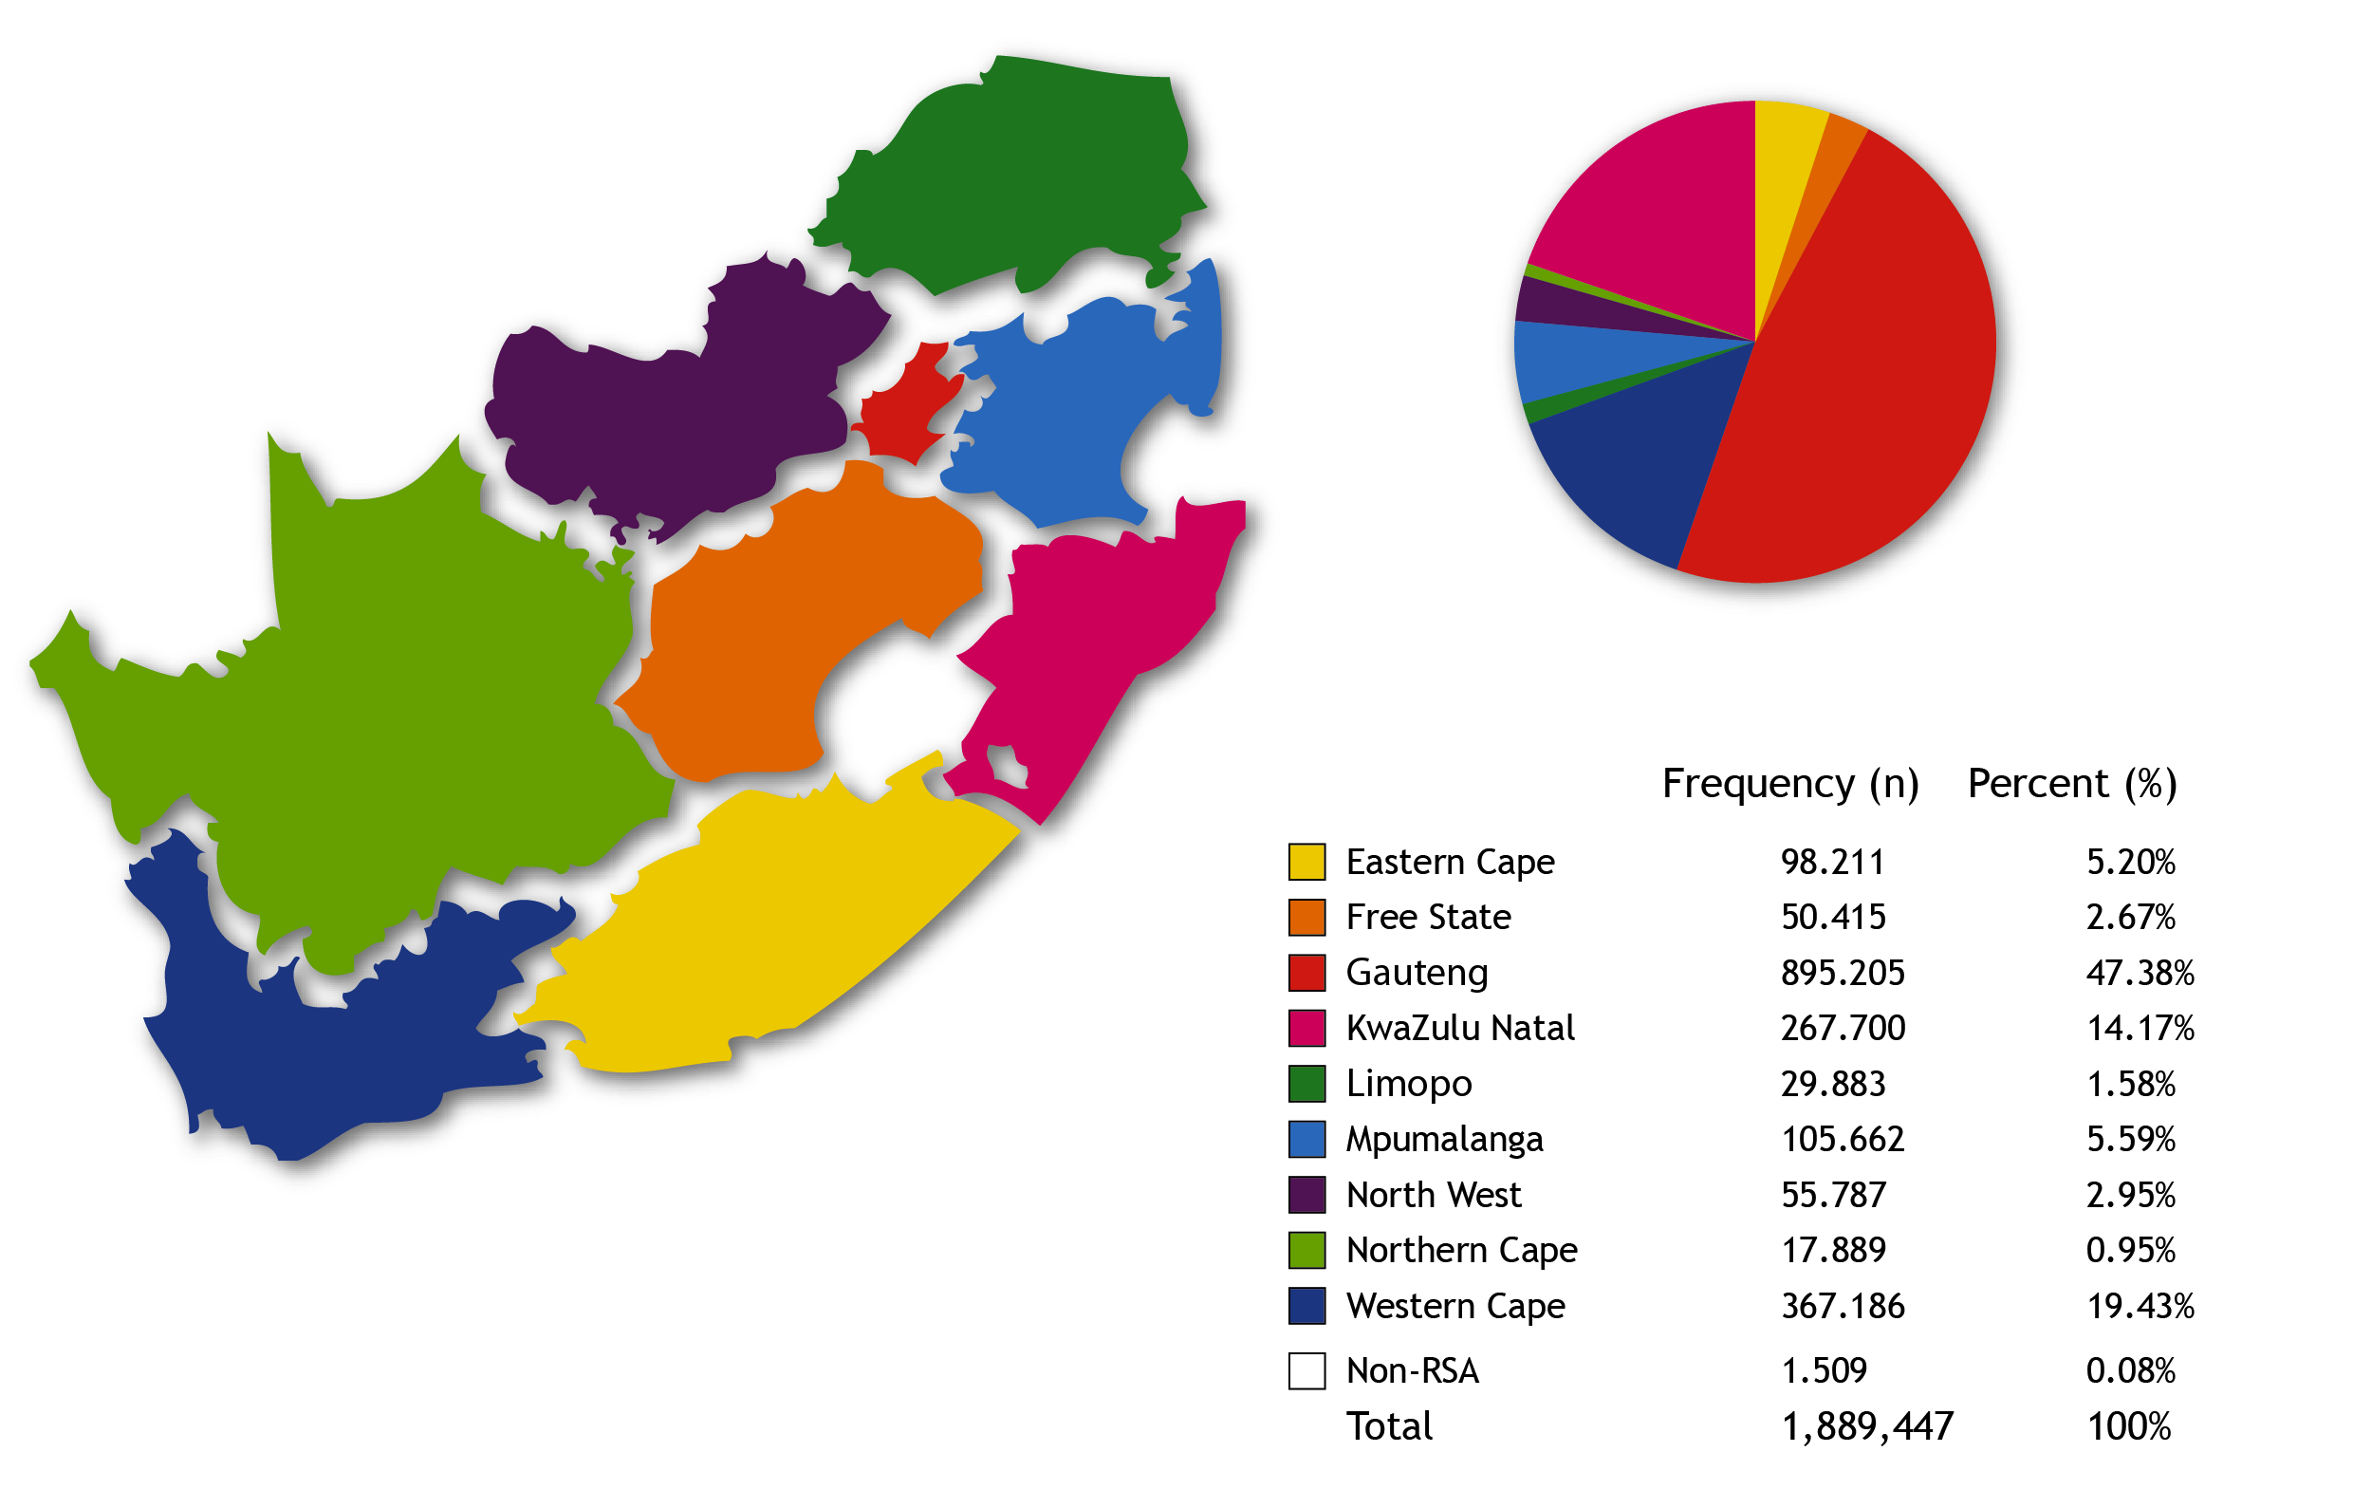
64% Members belong to Wellness Program

Slide 5
The Screening Program
Screening Test | Frequency (Adapted recommendations from USPSTF)
Cholesterol | Adults (18 years and older), Once every 5 years
Glucose | Adults, Once every 5 years
Pap Smear | Females (16 years and older), Once every 3 years
Mammogram | Females (35 years and older), Once every 2 years
Colorectal cancer test | Adults (50 years and older): Colonoscopy and Sigmoidoscopy, once every 5 years; Faecal occult blood: yearly
Prostate Specific Antigen | Males (50 years and older), Yearly
HIV | Adults, Yearly
Bone Density Scan | Females (60 years and older), Yearly
Glaucoma | Adults (40 years and older), Once every 5 years

Slide 6
Rationale for Research Question
Certain population-based screening programs- impact on decreasing morbidity and mortality
Prevention is not necessarily cheaper than cure, and not all population screening is less expensive than cure of the disease
BUT.......
Are there certain categories of people who when adhering to screening guidelines, Do Incur a Cost Saving?

Slide 7
Aim and Research Question of the Study
Aim: assess whether there is any difference in the level of health care utilization between those who are up to date with screening and those who are not

Slide 8
Methodology
  Retrospective longitudinal cohort: 2006-2011
  Random 1% sample -170,471
  Males and Females - disaggregated into different age groups (according to age-related screening recommendations)
  Screening rates calculated for different age groups
  Health care expenditure calculated (and compared) for those up to date with screening recommendations and those not up to date with screening recommendations for:
    Out Patients, In hospital, GP, Specialists, Acute medication, Chronic medication

Slide 9
Methodology
  Health care utilization and expenses calculated from claims data and CPT codes
  Difference in health care expenses and utilization - Wilcoxon Ranksum, Median & IQR; 95% CI at 5% significance
  Linear regression evaluate the association between expenses/utilization and up to date screening

Slide 10
Results
Age Category | Total number eligible | Recommended screening tests | Number up to date with screening tests | Screening rate
Females 16-18years | 1942 | Pap smears | 43 | 2.21%
Females 19-35years | 22 663 | Pap smears, Cholesterol, Glucose, HIV | 501 | 2.21%
Females 36-40years | 6 922 | Pap smears, Cholesterol, Glucose, HIV Mammogram | 89 | 2.29%
Females 41- 50years | 10 871 | Pap smears, Cholesterol, Glucose, HIV Mammogram Glaucoma | 36 | 0.33%
Males 18-40years | 26 537 | Cholesterol, Glucose, HIV | 775 | 2.95%
Males 41- 50years | 9 990 | Cholesterol, Glucose, HIV, Glaucoma | 97 | 0.97%

Slide 11
Results
Significant p<0.05

Slide 12
Results
Significant p<0.05
Specialist visits: Up to date: 3.4 vs. Not up to date: 2.3

Slide 13
Results
Significant p<0.05
Females 41 – 50 years
 | Up to date | Not up to date
Number of Acute meds | 13.4 | 6.1
Acute Meds Expenses | R2374.10 | R845.38
Males 41 – 50 years
 | Up to date | Not up to date
Number of Acute meds | 13.4 | 6.1
Acute Meds Expenses | R2374.10 | R845.38

Slide 14
Results
Significant p<0.05
Males 18 – 40 years
 | Up to date | Not Up to date
In patient Expenses | R2471.18 | R5171.29
Number of GP visits | 2.2 | 2.7
Number of Specialist visits | 1.9 | 2.4
Specialist expenses | R2302.59 | R2909.49
Number of acute meds | 5.0 | 6.0
Acute meds expenses | R724.90 | R847.47
Number of chronic meds | 1.2 | 3.4
Chronic meds expenses | R406.58 | R640.93

Slide 15
Difference in Health Care Cost and Resource Utilization Between those Up to Date with Screening and those Not Up to Date
Health Care Costs and Resource Utilization (Median ZAR per member per annum) | Females 16-18 | Females 19-35 | Females 36-40 | Females 41-50 | Males 18-40* | Males 41-50
Out Patient Expenditure | Higher | Higher | Higher | Higher | Lower | Higher
In Patient Expenditure | Higher | No difference | No difference | No difference | Lower | No difference
No. of GP Visits | Higher | No difference | No difference | No difference | Lower | No difference
GP Expenditure | Higher | Higher | No difference | No difference | No difference | Higher
No. of Specialist Visits | Higher | Higher | Higher | Higher | Lower | Higher
Specialist Expenditure | Higher | Higher | Higher | Higher | Lower | Higher
No. of Acute Meds | Higher | Higher | Higher | Higher | Lower | Higher
Acute Meds Expenditure | Higher | Higher | Higher | Higher | Lower | Higher
No. of Chronic Meds | Lower | No difference | No difference | No difference | Lower | No difference
Chronic Meds Expenditure | No difference | No difference | No differnece | No difference | Lower | No difference
Resource Utilization Bands | No difference | Higher | No differnece | Higher | Lower | Higher
No. of Chronic Conditions | No difference | Lower | No differnece | No difference | Lower | Higher
No. of Admissions | No difference | Higher | No differnece | No difference | Lower | Higher
Length of Stay | No difference | Lower | No differnece | No difference | Lower | No difference
All Significant p<0.05.

Slide 16
Correlation Co-efficient and Regression Output¶ | Females 16-18 years | Females 19-35 years | Females36-40 years | Females 41-50 years | Males 18-40 years | Males 41-50 years
Out Patient Expenditure | 0.003 | 0.006* F(1,140753)=11.28 | 0.003 | 0.011* F(1,140753)=11.90 | 0.004 | 0.014* F(1,140753)=29.74
In Patient Expenditure | -0.002 | 0.000 | -0.003 | -0.001 | -0.008* F(1,140753)=32.4 | -0.002
GP visits | 0.005* F(1,140753)=4.08 | -0.004 | -0.004 | 0.001 | -0.012* F(1,140753)=34.8 | 0.004
GP Expenditure | 0.007* F(1,140753)=6.50 | 0.006 | 0.000 | 0.005 | -0.001 | 0.008* F(1,140753)=6.51
Specialist visits | 0.001 | 0.013* F(1,140753)=30.69 | 0.001 | 0.005* F(1,140753)=6.10 | -0.008* F(1,140753)=11.2 | 0.004
Specialist Expenditure | -0.000 | 0.008* F(1,140753)=15.98 | -0.001 | 0.005 | -0.005 | 0.003
Acute Medications | 0.006* F(1,140753)=5.43 | 0.012* F(1,140753)=27.23 | 0.009* F(1,140753)=9.30 | 0.012* F(1,140753)=5.84 | -0.009* F(1,140753)=27.8 | 0.013* F(1,140753)=6.18
Acute Medication Expenditure | 0.006* F(1,140753)=3.72 | 0.008* F(1,140753)=13.15 | 0.009* F(1,140753)=6.95 | 0.014* F(1,140753)=4.86 | -0.001* F(1,140753)=8.84 | 0.017* F(1,140753)=4.60
Chronic Medications | -0.005 | -0.012* F(1,140753)=103.47 | -0.003 | -0.001 | -0.014* F(1,140753)=113.34 | 0.007* F(1,140753)=2.64
*Significant at p<0.05 ¶ R² = 0.00

Slide 17
Discussion
Proportion of eligible population up to date with all screening tests - extremely low
Screening rates tend to decrease with increasing age
Most Age categories health care expenses and utilization: 64% - 14% higher in Up to date category
Males 18 – 40 years; health care utilization and expenses: 64% - 16% LOWER in Up to date category
Significant association demonstrated for Males aged 18-40 years

Slide 18
Conclusion
Older age – smaller proportion up to date with screening
Up to date with screening tests – not necessarily infer cost saving for all
Males aged 18-40 years – up to date with screening – use less health care, lower costs
  May be: fewer tests, gender specific utilization patterns, compared to females in that age category – men may be healthier?

Slide 19
Limitations
Cross-sectional analyses – no causal inferences, only associations
Requires further exploration regarding disease specific outcomes and health care utilization
Need further research to understand male pattern of health care utilization – given that males generally have shorter life-expectancy

Slide 20
Thank You

