Slide 1
The cancer chemopreventive potential of novel Streptomyces strains derived from mangrove forest
Presented by: Lee Learn Han Cbiol MRSB
Core Member of Project: Ser Hooi-Leng & Goh Bey-Hing
2nd Applied Microbiology and Beneficial Microbes,
October 23-25, Osaka, Japan

Slide 2
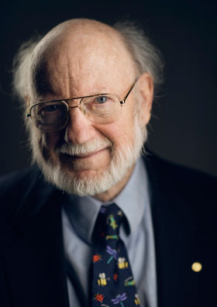
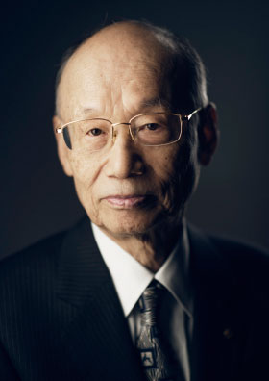
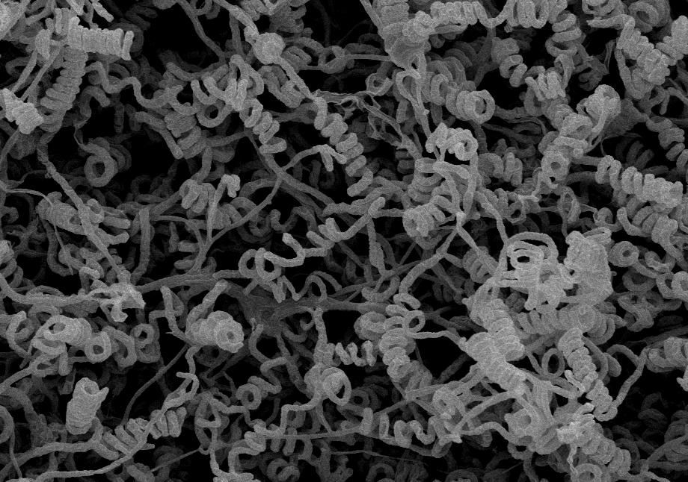
Background – Genus Streptomyces
Streptomyces avermitilis
Streptomyces
High GC %
Large genome
Complex life cycle
Prolific producers
Prof. William C. Campbell
Prof. Satoshi Ōmura
The Nobel Prize in Physiology or Medicine 2015
Avermectin & Ivermectin (synthetic)
Effective against river blindness and elephantiasis
(Subramani and Aalbersberg, 2012; Kumar et al., 2014; Mannivasagan et al., 2014a; Mannivasagan et al., 2014b; Xu et al., 2014)
Notes:
Streptomyces genome size - ~9-12 Mbps
Bacillus - ~5-6 Mbp

Slide 3
Background – Mangrove forest
Region | Area (km²) | Global total %
East Africa | 7,917 | 5.2
Middle East | 624 | 0.4
South Asia | 10,344 | 6.8
Southeast Asia | 51,049 | 33.5
East Asia | 215 | 0.1
Australasia | 10,171 | 6.7
Pacific Ocean | 5,717 | 3.8
North and Central America | 22,402 | 14.7
South America | 23,882 | 15.7
West and Central Africa | 20,040 | 13.2
Total | 152,361
Tidal current
Salinity
Oxygen
Temperature
Metabolic adaptations
Valuable useful metabolites
(Alongi, 2002; Giri et al., 2010)
Table 1: Summary of world mangrove areas (ITTO, 2014).

Slide 4
Background – Free radicals and cancer initiation
Antioxidant defence
Free radicals
Antioxidant defence
Free radicals
Pathological
Normal
Oxidative stress
Notes:
Free radicals are atoms or groups of atoms with an odd (unpaired) number of electrons and these are the main byproducts formed in the cells of aerobic organisms, and can initiate autocatalytic reactions so that molecules to which they react are themselves converted into free radicals to propagate the chain of damage. The harmful effects of ROS are balanced by the action of antioxidants, some of which are enzymes present in the body. When there is overproduction of free radicals and the antioxidant defence system fails to control these harmful molecules, a pathological condition called oxidative stress occurred.
Oxidative stress has been implicated in aging and age-dependent diseases such as cardiovascular disease, cancer, neurodegenerative disorders and other chronic conditions.
https://www.ncbi.nlm.nih.gov/pmc/articles/PMC2684512/

Slide 5
Background – Free radicals and cancer initiation
Free radicals accumulation
DNA damage
O₂⁻
O₂⁻²
O₂
Cancer initiation & progression
H₂O₂
Mitochondria damage
·OH
OH⁻
Oxidative stress
Cell membrane damage
Notes:
Oxidative stress has been implicated in aging and age-dependent diseases such as cardiovascular disease, cancer, neurodegenerative disorders and other chronic conditions.
To induce oxidative stress in the neuronal cells, hydrogen peroxide was used as a inducer. Even though with short half-life, H₂O₂ is highly soluble in water and dissociates to hydroxyl and superoxide ions, which leads to oxidative damage to important macromolecules and ultimately cell death.

Slide 6
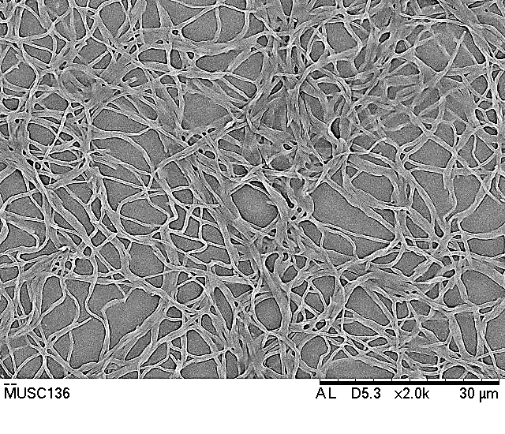
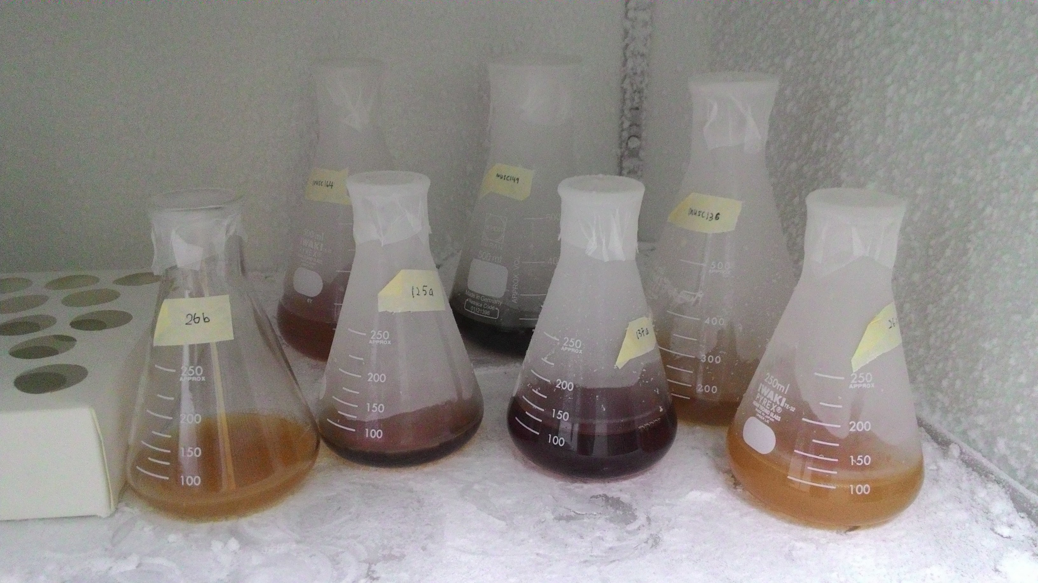
Aim of the study
87 Actinobacteria
52 Streptomyces
4 novel strains
To examine novel strains via polyphasic approach
To investigate bioactive potential of their extracts

Slide 7
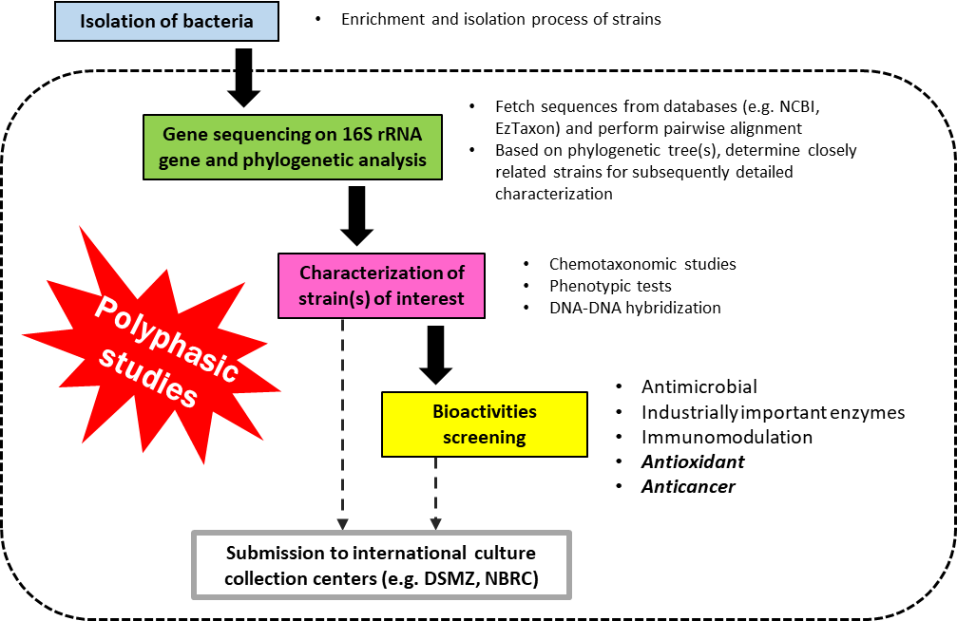
General workflow: The basis of polyphasic approach

Slide 8
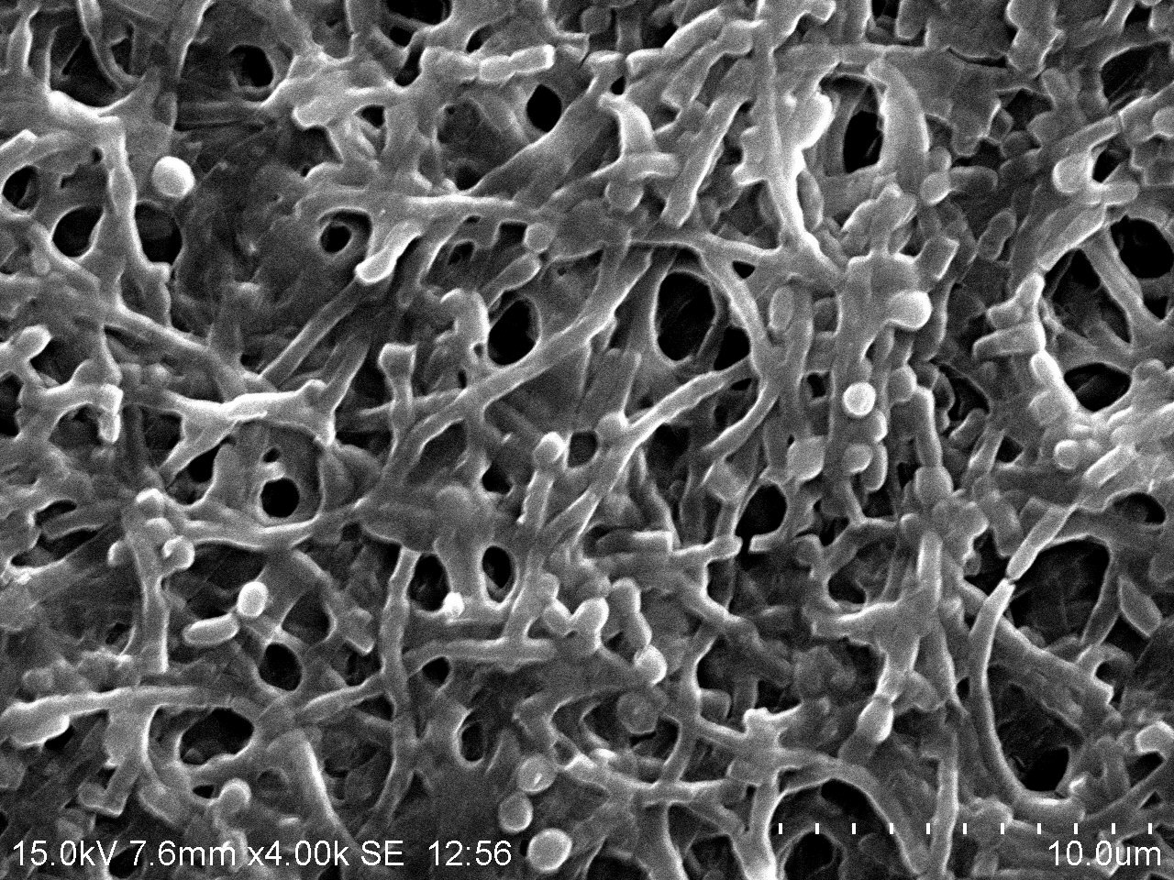
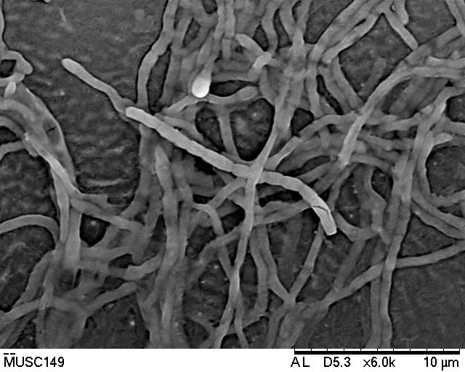
Results – Morphology of four novel strains
Streptomyces gilvigriseus MUSC 26^{T}
Streptomyces antioxidans MUSC 164^{T}
Streptomyces mangrovisoli MUSC 149^{T}
Streptomyces malaysiense MUSC 136^{T}
Notes:
gilvus, yellow; L. adj. griseus, grey – yellow-grey mycelium

Slide 9
Results – 16S rRNA sequencing of MUSC 136^{T}
Comparison of 16S rRNA genes on EzBiocloud server
Table 2: 16S rRNA gene similarities between MUSC 136^{T} and closely related strains.
Type strains | 16S rRNA similarities with MUSC 136^{T}
Streptomyces misionensis NBRC 13063^{T} | 99.6%
Streptomyces phaeoluteichromatogenes NBRC 5799^{T} | 99.6%
Streptomyces rutgersensis NBRC 12819^{T} | 98.9%
↑ similarity level
↑ number of species in Streptomyces genus
(823 species described)
Phylogenetic tree construction

Slide 10
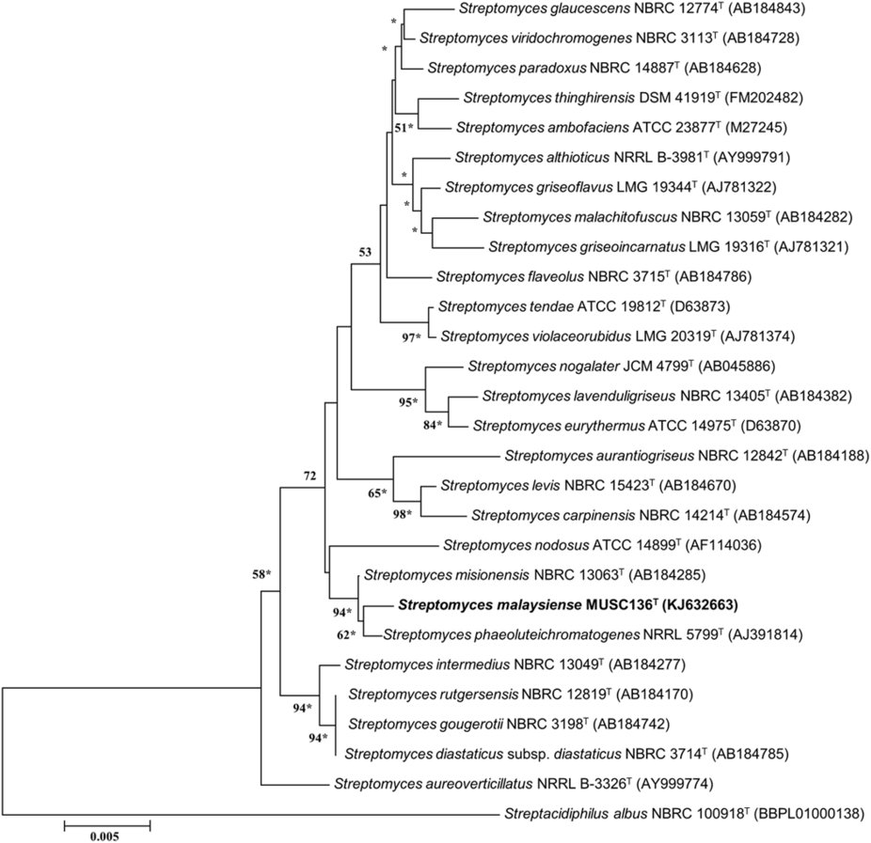
Results – Phylogenetic analysis of MUSC 136^{T}
Figure 1: Neighbour-joining phylogenetic tree of 16S rRNA sequences.
1000 bootstrap re-samplings, only values above 50% are shown.
Asterisks – corresponding nodes were also observed in neighbour-joining tree
Streptacidiphilus albus NBRC 100918^{T} was used as an outgroup.

Slide 11
Results – DNA-DNA hybridization of MUSC 136^{T} and type strains
Table 3: DNA-DNA relatedness between MUSC 136^{T} and closely related strains.
Type strains | DNA-DNA relatedness with MUSC 136^{T}
S. misionensis NBRC 13063^{T} | 46.5 ± 0.2 %
S. phaeoluteichromatogenes NBRC 5799^{T} | 44.5 ± 0.4%
S. rutgersensis NBRC 12819^{T} | 22.7 ± 0.5%
DNA-DNA hybridization value of
70% is used for delineation of bacterial species.
(Wayne et al., 1987)

Slide 12
Results – Chemotaxonomic characterization of MUSC 136^{T}
Table 4: Respiratory quinones and cell wall composition of MUSC 136^{T}.
Properties | Values
Diaminopimelic acid | ʟʟ-diaminopimelic acid (Xu et al., 2009; Lee et al., 2014)
Predominant menaquinones | MK-9(H₈) and MK-9(H₆) (Kim et al., 2003)
G+C content: 72.3 mol%
Within 67.0 – 78.0 mol% for species of the genus Streptomyces

Slide 13
Results – Chemotaxonomic characterization of MUSC 136^{T}
Table 5: Predominant cellular fatty acid composition (>10%) of strain MUSC 136^{T} and its closely related Streptomyces species.
Fatty acid | MUSC 136^{T} | S. misionensis NBRC 13063^{T} | S. phaeoluteichromatogenes NBRC 5799^{T} | S. rutgersensis NBRC 12819^{T}
iso-C_{15:0} | 12.2 | 7.2 | 12.3 | 5.2
anteiso-C_{15:0} | 35.3 | 40.1 | 35.5 | 32.2
iso-C_{16:0} | 12.4 | 14.4 | 17.7 | 10.3
anteiso-C_{17:0} | 11.8 | 19.3 | 13.4 | 13.9

Slide 14
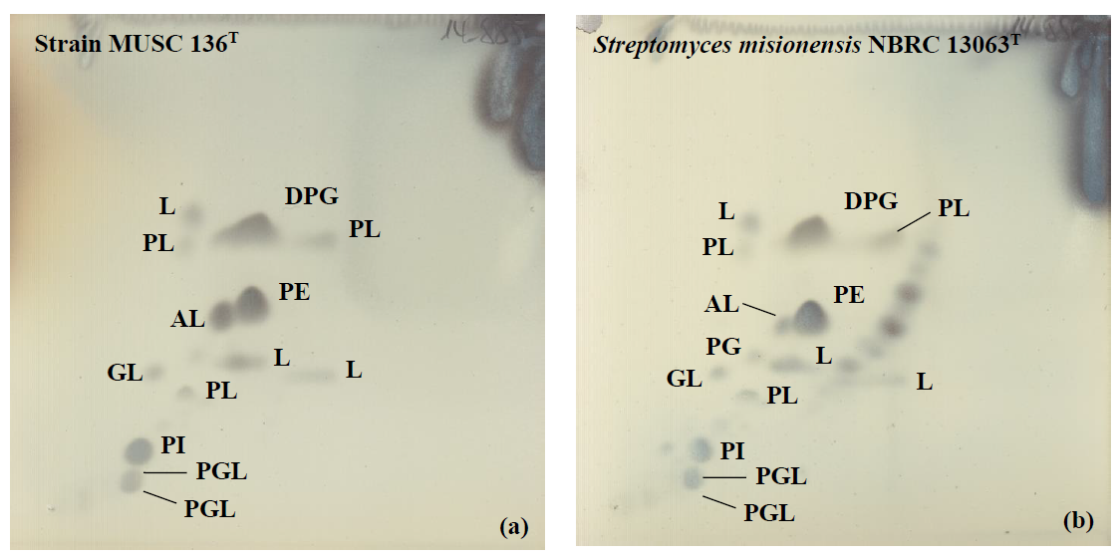
Results – Chemotaxonomic characterization of MUSC 136^{T}
Figure 2: Two dimensional total lipid profile of strain MUSC 136^{T} and Streptomyces misionensis NBRC 13063^{T}. AL, Aminolipid; DPG, Diphosphatidylglycerol; GL, Glycolipid; PL, Phospholipid; PI, Phosphatidylinositol; PE, Phosphatidylethanolamine; PG, Phosphatidylglycerol; PGL, Phosphoglycolipid; L, Lipid.

Slide 15
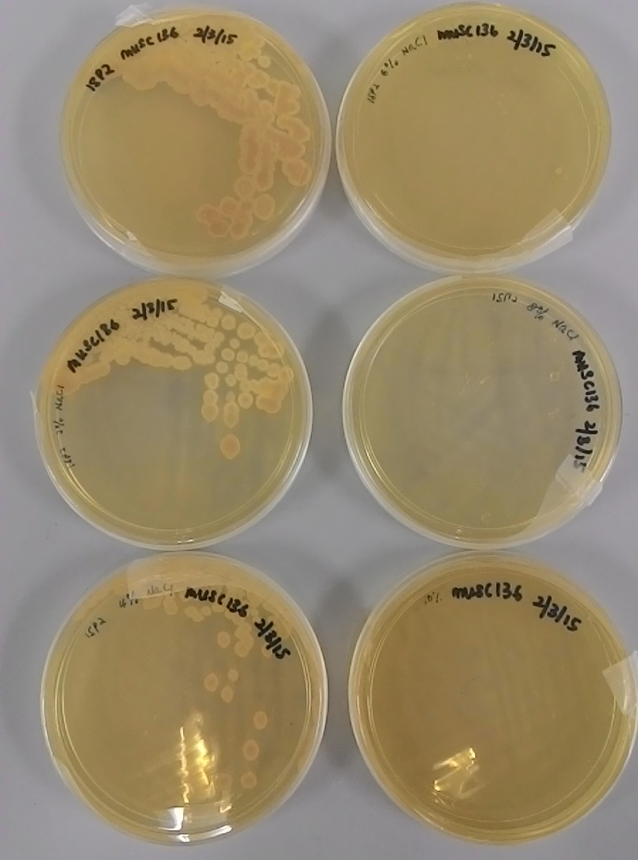
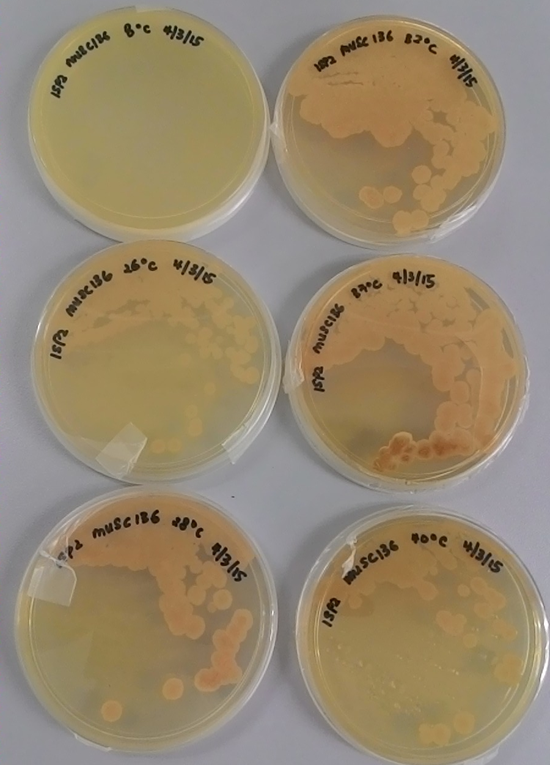
Results – Phenotypic characterization of MUSC 136^{T}
Table 6: Cultural characteristics of strain MUSC 136^{T} on different media at 28 °C after 7-14 days of incubation.
Salinity (NaCl)
Temperature
Medium | Growth | Colony color
 |  | Aerial mycelium | Substrate mycelium
Yeast malt agar (ISP 2) | Good | Yellowish white | Grayish yellow
Oat Meal agar (ISP 3) | Moderate | Yellowish white | Dark grayish yellow
Glycerol Asparagine Agar Base (ISP 5) | Good | Pale yellow | Yellowish white
Peptone Yeast Extract Iron agar (ISP 6) | Good | Yellowish white | Pale yellow
Tyrosine agar base (ISP 7) | Good | Pale yellow | Grayish yellow
Figure 2: Growth of MUSC 136^{T} at different salinity and temperature.

Slide 16
Results - Antioxidant activities of Streptomyces extract
Table 7: Antioxidant activity of 2mg/mL of extract tested using different assays.
Strain | Antioxidant activity (%)
 | DPPH | ABTS | Metal-chelating
MUSC 26^{T} | N.D. | 69.15 | 78.92
MUSC 149^{T} | 36.53 | 17.8 | 4.94
MUSC 164^{T} | 18.31 | 30.38 | 43.66
MUSC 136^{T} | 26.72 | 27.87 | 37.01
Notes:
To date, there is no “gold standard” in screening Streptomyces extract for antioxidant activities. Thus, to prevent misidentification of strains with bioactive potential, our study included 3 different antioxidant assays.
Most of these tests involving the use of free radicals and the antioxidant potential of the extract of interest is determined by spectrophotometer – the decrease in absorbance value, typically means a reduction in amount of free radicals, thus revealing antioxidant activity of the sample.
DPPH – measures scavenging of DPPH free radicals
ABTS – measures scavenging of ABTS radical cation
SOD – reduce radicals generated by xanthine oxidase thus to preventing formation of WST-1 formazan – dye to allow visualization of antioxidant activity
Metal-chelating assay – measurement of Fe2+-ferrozine complex
Based on the results, we observed that out of four strains, two strain, MUSC 164T and MUSC 136 showed consistent activities thus was selected for “priority screening” in our experiments.

Slide 17
Results – Antioxidant activity of MUSC 136^{T} extract
Table 8: Radical scavenging activity of MUSC 136^{T} evaluated using DPPH, ABTS, metal chelating and superoxide dismutase (SOD)-like assays (*, p >0.05).
Conc. (mg/mL) | Mean ± standard error(%)
 | DPPH | ABTS | SOD | Metal-chelating
0.25 | 4.87 ± 0.71 | 7.51 ± 2.19* | 45.98 ± 2.81* | 10.22 ± 1.58*
0.50 | 10.26 ± 2.44 | 11.59 ± 1.50* | 56.93 ± 3.76* | 17.00 ± 3.73*
1.00 | 11.15 ± 3.26 | 15.95 ± 2.34* | 59.72 ± 6.19* | 22.97 ± 1.51*
2.00 | 27.24 ± 1.91* | 27.87 ± 2.19* | 68.27 ± 3.67* | 37.01 ± 2.59*
Increase in antioxidant activity with increasing concentration!
Notes:
To confirm the antioxidant activity of MUSC 136T extract, the sample was also measured at different concentrations.
As high intake of antioxidants have been associated with decrease risk of cancer, the observed antioxidant activity of MUSC 136T extract implies that the strain may produce bioactive secondary metabolites that could potentially reduce cancer risk and form the basis for further development as chempreventive drugs.

Slide 18
Results: Cytotoxic activities of Streptomyces strains
Table 9: Cytotoxic activities of mangrove-derived Streptomyces sp. extracts (400 µg/mL).
 | MUSC 136^{T} | MUSC 164^{T} | MUSC 149^{T} | MUSC 26^{T}
HCT-116 | 48.8 ± 4.2 | 58.2 ± 5.1* | 69.8 ± 5.7* | 63.6 ± 3.6*
HT-29 | 61.9 ± 3.4 | 83.1 ± 8.3* | 85.8 ± 6.0 | 69.0 ± 6.4*
Caco-2 | 55.4 ± 1.9* | 71.7 ± 2.9* | 95.6 ± 4.3 | 86.9 ± 4.4*
SW480 | 68.6 ± 2.3* | 65.2 ± 2.9* | 79.9 ± 7.7* | 67.5 ± 1.5*
MCF-7 | 65.2 ± 1.9* | 66.0 ± 3.2* | 80.7 ± 10.7 | 72.7 ± 3.6*
DU145 | 80.2 ± 3.8 | 55.5 ± 3.6* | 57.2 ± 5.7* | 63.7 ± 6.8*
A549 | 67.1 ± 6.3 | 78.3 ± 6.9* | 88.6 ± 9.0 | 86.7 ± 4.2*
CaSki | 55.7 ± 1.2 | 60.9 ± 5.2* | 92.9 ± 2.1 | 79.1 ± 8.6*
Colon
Breast
Prostate
Lung
Cervical
Notes:
A recent report by American Cancer Society showed that the most common cancer found in lung and bronchus region in both male and females (52.1 % and 34.8 %), followed by prostate cancer in males (19.1 %) and breast cancer in females (20.5 %) (Siegel et al., 2017). These figures have highlighted the need to search for effective chemopreventive and/or chemotherapeutic agents that could prevent the occurrence of these cancer types. A total of eight cancer cell lines were included in this study, representing four different cancer types including colon, prostate, cervical and lung cancer.
Lowest cell viability was observed in HCT-116 cells treated with MUSC 136T.

Slide 19
Results – Cytotoxic activity of MUSC 136^{T}
(a)
(b)
(c)
(d)
HT-29
(Dysfunctional p53)
HCT-116
(Normal p53)
Ca Ski
A549
*
*
*
*
*
*
*
*
*
*
Percentage of cell viability (%)
*
*
Percentage of cell viability (%)
Percentage of cell viability (%)
Percentage of cell viability (%)
Figure 3: Cytotoxic activity of MUSC 136^{T} extract against human cancer cell lines. The measurement of cell viability was done using MTT assay.
Different susceptibility between colon cancer cell lines – HCT-116 and HT-29
Notes:
HCT-116 (normal p53), HT-29 (dysfunctional p53)– colon cancer cell lines
Ca Ski – cervical cancer cell lines
A549 – Lung carcinoma
p53 tumor suppressor protein – known to be involved in cancer initiation and progression – inducing growth arrest or apoptosis upon activation
All cell lines represent top 10 cancer that leads to mortality in 2015. At highest concentration, MUSC 136T extract exhibited cytotoxic activity against all cell lines; Highest activity was observed against HCT-116 cell (colon cancer cell line). In order to understand this phenomena, another colon cancer cell line with p53 mutation was also included to study the involvement of role of this tumor suppressor protein (p53). As expected, the difference in cell viability revealed that there might be some involvement of p53 proteins

Slide 20
Results – Apoptosis induction by MUSC 136^{T} extract
(a)
GSH depletion
(b)
p53 expression
*
*
*
*
*
*
*
*
*
*
Percentage of cell undergoing GSH depletion (%)
*
Relative p53 expression
*
*
*
*
Concentration (µg/mL)
Concentration (µg/mL)
Figure 4: Effects of MUSC 136^{T} extract on (a) intracellular glutathione (GSH) content and (b) p53 protein in HCT-116 cells.
Notes:
When treated with MUSC 136T extract, there is an increase in percentage of cancer cells experiencing GSH depletion. GSH is important in maintaining cell survival and decrease of this molecule could, in turn trigger apoptotic signalling cascades, including the activation of p53 signalling pathway.
As seen in Figure (b), there was increase in p53 expression after treated with MUSC 136T extract. All these results showed that the cytotoxic activity of MUSC 136T extract could potentially acting via effects on p53 protein. However, further mechanistic studies on p53 associated cell death pathway would be required to fully understand the action target of MUSC 136T extract.

Slide 21
Results – Apoptosis induction by MUSC 136^{T} extract
When treated with MUSC 136^{T} extract, there is an increase in percentage of cancer cells experiencing GSH depletion. GSH is important in maintaining cell survival and decrease of this molecule could, in turn trigger apoptotic signalling cascades, including the activation of p53 signalling pathway.
As seen in Figure (b), there was increase in p53 expression after treated with MUSC 136^{T} extract. All these results showed that the cytotoxic activity of MUSC 136^{T} extract could potentially acting via effects on p53 protein. However, further mechanistic studies on p53 associated cell death pathway would be required to fully understand the action target of MUSC 136^{T} extract.

Slide 22
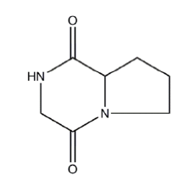
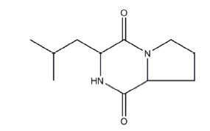
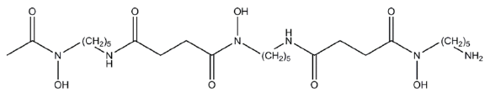
Results – Chemical profiling of MUSC 136^{T} extract
Table 10: GC-MS analysis of MUSC 136^{T} extract.
No | R.T. (min) | Compound | Formula | M.W.
1 | 14.370 | Isomeric dihydro-methyl-furanone | C₅H₆O₂ | 98
2 | 39.484 | 1-Pentadecene | C₁₅H₃₀ | 210
3 | 44.502 | Phenol, 2,5-bis(1,1-dimethylethyl)- | C₁₄H₂₂O | 206
4 | 51.569 | (3R,8aS)-3-methyl-1,2,3,4,6,7,8,8a-octahydropyrrolo[1,2-a]pyrazine-1,4-dione | C₈H₁₂N₂O₂ | 168
5 | 53.074 | 1,4-diaza-2,5-dioxobicyclo[4.3.0]nonane | C₇H₁₀N₂O₂ | 154
6 | 54.956 | Tetradecanoic acid, 12-methyl-, methyl ester | C₁₆H₃₂O₂ | 256
7 | 55.220 | Pyrrolo[1,2-a]pyrazine-1,4-dione, hexahydro-3-(2-methylpropyl)- | C₁₁H₁₈N₂O₂ | 210
8 | 58.063 | Pentadecanoic acid, 14-methyl-, methyl ester | C₁₇H₃₄O₂ | 270
9 | 71.544 | Deferoxamine (metal chelating drug) | C₂₅H₄₈N₆O₈ | 560
(5) Antioxidant
(7)
Anticancer
(9)
Bioactive compounds
Notes:
Results from both antioxidant assays and in vitro cytotoxic screening suggest presence of bioactive compounds thus chemical analysis using GC-MS was performed as an attempt to identify the compounds. A total of 9 compounds were detected in MUSC 136T extract with most of them being heterocyclic compounds including pyrrolizidines which are known to exhibit a wide spectrum of bioactivities (antimicrobial, anticancer and antioxidant activity). Among these compounds, there were three compounds that may potentially contribute to the bioactivities seen in our screening:
Deferoxamine – metal chelating drug with antioxidant and anticancer activity. This compound could potentially by altering signalling pathway crucial for cancer cell survival and decrease cell viability as seen in the in vitro cytotoxic screening.
1,4-diaza-2,5-dioxobicyclo[4.3.0]nonane – antioxidant which has been isolated from other marine microbes and highly capable of reducing amount of free radicals when assessed with reducing power assay (DPPH).
Pyrrolo[1,2-a]pyrazine-1,4-dione, hexahydro-3-(2-methylpropyl)- cytotoxic activity against human cervical cancer (in vitro)

Slide 23
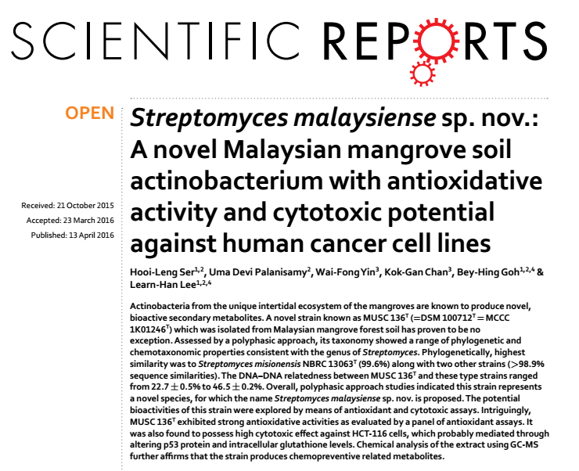
Publication

Slide 24
Conclusion
Strain MUSC 136^{T} is novel, hence named as Streptomyces malaysiense sp. nov. (referring to country of isolation for this strain)
Extracts of strain MUSC136^{T} exhibited antioxidative and cytotoxic activity in various cancer cells

Slide 25
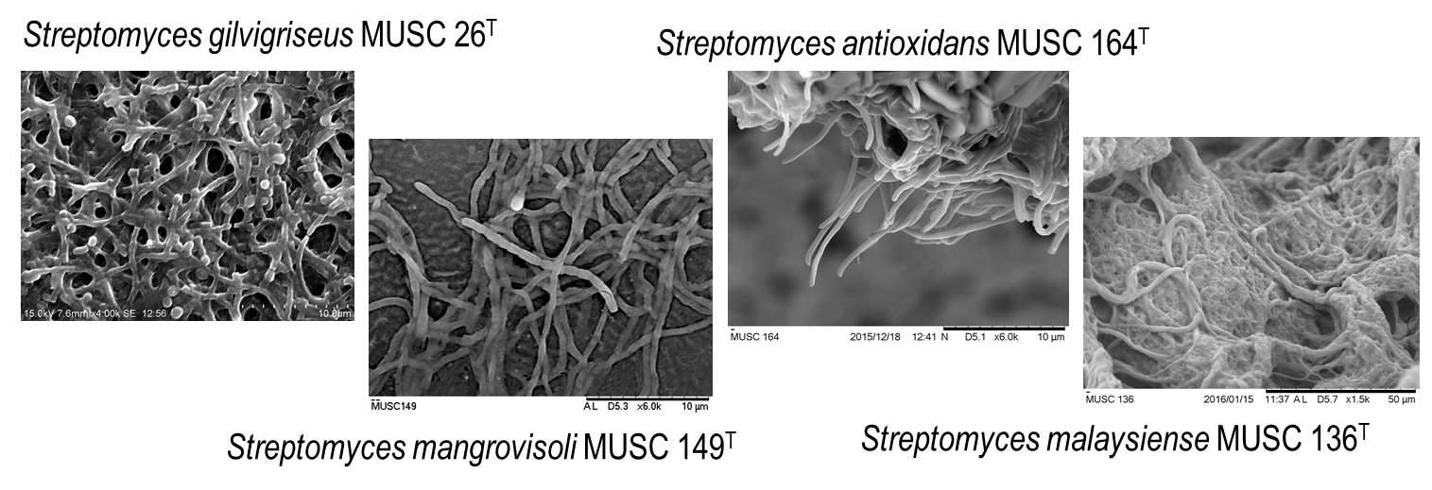
Chemical constituents of Streptomyces extracts
A total of 42 compounds were isolated from these mangrove-derived novel streptomycetes
Deferoxamine
Expensive drug, costly to synthesis (de novo)

Slide 26

Summary of the study
Significant antioxidant activities across all four assays (DPPH, ABTS, SOD, metal-chelating)
Mangrove forest
Neuroprotection against H₂O₂ insults
Antioxidant potential of mangrove derived Streptomyces sp.
Reduced cell viability of HCT-116 human colon cells to 48.8 %
Cytotoxic potential
Involvement of p53 signalling pathways → apoptosis
Activities ranged from 4.94 - 78.92%^
Activities ranged from 4.4 – 51.2%*
^tested with 2 mg/mL; *tested with 400 µg/mL

Slide 27

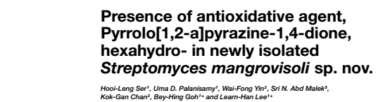
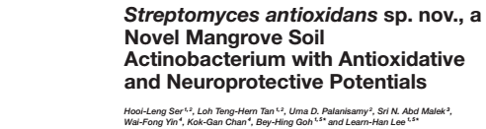
Publications
Impact factor: 4.165

Slide 28
Future work
Production of bioactive compounds
(e.g. Deferoxamine – drug listed on WHO List of Essential Medicines)
Novel Streptomyces
MUSC 26^{T}, 136^{T}, 149^{T}, 164^{T}
Next generation sequencing
Identification of biosynthetic gene clusters
Media optimization
Maximizing production of bioactive compound(s)
Isolation of bioactive compound(s)
Bioassay-guided fractionation

Slide 29

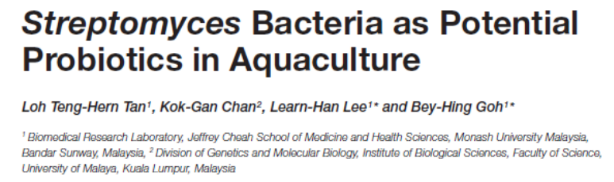
Main Research Areas
Biosystematics of Bacteria
Discovery of Bioactive Secondary Metabolites
Foodborne Pathogens
Vibrio Parahaemolyticus
Actinobacteria
Streptomyces
Non-Streptomyces
Bioactive secondary metabolites
Antimicrobial
Antioxidant
Anticancer

Slide 30
Acknowledgement
Monash University Malaysia UMBI, UKM
Dr Goh Bey Hing Dr Nurul Syakima Ab Mutalib
Dr Priyia Pusparajah
Vengadesh Letchumanan DSMZ, Germany
Dr Adzzie Shazeen Azman Dr Susanne Verbarg
Ser Hooi Leng
Jodi Law Woan Fei US-FDA, USA
Loh Tan Teng Hern Prof Dr Om V Singh
Ajaree Rayanakorn Prof Dr Marc Allard
Hefa Kemung
Wuhan University, China
University of Malaya Prof. Hong Kui
Assoc Prof Dr Chan Kok Gan Dr. Xie Qing-Yi
Yin Wai Fong Lin Hai-Peng
Dr Marilyn Tan Wen-Si Tang Yi-Li
Hu Hu

Slide 31

Acknowledgement

Slide 32
References
Alongi, D. M. (2002). Present state and future of the world's mangrove forests. Environ. Conserv. 29, 331-349. doi: 10.1017/S0376892902000231
Giri, C., Ochieng, E., Tieszen, L.L., Zhu, Z., Singh, A., Loveland, T., et al. (2011). Status and distribution of mangrove forests of the world using earth observation satellite data. Global Ecol. Biogeography 20, 154-159. doi: 10.1111/j.1466-8238.2010.00584.x
Gopi, M., Dhayanithi, N.B., Devi, K.N., and Kumar, T.T.A. (2014). Marine natural product, Pyrrolo [1,2-a] pyrazine-1,4-dione, hexahydro-(C7H10N2O2) of antioxidant properties from Bacillus species at Lakshadweep archipelago. J. Coastal Life Med. 2, 632-637.
ITTO (2014). Mangrove ecosystem. Trop. Forest Update 21(2), 3-15.
Kim, S. B., Lonsdale, J., Seong, C. N., & Goodfellow, M. (2003). Streptacidiphilus gen. nov., acidophilic actinomycetes with wall chemotype I and emendation of the family Streptomycetaceae (Waksman and Henrici (1943)^{AL}) emend. Rainey et al. 1997. Antonie van Leeuwenhoek 83, 107-116. doi: 10.1023/A:1023397724023
Kumar, P.S., Al-Dhabi, N.A., Duraipandiyan, V., Balachandran, C., Kumar, P.P., and Ignacimuthu, S. (2014). In vitro antimicrobial, antioxidant and cytotoxic properties of Streptomyces lavendulae strain SCA5. BMC Microbiol. 14, 291. doi: 10.1186/s12866-014-0291-6
Manivasagan, P., Kang, K.-H., Sivakumar, K., Li-Chan, E.C.Y., Oh, H.-M., and Kim, S.-K. (2014a). Marine actinobacteria: An important source of bioactive natural products. Environ. Toxicol. Pharmacol. 38, 172-188. doi:10.1016/j.etap.2014.05.014
Manivasagan, P., Venkatesan, J., Sivakumar, K., and Kim, S.-K. (2014b). Pharmaceutically active secondary metabolites of marine actinobacteria. Microbiol. Res. 169, 262-278. doi:10.1016/j.micres.2013.07.014
Subramani, R., and Aalbersberg, W. (2012). Marine actinomycetes: An ongoing source of novel bioactive metabolites. Microbiol. Res. 167, 571-580. doi:10.1016/j.micres.2012.06.005
Wayne, L. G., Brenner, D. J., Colwell, R. R., Grimont, P. A. D., Kandler, O., Krichevsky, M. I., et al. (1987). Report of the Ad Hoc Committee on Reconciliation of Approaches to Bacterial Systematics. Int. J. Syst. Bacteriol. 37, 463-464. doi: 10.1099/00207713-37-4-463
Xu, D.-B., Ye, W.-W., Han, Y., Deng, Z.-X., and Hong, K. (2014). Natural products from mangrove actinomycetes. Mar. Drugs 12, 2590-2613. doi:10.3390/md12052590

