Slide 1

Reprogramming the Gut:
Implications for the use of bacteriophages to reduce foodborne
Bacterial pathogens in pre-harvest food animal production
Lawrence Goodridge
Ian and Jayne Munro Chair in Food Safety
McGill University
Food Safety and Quality Program

Slide 2
Goodridge Lab
Research focused on food safety
Implementation of genomic approaches to better understand the ecology and pathogenicity of Salmonella
Understanding how bacteriophages contribute to the overall fitness and horizontal gene transfer within foodborne bacterial pathogens
Applied uses of bacteriophages to control and detect foodborne bacteria

Slide 3
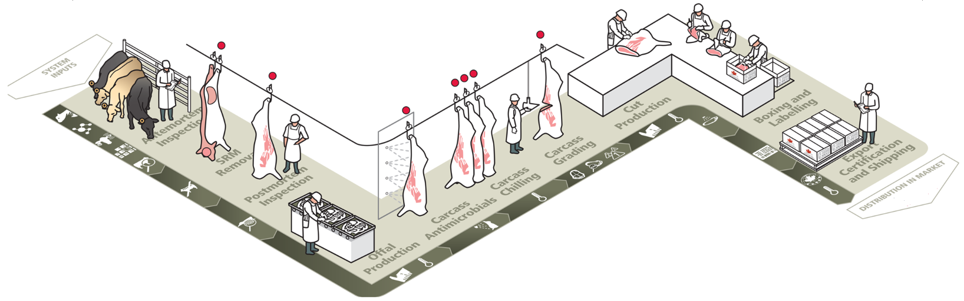
Beef Production
Pre-harvest

Slide 4
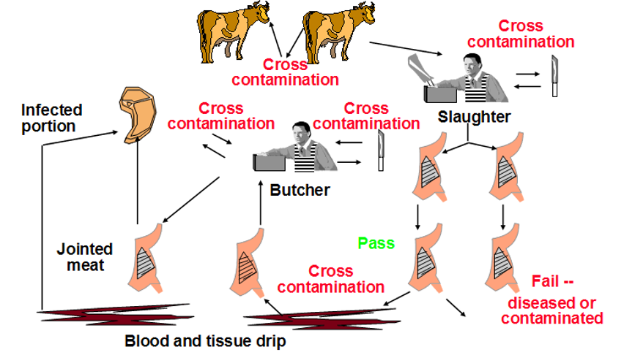
Animal Slaughter
Food Safety and Quality Program

Slide 5
Pre-Harvest Control Strategies
Probiotics
  Competition for nutrients or binding sites
  Production of antimicrobial compounds (bacteriocins)
Vaccination
  Used to decrease intestinal population of E. coli O157:H7 in cattle
Antibiotics
  Terminal treatment to reduce E. coli O157:H7 prior to slaughter

Slide 6
Pre-Harvest Control Strategies
Probiotics
  Varied results depending on probiotic strain used
  Reduce shedding and concentration of organism in the animal, but some animals are still positive at slaughter
  Recontamination
Vaccines
  Several studies have been effective and some haven’t
  Recontamination
Need to develop strategies to reduce foodborne pathogens prior to slaughter

Slide 7
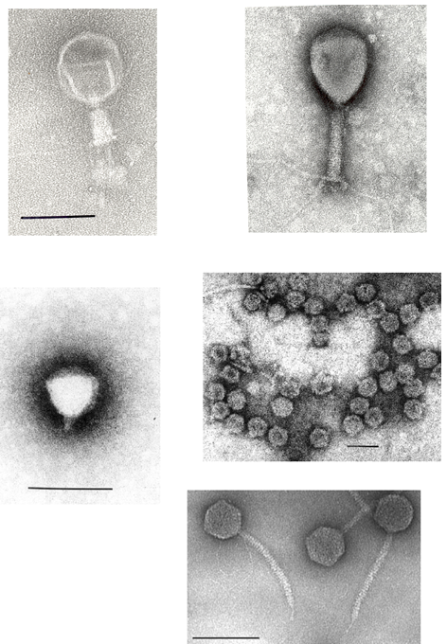
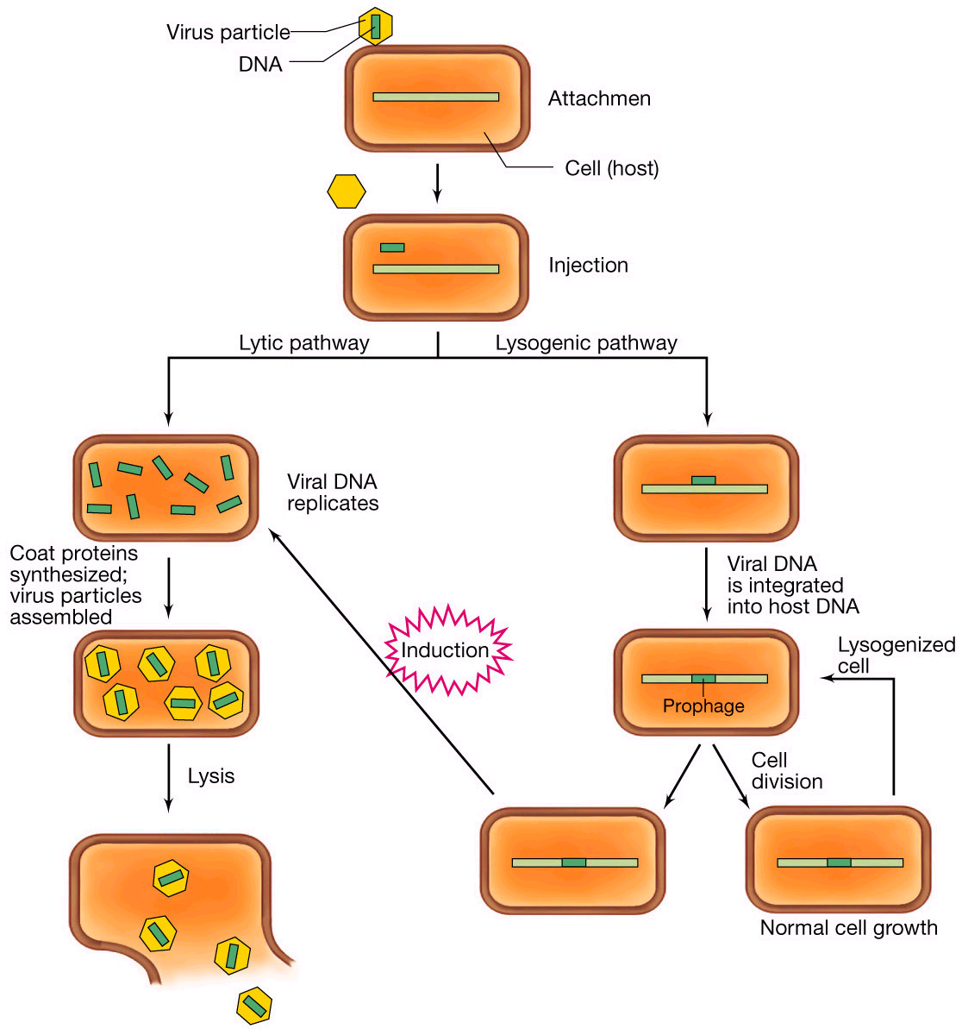
Bacteriophage Diversity
Food Safety and Quality Program

Slide 8
Objective
To investigate the use of phage therapy to reduce E. coli O157:H7 shedding immediately prior to slaughter
Vaccines and probiotics don’t inhibit recontamination
Post harvest interventions
  2-3 log reduction
  E. coli O157 can be higher on hide, and can be transferred to the carcass, overwhelming post harvest interventions

Slide 9
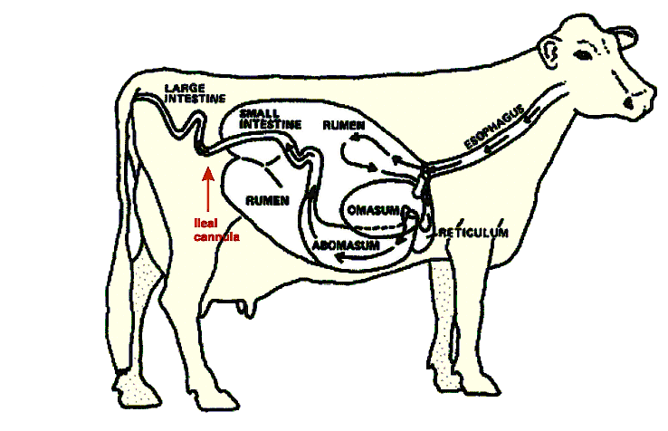
Biocontrol of E. coli O157:H7 in the Bovine GIT

Slide 10
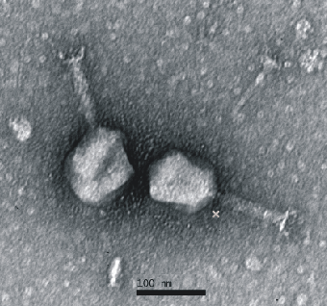
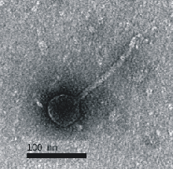
Methods (Bacteriophage Cocktail)
Phage cocktail (37 phages)
Transmission electron microscopy revealed that 30 of 37 phages (81%) belonged to Myoviridae and the remaining 7 (19%) belonged to Siphoviridae

Slide 11
Host Range Study
The cocktail was tested against 69 bacterial strains
The cocktail lysed 58 of 58 E. coli O157:H7 isolates and 10 of 11 E. coli O26 isolates
  E. coli O26: important cause of sporadic outbreaks

Slide 12
Methods
This study was conducted in two parts:
1. In vitro study (reduction of E. coli O157:H7 in bovine fecal samples in an anaerobic digester)
2. In vivo study (reduction of E. coli O157:H7 in the live animal)
  In vivo study #1 (reduction of E. coli O157:H7 in the bovine ileum)
  In vivo study #2 (reduction of E. coli O157:H7 in bovine feces)

Slide 13
Study One:
In vitro evaluation of the phage cocktail in reducing E. coli O157:H7 in an anaerobic digester
Evaluate the ability of the phage cocktail (37phages) to eliminate E. coli O157:H7 in bovine fecal samples

Slide 14
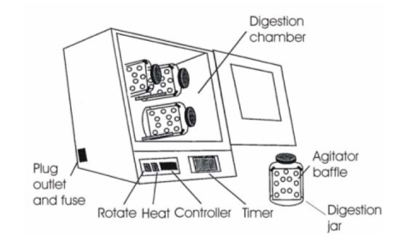
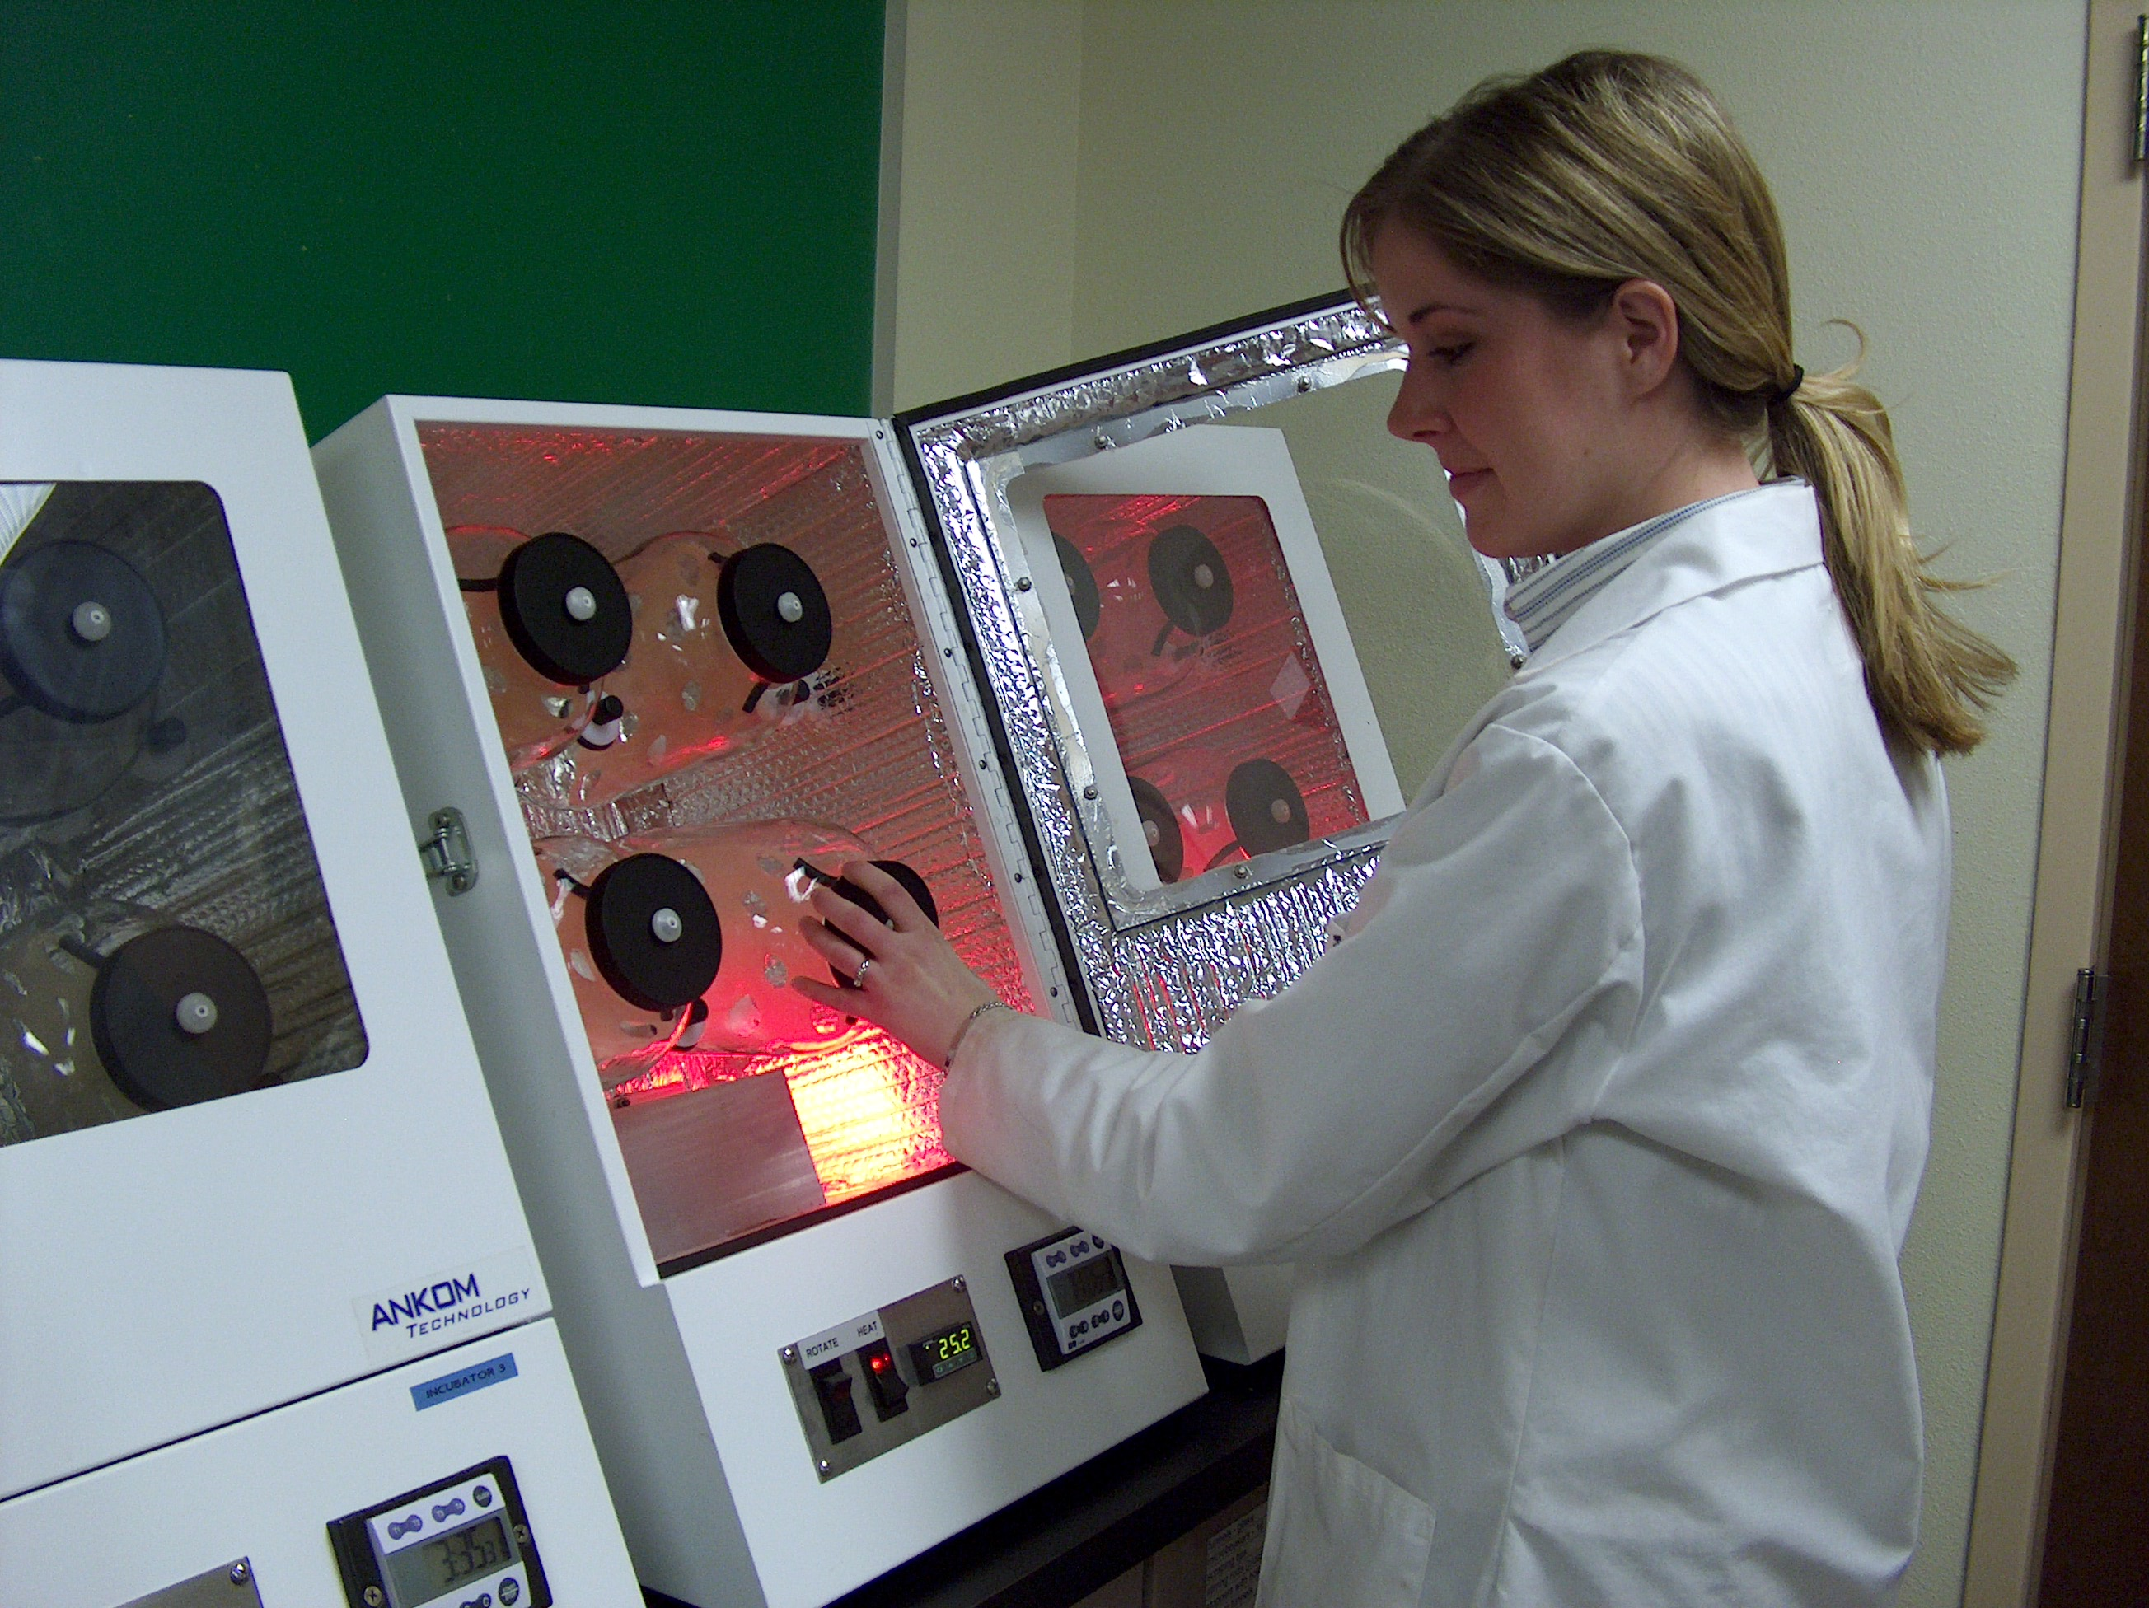
Methods: Study One
Obtained fecal samples from two 7 year old heifers
Samples clarified by filtration
Placed in anaerobic digest jars

Slide 15
Methods: Study One
For each jar added (batch system):
  1 L of clarified sample
  10⁴ CFU/ml of 2 strain mixture of E. coli O157:H7
  100 ml Nutrient broth + 200 mM Glucose
  Jars flushed with CO₂ and equilibrated for 3 hours in an Ankom Anaerobic Digester
For each sample: 2 treatments and 1 control

Slide 16
Methods: Study One
110 mls of phage cocktail added to treatment jars (10⁷ PFU/mL) (MOI = 10³)
110 mls of lambda buffer (pH 7.5) added to control jars
Aliquots taken at: 0, 4, 8, 12, 24, 36, and 48h
Spiral plate on MacConkey + Nalidixic Acid plates (64 µg/mL) in duplicate
Incubate at 37ºC for 24 hours

Slide 17
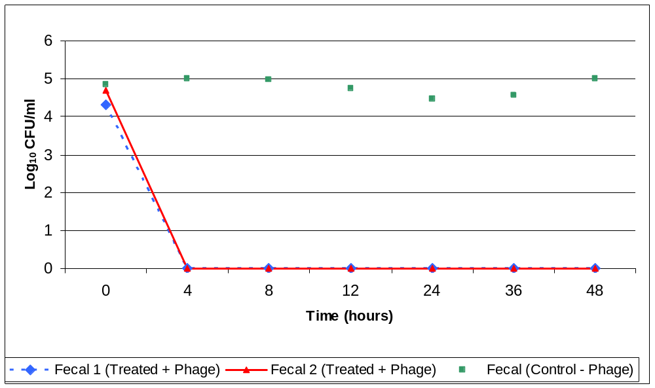
Results: Study One

Slide 18
Conclusions: Study One
Bacteriophage therapy was effective at eliminating high levels of E. coli O157:H7 in bovine GIT samples in an in vitro model
Provides the rationale for evaluating the ability of the phage cocktail to reduce E. coli O157:H7 in the live animal

Slide 19
Reduction of E. coli O157:H7 in the Bovine Ileum
Study two: 14 calves (Black Angus, Holstein) ranging from 4-6 months of age were orally inoculated with 10⁸ CFU/mL E. coli O157:H7
Consisted of two trials
  1st Trial: Evaluated the ability of the phage cocktail to reduce E. coli O157:H7 in the ileum
  2nd Trial: Evaluated the ability of the phage cocktail to reduce E. coli O157:H7 shedding in bovine feces

Slide 20
1st Trial: Reduction in the Bovine Ileum
Methods
Four Black Angus calves (6 months of age) with ileal cannulas, divided into 2 groups of 2 animals were used in a one week study
E. coli O157:H7 strain 602 (Nal^{R}) was used as the bacterial inoculum for the calves

Slide 21
1st Trial: Reduction in the Bovine Ileum
Methods
The calves were orally inoculated with 10⁸ CFU/mL E. coli O157:H7 strain 602 (Nal^{R})
On day 2 post-inoculation, treated calves were inoculated with 10⁹ PFU/mL phage cocktail
The control calves were orally inoculated with an equivalent amount of lambda buffer

Slide 22
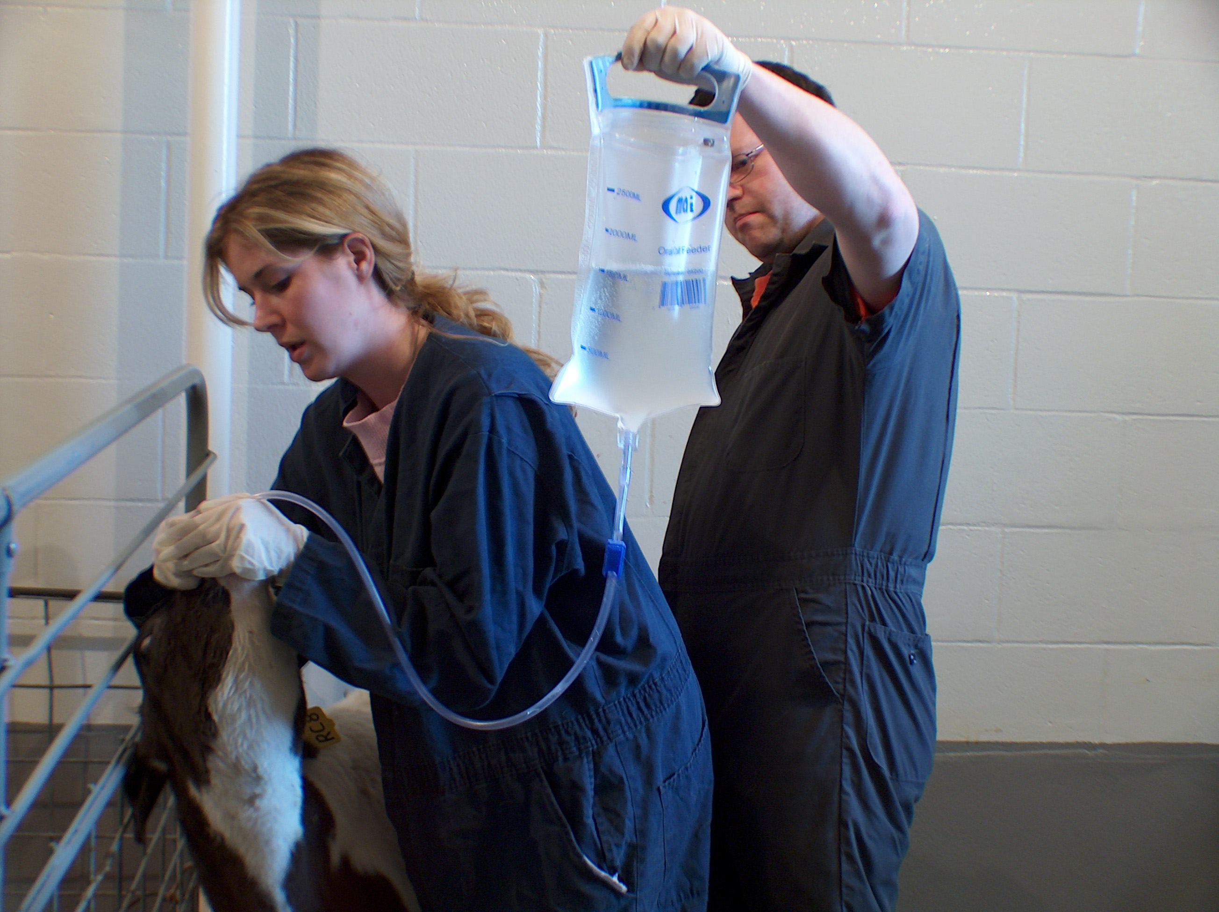
Oral Inoculation
Food Safety and Quality Program

Slide 23
1st Trial: Reduction in the Bovine Ileum
Methods
Ileal samples were sampled at 0, 4, 8, 12, 16, 24, and 48 hours
E. coli O157:H7 strain 602 (NalR) was enumerated by standard plate count on Sorbitol MacConkey Agar- nalidixic acid (SMAC-nal)

Slide 24
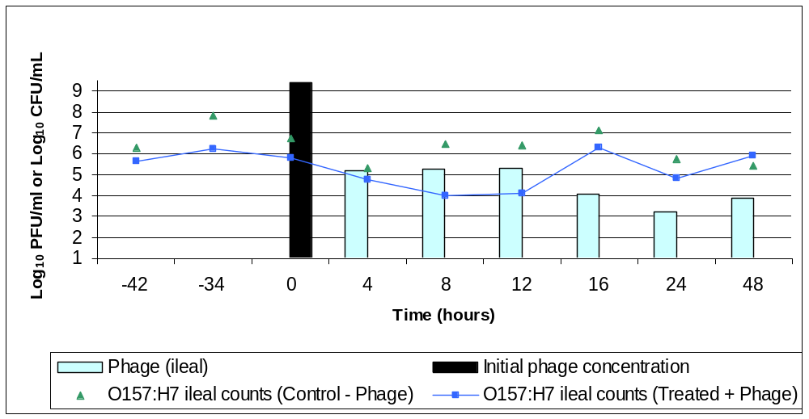
1st Trial: Reduction in the Bovine Ileum
Methods - Results
P = 0.0532

Slide 25
Conclusions: 1st Trial
Phages have been successful at reducing E. coli O157:H7 during in vitro studies (Bach et al., 2003; Chase et al., 2005)
However, the use of phages to control E. coli O157:H7 in ruminants has not been very successful (Bach et al., 2003; Callaway et al., 2003)
Several reasons for the inability of phage to reduce E. coli O157:H7 in animals include inactivation of the phage, development of phage resistance, or low MOI
  We detected phage in ileum
  No phage resistance observed
  Therefore low MOI

Slide 26
Conclusions: 1st Trial
In this study, the cocktail was ineffective after 12 hours at reducing E. coli O157:H7 in ileal samples
A continual administration of the cocktail may prove to be successful in sustaining the concentration of phage in the ileum (high MOI), leading to continued reduction of E. coli O157:H7

Slide 27
2nd Trial: Reduction in Bovine Feces
Methods
Ten Holstein calves (4 months of age), divided into 2 groups of 2 animals/pen were used in a one week study
E. coli O157:H7 strain 602 (NalR) was used as the bacterial inoculum for the calves

Slide 28
2nd Trial: Reduction in Bovine Feces
Methods
Calves were orally inoculated with 10⁸ CFU/mL E. coli O157:H7 strain 602 (Nal^{R})
On day 2 post-inoculation, treated calves were inoculated with 10⁹ PFU/mL phage cocktail
24 hours later, second dose of the cocktail (10⁹ PFU/mL) was administered to the treated group

Slide 29
2nd Trial: Reduction in Bovine Feces
Methods
Control calves were orally inoculated with an equivalent amount of lambda buffer
Fecal samples were sampled at 0, 4, 10, 16, 24, 36, and 48 hours
E. coli O157:H7 strain 602 (Nal^{R}) was enumerated by standard plate count on SMAC-nal plates

Slide 30
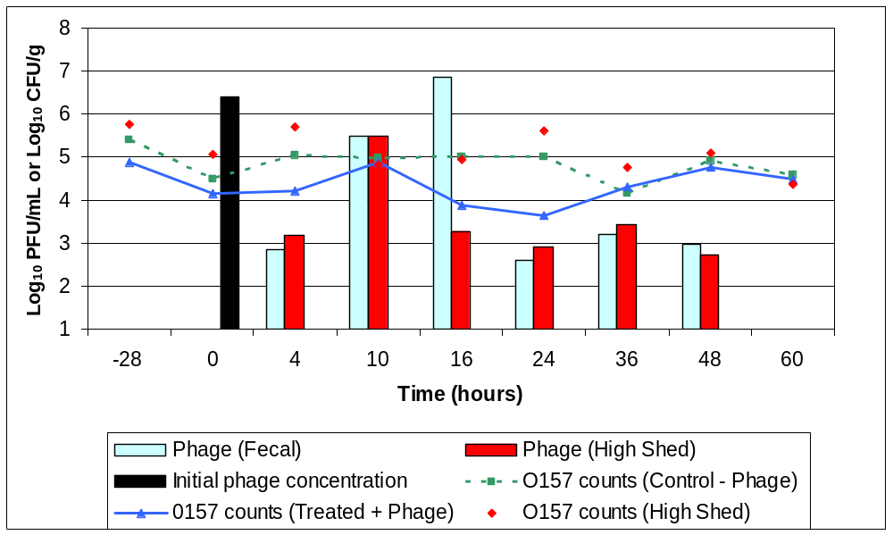
2nd Trial: Reduction in Bovine Feces
Results
P = 0.0505

Slide 31
Conclusions: 2nd Trial
Studies have shown that the use of more than one phage decreases the chance of resistance developing (Tanji et al., 2003; O’Flynn et al., 2004; Toro et al., 2005)
The results from this study showed that phage resistance did not occur when the phage was tested in vitro and in vivo

Slide 32
Conclusions: 2nd Trial
The phage cocktail developed in this study was able to infect 10 of 11 E. coli O26 strains
Although the cocktail did not completely eliminate E. coli O157:H7 in the calves, there was a time period of approximately 14 hours where the fecal shedding was decreased
Slaughtering the animals during this time period would decrease the amount of E. coli O157:H7 entering the plant thereby allowing post-harvest interventions to be effective
Combining phage therapy with probiotics or vaccines may lead to a greater reduction of E. coli in the bovine GIT

Slide 33
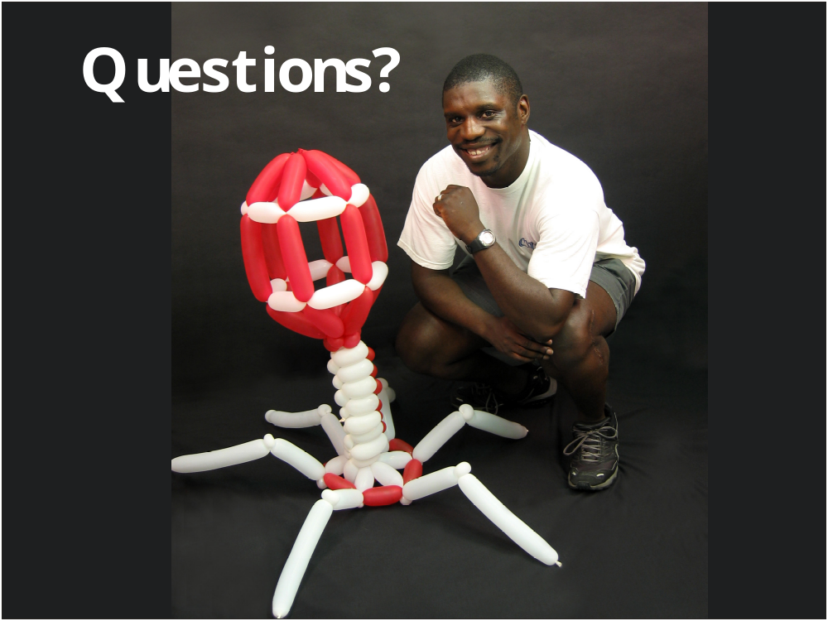
Food Safety and Quality Program

