Slide 1
Conference Series LLC Conferences
Conference Series LLC is a pioneer and leading science event organizer, which publishes around 500 open access journals and conducts over 500 Medical, Clinical, Engineering, Life Sciences, Pharma scientific conferences all over the globe annually with the support of more than 1000 scientific associations and 30,000 editorial board members and 3.5 million followers to its credit.
Conference Series LLC has organized 500 conferences, workshops and national symposiums across the major cities including San Francisco, Las Vegas, San Antonio, Omaha, Orlando, Raleigh, Santa Clara, Chicago, Philadelphia, Baltimore, United Kingdom, Valencia, Dubai, Beijing, Hyderabad, Bengaluru and Mumbai.

Slide 2
INTERCHANGEABILITY OF
BIOLOGICAL DRUG PRODUCTS
Laszlo Endrenyi
University of Toronto
5th European Biosimilars Congress
Valencia, Spain
June 27-29, 2016

Slide 3
SYNOPSIS
  Introduction to, definitions of prescribability,
  switchability, interchangeability
  Biosimilarity and its assessment
Regulation of interchangeability of biological
products in various jurisdictions
Study designs and assessment of
interchangeability

Slide 4
BIOEQUIVALENCE, BIOSIMILARITY, AND INTERCHANGEABILITY
Bioequivalence
Compare small-molecule, chemical drug products
Biosimilarity
Compare large-molecule, biologic
drug products
Bioequivalence vs. interchangeability
Simple relationship (generally)
Biosimilarity vs. interchangeability
Distinct considerations
→

Slide 5
BIOEQUIVALENCE AND
THERAPEUTIC EQUIVALENCE
Therapeutic equivalence:
Test product has the same clinical effect
and safety profile as reference product
Therefore:
the two drug products may be substituted
Statement of bioequivalence is generally
considered as a surrogate for
therapeutic equivalence
Implied assumptions:
Pharmaceutical equivalence
Same amounts of the same active drug ingredient
in the same dosage form and route of administration
Bioequivalence fully reflects
therapeutic equivalence, on the average
- For most (but not all) small-molecule drugs
/formulations, the assumption is reasonable

Slide 6
PRESCRIBABILITY, SWITCHABILITY, INTERCHANGEABILITY
Prescribability
A subject is naïve to the drug, i.e. has not taken it
in any form. The drug may be prescribed and its
licensed products may be administered. But an
ingested product may not be substituted with another.
Total variation (between + within subjects) is important.
Switchability
A subject has already taken a product of the drug
(e.g. brand-name, reference) and is to be switched
to another formulation (e.g. generic, test).
Within-subject variation is important.
R → T
Interchangeability / Alternating
A subject is switched from a reference product to a
test formulation, back to the reference preparation
or to another test product.
R → T₁ → T₂ → R → T₃
.

Slide 7
PRESCRIBABILITY, SWITCHABILITY,
INTERCHANGEABILITY
- EXPECTATIONS
Increasing expectations of bioequivalence
reflecting therapeutic equivalence
- not only on the average,
but also in individuals:
PRESCRIBABILITY
SWITCHABILITY
INTERCHANGEABILITY

Slide 8
((CONFUSION ON TERMINOLOGY))
European Commission
Steering Group on Access to Medicines
2013
Interchangeability
Change of medicine with the agreement
of the prescriber
Switching
Change of medicine with the agreement
of the treating physician
Substitution (automatic)
Change of medicine by a pharmacist
without the agreement of the prescriber

Slide 9
PRESCRIBABILITY, SWITCHABILITY,
INTERCHANGEABILITY
- STATISTICAL CONDITIONS
CROSSOVER STUDIES
Each drug product is administered to
each subject
Estimate (approximate) within-subject
variance
Can apply switchability, interchangeability
PARALLEL-GROUP STUDIES
Each drug product is administered to
a different group of subjects
Can estimate only total variance
(Between + Within subjects)
Can apply only prescribability

Slide 10
BIOSIMILARITY
Background:
In the U.S.:
Biologics Price Competition and Innovation Act (BPCI Act) in 2009
Part of the “Patient Protection and Affordable Care Act”
(healthcare reform)
Biosimilar or Biosimilarity means:
  The biological product is highly similar to the reference product (notwithstanding minor differences in clinically inactive components)
  There are no clinically meaningful differences between the biological product and the reference product (in terms of the safety, purity, and potency of the product)

Slide 11
BIOEQUIVALENCE vs. BIOSIMILARITY
Bioequivalence
Simple, clear criterion (80-125% PK
confidence interval)
Biosimilarity
Biologics:
Complicated
Many uncertainties, variations
Comparison of biologics:
Only to be “highly similar”
“No clinically meaningful differences”
No simple, clear criterion
A matter of judgement
based on the similarity of several
features

Slide 12
BIOSIMILARITY:
DEMONSTRATION AND ASSESSMENT
FDA Guidances
April, 2015
Scientific considerations
Quality considerations
Questions and answers
Scientific considerations
To deal with judgment
based on several features
Demonstrate biosimilarity
by stepwise approach
Consider, at each step,
residual uncertainly
Assess biosimilarity based on the
totality of the evidence

Slide 13
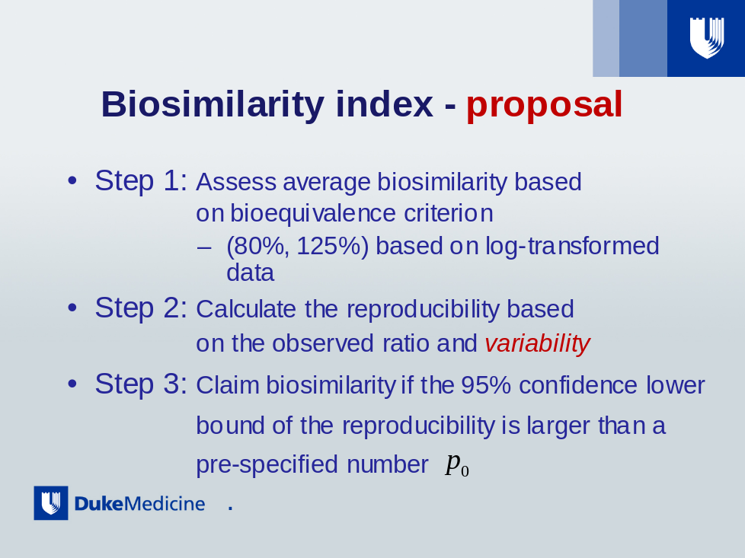
HOW SIMILAR IS “SIMILAR”?
- BIOSIMILARITY INDEX
FOR A GIVEN RESPONSE
Step 1: Assess average biosimilarity for a given
response
E.g., for pharmacokinetic response: 90%
confidence limits between 80% and 125%.
Step 2: Calculate the reproducibility (p_{RR}), in a
second study, based on the same observed
contrast (difference or ratio), i.e.,
estimate its variability.
Step 3: Claim biosimilarity if the 95% confidence
lower bound of the reproducibility is larger
than a pre-specified number (p₀)
(p₀)
S.-C. Chow. J.Bioeq.Bioavail. 2011;Suppl.1--002:1-8.
S.-C. Chow, et al. Biosimilars, 2011;1:13-26.
T.-C. Hsieh, et al. Stat. Med. 2013; 32: 406-414.

Slide 14
HOW SIMILAR IS “SIMILAR”?
- BIOSIMILARITY INDEX
FOR A GIVEN RESPONSE
p₀ can be obtained based on the comparison
of a “reference product” to the “reference product”.
That is, we can calculate the reproducibility (p_{RR}),
i.e. a measure of variability.
p₀ can be chosen e.g. as 80% of p_{RR}.
For example if p_{RR} = 90%, then we may choose
p₀ = 80% X 90% = 72%.
p₀ can reflect the degree of similarity that
the sponsor would like to achieve; i.e.
‘how similar is “similar”?’

Slide 15
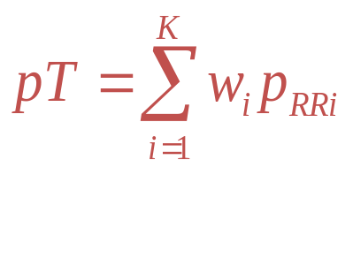
HOW SIMILAR IS “SIMILAR”?
- BIOSIMILARITY INDEX
FOR ALL RESPONSES
Step 1: Obtain p_{iRR}, the reproducibility probability for
the i-th response,
Step 2: Define the Global or Total biosimilarity index
where w_{i} is the weight for the i-th response
Step 3: Claim global biosimilarity if the 95%
lower confidencebound of p_{T} is higher than a
pre-specified value (p_{0T})

Slide 16
INTERCHANGEABILITY OF BIOLOGICALS
(BPCI ACT)
Interchangeable or interchangeability
means that:
The biological product is biosimilar to
the reference product; furthermore:
It can be expected to produce the same
clinical result as the reference product
in any given patient;
For a product administered more than
  once, the risks of alternating or
  switching, in terms of safety and
  reduced efficacy, are not greater than
  with use of the reference product
  without alternating or switching.
(R vs. T) risk, and also, say, (T1 vs. T3)
risk, compared with (R vs. R) risk!

Slide 17
INTERCHANGEABILITY OF BIOLOGICALS,
AND ITS CONSEQUENCES (BPCI ACT)
“The term ‘interchangeable’ or ‘interchangeability’,
in reference to a biological product … means that the biological product may be substituted for the reference product without the intervention of the health care provider who prescribed the reference product.”
INTERPRETATION: If a test product is judged to be interchangeable with the reference product then it may be substituted, even alternated, without a possible intervention, or even
notification, of the health care provider.
A very permissive stipulation!

Slide 18
INTERCHANGEABILITY:
US vs. STATES
  Interchangeability –
  Responsibility of state legislations
  January, 2016
  31 states have considered
  enabling legislation
  Replacement of reference drug:
  prescribability or switchability?
    Pharmaceutical substitution is allowed
    but the physician should be notified:
    “approves” or “does not object”
    Some: liability protection for substituting
    pharmacists
Less permissive than BPCI Act
Direct conflict
A lawyers’ delight!

Slide 19
INTERCHANGEABILITY:
CANADA vs. PROVINCES
Health Canada
“Biosimilars are not generics.
Authorization is not a declaration of
pharmaceutical or therapeutic
equivalence with the reference product.”
“Health Canada does not support the
automatic substitution of a subsequent-
entry biologic for its reference biologic
drug. Health Canada therefore recommends
that physicians make only well-informed
decisions regarding therapeutic
interchange.”
It is up to the provinces!...

Slide 20
INTERCHANGEABILITY OF BIOLOGICALS
BPCI Act condition:
“Expected to produce the same clinical outcome
in any given patient”
Could perhaps be interpreted:
“Expected: Same clinical outcome in any given
patient
with some stated (statistical) assurance”

Slide 21
INTERCHANGEABILITY:
EMA vs. MEMBER STATES
EMA (September 27, 2012)
“Can a biosimilar medicine and its reference
Medicine be used interchangeably?
The EMA evaluates biosimilar medicines for
authorization purposes. The Agency’s
evaluations do not include recommendations
on whether on a biosimilar should be used
interchangeably with its reference medicine.
For questions related to switching from
one biological medicine to another,
patients should speak to their doctor
or pharmacist.”
It is up to the member states!...

Slide 22
INTERCHANGEABILITY:
EMA vs. MEMBER STATES
Consequence – very diverse expectations:
Member states:
* Require prescription by brand name
(Austria)
* Prohibit automatic substitution
(most states)
* Require active prohibition by the
physician (Czech Rep., Slovenia)
* Official list states substitutable
products (e.g. Denmark, Finland)
* Permit substitution (Romania)
Influence of diverse reimbursement
policies

Slide 23
DISHARMONIZATION:
CENTRAL REGULATORS vs. PAYERS
An opinion:
* Central regulators have limited authority on
the implementation of interchangeability
* Central regulators actually evade
responsibility for interchangeability
* Consequence: each payer (state, province,
insurance co.) establishes its own rules
* Regulations (good and bad) vary widely,
and may conflict (in the US) with the law

Slide 24
EUROPE: BIOSIMILARS APPROVED
Erythropoietins
Epoietin-alfa
Epoietin-zeta
Human recombinant growth hormones
Somatotropin
Granulocyte colony stimulating factors
Filgrastim
Reviews:
No safety risks associated with
switching among products
H.C.Ebbers, et al. Expert Opinion Biol. Ther. 2012; 12: 1473-1485
H.C. Ebbers, et al. Biotechnology, 2012; 30: 1186-1190

Slide 25
EUROPE: SAFETY RISK
OF SWITCHING?
Reviews:
“No safety risks associated with
switching among products”
Cited by Finnish, Dutch, German regulators
However:
Relatively small biologicals studied,
with low immungenicity
Studies:
Small number of subjects
Short duration
Switch in only one direction
Continuing controversy

Slide 26
STUDY DESIGN FOR BIOLOGICS
& INTERCHANGEABILITY
Many biologics have long half-lives
Only parallel-design studies
Only prescribability
Some biologics have fairly short
half-lives (24 hours or less):
Crossover studies can be performed
Within-subject variation can be
estimated
Pharmacokinetic results could permit
switchability and interchangeability
BUT: Other than pharmacokinetic
factors may enable only prescribability
Could be sensitive to small changes in
conditions

Slide 27
STUDY DESIGNS FOR INTERCHANGEABILITY
Bridging crossover studies
Switching
R→T, T→R, R→R’, T→T’
Balaam’s crossover design
4x2: (RT, TR, RR’, TT’)
Alternating
R→T→R’, T→R→T’
2x3 dual design:
(RTR’, TRT’)
Switching and alternating
Modified Balaam’s design:
(TT’, RR’, TRT’, RTR’)

Slide 28
SWITCHING INDEX
Switching
R→T, T→R, R→R’, T→T’
(4x2 Balaam’s design)
Switching index
Step 1. Obtain pT_{i}, I = 1,…,4
Step 2. Switching Index:
SI = max{pT_{i}}
The largest Total Biosimilarity
Index
Step 3. Claim biosimilarity if 95% lower
bound of SI is larger than
a prespecified p_{S0}
S.-C. Chow et al., Stat. Med. 2013; 32: 442-448

Slide 29
SWITCHING/ALTERNATING INDEX
Switching/Alternating
T→T’, R→R’, T→R→T’, R→T→R’
(Modified Balaam’s design)
Switching/Alternating Index
Step 1. Obtain pT_{i}, I = 1,…,4
Step 2. Switching/Alternating Index:
SAI = max{pT_{i}} - min{pT_{i}}
The range of the Total
Biosimilarity Indexes
Step 3. Claim biosimilarity if 95% lower
bound of SAI is larger than
a prespecified p_{SA0}
S.-C. Chow et al., Stat. Med. 2013; 32: 442-448
Y. Lu, et al., Drug Des 2013; 2(3): 1-6

Slide 30
CONCLUSIONS
Regulatory authorities (FDA, EMA,
etc,) readily declare procedures and
conditions for biosimilarity (prescribability)
but NOT for interchangeability (switching).
The central regulatory agencies have limited
authority about interchangeability and,
generally, leave the essential details to
the payers (states, provinces, even
insurance companies).
Consequently, interchangeability will be increasingly adopted (with very large
variations) –in spite of the caution and reluctance of the central authorities.

Slide 31
A NEW BOOK
Development of Biosimilar Drug Products
Editors: Laszlo Endrenyi (Toronto), Paul
Declerck (Leuven), Shein-Chung Chow (Durham)
Publisher: CRC / Taylor Francis
To be published: End of 2016

Slide 32
THANK YOU !
l.endrenyi @ utoronto.ca

Slide 33
Let us meet again..
We welcome you to our future conferences of Conference Series LLC
through
6th International Conference and Exhibition on Biologics and Biosimilars
October 19-21, 2016 Houston, TX, USA
http://biosimilars-biologics.pharmaceuticalconferences.com/europe

