Slide 1
Conference Series LLC Conferences
Conference Series LLC is a pioneer and leading science event organizer, which publishes around 500 open access journals and conducts over 500 Medical, Clinical, Engineering, Life Sciences, Pharma scientific conferences all over the globe annually with the support of more than 1000 scientific associations and 30,000 editorial board members and 3.5 million followers to its credit.
Conference Series LLC has organized 500 conferences, workshops and national symposiums across the major cities including San Francisco, Las Vegas, San Antonio, Omaha, Orlando, Raleigh, Santa Clara, Chicago, Philadelphia, Baltimore, United Kingdom, Valencia, Dubai, Beijing, Hyderabad, Bengaluru and Mumbai.

Slide 2
Identifying hIGH-ALERT MEDICATIONS in an university hospital
Prof. Lasse Lehtonen, M.D.,
Helsinki University Hospital, Helsinki, Finland

Slide 3
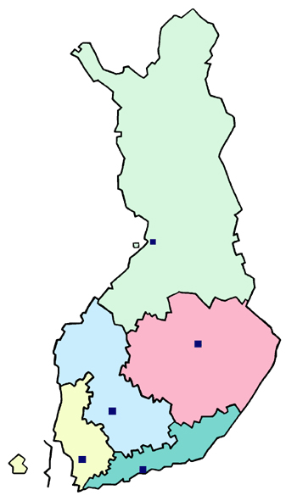
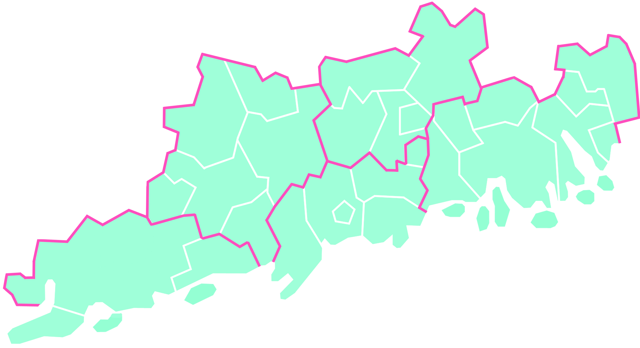
H
THE HUS HOSPITAL DISTRICT AND HELSINKI UNIVERSITY HOSPITAL
Hyvinkää
Hospital Area
Hyvinkää Hospital
Kellokoski Hospital
Mäntsälä
Lohja
Hospital Area
Hyvinkää
Lapinjärvi
Karkkila
Askola
Liljendal
Nummi-
Pusula
Nurmijärvi
Järvenpää
Pornainen
Pernaja
Vihti
Tuusula
Kerava
Loviisa
Lohja Hospital
Porvoo
Lohja
Vantaa
Sipoo
Länsi-Uusimaa
Hospital Area
Karjalohja
Espoo
Kauniainen
Porvoo Hospital
Siuntio
Kirkkonummi
Peijas Hospital
Porvoo
Hospital Area
Inkoo
Helsinki
HUS hospitals
in Helsinki
Raasepori
Jorvi Hospital
Helsinki University Hospital Area
Hanko
Tammiharju Hospital
Länsi-Uusimaa Hospital

Slide 4
Haipro incident reporting
HaiPro is a web-based tool for reporting patient safety incidents. HaiPro is used in over 200 social service and health care organizations of various sizes: from small health care centers to entire hospital districts.
HaiPro tool provides an indication of the sufficiency of current preventive procedures and can also be used to assess the effect of new measures.

Slide 5
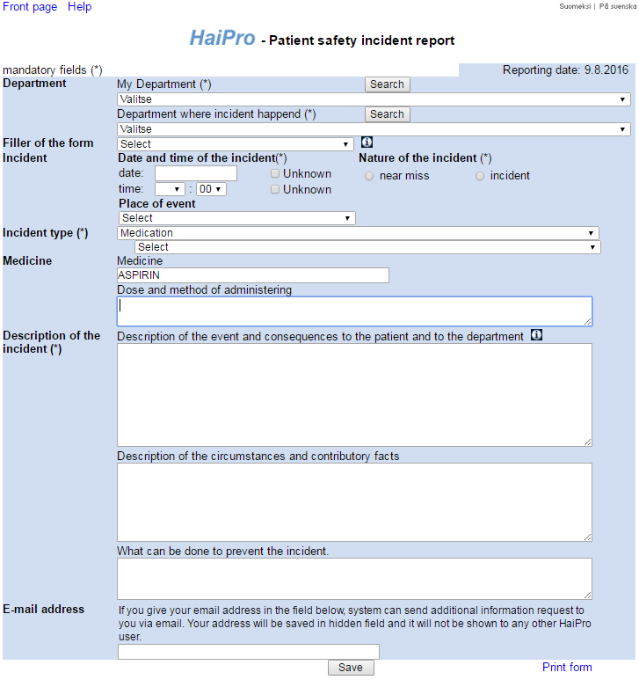

Slide 6
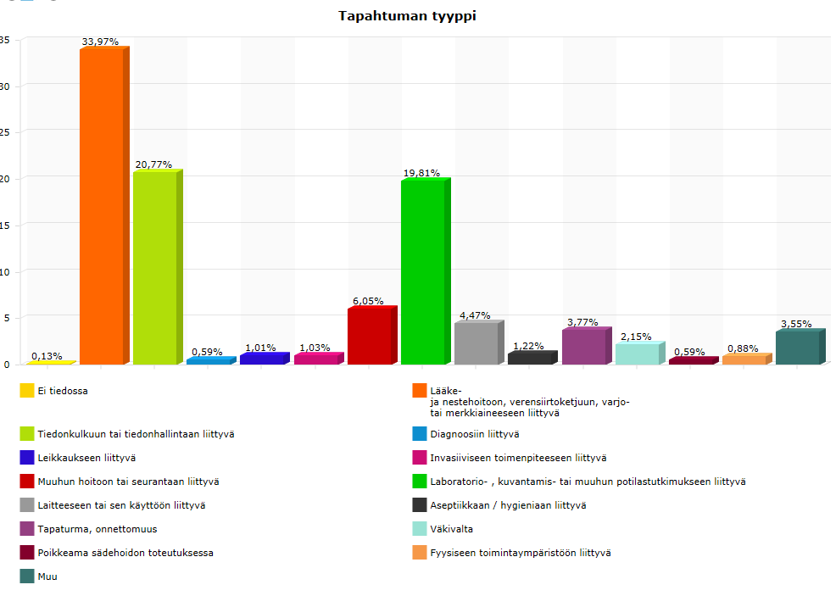
Types of incidents
(MEDICATION 34 %)

Slide 7
Hihg risk medications
There are medications that pose to a higher risk for harmful effects and medication errors (MEs)¹⁻³
It is possible to use existing high-alert medication lists, although they reflect clinical practices in the contexts where the lists are compiled.
Therefore, it is also preferable to use hospital-specific safety data to customize these lists to fit the local context.
The study objective was identify high-alert medications in Helsinki University Hospital (HUS) by using ME reports in the hospital’s patient safety incident reporting system (HaiPro)

Slide 8
METHODS
Altogether 18 136 MEs and near misses were reported in 2007–2013 with the HaiPro-tool)
We included the reports where medications were coded as a contributing factor to MEs
Therapy groups and medications were identified and compared to the hospital’s drug consumption and ISMP’s List of High-Alert Medications, which is probably the most widely used high-risk medication list
The reports including most reported medications were qualitatively analyzed with the simplified root cause analysis (RCA)

Slide 9
study outline
Patient safety incident reports in HaiPro during
2007–2013
(n=36 126)
Medication error (ME) and near miss reports
(n=18 136)
Specific active substance or proprietary name is not mentioned in a report (n=12)
Targeted sample: reports where medications were coded as a contributing factor to MEs (n=263)
Specific active substance or proprietary name is mentioned in a report (n=251)
Duplicate reports (n=2)
Total study sample:
249 reports with 280 different medications
Quantitative analysis
Most reported medications (≥4) and ISMP’s High-Alert Medications* (≥3)
→ (n=120)
Qualitative simplified root cause analysis

Slide 10
RESULTS: medication groups
The total sample included 249 reports with 280 medications
The most common therapeutic groups were
  antibacterials for systemic use (13%),
  psycholeptics (10%),
  analgesics (9%),
  antithrombotic agents (9%) and
  anesthetics (7%)
These five medication groups were involved in almost half (46%) of all reported MEs in the study sample

Slide 11
All reported medications (n=280) in the included ME and near miss reports (n=249) divided in 43 therapeutic classes by ATC-codes and compared to the hospital’s medication consumption in dispensing units* in 2007-2013.
Therapeutic Group | Number Of Cases n (%) | Consumption 2007-2013 (dispensing units*) |  |  |  | Errors/ Consumption (10⁻⁶)
Antibacterials for systemic use (J01) | 35 (12.5) |  | 8 616 351 |  |  | 4.1
Psycholeptics (N05) | 27 (9.6) |  |  | 12 180 221 |  | 2.2
Analgesics (N02) | 24 (8.6) |  |  | 17 237 117 |  | 1.4
Antitrombotic agents (B01) | 24 (8.6) |  |  | 4 601 147 |  | 5.2
Anesthetics (N01) | 20 (7.1) |  |  | 5 295 278 |  | 3.8
Psychoanaleptics (N06) | 12 (4.3) |  |  | 2 540 655 |  | 4.7
Diuretics (C03) | 11 (3.9) |  |  | 2 990 798 |  | 3.7
Cardiac therapy (C01) | 11 (3.9) |  |  | 2 195 909 |  | 5.0
Blood substitutes and perfusion solutions (B05) | 10 (3.6) |  |  | 15 234 626 |  | 0.7
Agents acting on the renin-angiotensin system (C09) | 10 (3.6) |  |  | 1 818 711 |  | 5.5
Calcium channel blockers (C08) | 7 (2.5) |  |  | 1 340 207 |  | 5.2
Drugs used in diabetes (A10) | 7 (2.5) |  |  | 1 274 021 |  | 5.5
Anti-inflammatory and antirheumatic products (M01) | 6 (2.1) |  |  | 5 160 053 |  | 1.2
Antiepileptics (N03) | 6 (2.1) |  |  | 3 224 212 |  | 1.9
Muscle relaxants (M03) | 6 (2.1) |  |  | 815 491 |  | 7.4
Anti-parkinson drugs (N04) | 5 (1.8) |  |  | 504 629 |  | 9.9
Mineral supplements (A12) | 4 (1.4) |  |  | 3 094 696 |  | 1.3
Drugs for acid related disorders (A02) | 4 (1.4) |  |  | 3 586 929 |  | 1.1
Drugs for functional gastrointestinal disorders (A03) | 4 (1.4) |  |  | 1 825 389 |  | 2.2
Urologicals (G04) | 4 (1.4) |  |  | 832 071 |  | 4.8
Beta blocking agents (C07) | 3 (1.1) |  |  | 3 115 490 |  | 1.0
Respiratory system (R) | 3 (1.1) |  |  | 2 949 970 |  | 1.0
Corticosteroids for systemic use (H02) | 3 (1.1) |  |  | 2 508 176 |  | 1.2
Pituitary, hypotalamic hormones and analogues (H01) | 3 (1.1) |  |  | 734 160 |  | 4.1
Antiprotozoals (P01) | 3 (1.1) |  |  | 442 716 |  | 6.8
Antigout preparations (M04) | 3 (1.1) |  |  | 192 124 |  | 15.6
Drugs for treatment of bone diseases (M05) | 3 (1.1) |  |  | 80 956 |  | 37.1
Other therapeutic groups** | 22 (1.1) |  |  | 31 551 905 |  | 0.7
TOTAL | 280 (100) 135 944 007 2.1
* Dispensing unit: tablet, capsule, vial, ampoule, injection/infusion bottle, infusion bag, sachet, transdermal patch etc. ** Reported twice: diagnostic agents (V04), lipid modifying agents (C10), sex hormones and modulators of the genital system (G03), antimycotics for systemic use (J02), antivirals for systemic use (J05) and all other therapeutic groups (e.g. antidotes, V03). Reported once: endocrine therapy (L02), dermatologicals (D), antihemorrhagics (B02), immune sera and immunoglobulins (J06), immunosupressants (L04), general nutritients (V06), vaccines (J07), antineoplastic agents (L01), contrast media (V08) and vitamins (A11).
These five medication groups were involved in almost half (46%) of all reported MEs in the study sample.
The highest error ratios

Slide 12
RESULTS: medications
Half (50%) of all reported medications were used via parenteral route (n=141)
  including the most reported specific medications ceftriaxone and oxycodone
Approximately 34% of all reported medications in the targeted sample were ISMP’s high-alert medications
  to test the validity of the targeted sample, we also took a same size random sample, which included only 10% ISMP’s high-alert medications
The most common high-alert medications were oxycodone (5%), enoxaparin (3%), noradrenalin (3%)
Ceftriaxone (administered IV) had the highest error ratio of 61.3, followed by insulin (SC, IV; error ratio 42.7) and noradrenaline (IV; error ratio 31.9)

Slide 13
RESULTS: medications
Drugs for treatment of bone diseases (M05) was the therapeutic group with the highest error ratio compared to the consumption (37.1), followed by antigout preparations (15.6) and antiparkinson drugs (9.9)

Slide 14
results: error types
A majority (80%) of the reported medication errors actually occurred to patients
  particularly most of these errors related to oxycodone (n=11) and enoxaparin (n=8)
Clearly the most common error type was administration errors (34% of the all reported MEs)
The proportion of medication errors reaching the patient was highest in administration errors (96%)

Slide 15
  Nature, number and distribution of reported medication error types (n=249).
Other error types: unexpected reaction to a patient (n=12), information (n=3), monitoring (n=1),
storage (n=1), ordering (n=1), distribution (n=1), and other than previously mentioned error type (n=7).

Slide 16
RESULTS: error types
Administration errors were most common with oxycodone and enoxaparin
Prescribing errors were usually related to ceftriaxone and cefuroxime
Preparing errors were usually related to ceftriaxone and oxycodone
Dispensing errors were usually related to paracetamol, hydrochlorothiazide and oral hypoglycemics

Slide 17
results: consequences
Consequences to a patient were classified in 90% (n=225) of reports:
  serious harm 3%(n=7) → cefuroxime, enoxaparin (n=2), ibuprofen, midazolam, propofol and warfarin (5/7 = ISMP’s high-alert medications)
  no fatal medication errors
ISMP’s High-Alert Medications were related to half (n=23/46) of the serious or moderate cases
  antithrombotic agents (13%) including ASA, clopidogrel, warfarin and enoxaparin and alteplase
  anaesthetics (11%) including fentanyl, remifentanil, propofol
Error types in cases usually followed by serious and moderate harm were administration (n=19) and prescribing errors (n=13)
  the role of prescribing errors is greater in serious or moderate cases (28%) compared to the entire data (15%)

Slide 18
results: key safety risks
Key safety risks were identified with the qualitative simplified root cause analysis of the reports with most reported (≥4) and ISMP’s High-Alert Medications (≥3)
Altogether 120 reports were analyzed using the qualitative method
The qualitative method deepened the understanding about key safety risks with high-alert medications, drug nomenclature, formulations and administration routes, and changes in the formulary

Slide 19
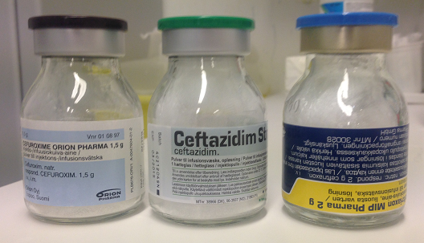
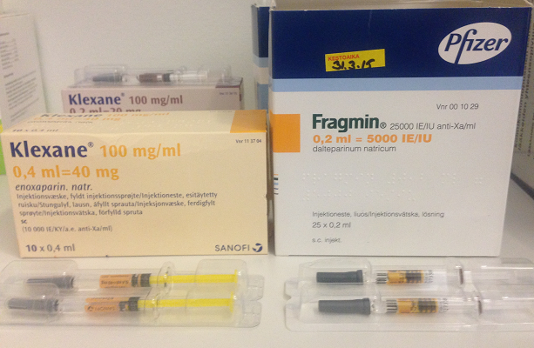
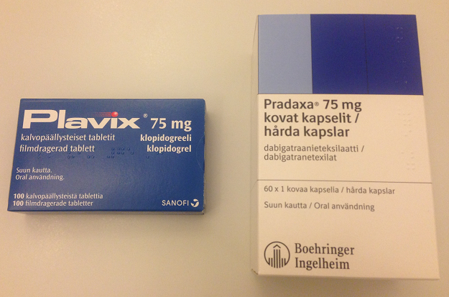
results: key safety risks
Confusing nomenclature was related to
  cefuroxime / ceftazidim / ceftriaxone
  Rocephalin® / Rocephalin cum Lidocain® / rocuronium
  citalopram / Cipralex®
  enoxaparin / dalteparin
  paracetamol (Panadol®) / paracetamol + codein (Panacod®)
  glucosamine / metformin (Glucophage®) / glimepiride;
  metformin / metoprolol
  clopidogrel (Plavix®) / dabigatran (Pradaxa®)

Slide 20
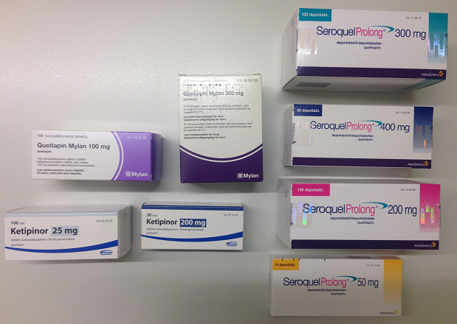
results: key safety risks
Safety risks related to formulary
  many different proprietary names for one active substance (quetiapin)
  no combination tablets available (hydrochlorothiazide)
  changes in the formulary (noradrenaline, ropivacaine, tramadol)
Organizational point of view
  nurses’ workload (fentanyl, morphin)
  inadequate induction or knowledge about used medications e.g. indication, interactions, incompatibilities and generic names (ceftriaxone, oral hypoglycaemics, propofol, oxycodone)
  unclear responsibilities (remifentanil)

Slide 21
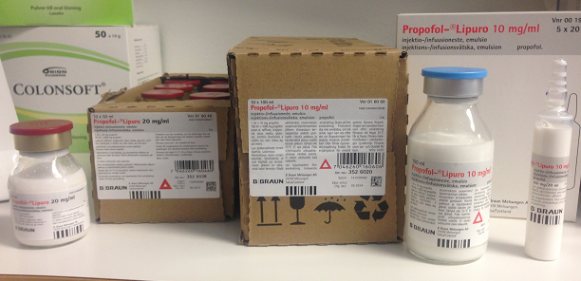
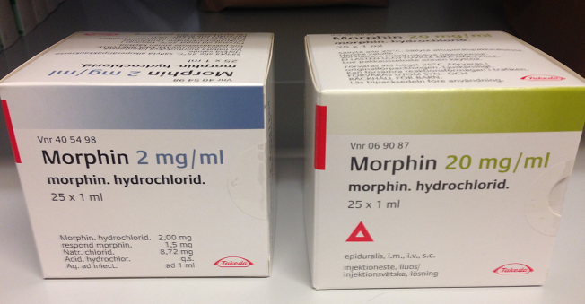
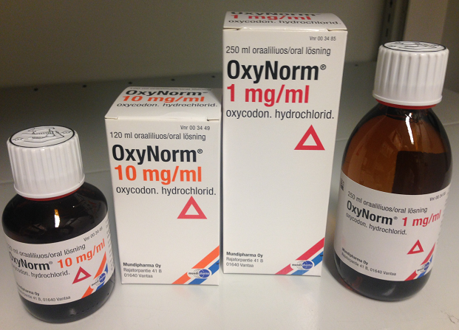
results: key safety risks
  Other confusion in concentrations, milligrams and millilitres),
  confusing normal/enteric coated/slow-release/combination tablets
  confusing infusion pumps/tubes when patient had several infusions (
  labelling syringes, infusions and tubes
  allergy information was missing or unnoticed
  hand written prescriptions (morphin)
  multiphasic documentation process (enoxaparin)
  lack of double checking (enoxaparin, dalteparin, ASA)

Slide 22
conclusions
This study provided a novel, hospital-specific approach to high-alert medications and complements the earlier studies.
We successfully combined quantitative and qualitative approaches to identify a hospital-specific high-alert medications by using segmented data from HaiPro error reporting system.
We identified several high-alert medications with quantitative methods. Qualitative method deepened the understanding about key safety risks with these high-alert medications, including drug nomenclature, preparation and administration routes, as well as changes in the formulary.
Further studies are needed to gain more comprehensive understanding of these multi-faceted safety problems of high-alert medications in different settings in HUS (e.g. paediatrics, intensive care, emergency and oncological wards).

Slide 23
STUDY GROUP
  Lotta Tyynismaa, Hospital Pharmacist (MScPharm; PhD student), HUS-Pharmacy, Hospital Pharmacy of Hospital District of Helsinki and Uusimaa (HUS), Finland
  Anni Honkala, Hospital Pharmacist (MScPharm), Hospital Pharmacy, Kanta-Häme Central hospital, Finland
  Marja Airaksinen, Professor (PhD), Clinical Pharmacy Group, Faculty of Pharmacy, University of Helsinki, Finland
  Kenneth Shermock, Professor (PharmD, PhD), Center for Drug Safety and Effectiveness, Department of Epidemiology, The John Hopkins Bloomberg School of Public Health, the United States of America (USA)
  Lasse Lehtonen, Professor (MD, PhD), Chief Administrative Physician, Department of Public Health, University of Helsinki and Helsinki University Hospital,

Slide 24
Let us meet again..
We welcome you to our future conferences of Conference Series LLC
through
9th International Conference and Exhibition on Pharmacovigilance
July 17-19, 2017 Munich, Germany
http://pharmacovigilance.pharmaceuticalconferences.com/

