Slide 1
Advances In The Management of Enteropathy and other Gastrointestinal Conditions
Larry Good, MD
Good Pharmaceutical Development Co., LLC
Lynbrook, NY

Slide 2
Program Agenda
What is a Medical Food?
Why use EnteraGamTM?
  Mechanism of Action
  Clinical Data
  Safety Profile
Discussion & Case Studies

Slide 3
Keynote Speaker
Larry Good, MD
Larry I. Good, MD, P.C.
Lynbrook, NY

Slide 4
Disclosure
Member of the Speakers Bureau of Entera Health, Abbvie, Cubist and Prometheus
Research Grants from Entera Health

Slide 5
What is a Medical Food?

Slide 6
Medical Progression to Today
Clinical Practice Use
1941
Hospital Use
Today
Digested Proteins
Carbohydrates
Oral Immunoglobulin
Rehydration Formulas
Lipids
Vitamin Formulations
Amino Acids
All Types of Medical Foods Regulated by the FDA-Food Safety is Required

Slide 7
FDA Category Comparison
 | Dietary Supplement | FDA Regulated Medical Foods | FDA Approved Drugs
Population | Healthy | Chronic Condition or Disease | Disease
Safety Standard | None Required, General Expectation | Expert Panel of Toxicologists Review and Establish Food Safety | Proven via Extensive Animal/Clinical
Scientific Studies | None | Recognized Science; Preclinical/Clinical Studies | Phase I, II, III
Medical Supervision | None | Required by Federal & State Statutes | Required by Federal & State Statutes
Governing Act | DSHEA | Orphan Drug Act | Fed. FD&C Act
Morgan and Baggett, 2006
DHSEA: Dietary Supplement Health and Education Act.
Fed. FE&C Act: Federal Food, Drug, and Cosmetic Act

Slide 8
Why Consider EnteraGam ™?
Serum-derived Bovine Immunoglobulin / Protein Isolate (SBI)

Slide 9
Diarrhea, IBS & IBD Therapy Options
Source Data: IMS SMART 12/12
USCs 13100, 23100 and 23200
A highly unsatisfied market with no single solution

Slide 10
Oral Immunoglobulin Use in Animal Health and Nutrition
Early weaned pigs are immunodeficient and have stunted growth with 10% mortality. Symptoms include:
  Enteropathy / Enteric Infection
  Diarrhea
  Dehydration
Pigs fed plasma proteins which contain immunoglobulins, post-weaning show consistent improvement in growth and overall health
75 studies of data from 43 publications (Torrallardona et al., 2010).
  Lean body mass increased 34%
  Food intake increased 23%
  Protein utilization increased 9%
Plasma protein containing immunoglobulins are used in 85% of the swine production operations in the US and 60% in Europe
25+ years of research. Over 350 peer-reviewed
publications in preclinical research.

Slide 11
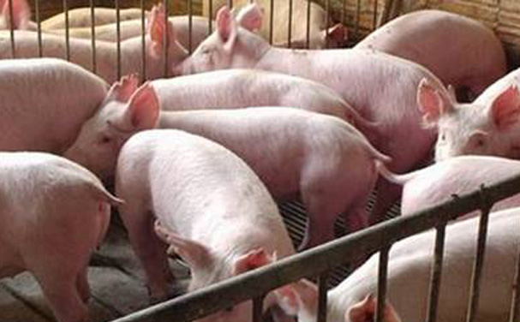
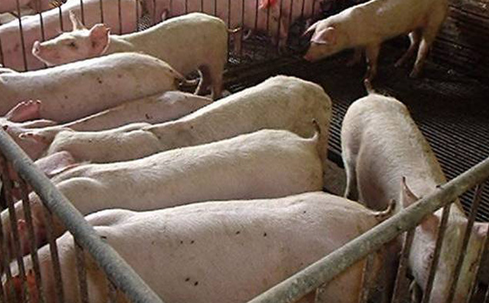
Visual Comparison Between Pigs
Fed / Not Fed Immunoglobulins
Pigs fed IgG
Pigs not fed IgG
Both Pens Contain Pigs Challenged with Pathogen

Slide 12
Immunoglobulins Survive GI Tract
FECAL RECOVERY | Donor Species | Population (n), Health Status | Preparation | Material* | Reference
13% | Bovine | Infant (10), Healthy | Powder | IgG, C | Zinkernagel et al. 1972
4-12% | Human | Infant (6), Healthy | Liquid | IgG, S | Blum et al. 1981
~25% | Human | Children (3), Primary Immune Deficiency | Liquid | IgG, S | Losonsky et al. 1985
10% | Bovine | Infant (164), Viral Gastroenteritis | Liquid | IgG, M | Hilpert et al. 1987
1-10mg/g of dry feces | Human | Infant (179), Low Birth Weight | Liquid | IgA-IgG, S | Eibl et al. 1988
10-20% | Bovine | Adult (65), Cholera | Powder | IgG, C | McClead et al. 1988
ǂ | Bovine | Adult (50), Shigella flexneri | Liquid | IgG, C | Tacket et al. 1992
1-80 mg/dL of feces | Human | Adult (72), Bone Marrow Transplant Patients | Liquid | IgG, S | Copelan et al. 1994
ǂ | Bovine | Adult (12), Healthy | Powder | IgG, S | Hanning and Drew. 1994
~19%† | Bovine | Adult (7), Healthy | Powder | IgG, C | Roos et al.1995
0.1% | Bovine | Adult (4), Healthy | Powder | IgG, C | Bogstedt et al. 1997
25% | Bovine | Adult, Healthy | Powder | IgG, C | Kelly et al.1997
<0.1% | Bovine | Adult (8), Healthy | Liquid | IgG, C | Lissner et al. 1998
49%† | Bovine | Adult (6), Healthy | Powder | IgG, C | Warny et al. 1999
5% | Bovine | Children (105), Healthy | Liquid | IgG, C | Pacyna et al. 2001
† Amount collected in the ileum
ǂ Indicates the presence of immunoglobulin in stool
* S = serum; C = colostrum; M = milk concentrate
Jaison, Burnett. Survival and digestibility of orally-administered immunoglobulins through the
gastrointestinal tract in humans. Nutrition J. 2015. In Press. Nutrition Journal

Slide 13
SBI – Product profile
Serum-derived Bovine Immunoglobulin/Protein Isolate:
  Pooled from over 3,000 cows per lot to maintain homogeneity and reproducibility
  Contain the immune experience of all these cows
  ~60% Immunoglobulins
    >50% IgG
    1% IgA
    5% IgM
  Albumin
  Other proteins (similar to those found in milk and colostrum)
EnteraGam™ contains 5 g of SBI and 5 g of dextrose with trace amounts of sunflower lecithin per packet.
  (~40 calories / package)

Slide 14
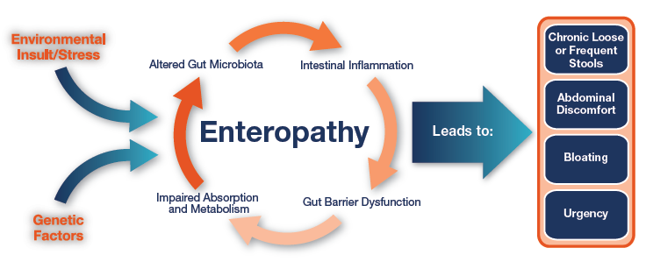
Interplay of Many Factors
(Specific Intestinal Disorders)
Petschow BW, Burnett BP, Shaw AL, Weaver EM, Klein GL. Dietary Requirement for Serum-Derived Bovine Immunoglobulins in the Clinical Management of Patients with Enteropathy. Dig Dis Sci. 2014 Aug 21; DOI 10.1007/s10620-014-3322-0.

Slide 15
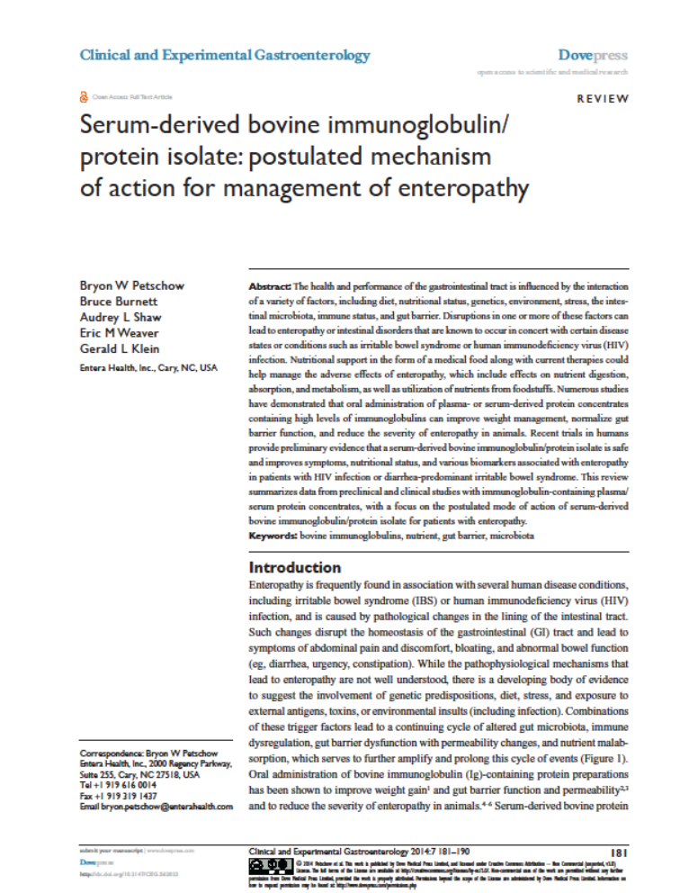
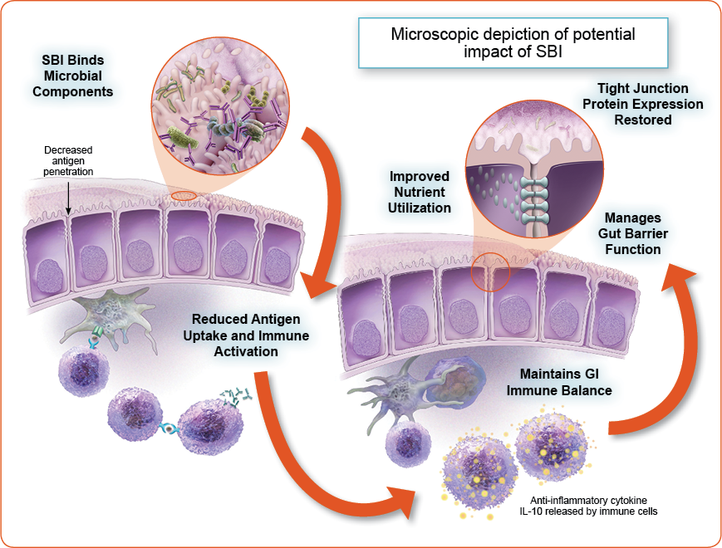
Mechanism of Action

Slide 16
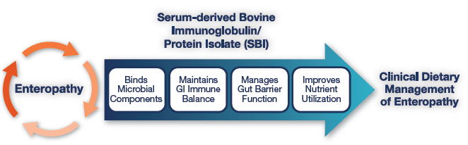
Summary of SBI Mechanism
In vitro /in vivo animal:
E. coli K88 & K99 Strains
S. aureus enterotoxin B
Rotavirus
Cryptosporidium
Various bacterial lipopolysaccharide (LPS)
C. Difficile toxins A & B (087, 078 & 027)
Yeast/fungus
Many more
In vitro /in vivo animal data:
Reducing pro-inflammatory and inducing anti-inflammatory proteins. In human HIV-enteropathy: increased CD4+ T-cells and reduced intestinal fatty acid binding protein and metalloproteinase in lamina propria.
Ex vivo /in vivo animal data showing attenuated intestinal permeability, most likely due to altered tight junction expression.
Animal /human data in HIV and malnutrition showing improved uptake and utilization.

Slide 17
Inflammatory Bowel Disease

Slide 18
Inflammatory Bowel Disease
An estimated 1.8 million Americans have inflammatory bowel disease (IBD).
  Nguyen GC et al. J Crohns Colitis . 2014;8(4):288-95.
IBD consists primarily of Crohn’s disease (CD) and ulcerative colitis (UC) but microscopic colitis is also considered IBD.
  Baumgart DC et al. Lancet 2012;380:1590-1605
CD is a relapsing, chronic, systemic, transmural inflammatory disease which can involve the entire gastrointestinal tract. UC is also characterized by inflammation of the GI tract; while it can be transmural in later stages, inflammation is usually only in the epithelial layer of the colon.
  Nguyen GC et al. J Crohns Colitis . 2014;8(4):288-95.
  Baumgart DC et al. Lancet 2012;380:1590-1605
  Podolsky DK. inflammatory bowel disease. N Engl J Med 2002;347:417-29

Slide 19
Symptoms of CD and UC
Symptoms:
  CD: abdominal pain with cramping, chronic diarrhea, lack of appetite/weight loss, fatigue, and fever. Other symptoms may include mouth sores, rectal bleeding, perianal disease as well as inflammation of joints, skin, eyes, and liver/bile ducts.
  UC: progressive deterioration in consistency and urgency of bowel movements that can lead to persistent chronic loose and frequent stools, which are generally bloody with cramping, abdominal pain, tenesmus, and occasionally decrease appetite that may lead to weight loss (4).
Nguyen GC et al. J Crohns Colitis . 2014;8(4):288-95.
Baumgart DC et al. Lancet 2012;380:1590-1605
Podolsky DK. inflammatory bowel disease. N Engl J Med 2002;347:417-29

Slide 20
Therapies and Goals
Common therapies for IBD:
  aminosalycilates (5-ASAs), anti-inflammatory drugs (including systemic steroids), immunomodulators, and biologic therapies.
  Antibiotics have also been employed for IBD treatment, particularly in CD.
  Other options for complicated cases or patients who do not respond to pharmaceutical therapy include surgery, particularly colectomy, bowel resections, strictureplasty, and abscess drainages.
Treatment Goals: So-call “complete” or “deep remission”
  Clinical remission
  Endoscopic remission
  Tissue healing
Talley NJ et al. An evidence-based systematic review on medical therapies for inflammatory bowel disease. Am J Gastroenterol. 2011 Apr;106 Suppl S2–25.
Abraham C, Cho JH. Inflammatory bowel disease. N Engl J Med. 2009 Nov 19;361(21):2066–78.
Crohn’s and Colitis Foundation of America. Treatment for IBD. 2014. Retrieved from http://www.ccfa.org/resources/treatment-options-in-ibd.html.
Panaccione R et al. Evolving definitions of remission in Crohn's disease. Inflamm Bowel Dis 2013;19(8):1645-53.
Bryant RV et al. Systematic review: Histological remission in inflammatory bowel disease. Is 'complete' remission the new treatment paradigm? An IOIBD initiative. J Crohns Colitis 2014;8(12):1582-1597.

Slide 21
Management of IBD Patients with Oral Serum-Derived Bovine Immunoglobulin:
A Retrospective Case Series
A single-center retrospective chart analysis of patients with IBD (n=45) utilizing SBI at 5 g/d as nutritional add-on therapy for management of chronic loose and frequent stools was performed to evaluate the medical food’s effect on overall disease management.
Standard-of-care measurement for change in therapeutic regimen: patients administered any new agent contacted weekly for assessment of their condition using a 5-tier scale to score overall disease management in response (0= none; 1= minimal; 2= moderate; 3= significant; 4= complete).
A multivariate ordered logistical regression model that controlled for patient characteristics was used to determine the odds ratio at week 1 (baseline) and after 12 weeks (end point).
Shafran et al. Management of IBD Patients with Oral Serum-Derived Bovine Immunoglobulin: A Retrospective Case Series. Submitted.

Slide 22
Patient Population
Characteristic | Analyzed Patients (N=45)
Age in years, mean (SD) | 51.5 (19.0)
Senior age group (>=65 years), n (%) | 10 (22.2%)
Female, n (%) | 17 (37.8%)
Race white, n (%) | 41 (91.1%)
Diagnosis, Crohn’s disease (CD), n (%) | 38 (84.4%)
Ulcerative colitis (UC), n (%) | 7 (15.6%)
Shafran et al. Management of IBD Patients with Oral Serum-Derived Bovine Immunoglobulin: A Retrospective Case Series. In preparation.

Slide 23
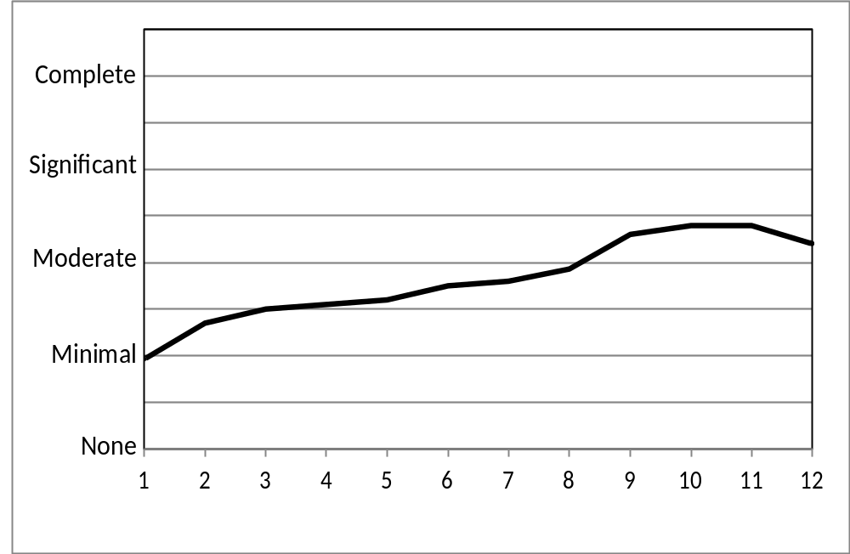
Average Patient Response per Week
Shafran et al. Management of IBD Patients with Oral Serum-Derived Bovine Immunoglobulin: A Retrospective Case Series. In preparation.

Slide 24
Results and Conclusion
The odds ratio resulting from the statistical model showed that the entire group of IBD patients were 2.8 (CI: 1.266 - 6.016, p = 0.011) times more likely to report management continuing on therapy after the initial measurement. These results were not significantly associated with age, sex, diagnosis, or race.
These results suggest that SBI increases the likelihood of patient-reported condition management in a variety of IBD patients and thus should be considered for the nutritional management of IBD regardless of disease activity, location, phenotype, duration, or complexity.
Shafran et al. Management of IBD Patients with Oral Serum-Derived Bovine Immunoglobulin: A Retrospective Case Series. In preparation.

Slide 25
Retrospective SBI Use in the Management of Patients with Inflammatory Bowel Disease
Retrospective review from a collection of seven patients with Crohn’s disease or ulcerative colitis (UC) who had SBI incorporated into their therapeutic regimens. All had previously failed to respond or fully respond to conventional therapies.
Their individual responses to SBI therapy were evaluated to determine the potential for use of SBI for patients with IBD.
Good L, Panas RM. Serum-derived bovine immunoglobulin/protein isolate (SBI) use in patients with ulcerative colitis. Advances in Inflammatory Bowel Diseases, Crohn’s & Colitis Foundation’s Clinical & Research Conference. December 4-6, 2014. Orlando, FL.
Good L, Panas RM. Use of Serum-Derived Bovine Immunoglobulin/Protein Isolate (SBI) in Patients with Crohn’s Disease. Advances in Inflammatory Bowel Diseases, Crohn’s & Colitis Foundation’s Clinical & Research Conference. December 4-6, 2014. Orlando, FL.

Slide 26
Crohn’s Disease Patients
Patient | Diagnosis | Other Therapies | Prior to SBI
53-year-old Caucasian male | 30 yr Hx of CD, Brooke ileostomy and small bowel resection, ~150 cm of small bowel resulting in chronic dehydration, short bowel syndrome, nephrolithiasis, hypomagnesemia | 6-mercaptopurine, fentanyl patch, alprazolam, and omeprazole | high ileostomy output (3.5 L/d),
54-year-old Caucasian male | Hx CD, right hemicolectomy 20 yr ago | 6-mercaptopurine, tadalafil and biweekly injection of adalimumab
21-year-old Caucasian male | 7 yr Hx of CD | adalimumab, mesalamine | Intermittent exacerbations w/ abdominal pain, anorexia, and weight loss
49-year-old Caucasian male | CD, right hemicolectomy for nearly 20 yr | patient failed on infliximab or adalimumab required steroids for maintenance | active small bowel disease w/ abdominal pain, cramps and loose, watery stools
Good L, Panas RM. Serum-derived bovine immunoglobulin/protein isolate (SBI) use in patients with ulcerative colitis; Good L, Panas RM. Use of Serum-Derived Bovine Immunoglobulin/Protein Isolate (SBI) in Patients with Crohn’s Disease. Advances in Inflammatory Bowel Diseases, Crohn’s & Colitis Foundation’s Clinical & Research Conference. December 4-6, 2014. Orlando, FL.

Slide 27
UC Patients
Patient | Diagnosis | Other Therapies | Prior to SBI
66-year-old Caucasian female | Recent diagnosis of pan colitis; UC | budesonide + mesalamine 14 d w/out effect, budesonide dc’ed | 10-12 watery stools/d with bleeding, urgency, nocturnal diarrhea
55-year-old Caucasian male | 14 yr Hx of UC led to a procto-colectomy and an ileoanal anastomosis (J-Pouch) | carbidopa-levodopa, Saccharomyces boulardii probiotic, and tamsulosin | chronic intermittent pouchitis and 10-12 loose stools/d along with urgency, bleeding and mucous discharge, budesonide and ciprofloxacin exacerbated pouchitis
24-year-old Caucasian male | Mayo Grade 3 ulcerative proctitis | no prior medications | presented with loose/water bowel movements and rectal bleeding
Good L, Panas RM. Serum-derived bovine immunoglobulin/protein isolate (SBI) use in patients with ulcerative colitis. Advances in Inflammatory Bowel Diseases, Crohn’s & Colitis Foundation’s Clinical & Research Conference. December 4-6, 2014. Orlando, FL.
Good L, Panas RM. Use of Serum-Derived Bovine Immunoglobulin/Protein Isolate (SBI) in Patients with Crohn’s Disease. Advances in Inflammatory Bowel Diseases, Crohn’s & Colitis Foundation’s Clinical & Research Conference. December 4-6, 2014. Orlando, FL.

Slide 28
Response with SBI
Patient | CD Patients After SBI
53-year-old Caucasian male | After ~10 wks ileostomy output was reduced from 3.5 L to 1.2 L/d, creatinine 3.2 to 2.9 mg/dL after 5 mo w/ further reduction to 2.6 mg/dL after 9 mo. Maintained on 5 g/d SBI plus other therapies now for 9 mo with no change
54-year-old Caucasian male | 5 g SBI BID added to other therapies, no symptoms after 3 mo, now stable on adalimumab,6-mercaptopurine, and 5 g SBI BID for 9 mo
21-year-old Caucasian male | 5 g/d added to other therapies, after 15 mo asymptomatic and gained back 10 lbs
49-year-old Caucasian male | 5 g SBI BID + steroids, after 2 wks no abdominal discomfort or cramps, after 3 mo steroids tapered replaced w/ vedolizumab, maintained for 8 mo on 5 g SBI BID + vedolizumab
Patient | UC Patients After SBI
66-year-old Caucasian female | 5 g/d SBI + mesalamine, after 4 wks, 3-4 formed stools/d with no GI symptoms or bleeding. Maintained 6 mo asymptomatic
55-year-old Caucasian male | 5 g/d SBI as monotherapy, after 6 wks, no loose or watery stools, urgency, blood or mucous, maintained 6 months w/out exacerbation of pouchitis
24-year-old Caucasian male | mesalamine suppositories and SBI 5 g/d for 14 d resulted in no loose/watery stools or rectal bleeding, mesalamine dc’ed, maintained 3 mo on 5 g/d SBI
Good L, Panas RM. Serum-derived bovine immunoglobulin/ protein isolate (SBI) use in patients with ulcerative colitis; Good L, Panas RM. Use of Serum-Derived Bovine Immunoglobulin/ Protein Isolate (SBI) in Patients with Crohn’s Disease. Advances in Inflammatory Bowel Diseases, Crohn’s & Colitis Foundation’s Clinical & Research Conference. December 4-6, 2014. Orlando, FL.

Slide 29
Results and Conclusions
The UC patients reported resolution of symptoms such as rectal bleeding, urgency, and/or nocturnal incontinence. For the CD patients, outcomes included improvements in weight, reduction in other therapies, and/or a decrease in ileostomy output and creatinine levels.
Although this is a retrospective assessment of a small number of cases, the evidence suggests that SBI had an impact on the management of ulcerative colitis and Crohn’s disease as a result of providing for the distinctive nutritional requirements of these IBD patients.
Good L, Panas RM. Serum-derived bovine immunoglobulin/protein isolate (SBI) use in patients with ulcerative colitis; Good L, Panas RM. Use of Serum-Derived Bovine Immunoglobulin/Protein Isolate (SBI) in Patients with Crohn’s Disease. Advances in Inflammatory Bowel Diseases, Crohn’s & Colitis Foundation’s Clinical & Research Conference. December 4-6, 2014. Orlando, FL.

Slide 30
Retrospective Analysis of Refractory Ulcerative Colitis Patient with Orally Administered Serum-Derived Bovine Immunoglobulin Therapy
Patient | Diagnosis | Other Therapies | Prior to SBI | After SBI
60-year old, 5 foot-7 inches, 220 lbs., Caucasian female | 10 years for treatment of pan-colonic ulcerative colitis | Maintained remission of her colitis symptoms for 2 yr w/ adalimumab. After C. difficile infection patient refused adalimumab | Adalimumab dc’ed after septic arthritis in the left knee, long-term antibiotics resulted in C. difficile infection which required 2 courses of vancomycin to resolve. Afterwards patient had 7-8 watery, bloody stools, flexible sigmoidoscopy revealed grade 2 colitis, oral prednisone, 30 mg/d, and rectal mesalamine, 1g at bedtime (QHS), was initiated. Prednisone was increased to 40 mg/d w/ no improvement | 5 g SBI QID for one week followed by 5 g/dy. After 4 wks of SBI, the patient reported 1 to 2 formed stools /d, no rectal bleeding or abdominal cramps. Over the next 6 wks, prednisone was tapered to 5mg. Erythrocyte sedimentation rate decreased from 90 mm/h to 11 mm/h over 4 mo. White blood cell count decreased from 12.4 to 10.9 thousand/μL; hemoglobin increased from 10.9 to 12.4 g/dL; hematocrit increased from 34.7 % to 38.0 % and platelet count decreased from 482 to 248 thousand/μL.
Dryden GW. Use of serum-derived bovine immunoglobulin/protein isolate (SBI) to manage refractory ulcerative colitis symptoms and avoid surgery. ACG, October 17-22, 2014. Philadelphia, PA.

Slide 31
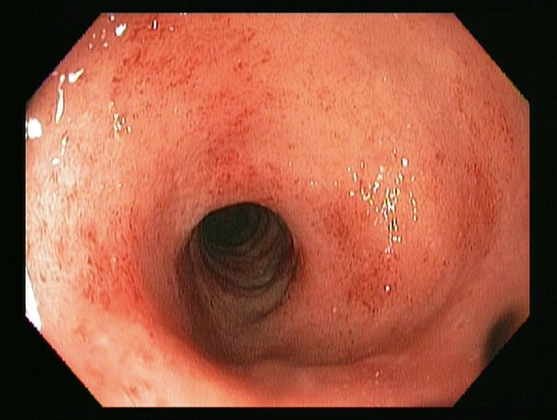
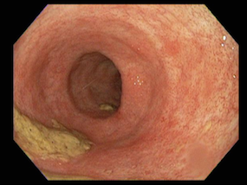
Endoscopic Evidence
Pre-SBI demonstrating grade 2 colitis Post-SBI demonstrating resolution of colitis
Dryden GW. Use of serum-derived bovine immunoglobulin/protein isolate (SBI) to manage refractory ulcerative colitis symptoms and avoid surgery. ACG, October 17-22, 2014. Philadelphia, PA.

Slide 32
Results and Conclusion
After two months, this patient had a vastly improved colitis score and corresponding decrease in inflammatory markers.
The patient also reported improved stool frequency, stool consistency and denied further bleeding or cramping.
This report suggests that such an agent could be considered as add-on therapy when dealing with refractory UC patients.
Dryden GW. Use of serum-derived bovine immunoglobulin/protein isolate (SBI) to manage refractory ulcerative colitis symptoms and avoid surgery. ACG, October 17-22, 2014. Philadelphia, PA.

Slide 33
Retrospective Analysis of a Patient with Drug Refractory Ulcerative Colitis
Patient | Diagnosis | Other Therapies | Prior to SBI | After SBI
26-year-old male patient of middle-eastern descent | 3 yr Hx diffuse, moderately severe pan-colitis diagnosed via colonoscopy. Biopsies confirmed UC with marked acute inflammation and ulceration of the mucosa, distortion of the glandular architecture, and crypt abscesses. | oral and rectal mesalamine and repeated courses of oral steroid | adalimumab, oral and rectal mesalamines, antibiotics (ciprofloxacin and metronidazole) and probiotics, the patient still required repeated courses of oral steroid, 5-10 bloody loose stools with tenesmus and cramping, each time his oral steroid dose was decreased | 5 g SBI BID , after 8 wks 1-2 normally formed stools per day) and no other symptomatology. Steroids tapered and SBI reduced to 5 g/d. Patient now maintained on adalimumab, oral mesalamine and SBI 5g/d for 12 mo. Colonoscopy performed a year after starting SBI appears normal, with no active inflammation. Random biopsies confirmed chronic inactive colitis.
Awad and Jasion. Use of a Nutritional Therapy, Serum-Derived Bovine Immunoglobulin/Protein Isolate (SBI), to Achieve Improvement in Two Different Cases of Colitis. Submitted.

Slide 34
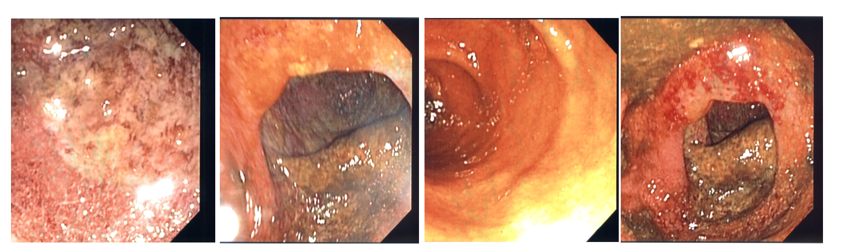
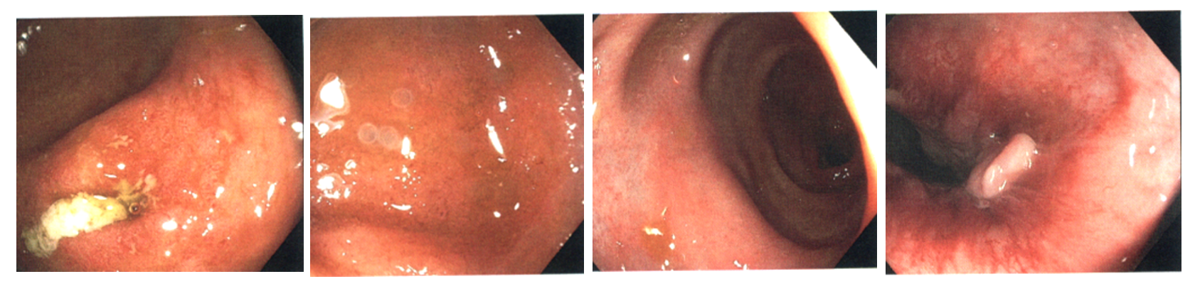
Endoscopic Evidence
Prior to SBI
After one-year of co-administration of SBI.
Awad and Jasion. Use of a Nutritional Therapy, Serum-Derived Bovine Immunoglobulin/Protein Isolate (SBI), to Achieve Improvement in Two Different Cases of Colitis. Submitted.

Slide 35
Results and Conclusion
The patient was symptomatic with mucosal ulcerations even while on multiple traditional therapies.
He was able to taper steroid therapy
After one year on SBI , a colonoscopy illustrated improved mucosa with resolution of ulcerations.
He remained on adalimumab, oral mesalamine and SBI 5 g QD for about one year when a colonoscopy revealed mucosal healing and histological evidence of quiescent colitis. Both patients continue on SBI therapy. These cases suggest that colitis patients with refractory symptomology may have a distinct nutritional requirement that is satisfied by SBI. This has been suggested for enteropathies where SBI may help restore intestinal homeostasis¹⁶.
Awad and Jasion. Use of a Nutritional Therapy, Serum-Derived Bovine Immunoglobulin/Protein Isolate (SBI), to Achieve Improvement in Two Different Cases of Colitis. Submitted.

Slide 36
Intended Use and Safety

Slide 37
EnteraGam™ (SBI) Intended Use
EnteraGam™ is a prescription medical food product intended to provide for the distinctive nutritional requirements unique for the clinical dietary management of intestinal disorders [e.g., irritable bowel syndrome with diarrhea (IBS-D), inflammatory bowel disease (IBD), and HIV-associated enteropathy].
EnteraGam™ must be used under physician supervision.

Slide 38
Important Safety Information
EnteraGam™ contains beef protein; therefore, patients who have an allergy to beef or any component of EnteraGam™ should not take this product.
The most commonly reported adverse events in clinical studies (incidence of 2-5%) include mild nausea, constipation, stomach cramps, headache, and increased urination.
No interactions with food or drugs have been observed.
EnteraGam™ does not contain any milk products such as lactose, casein, or whey. It is gluten-free, dye-free, and soy-free. It contains the following inactive ingredients: dextrose and sunflower lecithin.

Slide 39
Summary
EnteraGam™ represents a safe option for patients with IBS-D and other GI conditions/diseases characterized by chronic loose and frequent stools.
EnteraGam™ has a multifaceted mechanism for enteropathy – which itself has heterogeneous etiologies.
EnteraGam™ provides distinct nutritional support for GI conditions / diseases.

Slide 40
Discussion & Case Studies

Slide 41
How do I explain EG to a patient?
The main ingredient in EnteraGam™ is a purified beef protein (in layman’s terms, antibodies) shown to help restore intestinal balance.
EnteraGam™ does not contain any milk products such as lactose, casein, or whey. It is gluten-free, dye-free, and soy-free.
When taking EnteraGam™, be sure to mix the powder with at least 4 oz. of liquid (stir, don’t shake) – fruit punch or orange flavored sports beverages and yogurt are great choices.
EnteraGamTM can start working in as little as 2-4 weeks but it can take up to 10 weeks to see maximum results.
If patients discontinue therapy, remind them that they suffer from a chronic condition and symptoms will likely return.

Slide 42
Case 1: Crohn’s Disease
History: 56-year-old female patient. 30 years duration with low-grade fibrostenosis and intermittent abdominal distention, diarrhea, and symptoms consistent with low-grade fibrostenotic ileocolonic Crohn’s disease. Bacterial overgrowth is thought to be operative in this patient’s symptoms. Bloating with elevated stool frequency.
Previous treatment: Patient has declined therapy with steroids, biologics or immunosuppressants. Prior broad spectrum antibiotic therapy (including rifaximin) has been successful in controlling symptoms. Budesonide helped with episodic symptoms.
SBI Therapy: Therapy on SBI 5 g daily (1 packet EnteraGam™) initiated . After 8 weeks significant improvement in bloating, diarrhea, and symptomatology (1-2 normally formed stools per day). Patient is on monotherapy with SBI and has made a significant improvement.

Slide 43
Case 2: Ulcerative Colitis
History: 30-year-old male patient with a 10 year duration diagnosis with longstanding ulcerative colitis with persistent diarrhea, cramping, and symptomatology consistent with ulcerative colitis. 5-10 bloody loose stools with tenesmus and rectal urgency.
Previous treatment: Prior steroid dependence and currently on biologic therapy with infliximab 10 mg/kg. On his own, patient tried oral colostrum (nutraceutical) with no benefit.
SBI Therapy: The patient was started on 5 g SBI daily (1 packet EnteraGam™) and was maintained on infliximab 10 mg/kg. Patient had complete resolution of diarrhea with formed stool (2-3 normally formed stools per day), no abdominal cramping, or symptoms within 2 months. No more rectal urgency.

Slide 44
Case 3: Lymphocytic Colitis
History: 74-year-old female with chronic diarrhea with colonoscopy biopsies suggestive of lymphocytic colitis, fecal incontinence associated with hx of anal fistula repairs. Loose BM semi-formed followed by multiple loose BM in am; intermittent episodes. If very loose BM will have episodes of incontinence.
Previous Treatment: Failure on all antidiarrheals
On SBI: Within four weeks of initiating therapy (5 g SBI), she had normal BM 1-2 times a day. Is able to go out without episodes of incontinence.

Slide 45
References

Slide 46
References Cited
Morgan SL, Baggott JE. Medical foods: products for the management of chronic diseases. Nutr Rev. 2006;64(11):495-501.
Jaison, Burnett. Survival and digestibility of orally-administered immunoglobulins through the gastrointestinal tract in humans. Nutrition J. 2015. In Press. Nutrition Journal.
Petschow BW, Burnett BP, Shaw AL, Weaver EM, Klein GL. Dietary Requirement for Serum-Derived Bovine Immunoglobulins in the Clinical Management of Patients with Enteropathy. Dig Dis Sci. 2014 Aug 21; DOI 10.1007/s10620-014-3322-0.
Petschow BW, Burnett B, Shaw AL, Weaver EM, Klein GL. Serum-derived bovine immunoglobulin/protein isolate: postulated mechanism of action for management of enteropathy, Clin Exp Gastroenterology. 2014;7:181-190.
Nguyen GC, Chong CA, Chong RY. National estimates of the burden of inflammatory bowel disease among racial and ethnic groups in the United States. J Crohns Colitis . 2014. Apr 1 ;8(4):288–95.
Baumgart DC, Sandborn WJ. Crohn's disease. Lancet 2012;380:1590-1605 .
Podolsky DK. Inflammatory bowel disease. N Engl J Med 2002;347:417-29.
Talley NJ, Abreu MT, Achkar J-P, Bernstein CN, Dubinsky MC, Hanauer SB, et al. An evidence-based systematic review on medical therapies for inflammatory bowel disease. Am J Gastroenterol. 2011 Apr;106 Suppl S2–25.
Abraham C, Cho JH. Inflammatory bowel disease. N Engl J Med. 2009 Nov 19;361(21):2066–78.
Crohn’s and Colitis Foundation of America. Treatment for IBD. 2014. Retrieved from http://www.ccfa.org/resources/treatment-options-in-ibd.html.
Panaccione R, Colombel JF, Louis E, Peyrin-Biroulet L, Sandborn WJ. Evolving definitions of remission in Crohn's disease. Inflamm Bowel Dis 2013;19(8):1645-53.
Bryant RV, Winer S, Spl T, Riddell RH. Systematic review: Histological remission in inflammatory bowel disease. Is 'complete' remission the new treatment paradigm? An IOIBD initiative. J Crohns Colitis 2014;8(12):1582-1597.
Shafran et al. Management of IBD Patients with Oral Serum-Derived Bovine Immunoglobulin: A Retrospective Case Series. Submitted.
Good L, Panas RM. Serum-derived bovine immunoglobulin/protein isolate (SBI) use in patients with ulcerative colitis. Advances in Inflammatory Bowel Diseases, Crohn’s & Colitis Foundation’s Clinical & Research Conference. December 4-6, 2014. Orlando, FL.
Good L, Panas RM. Use of Serum-Derived Bovine Immunoglobulin/Protein Isolate (SBI) in Patients with Crohn’s Disease. Advances in Inflammatory Bowel Diseases, Crohn’s & Colitis Foundation’s Clinical & Research Conference. December 4-6, 2014. Orlando, FL.
Good L, Panas R. Applicable use of serum-derived bovine immunoglobulin/protein isolate (sbi) in the clinical management of patients with inflammatory bowel disease. Submitted.
Dryden GW. Use of serum-derived bovine immunoglobulin/protein isolate (SBI) to manage refractory ulcerative colitis symptoms and avoid surgery. ACG, October 17-22, 2014. Philadelphia, PA.
Awad A, Jasion V. Use of a nutritional therapy, serum-derived bovine immunoglobulin/protein isolate (sbi), to achieve improvement in two different cases of colitis. Submitted.
Awad and Jasion. Use of a Nutritional Therapy, Serum-Derived Bovine Immunoglobulin/Protein Isolate (SBI), to Achieve Improvement in Two Different Cases of Colitis. Submitted.

Slide 47
References for IgG Survival
Zinkernagel RM et al. The digestion of colostral bovine immunoglobulins in infants. Experientia. 1972; 28:741.
Blum PM et al, Stiehm ER. Survival of Oral Human Immune Serum Globulin in the Gastrointestinal Tract of Low Birth Weight Infants. Pediatr Res. 1981; 15:1256-1260.
Eibl MM et al. Prevention of necrotizing enterocolitis in low-birth-weight infants by IgA-IgG feeding. New Engl J Med. 319:1-7.
Hilpert H et al. Use of bovine milk concentrate containing antibody to rotavirus to treat rotavirus gastroenteritis in infants. J Infect Dis. 1987; 156:158–66.
Losonsky GH et al. Oral administration of human serum immunoglobulin in immunodeficient patients with viral gastroenteritis: A pharmacokinetic and functional analysis. J Clin Invest. 1985; 76:2362-2367.
Roos N et al. ¹⁵N-Labeled immunoglobulins from bovine colostrum are partially resistant to digestion in human intestine. J Nutr. 1995; 125:1238-1244.
Warny M et al. Bovine immunoglobulin concentrate-Clostridium difficile retains C difficile toxin neutralising activity after passage through the human stomach and small intestine. Gut. 1999; 44:212–217.
Kelly CP et al. Survival of anti-Clostridium difficile bovine immunoglobulin concentrate in the human gastrointestinal tract. Antimicrobial Agents and Chemotherapy. 1997; 41(2):236-241.
Tacket CO et al Efficacy of bovine milk immunoglobulin concentrate in preventing illness after Shigella flexneri challenge. Am J Trop Med Hyg. 1992; 47(3):276-283.
Bogstedt AK et al Survival of immunoglobulins from different species through the gastrointestinal tract in healthy adult volunteers: Implications for human therapy. Antimicrobial Agents and Chemotherapy. 1997; 41(10):2320.
Lissner R et al. Antibody reactivity and fecal recovery of bovine immunoglobulins following oral administration of a colostrum concentrate from cows (Lactobin) to healthy volunteers. Intl J Clin Pharmacol Therapeutics. 1998; 36(5):239-245.
Copelan EA et al, Avalos BR. Controlled trial of orally administered immunoglobulin following bone marrow transplantation. Bone Marrow Transplantation. 1994; 13:87-91.
McClead RE et al. Orally administered bovine colostral anti-cholera toxin antibodies: Results of two clinical trials. Am J Med. 1988; 85:811-816.
Pacyna J et al. Survival of rotavirus antibody activity derived from bovine colostrum after passage through the human gastrointestinal tract. J Ped Gastroenterol Nutr. 2001; 32:162-167.

Slide 48
THANK YOU!

