Slide 1


Application of Polyvinylpyrrolidone-polystyrene composite nanofibers coupled HPLC in the analysis of several polar molecules
Lanling Chu
Southeast University, China
Mar. 14, 2016 London

Slide 2

contents
Sample Pretreatment
Packed nanofiber solid-phase extraction-Polyvinylpyrrolidone-polystyrene (PVP-PS) composite nanofibers
Monoamine neurotransmitters (MANTs) in human plasma ---- norepinephrine (NE), epinephrine (E) and dopamine (DA), and 5-hydroxytryptamine (5-HT)
Quinolones in Spicy Soup
Chloramphenicol (CAP) in milk

Slide 3
Sample Pretreatment
Objectives
Separation Purification Enrichment
Trends of development
Smaller initial sample sizes even for trace analyses.
Greater specificity or selectivity in extraction.
Automation or for online methods.
Reduction or elimination of organic solvents.

Slide 4
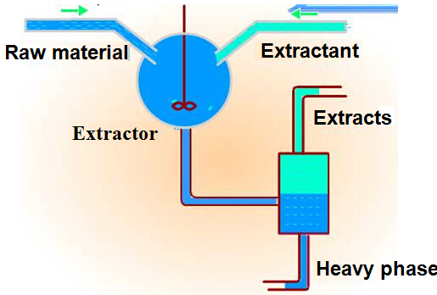
Liquid-liquid extraction（LLE）
Disadvantages
Multiple extraction
organic solvent consumption
low extraction efficiency

Slide 5
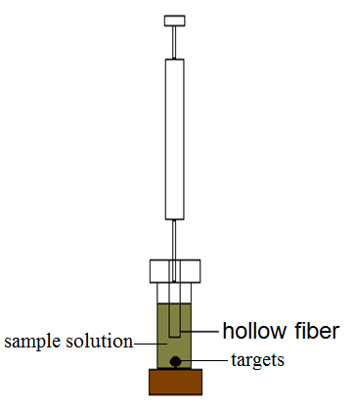
Liquid Phase Microextraction(LPME)
Advantages
Less organic solvent and pollution
Extraction , purification and enrichment
Easy adjustment of the polarity and acid-base of extraction solvent and high selectivity
Disadvantages
High selectivity of extractant

Slide 6
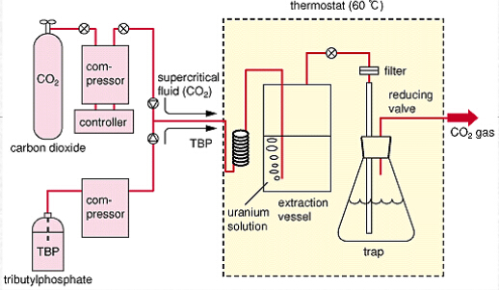
Supercritical fluid extraction( SCF)
Advantages
No organic solvent
Cheap and recyclable extraction agent
Disadvantages
Strong polarity and high molecular is unachievable weight
Expensive equipment

Slide 7
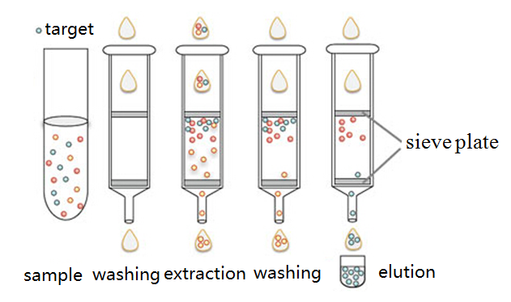
Solid phase extraction(SPE)
Advantages
Wide range of sorbent material
Easy operation
Less organic solvent and fast speed
Batch processing

Slide 8
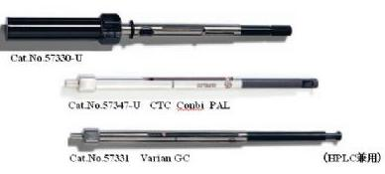
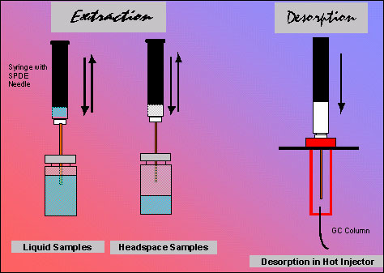
Solid-phase microextraction (SPME)
Advantages
Integration of sampling, extraction , purification ,enrichment and even injection
Disadvantages
Expensive
Limited coating
Small size samples

Slide 9
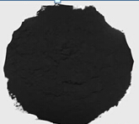
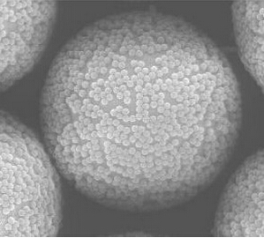
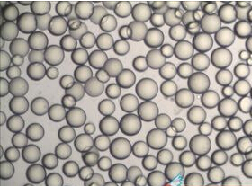
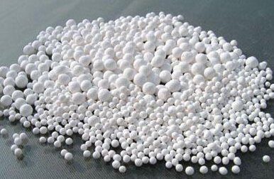
SPE--sorbent materials
Carbon
polymers
Silica
Alumina

Slide 10
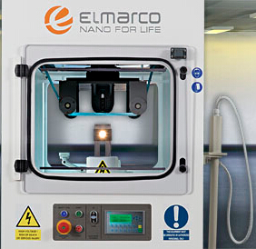
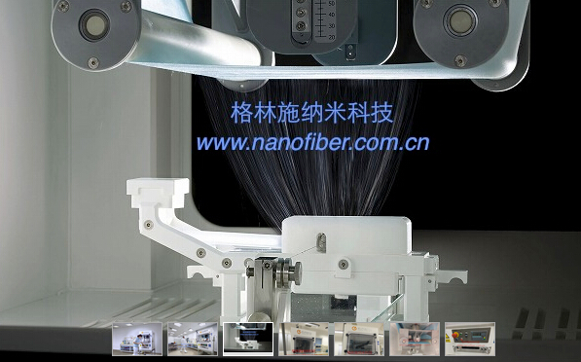
SPE sorbent materials-Electrospun nanofibers
Electrospinning device
Polymer solution
nanofibers
syringe
Large surface area to volume ratio
A wide variety of chemical and
morphological modification
Low pressure and fast speed
liquijet
Syringe pump
collector
High voltage
nanospider

Slide 11
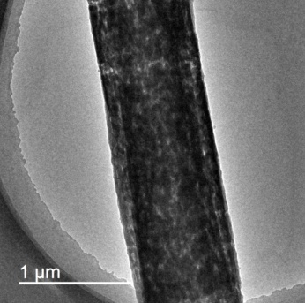
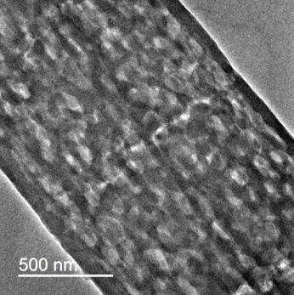
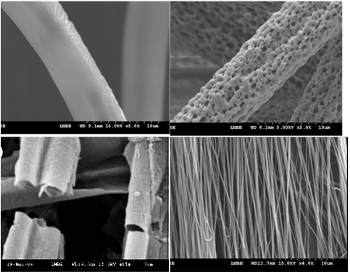
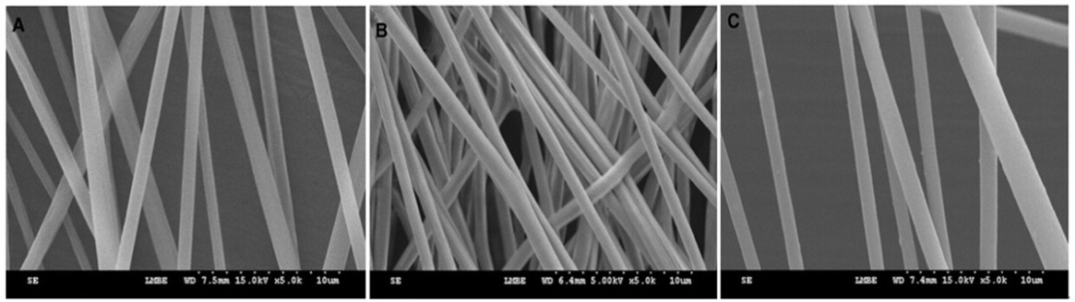
Electrospun nanofibes
SEM and TEM images of nanofibers
Alternately dark and bright spots signifying numberous nanopores
Intra- and inter-fiber porosity will enhance the functionality of fiber webs
Increasing mass transfer during the adsorption desorption process

Slide 12
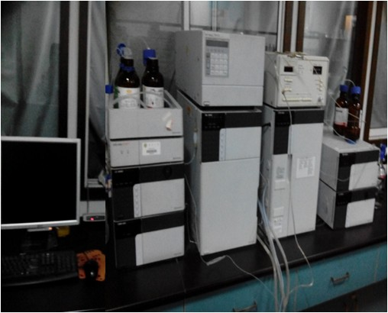

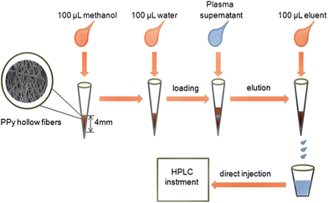

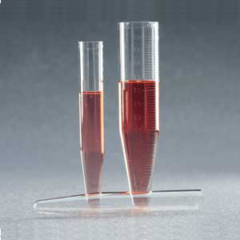
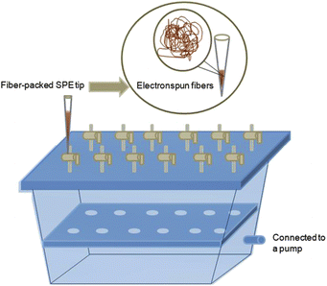
Electrospun nanofibes and extraction
PF-SPE
nanofibers
Dtection
Spinning
HPLC
HPLC-MS
GC
GC-MS
ICP-MS
ECL
CL
CLIA
ELISA
Sampling
Key process

Slide 13
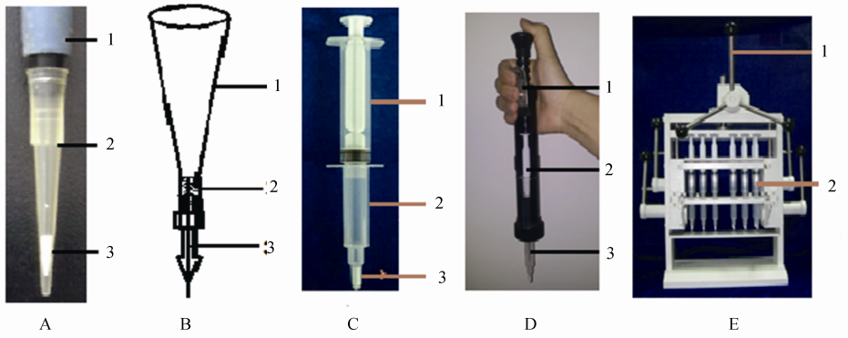
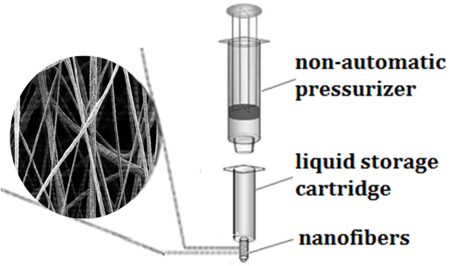
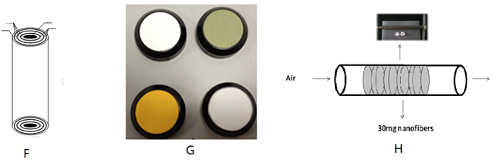
Packed nanofiber solid-phase extraction devices

Slide 14
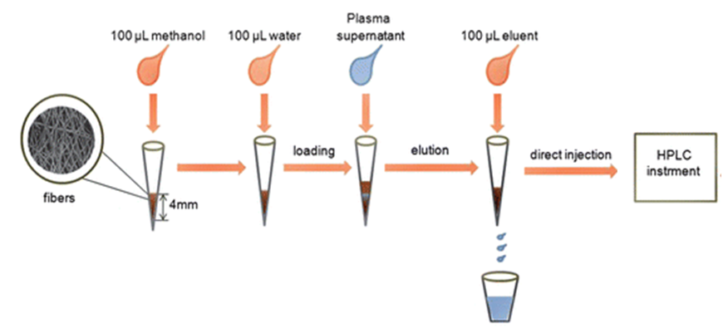
Extraction procedure
1. Prepared columns: packing 5-10mg nanofibers
2. Activated columns: 100 µL of methanol, followed by 100 µL of deionized water
3.Sample pretreatment
4. Elution: quantitatively eluted with 200 µL of ethanol
5. eluate20μL was injected into the HPLC via an autosampler

Slide 15
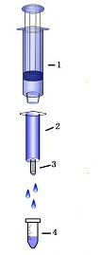
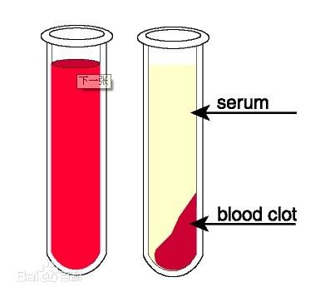
Monoamine neurotransmitters (MANTs) in human plasma- norepinephrine (NE), epinephrine (E) and dopamine (DA), and 5-hydroxytryptamine (5-HT)
Procedures
gastight syringe
Sample centrifugation
Supernatant transfer
Solid phase extraction
Eluent injection
solid phase column
packed nanofibers
receiver tube
HPLC- fluorescence detection

Slide 16
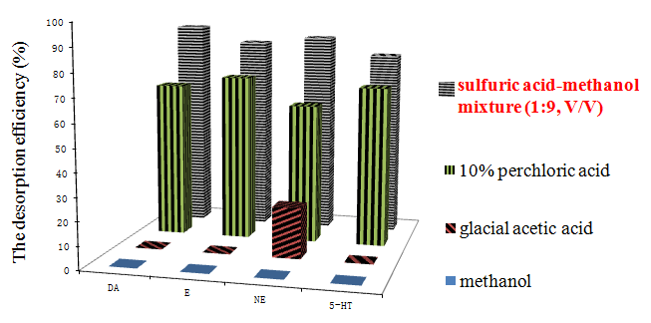
Optimization of extraction condition: elution solvent
optimizing adsorption conditions, such as adjusting PH, changing ion concentration, elution solvent
The absolute extraction recovery of the composite nanofibers
MANTs | DA | E | NE | 5-HT
Absolute recoveries (%) | 72.5 | 67.0 | 68.1 | 60.3

Slide 17
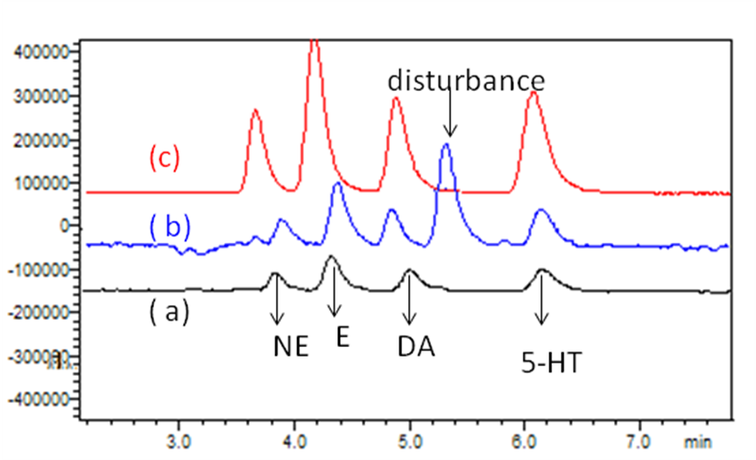
Monoamine neurotransmitters (MANTs) in human plasma ---- norepinephrine (NE), epinephrine (E) and dopamine (DA), and 5-hydroxytryptamine (5-HT)
The chromatograms:
(a) standard solution
(b) spiked plasma sample
(c) eluate of spiked solution extracted by the PFSPE column
The target analytes in the plasma sample extracted by the PFSPE column were clearly visible and the signal were enhanced.
In addition, the PFSPE column removed most of the interfering substances in the plasma sample, which reflected a good characteristic of selective extraction of the targets.

Slide 18

The possible extraction mechanism
The schematic diagram of interactions between MANTs and PVP-PS composite nanofibers. The red dotted lines represent hydrogen bonds
Strong hydrogen bond
Multiple attachment sites

Slide 19
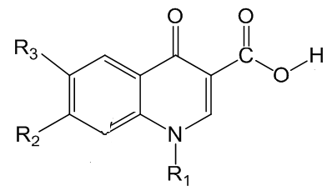
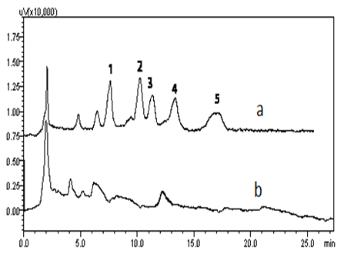
2. Quinolones in Spicy Soup
1mL sample +0.2g EDTA-2Na
ultrasonic extraction
Reducing complex matrix disturbance
supernatant +1mL EDTA-Mcllvaine buffer solution
HCX extraction column
washing、elution
detection
(a) Spiked 25ng/ml (b) Spicy Soup sample
HCX extraction column
( sulfonated PS-PVP composite nanofibers packed column, 10mg )

Slide 20
The possible extraction mechanism
① increased hydrophilicity
② formation of hydrogen bond
③ Ion exchange
④ π-π conjugation
Schematic diagram of the interaction between ( A) quinolones and ( B) sulfonated polystyrene-polyvinylpyrrolidone co-spinning nanofibers

Slide 21
Comparison of different solid phase extraction
Sample | Extraction method | Time of Pretreatment (min) | Organic solvent (ml) | Evaporation under Nitrogen stream | Recovery (%)
Vegetables | HLB Column | >60 | 12 | yes | 61～90
Animal muscle | HLB Column | >40 | 3 | yes | 70～103
Animal muscle | HLB Column | >50 | 5 | yes | 70～106
Spicy soup | HCX Column | 30 | 0.2 | no | 72～110
LOD 1.20～1.30ng/ml， LOQ 4.8～8.1 ng/ml
More convenient and selective one-step packed-fiber solid-phase extraction procedure using electrospun composite nanofibers

Slide 22

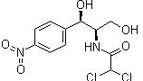
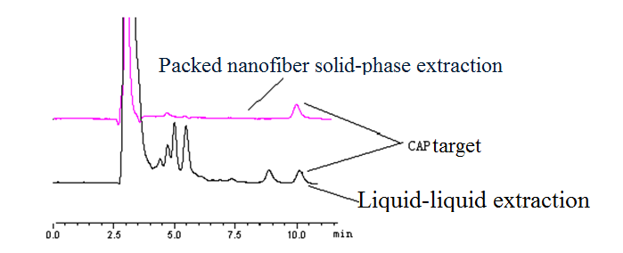
3. CAP in milk
Regression equation：y = 10260x+ 46.050
Correlation coefficient：R² = 0.9998
Absolute recoveries (%)：74.56%---81.67%
Better purification , little disturbance,
simple, sensitive and cost-effective

Slide 23
THANK YOU !
Lanling Chu
SEU
Chu_lanling@126.com

