Slide 1
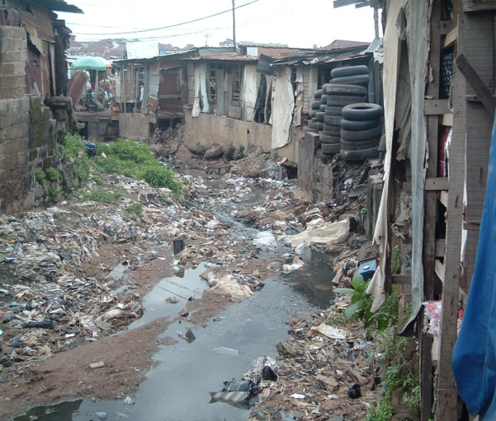
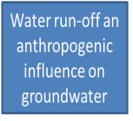

Anthropogenic influence within various zones on urban city of Nigeria
Dr Temitope, A. LANIYAN

Slide 2


Slide 3
INTRODUCTION
Pollution of groundwater has become a major environmental problem in many developing countries.
The main challenge of urbanization in many developing countries (Nigeria) is accessibility to good potable water,
reinforced by uncontrolled population growth;
the effect lead to inadequate hygienic infrastructural facilities with no actual waste dump site: dissolution of organic matter; infiltration of rainwater into the refuse pile; which then lead to leaching of soluble metals in form of toxic wastes into the ground water (Tijani, et al., 2004 and Adeniji, 2009.
Persistent discharge of these wastes led to high contamination (IPCC, 2001, 2007).
Groundwater quality degradation is related primarily to what the land is being used for and this could be;
An industry (food, clothe or drug);
Agricultural plantation;
Mechanical workshop,
and many others that contains anthropogenic products from emission of fuel combustion into the atmosphere which precipitated as rain and leached as water run-offs into the underlying aquifer thereby polluting the aquifer.

Slide 4
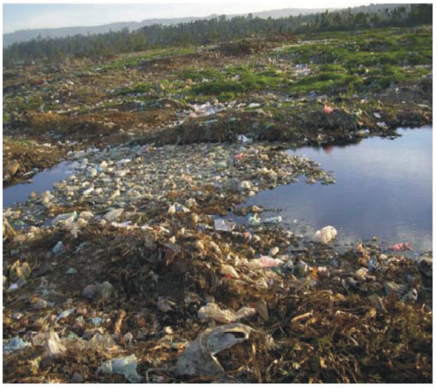
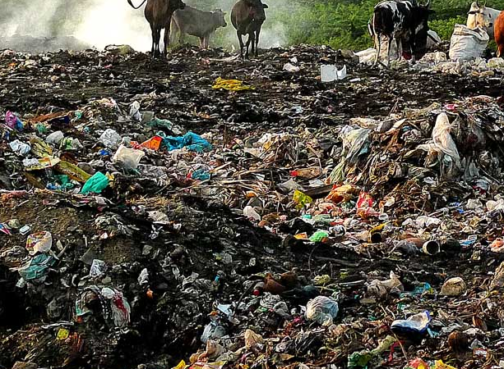
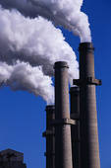
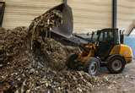
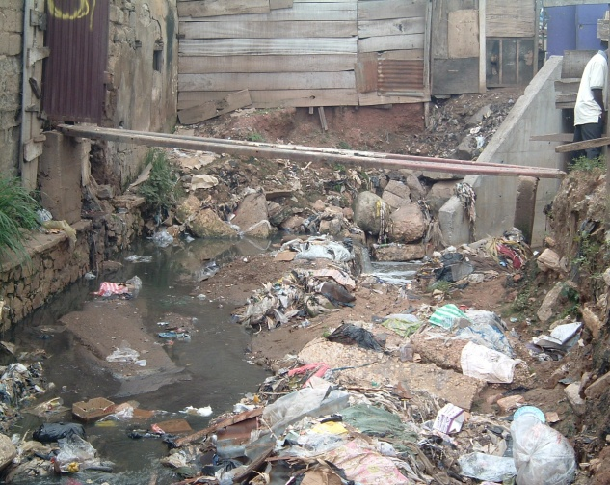
Groundwater contamination associated with man occurs from sources such as:-
Chemicals and waste dump sites
Sewage pits
Seth et al 2002
burning of fossil fuels (especially coal),
waste incineration
High water run-offs
Figure 1: Contamination by Man

Slide 5
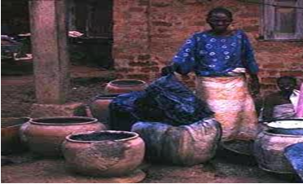
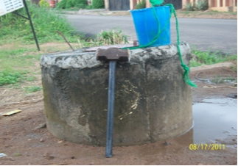


Contamination occurs from tye and dye
Affects the Groundwater through leaching
Element gets Introduced into Drinking water
With deadly diseases such as cholera, dysentery, diaherrea, with other diseases and ultimately death
Figure 2: Contamination by Man

Slide 6
JUSTIFICATION
Due to the toxicity and health impact;
Research was focused on the impact of contamination on groundwater of different zones;
Information about impact of contamination on zones of a particular city is scarce
OBJECTIVES
This study is therefore aimed at assessing the impact of anthropogenic activities on groundwater in crowded, market, residential and industrial zone;
to determine the source of groundwater pollution in the study area.

Slide 7
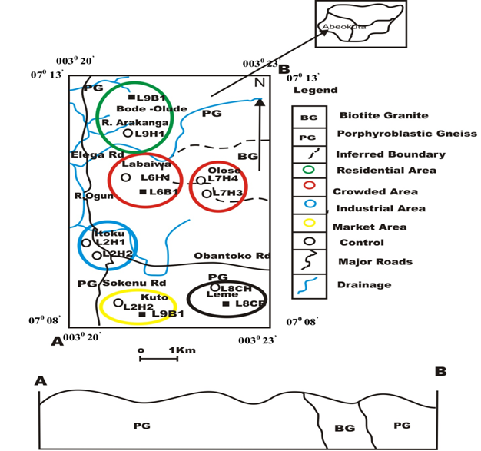
Study Location and Geology
Abeokuta metropolis the study area was divided into four zones:
Crowded zone of Labaiwa and Olose area;
Industrial zone of Itoku;
Market zone of Kuto area and
Residential zone of Elega Housing area,
All falls within the Basement Complex of Southwestern Nigeria.
The study area lies within the Southeastern part of Abeokuta in Ogun State of Nigeria
With latitudes 070 08’N and 070 13’ N of the equator and longitudes 0030 20’ E and 0030 23’ E of the Greenwich meridian.
The study area contains two major rocks types: Biotite Granite which covers approximately 10% of the study area, and it is observed in the North–Eastern part of the study area and
Porphyroblastic Gneiss which covers about 90% of the study area (Fig 1).
Figure 3: Location and Geology map of the study area

Slide 8
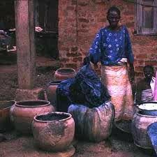
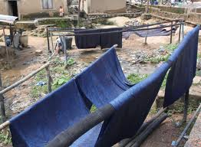
Study Design
The study area was divided into zones for better evaluation these are:
INDUSTRIAL ZONE at Itoku – Tie and Dye, with chemicals such as Sodium Hydro-sulfite(sodium dithionite) (NaHSO₃), Soda ash (Na₂CO₃), Common salt (NaCl), and Caustic Soda (NaOH)

Slide 9
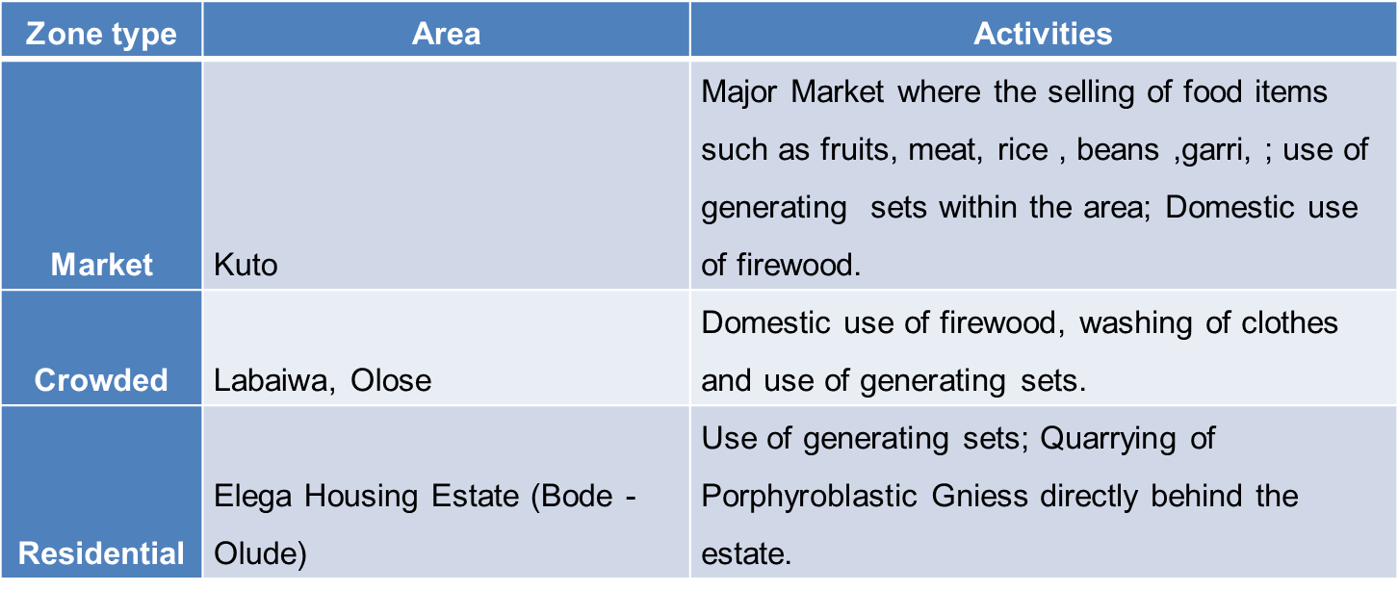
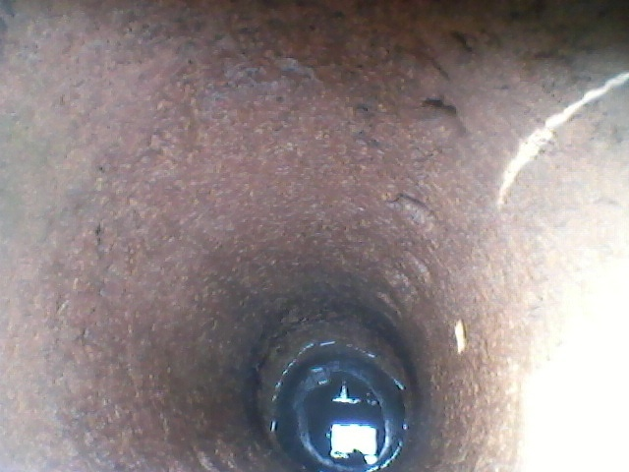
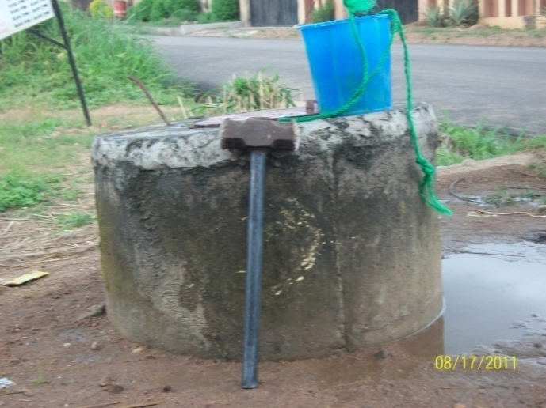

Slide 10
Analytical Procedures
  Physico-chemical parameters; pH, EC, ºT & TDS
  were measured in-situ on Hand-dug wells and deep wells.
  inductively coupled plasma mass spectrometry was used to determine cations, while anions were analyzed in the University of Ibadan, Chemistry laboratory
Determination of Factors and Indices
Contamination Factor (C.f),
(1) Cf = mean value of metal/W.H.O standard
Geo Accumulation (Igeo)
I geo = Log₂ (Cn/ 1.5 x Bn) (Cn = measured concentration , Bn = World Health Organization standard)
Degree of Contamination (Cd)
C.d = sum total of contamination factor (C.f)
Results and Discussion

Slide 11
Table 1: Mean Physico-chemical results of trace metals of rocks and water sources
Parameters (ppm) | Mean | Range | WHO (2006) | EPA (2008) | SON (2006)
K | 19.05 | 1.74-88.91 | 13.48 | - | -
Ca | 49.11 | 17.07-86.63 | 75 | - | -
Mg | 8.78 | 3.14-18.60 | 200 | - | 0.2
Fe | 0.99 | 0.01-10.01 | - | 0.03 | -
Cu | 0.00 | 0.00-0.00 | 2 | 1.3 | 1
Pb | 0.00 | 0.00-0.02 | 0.01 | - | 0.01
Cl⁻ | 168.33 | 60.00-350 | 200 | - | -
NO₃⁻ | 28.08 | 16.72-46.01 | 25 | - | -
Mn | 0.19 | 0.00-1.27 | 0.4 | 0.05 | 0.2
Na | 47.48 | 8.81-168.6 | 200 | - | 200
Zn | 0.03 | 0.01-0.04 | 3 | 5 | 3
TDS(ppm) | 269.17 | 67-649 | 500 | 500 | 500
EC(us) | 405.79 | 103.07-984.61 | 1400 | 1400 | 1000
pH | 8.16 | 6.6-8.9 | 6.5-8.5 | 6.5-8.5 | 6.5-8.5
Temp (0C) | 27.12 | 26-29 | - | - | -
SAL (%) | 0.03 | 0.01-0.06 | - | - | -

Slide 12
Table 2: Contamination Factor for the various zones
Zones | Cu (ppm) | Mn (ppm) | Pb (ppm0 | Zn(ppm) | Na(ppm) | Ca (ppm) | Mg (ppm)
Industrial | 0.00 | 0.08 | 0.23 | 0.01 | 0.65 | 0.91 | 0.14
Market | 0.00 | 0.00 | 0.10 | 0.01 | 0.40 | 0.85 | 0.11
Crowded | 0.00 | 0.55 | 0.26 | 0.01 | 0.25 | 0.46 | 0.07
Residential | 0.00 | 1.83 | 0.15 | 0.02 | 0.16 | 0.57 | 0.06
Control | 0.00 | 0.01 | 0.59 | 0.02 | 0.22 | 0.57 | 0.09
W.H.O (2006) | 2.00 | 0.40 | 0.01 | 3.00 | 200.00 | 75.00 | 100.00
C.D | 0.00 | 6.02 | 2.94 | 0.17 | 3.88 | 7.64 | 1.06
CONTAMINATION FACTOR (Cf)
The contamination factor (Hakanson, 1980) is used to classifying the level of contamination of metals in water.
It is expressed as
Cf = mean value of metal/W.H.O standard
Where:
Cfi <1 Low contamination factor
1<Cfi < 6 Moderate contamination factor
3 < Cfi < 6 Considerable contamination factor
All the elements have a contamination degree of < 8 (cfi < 8 ), thus are said to have low a low degree of contamination

Slide 13
Table 3: Geo- accumulation index of the different zones
GEOACCUMULATION INDEX (I geo)
The index is used in assessing contamination by Muller (1981)
That is; Log₂ (Cn/ 1.5 x Bn)
Cn = measured concentration
Bn = World Health Organization standard
Where;
0 Igeo <0 Practically uncontaminated
1 0<Igeo<1 Uncontaminated to moderately contaminated
2 1<Igeo<2 moderately contaminated
3 2<Igeo<3 moderately to heavily contaminated
4 3<Igeo<4 heavily contaminated
5 4<Igeo<5 Heavily to extremely contaminated
6 5<Igeo<6 extremely contaminated
Geo-accumulation index result showed contamination only in the industrial zone with Cd with all the other zones showing practically no contamination
Zones | As ppm | Cd ppm | Cu ppm | Mn ppm | Pb ppm | Zn ppm
Industrial | -3 | 0.65 | -17.5 | -3 | 0.49 | -7
market | -2.7 | -0.5 | -17 | -14.5 | -7 | -7.5
Crowded | -7.5 | 0.55 | -18 | -2.4 | -2.5 | -7.25
Residential | -4 | 0 | -15.5 | -2 | -3.5 | -6.5
control | -6.5 | 0.05 | -18 | -6 | -3 | -7.5

Slide 14
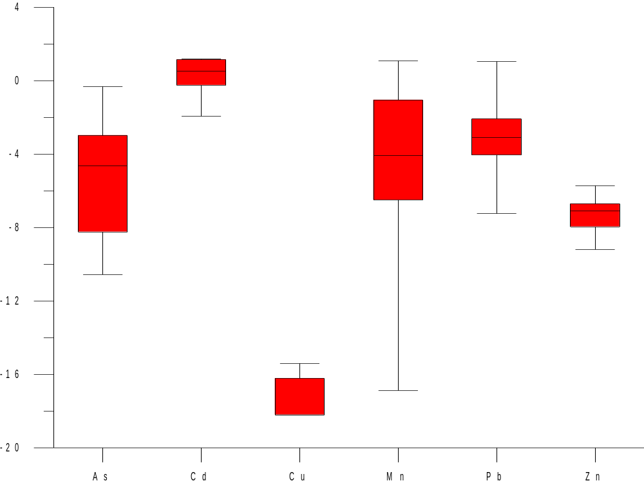
Figure 4: Box Plot for Igeo of Trace elements

Slide 15
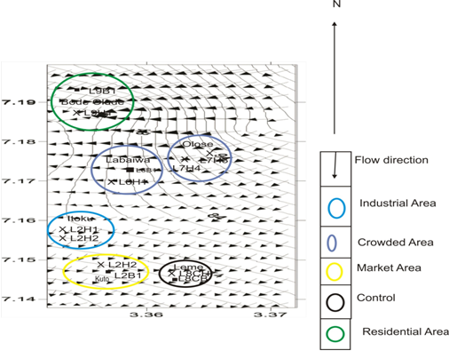
Piezometric Map (Plummer et al., 2011) revealed a general flow direction of North - East- South- West direction. Contaminated water flowing westward and southward in the crowded area may get leached and thus, affecting the aquifers of industrial area, and this could enhance the rate of contamination of the area.
Figure 5: Piezometric map of the Study area

Slide 16
Conclusion and Recommendation
Future pollution is certain especially in the industrial, market and crowded areas due to long term effects of the contaminants such as tie and dye, food items rich in Na, domestic activities with metal laden wastes, fuel combustion found within the area.
Though the contamination factor (C.f), of trace or heavy metals is relatively low in the zones proper monitoring of the areas are needed to avoid a long term effects of the metals in the area.
The study thus recommended that proper waste disposal systems should be in place to avert epidemic due to pollution in the environment.

Slide 17
Some Of My Other Works
Environmental impact of cement factories was evaluated around Ewekoro environ. Soil samples and consumable vegetales (Sugar-cane (Saccharumofficinarum), Soko(Celosia argentea), Cocoyam (Colocasiaesculerita) and Ewedu (Corchoruos olitorius)) were collected 200m apart around the cement factory. Soils and vegetables of areas around the cement factory are contaminated with metals especially Zn and Mn.
Remediation of arsenic in concentrated waters of highly urbanized Nigerian city.
Comparison of phytoremediation water hyacinth (Eichhornia crasspipes Mart. Solms) and filtration with the use of geo-materials (marble, activated charcoal, filtration carbon and clay).

Slide 18
THANK YOU AND GOD BLESS

