Slide 1

Langzhou Song
VaxInnate Corporation
September 26, 2014
A Rationally Designed Form of The TLR5 Agonist, Flagellin, Supports Superior Immunogenicity of Influenza B Globular Head Vaccines

Slide 2
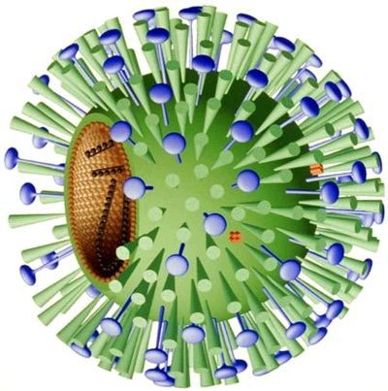
VaxInnate Influenza Vaccine Development
Traditional flu vaccine contains three components: 1 H1, 1 H3 and 1 B
More recently quadrivalent flu vaccine was introduced to the market which includes 1 H1, 1 H3 and 2 Bs from both lineages (Yamagata and Victoria).
VaxInnate has successfully developed flu A vaccines that include H1, H3 and H5 subtypes which are immunogenic and safe in pre clinical animal models and in human clinical trials. However, influenza B vaccines based on the same vaccine formats are poor triggers of TLR5 and consequently poorly immunogenic.

Slide 3
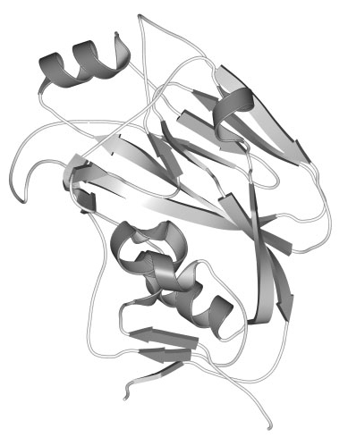
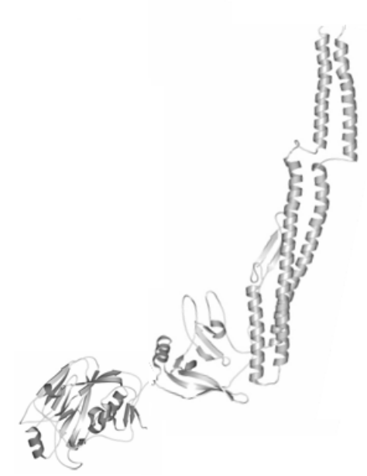
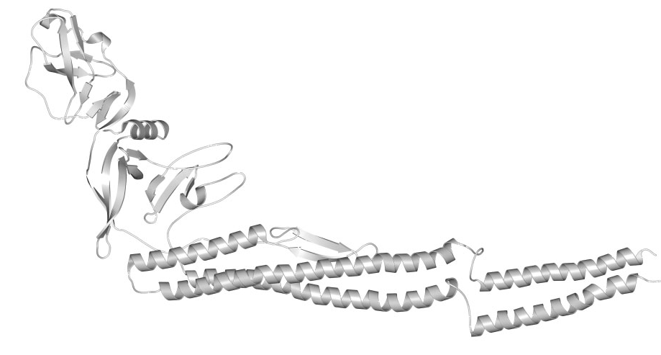
VaxInnate’s HA Subunit Vaccines
Development of Initial Vaccine Formats
HA Globular
Head
D0
D0
D0
D1
D1
D1
D2
D2
D2
D3
HA Monomer
C Term
(Antigen Attached
to C-terminus)
R3
(Antigen Replaces
D3 Domain)
R3.2x
(2 Antigens Fused
to Flagellin)
The vaccine format, or point of attachment of the vaccine antigen to flagellin, can dramatically affect the immunogenicity and safety profile of the vaccine.

Slide 4
Rationale for Flu B vaccine Design
A major difference between the influenza A and B globular head domains is their iso-electric points (pIs), which for influenza B is among the highest (above 9.0 for the HA1 subunit) as compared to most influenza A HA1s. Flagellin, on the other hand, has pI around 5.
We speculated that the positively charged influenza B HA heads might be interacting with the negatively charged flagellin at neutral pH, thereby interfering with TLR5 signaling and/or antigen presentation.
To test this, we introduced two negatively charged residues, to mitigate potential charge interactions, in the region linking HA to flagellin in the R3 format.
We also generated a second construct in which the globular head was inserted into D3 rather than fully replacing it, to form the D3Ins format. The latter design serves to move the globular head further away from the primary TLR5 binding sites in D1.

Slide 5
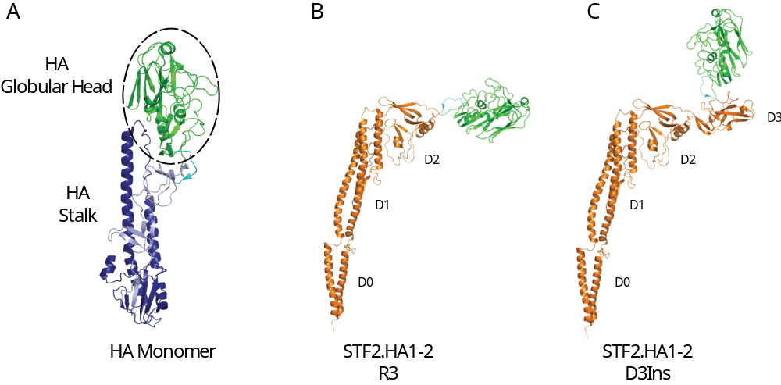
Design of Flu B Vaccines
R3 and D3Ins Format
The vaccine format design aims to reduce charge-charge interactions between HA head and flagellin to facilitate antigen presentation and TLR5 signaling.

Slide 6
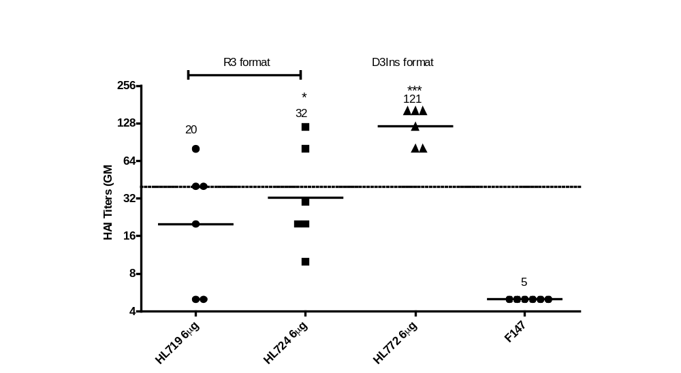
Comparison of R3 and D3Ins formats in Mice
Neutralizing Antibody Responses (HAI)
BALB/c mice (6 per group) were immunized s.c. twice (3 weeks apart) with 6 μg of Flu B vaccines.
Sera were harvested two weeks post the booster and evaluated for HAI titers using ether extracted B/Wisconsin/01/2010 virus antigen. Titers of individual mice with GMTs are shown.
HL719 (R3 B/WI, an R3 format), HL724 (R3 B/WI, an R3 with negative charges in the linker),
HL772 (D3Ins B/WI , a D3Ins format), F147 buffer
Introduction of the two negatively charged residues in the linking region of the R3 construct modestly improved titers. The use of the D3Ins format provided the most significant improvement in HAI titers.

Slide 7
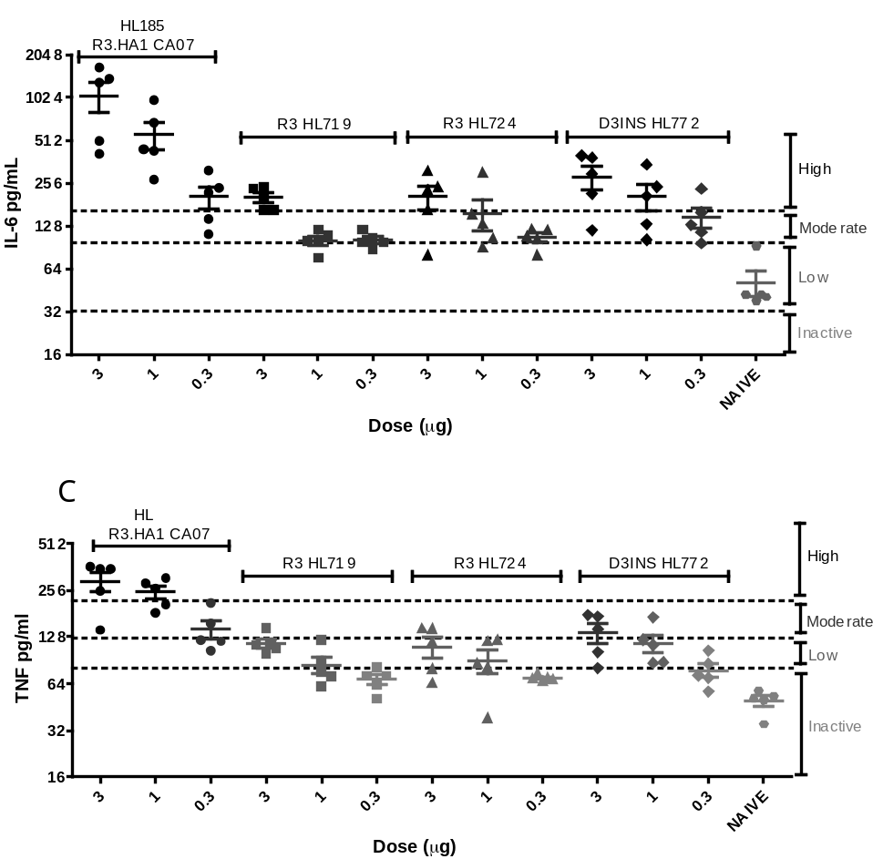
Flagellin function of the fusion vaccines
TLR5 Activity by In Vivo Cytokine Assay
BALB/c mice (n = 5) were immunized once (i.m.), sera harvested 3 h later and evaluated for IL-6 and TNF levels using a mouse cytometric bead array (CBA) from BD Biosciences.
HL185 (R3 A/CA07): positive control; HL719, (R3 format, B/WI), HL724 (R3 B/WI with negative charges in the linker) and HL772 (D3Ins format, B/WI ).
The results show that introduction of the two negatively charged residues provides an incremental improvement while movement of the globular head to the D3Ins position provides a distinct improvement in the TLR5 activity, particularly as measured by IL-6 production

Slide 8
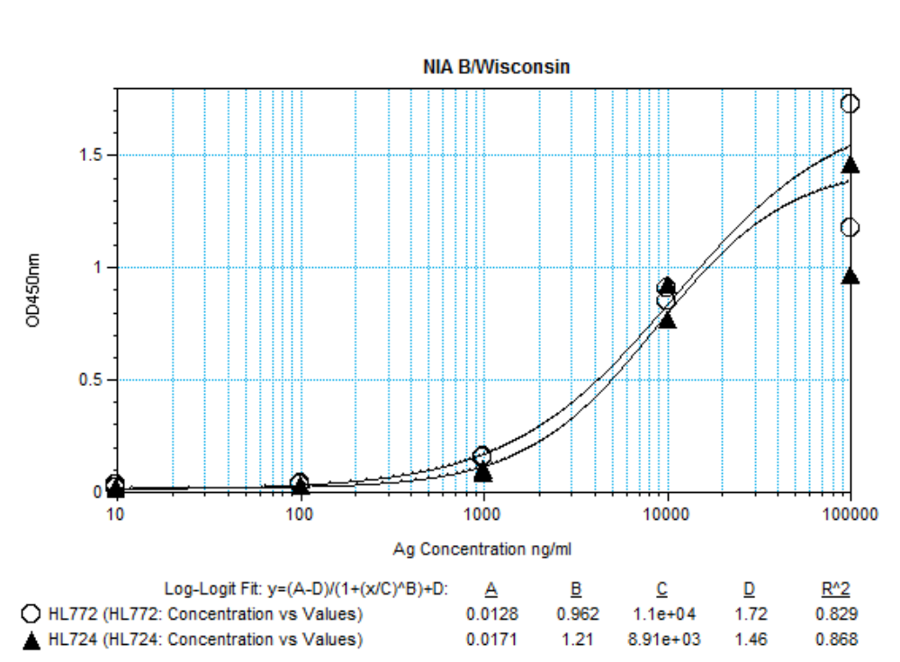
Antigenicity of HA in Fusion Vaccines
Neutralizing Inhibition Assay (NIA)
NIA measures the ability of a vaccine candidate to bind and deplete neutralizing antibodies presented in the immune serum, thereby assessing the integrity of neutralizing epitopes on the flagellin-HA fusion immunogen.
The higher potency of the vaccine candidate, the greater the depletion of the neutralizing antibodies in the serum that allows the test virus to infect MDCK cells.
HL724 (R3 B/WI, an R3 with negative charges in the linker),
HL772 (D3Ins B/WI , a D3Ins format)
The R3 format and the D3Ins format compete equally well for binding to neutralizing antibodies in the hyper-immune serum indicating that the antigenicity of the HA head is unaltered across the different constructs. Thus the poor immunogenicity of the R3 format of the B/Wisconsin vaccine likely relates primarily to impaired TLR5 signaling activity

Slide 9
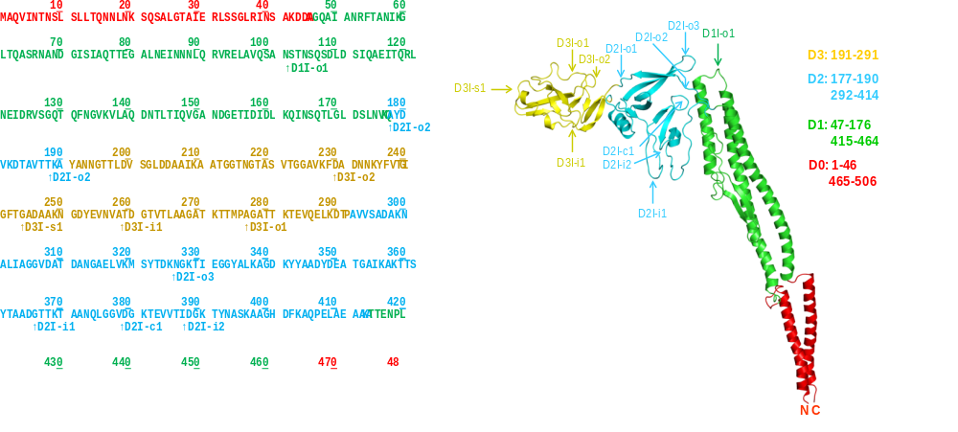
Insertion Points of Flu B Vaccine Variants
D3Ins Format Optimization
Various insertion points in D3 and D2 were tested. The D3Ins vaccines were found to outperform the D2Ins vaccine candidates.

Slide 10
Insertion Points of Flu B Vaccine Variants
D3Ins Format Optimization
Construct | In Vivo TLR5 Activity | Construct | In Vivo TLR5 Activity
HL772, D3I-o1 | High (IL-6), Moderate (TNF-α) | HL826, D2I-o2 | Low (IL-6), Inactive (TNF-α)
HL849, D3I-i1 | High (IL-6), Moderate (TNF-α) | HL827, D2I-o3 | Low (IL-6), Inactive (TNF-α)
HL848, D3I-s1 | Moderate (IL-6), Inactive (TNF-α), | HL850, D2I-i1 | Low (IL-6), Inactive (TNF-α)
HL888, D3I-o2 | Low (IL-6), Inactive (TNF-α) | HL892, D2I-i2 | Low (IL-6), Inactive (TNF-α)
HL825, D2I-o1 | Moderate (IL-6), Low (TNF-α) | HL828, D1I-o1 | Inactive (IL-6), Inactive (TNF-α)
Various insertion points in D3 and D2 were tested. The D3Ins vaccines were found to outperform the D2Ins vaccine candidates.

Slide 11
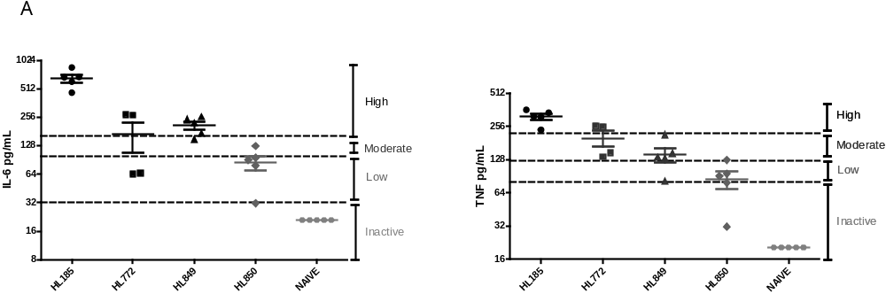
Insertion Points of Flu B Vaccine Variants
In Vivo TLR5 Assay for the Representative Vaccine Variants
D3Ins: HL772 (D3I-o1, B/WI) and HL849 (D3I-i1, B/WI)
D2Ins: HL850 (D2I-i1, B/WI)
Positive Control: HL185 (R3 A/CA07)
Various insertion points in D3 and D2 were tested. The D3Ins vaccines were found to outperform the D2Ins vaccine candidates.

Slide 12
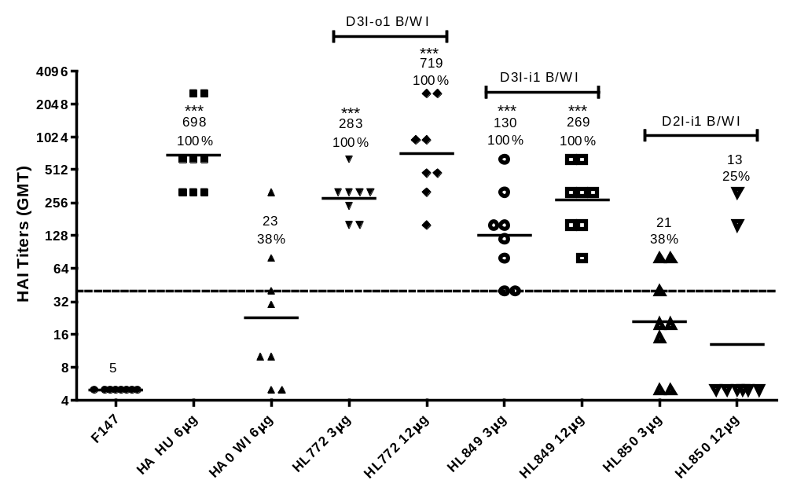
Insertion Points of Insertion Variants
Mouse Immunogenicity by HAI
Various insertion points in D3 and D2 were tested. The D3Ins vaccines were found to outperform the D2Ins vaccine candidates.

Slide 13
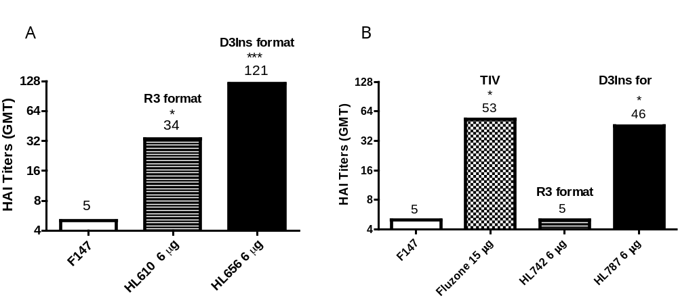
Application of D3Ins Format to Both Flu B Lineages
HAI Titers of Flu B Vaccines of Two Lineages
Yamagata Lineage: B/Florida/4/2006
Victoria Lineage: B/Bangladesh/5945/09
F147: Formulation buffer
HL610 (R3 B/FL, an R3 with negative charges in the linker),
HL772 (D3Ins B/FL, a D3Ins format)
F147: Formulation buffer; TIV, Fluzone positive control
HL742 (R3 B/BD, an R3 with negative charges in the linker),
HL787 (D3Ins B/BD, a D3Ins format)
D3Ins format is applicable to both B lineages.

Slide 14
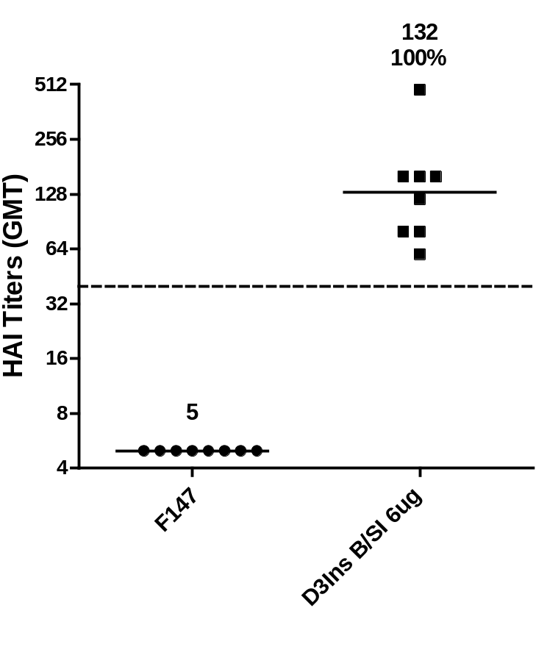
Immunogenicity and Efficacy of Flu B Vaccines
Flu B Challenge Model (B/Sichuan/379/1999)
Flu B challenge mouse model using B/Sichuan/379/1999 (D3Ins B/SI, Yamagata lineage).
Groups of 10 BALB/c mice were immunized twice with 6 μg of a D3Ins format vaccine against the B/SI.
Sera were harvested two weeks post the booster dose and evaluated for HAI titers.
A robust immune response was shown in all mice in the challenge model.

Slide 15
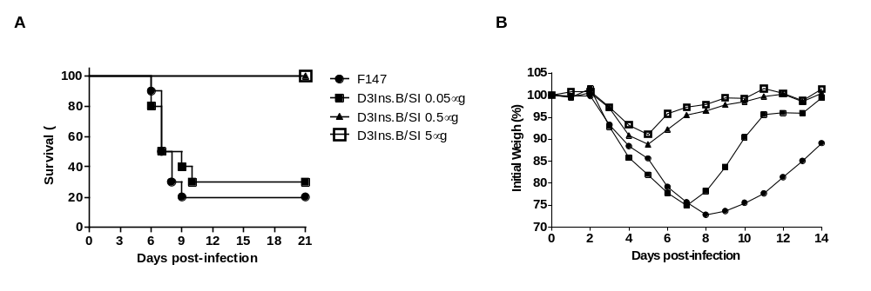
Immunogenicity and Efficacy of Flu B Vaccines
Flu B Challenge Model (B/Sichuan/379/1999)
Groups of 10 BALB/c mice were immunized s.c. with the indicated doses of D3Ins B/SI or F147 formulation buffer on days 0 and 21. On day 42, mice were challenged i.n. with 5 LD50 of B/SI, and monitored daily for mortality for 21 days and weight change for 14 days. Survival rates (A) and weights (mean percentage of initial weight) (B) are plotted.
D3Ins vaccine of B/Sichuan/379/1999 is efficacious at a submicrogram dose. The efficacy results of D3Ins B/SI thus support the general suitability of D3Ins format for our influenza B vaccines.

Slide 16
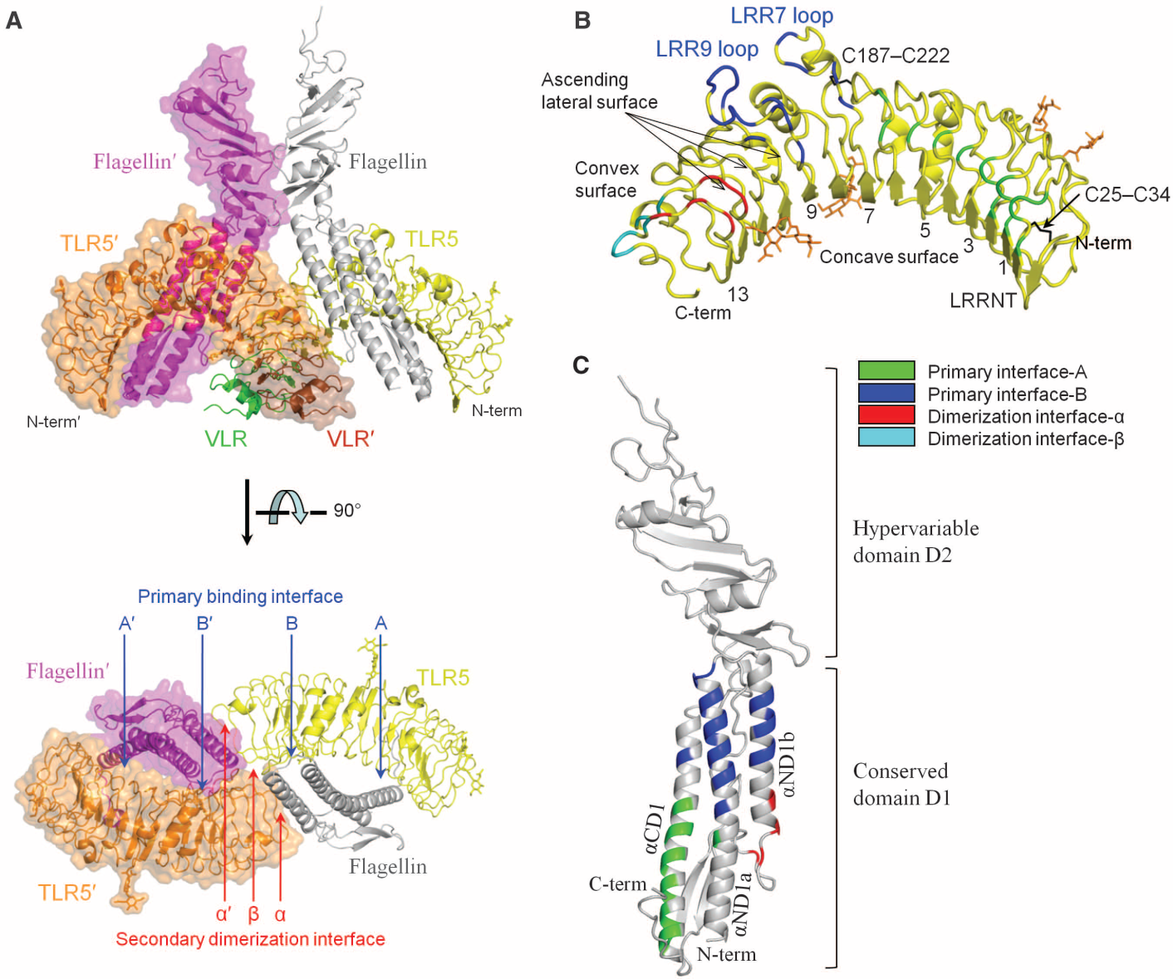
Flagellin and TLR5 (Yoon, et al., Science 2012)
X-Ray Crystal Structure of Flagellin and TLR5 Complex
The Flagellin/TLR5 structure confirmed that all known agonist-activated TLR structures form a similar dimer organization, which brings their C-terminal regions into juxtaposition so that their intracellular TIR domains can initiate a signaling cascade.

Slide 17
Summary
We have developed an alternative vaccine format for influenza B vaccines for which the HA head is inserted into domain 3 of flagellin and we have confirmed the optimal insertion point within domain 3.
We have shown that the redesigned format maximizes TLR5 signaling and immunogenicity for multiple influenza B strains.
Similar to the A strain vaccines, the Flu B vaccines are economically and efficiently produced in our standard prokaryotic system which therefore allows for time and cost efficient production of a multivalent seasonal product comprising A and B strains.

Slide 18
Acknowledgements
VaxInnate: Molecular Biology and Protein Sciences; Process Development; Analytical Development; Virology and Immunology Departments. Especially, Dr. Lynda Tussey (VP, R&D), Dr. Ge Liu (Virology) and Dr. Scott Umlauf (Immunology).
Scripps Research Institute: Dr. Andrew Ward and Dr. Ian Wilson
This project has been funded in part with Federal funds from the Office of the Assistant Secretary for Preparedness and Response, Biomedical Advanced Research and Development Authority, Department of Health and Human Services, under Contract No. HHSO100201100011C and from VaxInnate Corporation.

