Slide 1
Clinical Audit of Ankle Fracture Management in the Elderly
Heygroves Theatre, BRI
Langhit Kurar MBChB BSc, CST
Mr. Steve Mitchell, Consultant in Trauma and Orthopaedics
Notes:
Hi, my name is Langhit, im a Foundation doctor at UHL and over a retrospective 3 week period I reviewed results of ankle fracture management in the elderly.

Slide 2
1. INTRODUCTION
Notes:
So why consider performing the audit.

Slide 3
Management Challenge
Exponential rise in fracture incidence
Unstable patterns of injury
No rigid protocols exist
Complex associated co-morbidity
Limited evidence available
Notes:
I am sure we are all aware Fragility fractures of the ankle are common, and mainly occur in elderly osteoporotic women. Low-energy, trivial trauma often associated with osteoporotic fractures can predispose to more unstable, severe patterns of injury. Establishing a positive treatment outcome is therefore vital to promote early mobilisation, restore independence, and reduce hospital-associated morbidity. To complicate matters. management remains controversial. Although surgery may be warranted in the majority of younger patients, osteoporotic bone can be associated with poor vascularity, prolonged healing, and failure of fixation^{1,2}. as no rigid protocls exist, further debate as to whether less invasive methods, including cast application following MUA, should be routinely advocated in the elderly.

Slide 4
Aims and Objectives
Isolate trends in surgical vs. non-surgical
Review outcome measures (e.g. LOS)
Collaborate with evidence-base
Recommend clinical guidelines
PILOT
Notes:
What are the aims and objectives. Firstly, it is important to isolate trends in surgical and non-surgical patients, to ensure longer-term outcomes can be compared. Secondly, all patients meeting inclusion criteria will be reviewed for various outcome measures (e.g. LOS). With no recommended guideline in place, management protocol identified through the audit will be compared to evidence-base to assess for marked discrepancy. Finally, any recurring trends facilitating better outcomes will be identified and used to propose future improvements in clinical practice. Recommended standards can then be piloted although this is ouitside the scope of this essc period.

Slide 5
2. METHODS
Notes:
Now onto the methods

Slide 6
2.1 Patient Characteristics
Retrospective 3-week data collection
50 patients aged 50-80 years
Inclusion vs. Exclusion criteria
Patient demographics and falls assessment
Intra/Post-operative complications
Case notes (incl. discharge summaries)
Notes:
This was the basic method used to conduct the audit. Like I said it was done over a 3 week period, and included 50 most recent patients managed for ankle fracture management meeting inclusioon criteria . Pre-operative details including patient demographics and falls assessment were noted (see TABLE 1). The operative details included grade of surgeon, duration, previous manipulation, delay to theatre, and category of surgery (e.g. primary, revision, planned delay etc.). Post-operative/non-operative variables included length of stay (LOS), revision, and follow up care. Time for fracture union and mal-union was assessed independently using patient X-rays.

Slide 7
2.2 Treatment
Planned surgical delay
Non-operative (MUA*/POP)
Operative (ORIF/Ex-Fix followed by POP)
Follow-up at two and six weeks
Physiotherapy and Occupational therapy
* revision assessed in operative group
Notes:
Management was subdivided into non-operative (MUA/ POP) or surgical (ORIF/Ex-Fix followed by POP). By consensus, severity of injury, degree of swelling and associated co-morbidity helped guide treatment, with decisions on management made by senior clinicians. . Follow-up with repeat X-rays was conducted at two and six weeks. Planned surgical delay was often recommended for patients with extensive swelling. Patients requiring operative intervention following MUA were excluded from non-operative management and assessed under the surgical group.

Slide 8
Example Performa
Patient ID No.
Age | yrs
Sex | M/F
Falls Assessment | Y/N
DEXA | Y/N
Operation
1°/Revision/Late/Staged/Planned Delay*
Type of Surgery | ORIF/EX-FIX/HIND-FOOT
Grade of Surgeon
Delay to Theatre (days)*
Surgical Time (mins)-recent
MUA | Y/N
Measured Variables
Time to Union (weeks) | _____:_____
Non-union | Y/N
Malunion/Deformity | Y/N
Failure of Fixation | Y/N
Revision | Y/N
LOS (days) | _____:_____
*-incl. reason
Notes:
This is an example proforma I used to help keep a track of key times and dates including,…

Slide 9
Example Performa
Non-Operation
Measured Variables
Time to Union (weeks) | _____:_____
Non-union | Y/N
Malunion/Deformity | Y/N
Late Surgery (e.g. revision/fusion) | Y/N
LOS (days) | _____:_____
*-incl. reason
Notes:
This is an example proforma I used to help keep a track of key times and dates including,…

Slide 10
RESULTS
Notes:
Now onto the results.

Slide 11
Bone Protection
 | Operative (n=42) | Non-operative (n=8) | p-value
Mean age (range) | 63 (50-80) | 69 (56-80) | 0.127
Male:Female ratio (%male) | 13:28 (46%) | 1:2 (50%)
Falls assessment* (%) | 12 (29%) | 4 (50%)
DEXA scan* (%) | 3 (7%) | 1 (13%)
*performed
Notes:
A formal bone protection strategy was performed on only three patients (6%) in both operative and non-operative groups. This included a comprehensive falls history taken on admission and DEXA scan result. Furthermore, only 4 patients aged over 65 years had received a DEXA scan out of 23, inconsistent with recommendations made by NICE (2011)¹⁰ on osteoporosis screening

Slide 12
Fracture Classification
SURGICAL
NON-SURGICAL
Weber Classification | Incidence(%)
A | 2(4%)
B | 39(78%)
C | 9(18%)
Notes:
Now in terms of incidence of fracture, from the pie chart we can see that the more complex bi and tri malleolar fractures were more likey to be managed surgically as opposed to non-operativey.
Majority of trimallerolar fractures classed as weber b (14/17) and required urgical fixation. This contributed to overt antero-posterior joint instability, requiring fixation with locking-plate constructs. Generally unstable

Slide 13
Inpatient Stay
 | Operative (n=42) | Non-operative (n=8) | p-value
LOS (days) * | 7.44 | 9.50 | 0.533
Time to Union (weeks) * | 9.83 | 9.97 | 0.976
*Values presented as averages, (Mann–Whitney test, p <0.05).
Planned surgical delay (≥7 days): 10(24%)
Notes:
Patients managed non-operatively had a mean LOS of 7.44 days (SD 8.78), compared with 9.50 days (SD 8.88) in the surgical group (e.g. ORIF, ex-fix). This was not statistically significant (p=0.533). Planned surgical delay (≥7 days) was scheduled for ten patients (24% surgical patients), due to medical co-morbidity (e.g. extensive swelling) that needed to be optimised. Four patients required further revision following failed MUA. However, this had no significant influence on total inpatient stay (p=0.740).

Slide 14
Grade of Surgeon
(%)
Notes:
Incidence of fracture malunion (48%) was significantly higher following surgery without consultant supervision (p=0.043). Similar failure rates were not reproducible following surgery performed by a consultant lead .

Slide 15
Radiological Results*
SURGICAL
NON-SURGICAL
Fracture union (≤6 weeks): 23 (surg.) vs. 0 (non-surg.)
* No operative complications (e.g. haemorrhage, infection, wound edge necrosis) reported.
Notes:
Now perhaps the most significant slide derived from the report, Malunion (63%) and failed fracture fixation (25%) was more commonly reported in patients managed non-operatively. And you can see…
Following radiological confirmation, at six weeks,
However,
average time for fracture union was similar in patients treated by either non-operative (mean average: 9.83 weeks, SD 0.75) or operative (mean average: 9.97 weeks, SD 11.41) approaches (p=0.976). However,

Slide 16
DISCUSSION
Notes:
So now onto the discussion.

Slide 17
Fracture Management
- ‘Operative’ vs. ‘Non-operative’
Key components
Anatomical congruity
‘Weber B’ subclass
LOS
Level of training
Notes:
And iv subdivided this segment of the talk into 4 key areas…

Slide 18
Fracture Management
- Anatomical Congruity
63% impaired when managed conservatively
36% impaired when managed surgically
8% required further surgical intervention
Notes:
A lower rate of complications was noted in patients following ORIF as opposed to MUA or POP. This has helped answer several key learning objectives stated at the start of the audit. Although no significant difference was identified in time for fracture union, achieving anatomical restoration after non-operative management was difficult. Sixty-three percent patients lost anatomical congruity following non-operative management (e.g. externally rotated fibula) with 8% requiring further surgical intervention as opposed to only 3 surgical patients requiring revision.

Slide 19
Fracture Management
- ‘Weber B’ subclass
Majority (78%) sustained fracture at level of syndesmosis.
76% Weber B fractures associated with subluxation/dislocation
25% failed fixation following conservative management
Notes:
In terms of the type of fracture sustained, Seventy-six percent of Weber B fractures were associated with subluxation/dislocation, with internal-fixation the preferred mode of treatment. Manipulation and POP for similar patterns of injury have been shown to promote malunion or non-union, with a significant number requiring surgical revision^{11,12}. Although only 8% of the patient cohort required internal-fixation following failed MUA, failed fracture fixation was reported in 25% patients managed solely with MUA or POP.

Slide 20
Fracture Management
- LOS
No significant difference (p=0.533)
Delaying surgery did not have significant bearing
Intensive physiotherapy and early-facilitated discharge
Notes:
No significant difference in mean LOS (p=0.533) was noted between either treatment arm. Furthermore, total inpatient stay was not significantly influenced by delayed surgery, aimed at optimising patient co-morbidity (e.g. reduce extensive swelling). This correlates poorly with previous reports showing a mean average increase of 4.1 days in surgical patients delayed due to overrun theatre list or patient co-morbidity¹⁴. so wer certainly doing something right with respect to intensive physio and early discharge.

Slide 21
Fracture Management
- Level of Training
Failed fixation significantly higher without consultant supervision (p=0.043)
Often following trimalleolar and bimalleolar repair (80% malunion)
Notes:
This slide is simply reiterating the chart I showed you earlier, rates of fracture malunion and failed fixation were significantly higher in the latter group. This was more commonly reported following trimalleolar and bimalleolar repair without consultant supervision (80% of fracture malunion). This was largely expected given the lower levels of surgical experience and level of training held by registrars.

Slide 22
Key Recommendations
Screening for reduced BMD (>65yrs)
Targeted bone protection therapy
Surgical fixation supervised (particularly for bi-/tri-malleolar)
IF MEDICALLY FIT, surgical intervention favoured (ORIF/hind-foot nail)
Notes:
Following audit, a number of key recommendations can be made. . Firstly, primary prevention should involve screening all patients over the age of 65 for reduced bone mineral density, using DEXA scanning. Hence, at risk patients can be identified early and treated with combination bone protection therapy if required. Such recommendations are consistent with national guidelines produced by NICE (2011)¹⁰. Secondly, failed anatomical reduction following internal fixation of complex ankle fractures (e.g. bi- or trimalleolar) was more likely when performed by registrars without supervision. Therefore, all surgical fixation performed on either bi- or trimalleolar fractures should be supervised or performed by a lead consultant. Finally, as incidence of fracture malunion and failed fixation was approximately half the failure rate associated with non-operative management, internal-fixation or hind-foot nail should be the preferred mode of treatment. This is provided patients are medically fit and eligible for surgery.

Slide 23
Audit Limitation
(Sample Size)
Insufficient to detect rare treatment outcomes
Type II statistical error
256 patients required for 80% statistical power.
(Patient Domain)
Absent long-term follow-up
Notes:
So how can we improve the audit for next year?
Given the small sample size, reasonable assumptions cannot be made about the statistical significance of the data set. The audit is insufficiently powered to detect rare treatment outcomes (e.g. malunion and failed fixation), particularly as only nine patients were managed non-operatively across the cohort. Therefore, to avoid type-II statistical error a reasonable sample size of at least 256 patients in each treatment arm, at 80%-power is required. Certain patient details had been lost to follow-up and therefore failure rates of implant prosthesis and wound edge necrosis were underreported.

Slide 24
CONCLUSION
Notes:
BOAST GUIDELINES PUBLISHED 2016

Slide 25
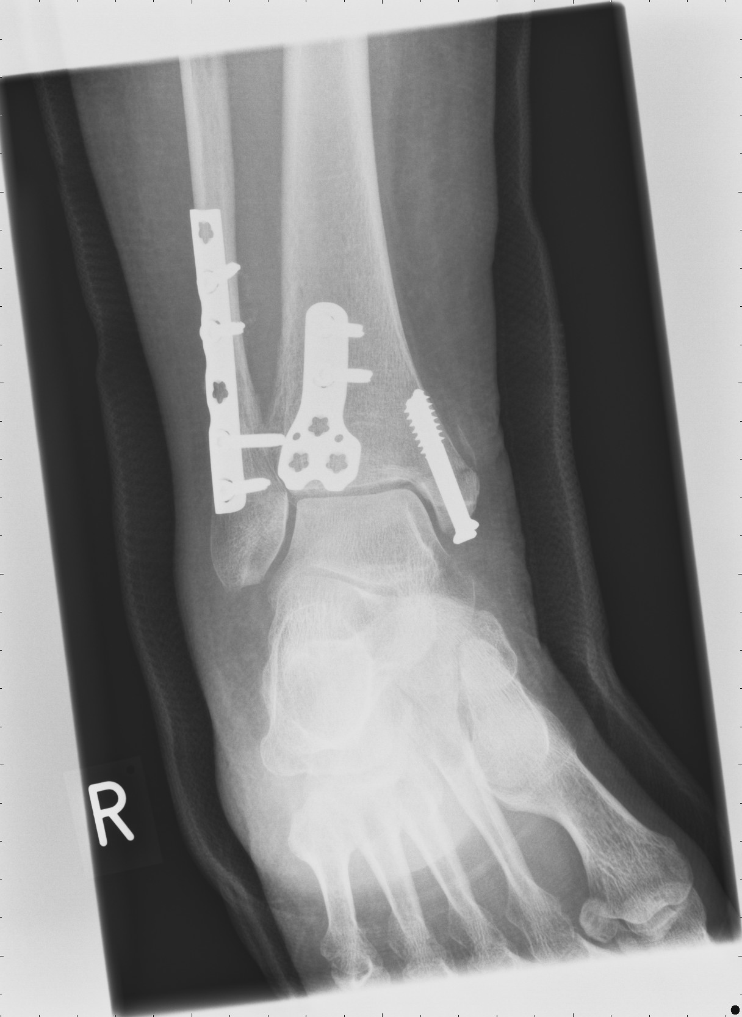
Significant ambiguity persists
Inherently unstable fractures
Surgery preferred
Re-audit required!
Notes:
So to conclude, significant ambiguity still persists on the most appropriate treatment strategy for patients with inherently unstable fractures and extensive co-morbidity. However the audit has shown that if patients can be optimised prior to surgery, the longer term anatomical restoration rates are far moer favourable when compared to non-operative treatment. Now the next step following these recommendations would be to close the loop through re-audit which would hopefully confirm a marked treatment benefit for patients.

Slide 26

Notes:
Thankyou all for listening.

