Slide 1


The Impact of Non-Thermal Processes on Food Quality and Safety
by
Lamin S. Kassama, PhD
Department of Food and Animal Sciences
Alabama A&M University
Normal, Alabama
Symposium on Bio-control & antimicrobials for sustainable control of food-borne pathogens – Are we there yet?
3rd International Conference and Exhibition on Food Processing and Technology July 21, 2014. Hampton Inn Tropicana, Las Vegas

Slide 2
Outline
Technologies and Principles
  Ultrasonication (US)
  Pulsed Ultraviolet light (PUV)
  Antimicrobials
Applications and Effects
Future Implications

Slide 3
Introduction: Ultrasonication
Ultrasonication
  Ultrasonic pressure wave directed to food surface
  Generates force
  if perpendicular
    Results to compression waves
  If parallel
    Shearing waves
  Both waves attenuate as they move through food
  Depth of penetration and antimicrobial effect
    Dependent on the frequency and intensity of waves
    Composition of food

Slide 4
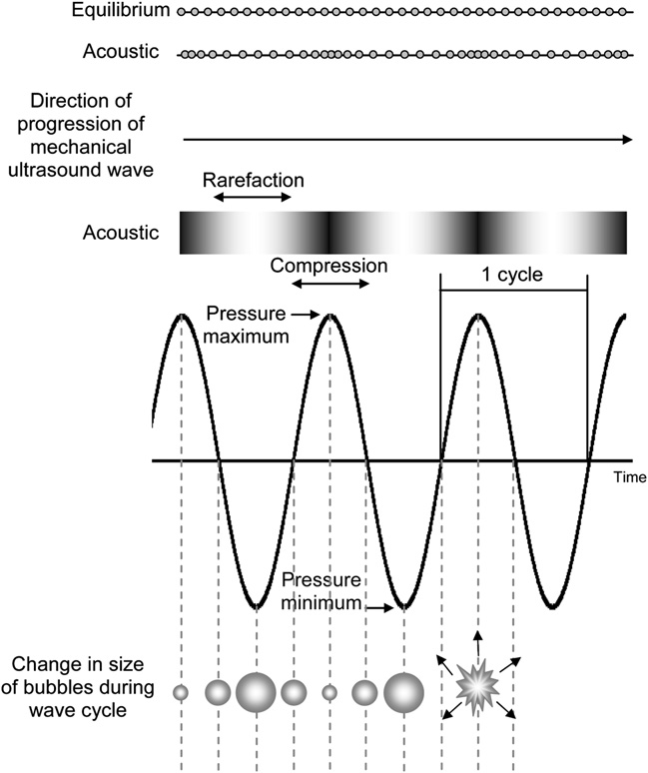
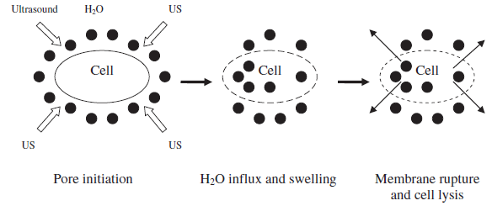
Introduction: Ultrasonication
Ultrasonication
  The rapid localized change in pressure
    Cause shear disruption
    Cavitation
      Creation and rupture of
      microscopic bubbles
      Thinning of cell membranes
      localized heating
        Lethal effect on microorganisms
        Detachment of microbes in surfaces
High pressure breaks cell wall
Disrupt cell membrane
Damage DNA
Source: Soria and Villamiel, 2010

Slide 5
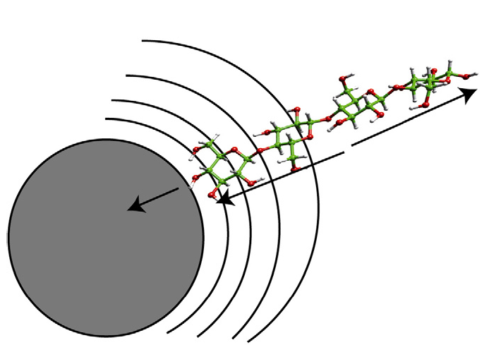
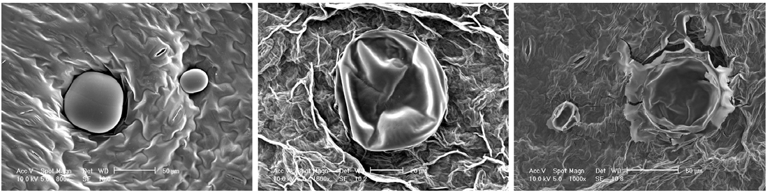
Introduction: Ultrasonication
Depolymerization effect on Cell Structure
Source: Chemat et al., 2011

Slide 6
Introduction: Ultrasonication
Low Energy (< 1 W/cm²; >100 KHz)
  Non-invasive detection
  Stimulate activity of living cells
  Surface cleaning
  Effects on enzyme
  Extraction
  Crystallization
  Emulsification
  Filtration
  Drying
  Tenderization of meat

Slide 7
Introduction: Ultrasonication
High Energy (>1 W/cm² (10 – 1000 W/cm²) ; Between 18 & 100 KHz)
  Physical disruption,
  Acceleration of chemical reaction
    Degassing of liquid foods
    Extraction of enzymes and proteins
    Inactivation of enzymes
    Induction of nucleation for crystallization
    Enhance drying and filtration

Slide 8
Introduction: Ultrasonication
Methods of US Applications
  Ultrasonication
  Low temperature
    Inactivate enzymes and microbes
    Heat liable products
    Requires long treatment time
  Themosonication
  Combination of untrasound and heat
    Greater effects on microbes
    Lower D and Z values than conventional thermal processing

Slide 9
Introduction: Ultrasonication
Method and Applications
  Manosonication
  Combined sonication and pressure
    Effectively inactivates microbes than ultrasound
    Efficacy higher than ultrasound alone at the same temperature
  Manothermosonication
  Combination of heat, ultrasound and pressure
    Much more effective than the three categories above
    Inactivate enzyme/microbes at low temperature and short time
    Heat stable enzymes also effectively destroyed
  Effect on cavitation
    Application of temperature and pressure maximizes cavitation
    Heat resistant enzymes
      Lipoxygenase, peroxydase ettc

Slide 10
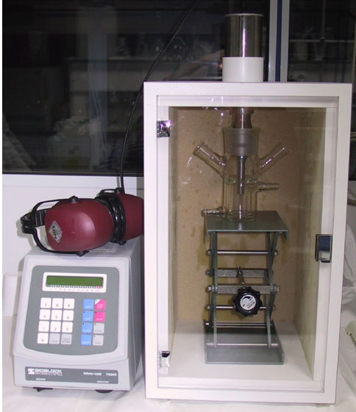
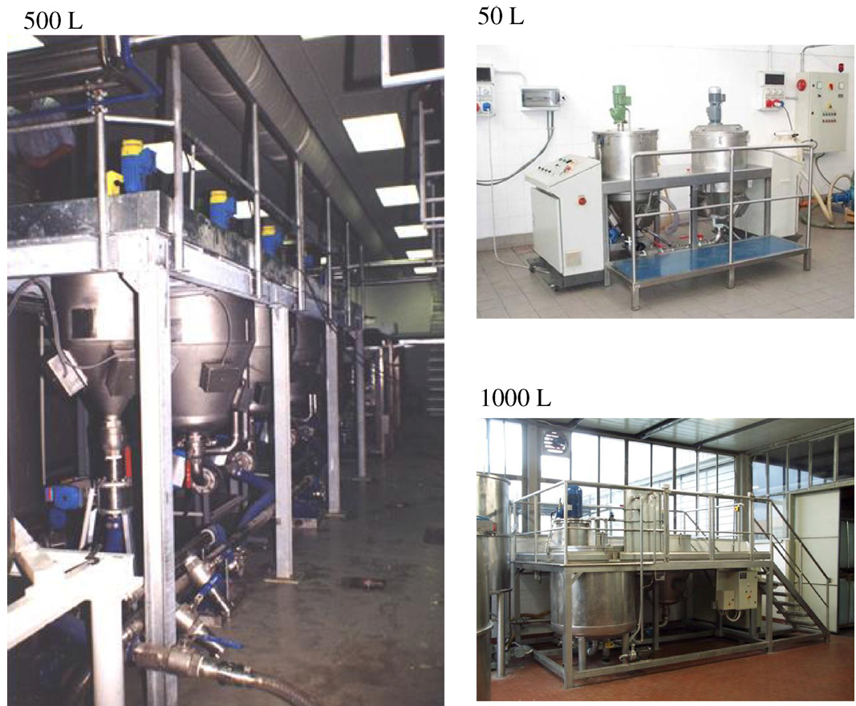
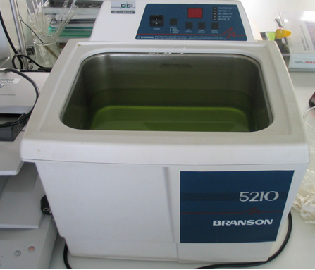
Applications: Ultrasonication
Different scales
Source: Chemat et al., 2011

Slide 11
Ultrasonication: Enzymatic inactivation
Inactivation of PME in tomato juices
Methods | °C | Volume (mL) | Intensity mg/L.min | D-Value (min)
Conventional | 50 | 100 | NA | 25.3
Ultrasonication | 50 | 200 | 0.007 | 241
 | 50 | 100 | 0.012 | 43
 | 50 | 50 | 0.020 | 24
Thermosonication | 61 | 200 | 0.005 | 8
 | 61 | 100 | 0.007 | 2
 | 61 |  | 0.012 | 0.8
 | 72 | 200 | 0.004 | 0.7
 | 72 | 100 | 0.005 | 0.4
 | 72 | 50 | 0.008 | 0.3
Source: Raviyan et al., 2005

Slide 12
Ultrasonication: Effect on Quality
The effect of ultrasonication on color and anthocyanin content in grape juices
Parameters | Before | After
pH | 3.78
Brix | 7.02
L* | 22.06 | 22.69
a* | 9.27 | 9.79
b* | -8.79 | -7.97
Cyanidin-3-O-glucosides (CA) (mg/100 mL) | 13.39 | 13.68
Source: Tiwari et al., 2010

Slide 13
Introduction: PUV
Pulsed Ultraviolet light
  Is a method of food preservation
  Using intense and short duration of pulses of broad spectrum white light
  The spectrum involves wavelength in the UV and near infrared region
    Materials exposed to at least 1 pulse of light having an energy density in the range of 0.01 to 50 J/cm²
  Wavelength distribution
    About 70% of the electromagnetic energy is within the range of 170 to 2600 nm used

Slide 14
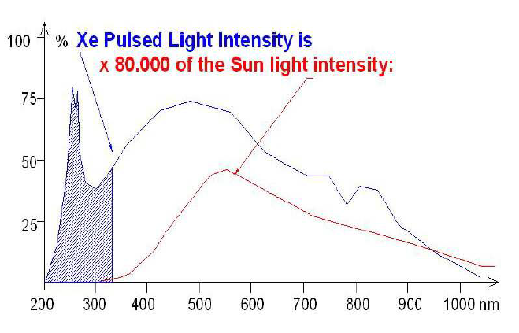
Introduction: PUV
Pulsed Ultraviolet light
  Similar spectrum as sunlight
  Emits electromagnetic radiation from 100 to 1100 nm
    from the UV region to Infrared region
    Peak emission between 400 to 500 nm
    It is non-ionizing part of the electromagnetic spectrum
Source: http://steribeam.com/technology/SBS-PUV-principles

Slide 15
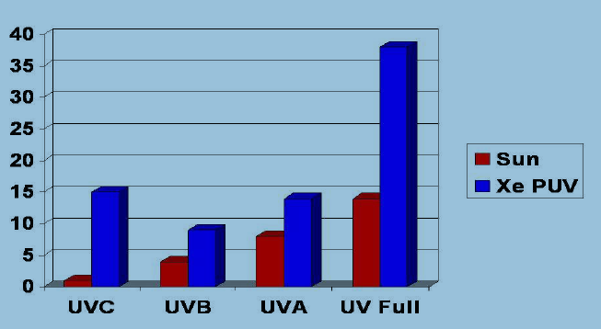
Introduction: PUV
Pulsed Ultraviolet light
  Short pulses (1 μs to 0.1 s)
  Typically 1 – 20 flashes per second
    Spectrum Intensity (Xenon produce about (80,000 x) at sea level
Source: http://steribeam.com/technology/SBS-PUV-principles

Slide 16
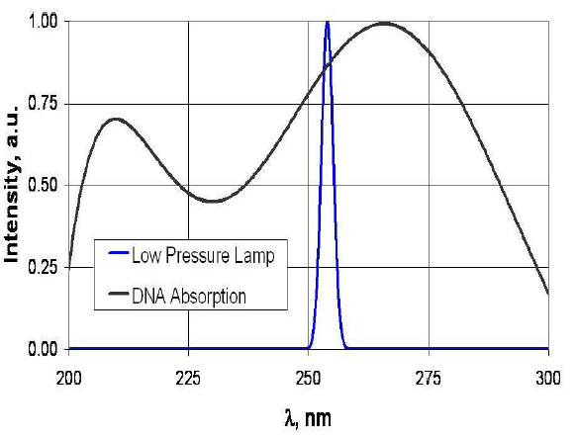
Introduction: PUV
Pulsed Ultraviolet light
  Energy input to food surface or package surface area
    Expresses in Energy per square area (J/cm²) or energy density
  Broad spectrum of Pulse light inactivates microbes
    Via the combination of photochemical and photothermal mechanism
    Photochemical
      Chemical modifications of proteins membrane
      and other cellular materials and DNAs
      The UV-C provide greater
      photochemical effects
Source: http://steribeam.com/technology/SBS-PUV-principles

Slide 17
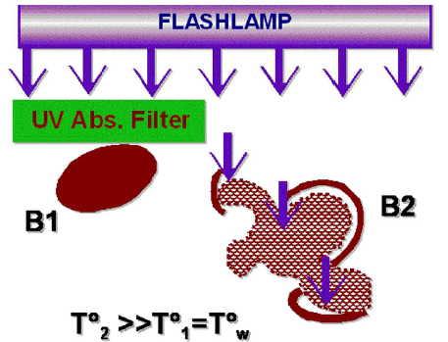
Introduction: PUV
Pulsed Ultraviolet light
  Energy in the visual spectrum
    Contributes to the photothermal effect
    Large amount of energy is transferred rapid to the surface
    Temperature increase
      Sufficient to destroy vegetative cells
Source: http://steribeam.com/technology/SBS-PUV-principles

Slide 18
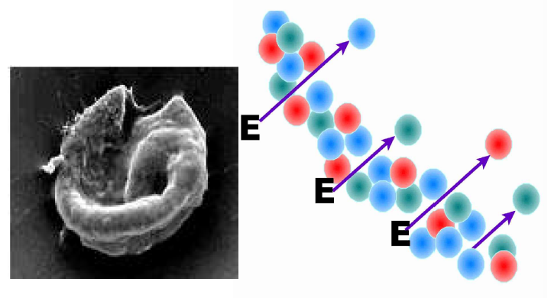
Introduction: PUV
Pulsed Ultraviolet light
  Wavelength is divided into different regions of
    UA-A: 315 - 400
    UV-B: 280 - 315
    UV-C: 200 – 280
  Microbial Effect
    Absorption of energy by the conjugated double carbon bonds in proteins and nucleic acids
    Cause crosslinking between the pyrimidine nucleoside bases in DNA
    Disruption of cellular metabolism
    Results of irreversible changes
Source: http://steribeam.com/technology/SBS-PUV-principles

Slide 19
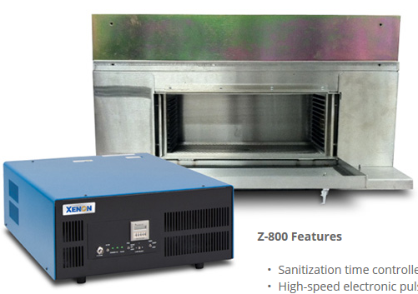
Application: PUV Systems
Treatment chamber and generator
  Static and or continues systems

Slide 20
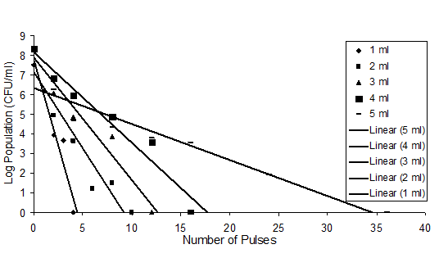
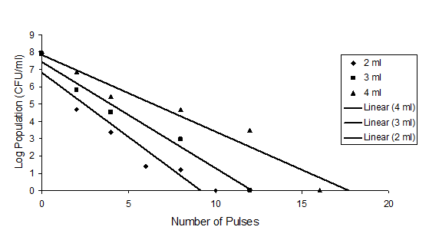
Application: PUV Systems
Effect on Salmonella Enteritidis
Source: Yang and Singh 2010

Slide 21
Application: PUV Systems
Continuous UV Decontamination system for treating poultry chiller water
UV generator
UV Reactor
Flow Meter
Treated Samples
Peristaltic pump
  Made of stainless steel
  Reactor Capacity = 151.1 cc
Sample

Slide 22
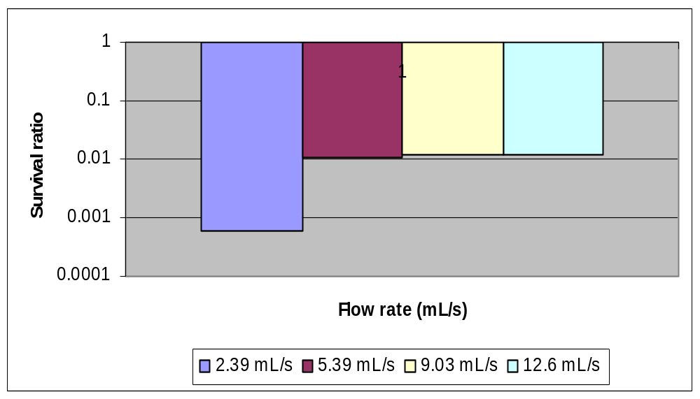
Application: PUV Systems
Continuous reactor

Slide 23
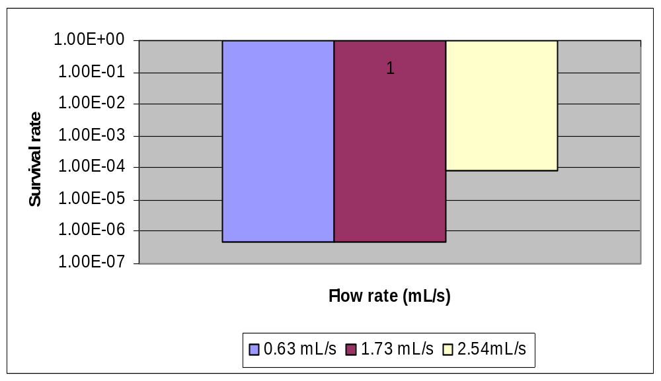
Application: PUV Systems
Continuous reactor

Slide 24
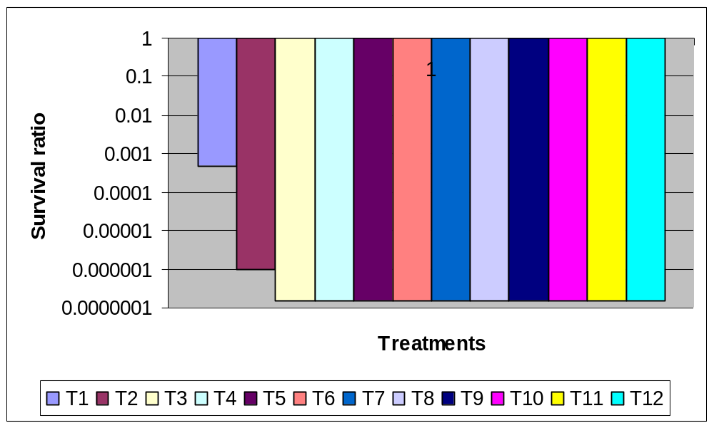
Effect on Salmonella
Pulsed UV effect on Salmonella

Slide 25
Introduction: Antimicrobials
Crave for natural foods, organic and less chemically processed food are the trend
Therefore, the application of Conventional aqueous Sanitizers for washing
  Chlorine
  Hydrogen peroxide
  Trisodium phosphate
    The use of this solution has not be successful in controlling
    Produce adverse effect: chlorine --- trihallomethanes
Use of Organic acids as antimicrobial
  They are GRAS and known to inactivate foodborne pathogen

Slide 26
Introduction: Antimicrobials
For example
  Lactic Acid: are know to increase the lag phase of pathogens, lower the growth rate during storage
  Lactic acid surface treatment: usually in water base solution and hydrophilic
Challenges
  Use of hydrophilic agent in hydrophobic environments
  Many studies has shown microbes to be entrapped in fat matrix in meats and poultry
  Thus limit the effectiveness of some antimicrobial
  Surfactants (Sodium Lauryl sulfate)
    Decrease surface tension and enhance wettability of hydrophobic surfaces
    Amphiphilic, thus enhance mobility when mixed with antimicrobials

Slide 27
Applications: Antimicrobials
Antimicrobial
Table: Organic acid antimicrobial effects in lettuces
Microbes | Trtm | Lactic Acid (Log CFU/g)
 | Con (%) | 10 min | 20 min | 30 min
E. Coli | 0.3 | 0.73 | 1.87 | 2.51
 | 0.7 | 1.26 | 1.92 | 3.09
 | 1.0 | 1.57 | 2.07 | 3.42
S. Typhimurium | 0.3 | 0.72 | 1.46 | 2.08
 | 0.7 | 1.50 | 1.62 | 2.49
 | 1.0 | 1.76 | 2.06 | 2.67
L. Monocytogenes | 0.3 | 0.70 | 1.71 | 2.52
 | 0.7 | 1.13 | 2.03 | 3.03
 | 1.0 | 1.20 | 2.14 | 3.45

Slide 28
Applications: Antimicrobials
Effect of Essential oils on growth of E. coli ATCC 25922
Essential Oils | Concentration | Lag phase (h) | Growth rate (/h)
Lemon balm | 20,000 ppm | 5.21 | 0.4
Oregano | 300 ppm | 3.84 | 0.36
Rosemary | 10,000 | 4.55 | 0.48
Oregano+Basil | 1:2 | 11.28 | 0.45
Oregano+lemon balm | 1:2 | 8.76 | 0.31
Oregano+Rosemary | 1:2 | 5.84 | 0.38
Source: Gutierrez et al., 2008

Slide 29
Applications: Combine Ultrasound and OA
Combine ultrasound and organic acid treatment of Escherichia coli O157:H7 in lettuce
Organic Acids | Concentration (%) | Log CFU/g
 |  | Organic Acid Treatments | Organic acid and Ultrasonic Treatments (40 Hz and 30 W/L)
 | 0.0 | 0.3ª | 0.89ª
Malic acid | 0.3 | 0.57^{ab} | 1.09^{b}
 | 0.7 | 1.23^{bc} | 1.78^{c}
 | 1.0 | 1.45^{d} | 2.26^{d}
Lactic Acid | 0.3 | 0.53ª | 1.4^{ab}
 | 0.7 | 0.97^{ab} | 2.21^{c}
 | 1.0 | 1.03^{bc} | 2.53^{d}
Citric Acid | 0.3 | 0.5ª | 1.62^{b}
 | 0.7 | 0.91^{ab} | 1.84^{c}
 | 0.1 | 1.15^{bc} | 2.09^{d}
Source: Sagong et al., 2011

Slide 30
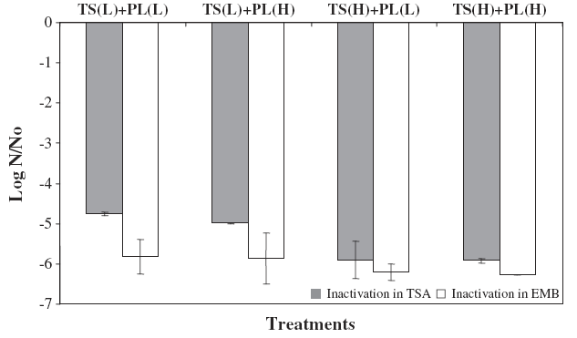
Applications: Combine Ultrasound and PUV
Combine ultrasound and PUV inactivation E. coli O157:H7 in apple juice
Source: Munoz et al., 2012

Slide 31
Future Implications
Potential in Food safety
  Ultrasound
    Enhance penetration to inaccessible sites (hydrophobic pockets in foods),
  Combination of this technologies improve safety issues
    Fresh cut fruit and vegetables; meat and poultry
  Design of a suitable system
    Combine PUV, Ultrasound and Acidification
    Low cost and ‘Green technology’
    Automated system in food production lines

Slide 32
References
Awad, T. S., et al. (2012). "Applications of ultrasound in analysis, processing and quality control of food: A review." Food Research International 48(2): 410-427.
O’donnell, C., et al. (2010). "Effect of ultrasonic processing on food enzymes of industrial importance." Trends in food science & technology 21(7): 358-367.
Piyasena, P., et al. (2003). "Inactivation of microbes using ultrasound: a review." International Journal of Food Microbiology 87(3): 207-216.
Sagong, H.-G., et al. (2011). "Combined effect of ultrasound and organic acids to reduce Escherichia coli O157:H7, Salmonella Typhimurium, and Listeria monocytogenes on organic fresh lettuce." International Journal of Food Microbiology 145(1): 287-292.
Soria, A. C. and M. Villamiel (2010). "Effect of ultrasound on the technological properties and bioactivity of food: a review." Trends in food science & technology 21(7): 323-331.
B.K. Tiwari., et al. (2010). “Effect of ultrasound processing on anthocyanins and color of red grape juice.” Ultrasonics sonochemistry 17: 598-604.
Monoz et al. (2012). Effect of E. coli inactivation and quilaity attributes in apple juice treated by combination of PUV and thermosonication. Food Research International. 45: 299-305.
Chemat, F., Z. Huma and M.K. Khan. (2011). Applications of ultrasound in food technology: processing, preservation and extraction. Ultrasonic Sonochemistry. 18: 813-835.

Slide 33
Thank you

