Slide 1

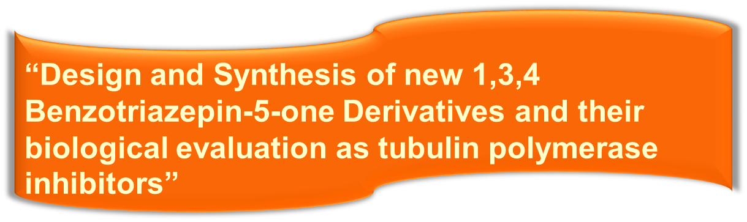
Dr. Lamia Wagdy Mohamed
Associate Professor of Pharmaceutical Organic Chemistry
Faculty of Pharmacy- Cairo University

Slide 2
During mitosis, tightly regulated microtubule dynamics is essential for spindle formation and chromosomal separation.
Targeting tubulin is a successful strategy for cancer therapy.
it is highly desirable to develop safe and
effective anticancer drugs to treat this disease and to improve the quality of life of patients with cancer

Slide 3

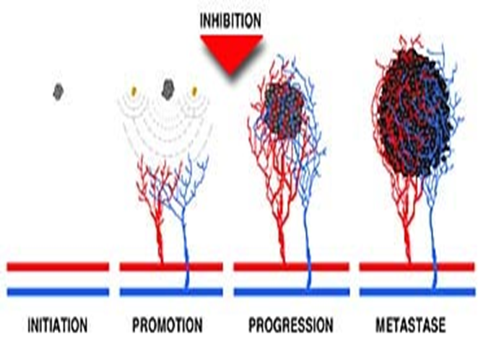
Angiogenesis

Slide 4
Considerable amount of research focuses on benzotriazepinones and benzodiazepinones due to their specificity on different types of normal and cancer cells.
1,4-benzodiazepine has unique structure that mimics the peptide linkage. This interesting observation completely shifted the interest of medicinal chemist for [1,4]-benzodiazepine from CNS acting drugs to anticancer agent.

Slide 5

During last few decades, large number of reports has appeared in the literature highlighting the anticancer activity of [1,4]-benzodiazepines.
Several derivatives of 1,3,4-benzotriazepine have been synthesized and showed distinctive antitumor activity
European Journal of Medicinal Chemistry 89 (2015) 147e155
Sinha, J., Kurup, A., Paleti, A., and Gupta, S. Quantitative structure-activity relationship study on some nonepeptidal cholecystokinin antagonists. Bioorg. & Med. Chem., 7, 1127-1130 (1999).

Slide 6
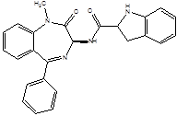
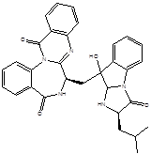
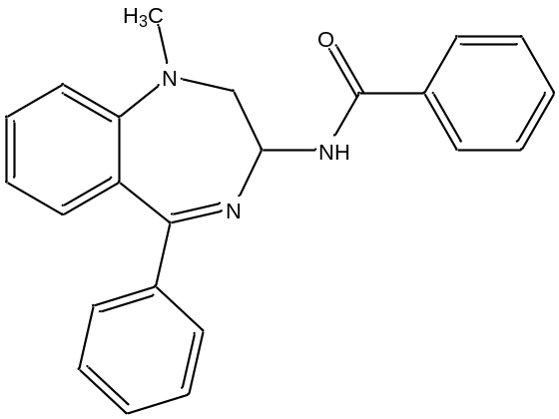
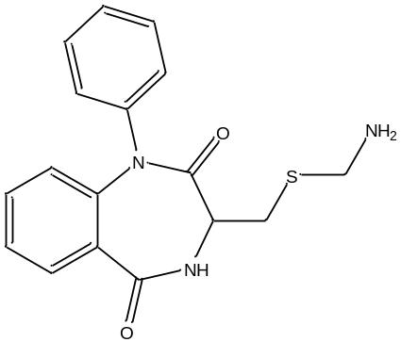
Devazepide
Asperlicin
N-(1-methyl-2-oxo-5-phenyl-2,3-dihydro-1Hbenzo[
e][1,4]diazepin-3-yl)-benzamide-[carboxyl-14C]
J Label Compd Radiopharm 2006; 49: 71–76.
Biopolymers, Vol. 56, 55–76 (2001

Slide 7
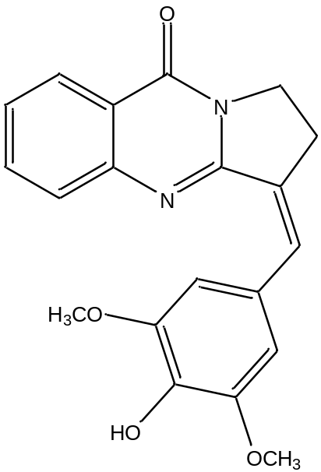
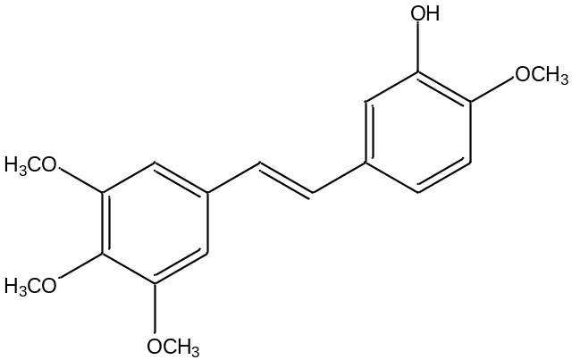
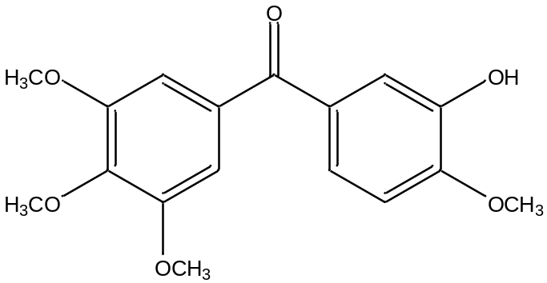
Many natural and synthetic products of varied structures bind to the colchicine site of tubulin
As: Isaindigotone Combretastatin phenstatin

Slide 8
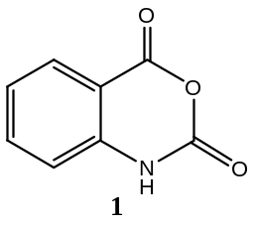
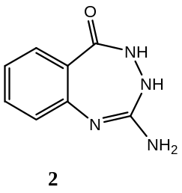
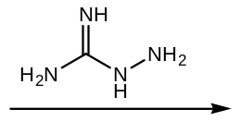
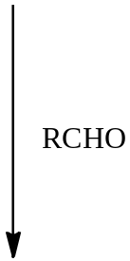
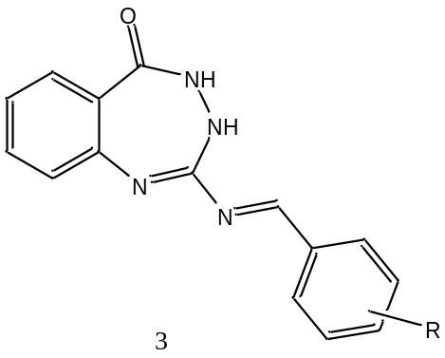
Scheme:

Slide 9
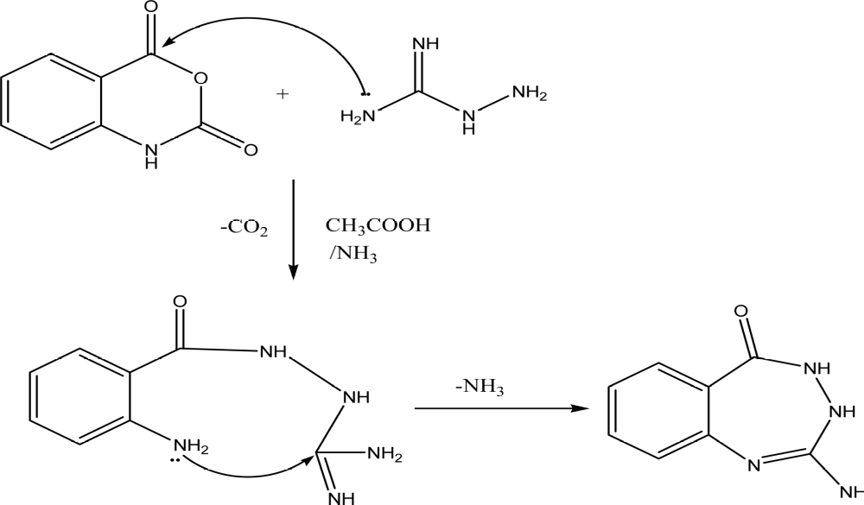
First step

Slide 10
Second step
The use of aldehydes substituted with hydroxyl and methoxy groups to compare
4- hydroxyl (I) | 2,4-dihydroxy ( II)
2-Hydroxy ( III ) | 2- methoxy ( IV)
3,4-dihydroxy ( V) | 3,4-dimethoxy ( VI)
3,4,5-trihydroxy ( VII) | 3,4,5-trimethoxy ( VIII)
3-methoxy-4-hydroxyl ( IX)
3-Pyridyl (X) | 4- Pyridyl ( XI)
4-(N,N-dimethyl amino) ( XII)

Slide 11
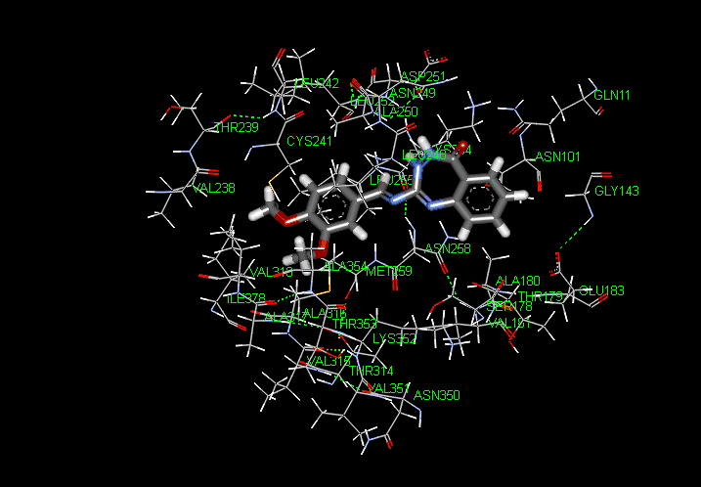
Tubulin Polymerase with compound VI

Slide 12
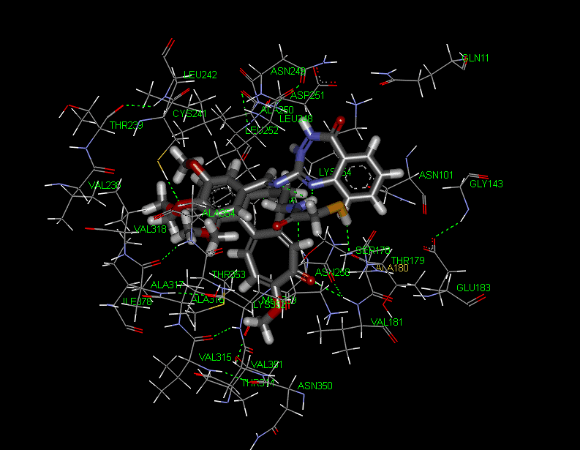
Tubulin Polymerase with compound VI overlapped with colchicine

Slide 13

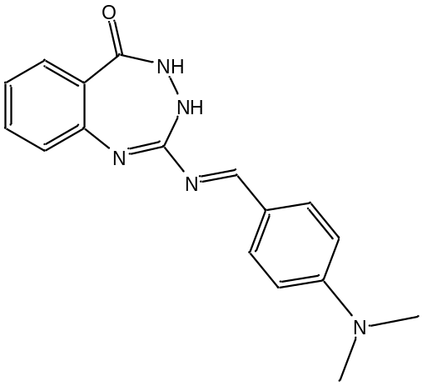
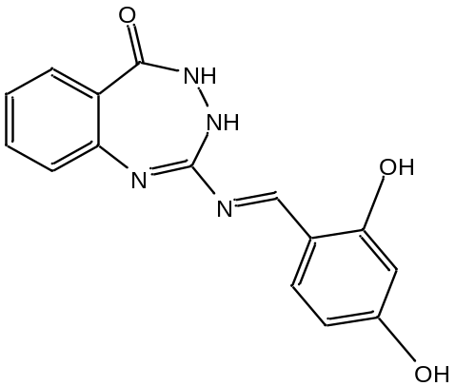
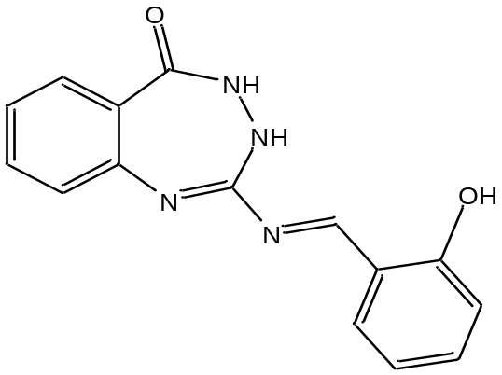
Pharmacological Results
XII II III

Slide 14


