Slide 1

7th Global Summit October 05-07, 2015 on Cancer Therapy Dubai, UAE
CD49d and CD26 are independent prognostic markers for disease progression in patients with chronic lymphocytic leukemia
Lamia Ibrahim
Associate professor of clinical pathology and hematology
Hematology Unit. Mansoura Cancer Institute, Mansoura Faculty of Medicine, Mansoura, Egypt

Slide 2
7th Global Summit October 05-07, 2015
on Cancer Therapy Dubai, UAE
CLL is characterized by extremely variable clinical course. Several prognostic factors can predict disease progression and therapeutic outcomes in those patients.
CD49d, an adhesion molecule belonging to integrin family, plays a critical role in leukocyte trafficking, activation, and survival.

Slide 3
7th Global Summit October 05-07, 2015
on Cancer Therapy Dubai, UAE
CD49d expression may affect prognostic stratification and overall survival in CLL patients. However, little is published on the value of CD49d as an independent prognostic factor for OS and disease progression.
CD26 is a multifunctional type II cell surface glycoprotein that is widely expressed by T lymphocytes, natural killer cells. CD26 expression is very low in B-cells; however, it is up regulated following in vitro activation.

Slide 4
7th Global Summit October 05-07, 2015
on Cancer Therapy Dubai, UAE
The aim of this study was to evaluate the use of CD49d and CD26 as independent prognostic markers in CLL patients.
We evaluated the prognostic role of CD49d and CD26 to predict the risk of lymphocyte doubling, disease progression and overall survival.

Slide 5
7th Global Summit October 05-07, 2015
on Cancer Therapy Dubai, UAE
Methods:
The present study measured surface expression of CD49d and CD26 by three-color flowcytometry in a series of 103 previously untreated CLL patients.

Slide 6
7th Global Summit October 05-07, 2015
on Cancer Therapy Dubai, UAE
Results:
We confirmed that CD49d and CD26 were significant predictors of lymphocyte doubling and disease progression (P < 0.001) but insignificant for overall survival (P = 0.303 and 0.519 respectively).
Furthermore, multivariate analysis between clinical parameters and flowcytometry markers revealed that CD49d and CD26 are independent prognostic markers for lymphocyte doubling and progression to a more advanced stage. Also, concordant expression of both markers was found to improve their predictive power.

Slide 7
7th Global Summit October 05-07, 2015
on Cancer Therapy Dubai, UAE
Measurement of CD49d expression in CLL patients may have therapeutic implications. Anti-CD49d antibodies could impair migration and adhesion of leukaemic cells and overcome apoptotic resistance. Natalizumab, commercially available anti-CD49d antibodies, use in combination with established chemotherapy or immunotherapy protocols may give a promise in CLL therapy.

Slide 8
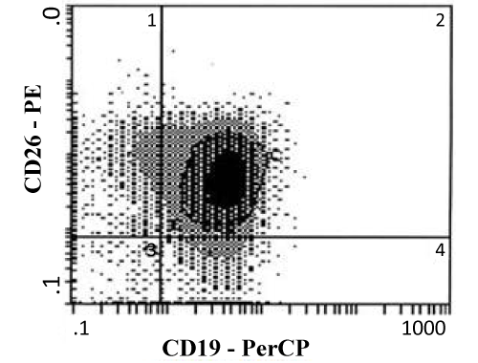
7th Global Summit October 05-07, 2015
on Cancer Therapy Dubai, UAE
Figure : the gating strategy used to quantify the expression of CD 26 by CLL cells. Histogram shows CD 26 expression after CLL cells (R1) gating. CLL cells were plotted, and the cells in the upper left quadrant were quantified as CLL cells with a high level of CD 26.

Slide 9
7th Global Summit October 05-07, 2015
on Cancer Therapy Dubai, UAE
Discussion:
Many studies reported that CD49d and CD26 combined analysis was found to improve their power to predict the risk of lymphocyte doubling and disease progression.

Slide 10
7th Global Summit October 05-07, 2015
on Cancer Therapy Dubai, UAE
Conclusion:
CD49d and CD26 have independent prognostic value and we suggest its use as a part of routine panel for prognostic stratification of CLL at diagnosis.

Slide 11

7th Global Summit October 05-07, 2015
on Cancer Therapy Dubai, UAE
THANK YOU

