Slide 1
A preliminary finding of implementing community-based hospice care in New Taipei City, Taiwan
Lai-Chu See, Ph.D.
Professor
Department of Public Health, College of Medicine, Chang Gung University, Taiwan
Email: lichu@mail.cgu.edu.tw

Slide 2
Introduction _1
1. Good death (Weisman)
Awareness of the death,
Accepting it peacefully,
Arranging one’s will properly,
Timing the death appropriately.

Slide 3
Introduction _2
2. Hospice care
end-of-life care,
help people who are dying have peace, comfort, and dignity.
focuses on caring, not curing.
focuses on the quality of life instead of prolong life.

Slide 4
Introduction _3
3. Interdisciplinary team
The patient' s personal physician,
Hospice physician (or medical director),
Nurses,
Home health aides,
Social workers,
Clergy or other counselors,
Trained volunteers
and speech, physical, and occupational therapists, if needed.

Slide 5
Introduction _4
4. Services
Manages the patient’s pain and symptoms;
Assists the patient with the emotional and psychosocial and spiritual aspects of dying;
Provides needed drugs, medical supplies, and equipment;
Coaches the family on how to care for the patient;
Delivers special services like speech and physical therapy when needed;

Slide 6
Introduction _4
4. Services
Makes short-term inpatient care available when pain or symptoms become too difficult to manage at home, or the caregiver needs respite time; and
Provides bereavement care and counseling to surviving family and friends.

Slide 7
Introduction _5
5. Setting
in the patient's home,
in freestanding hospice centers,
hospitals,
nursing homes,
and other long-term care facilities.

Slide 8
Introduction _6
6. Taiwan
In 1990, first hospital with hospice wards was Mackay Memorial Hospital.
July 1, 2013, New Taipei City Government first initiated community-based hospice program.
Jan. 1, 2014, National Health Insurance (10 categories of terminally illness)

Slide 9
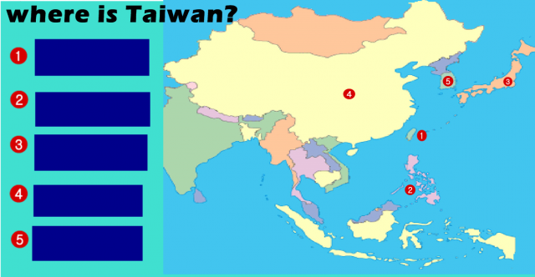
Introduction _6

Slide 10
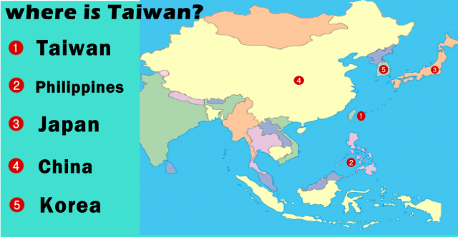
Introduction _6

Slide 11

Introduction _7

Slide 12
Introduction _7
6.1 New Taipei City Government, Taiwan
link to 7 hospitals to provide the service.
patient is expected to live 3 months or less, he/she stay either at home or at a nursing home, or at an institute.
hospice staff make regular visits to assess the patient and provide additional care or other services 3-4 times a month.
The patient only pays the travel expense, the fee of medicine and medical device not covered by National Health Insurance.

Slide 13
Aims
Find out the use, satisfaction, score of good death, physical and spiritual change at last month before death.

Slide 14
Material & Methods_1
1. Study design
Secondary data analysis.
Patients were those who received community-based hospice care at New Taipei City Government from July 2013 till May 2014.
We had obtained approval from IRB of CGMH.

Slide 15
Material & Methods_2
2. Variables
(1) demographic, disease, caregiver (Table 1)
(2) information source and sign relevant document (Table 2)
(3) physical, psychologicial , spiritual change a month before death (score from 0-4) (Figure 1-3)
(4) preparation of good death (Table 3)
(5) scores of good death (score from 0-3) (Table 3)
(6) satisfaction of the program (0-5) (Table 5)

Slide 16
Material & Methods_3
3. Statistical analysis
Descriptive statistics and paired t-test

Slide 17
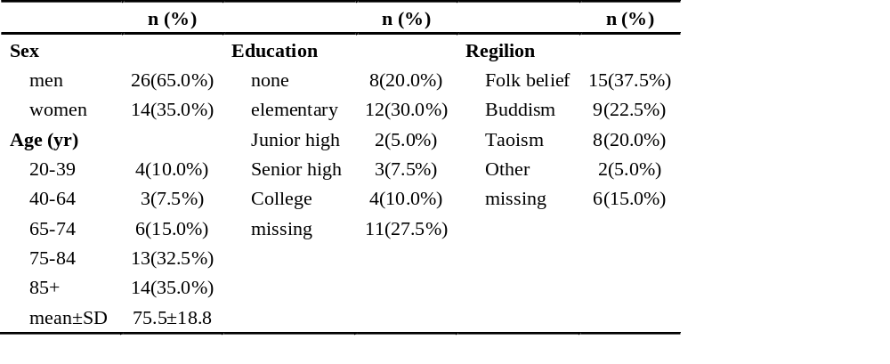
Results_1
Table 1a. Demographic characteristics

Slide 18
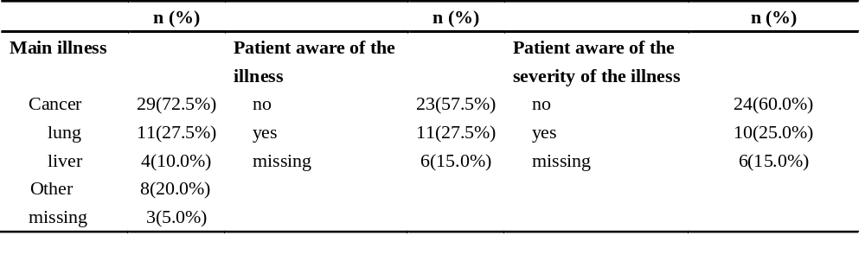
Results_2
Table 1b. Disease characteristics

Slide 19
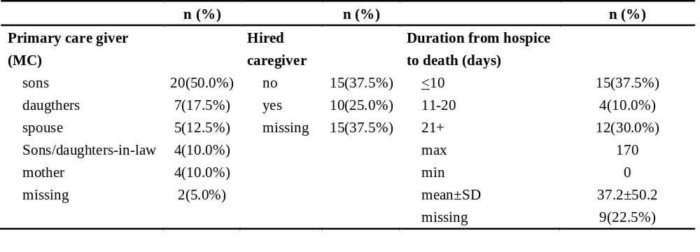
Results_3
Table 1c. Caregiver characteristics

Slide 20
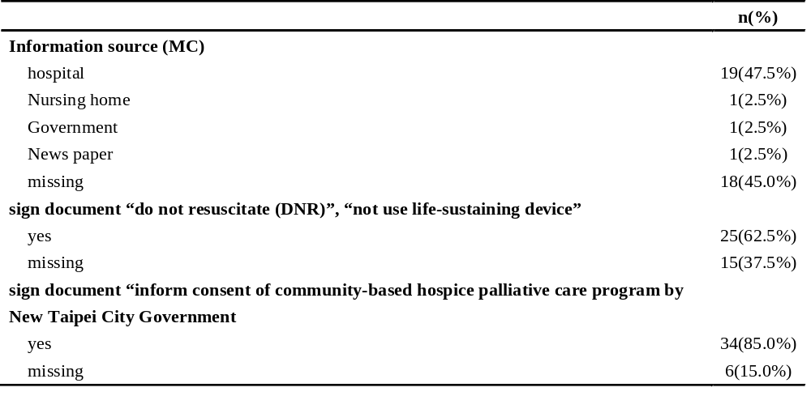
Results_4
Table 2. Information source and sign relevant documents (n=40)

Slide 21
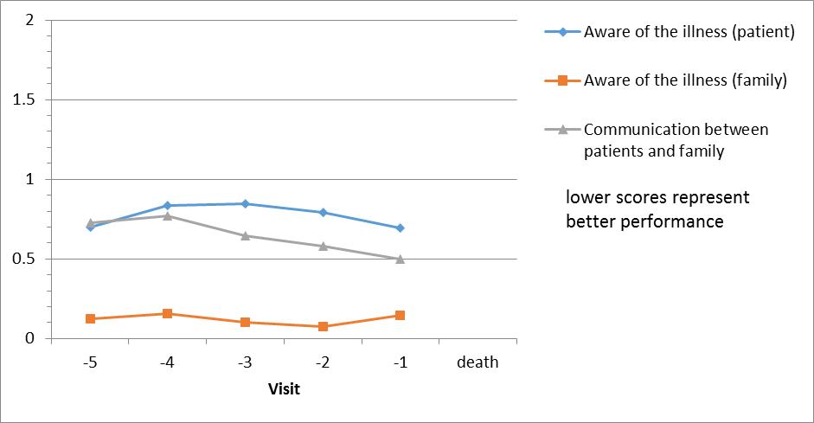
Results_5
Fig. 1. Awareness of the illness and communication

Slide 22
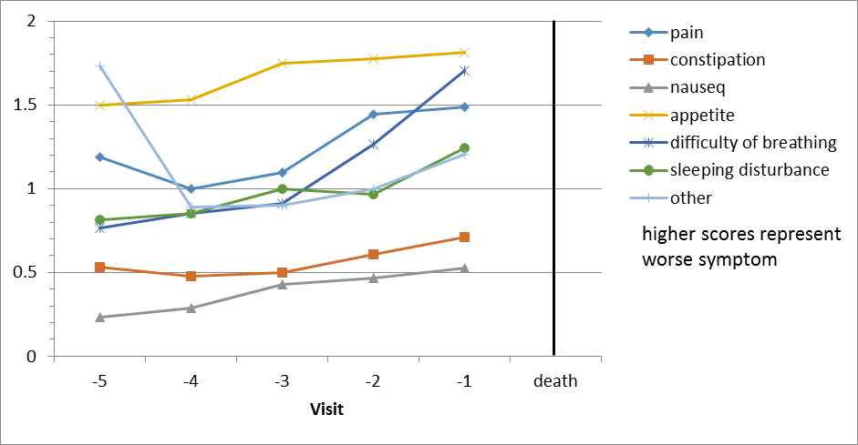
Results_6
Fig. 2. Change of patient’s symptom

Slide 23
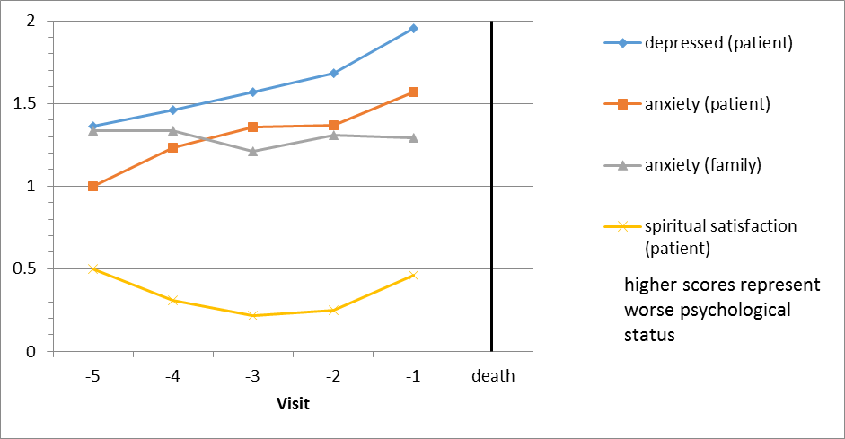
Results_7
Fig. 3. Change of psychological and spiritual status

Slide 24
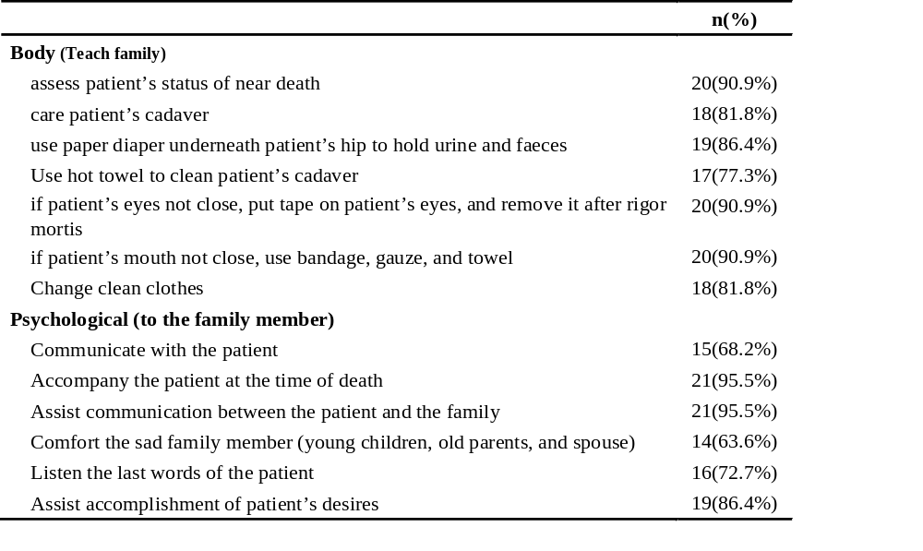
Results_8
Table 3a. Preparation of good death (n=22)

Slide 25
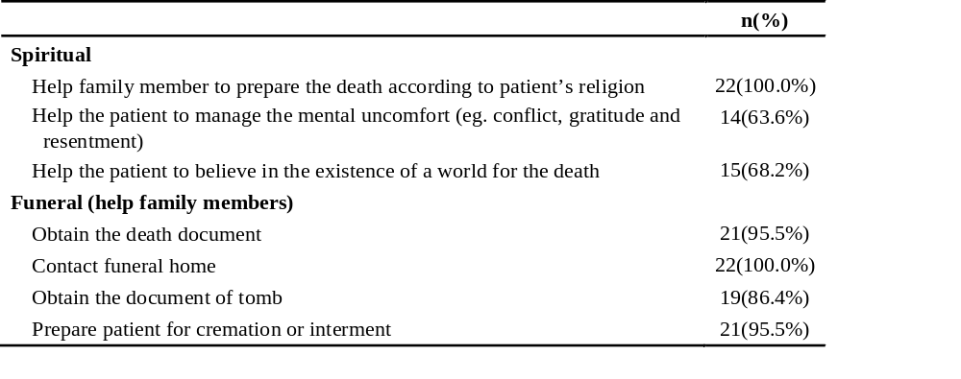
Results_9
Table 3b. Preparation of good death (n=22)

Slide 26
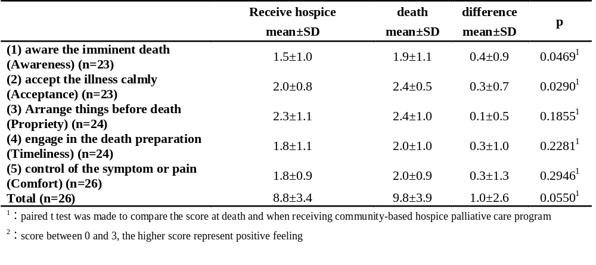
Results_10
Table 4. Scores of good death at receiving community-based hospice care and at death

Slide 27
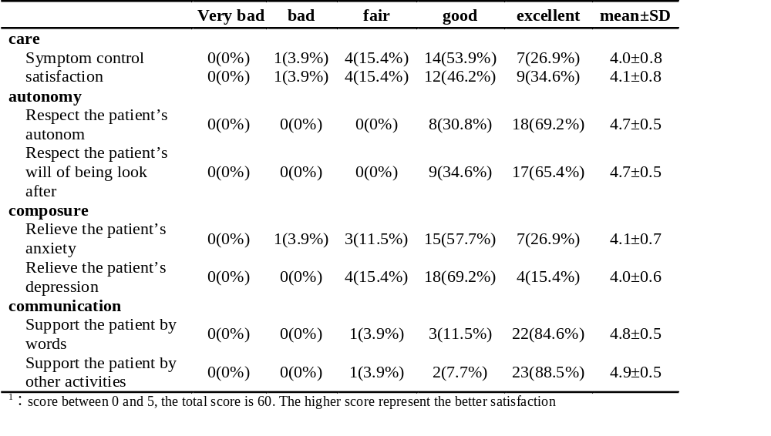
Results_11
Table 5a. Satisfaction of good death program (n=26)

Slide 28
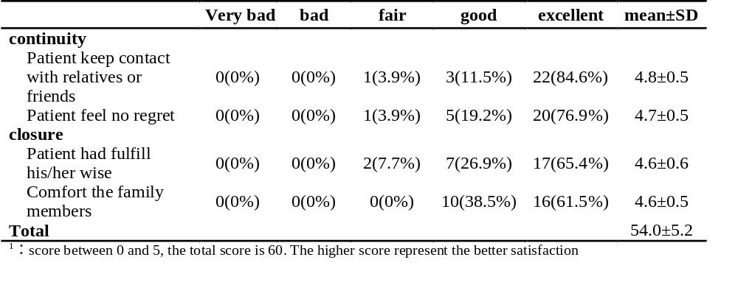
Results_12
Table 5b. Satisfaction of good death program (n=26)

Slide 29
Discussion_1
Cancer were the major illness (72.5%)
Most sign NDR and the consent form
Pain, constipation, nausea, poor appetite
Mental status (depressed, anxiety) is worse near death
Good satisfaction of the service

Slide 30
Discussion_2
In New Taipei City, Taiwan, 20,000 terminally ill patient and 92% are qualified for hospice care annually and only 74 (this study) received the service.
47.5% learn the service from the hospital. Different decision between patients and family member, lack of manpower at home, worry, wrong perception (giving up on life or lower level of medical care)

Slide 31
Discussion_3
Timing of the service: 3 (died on the same date, one or two day after receiving hospice care).
Duration (mean=37.2 days, 0-170 day) > hospitals.

Slide 32
Discussion_4
Limitation
(1) sample size too small
(2) only quantitative information

Slide 33
Thank you for your attention

