Slide 1
Innovations in Corporate Wellness:
Beyond Lunch and Learns
Presented by
Lacey Durrance, MS, RD, LDN

Slide 2
What is Corporate Wellness?
Focus on health of employees to
  Increase employee morale
  Increase productivity and performance
  Reduce sick leave
  Reduce medical expenses
  Boost acquisition and retention
Notes:
Focus today on health-related programs

Slide 3
What is Corporate Wellness?¹
“…programs, policies, benefits, environmental supports, and links to the surrounding community designed to encourage the health and safety of all employees.” -CDC
Notes:
Focus today on health-related programs

Slide 4
Nutrition Risk
High for majority
  Low intakes of fruits and vegetables
  Low intake of water
  Low intake of fiber

Slide 5
Cofounding Variables
Malnourishment can lead to…
  Fatigue
  Imparied concentration
  Irritability
  Sickness
Which then leads to..
  Low physical activity
  High stress
  Poor performance
  Poor relationships

Slide 6
Traditional Programming
Health Risk Appraisal/Personal Health Assessment
  Lifestyle habit survey + biometrics
    Height, weight, blood sugar, blood pressure, blood lipids (HDL, LDL, Total), A1C, bone density
    Exercise, stress, nutrition, tobacco

Slide 7
Traditional Programming
Health coaching
Educational sessions
  Onsite or webinar
    Lunch and Learns
    Lecture-style

Slide 8
Need for Innovation
Low engagement
Poorly addresses learning styles
  Tactile, auditory, visual
Lack of long-term behavior change
Lack of significant behavior change

Slide 9
Driving Behavior Change and Engagement
Educational Series
  5-6 session program series
  Workbook included
  Hands-on activities in-class/simulated via webinar
  Homework activities

Slide 10

Nutrition Innovation
Café Tours
  Color-coded options based on health criteria
Farmers Market
Tasting Parties
  Sampling “tastes” of various healthy foods
Grocery Store Tours
  Teambuilding, out-of-office
Movie Screenings

Slide 11
Nutrition Innovation
Menu Consultations
  Food Service Providers
Eating Out Guidance
Dietitian Consultations
  Telephonic and/or onsite
  Increase significance and safety of behavior changes

Slide 12
Nutrition Innovation
Workshops
  Do-it-yourself:
    Water bottle
    Spice blend or tea blend
    Lunch box
Family-specific events
  Back to School Health Fair
  Movie or game nights
  Cooking classes

Slide 13
Satisfaction Outcomes
Highly satisfied
Unique
Fun
Thankful
Impactful

Slide 14
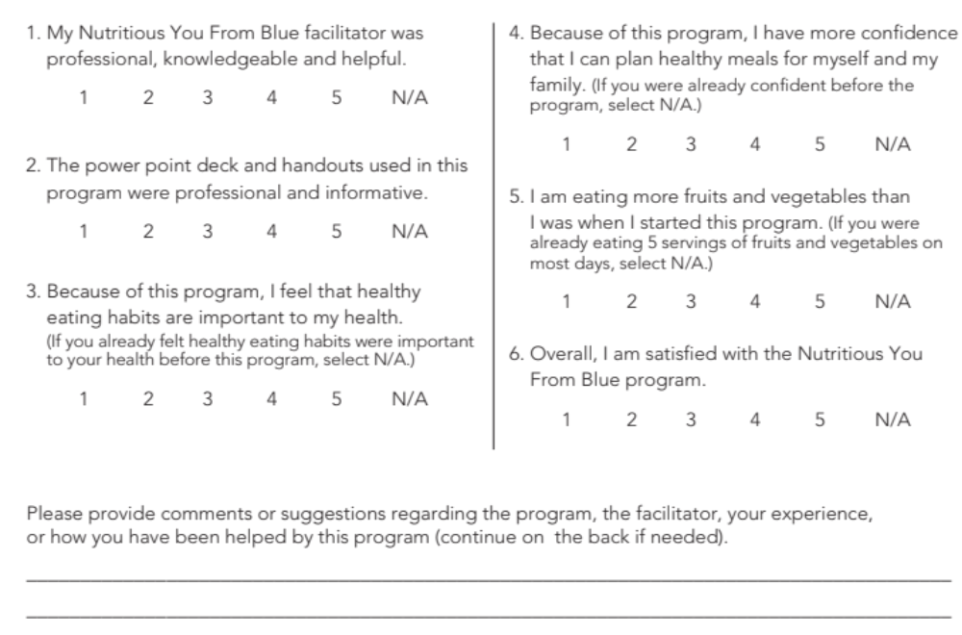
Key to Implementation
Properly assess outcomes
  Assess target behaviors

Slide 15
Key to Implementation
Expert staff
  Trained facilitators
  Registered Dietitians
Privacy secured
Internal incentives
Include family/support system
Access

Slide 16
Behavior Change Outcomes
52% increased fruit and vegetable consumption
  35% already eating daily recommendation
73% increased confidence with meal planning
40% increased belief that eating healthy is important
  60% already believed healthy eating was important

Slide 17
References
1. Workplace Health Program Definition and Description. Centers for Disease Control and Prevention. Available at http://www.cdc.gov/workplacehealthpromotion/pdfs/Workplace_Health_Program_Definition_and_Description.pdf. Accessed on November 28, 2015.

