Slide 1
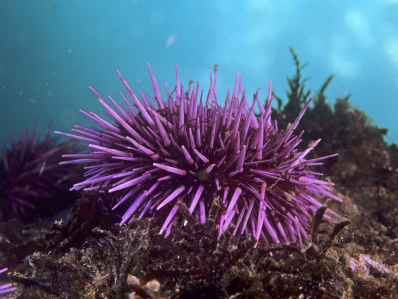
Innate Immunity in the Purple Sea Urchin and Diversity of the Sp185/333 System
L. Courtney Smith
Department of Biological Sciences
George Washington University
Washington DC

Slide 2
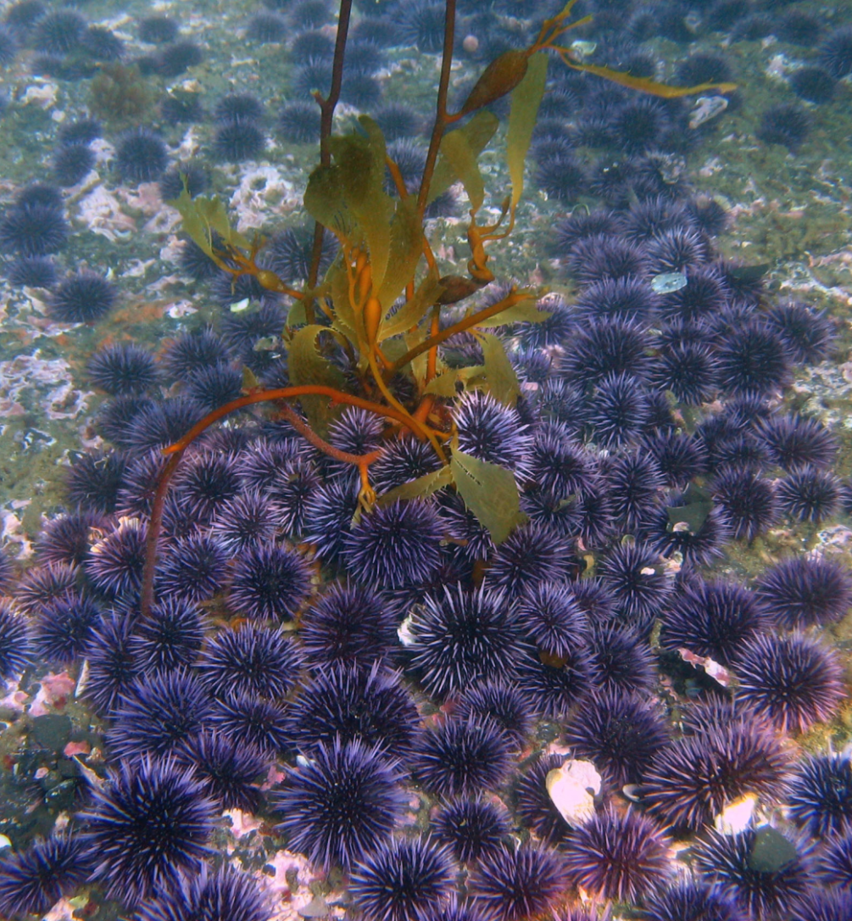
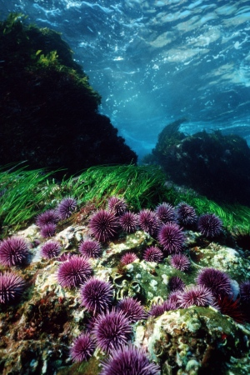
Strongylocentrotus purpuratus
Pacific ocean, west coast of North America
Near shore habitat in kelp forests
Good model for developmental biology
Genome sequenced in 2006

Slide 3
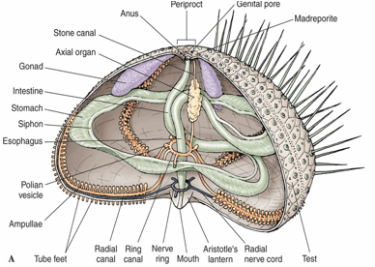
Sea urchin anatomy
Immune cells; coelomocytes
Eat, spawn, live ~50 years

Slide 4
Deuterostomes
Animal Phylogeny
Protostomes
*
Chordates
Vertebrates
Mammals
Birds
Reptiles
Amphibians
Fish
Sharks & Rays
Agnathans
Lampreys
Hagfish
Innate and Adaptive Immunity
Arthropods
Molluscs
Annelids
Protochordates
Ascidians
*
*Innate Immunity only
Echinoderms
Sea Urchins
*
Notes:
Relationship between mammals and SU
Animals with adaptive immunity,
higher and lower vertebrates
those without
everyone else

Slide 5
Staying ahead of the pathogens
Problem:
Microbes typically have very short generation times
  diversification through rapid proliferation and/or gene exchange
  selection for virulence
Hosts generally have long(er) generation times
Solution:
To survive, hosts use molecular mechanisms to generate immune diversity within the lifespan of the individual
How is this accomplished without adaptive immunity?
Haldane, 1949
Notes:
Statement of the problem.
Short vs long lifespan
SU life span of ~50 years
How to stay ahead of the pathogens if you don’t have rearranging or assembly capabilities

Slide 6
Sea urchin genome reveals a complex and sophisticated innate immune system
Large gene families
  Toll-like receptors, 253 gene models
    expressed in phagocytes
  NOD-like receptors, 203 gene models
    expressed in gut
  Scavenger receptors, 218 gene models
    expressed in coelomocytes
  Sp185/333 system
    20-60 genes, small, clustered, diverse
Sodergren et al., 2006
Rast et al., 2006
Hibino et al., 2006
Buckley & Rast, 2012

Slide 7
The Sp185/333 System
Outline
Sp185/333 Genes
  structure
  sequence diversity
  family structure
SpShapeshifter Proteins
  diversity
  native protein function
  recombinant protein
    function
    structure

Slide 8
Sp185/333 gene structure
1
2
Leader Mature protein
genes are <2kb, 2 exons
1 pseudogene of 171 sequenced genes
no gene fragments found
Terwilliger et al., 2006; 2007
Buckley & Smith, 2007
Oren et al., unpub
Notes:
Early search of the genome
the genes are small
Two exons; leader, mature protein
50 genes, based on
1. qPCR of genomic DNA
2. Statistical estimate of the number of genes based on
total genes sequenced from an individual
number of genes with identical sequence
=how many times do you have to sample the gene family before you sequence the same gene twice
this provides an estimate of family size
assumes all gene sequences are different
3. BAC library screens
numbers of positive clones, gene size, estimate of linkage for most genes
No pseudogenes or gene fragments
may be an artifact of our PCR based cloning/sequencing approach
very odd for a large gene family with shared sequences and repeats
Elements and element patterns
37 different element patterns recognized
Sequence diversity within elements
= huge diversity of sequence
No pseudogenes, no frameshifts, no missense sequence, no early stop codons

Slide 9
Sequence diversity of the Sp185/333 genes
Exon 2
Exon 1
14
16
20
22
24
L
Int
1
2
3
4
5
6
7
8
9
10
11
12
13
15
17
18
19
21
23
25
26
27
Elements
A1γ
γ
a
F1β
β
f
C2α
α
c
Element Pattern
B2α
α
b
D1α
α
d
E2δ
δ
e
01α
α
Repeats
Intron (int) is ~400 nt; not to scale
300 nt
Element pattern names are defined by the
sequence of element 10
sequence of the intron
Buckley & Smith, 2007
Notes:
Switch to the Sp185/333 system
Illustration of the diversity of the genes and proteins
Blocks of shared sequence, mosaic patterns
Tandem and interspersed repeats

Slide 10
Gene family structure:
Six linked Sp185/333 genes in a BAC insert
Seven
34 kb
20 kb
6.9 kb
Insert = 117 kb
~3.2 kb
Overlapping BAC
A2
B8
D1-y
D1-g
D1-b
E2
01
14 kb
7.3 kb
GA microsatellite, 140-165 repeats
GAT microsatellite, 37-60 repeats
Oren, Barela Hudgell, Podini, Smith, unpub Miller et al., 2010
Notes:
six genes clustered in about a 34 kb region with 5 of the 6 genes tightly clustered in about 20 kb.
four different element patterns
three with the D1 element pattern
Orientation:
two outer genes are facing in the same direction
four inner genes are all facing in the opposite direction.
Linkage:
12 kB to the red gene
~3kB between four closely linked genes
Three genes with D1 element pattern linked to each other. Almost identical
Microsatellites:
GA repeats were found flanking each gene
140-165 repeats
GAT Repeats surrounding the D1 genes plus flanking region
37-60 repeats
10

Slide 11
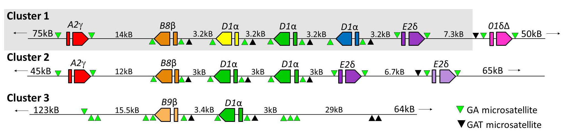
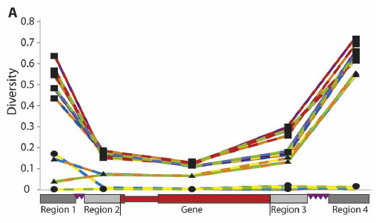
Three clusters of Sp185/333 genes
in different sea urchin BACs
Six genes in Cluster 1:
Low sequence diversity between the GA microsatellites
Miller et al., 2010
Oren, Barela Hudgell, Podini, Smith, in prep

Slide 12
How many Sp185/333 genes are expressed in single phagocytes?
Notes:
Question imposed on the lab by an NSF panel.

Slide 13
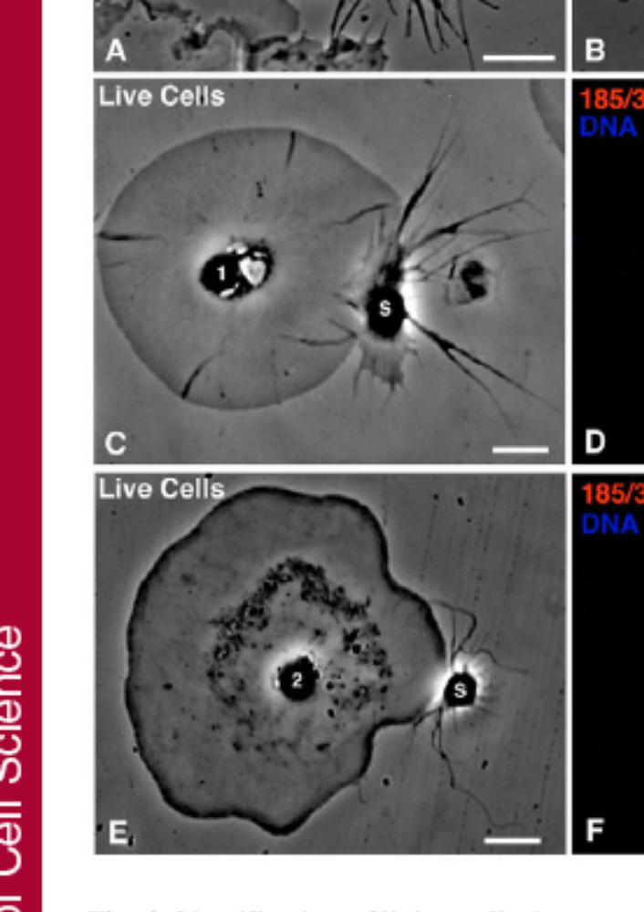
Enrichment of immune activated phagocytes by density centrifugation
P,S
Polygonal cells = 75% – 85%
Small phagocytes = 10%
P
2.5%
20%
D,S
Discoidal cells = 90%
Small phagocytes = 5%
Discontinuous Percoll fractions
Brockton et al., 2008
40%
Vibratile cells = 66%
Red spherule cells = 20%
D
70%
Red spherule cells = 85%
Vibratile cells = 10%
90% cell viability based on propidium iodide exclusion
Majeske, Oren, et al., 2014
Notes:
Some don’t add to 100. Other cell types not reported.

Slide 14
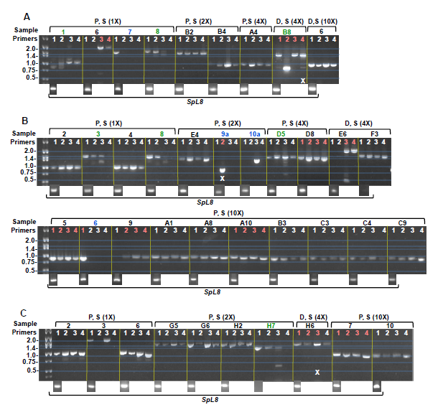
Limiting dilution, nested RT-PCR of single phagocytes
Dilutions (cell/sample)
1X = 1
2X = 0.5
4X = 0.25
10X = 0.1
Sea urchin
11
Sp185/333 Primers
One pair of external universal primers
Four pairs of internal primers (1-4)
17
17
26
Majeske, Oren, et al., 2014
Notes:
Count cells, dilute to estimated 1 cell/sample
Dilute again by 2X, 4X and 10X
Single pair of degenerate external primers. Universal. Work with all sequences
4 pairs of degenerate internal primers. Required based on sequence diversity of the mRNAs. Some diversity based on gene sequence, some based on mRNA editing.
Expected to see multiple bands for each cell; expression of multiple genes with mRNAs of different sizes.
Every sample of 10X dilution has bands of the same size
Results:
Green; multiple bands
Blue; single band, single lane
Black; single band in multiple lanes
Red; sequencing
Implications
The complexity of regulation and coordination of 185 expression in populations of phagocytes responding to pathogens must now be taken into consideration

Slide 15
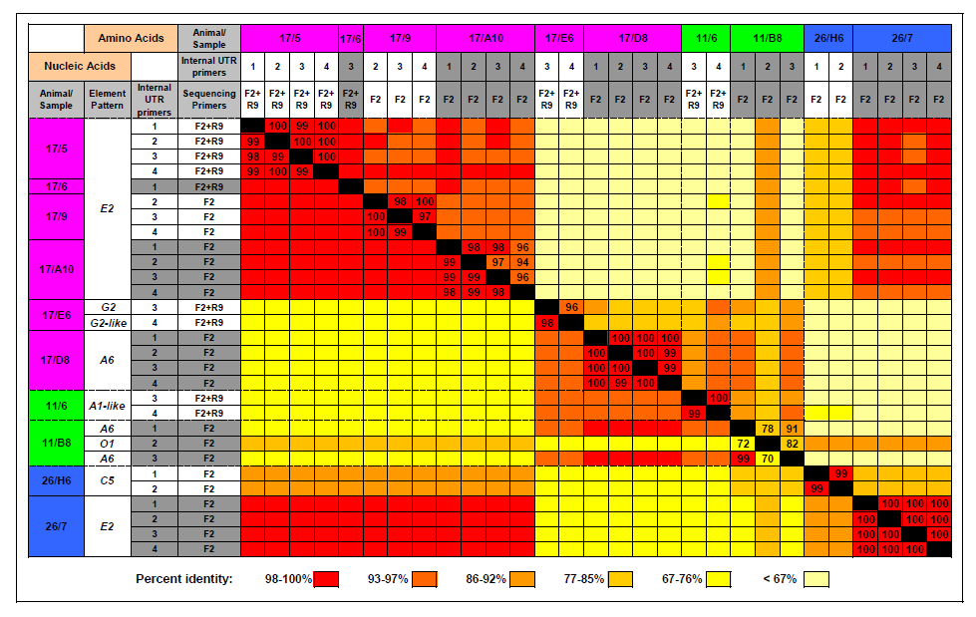
A single Sp185/333 mRNA sequence per cell; single phagocytes express a single Sp185/333 gene
Majeske, Oren, et al., 2014

Slide 16
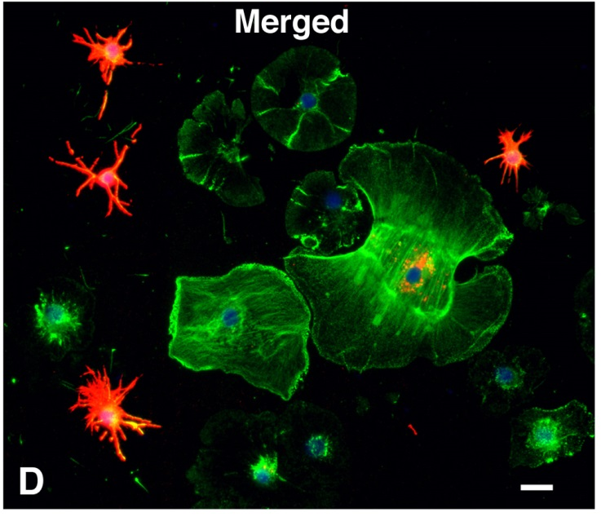
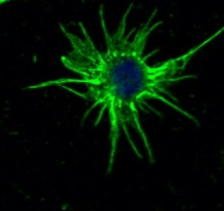
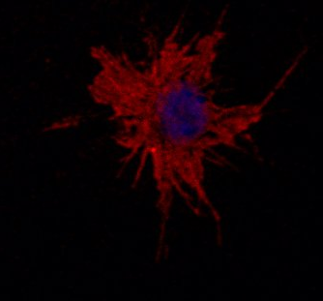
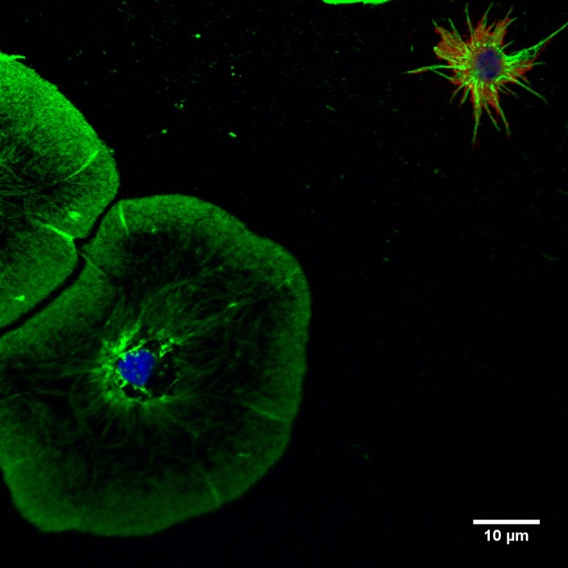
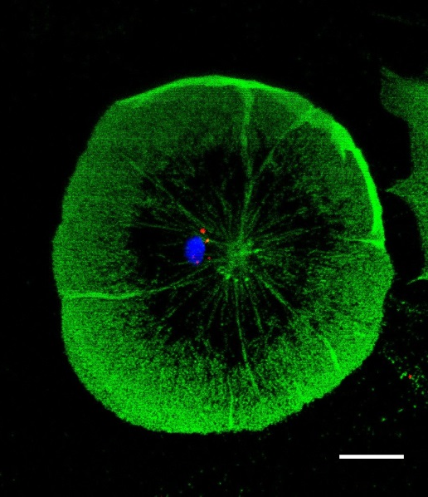
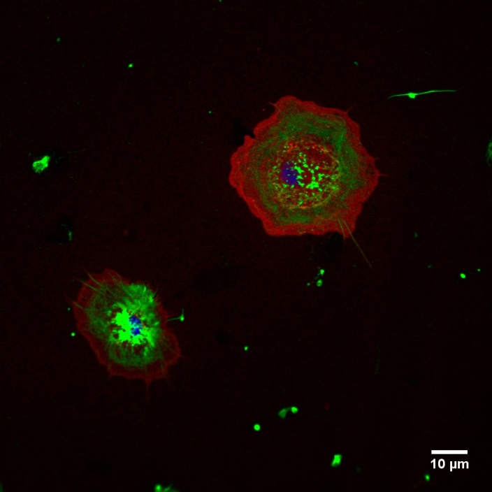
SpShapeshifter proteins are expressed by phagocytes
SpShapeshifter
Actin
DNA
Small
Discoidal
Small
Discoidal
Medium
Polygonal
transport vesicles
surface of small phagocytes
Brockton et al., 2008
Majeske, Oren, et al., 2014
Golconda & Smith, unpub

Slide 17
SpShapeshifter protein structure
N
C
L
Gly-rich
His-rich
RGD
100 aa
leader
glycine-rich region
RGD motif within the glycine-rich region
histidine-rich region
no amino acid sequence predictions for membrane association
no cysteines
Notes:
Predicted size range from 4-54kD
Proteins on gels are almost all above 60 kD
unknown mechanism of aggregation
Broad array of spots on 2D Westerns

Slide 18
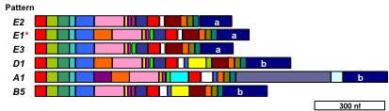
Diversity of the SpShapeshifter proteins
100 aa
Diversity within and among animals
mosaic of element patterns
broad size range
sequence variations within elements among proteins
mRNA editing
missense sequence
truncated proteins
putative post translational processing

Slide 19
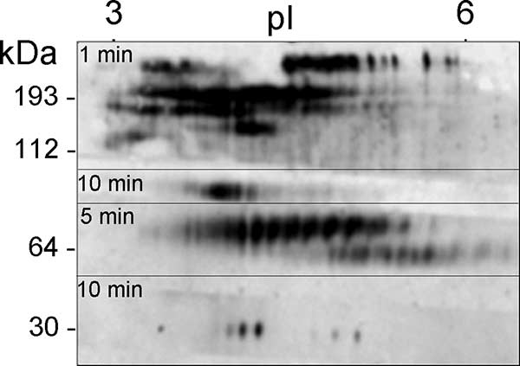
SpShapeshifter protein diversity in one animal
>260 SpShapeshifter spots
multimerization
Dheilly et al., 2009
Notes:
2D Western
Describe minutes shown on gel = exposure time

Slide 20
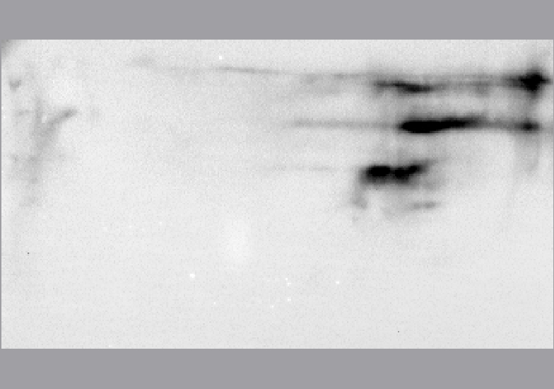
Native SpShapeshifter proteins can be isolated by nickel affinity based on the His-rich region
0
4
6
8
10
12
14
16
18
20
22
pI
3
10
Bacillus subtilis
250
150
100
80
60
50
40
30
25
Sherman, Schrankel, Brown, Smith, submitted
Notes:
Peter wondered whether other versions of the Sp185/333 proteins had antimicrobial activities
Ni affinity isolation first used successfully by Cat Schrankel
Evaluate native Sp185/333 proteins isolated by Nickel affinity
Mixture of native 185 proteins. Many versions.

Slide 21
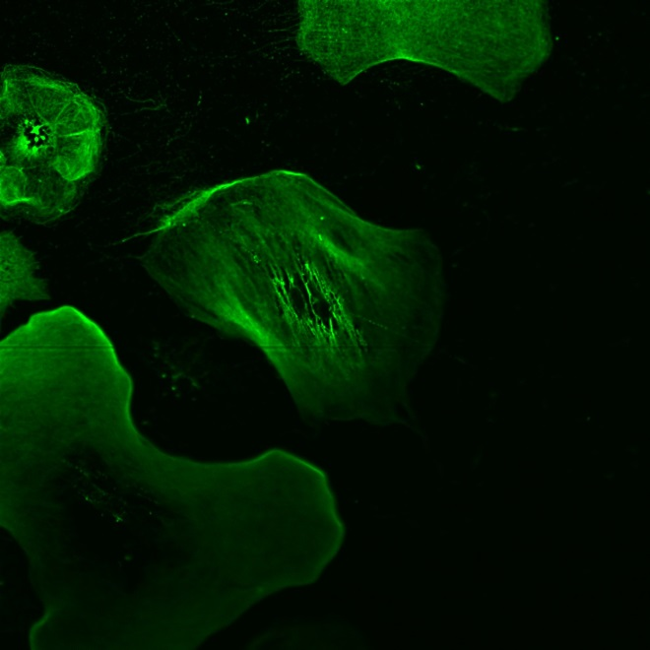
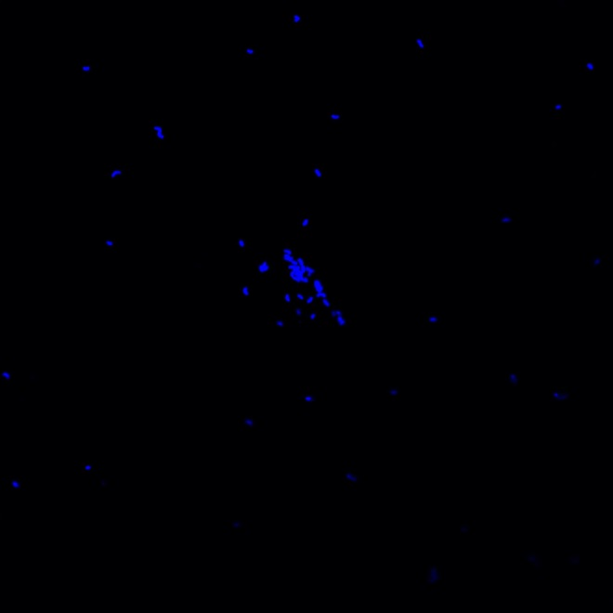
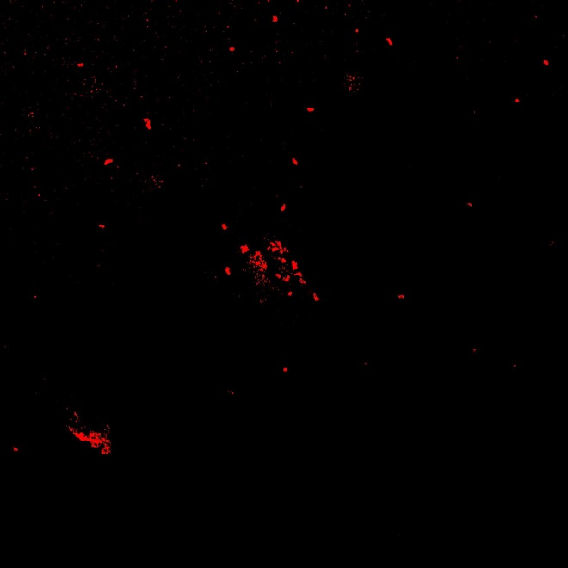
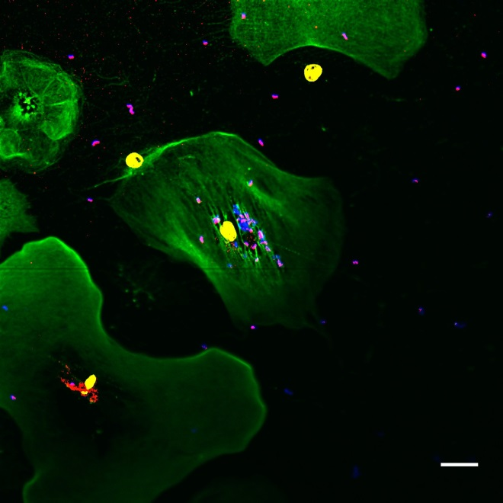
SpShapeshifters are secreted and opsonize bacteria
Sp185/333
Vibrio
Actin
Vibrio
actin
merge
SpShapeshifter
Merge
DNA
Chou & Smith, unpub
Notes:
Never found 185 proteins free in the CF.
EM results showing that they are associated with vesicle and plasma membrane
Peter questioned the results for opsonization and antimicrobial activity
if the proteins weren’t secreted, how did this work?
Inside vs outside
clusters, Z stacks.

Slide 22
SpShapeshifter
Vibrio
Actin
DNA
Chou & Smith, unpub
Notes:
Opsonized and non-opsonized Vibrio in phagosomes
185+ vesicles
24 hr

Slide 23
SpShapeshifter proteins opsonize Vibrio and induce phagocytosis
ns
**
**
**
Mean Vibrio per phagocyte
cell-free coelomic fluid
aCF
cell-free coelomic fluid
aCF (buffer)
cNi-SpShapeshifter
cNi-SpShapeshifter
Chou & Smith, unpub
Notes:
70 min expt

Slide 24
One recombinant SpShapeshifter protein can be expressed in E. coli
100 aa
rSp0032 (= rSpTransformer)
E1 element pattern
Could be expressed in bacteria
Not as lethal as other versions
Lun, Schrankel, Chou, Sacchi, Smith, unpub

Slide 25
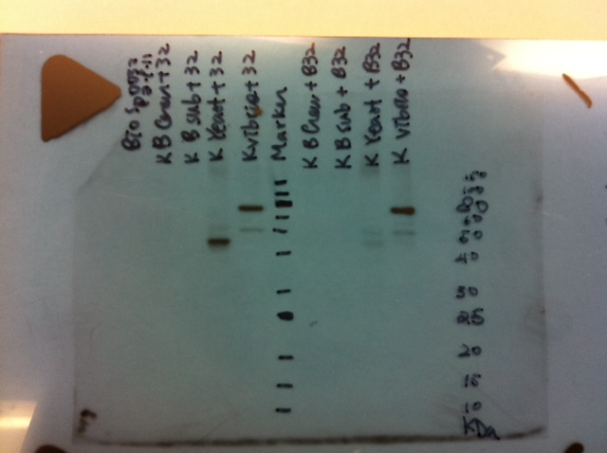
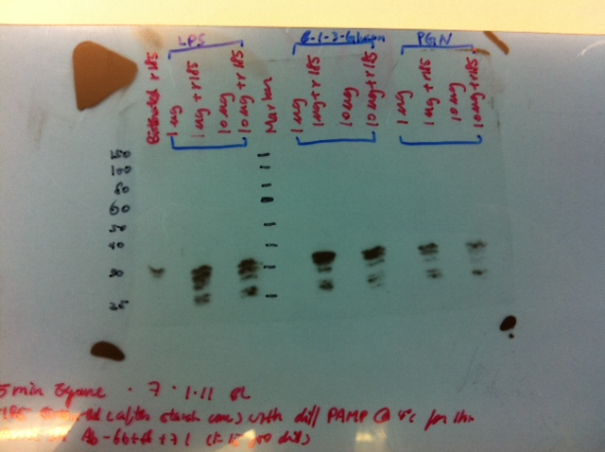
rSpTransformer binds to Vibrio and yeast but not Bacillus
V. diazotrophicus
V. diazotrophicus
rSpTransformer
B. subtillus
B. subtillus
B. cereus
B. cereus
Yeast
Yeast
-
-
-
-
+
+
+
+
+
rSpTrf
80kDa
50kDa
40kDa
Bacillus cereus (Marine Gm positive)
B. subtillus (Soil Gm positive)
Vibrio diazotrophicus (Marine Gm negative)
Baker’s yeast
Lun, Schrankel, Chou, Sacchi, Smith, unpub
Notes:
Recombinant is ~35kD
Binds to Vibrio and yeast
Doesn’t bind to Bacillus spp.

Slide 26
rSpTransformer binds specifically and with high affinity
Competition
Displacement
Vibrio
rSpTrf μM
rSpTrf μM
yeast
rSpTrf μM
rSpTrf μM
Lun, Schrankel, Chou, Sacchi, Smith, unpub
Notes:
Specific binding to Vibrio and Yeast
Very high affinity; displacement fails

Slide 27
rSpTransformer does not augment phagocytosis of opsonized Vibrio
Mean Percentage of coelomocytes with phagocytosed Vibrio
ns
**
40
35
30
25
20
15
10
5
0
**
**
**
ns
ns
Mean Vibrio per phagocyte
cfCF
aCF
cfCF
aCF
rSpTransformer
rSpTransformer
cNi-SpShapeshifter
Chou, Smith, unpub
Notes:
70 min expt

Slide 28
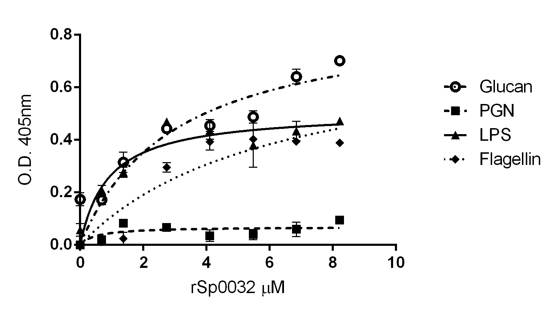
rSpTransformer binds to LPS, β,1-3,glucan and flagellin, but not PGN
K_{d}
3 μM
---
0.9 μM
6 μM
rSpTransformer (μM)
Lun, Schrankel, Chou, Sacchi, Smith, unpub
Notes:
Elisa with PAMP bound to the well
Recombinant binds to Glucan, LPS, flagellin, not peptidoglycan
LPS and PGN from E. coli
flagellin from Salmonella
Predicted intrinsic disorder suggests flexible folding/binding to very different targets
Perhaps target contact induces folding and binding

Slide 29
LPS, flagellin and β,1-3,glucan compete for rSpTransformer binding
rSpTransformer
+
LPS Glu Flg PGN
LPS
LPS
LPS
LPS
LPS
Lun, Schrankel, Chou, Sacchi, Smith, unpub
Notes:
Flagellin from Salmonella typhimurium

Slide 30
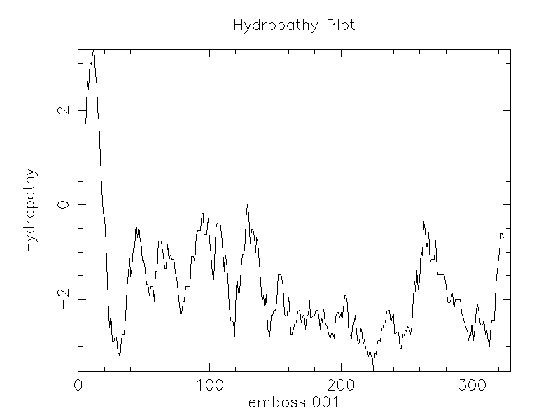
rSpTransformer is predicted to be hydrophilic and intrinsically disordered
Hydrophobic
Hydropathy
Hydrophilic
rSpTransformer
L
Glycine Rich region
Histidine Rich region
RGD
Disorder consensus
(7 predictors used)
Disordered
Ordered
rSpTransformer amino acid
Lun, Bishop, Smith, unpub
Notes:
Bioinformatic analyses of the rSp0032 (recombinant protein) indicate that it is generally unfolded and intrinsically disordered, The lack of stable structure may form highly flexible conformational ensemble and may possibly enable the protein to adopt structure when bound to interacting target (?)

Slide 31
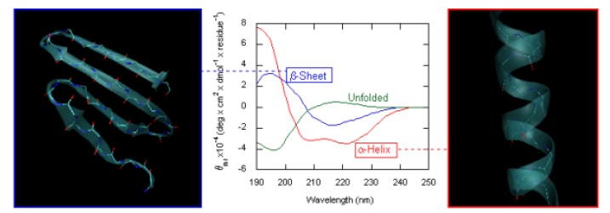
Secondary structure of proteins by
Circular Dichroism

Slide 32
rSpTransformer structure is disordered
2E+08
Lun, Bishop, Smith, unpub

Slide 33
rSpTransformer plus LPS;
transforms from disordered to α helical
5E+8
no LPS
1 μg LPS
2 μg LPS
4 μg LPS
8 μg LPS
10 μg LPS
Lun, Bishop, Smith, unpub

Slide 34
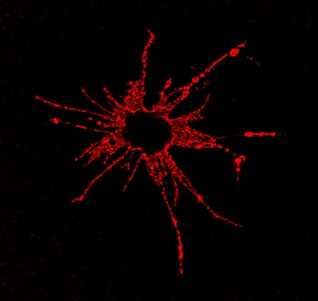
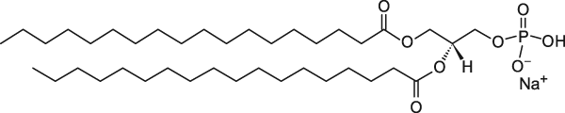
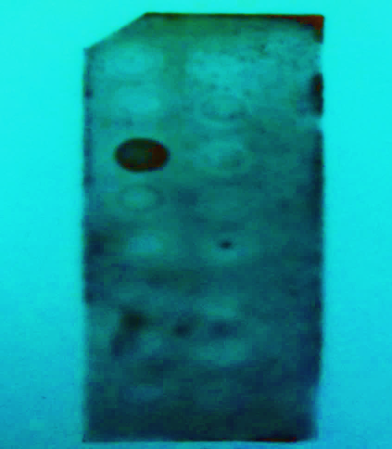
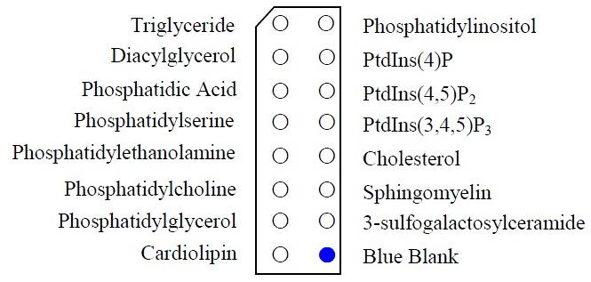
rSpTransformer binds to a lipid
Phosphatidic acid
SpShapeshifter proteins on small phagocytes
Small phagocyte; SpShapeshifter proteins are on the membrane
from Brockton et al., 2008
Phosphatidic acid (PA)
rSpTransformer binds to liposomes that are 10% PA based on FRET
Lun, Samuel, Boyd, Bishop, Gillmor, Smith, unpub
Notes:
John found that the small phagocytes have 185 on the surface
Deduced protein sequences indicate that there is no TM, GPI linkage
Bonnie did a lipid strip analysis; recombinant binds to PA
Anthony confirmed with by FRET
liposomes with PA and DiI
recombinant labeled with FITC

Slide 35
rSpTransformer binds to liposomes with 10% PA; transforms from disordered to α helical
CD [mdeg]
Liposomes, 10% PA, α helical
No liposomes, disordered
wavelength (nm)
Lun, Samuel, Boyd, Bishop, Gillmor, Smith, unpub

Slide 36
rSpTransformer alters liposome shape
Invagination
00:18:00 sec
00:18:30 sec
00:19:00 sec
00:19:30 sec
Budding
00:24:30 sec
00:25:00 sec
00:25:30 sec
00:26:00 sec
PA clusters may induce membrane curvature
Lun, Samuel, Boyd, Bishop, Gillmor, Smith, unpub

Slide 37


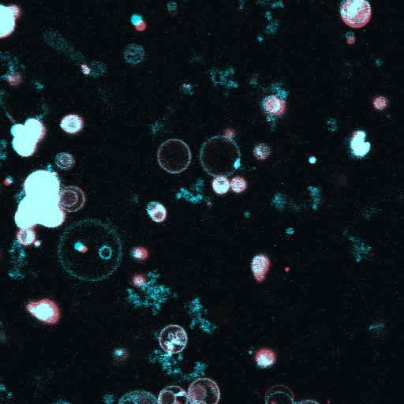
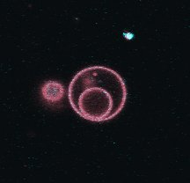

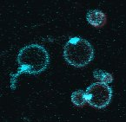
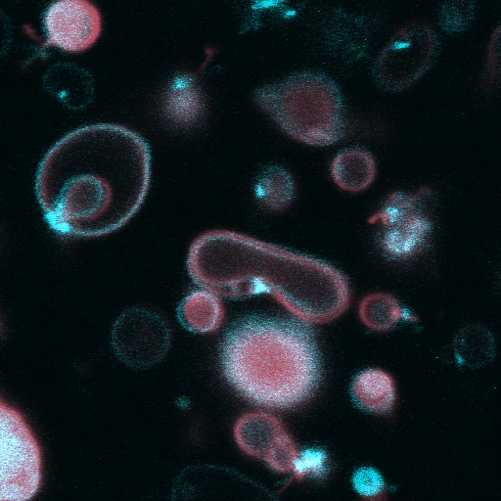



PA clusters in liposomes
in the presence of rSpTransformer
10 μM rSpTransformer (30 min)
PA Dye I
No rSpTransformer
Lun, Samuel, Boyd, Bishop, Gillmor, Smith, unpub

Slide 38
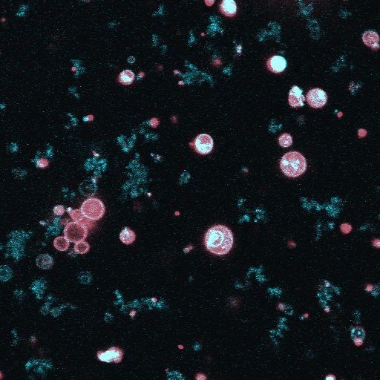
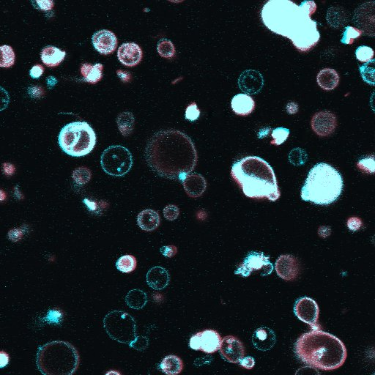
PA is extracted from liposomes in the presence of rSpTransformer
10 μM rSpTransformer (2 hrs)
PA Dye I
No rSpTransformer
Lun, Samuel, Boyd, Bishop, Gillmor, Smith, unpub

Slide 39
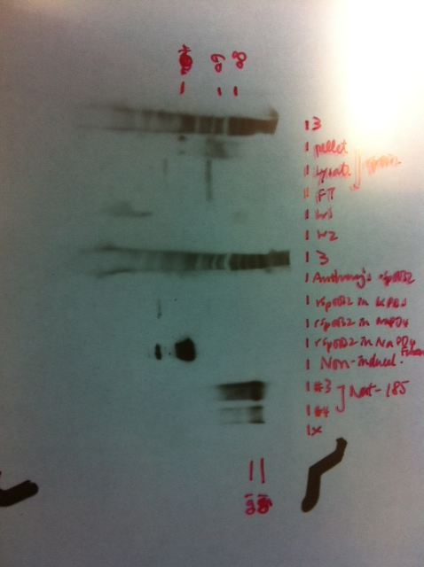
rSpTransformer induces liposome leakage
rSpTrf
Non-induced
Monomers
Dimers
100kDa
80kDa
60kDa
40kDa
Fractional Fluorescence
Time (seconds)
Dye
Liposome
10% PA
released from
Dye plus Quencher
rSpTransformer
Quencher
Lun, Samuel, Boyd, Bishop, Gillmor, Smith, unpub
Notes:
Non-induced bacteria = no protein from protein isolation protocol. Talk about western blot data first, then the leakage assay.

Slide 40
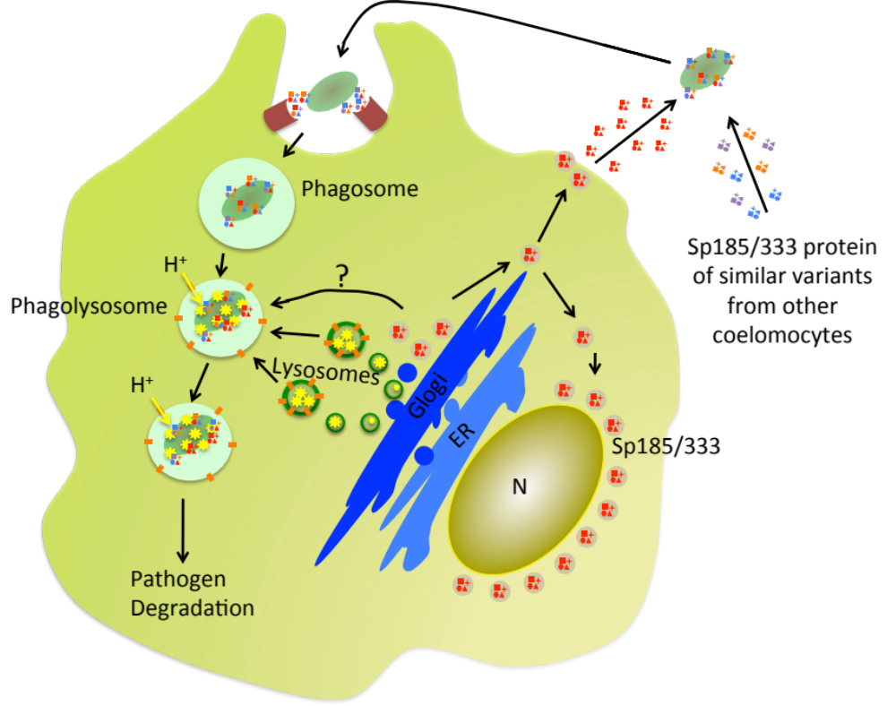
Summary: SpShapeshifter Diversity
Synergistic activity; opsonize pathogens, shift conformation, multimerize
Augmented phagocytosis
Membrane associated
Each SpShapeshifter protein may be multifunctional
SpShapeshifter proteins secreted from many phagocytes
  The sea urchin immune system is complex and flexible
SpShapeshifter proteins in perinuclear vesicles
Multiple levels of sequence diversification in the Sp185/333 system
SpShapeshifter protein variations from mRNA editing
Single Sp185/333 gene expressed per cell
Sequence diversity of the Sp185/333 gene family; recombination, duplication, deletion, etc
from Chou & Smith, unpub

Slide 41
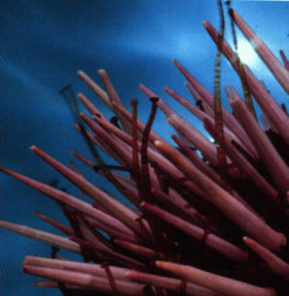

Acknowledgements
George Washington University
Biology
  David Terwilliger
  Katherine Buckley
  Chase Miller
  Catherine Schrankel
  Virginia Brockton
  Bonnie Lun
  Peter Chou
  Anthony Boyd
  Sandro Sacchi
  Audrey Majeske
  Matan Oren
  Megan Barela Hudgell
  Chemistry
  Robyn Samuel
  Susan Gillmor
  George Mason University
  Barney Bishop
Dickinson College
  John Henson
Chinese Academy of Sciences
  Limei Qiu
Sea Urchin Immunology is funded by the US National Science Foundation
http://biology.columbian.gwu.edu/l-courtney-smith

Slide 43
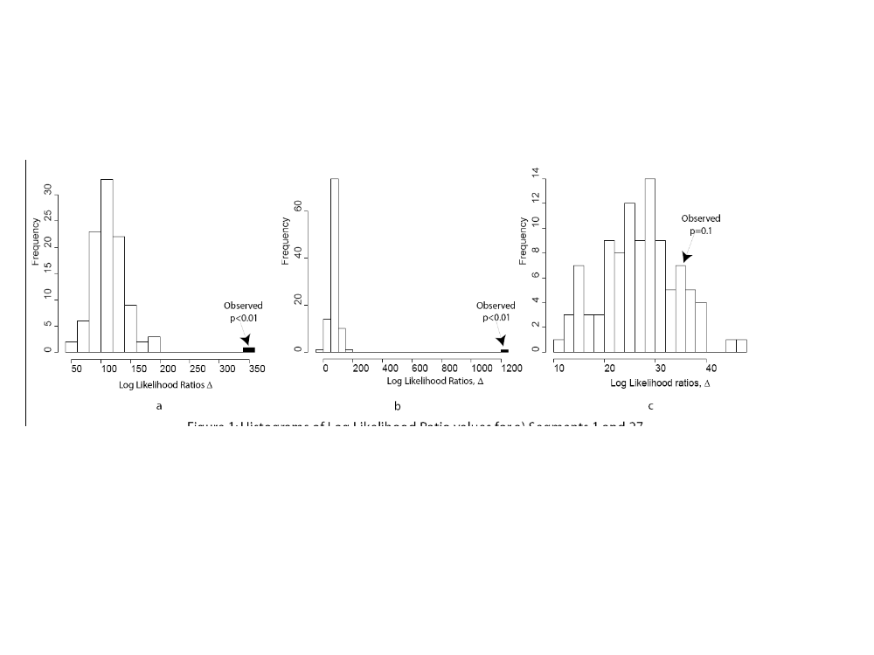
Gene recombination among elements
Sp185/333
Elements 1, 27
TCR
V and J segments
SpH3 histone
14
16
20
22
24
L
Int.
1
2
3
4
5
6
7
8
9
10
11
12
13
15
17
18
19
21
23
25
26
27
Elements
A1γ
γ
a
Incongruence (phylogenetic tree) length difference
+
>>
+
=
n
n
n
n
n
n
Buckley et al., 2008a
Notes:
ILD, incongruence length difference
IP, Incongruence permutation
Buckley et al., 2008 JMB, figure 6, page 922
Align two elements from all genes, run phylogenetic tree, get tree length
Concatenate the two regions from all genes, align, run phylogenetic tree, get tree length
Compare tree lengths
If the length of the concatenated tree is significantly less than the sum of trees for individual sequences, then the sequences have incongruent history (different evolutionary histories)
infers recombination of the gene between the elements that were tested
Compared to randomized sequences, which destroys the recombination signal,
are shown as the histograms.
185 and TcR recombine; results are outside the control results
Histones do not recombine; results are not outside controls
Segway: what drives this recombination in the 185 genes
sequence shared among the genes
repeats within the genes

Slide 44
Recombination may occur at any point within the gene
 | L | Int a | Int b | 1 | 6 | 6a | 6b | 26 | 27 | 27a | 27b | H3.1 | H3.2 | TcRV | TcRJ
L |  | *** | *** | ** | ** | · | · | *** | *** | · | · | · | · | · | ·
Int a | ** |  | *** | ** | *** | · | · | *** | *** | · | · | · | · | · | ·
Int b | ** | ** |  | ns | *** | · | · | *** | *** | · | · | · | · | · | ·
1 | ** | ** | * |  | *** | · | · | *** | *** | · | · | · | · | · | ·
6 | * | ** | ** | ** |  | · | · | *** | *** | · | · | · | · | · | ·
6a | · | · | · | · | · |  | * | · | · | · | · | · | · | · | ·
6b | · | · | · | · | · | * |  | · | · | · | · | · | · | · | ·
26 | ** | ** | ** | ** | ** | · | · |  | *** | · | · | · | · | · | ·
27 | ** | ** | ** | ** | ** | · | · | * |  | · | · | · | · | · | ·
27a | · | · | · | · | · | · | · | · | · |  | * | · | · | · | ·
27b | · | · | · | · | · | · | · | · | · | ** |  | · | · | · | ·
H3.1 | · | · | · | · | · | · | · | · | · | · | · |  | ns | · | ·
H3.2 | · | · | · | · | · | · | · | · | · | · | · | ns |  | · | ·
TcRV | · | · | · | · | · | · | · | · | · | · | · | · | · |  | ***
TcRJ | · | · | · | · | · | · | · | · | · | · | · | · | · | **
· = not done
a = 5’ end
b = 3’ end
Buckley et al., 2008a
Notes:
ILD analysis among many of the elements
ILD within elements
Recombination is not restricted to edges of elements
elements are artificially defined by alignment
Histone negative control
TcR positive control

Slide 45
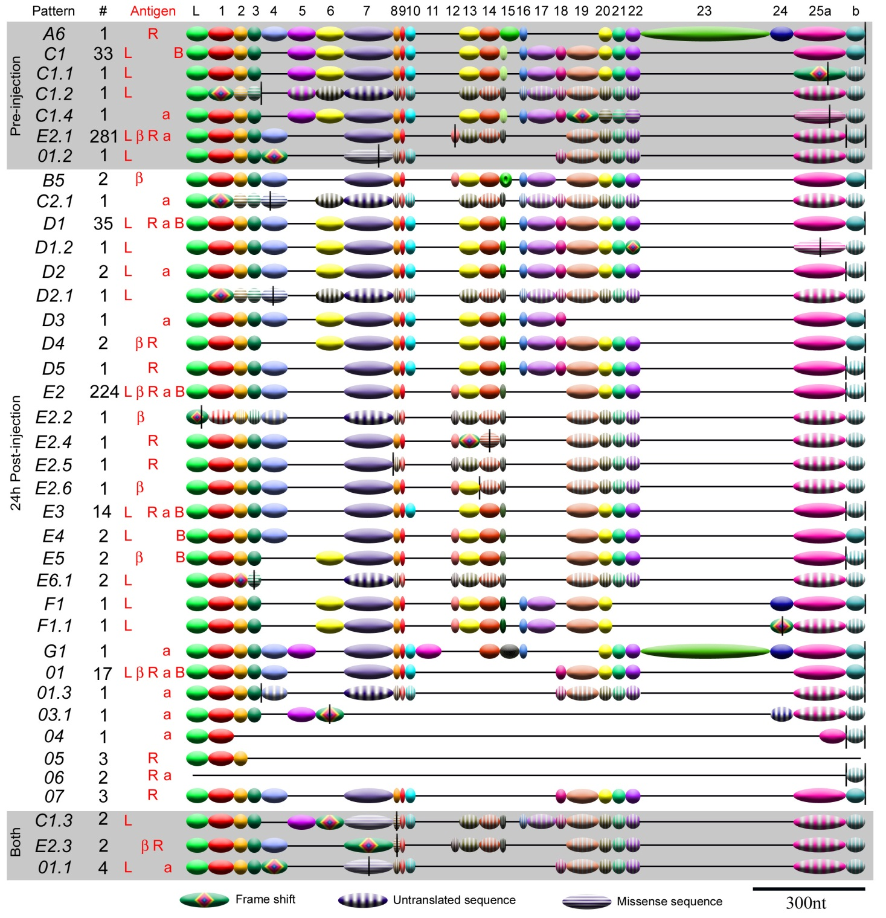
Sp185/333 cDNAs have SNPs and Indels
SNP, early stop codon
Indel, frameshift
Terwilliger et al., 2007
Notes:
Illustration of low fidelity of the mRNAs
SNPs generating stops
Indels generating frameshifts resulting in missense and/or stops
Not introduced by PCR and sequencing; used the same methods to clone and sequence the genes.
Example of E2.1 and E2 before and after challenge
Best explanation is RNA editing

Slide 46
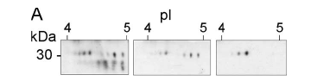
Edited mRNAs express truncated SpShapeshifter proteins
Gly-rich
region
RGD
region
C terminal
region
Antibody against:
N
C
L
Gly-rich
His-rich
RGD
100 aa
Dheilly et al., 2009
Notes:
Fewer spots with sequence at the C terminus indicates truncation
Missense sequence identified by proteomic analysis

Slide 47
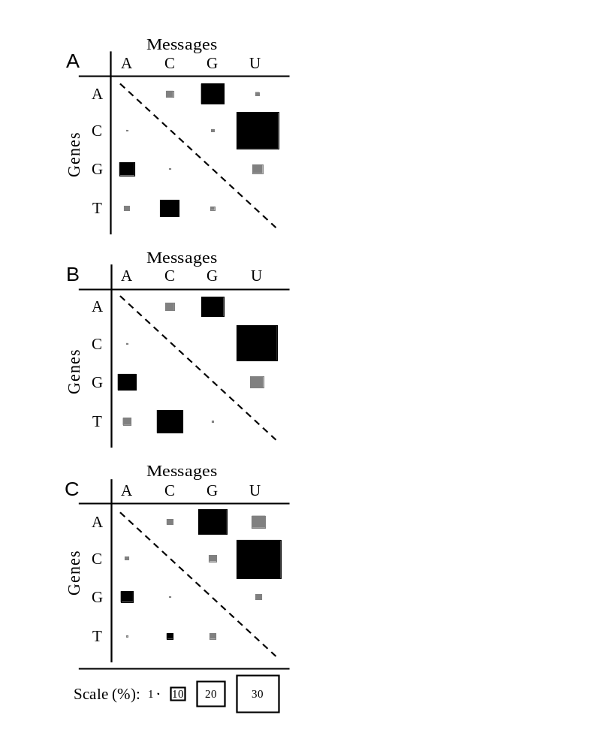
C to U substitutions in the Sp185/333 cDNAs compared to the genes
– Looks like RNA editing
Transitions >> transversions
Most of the substitutions are C to U
Several cytidine deaminase gene models
TdT/Polμ gene model
Buckley et al., 2008b
Notes:
Lots of changes from gene to message – lots of editing?
Typical of cytidine deaminase activity
None of the cytidine deaminase gene models cluster with activation inducible deaminase that modifies Ig genes
Could be a combination of enzymes, cyt deaminase plus Pol μu = low fidelity polymerase

Slide 48
Edited Sp185/333 mRNAs
SNPs, indels, missense sequence, early stop codons in half of the mRNAs
170 of 171 genes have perfect open reading frames
  Very few of the cDNAs match perfectly to a gene from the same sea urchin
Breaks the rule of transcription fidelity
Buckley et al., 2008b
Notes:
Missense mRNAs
Perfect open reading frames in the genes

Slide 49
Sp185/333 genes from three sea urchins
- 171 sequenced genes one pseudogene
- no shared full length sequence
- some shared element sequences
82
64
21
10
46
68
17
66
38
30
Elements
Full Sequences
Buckley et al., 2008a

Slide 50
rSpTransformer in SDS
5E+08
Secondary structure prediction:
disordered to mostly α helical
Bonnie Lun
Notes:
Excel file “082914_1mm_081014rSp0032_100ul_SDS_updated091514.xlsb” under “Lun_Chapter2”

Slide 51
rSp0032 in trifluoroethanol
1.5E+08
1E+08
5E+07
-5E+07
Secondary structure prediction:
Disordered, weak α helical
Bonnie Lun
Notes:
Excel file “090214_081014rSp0032100ul_DiffConcTFE” under “Lun_Ch2”
Used 0.25uM in volume of 300ul
TFE induces alpha helical structures in proteins

Slide 52
rSpTransformer; full length and fragments
Full length; 32 kD
N
C
L
Gly-rich
His-rich
Gly-rich fragment
His-rich fragment
AHAQRDYNELRGNKNGRERGQGRFGGRPGGMQMGGSRQDGGPMGGRRFDGPDSGAPQMDGRRQDGGPMGGRRFDGPGFGAPEMDGRRQNGGPMGGRRFDGPGFGGSRPDGAGGR….
10 kD
RGD
….RRHHGHRQGHPQDQAEEQPFGQRNESSEEDGRPHPHHHRHHGHHHRHHNQTEGHQGHNETGDQDQDKLHDTRPFRYNHFGRKPFGDRPFGRRNHTEGHQGHNETGDHPHRHHNKT….
20 kD

Slide 53
rSpTranformer shifts secondary structure
Treatment | Full length | Gly-rich fragment | His-rich fragment
---- | Disordered | Mostly α helical | Mostly α helical
SDS | α helical | Enhanced α helical | Enhanced α helical
TFE | weak α helical | β strand | β strand
LPS | α helical | β strand | α helical
PA:PC liposomes | α helical
PA micelles | α helical
PC micelles | disordered
4-44ºC | No change | No change | No change

Slide 54
rSpTransformer fragment binding to LPS
glycine-rich fragment
histidine-rich fragment
Secondary structure prediction:
α helical to β strand
Secondary structure prediction:
Enhanced (mostly) α helical
Bonnie Lun

Slide 55
glycine-rich fragment
rSpTransformer fragments plus SDS
histidine-rich fragment
Secondary structure prediction:
Enhanced α helical
Secondary structure prediction:
Enhanced α helical
Bonnie Lun
Notes:
Excel file is “091814_Gly#1_allfiles_updated101414.xlsx” in folder “Sept2014_Gly#1_studies”
Used
Used 9.07 uM in SDS exp. Total volume is 300ul.

Slide 56
rSpTransformer fragments in TFE
glycine-rich fragment
histidine-rich fragment
Secondary structure prediction:
α helical to β strand
Secondary structure prediction:
~α helical to β strand
Bonnie Lun

Slide 57
rSpTransformer retards the growth of E. coli
Vibrio diazotrophicus
Bacillus cereus
ns
*
0
4
6
8
10
12
14
16
18
20
22
0
4
6
8
10
12
14
16
18
20
22
Bacillus subtilis
Escherichia coli
Growth Rate (OD₆₀₀/hr)
ns
**
0
4
6
8
10
12
14
16
18
20
22
0
4
6
8
10
12
14
16
18
20
22
rSp0032 (μg/200 μl)
Peter Chou
Notes:
If the recombinant binds to Vibrio, does it affect growth
does it have anti-microbial activities?
Not impressive results

Slide 58
Native SpShapeshifter proteins variably retard
bacterial growth (sea urchin A)
Vibrio diazotrophicus
Bacillus cereus
**
ns
0
4
6
8
10
12
14
16
18
20
22
0
4
6
8
10
12
14
16
18
20
22
Growth Rate (OD₆₀₀/hr.)
Bacillus subtilis
Escherichia coli
*
*
0
4
6
8
10
12
14
16
18
20
22
0
4
6
8
10
12
14
16
18
20
22
cNi-Sp185/333 (μg/200 μl)
Peter Chou
Notes:
Peter wondered whether other versions of the Sp185/333 proteins had antimicrobial activities
Ni affinity isolation first used successfully by Cat Schrankel
Evaluate native Sp185/333 proteins isolated by Nickel affinity
Mixture of native 185 proteins. Many versions.
58

Slide 59
Native SpShapeshifter proteins variably retard
bacterial growth (sea urchin C)
Vibrio diazotrophicus
Bacillus cereus
**
**
0
4
6
8
10
12
14
16
18
20
22
0
4
6
8
10
12
14
16
18
20
22
Growth Rate (OD₆₀₀/hr.)
Escherichia coli
Bacillus subtilis
*
**
0
4
6
8
10
12
14
16
18
20
22
0
4
6
8
10
12
14
16
18
20
22
cNi-Sp185/333 (μg/200 μl)
Peter Chou

Slide 60
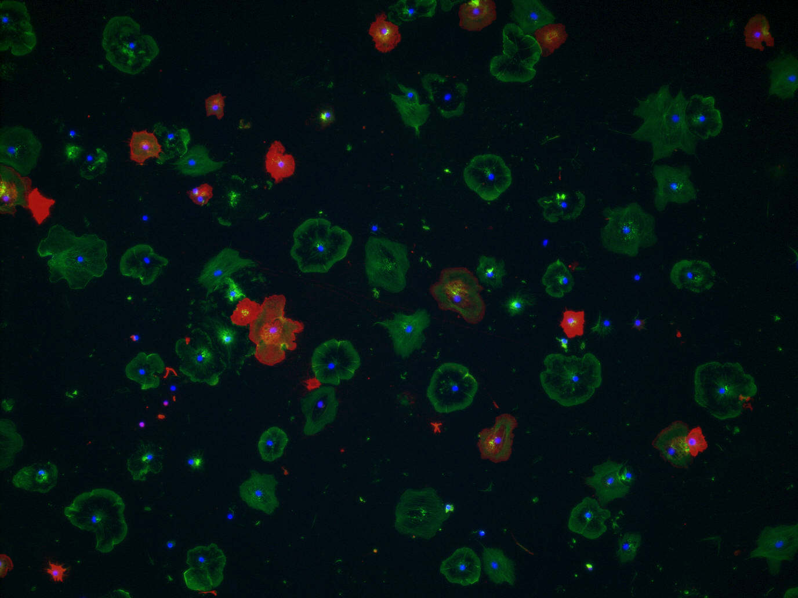
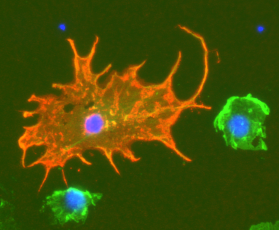
SpShapeshifter proteins in phagocytes
Sp185/333
Actin
DNA
John Henson
Preethi Golconda

Slide 61
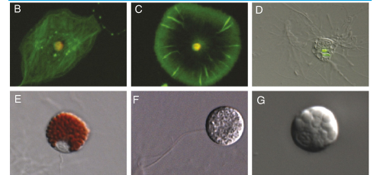
Coelomocytes
What genes do coelomocytes express?
Polygonal Phagocyte Discoidal Phagocyte phagocytosis
Small Phagocytes
Gross et al., 2000
Brockton et al., 2008
Red Spherule Cell Vibratile Cell Colorless Spherule Cell
Hibino et al., 2006
Notes:
Coelomocytes
Types of coelomocytes including the small phagocytes
Immune functions mediated by coelomocytes
what genes run in coelomocytes?

Slide 62
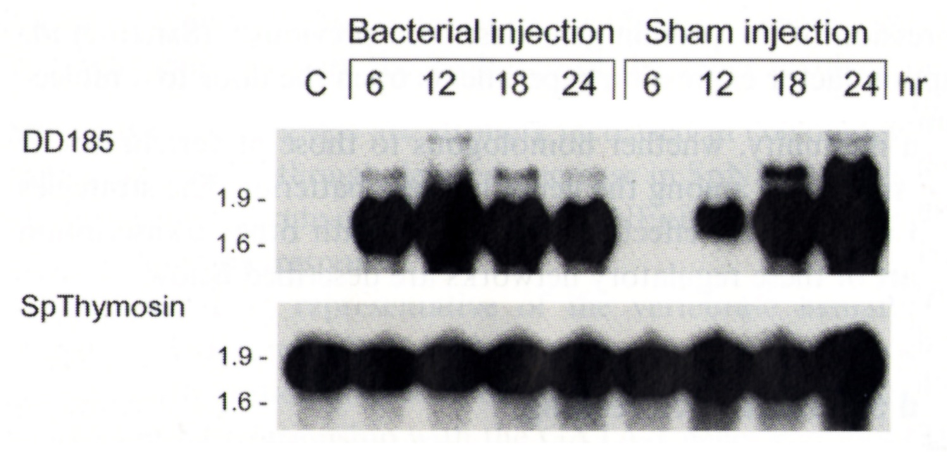
Immune challenge induces Sp185/333 expression by coelomocytes
Rast et al., 1999
Notes:
First caught our attention because of striking upregulation of the genes

Slide 63
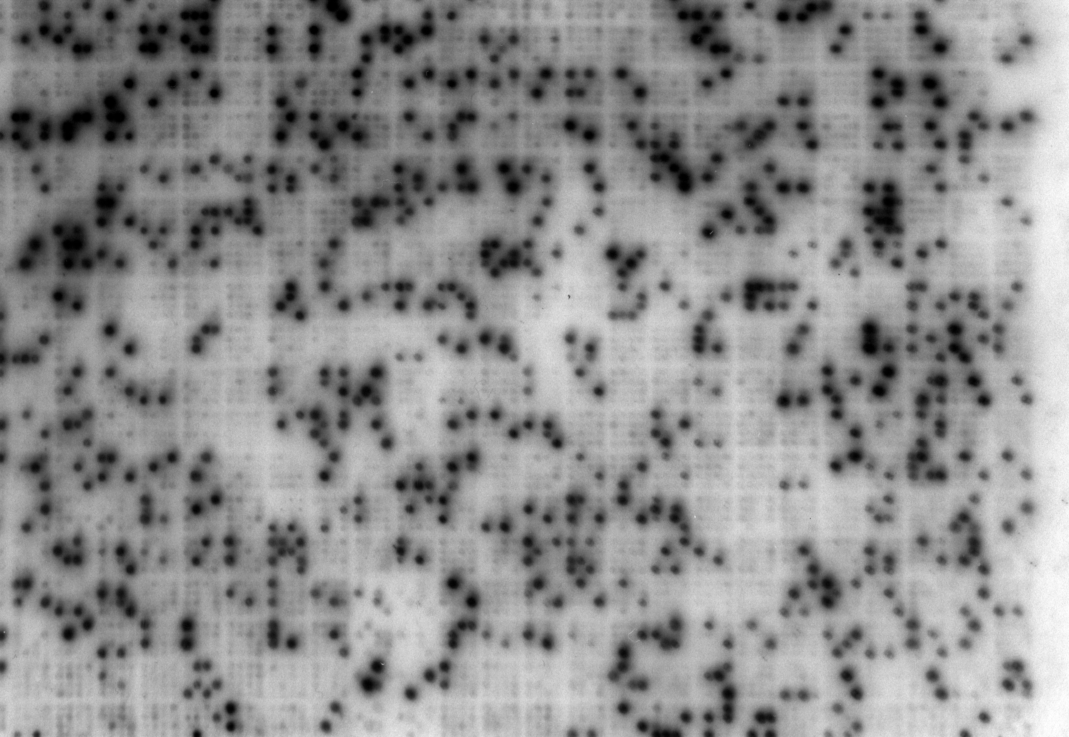
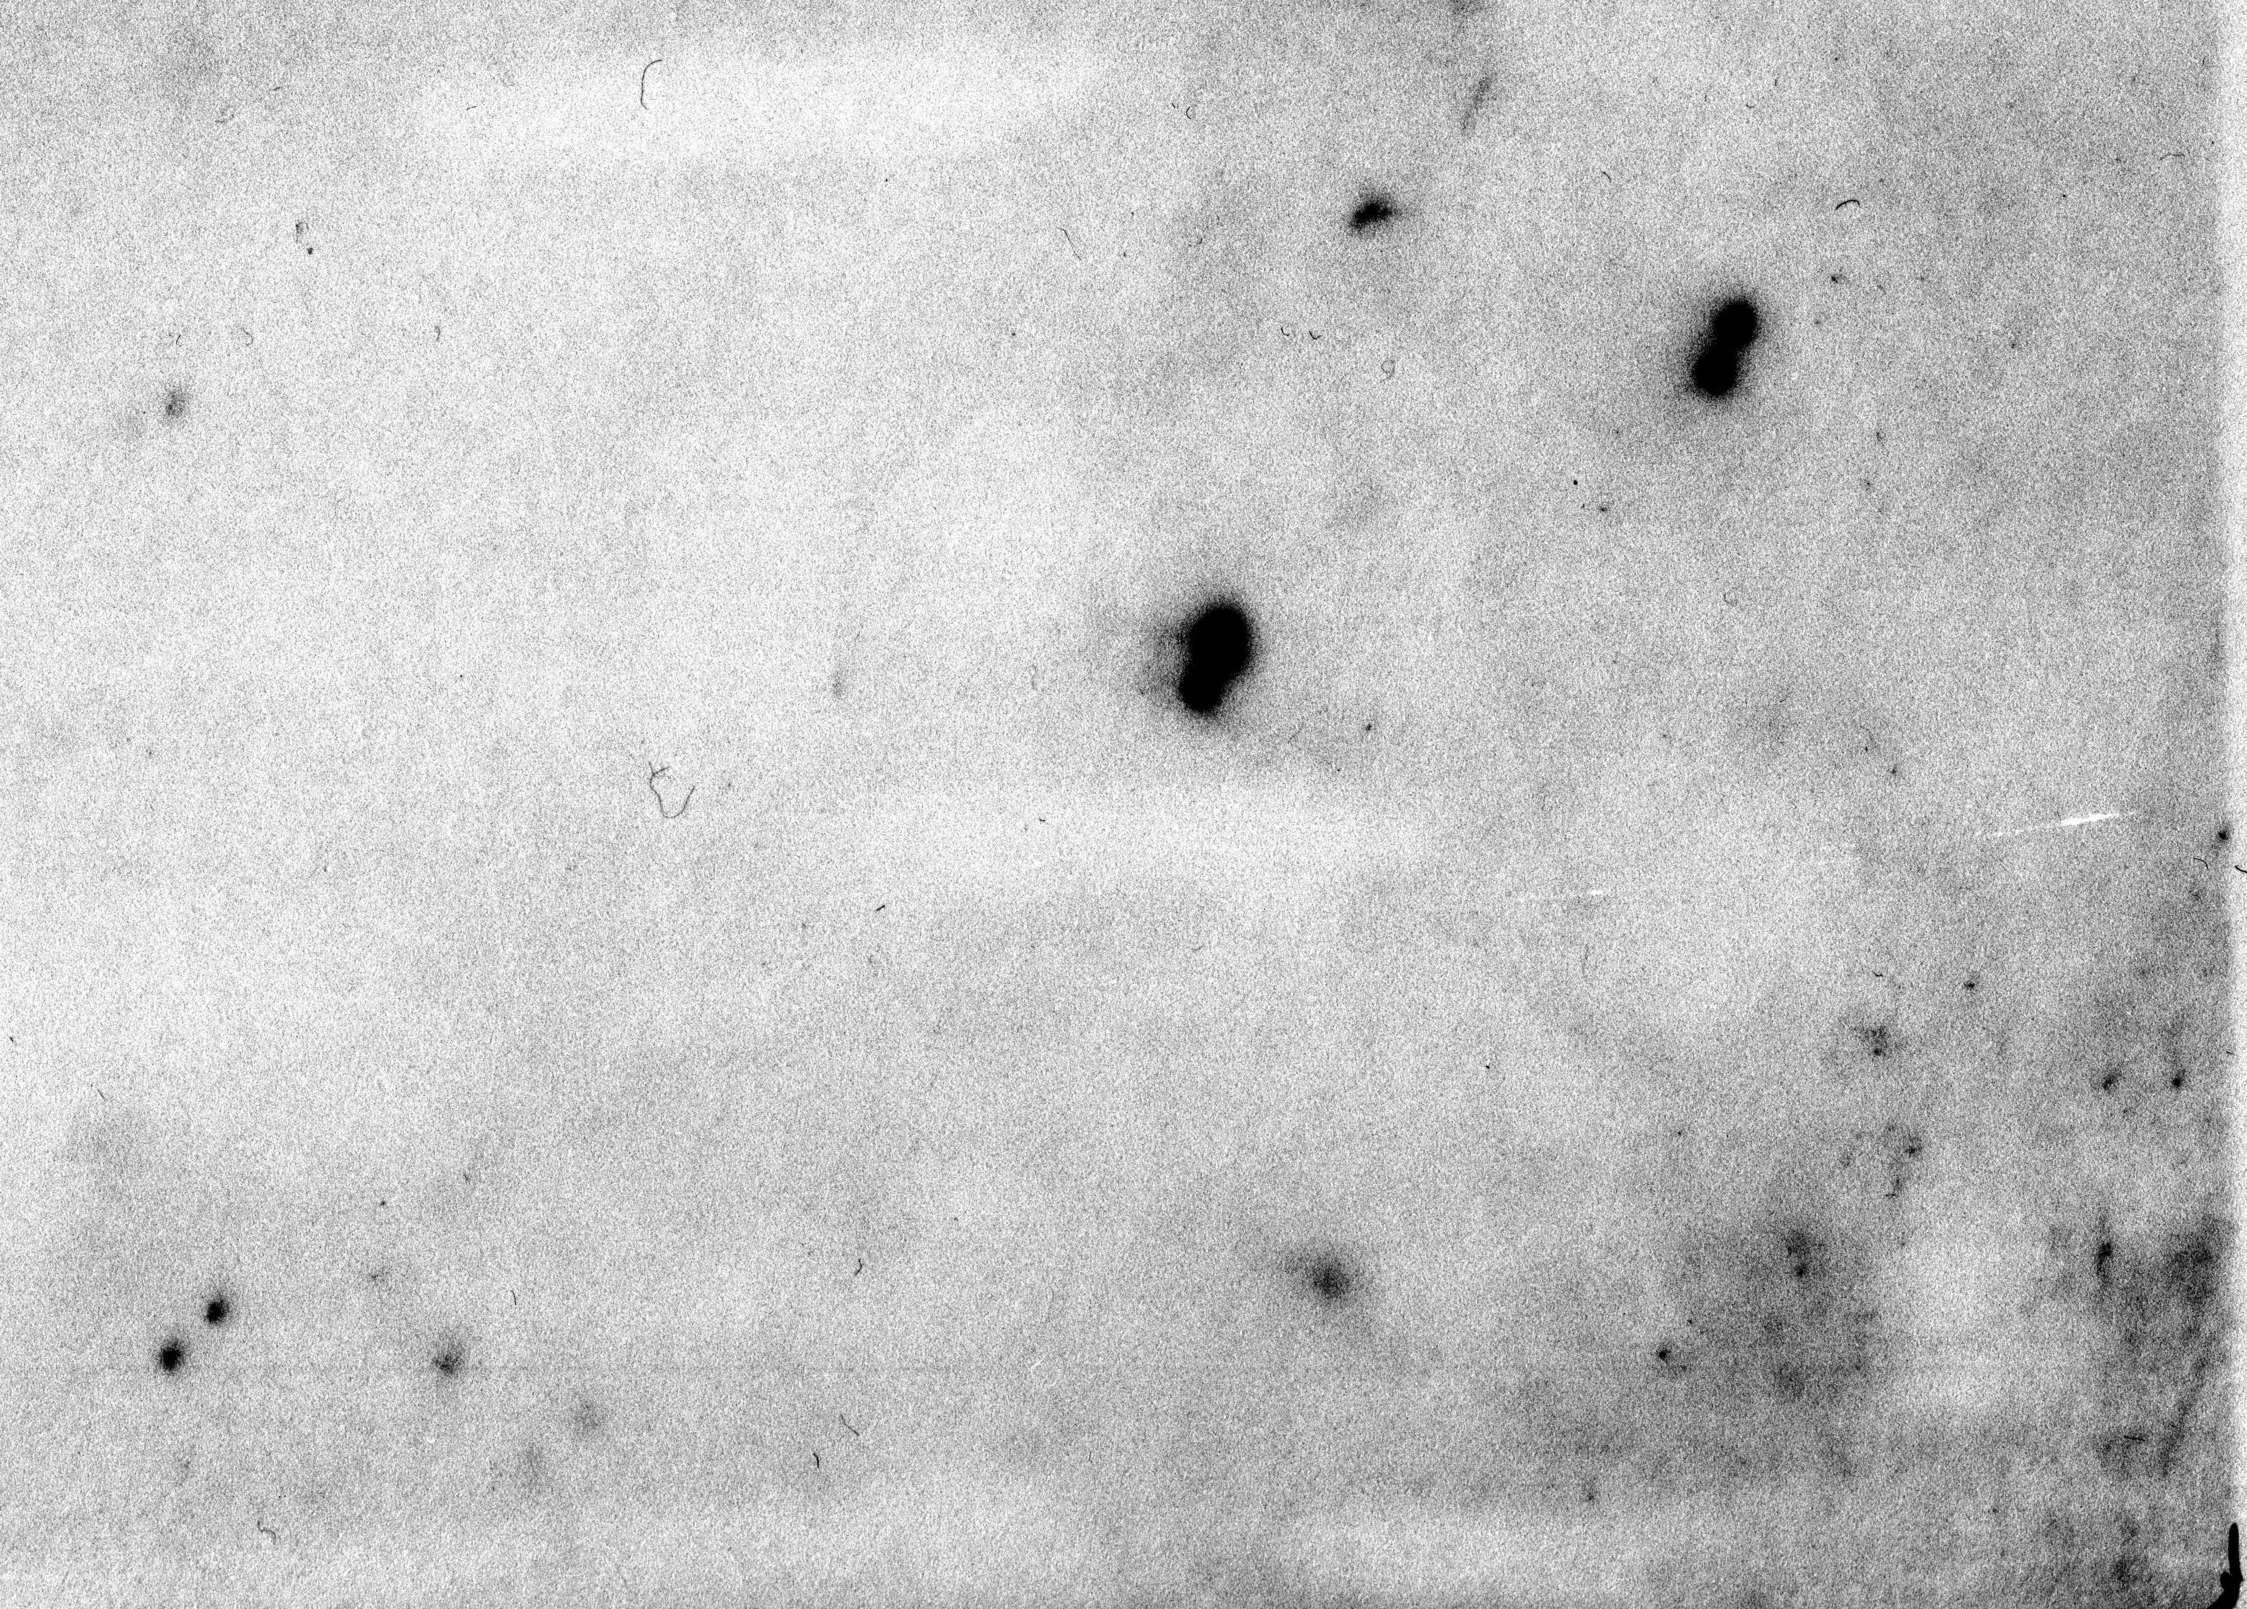
Sp185/333 gene expression is induced by LPS and bacterial challenge
~5,925 / 91,920 = 6.45%
79 / 91,920 = 0.086%
Arrayed cDNA library from coelomocytes activated by bacterial challenge
Arrayed cDNA library from non-activated coelomocytes
Nair et al., 2005
Notes:
Screen of two arrayed cDNA libraries shows differential expression
bacterial challenge, vs non challenged
Differential display by Rast/Pancer
striking upregulation in response to bacterial challenge
in agreement with library screens
injury response is delayed

Slide 64
Elements are shared among genes
46
38 genes from animal 10
57
3
11
11
2
2
4
4
12
67
intron
37
9
11
3
3
3
8
5
2
7
13
1
1
1
1
2
2
19
20
3
3
61
21
1
1
1
2
14
19
1
2
1
2
2
2
20
2
2
2
1
1
9
19
10
1
11
2
17
1
1
5
5
10
4
1
10
16
1
1
1
17
1
1
1
1
1
1
11
6
3
16
17
6
6
19
7
6
3
2
2
3
2
3
12
6
34
3
4
3
2
2
3
1
2
2
4
4
6
6
7
30
4
17
3
3
13
6
18
39
8
35
9
9
13
4
5
5
3
1
2
1
5
3
6
3
13
9
5
6
7
9
5
9
23
2
1
4
6
4
2
17
14
29
11
1
10
10
18
8
22
7
25
4
7
3
5
13
8
19
6
7
7
8
4
41
14
18
21
10
25
1
5
1
1
6
8
5
10
2
12
14
12
12
3
1
7
15
1
9
9
5
5
20
28
7
Buckley et al., 2008a
Notes:
Vertical columns of circles represent all possible sequence variants for a specific element
leader, shades of brown are different regions of the intron, element 1, 2, 3, etc.
Lines indicate that two adjacent elements are found together in at least one of the 38 genes.
Illustration of four genes and how they share some elements and not others.
Leads to the question of how this happens. What drives fast gene recombination. Are other forces in play?
leads us to the next question…

Slide 65
**
**
**
ns
cfCF
aCF
cfCF
aCF
rSp0032
cNi-Sp185/333
Opsonins
Notes:
Fig. 5A (11A). Sp185/333 opsonization of Vibrio induces phagocytosis
70 min expt

Slide 66
Phagocytosis per individual phagocyte is increased
for Vibrio opsonized with cNi-SpShapeshifter proteins
ns
**
Mean Vibrio per phagocyte
cfCF
aCF
SpShapeshifter
Peter Chou
Notes:
70 min expt

Slide 67



SpShapeshifter proteins are expressed by phagocytes
SpShapeshifter
Actin
DNA
Small
Discoidal
Polygonal
Cell surface
Medium
Perinuclear vessicles
Peter Chou
Preethi Golconda

Slide 68

rSpTransformer binds to phosphatidic acid
FRET
Small phagocyte
Image by John Henson
Liposome; % Phospatidic Acid
Bonnie Lun
Liposomes labeled with DiI
Anthony Boyd
Notes:
John found that the small phagocytes have 185 on the surface
Deduced protein sequences indicate that there is no TM, GPI linkage
Bonnie did a lipid strip analysis; recombinant binds to PA
Anthony confirmed with by FRET
liposomes with PA and DiI
recombinant labeled with FITC

Slide 69
Multiple levels of sequence diversification in the
Sp185/333 system
Genes
multiple per genome, clustered
recombination, duplication, deletion
single gene expressed per phagocyte
mRNA
editing, amplifies protein sequence diversity
Proteins
Putative post translational modifications
secretion, opsonins, induce phagocytosis
disordered, shift to ordered upon binding to targets
synergistic function in complexes to target pathogens
  The immune system is sophisticated and flexible

