Slide 1
Nuclear Transport Inhibitors Alter Capsid Subcellular Localisation and Replication of Venezuelan Equine Encephalitis Virus and Related New World Alphaviruses
Kylie M. Wagstaff, Lindsay Lundberg, Chelsea Pinkham, Ashwini Benedict, Nazly Shafagati, Moushimi Amaya, Aarthi Narayanan, David Thomas, Aaron DeBono, Jonathan Baell, David A. Jans, Sharon Tamir, Kylene Kehn-Hall

Slide 2
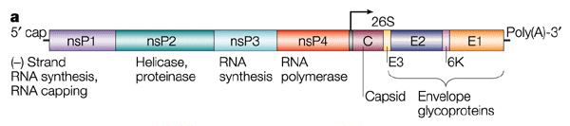
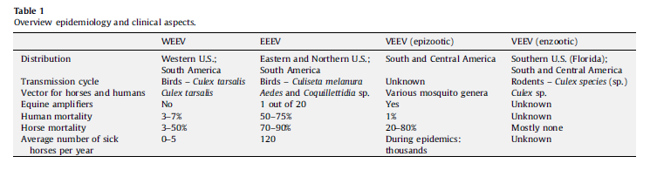
Venezuelan Equine Encephalitis Virus
Family: Togaviridae; Genus: Alphavirus
Category B select agent
Overlap priority pathogen for CDC and USDA
Enveloped, Icosahedral symmetry
Positive ssRNA genome
Cytoplasmic replicating virus
Zacks, M.A., Paessler, S., Encephalitic alphaviruses. Vet. Microbiol. (2009)

Slide 3
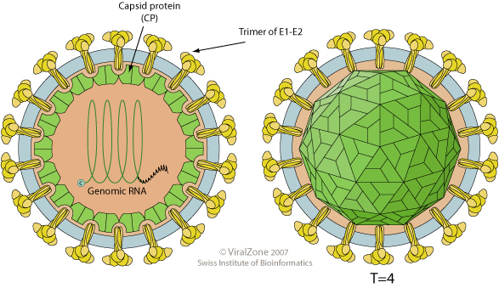
VEEV Capsid is a major pathogenicity factor
Capsid protein has multiple functions
  Packaging of the viral genome
  Protease activity for processing the structural proteins
  Host cell transcriptional inhibitor
  Causes extensive CPE
Cellular transcriptional inhibition is:
  Independent of its protease activity and RNA binding domain
  Dependent on a short amino-terminal peptide
Present at the nuclear envelope embedded nuclear pore complex (NPC) and is a potent inhibitor of nucleo-cytoplasmic trafficking

Slide 4
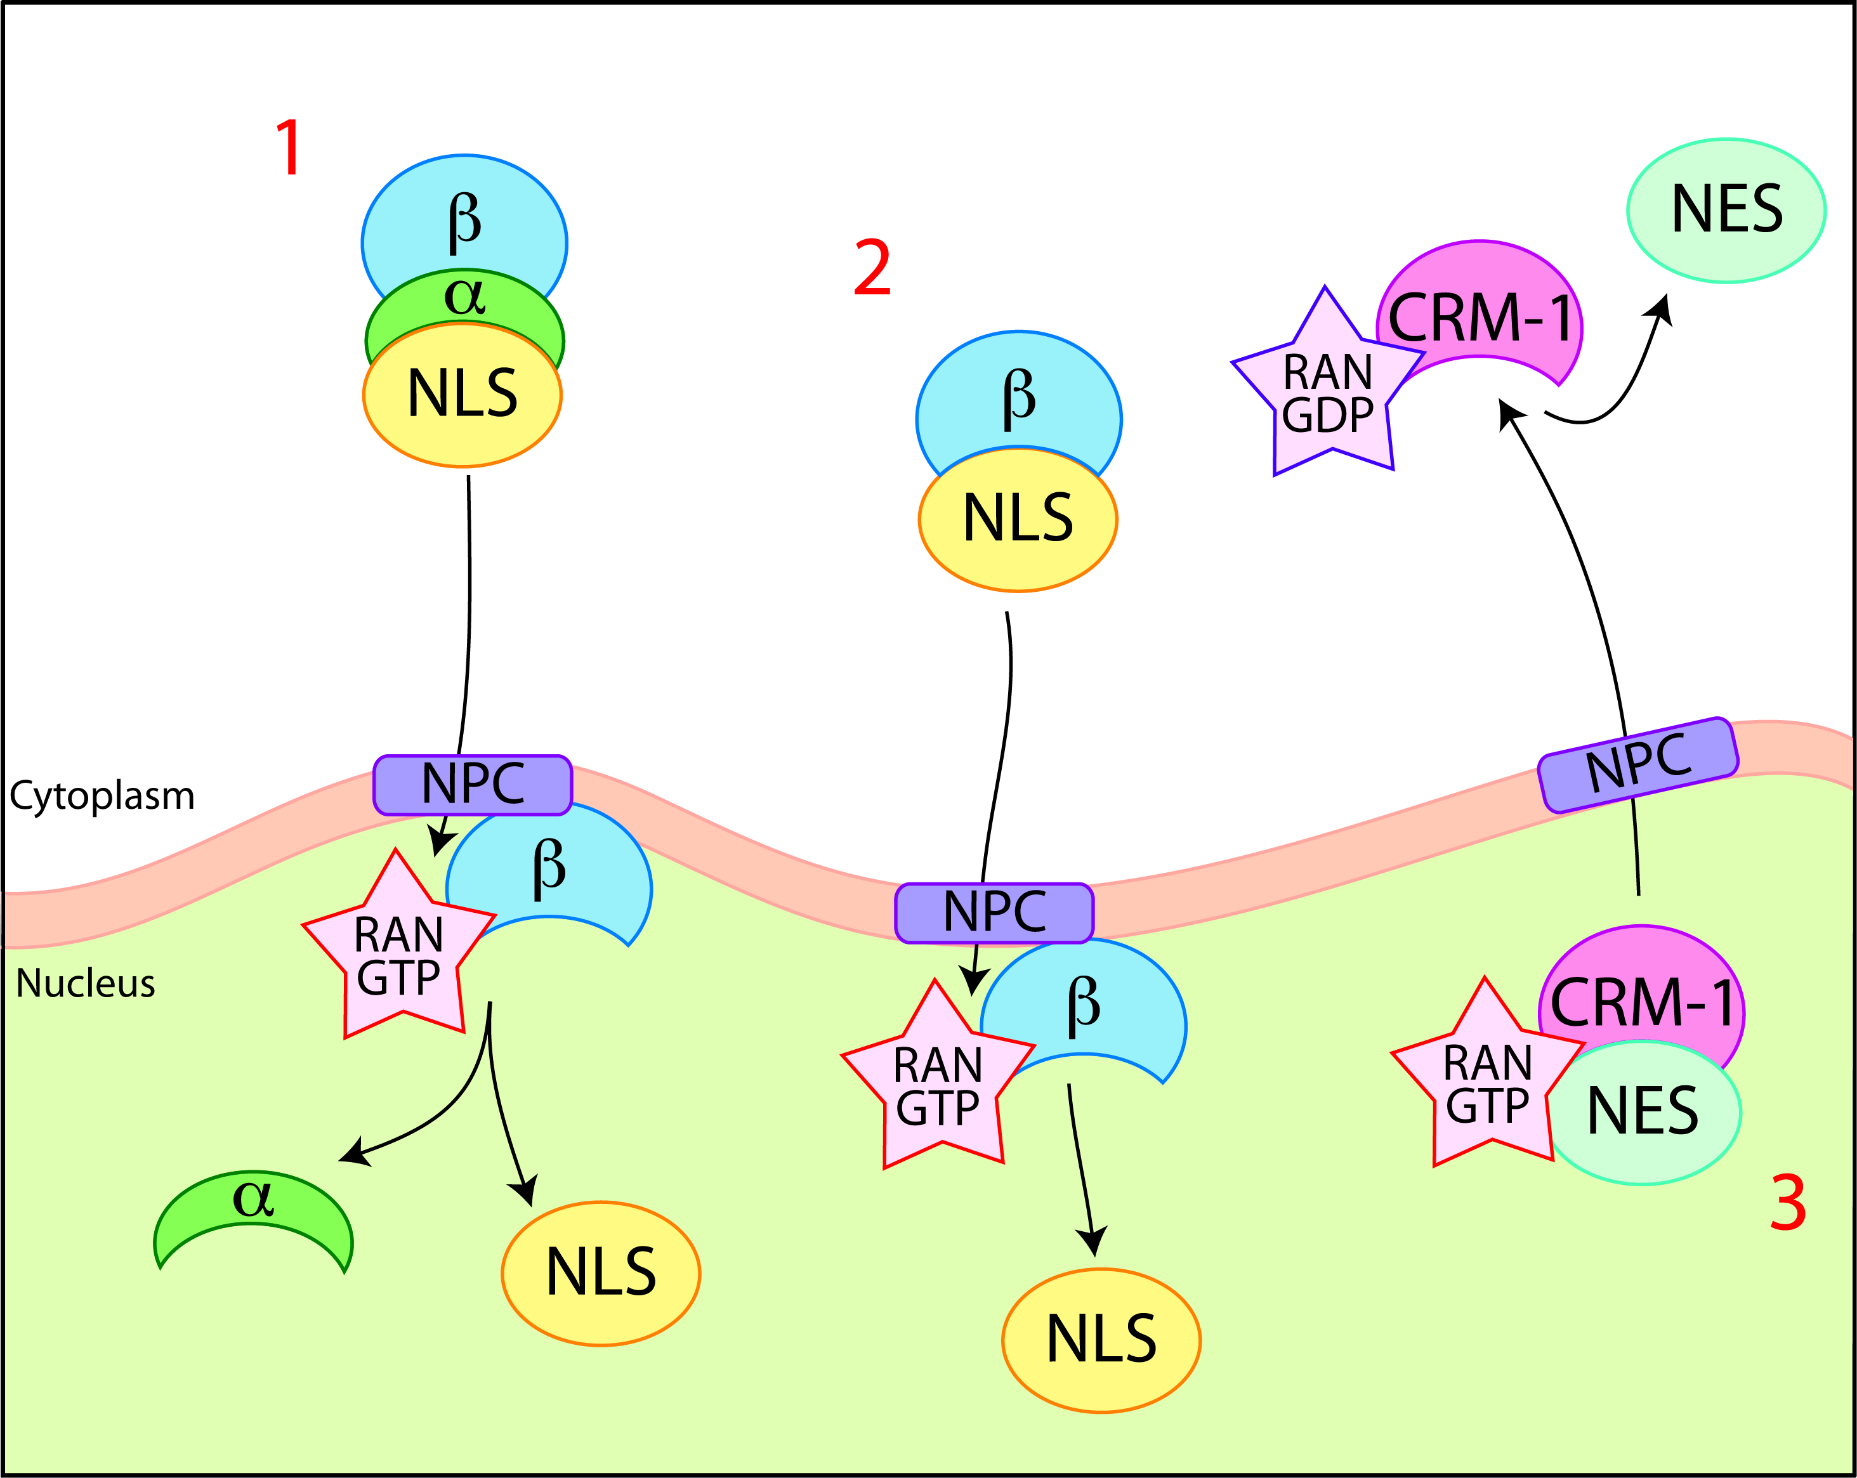
Nuclear transport
NLS, nuclear localisation signal
(Lys-Arg rich)
NES, nuclear export signal
(generally hydrophobic)
Wagstaff and Jans (2009) European Journal of Pharmacology, invited review

Slide 5
Inhibition of nuclear transport by VEEV capsid protein
β
α
Blocks Nuclear Import
NLS
NPC
β
α
Capsid
CRM-1
CRM-1
Target for inhibitors
Blocks Nuclear Export
RANGTP
NES

Slide 6
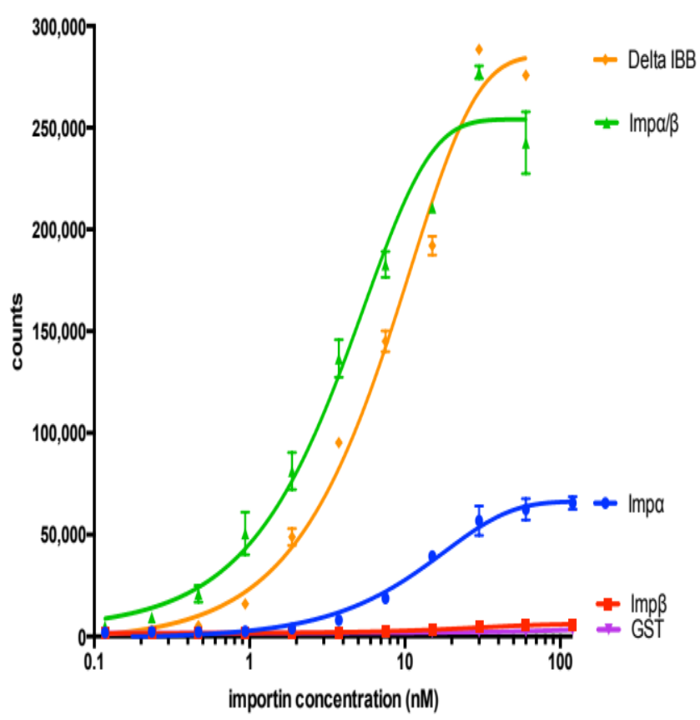
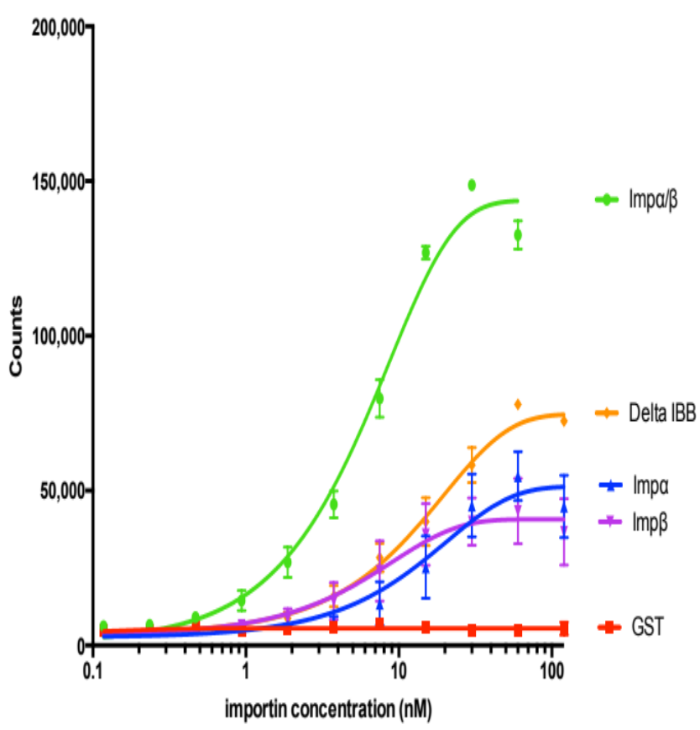
Capsid binds to both Impα and Impβ1 directly
SV40 T-ag
Capsid

Slide 7
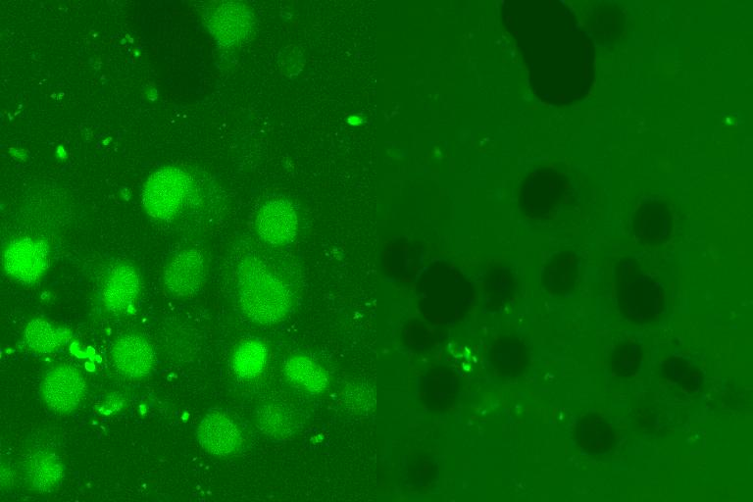
In Vitro Nuclear Transport Assay
Fluorescent IN
+/- DNA etc.
+ ATP/GTP
+/- Cytosol
+/- antibodies inhibitors
Mechanically perforated
HTC cells
Fn/c
8
IN
6
Analysis of Nuclear import by CLSM
4
2
0
0
5
10
15
20
Time (mins)

Slide 8
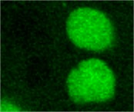
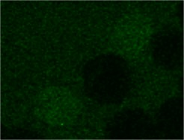



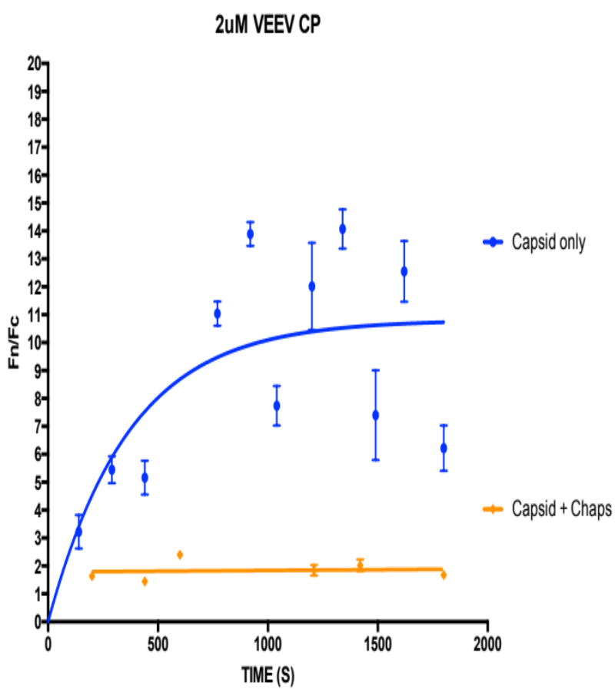
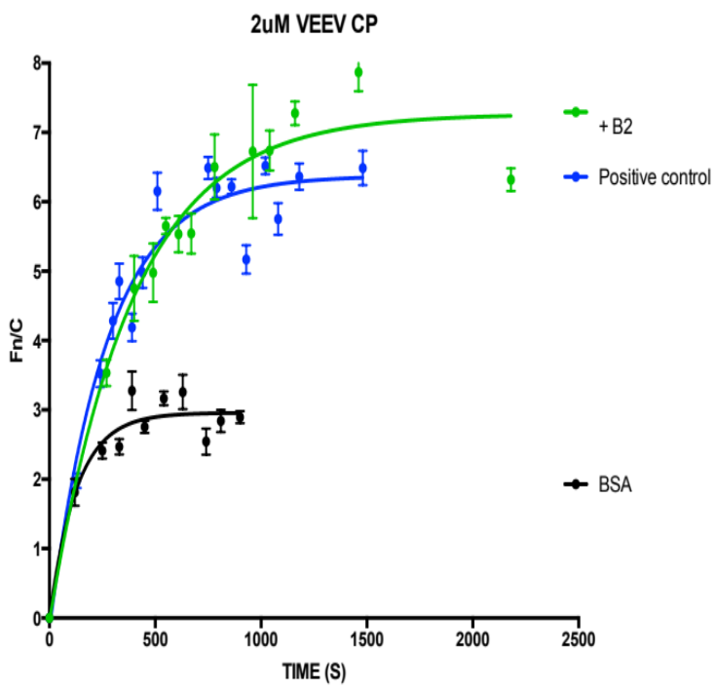
Nuclear Import of Capsid is dependent on both Impα and Impβ1
Capsid
+ CHAPS
Capsid
+ BSA
+ anti-Impβ2
+ anti-Impβ2
Capsid alone
Capsid alone
+ CHAPS
+ BSA

Slide 9
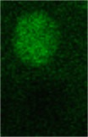
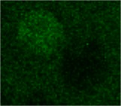
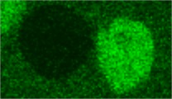
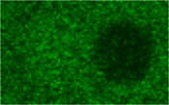
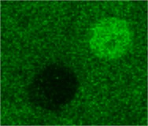
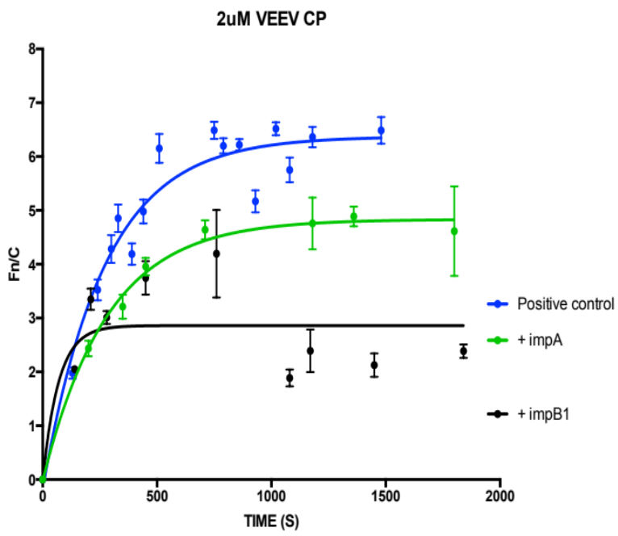
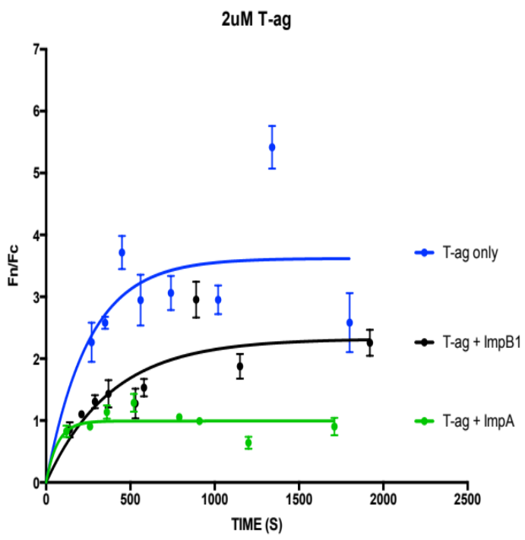
Nuclear Import of Capsid is dependent on both Impα and Impβ1
Capsid
+ anti-Impα
+ anti-Impβ1
T-ag
+ anti-Impα
+ anti-Impβ1
Capsid nuclear transport appears to be mediated by multiple pathways.
Capsid alone
T-ag alone
+ anti-Impα
+ anti-Impβ1
+ anti-Impβ1
+ anti-Impα

Slide 10
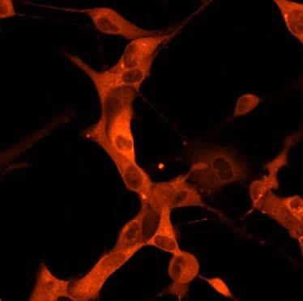
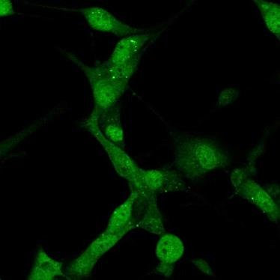
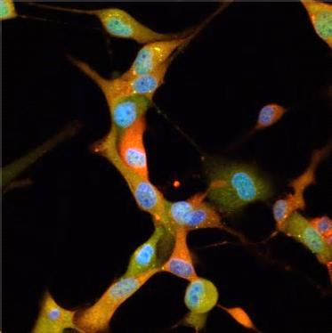
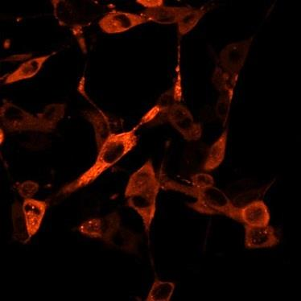

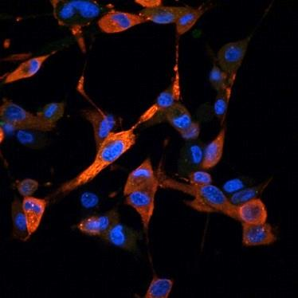
Depletion of Imps inhibits Capsid nuclear accumulation in infected cells
Capsid
Importin α
Merge
siNeg
siImpα/β1
****
****
****
Lundberg et al., Antiviral Research 100 (2013) 662–672

Slide 11
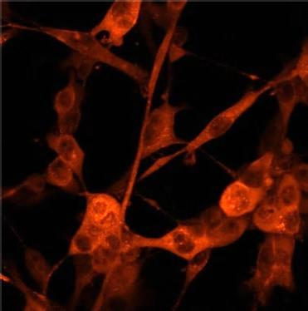
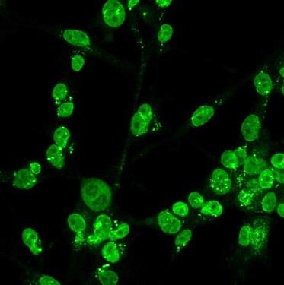
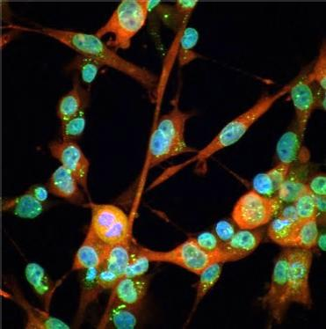
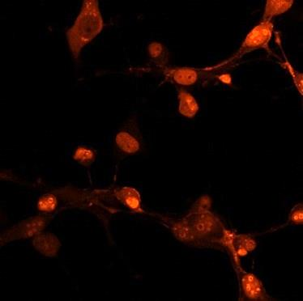
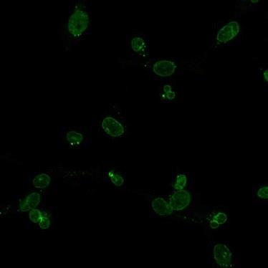
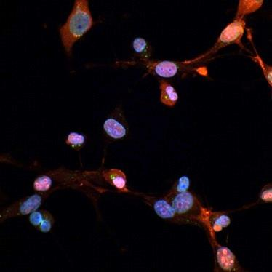
Depletion of CRM-1 enhances Capsid nuclear accumulation in infected cells
Capsid
Importin α
Merge
siNeg
siImpα/β1
****
Lundberg et al., Antiviral Research 100 (2013) 662–672

Slide 12
Nuclear import and export inhibitors alter Capsid nuclear accumulation

Slide 13
Nuclear import and export inhibitors alter Capsid nuclear accumulation

Slide 14
Nuclear transport inhibitors increase cell survival following VEEV infection

Slide 15
Nuclear import and export inhibitors inhibit VEEV replication
TC-83
TC-83
**
**
**
**
TrD
****
****
Lundberg et al., Antiviral Research 100 (2013) 662–672

Slide 16
Nuclear transport inhibitors also inhibit other important new world alphaviruses
EEEV
WEEV
**
**
**
**
**
**
**
**

Slide 17
Conclusions
VEEV capsid undergoes active nuclear transport via multiple importin-mediated pathways
Inhibitors of Nuclear import and export efficiently alter Capsid nuclear accumulation in transfected and infected cells
Nuclear transport inhibitors reduce VEEV infection, increase cell survival following infection and reduce viral titre
Similar mechanisms are observed in the related WEEV and EEEV.

Slide 18

Acknowledgements
Monash University
David Jans (Dept. Biochemistry)
David Thomas
Jonathan Baell (MIPS)
Aaron DeBono
George Mason University
Kylene Kehn-Hall
Lindsay Lundberg
Chelsea Pinkham
Ashwini Benedict
Nazly Shafagati,
Moushimi Amaya
Aarthi Narayanan
Karyopharm Therapeutics
Sharon Tamir
Schecter Computational Solutions
Sharon Schecter
Defense Threat Reduction Agency

