Slide 1
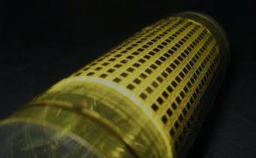

Printed Nanomaterial-Based Flexible Device Sheets
Kuniharu Takei
Department of Physics and Electronics
Osaka Prefecture University, JAPAN
Nanotechnology 2015, August 12th, 2015

Slide 2
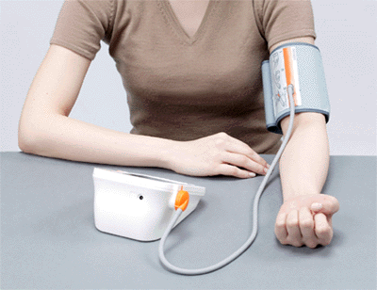
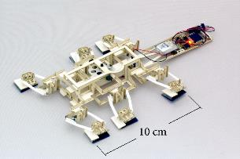

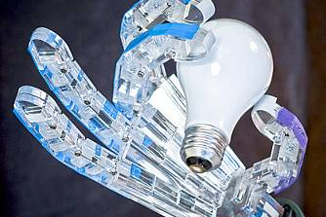
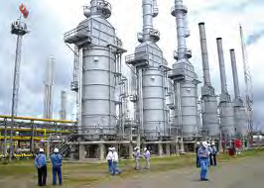



Flexible sensor sheets for what?
Large-scale, flexible sensor network that can conformably cover any surfaces
Health monitor
Human Interface
Robotics
Environmental
Energy
Transportation

Slide 3
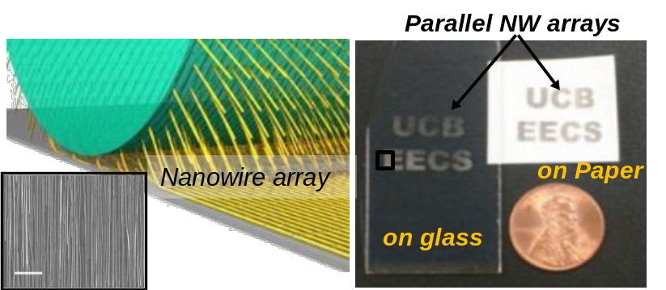
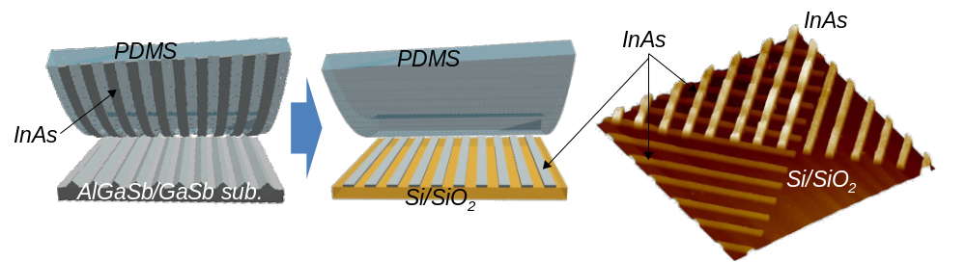
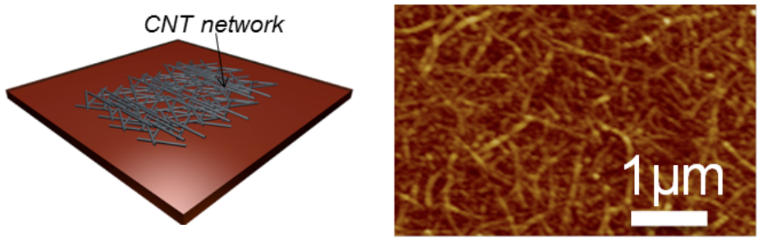
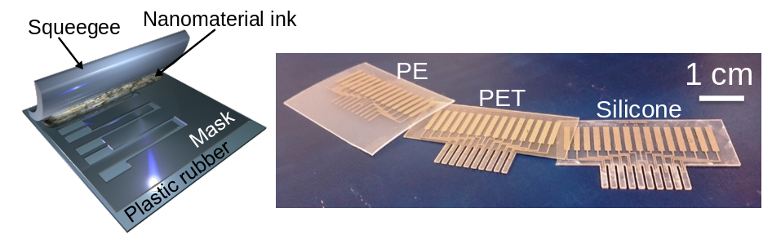
Printing fabrication methods
Nanowire printing (Si, Ge, Ge/Si, InAs etc.)
2D film transfer (InAs, InGaSb etc.)
Nature, 468, 286, 2010. APL, 99, 103507, 2011.
Nano Lett., 11, 5008, 2011. Nano Lett., 12, 2060, 2012.
APL, 102, 153513, 2013. JPC C, 117, 17845, 2013
Nature Mater., 9, 821-826, 2010.
ACS Nano, 4, 5855-5860, 2010.
Nanotech., 23, 045201, 2012.
Nanotube printing
Screen printing
Nano Lett., 11, 5408, 2011. Nano Lett., 12, 1527, 2012.
Nature Mater., 12, 899, 2013. Nano Lett., 13, 5425, 2013.
Adv. Mater., in press, 2015
PNAS, 111, 1703, 2014. Adv. Funct. Mater, 24, 3299, 2014.
ACS Nano, 8, 3921, 2014. pss A, 11, 2631, 2014.
ACS Nano, 8, 12851, 2014. RSC Adv. 5, 30170, 2015.
Adv. Ele. Mater. in press, 2015

Slide 4
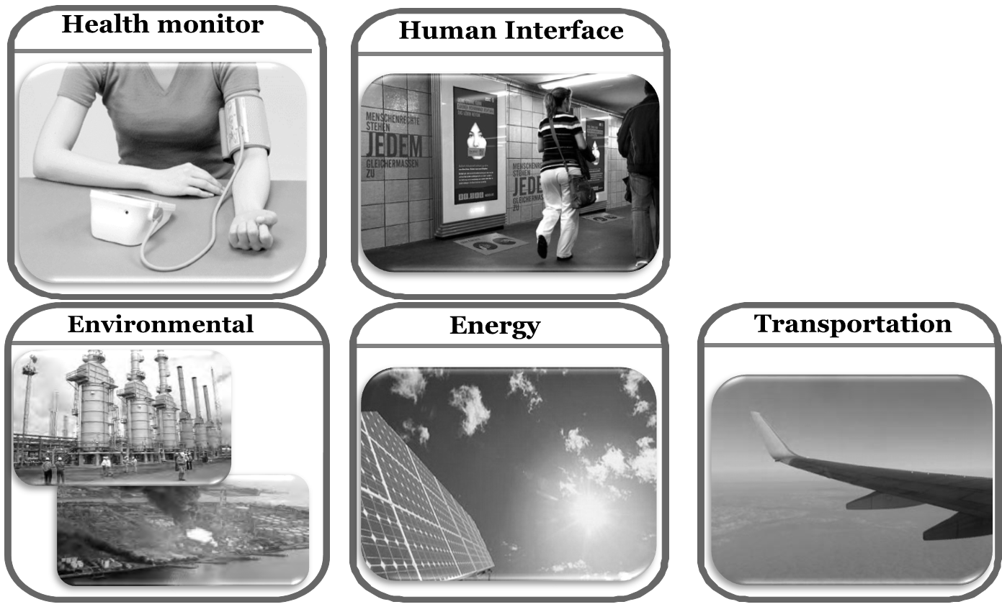
Robotic applications
Large-scale, flexible sensor network that can conformably cover any surfaces
Robotics

Slide 5
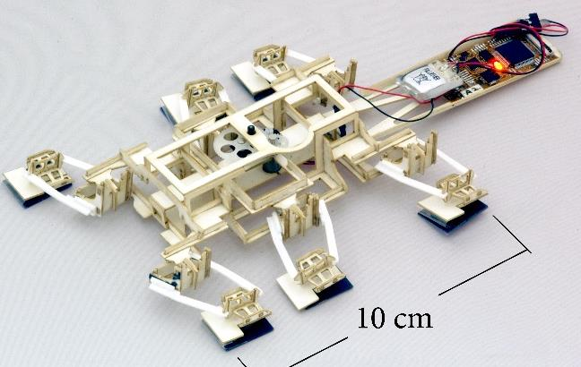
Artificial electronic whisker (e-whisker)
How can this robot distinguish whether it can go forward or not between obstacles like a cat.

Slide 6
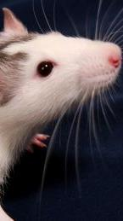
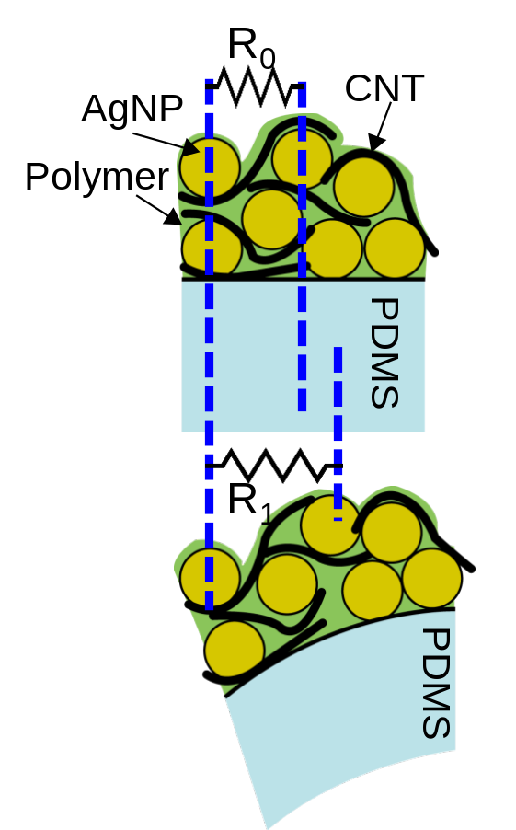
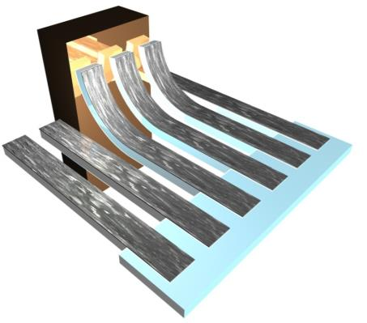
Printable strain sensor array
Artificial electronic whisker
Animal whiskers detect:
Spatial distribution by touching an abstacle
Wind flow
Temperature
Scan direction
Object
Whisker of rat
K. Takei et al., PNAS 2014, S. Harada et al., ACS Nano 2014.

Slide 7
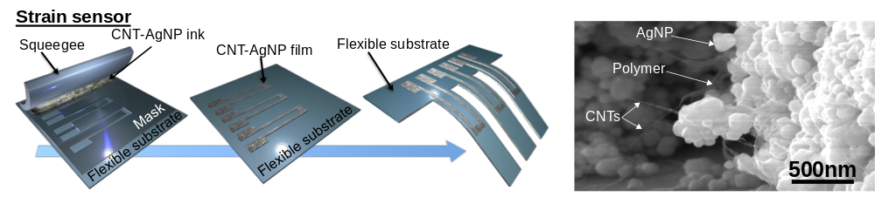
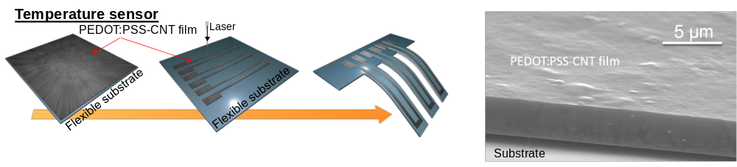
Printable strain sensor array
Sensor material: Mixture of CNT and AgNP inks
Sensor material: Mixture of CNT and PEDOT:PSS inks
S. Harada et al. ACS Nano 2014.

Slide 8
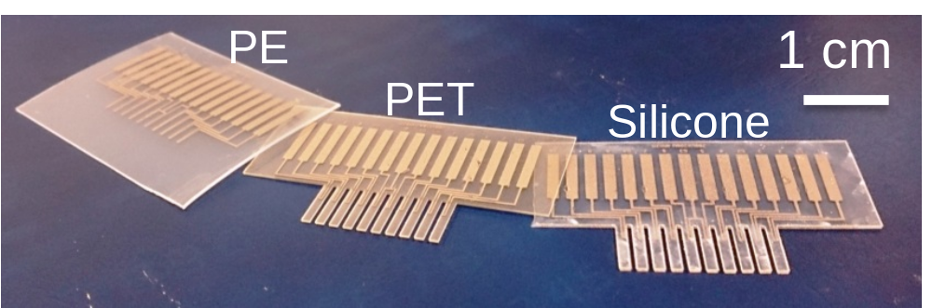
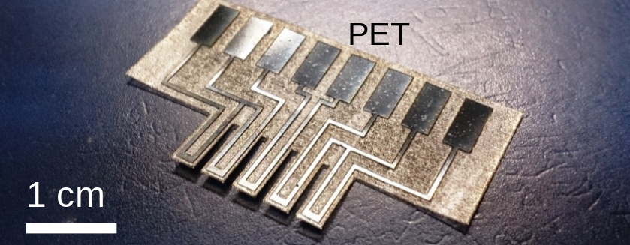
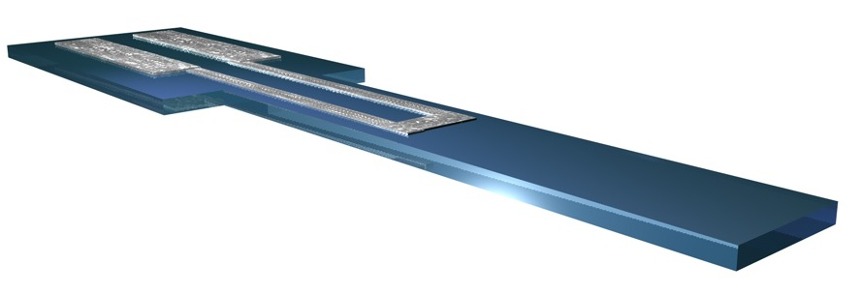
Printable strain sensor array
A
L_{flex}=0.5mm-9mm
Thickness
(0.1-1.5 mm)
Sensor materials
CNT-AgNP
or
PEDOT:PSS-CNT
Flexible substrate
L_{sensor}=3-8 mm
1.5mm-3mm
S. Harada et al. ACS Nano 2014.

Slide 9
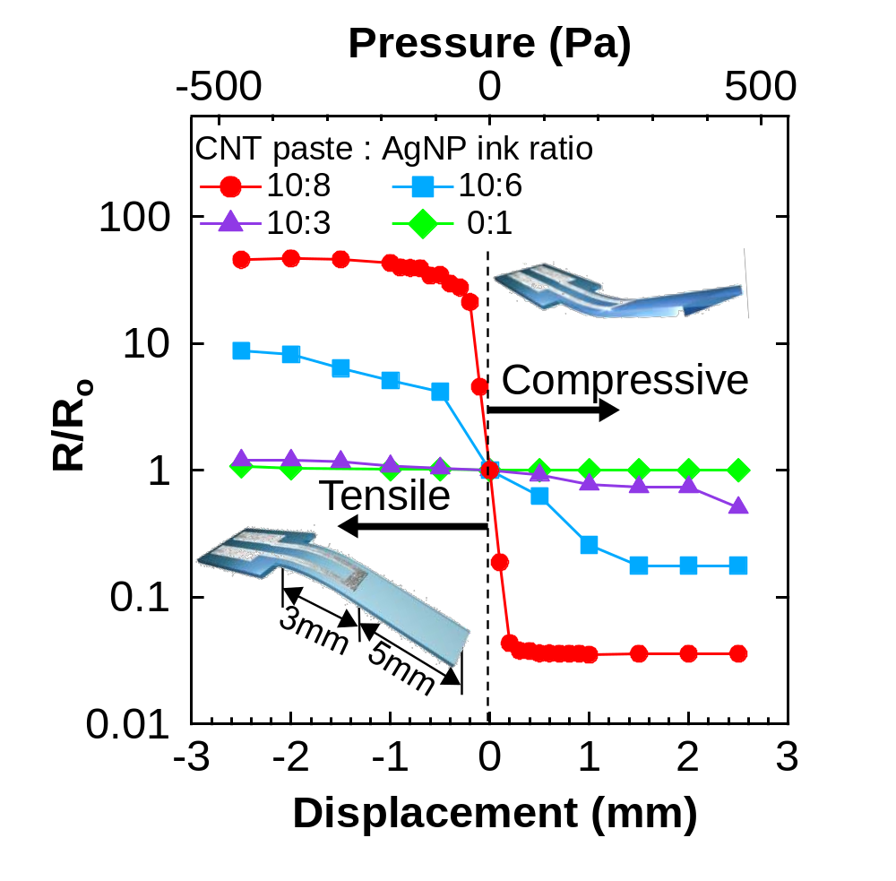
Printable strain sensor
Strain sensor : Mixture of CNT ink and Ag nanoparticle ink
High strain sensitivity ~59 %/Pa
Sensitivity tunability
S. Harada et al. ACS Nano 2014.

Slide 10
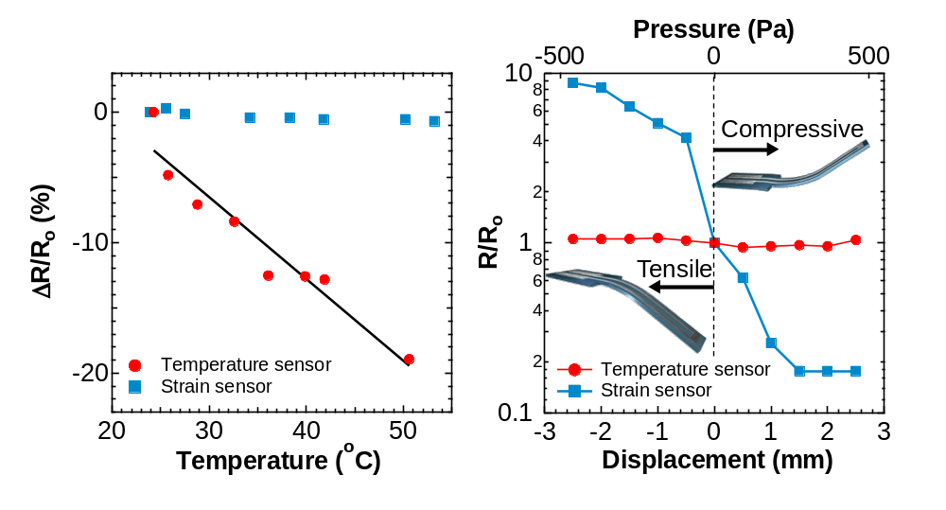
Printable temperature sensor array
Strain sensor : Mixture of CNT ink and Ag nanoparticle ink
Temp. sensor : Mixture of CNT ink and PEDOT:PSS
Temperature sensitivity ~0.6 %/°C
High selectivity between strain and temperature
S. Harada et al. ACS Nano 2014.

Slide 11
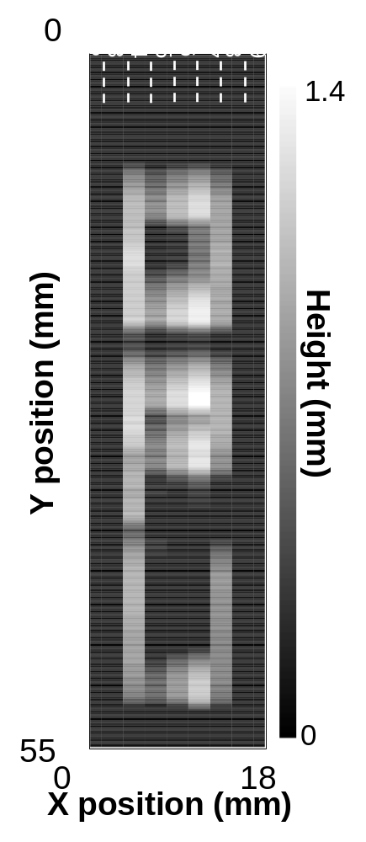
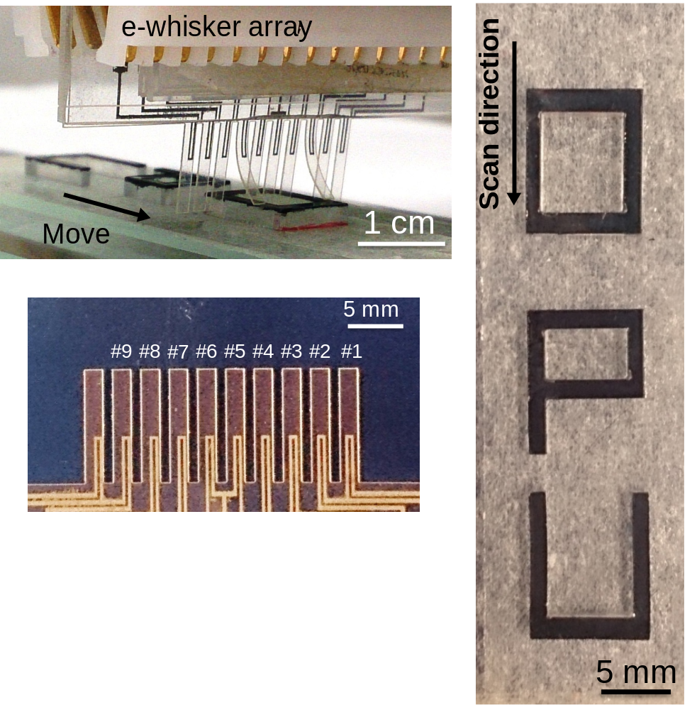
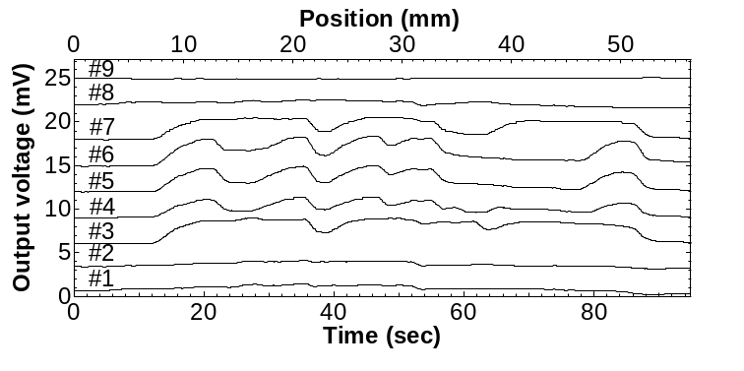
Printable strain sensor array
S. Harada et al. ACS Nano 2014.

Slide 12
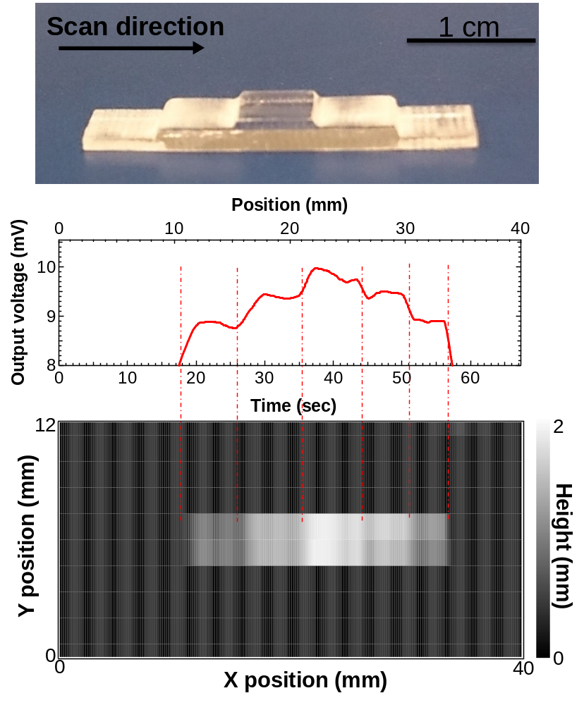
Printable strain sensor array
#9
#8
#7
#6
#5
#4
#3
S. Harada et al. ACS Nano 2014.

Slide 13
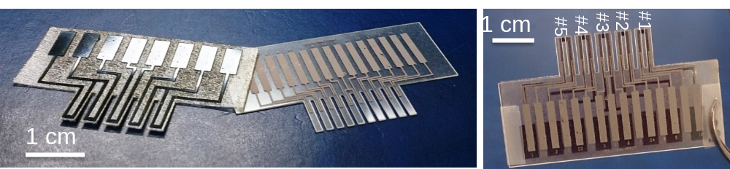
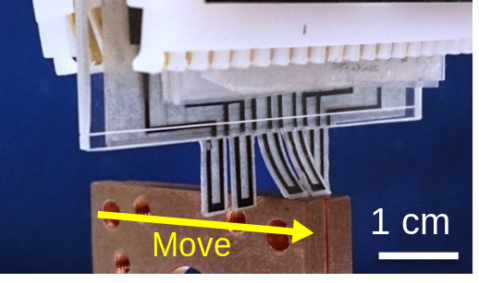
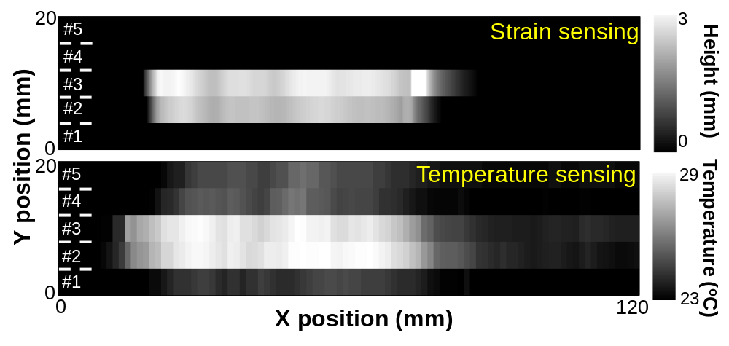
Multi-functional e-whisker (Temp & Strain)
S. Harada et al. ACS Nano,2014 2014.

Slide 14
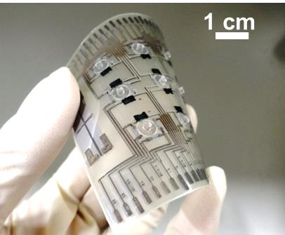
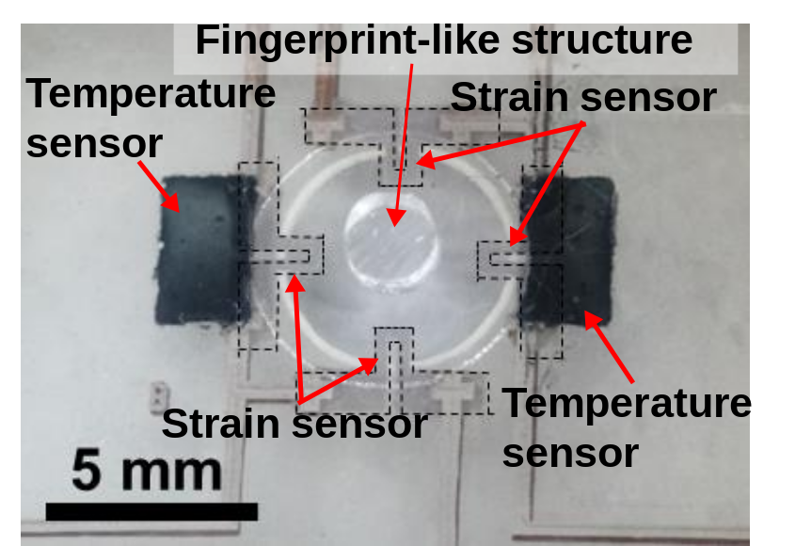
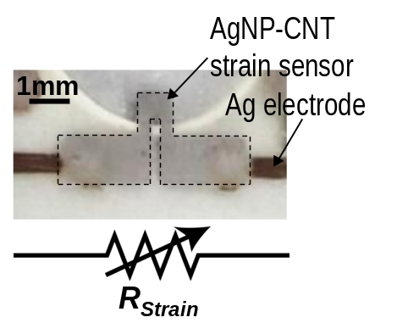
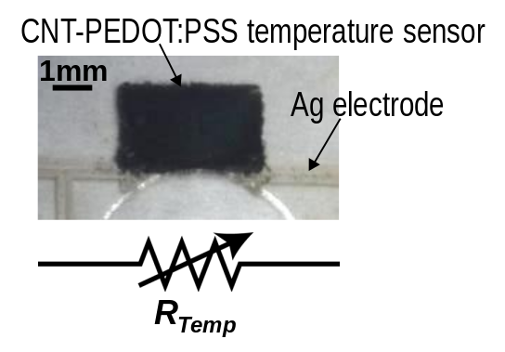
Three-axis force detections
Strain sensor : Mixture of CNT ink and Ag nanoparticle ink
Temp. sensor : Mixture of CNT ink and PEDOT:PSS
Fully printed strain and temperature sensor arrays
S. Harada et al. ACS Nano 2014.

Slide 15
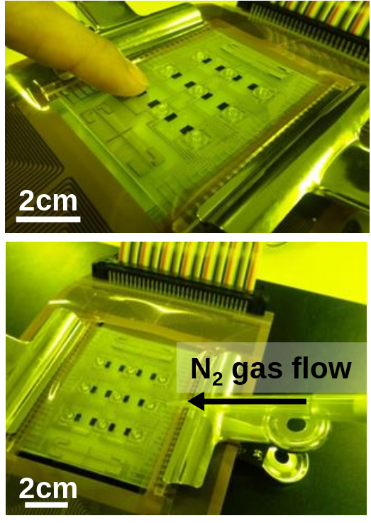
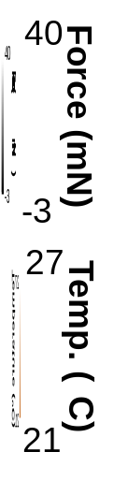
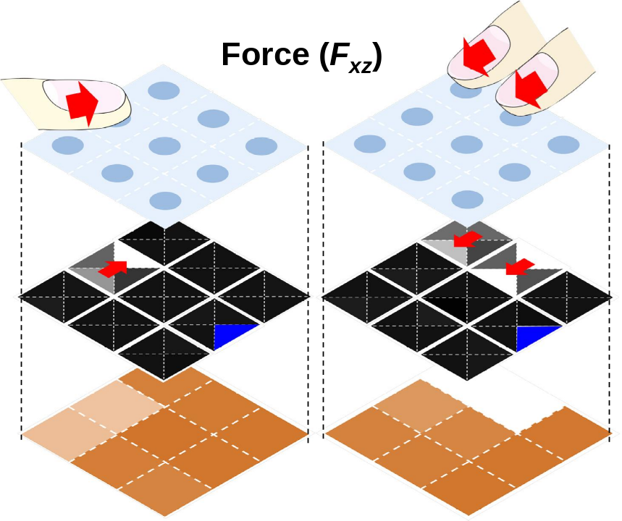
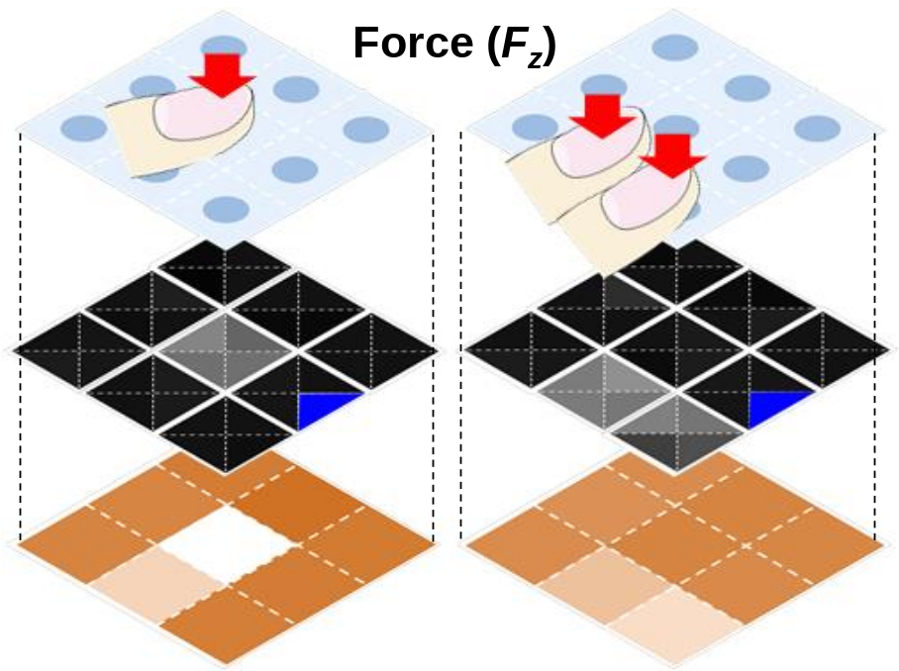
Three-axis force and temp. mappings
Defective pixel
S. Harada et al. ACS Nano 2014.

Slide 16
What else do we need?
Signal processing circuits are required to integrate with the sensors on a flexible substrate

Slide 17
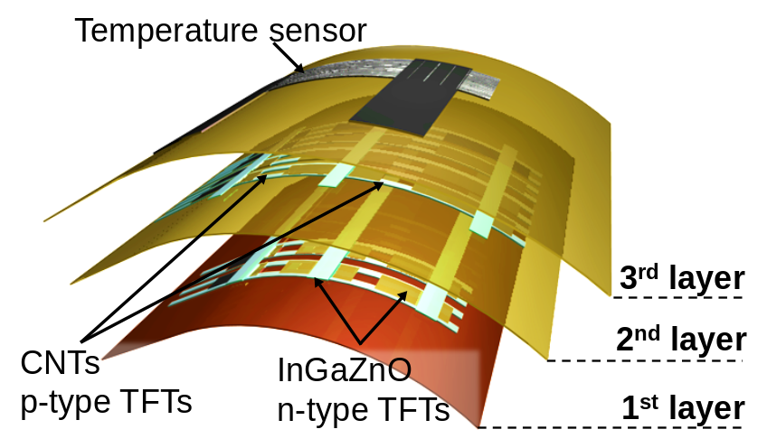
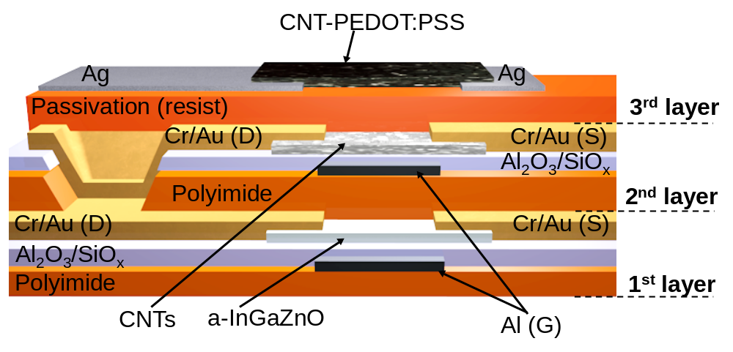
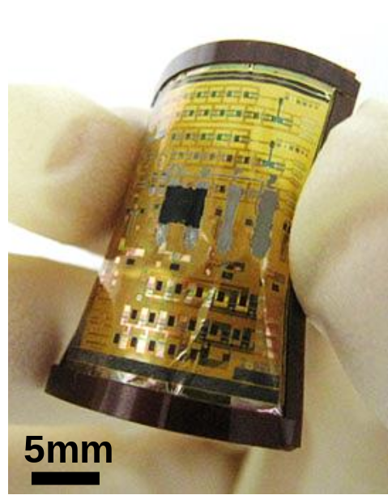
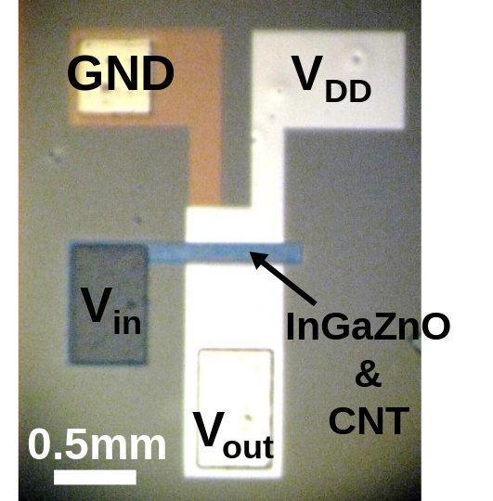
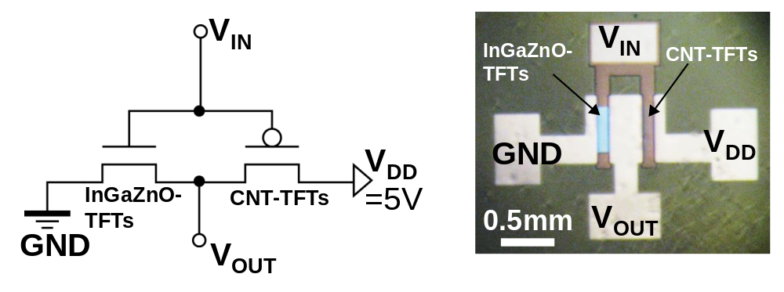
Flexible CMOS circuits
W. Honda et al. Advanced Materials, 2015.

Slide 18
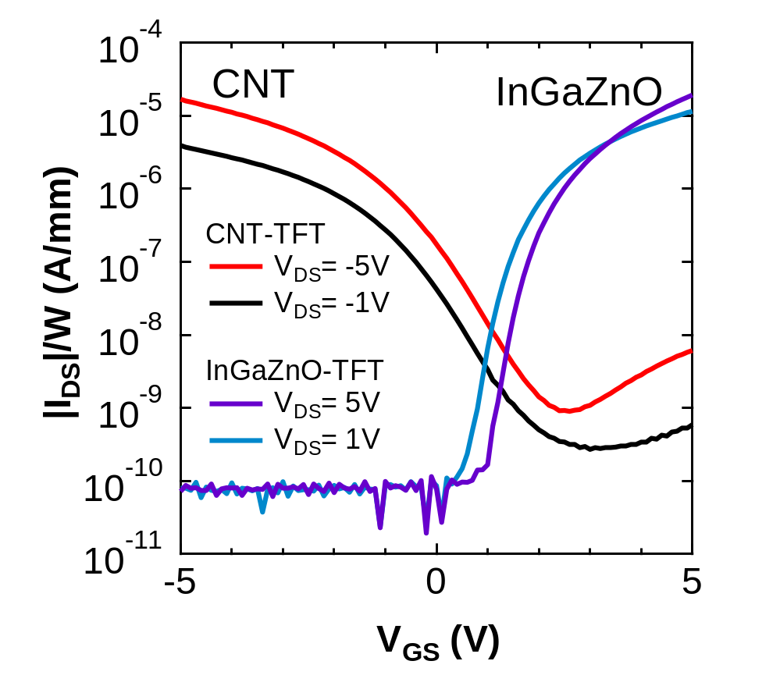
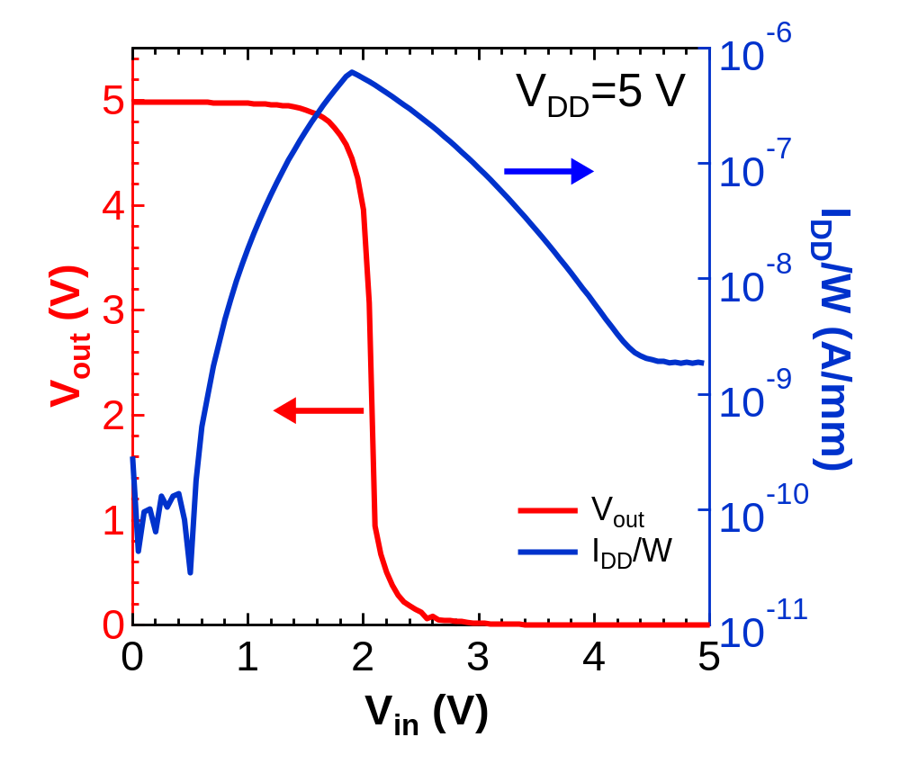
Electrical characteristics
Voltage gain ~50
Field-effect mobility: CNT-TFT ~4 cm²/Vs, InGaZnO-TFT ~6 cm²/Vs
Voltage gain ~50
Power consumption at the steady state : < 7 nW/mm
W. Honda et al. Advanced Materials, 2015.

Slide 19
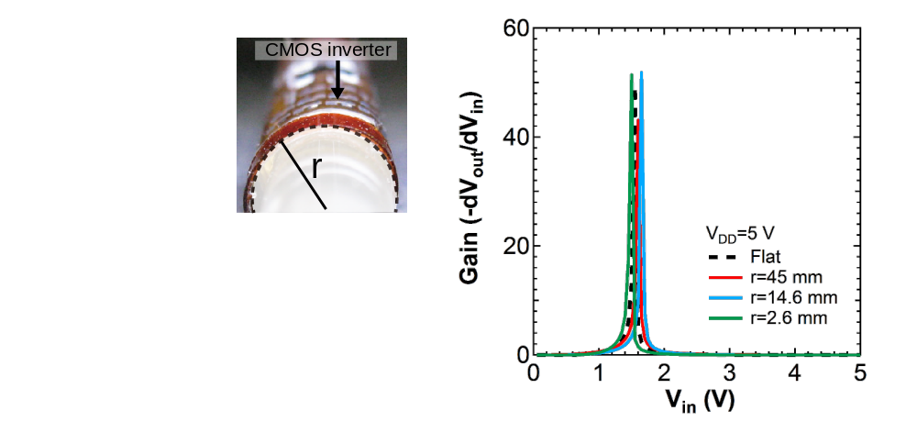
Electrical characteristics under bending
Almost no change is observed under bending up to 2.6 mm radius
Small V_{th} shift is most likely due to hysteresis of CNT-TFTs
W. Honda et al. Advanced Materials, 2015.

Slide 20
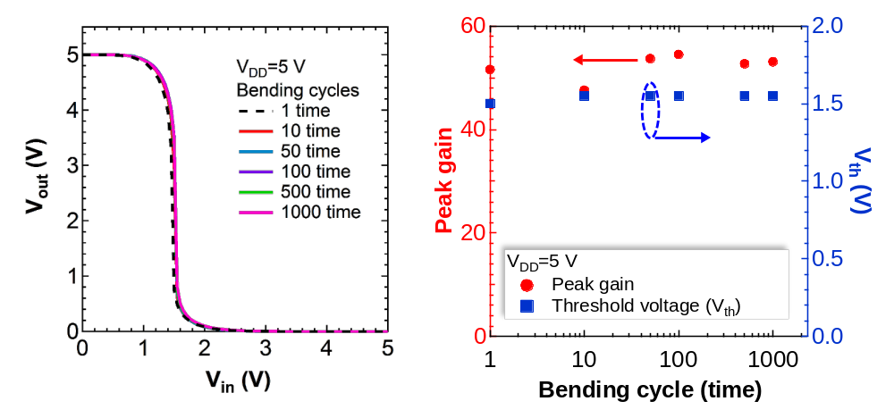
Electrical characteristics under bending
High reliability against bending cycles up to 1000 times (<6mm radius)
W. Honda et al. Advanced Materials, 2015.

Slide 21
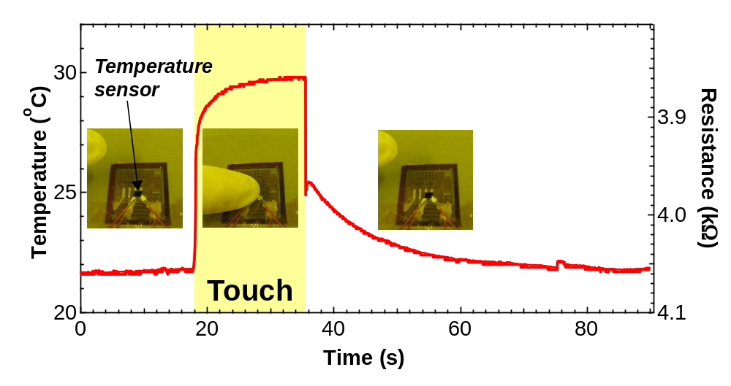
W. Honda et al. Advanced Materials, 2015.

Slide 22
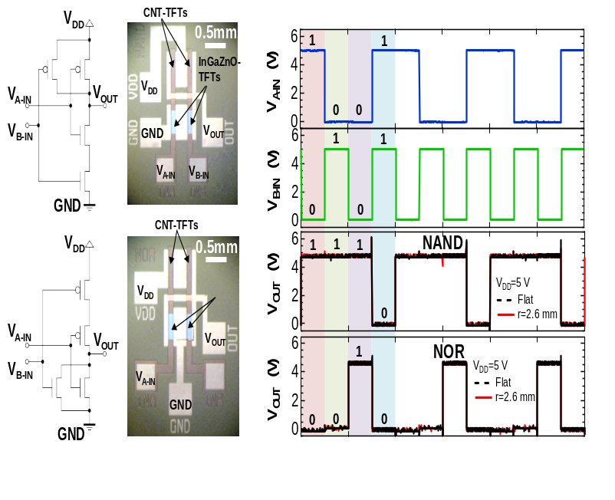
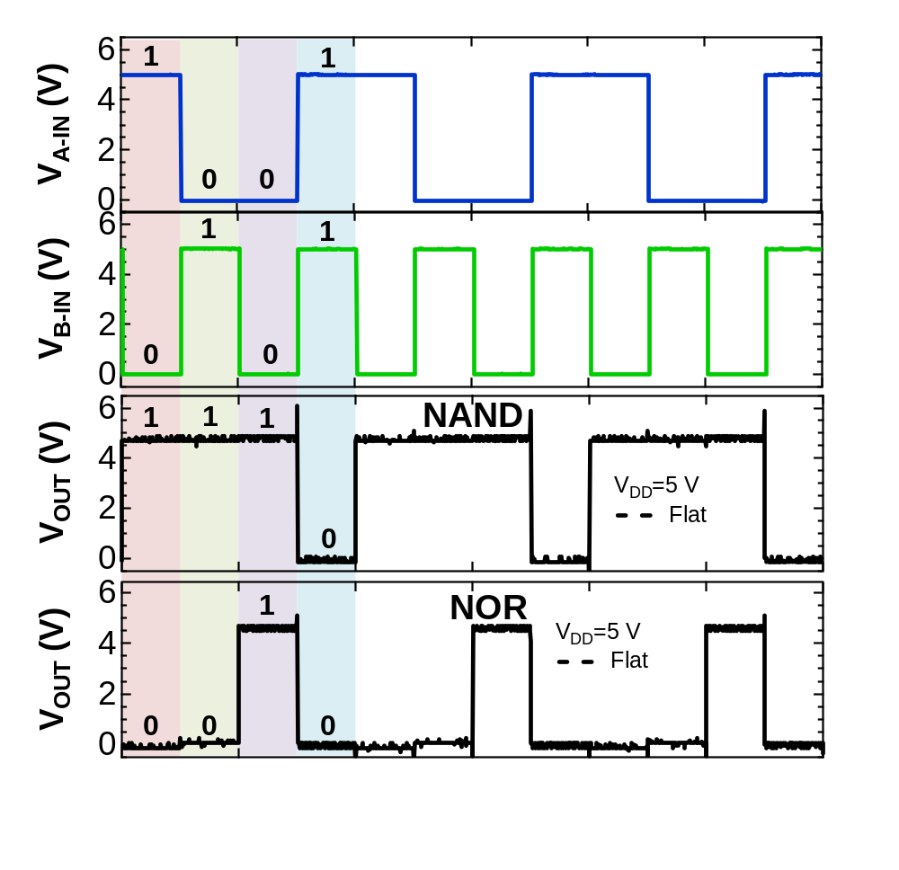
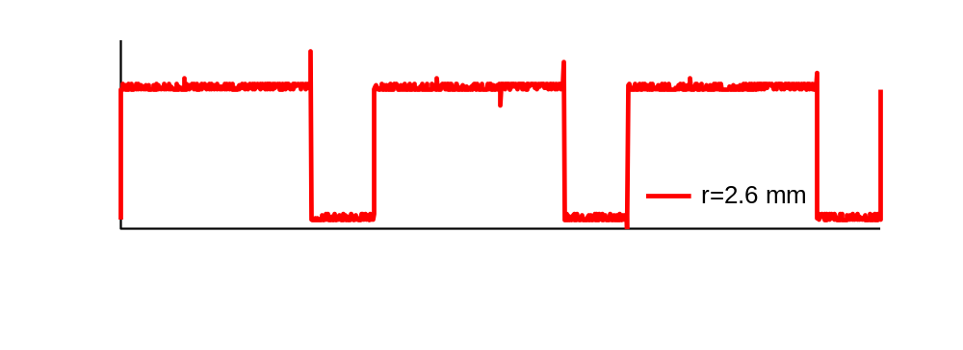
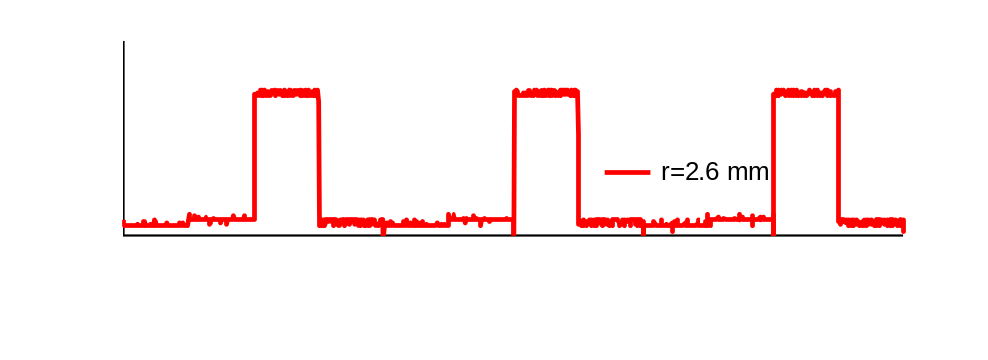
Good mechanical flexibility of CMOS
CMOS NAND
Bending radius ~2.6 mm
CMOS NOR
W. Honda et al. Submitted 2015.

Slide 23








Toward future wearable electronics
Painless needle
Drug delivery
Display
Wireless coil
Temp. sensors
Circuits
Heart race sensor
takei@pe.osakafu-u.ac.jp

Slide 24







Acknowledgements
Osaka Prefecture Univeristy
Prof. Seiji Akita
Prof. Takayuki Arie
Mr. Shingo Harada
Mr. Wataru Honda
Mr. Kenichiro Kanao
Mr. Yuki Yamamoto
Research fundings
Tateishi Science and Technology Foundation
Thank you for your attention!!
Contact: takei@pe.osakafu-u.ac.jp

