Slide 1



Slide 2

Presentation on
“EVALUATION OF NEUROPROTECTIVE EFFECT OF SILK
PROTEIN, SERICIN IN ALZHEIMER'S DISEASE INDUCED RAT BRAIN”
By
Prof. K.YELLAMMA
Principal & Professor
Director Research Centre for Neurological Disorders (RCND) Division of Neurobiology, Department of Zoology
Sri Ventakeswara University, Tirupati, India

Slide 3

Introduction
Alzheimer’s Disease, the most common type of Dementia also called as
Senile Dementia of Alzheimer Type (SDAT) frequently occurs in elders.
Globally it was noticed that every year 3,60,000 new cases were admitted with severe AD in hospital though the world.
The incidence of AD rises from 2.8% per every 1000 persons in the age group of 65-69 to 56.1 % per every 1000 persons in people older than 90 years.
It is Estimated that 30 million people world wide had Alzheimer’s disease. This number may quadruple by 2050.
Alzheimer’s disease is listed as the fourth leading cause of ages.
AD was first described by a German Psychiatrist and Neuropathologist,
Alois Alzheimer in 1906 and was named after him.
death for all

Slide 4





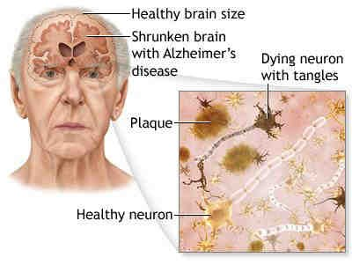
Alzheimer’s Disease, a growing health problem is characterized by formation of amyloid plaques and neurofibrillary tangles and by loss of neurons.
AD is a progressive dementia with the decline of intellectual functions. Later,
patient becomes disabled, mute and immobile.

Slide 5
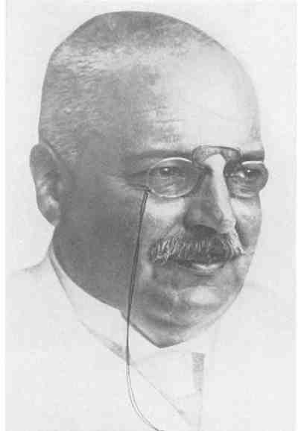
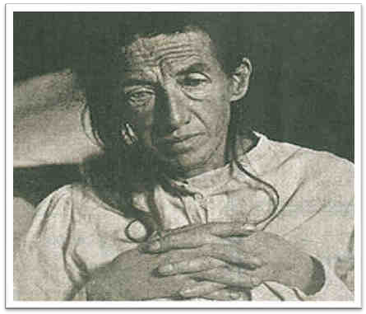
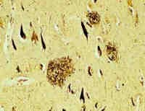
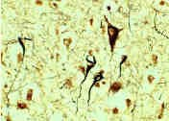
Dr. Alois Alzheimer
Auguste . D
In 1907, in the first report, Alois Alzheimer described senile plaques (SP) and Neurofibrillary Tangles (NFT), SP are found in neocortex, hippocampus and in several subcortical areas NFT density correlates with disease duration and severity of dementia.

Slide 6
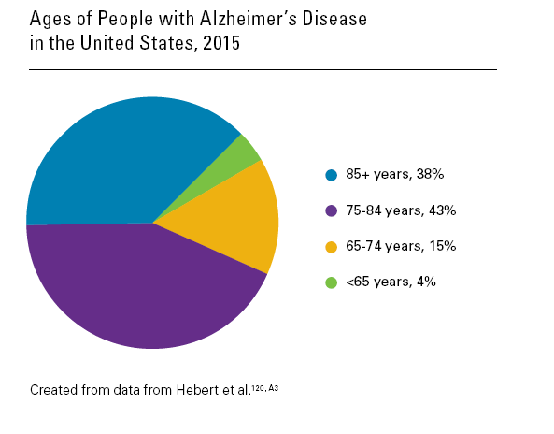

Slide 7
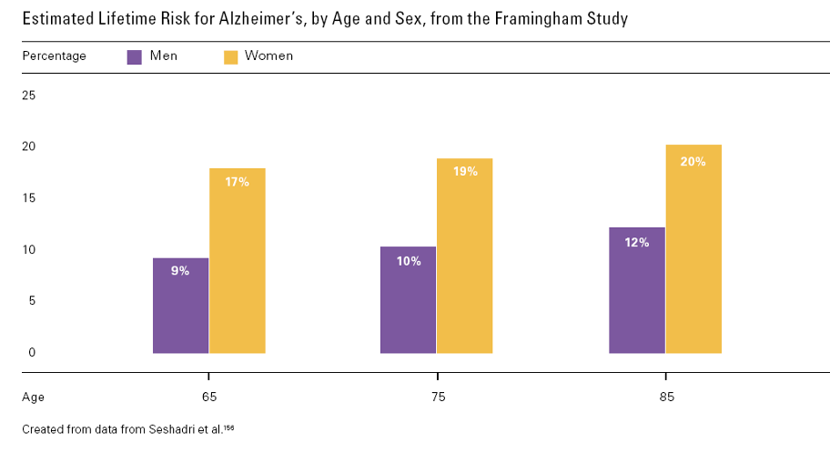

Slide 8
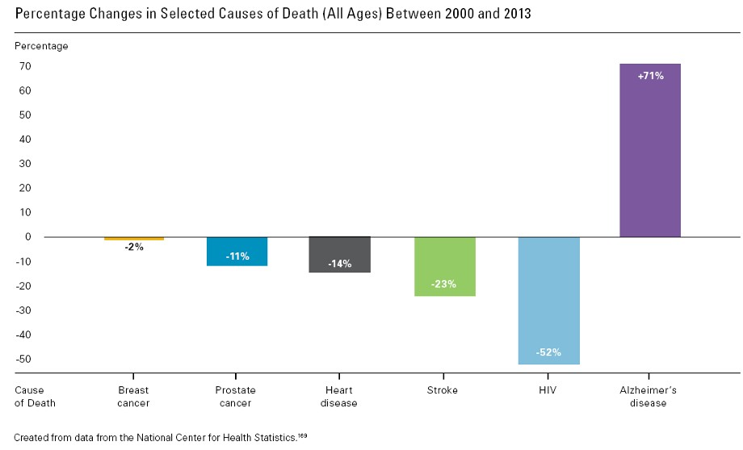

Slide 9



TYPES OF ALZHEIMER’S DISEASE
Basically there are three types of Alzheimer’s disease :
Early onset Alzheimer’s disease:
Rare form of Alzheimer's disease in which people are diagnosed with the disease before age 65 and they experience premature aging. Less than 10% of all Alzheimer's disease patients have this type.
Late onset Alzheimer’s disease:
Most common form of Alzheimer's disease, accounting for about 90% of cases and usually occurring after age 65.
Familial Alzheimer’s disease:
this form of Alzheimer’s disease is entirely inherited. FAD is rare type, affecting less than 1% of sufferers and in nearly all cases it attacks younger people, mainly in their 40s and 50s. In some extremely rare cases people in their 30s have been known to develop it.

Slide 10

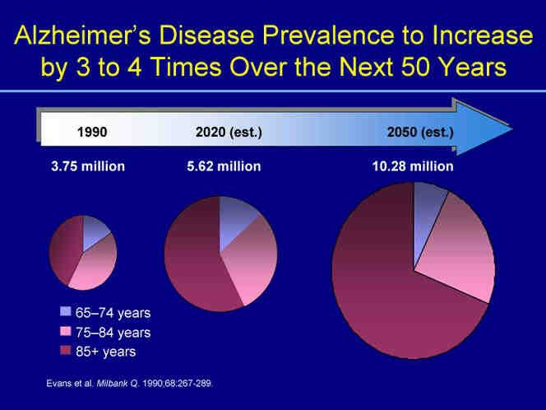

Slide 11
Causes For Alzheimer's Disease
AGE
HERIDITARY FACTORS
HEAD INJURIES
CONSUMPTION OF HIGH FAT
& HIGH CALORIFIC DIET
CARDIOVASCULAR
DISORDERS
DIABETES MELLITUS etc.,
FAMILY HISTORY
DOWN’S SYNDROME
POOR EDUCATION
SMOKING
HYPER CHOLESTEROLEMIA

Slide 12
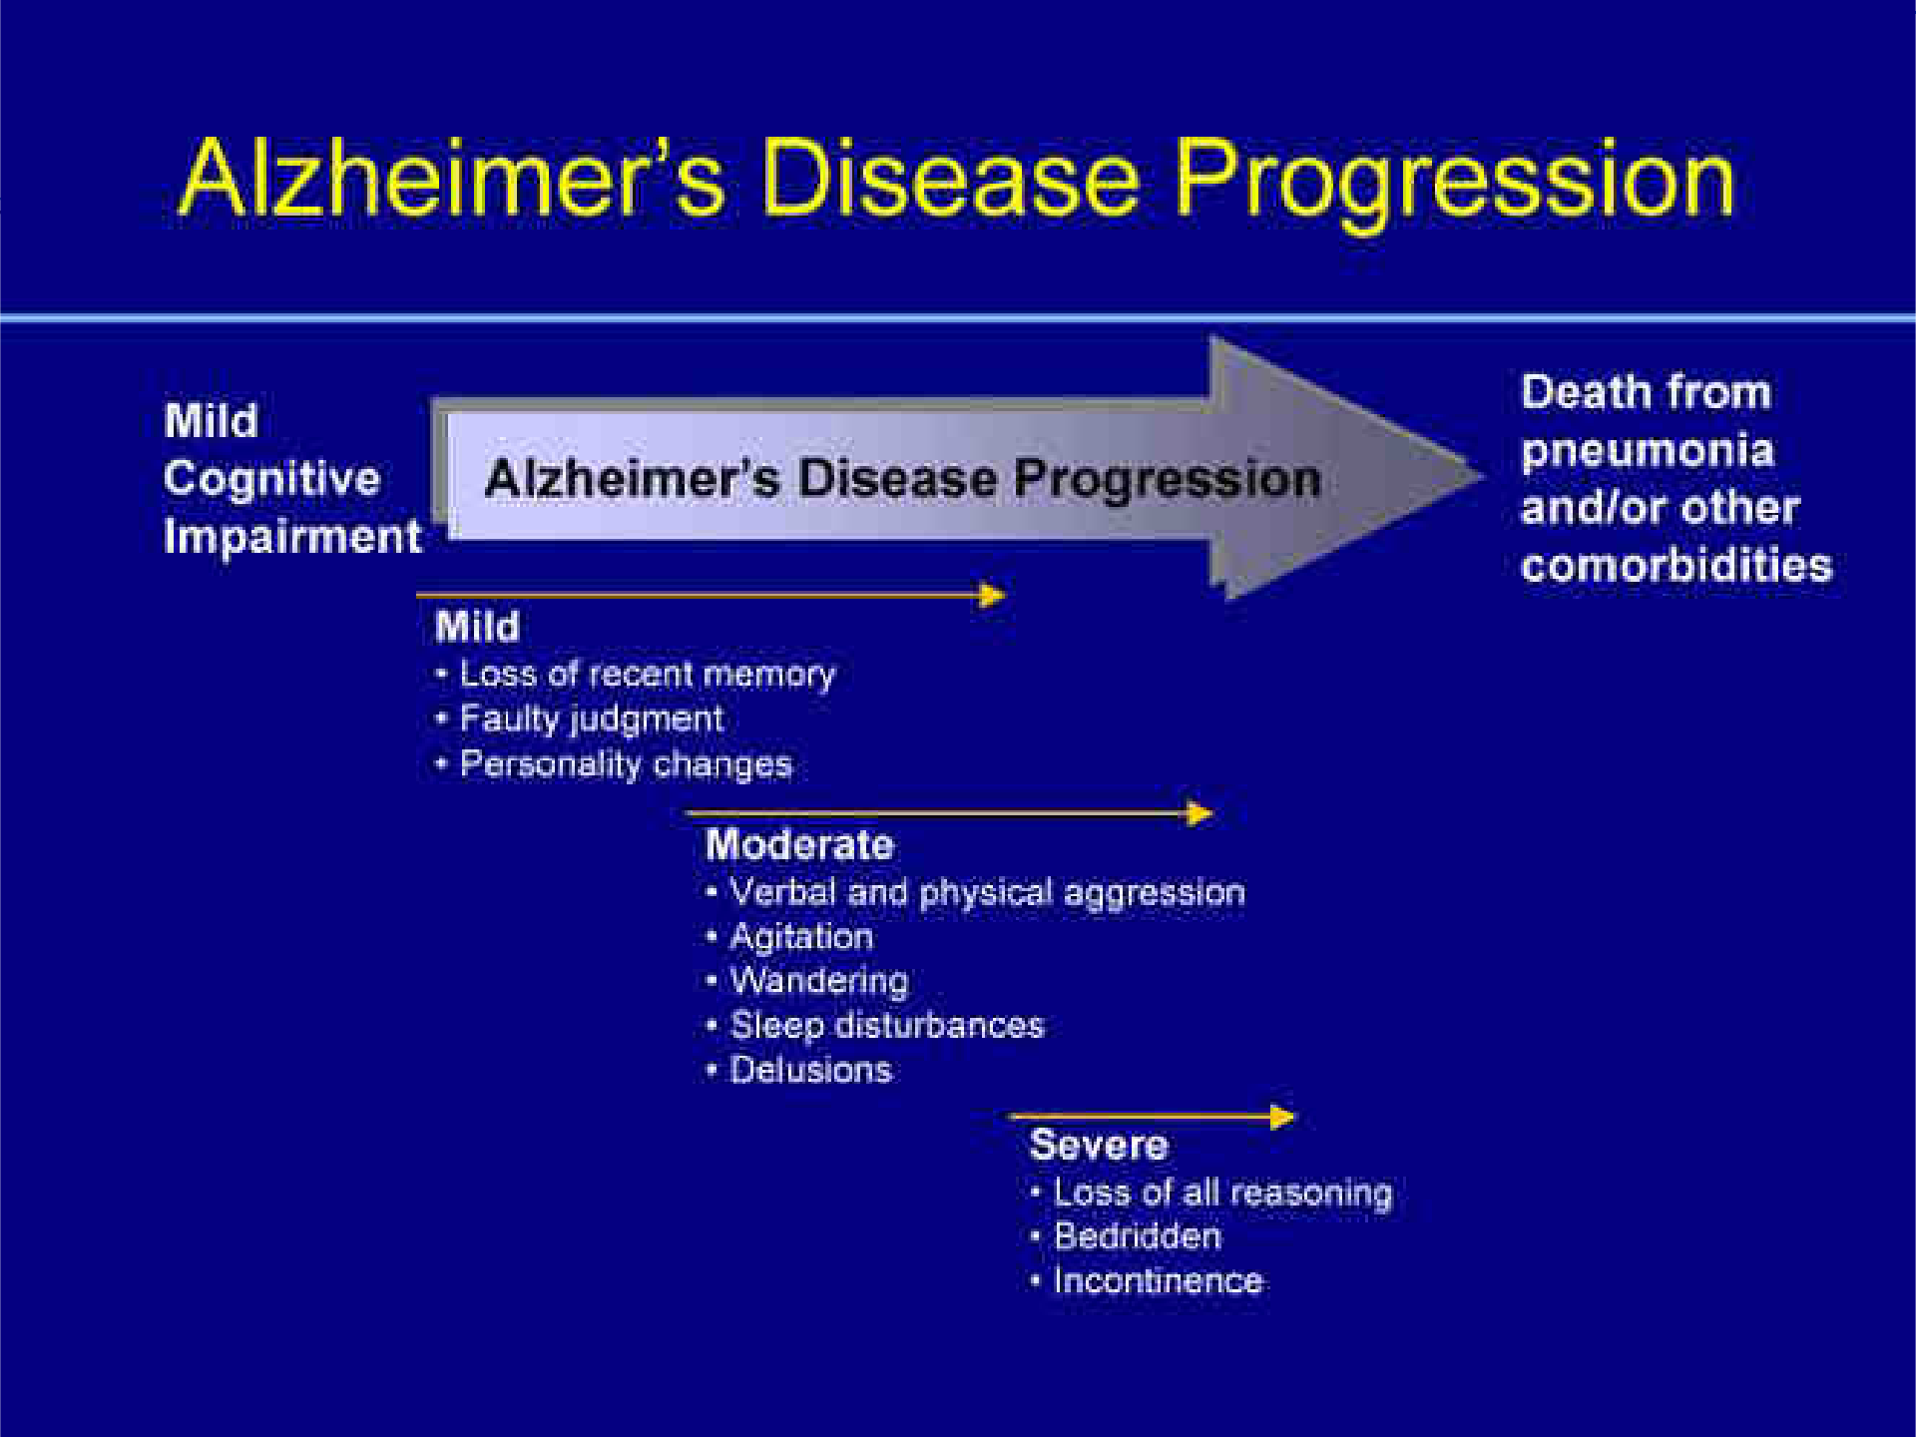
8 years average. Range – 2-20 years

Slide 13

CHARACTERISTICS OF AD
Aphasia
Loss or impairment of language caused
by brain dysfunction
Loss or impairment of language caused
by brain dysfunction
Inability to recognize
Inability to perform arithmetical
calculations
Inability to write Inability to read
➢Aphraxia
➢Agnosia
➢Acalculia
➢Agraphia
➢Alexia

Slide 14

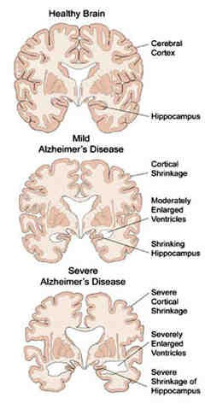

STAGES OF ALZHEIMER’S DISEASE
Alzheimer’s Disease was divided into four stages based on increasing
intellectual impairment in patients (Hasegawa and Aoba, 1994)
Predementia : In this stage, Mild cognitive impairments are noticed, doing mistakes in daily living activities. The most noticeable deficit is short term memory loss, semantic memory (Memory of meanings and concept relationships).
Early/Mild dementia
: In this stage, memory loss continues and changes in other cognitive abilities can be observed in the patients.
Moderate dementia
: In this stage, damage occurs in areas of the brain that controls language, reasoning, sensory processing and
conscious thought. Memory loss and confusion increase and people begin to have problems to recognizing family and friends.
Severe AD/ Advanced dementia
: In this stage, Plaques and tangles have spread throughout the brain and brain tissue has shrunk significantly. Patient with Severe AD cannot communicate and are completely dependent on others. Ultimately the patient dies from a secondary illness or infection or aspiration.

Slide 15

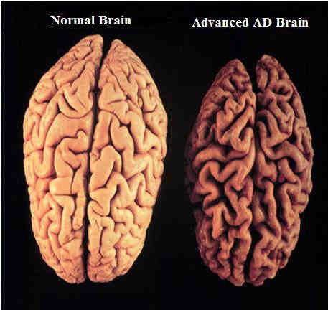
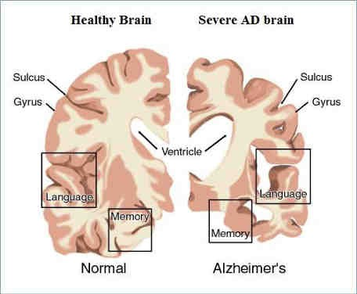

Slide 16
Hypothesis to explain the Biochemical Basis of AD
Cholinergic hypothesis:
The oldest hypothesis. According to this hypothesis Alzheimer’s Disease is caused by reduced synthesis of the neurotransmitter Acetylcholine, ultimately Acetylcholinesterase levels were increases which cause damage to the cholinergic neurons finally resulting in cognitive impairments.
Amyloid hypothesis:
The amyloid hypothesis was proposed by Hardy and Allsop in 1991. In AD, amyloid plaques are primarily composed of A-Beta peptides which are produced by cleavage of Amyloid Precursor Protein (APP). Mutations in APP lead to overproduction of insoluble Amyloid peptide and its deposition in the Neuritic Plaques.
Tau hypothesis:
In this Hypothesis, Hyperphosporylated tau begins to pair with other threads of tau and they become tangled up together inside nerve cell bodies into masses known as Neuro Fibrillary Tangles (NFT). Once this occurs, the microtubules disintegrate, collapsing the neuron’s transport system. This may result first in malfunctions in biochemical communication between neurons and later in the death of the cells (Chun and Johnson. 2007).

Slide 17

Treatments
Acetylcholinesterase inhibitors
NMDA Receptor Antagonists
Memantine (Namenda)
β-secretase (BACE) inhibitor
Anti-amyloid vaccine
Detoxification of β-amyloid
Metal ions reduction (Clioquinol)
Vitamin E intake

Slide 18

Now-a-days, several anti-Alzheimer's drugs available in the market are cholinesterase inhibitors. These drugs act on acetylcholinesterase (AChE) to reverse the enzyme activity or to restore acetylcholine levels in brain. Recent research findings suggested that, due to complex nature of the Alzheimer's Disease, it is necessary to find out the drug compound which is having AChE inhibitory activity along with antioxidant nature to treat Alzheimer’s Disease effectively.

Slide 19
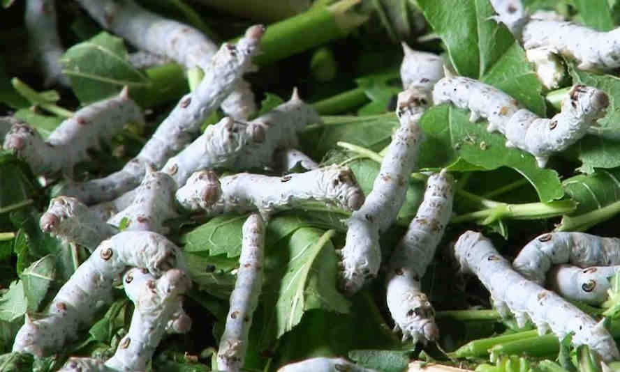
Silk Worm B.morri L. as a source of Sericin

Slide 20

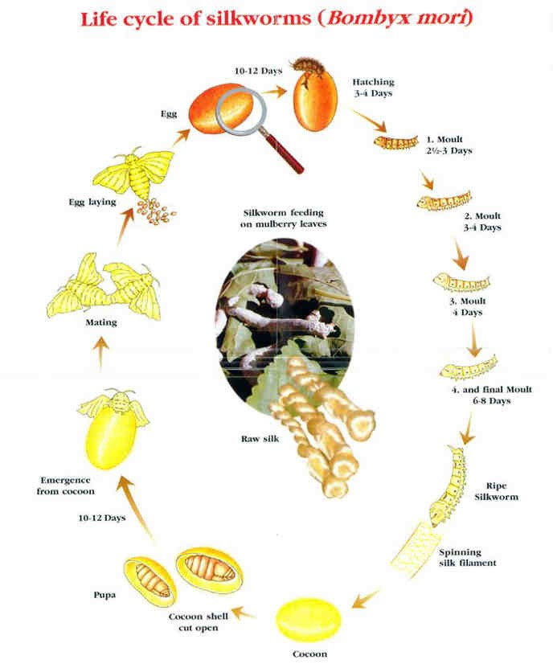



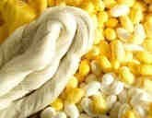


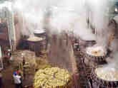


Silk cloth
Textiles
Sericin

Slide 21


Biological value of Sericin
Silk worm is biofactory for the production of silk. Silk cocoon consists
of two major proteins, fibroin and Sericin. Sericin contributes about 20-
30% of total cocoon weight and remaining fibroin.
Sericin is a value added biological product, because it contains serine and other essential 18 amino acids out of them 8 are essential amino acids for human, which plays a key role in different metabolic pathways.
It has wide application in Pharmaceuticals, Cosmetic industry and Food industry.
In Pharma industry, it has wide application viz., Anti-bacterial, Antioxidant, Wound healing, cell proliferation, antitumor activity and UV protection.
Due to its water soluble nature, it is widely used as a material for cosmetic industry as bioadhesive, moisturizing, antiwrinkle and antiaging factor.

Slide 22
Intake of sericin enhances bioavailability of Zn, Fe, Mg and Ca etc., Hence, it is the one of the valuable natural ingredient for the food industry.
Sericin is a complete protein and the amino acids compositions are with appropriate proportions in line with FAO/WHO standards. Nutritional values of sericin is 2 times higher than pork and 3times higher than meat.
Amount of Amino acid present in Silk protein, Sericin
Histidine - 0.64 Methionine - 0.63 Threonine
Isoleucine - 0.74 cystine - 0.7
- 0.72
Tryptophane - 1.1
Leucine Lysine
Methionine + cysteine –ab Phenylalanine + Tyrosine - 1.1
- 0.51
- 0.56
Valin - 0.57

Slide 23
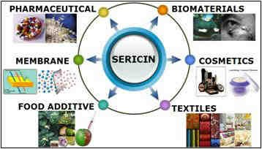
Due to soluble and Biodegradable characteristics, silk sericin has its bright prospect in tonics and cosmetic industry. Presently, many companies and research institutions have been involved in the development of sericin and fibroin biproducts, sericin protein powder.
In processing of raw silk cocoon, about 50,000 tons of sericin produced each year world wide, which is mostly discarded. If these sericin is recovered and recycled it will be a significant economic and social Benefit .

Slide 24
OBJECTIVES OF THE PRESENT STUDY
To
Evaluate the protective role of Silk Protein, Sericin against AD-
induced Rat.
Observe the Morphometric changes in control and experimental rats.
Assess the Learning and Memory efficiency by water Morris Water
Maze Test.
Investigate the effect of Sericin on cholinergic neurotransmitters viz.,
ACh and AChE.
Examine the changes in the enzymes connected with Antioxidant
system Viz., SOD, Catalase, GR and MDA.
Study the Histological changes in selected regions of control and experimental groups of Rats.
And finally to correlate these changes to the overall behavior of rat and to assess the anti-Alzheimer’s properties of Sericin.

Slide 25
MATERIALS & METHODS
Animal model
Age of Rat
Weight of Rat
Chemical agents used for Induction of AD in Rat
Route of Administration
Test substance
Route of Administration
Tissue selected
Regions selected
Isolation of tissues for Biochemical estimation
Institutional Animal Ethical :
Committee. Resolution No.
: Male Albino Rat
: Three months old
: 160±20 grams
: D-Galactose (D-Gal)
: Intraperitoneal injection (IP)
: Silk Protein, Sericin
: Oral
: Brain
: Cerebral cortex (CC) & Hippocampus (HC)
: 60th day and 90th day
04/(i)/a/CPCSEA/ IAEC/ SVU/ KY-KPR/
Dt.28-03-2011.

Slide 26
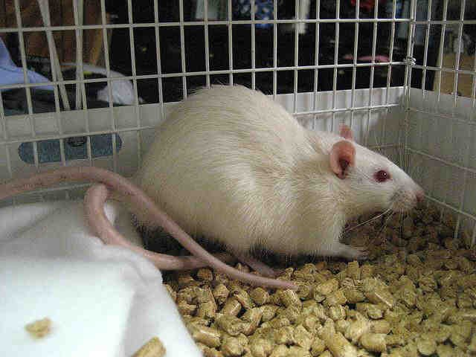
Experimental Animal model: Albino Wistar Strain Rat (Male) (04/(i)/a/CPCSEA/ IAEC/ SVU/ KY-KPR/ Dt.28-03-2011)

Slide 27
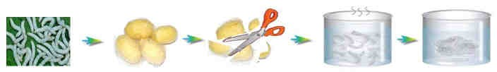

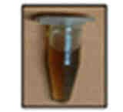
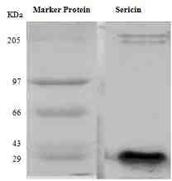
Extraction of Sericin from Silk Cocoons
Sericin
Fibroin
Degumming Process
Auto clave 120 ⁰C for 3 time
Separation of liquid and filament particles Concentration of liquid by using Rota evaporator
Identification of Sericin by SDS PAGE
Add 90% Ethanol to precipitate the Sericin
Sericin precipitate was separated by filtration
Sericin precipitate Allowed to air dry and lyophilized
Sericin Dissolved in water
Sericin Powder was collected in clean container and used to treat the rats

Slide 28
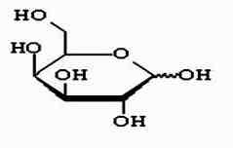
INDUCTION OF ALZHEIMER’S DISEASE IN RAT
Until now, researchers developed several methods to induce AD in animal model but the application of D-Galactose is considered to be quite successful method to inducing AD symptoms in animal models.
D-galactose (D-gal) is a common reducing sugar of mammalian body and can be converted to glucose under normal condition. Overloading of D- galactose, however, causes the accumulation of the metabolic products of sugar, such as galactitol (causing osmotic stress and generationn of ROS ) and it react with free amines of amino acids in proteins and peptides to form Advanced Glycation End Products (AGE) and results in oxidative damage of the tissue.
Intraperitoneal injection of D-Galactose induces the symptoms in animals, such as abnormal alterations in biochemistry markers, retrograde changes in neural cells, and memory impairments like Alzheimer’s Disease.

Slide 29
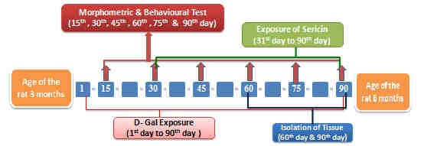
Schematic representation of experimental design

Slide 30











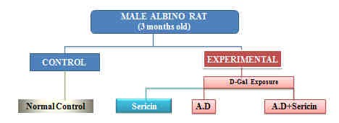
GROUP I
Control Rat
GROUP II
Rat, orally administered with Sericin (200 mg/kg body weight) up to 60
days (31st day to 90th day) continuously once in a day.
GROUP III
Rat, intraperitoneally (IP) administered with D-Galactose (120 mg/kg
body weight ) up to end of the experiment (1st day to 90th days).
GROUP IV
Rat, intraperitoneally injected with D-Galactose ( 120 mg/kg body weight ) once daily for first 30 days. from 31day onwards rats were administered (oral) with Silk extract Sericin (200 mg/kg body weight) along with D-Galactose up to 90th day.

Slide 31

STANDARD METHODS APPLIED FOR VARIOUS PARAMETERS
S.NO | NAME OF THE PARAMETER | METHODS EMPLOYED
I | Behavioural Aspects | Morris water maze experiment(1984)
II | Cholinergic system
 | Acetylcholine (ACh) | Metcalf method (1957) as given by Augustinsson (1957).
 | Acetylcholinesterase (AChE) | Ellman et al., (1961).
III | Antioxidant system
 | Superoxide dismutase (SOD) | Misra and Fridovich, (1971)
 | Catalase (CAT) | Modified version of Aebi, (1984)
 | Glutathione Reductase(GR) | Carlberg and Mannervik. (1985)
 | Lipid peroxidation (MDA) | Ohkawa et al., (1979)
IV | Histology | Humason et al., (1972)
31

Slide 32



STATISTICAL ANALYSIS
Values of the measured in different parameters were expressed as Mean ± SEM, Standard deviation and Analysis of variance (ANOVA) with Dunnett’s post-hoc test for multiple comparisons, using standard statistical software, SPSS (version 16). The results were presented with the F-value and p-value. In all cases F-value was found to be significant with p-value less than 0.01. This indicates that the effects of factors are statistically significant.

Slide 33

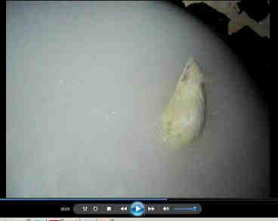
MORPHOMETRIC AND BEHAVIOURAL
ASPECTS

Slide 34
Graph-1: Graphical representation of differences in total body weights of Control and experimental groups of rats on selected days.
350
300
Body Weight
250
Weight in Grams
200
Control
SP-S
150
AD
AD+ SP-S
100
50
0
15th day
30th day
45th day 60th day
Days of Exposure
75th day
90th day

Slide 35



Graph-2: Graphical representation of learning and Memory efficiency of Control and experimental groups of rats by Morris Water Maze Test.
140
120
Morris Water Maze
Time in Seconds
100
Control SP-S AD
AD+ SP-S
80
60
40
20
0
15th day
30th day
45th day 60th day
Days of Exposure
75th day
90th day

Slide 36
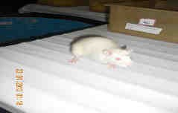
CHOLINERGIC SYSTEM

Slide 37


Graph-3: Graphical representation of changes in Acetylcholine content (µmoles of ACh/gm) in Cerebral cortex (CC) and Hippocampus (HC) brain regions of control and Experimental rats
Acetylcholine content (µmoles of ACh/gm)
50.00
Acetylecholine (ACh)
45.00
40.00
35.00
Control
30.00
SP-S
25.00
AD
20.00
AD+ SP-S
15.00
10.00
5.00
0.00
CC
HC
CC
HC
30 days
60 days
Dueration of the Treatment

Slide 38


Graphical representation of alterations in the activity of Acetylcholinesterase (invivo) in Cerebral cortex (CC) and Hippocampus (HC) brain regions of control and Experimental of rats.
Graph-4:
16.00
Acetylcholinesterase (AChE)
µmoles of ACh hydrolyzed/mg protein/h
14.00
12.00
10.00
Control
8.00
SP-S
AD
6.00
AD+ SP-S
4.00
2.00
0.00
CC
HC
CC
HC
30 days
60 days
Dueration of the Treatment

Slide 39

ANTIOXIDANT SYSTEM

Slide 40




Graph-5: Graphical representation of Alterations in Superoxide Dismutase activity level (units of superoxide anion reduced/mg protein/min) in Cerebral cortex (CC) and Hippocampus (HC) brain regions of control and Experimental rats
Superoxide dismutase (SOD)
3.50
3.00
superoxide anion reduced/
mg protein/min
2.50
Control
2.00
SP-S
1.50
AD
AD+ SP-S
1.00
0.50
0.00
CC
HC
CC
HC
30 days
60 days
Duration of the Treatment

Slide 41


Graph-6: Graphical representation of Alterations in Catalase activity level (µ moles of H₂O₂ decomposed / mg protein / min) in Cerebral cortex (CC) and Hippocampus (HC) brain regions of control and Experimental rats.
Catalase (CAT)
2.50
µ moles of H₂O₂ decomposed / mg
protein / min
2.00
1.50
Control
SP-S
1.00
AD
AD+SP-S
0.50
0.00
CC
HC
CC
HC
30 days
60 days
Duration of the Treatment

Slide 42




Graph -7: Graphical representation of Alterations in Glutathione Reductase(GR) activity (μ moles of NADPH Oxidized /mg protein /min) levels in Cerebral cortex (CC) and Hippocampus (HC) brain regions of control and Experimental rats.
2.00
Glutathione Reductase (GR)
μ moles of NADPH Oxidized /mg protein /min
1.80
1.60
1.40
1.20
1.00
Control SP-S AD
AD+SP-S
0.80
0.60
0.40
0.20
0.00
CC
HC
CC
HC
30 days
60 days
Duration of the Treatment

Slide 43


Graph -8 : Graphical representation of LPO levels (µ moles of MDA formed / g tissue / hr) in Cerebral cortex (CC) and Hippocampus (HC) brain regions of control and Experimental groups of rats.
Lipid Peroxidation (LPO)
8.00
7.00
6.00
µ moles of MDA formed / g tissue / hr
5.00
Control
4.00
SP-S
AD
3.00
AD+SP-S
2.00
1.00
0.00
CC
HC
CC
HC
30 days
60 days
Duration of the Treatment

Slide 44

Histological Aspects

Slide 45

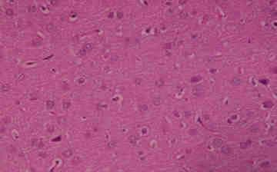
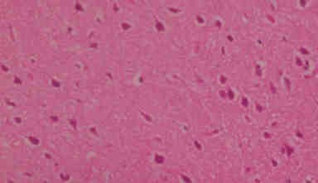
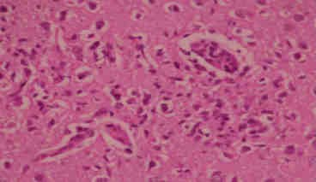
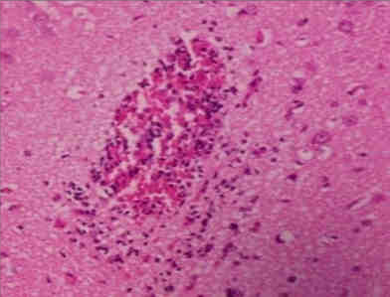



Plate-1: Sections of Cerebral Cortex region , stained with H & E – 60th day of experimentation (40 X)
Group - I (Control) Group - II (SP-S)
Group - III (AD)
Group - IV(AD + SP-S)
Group 1 & II Group III
: Brain Cerebral Cortex region showing highly active nerve cells with prominent nuclei.
: Arrows indicating the Amyloid Plaques with focal, spherical collections of dilated, neuritic
processes (dystrophic neurites) often around a central amyloid core in Cerebral cortex region.
: Neuritic plaques were observed in reduced size in the cerebral cortex than AD group.
Group IV

Slide 46
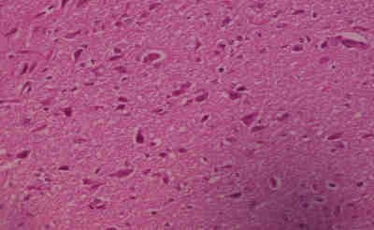
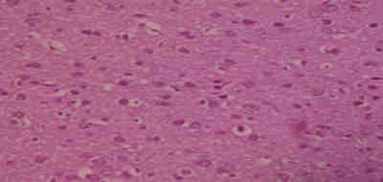
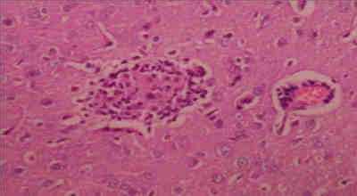
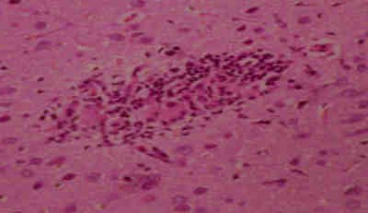




Plate-II: sections of Cerebral Cortex region stained with H & E – 90th day of experimentation (40 X)
Group - I (Control) Group - II (SP-S)
Group - III (AD)
Group - IV(AD + SP-S)
Group 1 & II Group III
: Brain Cerebral cortex region showing highly active nerve cells with prominent nuclei.
: Arrows showing Neuritic Plaques in cerebral cortex region with central amyloid core surrounded by dystrophic neurites and clear halo region.
: Arrows showing focal gliosis in the cerebral cortex with disappearance of the most AB plaques
Group IV

Slide 47

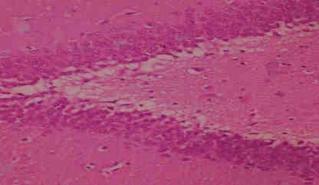
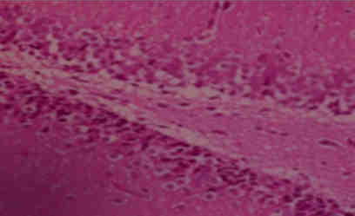
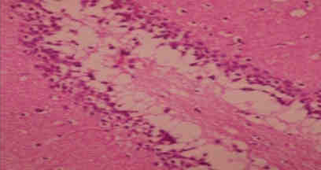
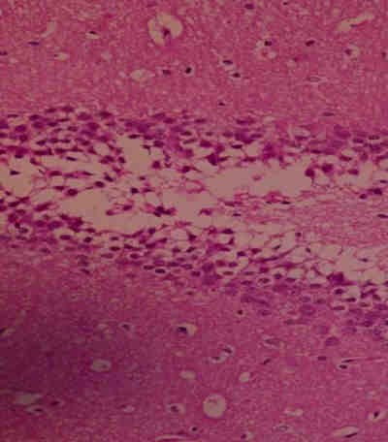

Plate –III : Sections of hippocampus region stained with H & E – 60th day of experimentation (40 X)
Group - I (Control) Group - II (SP-S)
Group - III (AD)
Group - IV(AD + SP-S)
Group 1 & II
: Hippocampus region showing neurons with large vesicular nuclei with prominent nucleoli and amphophilic cytoplasm.
: Hippocampus region showing shrunken in neuron cell size with dense and hyper chromatic nuclei, and each neuron has now acquired a clear space around itself due to retraction of the cell body.
: showing slight neuronal shrinkage with large and vesicular nuclei .
Group III
Group IV

Slide 48
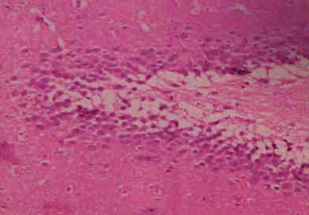
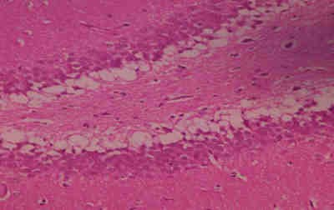
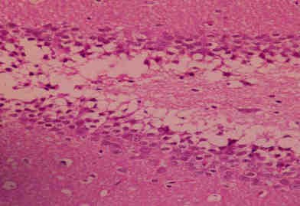
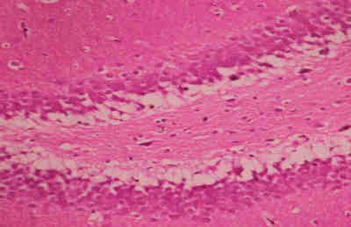


Plate IV: Sections of Hippocampus region stained with H & E – 90th day of experimentation (40 X)
Group - I (Control) Group - II (SP-S)
Group - III (AD)
Group - IV(AD + SP-S)
Group I & II
: Hippocampus region showing neurons with large vesicular nuclei with prominent nucleoli and amphophilic cytoplasm.
: Hippocampus region Showing shrunken in neuron cell size with dense and hyper chromatic nuclei, and
each neuron has now acquired a clear space around itself due to retraction of the cell body (Arrows)
: Hippocampus region showing reduced vacuole around neuron with large and vesicular nuclei (Arrows).
Group III
Group IV

Slide 49



CONCLUSIONS
Morphometric and Behavioural studies:
From the results, it was observed that, Silk Protein, Sericin showed positive effects
on body weight, learning skills, memory (Cognitive) abilities in AD-induced rats.
Cholinergic system: (ACh and AChE):
From my observations, it was obvious that Sericin exerted anti-cholinesterase properties in AD-induced rats by elevating the levels of ACh and inhibiting the AChE activity in all selected regions of brain
Antioxidant System:
The AD induced rats showed down regulation of SOD, CAT, GR activities, while MDA levels were increased. Where the AD- induced rats simultaneously treated with Sericin showed antioxidant activity by increasing the levels of SOD, CAT and decreased levels of GR levels. It indicates that, Sericin has Antioxidant property.
Histological studies:
From my observations on the histological studies, it was obvious that AD- induced changes were reversed by treating rat with Sericin.
From this study, it was concluded that Silk Protein, Sericin can be suggested as a
potential cognitive enhancer for Alzheimer’s Disease.

Slide 50


ACKNOWLEDGEMENTS
We thank Department of Biotechnology (DBT), New Delhi for
providing Travel support to present my research work at this
conference.
We also thank to UGC, New Delhi for providing Financial support to carryout research work through Moulana Azad National Fellowship (MANF) to my research Student Dr. K. Peera.

Slide 51




