Slide 1
Make Your
Immunology Research Easy
Kun YIN
Associate Director of Marketing Division, GenScript

Slide 2
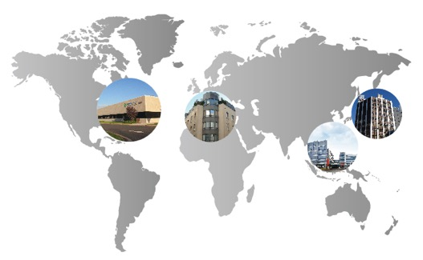
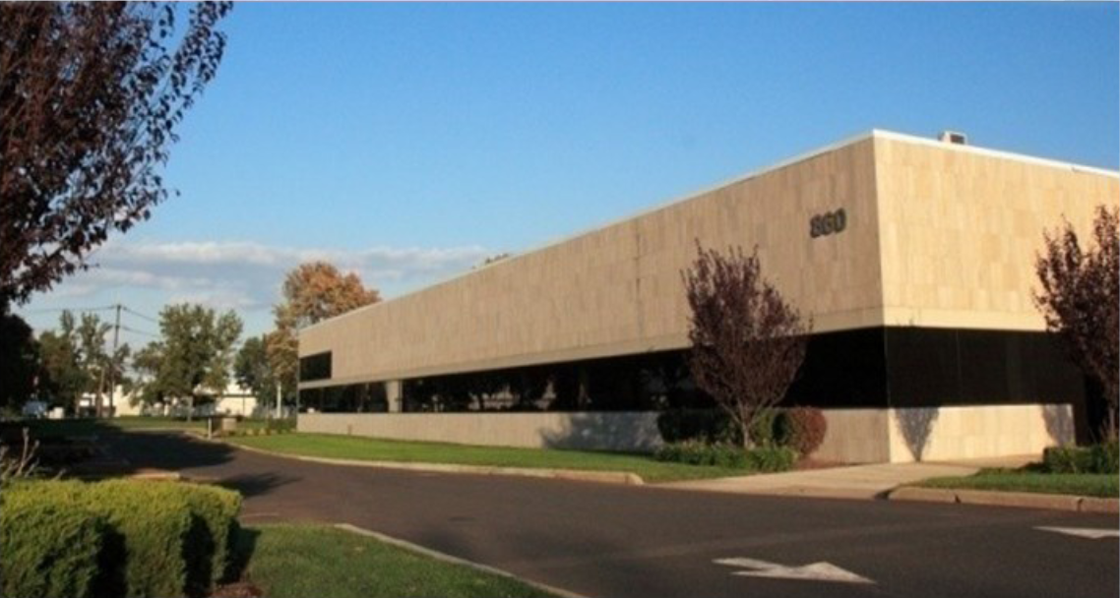
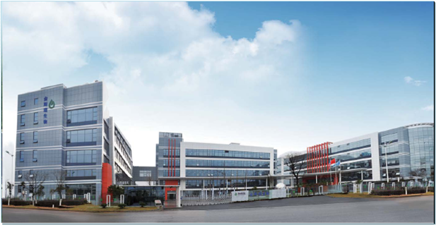
GenScript Overview
Branch Office
Amsterdam, Netherlands
Branch Office
Tokyo, Japan
Headquarter, New Jersey, US
Headquarters
Piscataway, NJ
R&D Facility
Nanjing, China
  Founded in 2002
  Headquarters in Piscataway, NJ
  Facilities and branches: Europe, Japan, China
  1,700 employees
  Leading CRO (Contract Research Organization)
    2014/2015 CRO Leadership Award
Production Center, Nanjing, China

Slide 3
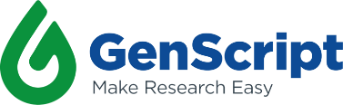
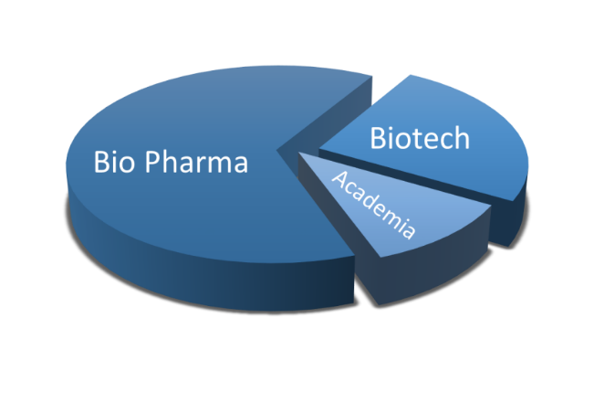
























Customer Composition
30,000 customers in 90+ countries
Including big bio pharma and famous scientific research institutions

Slide 4
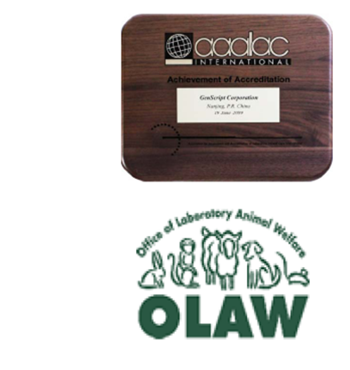
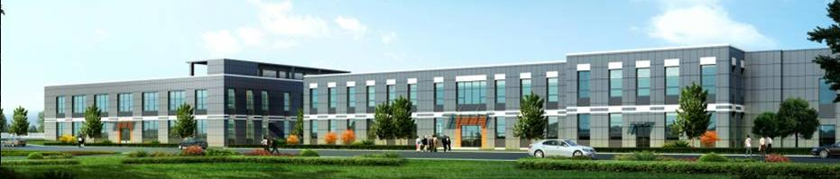
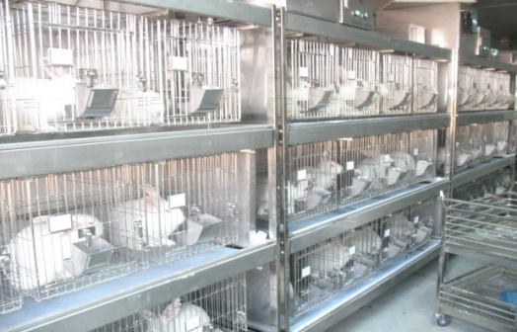
Antibody Capacity at GenScript
AAALAC International and OLAW accredited animal facility
  6,000 sq.m, hosting more than 8,000 rabbits and 12,000 rodents
  Providing a broad range of antibody services from individual cases to bulk orders
High volume output and track record
  >100,000 pAb projects
  >10,000 mAb projects (delivered ~ 1 million monoclones)
  >200 therapeutic lead generation projects
  >60 lead optimization projects
Global headquarters
Piscataway, New Jersey, USA
Polyclonal Antibody Project
500-800/Month
Monoclonal Antibody Project
50-100/Month
Antibody Related Project
50/Month

Slide 5
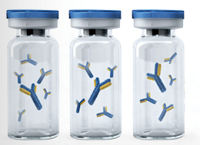
Therapeutic Antibody Discovery

Slide 6
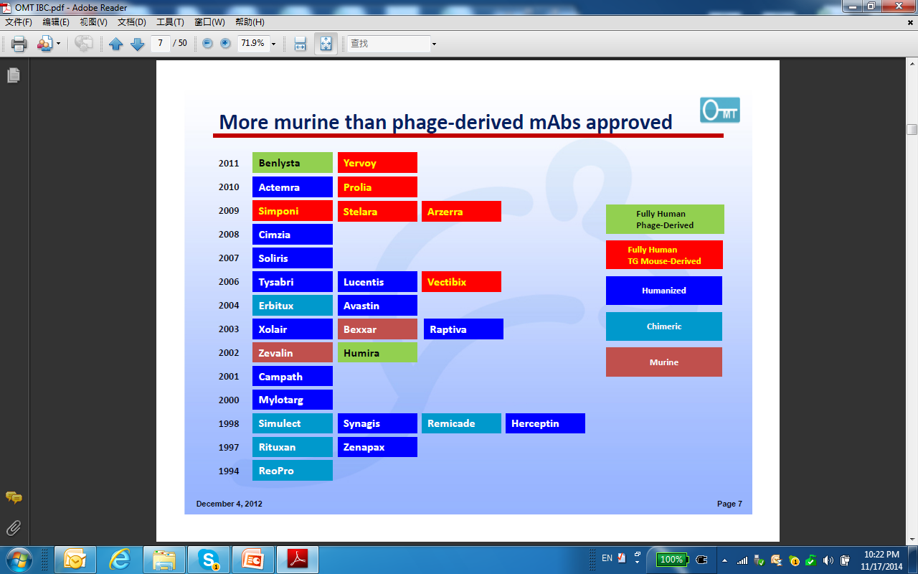
Hybridoma Technology–Old but Powerful
By 2016, FDA has approved over 62 therapeutic antibody drugs.
Over 50 were derived from hybridoma technology, 8 from phage-display technology.
The hybridoma technology generates high market value.
Notes:
There are several technologies to generate therapeutic antibody leads. Hybridoma approach with human transgenic mice or B-cells from immunized human body can directly generate human antibodies. We have collaborated with Harbour to use their H2L2 mice for fully human antibody generation. The major limitations of using transgenic animals for fully human antibody are that the technologies are very limited and the cost is extremely high. The most popular one is still hybridoma approach with rodent system in which you get rodent antibodies and then perform humanization to get humanized antibodies. Phage or yeast display is also an option to get humanized or human antibodies depending on the library built, and we also have this capability. Besides the hybridoma and library approaches, there are other technologies for generating therapeutic antibodies, including the SLAM technology which recovers the variable region sequences from specific single B cell from immunized animals and is able to generate humanized antibodies. More recently, next generation of antibody sequencing from naïve or immunized individuals can also be applied to generate human or humanized antibodies.
As mentioned, hybridoma technology has been around since 1970s, but still powerful. By 2016, FDA has approved over 62 therapeutic antibody drugs, and most of them are derived from hybridoma technology, and only 8 from phage-display platform. The hybridoma technology still generates high market value by inputting more therapeutic antibodies into the market. Here are several approved antibody drugs from each technology platform. As you can see that most of them are derived from hybridoma approach as fully human antibodies from transgenic mice (colored red) or humanized antibodies from rodent system (colored blue).

Slide 7
Discovery Roadmap
Milestone | Timeline (months)
 | 1 |  | 2 |  | 3 |  | 4 |  | 5 |  | 6 |  | 7 |  | 8 |  | 9 |  | 10 |  | 11 |  | 12 |  | 13
Material Preparation Protein antigen, Overexpressing cell line for membrane target, Reference Ab, DNA plasmids for DNA immunization
2. Immunization Protein immunization for soluble targets and ECD of TM targets, Cell and DNA immunization for TM targets, ImmunoPlus modification for high homology targets, Carrier protein conjugation to enhance immune responses
3. Fusion & Screening Cell fusions with ELISA and/or FACS screening, Other screening(such as ligand blocking screening, cross-species reactivity test)
4. Subcloning One-round subcloning with ELISA and/or FACS screening, Final subcloning and cryopreservation of final subclones, Other screening (such as ligand blocking screening, cross-species reactivity test)
5. Antibody Production Antibody mini-production (0.1mg), Antibody midi-production (0.5-1mg), Antibody maxi-production (5-15mg)
6. Antibody Characterization ELISA EC50, Binding by FACS for membrane targets, Species cross-reactivity test, ELISA IC50, Ligand blocking by FACS for membrane targets, Epitope binning, Affinity measurement, Antibody sequencing, In vitro functional assay
7. Antibody Humanization Chimeric antibody production and affinity confirmation, Humanization by rationale design, Thermal stability and expression level evaluation, Humanized antibody production and affinity determination
Testing
Development
Discovery

Slide 8
Hybridoma Platform for Lead Generation
Conventional Hybridoma
Generation Procedures
GenScript’s Expertise
Immunogen Preparation
Multiple approaches on immunogen preparation
Variety of choices on host animals
Optimized adjuvant and immunization schedule
ImmunoPlusTM to break immune tolerance
Immunization
.
Fusion Screening
Electro-fusion with high fusion efficiency
Subcloning and Stabilization
High throughput screening for the binders against
the most native epitopes
Antibody Production
High quality, multi-scale (serum free, Low endotoxin)
Antibody Characterization
Multiple characterization tools to narrow down
the hits list for lead selection
Notes:
Conventional hybridoma generation procedures follow immunogen preparation, animal immunization, fusion and hybridoma screening, subcloning and hybridoma cryopreservation and antibody production. GenScript has extensive experience in all of these critical steps, from multiple approaches on immunogen preparation to variety of choices on host animals and optimized adjuvant and immunization schedules. We also have high efficient electro-fusion platform and high throughput screening platforms for identifying binders against the most native epitopes. Multiple characterization tools are built in to narrow down the hits list for lead selection. Moreover, we have a very experienced team for project management and in the last 13 years we have successfully delivered more than 10000 antibody projects including over 200 therapeutic antibody projects. In the next couple slides, I will expand a little bit on each of our expertise in the critical paths.

Slide 9
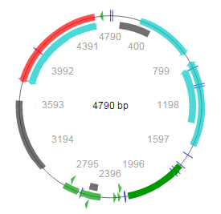
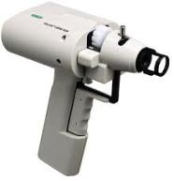


Multiple Immunogen Designs
DNA immunization to deliver the target DNA plasmid into the host animals and make protein of interest expressed in vivo
Peptides designed by OptimumAntigenTM design tool
Recombinant proteins secreted proteins, extracellular domain of membrane proteins, membrane preps
Whole cell Receptors including GPCRs; surface antigens including immune checkpoint proteins, ion channels and transporters
Virus like particle (VLP) that contains enriched membrane protein
Combination of the above
CHO-K1
pCAGGS
Target transfected cell
Target expression plasmid
Gene Gun
Notes:
We have multiple choices of immunogens on a target basis, from peptide which can be native or modified, to protein including secreted proteins, extracellular domain of membrane proteins and membrane preps. Whole cell and DNA immunization are suitable for receptors including GPCRs, surface antigens including immune checkpoint proteins, ion channels and transporters. Virus-like particle is efficient in incorporating membrane targets for immunization. Each of the immunogen design has its own advantages and limitations. We can also use a combination of the various immunogen options following specific project requirement.

Slide 10
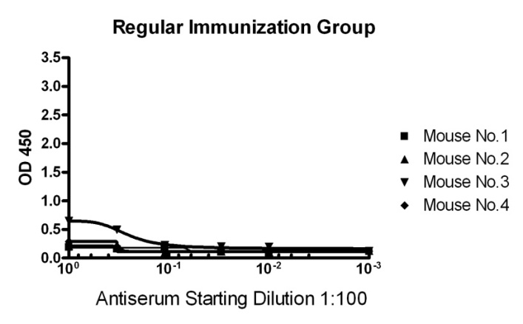
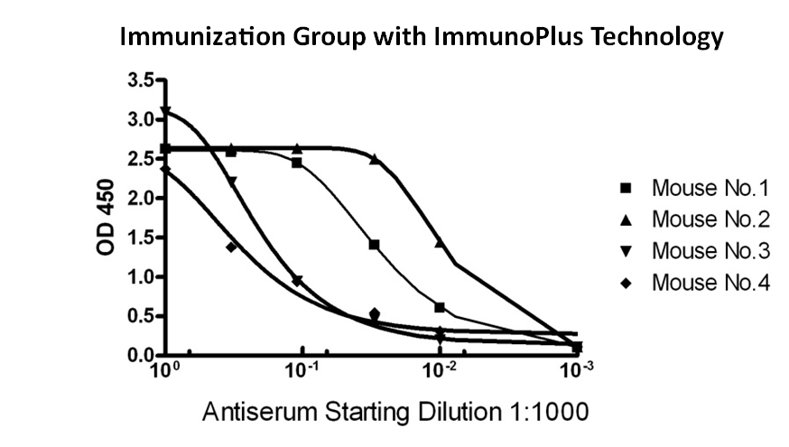
ImmunoPlusTM Break Immune Tolerance
ImmunoPlusTM: A powerful tool to break immune tolerance and enhance Antigenicity
Ideal for raising antibodies against antigens of high degree of homology between human and rodent counterparts
Case: an Ag, human/mouse seq identity: 96%
Surrogate Ab of ‘mouse against mouse’ or ‘rat against rat’ can be generated, which have great utility in drug validation and development.
10
Notes:
In the case that our human target has high homology with the rodent counterparts, we have the proprietary ImmunoPlus technology to break the immune tolerance. In the case shown below, before applying this technology, all the four mice did not generate sufficient antibody response against the high homology target. However, after applying the ImmunoPlus technology, all mice generated significant antiserum titers. Another application of this ImmunoPlus technology is to develop surrogate antibody such as mouse anti-mouse antibody for target validation.

Slide 11
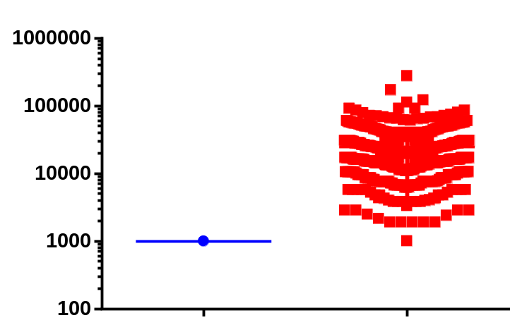
Immunization and Hybridoma Fusion
Multiple choices of animal strains
  Mouse: Balb/c, C57Bl/6, MRL, C3H/He, SJL and GANP transgenic mouse
  Rat: Wistar and Sprague Dawley
  Rabbit: MonoRabTM platform
  H2L2 Transgenic mouse from Harbour
Reproducible high-titer in most cases
  By average >1:512,000
Electrofusion
  High cell-fusion efficiency to increase the size of library
Hybridoma number
Traditional method
GenScript high efficiency fusion
Notes:
After the project is evaluated on a target-basis, and the immunogens have been prepared accordingly, we could start immunization and hybridoma fusion. As mentioned, multiple choices of animal strains are available and in most cases they can reach a very high titer after third immunization with an average titer of 512K. Based on our experience, SJL mice offers high antibody diversity. Our licensed GANP mice are good for generating high affinity antibodies. Besides mice and rat, we have also established our proprietary MonoRab rabbit monoclonal antibody platform, even though to date no rabbit antibodies are approved by FDA or EMA probably due to immunogenicity concerns, but several are in clinical trials. H2L2 mice from Harbour are able to generate fully human antibodies. Compared with library approach, hybridoma approach offers the great advantage of high developability of antibody leads, but has the intrinsic disadvantage of missing potential antibody sequences due to low fusion efficiency. The electrofusion method we used guarantees high cell-fusion efficiency to increase the size of hybridoma for screening. We observed an average fusion efficiency of 1 hybridoma over 2000 B cells, resulting 20000 to 50000 hybridomas per animal. The plot on the right is a summary of the hybridoma obtained from our recent 575 projects. Compared with traditional PEG fusion, which usually results in 1000 to 2000 hybridomas, the high-efficient electro fusion generated an average of 50000 hybridomas for screening.

Slide 12
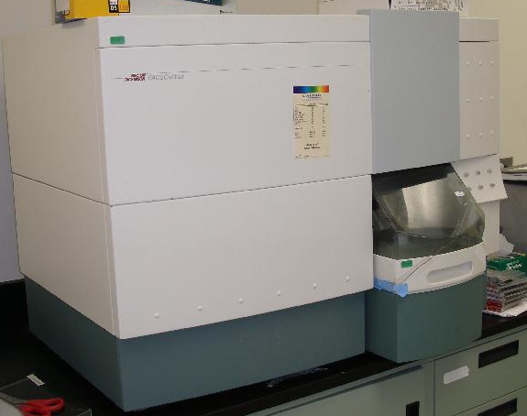
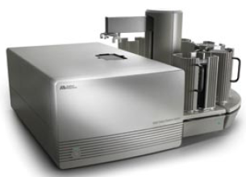
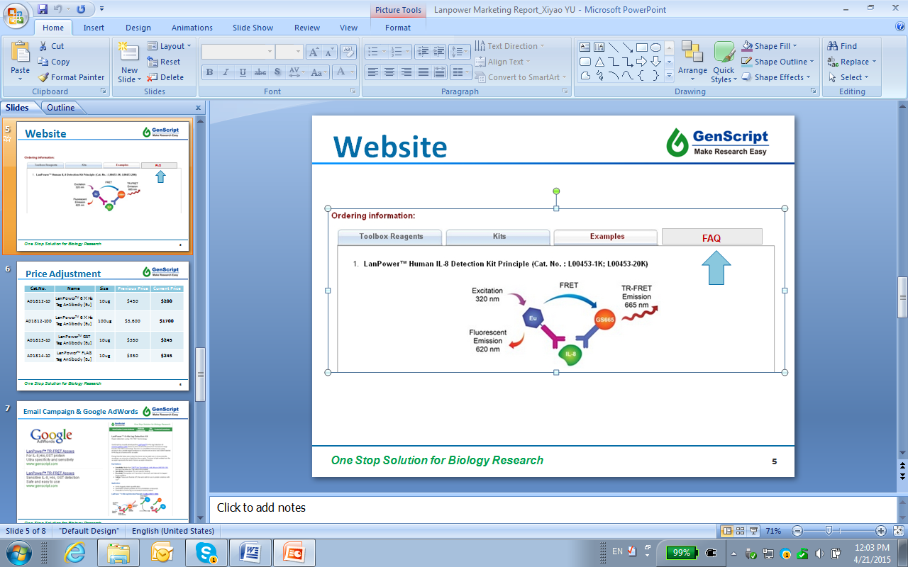
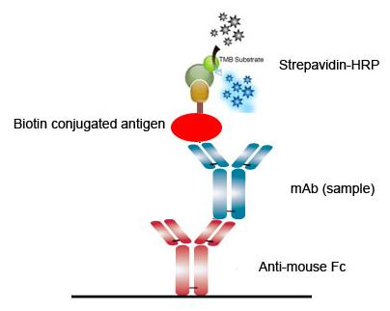
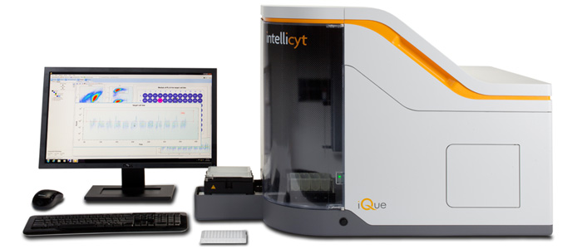
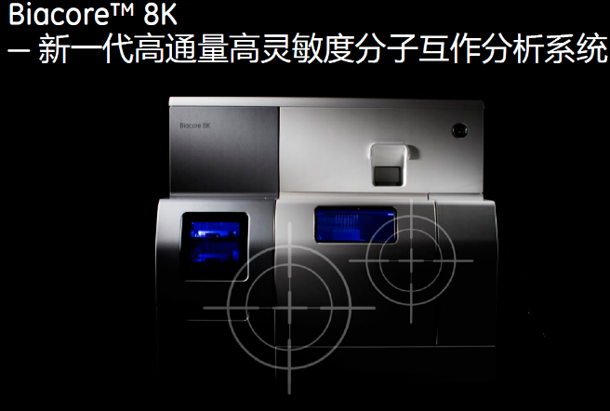
High-Throughput Binder Screening
Natural epitope-based
  Soluble target: ELISA (capture and indirect), TR-FRET
  Membrane target: FACS and FMAT
BD FACSCalibur with HTS loader
Homogeneous (HT MarchTM )
  NativeSelectTM screening
  HTS iQue™ Screening System
Notes:
After we obtain a large number of hybridomas, the next step is to perform hybridoma screening for binders. We have multiple natural epitope-based high throughput screening platforms. For soluble target, both capture and indirect ELISA are in place. For membrane target, we have BD FACS Calibur with HTS loader and HTS iQue Screening System which can read a 96-well plate in 3-5 minutes by FACS. We are also equipped with the homogeneous HT March binding assay system for membrane target binder screening. Next generation Biacore 8K is also in place for high through screening and characterization. With these HTS platforms, we are able to identify numerous hits of binders.

Slide 13
Lead Characterization
Therapeutic antibody discovery aims to identify highly specific functional clones as the leads for downstream antibody drug development, and therefore multiple antibody characterizations are needed.
A pack of tools:
ELISA, WB, DOT, IP, FACS
Binding activity (EC50)
Ligand blocking activity (IC50)
Species cross-reactivity and family member specificity
Epitope binning (ELISA or SPR based)
Affinity measurement (Kd by Biacore T200)
Cell-based functional assays (EC50 or IC50)
Antibody sequencing
Notes:
After we get large number of hits, multiple characterization methods need to be performed to identify functional antibody leads with high specificity and affinity.

Slide 14
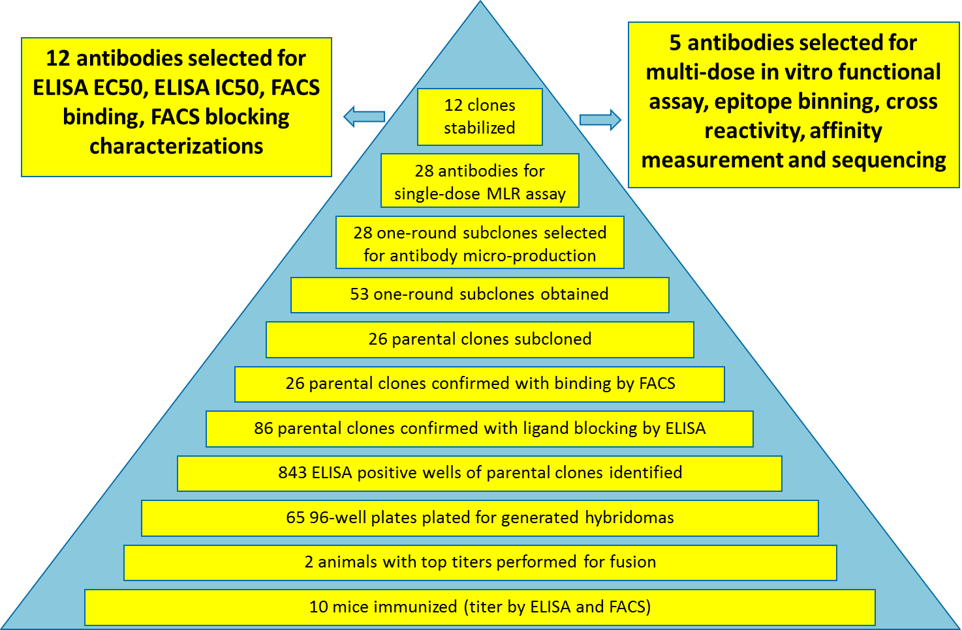
Case Study: Anti-Immune Checkpoint Lead Identification
Note: the marketed drug was used as positive control
Notes:
This is the overview of this comprehensive case study. In this practice, 10 mice were immunized and the bleed titers were evaluated by both ELISA and FACS. After that, 2 animals with top titers were performed for fusion, and the generated hybridomas were plated into 65 96-well plates. After primary and confirmative screening, 843 ELISA positive wells of parental clones were identified, and 86 of them were confirmed with ligand blocking activity by ELISA. Of which 26 parental clones were confirmed with binding by FACS, and they proceeded to one-round subcloning. 53 one-round subclones were obtained and we selected 28 of them for antibody micro-production. Those 28 antibodies were validated by mixed lymphocyte reaction functional assay, which is a standard functional assay for immune checkpoint antibody lead identification. After the single-dose MLR functional assay, 12 of the one-round subclones were further subcloned to obtain stabilized final clones, and then larger scale antibody production was performed. For those 12 antibodies, multiple characterizations, including ELISA EC50 and FACS for binding activity, ELISA IC50 and FACS for ligand blocking activity. After those characterizations, 5 antibodies were selected for multi-dose MLR functional assay, epitope binning, cross-species reactivity, affinity measurement and sequencing. In this way, we showed how functional leads were identified through hybridoma approach. In the next few slides, detailed data will be presented.

Slide 15
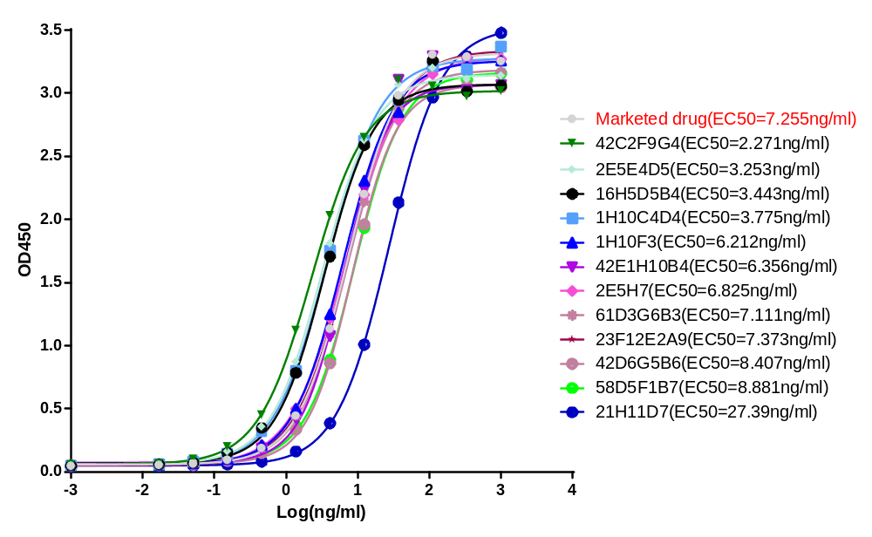
12 Antibodies ELISA EC50
Notes:
This slide shows the ELISA EC50 to evaluate the binding activity of 12 antibodies, using the marketed drug as the reference. As you can see that, many good binders have been obtained with comparable or even better binding activity compared with reference marketed drug.

Slide 16
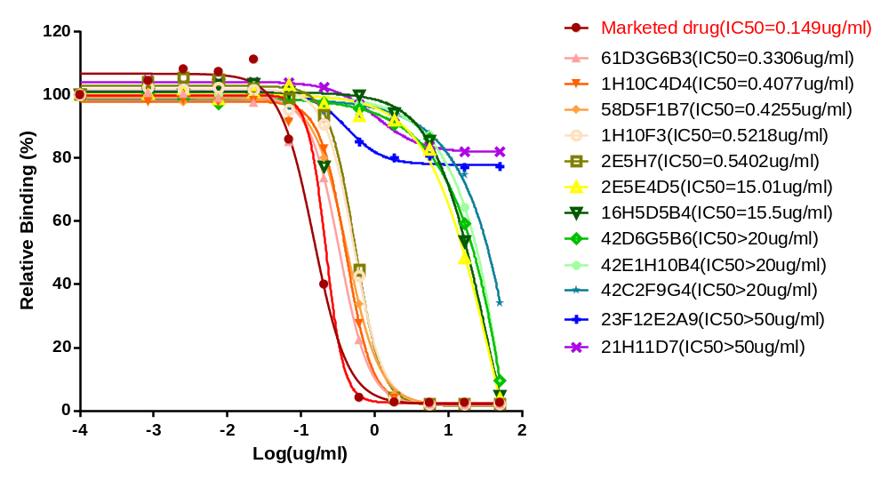
12 Antibodies ELISA IC50
Notes:
In this slide, the 12 antibodies were evaluated for their ligand blocking activity, and again we have obtained several antibody leads comparable to marketed drug. There are some antibodies showed very low ligand blocking activity such as 21H11D7 and 23F12E2A9, which probably should not be selected as leads for further downstream development.

Slide 17
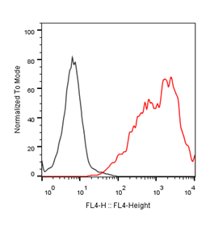
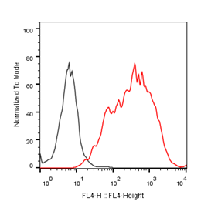
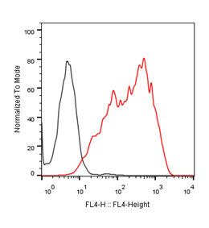
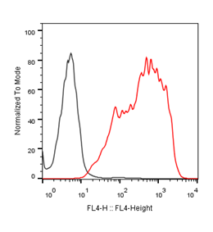
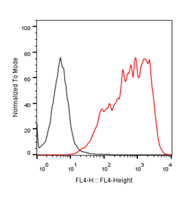
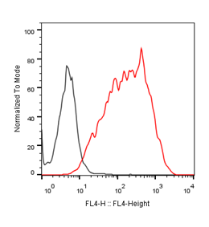
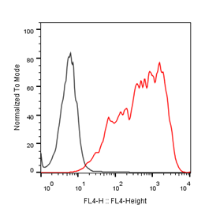
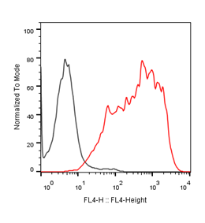
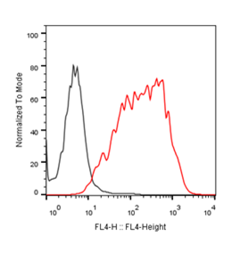
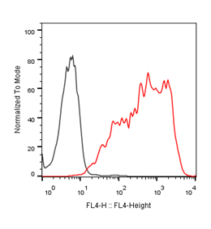
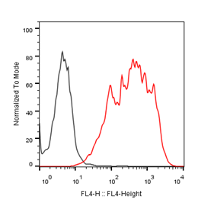
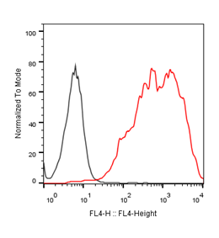
12 Antibodies FACS Binding
1H10F3
42C2F9G4
21H11D7
23F12E2A9
61D3G6B3
2E5E4D5
58D5F1B7
42E1H10B4
2E5H7
42D6G5B6
16H5D5B4
1H10C4D4
Black: negative cell line + purified antibody + secondary antibody
Red: Positive cell line + purified antibody + secondary antibody
Notes:
This slide evaluated the surface binding of 12 antibodies to cell lines overexpressing the target. As you can see from the data, all 12 antibodies showed decent binding to membrane bound target.

Slide 18
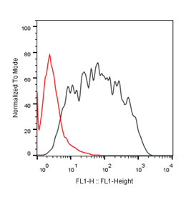
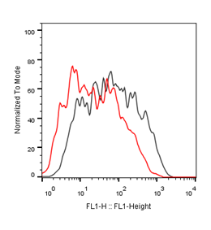
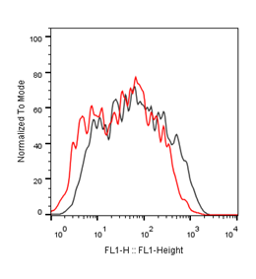
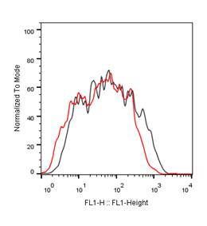
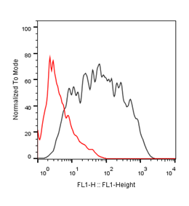
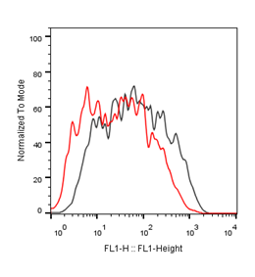
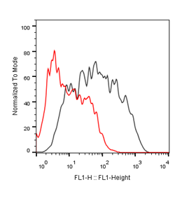
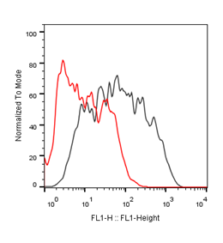
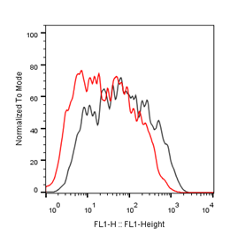
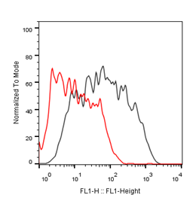
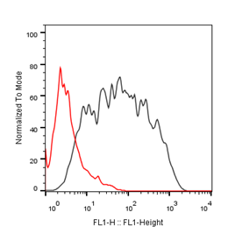

12 Antibodies FACS Blocking
1H10F3
42C2F9G4
21H11D7
23F12E2A9
61D3G6B3
2E5E4D5
58D5F1B7
42E1H10B4
2E5H7
42D6G5B6
16H5D5B4
1H10C4D4
Black: Positive cell line + PBS + ligand protein + secondary antibody
Red: Positive cell line + purified antibody + ligand protein + secondary antibody
Notes:
In this slide, ligand blocking activity of the 12 antibodies was evaluated by FACS against membrane bound target. Most antibodies showed efficient ligand blocking activity, but not 21H11D7 and 23F12E2A9, which is consistent with the ELISA IC50 results.

Slide 19
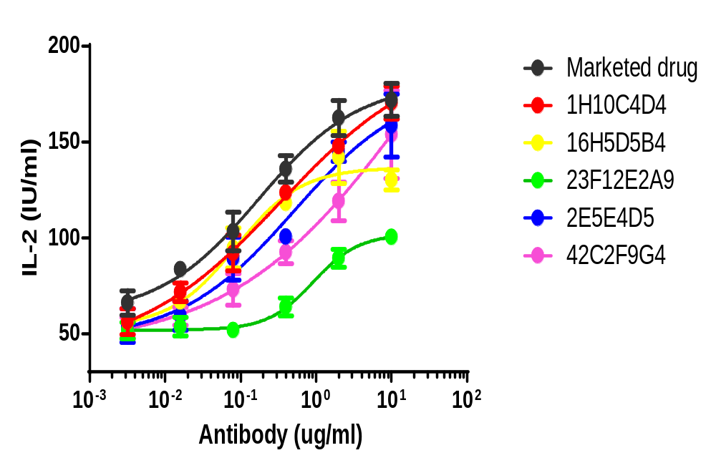
5 Antibodies Multi-dose MLR
Notes:
After those binding and ligand blocking activity tests, 5 antibodies were selected for multi-dose functional assay, which is the mixed lymphocyte reaction assay. Again, the marketed drug was used as the reference control, and we have obtained therapeutic leads with comparable in vitro functional activity with reference marketed drug.

Slide 20
5 Antibodies Epitope Binning
 | Marketed Drug-biotin | 1H10C4D4-biotin | 23F12E2A9-biotin | 42C2F9G4-biotin | 16H5D5B4-biotin | 2E5E4D5-biotin
control | 2.024 | 2.568 | 1.008 | 1.398 | 2.446 | 1.116
Marketed drug | 0.082 | 1.371 | 0.842 | 0.145 | 1.229 | 0.183
1H10C4D4 | 0.118 | 0.102 | 0.812 | 0.083 | 0.094 | 0.059
23F12E2A9 | 1.811 | 2.432 | 0.058 | 1.462 | 2.374 | 1.08
42C2F9G4 | 0.655 | 1.713 | 0.984 | 0.134 | 1.485 | 0.23
16H5D5B4 | 0.142 | 0.116 | 0.905 | 0.076 | 0.097 | 0.056
2E5E4D5 | 0.24 | 0.307 | 0.884 | 0.08 | 0.236 | 0.064
The epitope of 23F12E2A9 is different with other antibodies
1H10C4D4 and 16H5D5B4 may have stronger affinity than marketed drug to the same epitope on the target
Notes:
In the last slide of this case study, epitope binning was performed for the five antibodies to see whether they share the same epitope or not. As you can see from the checkerboard assay format, four antibodies could compete with the marketed drug for the binding of antigen, which showed that probably they share the same epitope. In contrast, the antibody 23F12E2A9 did not compete with other four antibodies as well as the marketed drug, which showed that very likely this antibody binds to a different epitope on the antigen. If you remember from the previous ELISA IC50 and FACS blocking data, this antibody also did not have ligand blocking activity, and this is consistent with the idea that it binds to a different epitope. Another message is that 1H10C4D4 and 16H5D5B4 may have stronger affinity than marketed drug to the same epitope on the target, as demonstrated by better competing ability with marketed drug, which is also consistent with previous ELISA EC50 data.
So far, we have shared a case study of how therapeutic antibody leads were identified by hybridoma approach.

Slide 21
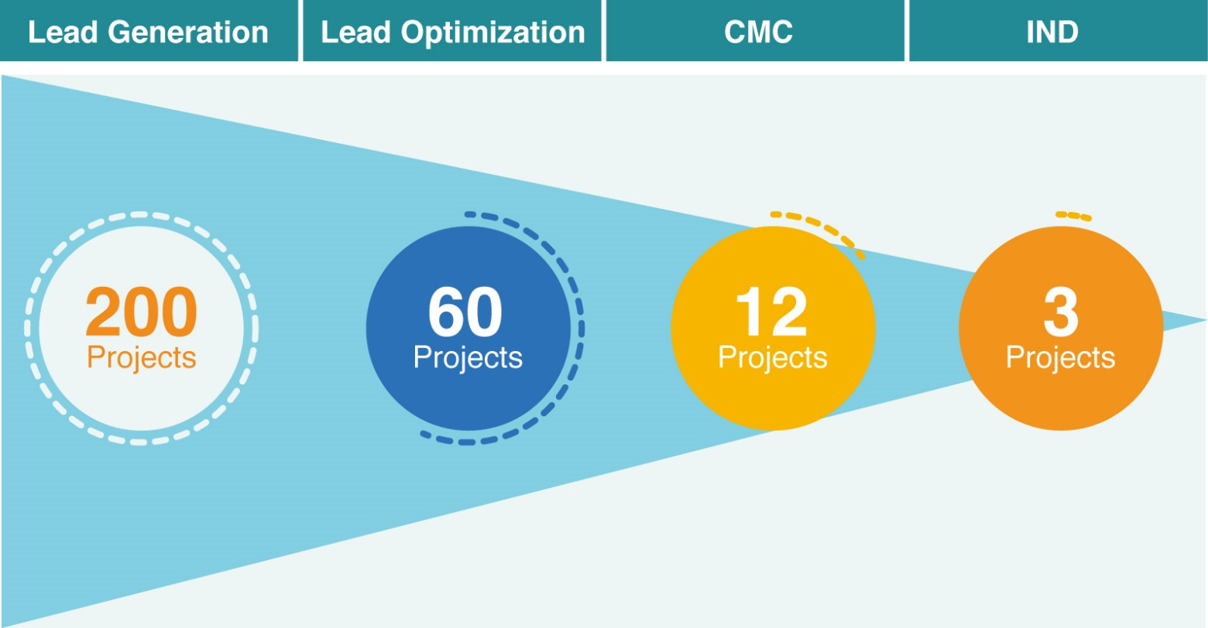
Track Records
In the past 3 years (by Mar, 2017)
GenScript has delivered more than 200 antibody lead generation projects.
GenScript has delivered 60 antibody lead optimization projects.
GenScript has delivered 12 biologics CMC projects.
3 of them were/ will be moved forwards to IND filing stage before the end of 2017.
Notes:
Using the hybridoma platforms and our over-13-years expertise, we have successfully raised antibodies to various targets, including soluble proteins like cytokines, single transmembrane proteins like the immune checkpoint proteins, multiple transmembrane targets, like GPCRs and ion channels. We delivered over 200 pharmaceutical antibody campaigns, with over 60 of them are in downstream humanization and cell line development. Notably, 3 of them are ready to file IND soon. In the recent several years, therapeutic antibodies targeting immune checkpoint proteins have achieved great success in multiple oncology indications, including Yervoy against CTLA4, Keytruda and opdivo against PD-1 and tecentriq and bavencio against PD-L1. We catch the wave and accumulate extensive experience in identifying therapeutic antibody leads against those targets.

Slide 22
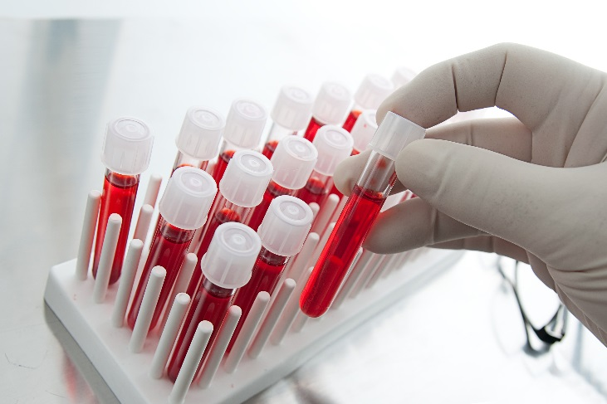
Diagnostic Antibody Development

Slide 23
GenScript MonoRabTM Technology
Kd typically at the picomolar (10⁻¹²) level [mouse mAbs: Kd at nanomolar (10⁻⁹) level]
Permit higher working dilutions (5 -10 times)
Able to distinguish between very similar proteins or sequences
Lower cross reaction
High Affinity
High Specificity
Rabbit monoclonal antibody
High Diversity
Robust immune system
Extensive Applications
Recognizes wider range of epitopes, novel epitopes
More immuno-responsive to small epitopes (<1kDa)
bigger spleen
Against antigens that are not immunogenic in mice
ELISA, Westerns, FACS, IP, ICC…
Excellent results in IHC
Good for IVD/anti-idiotype Ab…
GenScript developed the Rabbit-Mouse (Rb-Ms) chimeric hybridoma technology
We have studied extensive cases against idiotypes, small molecules, receptors, epigenetic modifications for various applications.

Slide 24


Case Study: Anti-Pembrolizumab idiotype Rb mAb
High affinity: Kd ≈ 10⁻¹¹M
High specificity: lower cross reactivity
Inhibitory function: high antigen blocking activity
Diversity: more suitable candidates for PK and ADA assay development
EC50=5.001ng/ml IC50=18.8ng/ml

Slide 25
Anti-Pembrolizumab idiotype Rb mAb
The affinity and specificity of rabbit monoclonal Anti-Pembrolizumab antibody is equal to mouse monoclonal antibody. While the blocking function of rabbit monoclonal Anti-Pembrolizumab antibody is much better than mouse monoclonal antibody.
EC50 comparison
IC50 comparison

Slide 26
Anti-Pembrolizumab idiotype Rb mAb
Hybridoma Production vs Recombinant Production
Ab sequencing and express 3 clones in mammalian cells
The sensitivity and affinity of the anti-Pembrolizumab antibody produced by recombinant expression or hybridoma cells is equal to each other.

Slide 27


Slide 28


