Slide 1



Drug development: ethics versus efficacy
Presented by: Mr.Kumaresh Pandian, Final MBBS part I.
Guided by: Dr. Krishnan, Assistant professor,
Department of Pharmacology,
Saveetha Medical College, Chennai.
Field of Research –Pharmacology- Drug development and approval.

Slide 2
Relevant Introduction
To expedite the drug review process of drugs filling unmet medical need , US FDA introduced various schemes in 1990s.
Unmet Need:
Providing a therapy where none exists or
Providing a therapy which may be potentially superior to existing therapy
Or a new therapy that reduces adverse effects of existing one.
This has lead to a Fast –Track Process:
Decision within 180 days than conventional 10-18 months , after single phase 2 trial.

Slide 3
Scope of Presentation
Fast track processing of drugs facilitates earlier access of drugs but also undermine the safety involved.
From 1988 to 2010, Some of the fast track products have gone unpredicted and withdrawn. Eg .Increased cardiovascular events from selective cox-2 inhibitors valdecoxib & rofecoxib.
There are critics that FDA is liberal , not following criteria and approve the molecules in an accelerated way based on trivial information submitted by marketing authorities.

Slide 4
Scope of Presentation
Objectives
To assess the number drugs and biologics approved by fast track evaluation , between 2011-2015.
To assess the average time of evaluation of fast track drugs, approved between 2011-2015.
To assess the post marketing status of drugs and biologics approved under expedited review.

Slide 5
Methods
This analysis was carried out between January and April 2016.
Drug approval status and average time of review process was obtained from US-FDA, Centre for Drugs and Biologics centre (CDER & CBER).
Post marketing data and safety issues was collected from FDA adverse effects reporting system (FAERS).
Further, evidence on efficacy and safety of drugs was taken from various meta-analysis, credible biomed journals and Cochrane database.
Descriptive statistics and non parametrics applied to find significance using SPSS Version 17.

Slide 6
Results
Results
Year | No of molecules
2011-12 | 30
2012-13 | 29
2013-14 | 32
2014-15 | 41
2015 | 34
Year | Average time of evaluation
2011 | 11.2 Months
2012 | 9 Months
2013 | 8.7 Months
2014 | 8.2 Months
2015 | 6.4 Months

Slide 7
No of molecules approved
Average time of evaluation

Slide 8
No of molecules | No of molecules with proven efficacy in real scenario | No of molecules received SAEs | No of molecules issued warning drug label change | No of molecules induce second tumour | No of molecules withdrawn
166 | 58[45.8%] | 37 [22.3%] | 54[34.3%] | 6.6% | 07 [4.2%]
Significance between no of molecules showing efficacy in trial versus in clinical scenario P < 0.05
Association between less time of evaluation and More No of SAEs P < 0.05

Slide 9
Discussion
Is Unmet Criteria followed ?
Drug –Ponatinib Indication –CML
Approval –Fast track approval based on single Phase 2 trial with Historical Control
Post marketing status- Removed from market because more than 70 % of receivers developed Fatal Veno-occulsive disease.
Already drugs used in CML-Imatinib ,Dasatinib, Nilotinib
Existing success rate – Imatinib Complete remission at 18 months was 87%
Need of Ponatinib and accelerated approval ?

Slide 10
Is only surrogate points assessed in expedited review ?
Drugs –Ombitasvir, Paritaprevir –July 2015
Post Marketing status–Severe fatal hepatic injury within 4 weeks of treatment. Warning issued on 22/10/2015 .
Assessment –Hepatitis C Viral load reduction , reviewed in 6 months , Why again expedited review approval was given based on viral load reduction ?

Slide 11
Why molecules of the same family were granted fast track approval without sufficient post marketing evaluation?
DPP IV Inhibitors | Post marketing status | SGLT 2 inhibitors | Post marketing status
Saxagliptin 2009 | Renal failure | Dapagliflozin 2013 | Urosepsis
Alogliptin 2011 | Pancreatitis | Canagliflozin 2014 | Ketoacidosis
Linagliptin 2013 | Pancreatitis | Empagliflozin 2014 | Ketoacidosis

Slide 12
Are the biologics suitable for rapid review?
Almost all the biologics were granted accelerated approval .
Biologics produces complex interactions with body proteins.
They need careful interpretation
All the recent fast-track biologics Adalimumab, Golimumab, Etanercept causes SAEs, they are proved to induce Hepatosplenic lymphoma, apart from other side effects.
This is fatal, No treatment available.

Slide 13
`
Discussion - Efficacy Vs Safety ?
Unfortunately, newer anticancer drugs and biologics are very trivial in benefits.
They gain statistical significance, but clinical failure is high.
Vemurafenib, is a classical example which is approved for metastatic melanoma against dacarbazine.
Increase in survival mere 3-4 months, no improvement in quality of life.
Vemurafenib induces cutaneous cancers among survivors within their life span.
Beyond doubt their safety issues outweigh benefits.

Slide 14
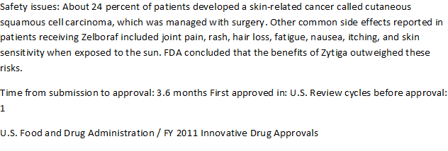
Efficacy Vs Safety
Efficacy Vs Ethics

Slide 15
Discussion - Corroboration with other findings.
Average time of evaluation is reduced from 19.2 months to 8.9 months between 1990s and 2015
Aforesaid statement confirmed by FDA Annual release Innovative drug approvals statement from 2011 -2015.
Increased No SAEs reported recently is more in FAERS.
Our study findings also reflected the same and revealed positive association between less time of evaluation and more no of SAEs.
A report by Fleming clearly reflects failure of newer anti cancer drugs in clinical scenario supports our findings in Health Affairs in June 2015.

Slide 16
Discussion - Implications and suggestions
Fast-track process given us many classical molecules since 1997 including Imatinib , Cisplatin etc. However in recent years, reluctant interpretation approves molecules which results in serious SAEs after approval.
Expedited review must be restricted to only drugs for unmet need diseases.
Drugs of same family should be granted fast track processing only after sufficient post marketing findings.
Decision based only surrogate end point should be reconsidered.
Statistical significance should be cross matched clinical success.
Regulatory authorities should be more vigil about undue or fallacious evidence information given by some pharmaceuticals.

Slide 17
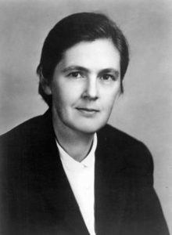

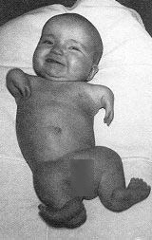
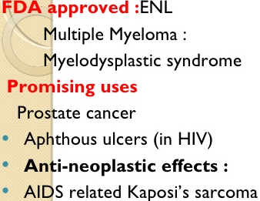
Conclusion: Drug interpretation is a critical process, it must be done carefully to optimize the benefits and to reduce the adverse effects of the drugs; Be it standard or expedited review.
Kelsey prevented Thalidomide tragedy in United States
Thalidomide = Phocomelia in Europe

Slide 18
THANK YOU!
Judges
Audience
Organizers

Slide 19
References
Fast Track, Breakthrough Therapy, Accelerated Approval, Priority Review[Internet]. U.S.Food and Drug Administration; [updated 2015 september 14;cited 2016 March 01]
Guidance for Industry Expedited Programs for Serious Conditions – Drugs and Biologics[Internet]. U.S.Food and Drug Administration; [updated 2014 May ;cited 2016 March 01] Available from: http://www.fda.gov/downloads/drugs/guidancecomplianceregulatoryinformation/guidances/ucm358301.pdf.
Recalls, Market Withdrawals, & Safety Alerts[Internet]. U.S.Food and Drug Administration; [updated 2016 February 29 ;cited 2016 March 01]
/
Aaron S Kesselheim,Bo Wang, Jessica M Franklin, Jonathan J Darrow. Trends in utilization of FDA expedited drug development and approval programs, 1987-2014: cohort study.BMJ 2015; 351
Potential Signals of Serious Risks/New Safety Information Identified by the FDA Adverse Event Reporting System (FAERS) between July – September 2015[Internet]. U.S.Food and Drug Administration; [updated 2016 February 02; cited 2016 March 01]
Potential Signals of Serious Risks/New Safety Information Identified by the FDA Adverse Event Reporting System (FAERS) between July – September 2015[Internet]. U.S.Food and Drug Administration; [updated 2015 September 11; cited 2016 March 01] Available from: http://www.fda.gov/Drugs/GuidanceComplianceRegulatoryInformation/Surveillance/AdverseDrugEffects/ucm281856.htm

Slide 20
