Slide 1

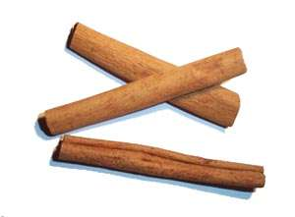
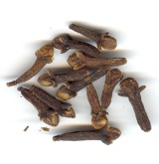
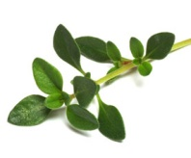
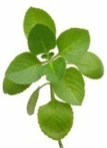
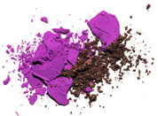
Potential of plant-derived antimicrobials for controlling zoonotic and food-borne diseases
Kumar Venkitanarayanan, DVM, MVSc, MS, Ph.D.
Professor of Microbiology
Graduate Programs Chair
Department of Animal Science
University of Connecticut
Storrs, CT 06269, USA

Slide 2
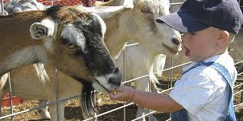

Zoonotic Diseases
About 75% of recently emerging infectious diseases affecting humans are diseases of animal origin, and approximately 60% of all human pathogens are zoonotic.
Food-borne diseases
Wide range of animal reservoirs
Emergence of antibiotic resistance

Slide 3


Plant-Derived Antimicrobials (PDAs)
An alternative approach
Phytophenolics
Plant defense mechanism
Wide spectrum of biological effects
Bacterial resistance low
Burt et al., 2004; Ohno et al., 2007; Wollenweber, 1988

Slide 4
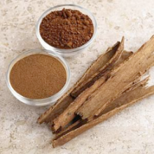
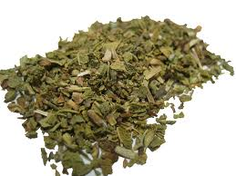
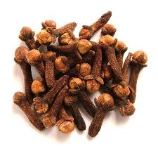
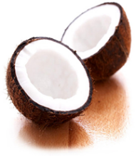
Plant-derived antimicrobials (PDAs)
Trans-cinnamaldehyde (TC)
Carvacrol (CR)
Thymol (TH)
Eugenol –(EU)
Caprylic acid –(CA)
Cinnamon oil
Oregano oil
Clove oil
Coconut oil
Notes:
All the aforementioned plant molecules are categorized as generally regarded as safe (GRAS) by the Food and Drug Administration (Knowles et al. 2005; Baskaran et al. 2010).
various active molecules, such as Trans-cinnamaldehyde, carvacrol and

Slide 5
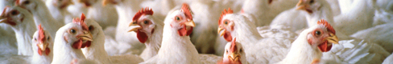
Efficacy of PDAs for reducing egg-borne transmission of Salmonella Enteritidis

Slide 6
Salmonella
Major food-borne pathogen worldwide
Highest incidence rate for Salmonella infections¹
Total estimated annual cost – 4 billion USD²
¹CDC 2010, ²Scharff, 2012

Slide 7
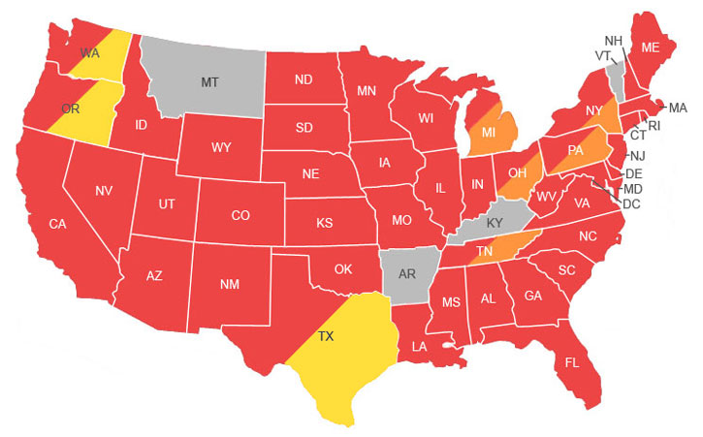
Listeria monocytogenes
No reported outbreaks
Salmonella outbreaks in the US
Salmonella
Pathogenic E. coli

Slide 8
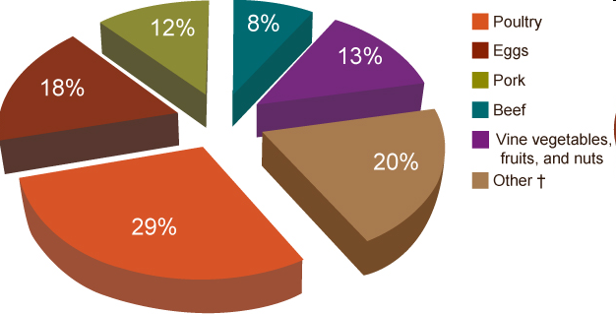
Foods associated with
Salmonella outbreaks
Source: CDC National Outbreak Reporting System, 2004–2008

Slide 9
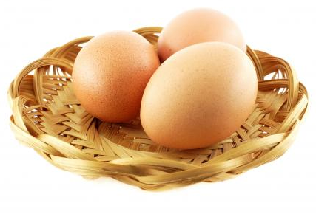
Salmonella Epidemiology
Chicken – reservoir host
Salmonella Enteritidis (SE) – most common
Salmonella from poultry¹
Consumption of raw or undercooked eggs
100 billion table eggs are produced annually
¹ Marcus et al., 2007; ² AMI, 2009; ³ CDC, 2010

Slide 10
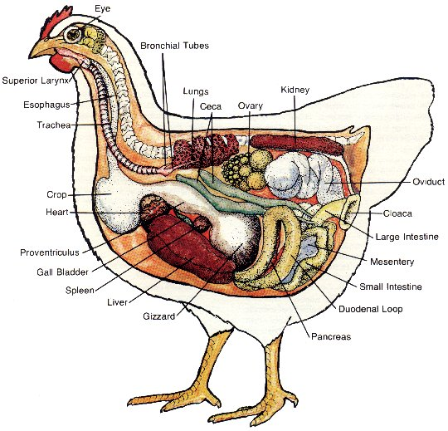
Salmonella chicken link
Primary colonization site – cecum
Other sites – crop, intestine, cloaca
Internal organs – liver, spleen, oviduct
Transmission routes:
Horizontal – bird to bird
Vertical – Transovarian - bird to yolk
(macrophages involved in systemic spread)^{1,2}
¹ Gast et al., 2007; ² Gantois et al., 2009

Slide 11
Controlling Salmonella
Ideal Intervention Strategy
Economically viable
Practical for farmers to adopt
No toxicity
Organic farming
Environmentally friendly
No bacterial resistance development

Slide 12
Rationale
Supplementation of PDAs
Reduce cecal colonization
Reduce oviduct colonization
Reduce fecal contamination of
shelled eggs
Reduce yolk and membrane contamination
Control salmonellosis

Slide 13
Challenge experiment in chickens
120 White Leghorn layer chickens
25 & 40 weeks of age
Treatments
        1% TC control (No SE, 1% TC)
        1.5% TC control (No SE, 1.5% TC)
        Positive control (SE, No TC)
        1% TC (SE, 1% TC)
        1.5% TC (SE, 1.5% TC)
SE-28, SE-21, SE-12, SE-31, SE-90
13

Slide 14
Protocol
TRANS-CINNAMALDEHYDE FEEDING PHASE
Weeks
1 | 2 |  | 10
Day 1
Grouping
of birds
Daily egg collection
Weekly fecal swab
Day 14
Egg
Collection
starts
Day 70
End of trial
Collection
of tissues
Day 12
Challenge
check
Day 10
Challenge
with
SE

Slide 15
RESULTS

Slide 16
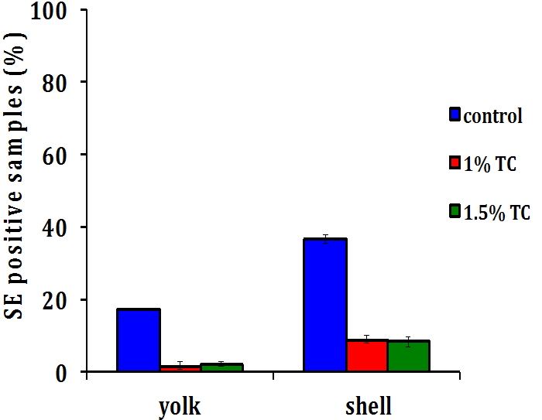
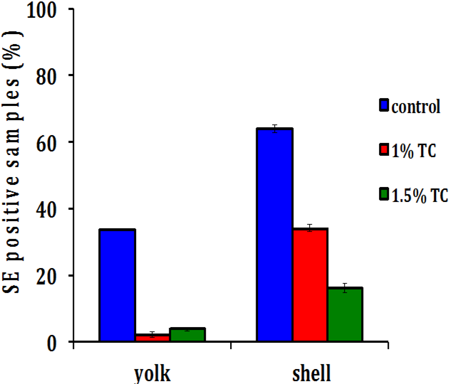
Effect of TC on SE contamination of eggs *, week 1
25 WEEKS
40 WEEKS
a
a
b
a
a
c
b
b
b
b
b
b
*Treatments with different superscripts significantly differed from each other at P < 0.05

Slide 17
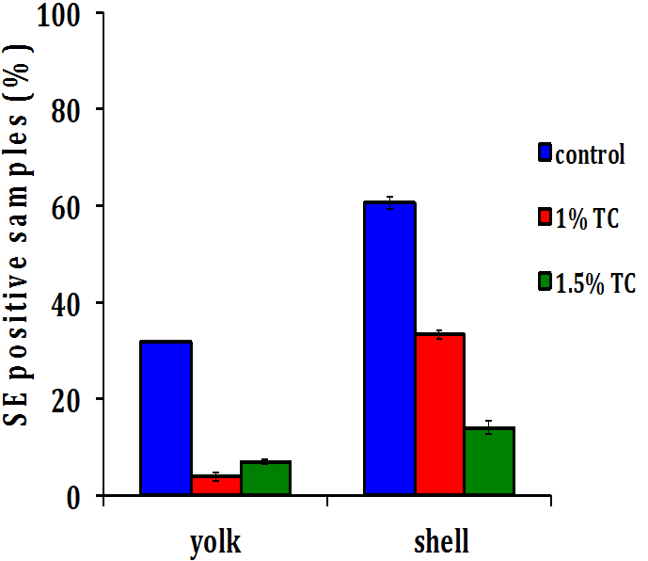
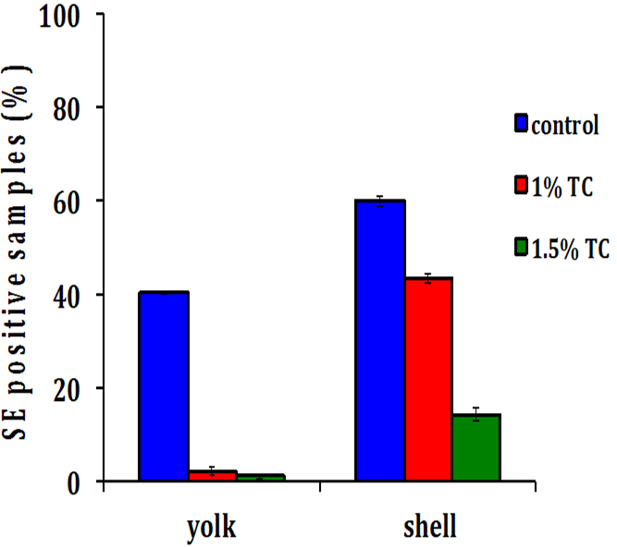
Effect of TC on SE contamination of eggs *, week 2
25 WEEKS
40 WEEKS
a
a
a
b
a
b
c
c
b
b
b
b
*Treatments with different superscripts significantly differed from each other at P < 0.05

Slide 18
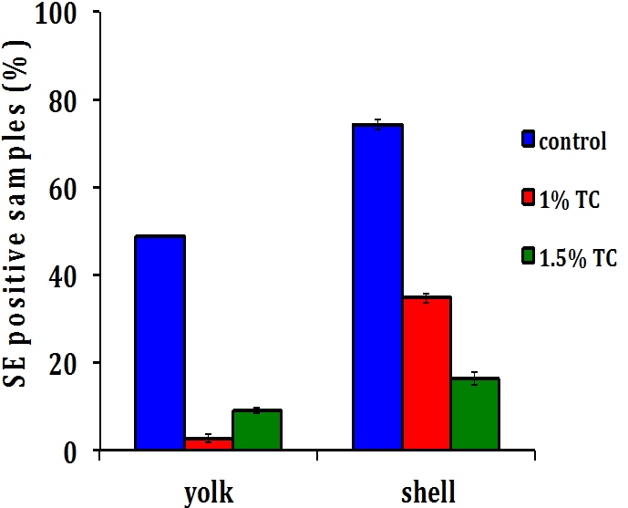
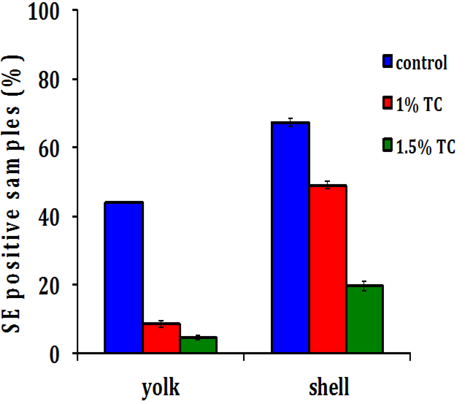
Effect of TC on SE contamination of eggs *, week 3
25 WEEKS
40 WEEKS
a
a
a
b
a
b
c
c
b
b
b
b
*Treatments with different superscripts significantly differed from each other at P < 0.05

Slide 19
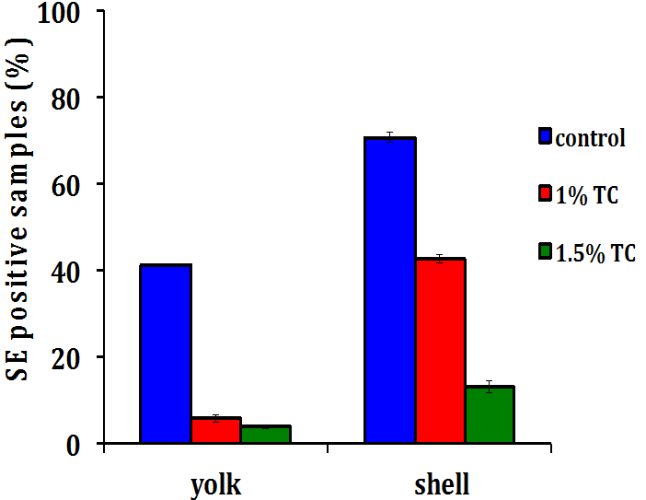
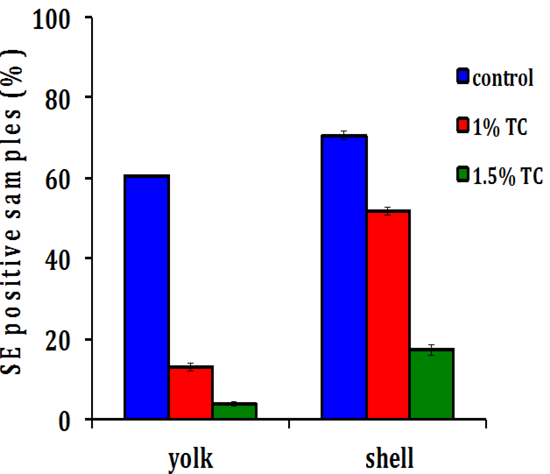
Effect of TC on SE contamination of eggs *, week 4
25 WEEKS
40 WEEKS
a
a
a
b
a
b
c
c
b
b
b
c
*Treatments with different superscripts significantly differed from each other at P < 0.05

Slide 20
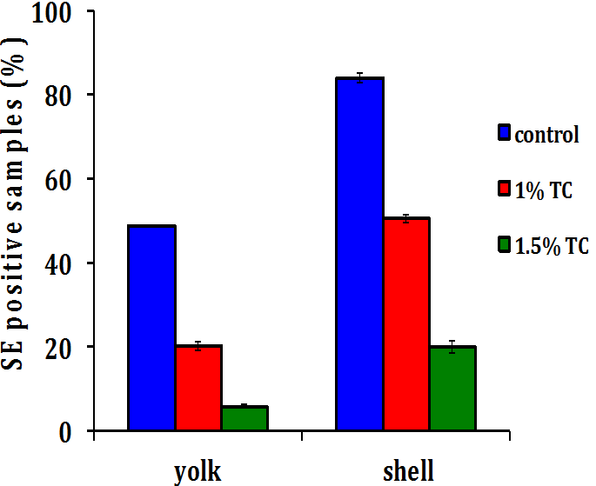
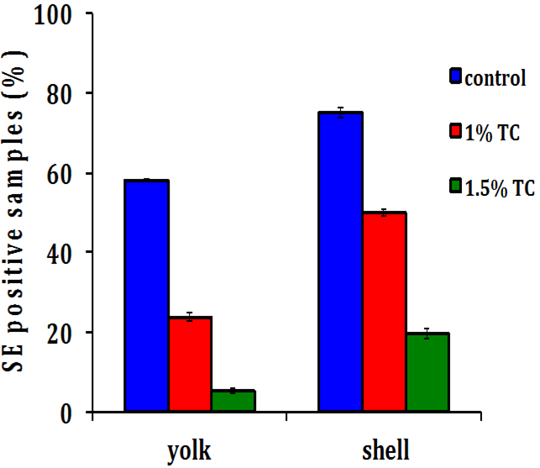
Effect of TC on SE contamination of eggs *, week 5
25 WEEKS
40 WEEKS
a
a
a
a
b
b
b
b
c
c
b
c
*Treatments with different superscripts significantly differed from each other at P < 0.05

Slide 21
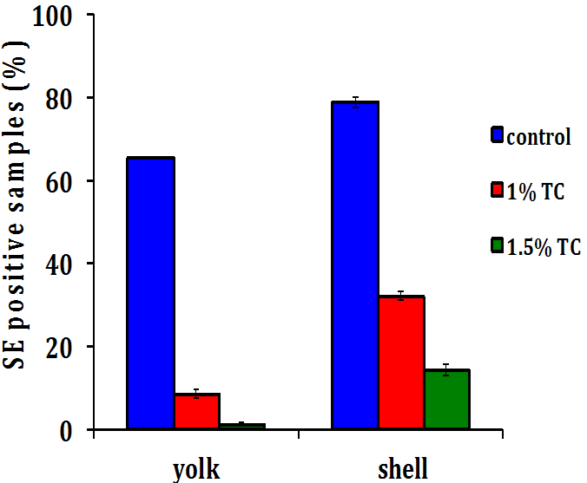
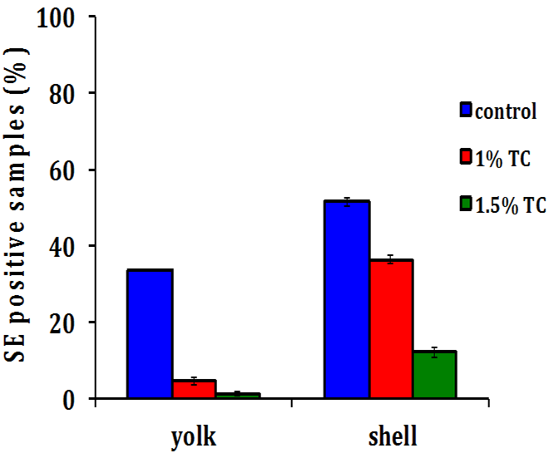
Effect of TC on SE contamination of eggs *, week 6
25 WEEKS
40 WEEKS
a
a
a
b
a
b
b
c
c
b
c
c
*Treatments with different superscripts significantly differed from each other at P < 0.05

Slide 22
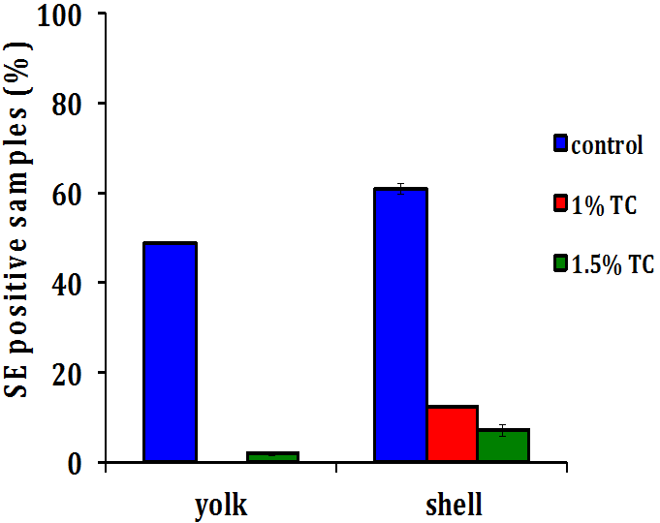
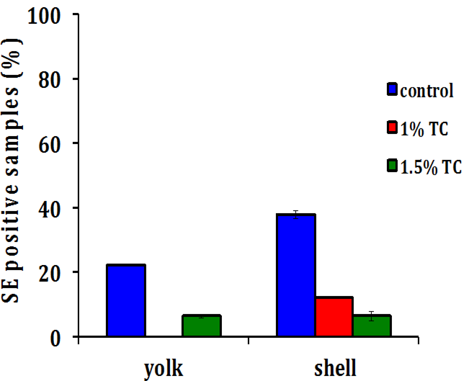
Effect of TC on SE contamination of eggs *, week 7
25 WEEKS
40 WEEKS
a
a
a
a
b
b
c
b
c
b
b
c
*Treatments with different superscripts significantly differed from each other at P < 0.05

Slide 23
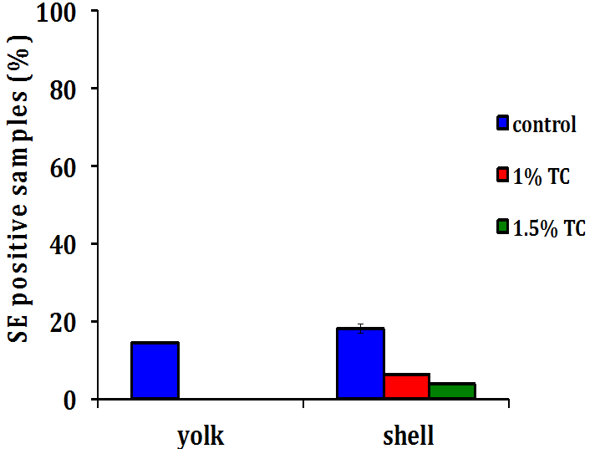
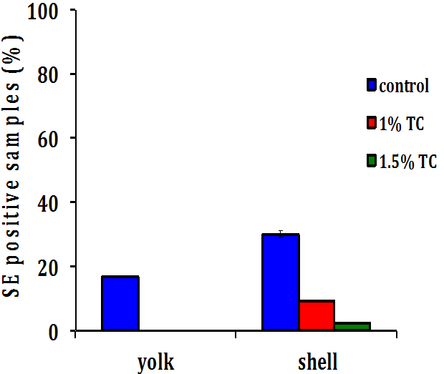
Effect of TC on SE contamination of eggs *, week 8
25 WEEKS
40 WEEKS
a
a
a
a
b
b
b
b
b
b
b
c
*Treatments with different superscripts significantly differed from each other at P < 0.05

Slide 24
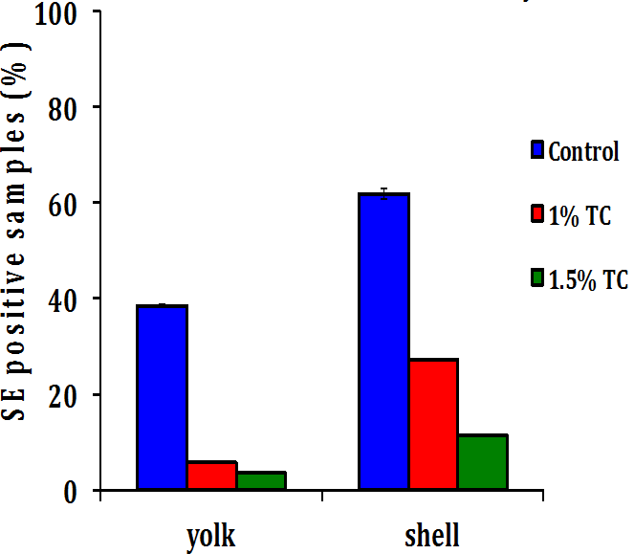
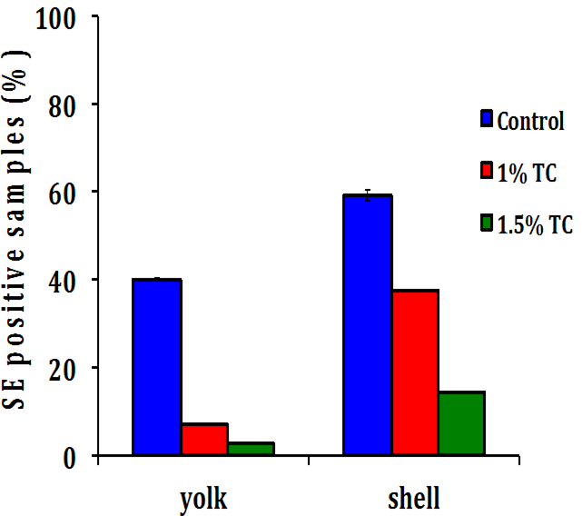
Effect of TC on SE contamination of eggs (N=2195) cumulative data
25 WEEKS
40 WEEKS
a
a
a
a
b
b
c
c
b
b
b
c
No change in egg production due to TC supplementation
*Treatments with different superscripts significantly differed from each other at P < 0.05

Slide 25
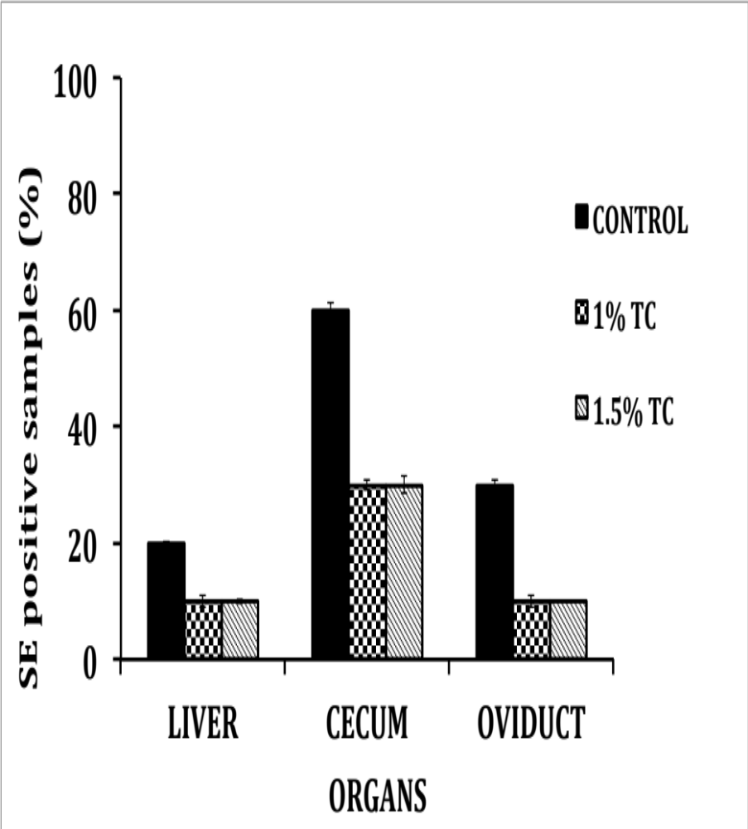
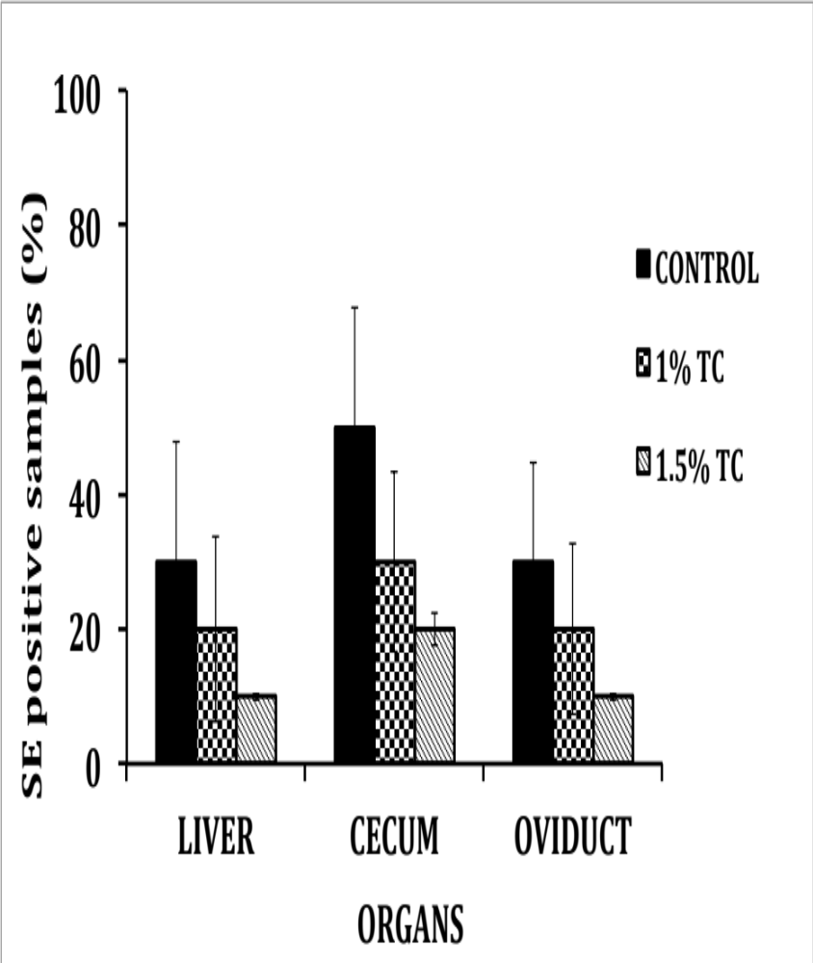
Effect of TC on SE in Chicken Organs*
*p < 0.05

Slide 26
Impact of research
In-feed supplementation of TC could be used to reduce egg-borne transmission of SE and improve microbiological safety of eggs.

Slide 27
Attenuation of Vibrio cholerae infection using plant molecules
Varunkumar Bhattaram
PhD Student
Department of Animal Science
University of Connecticut
PI: Dr. Kumar Venkitanarayanan

Slide 28
Vibrio cholerae (VC)
Causative agent of human cholera
Toxin-mediated watery diarrhea
Life threatening dehydration and electrolyte imbalance
Extreme cases lead to kidney failure and death
Serogroups O1 and O139
Globally - excess of 300,000 cases; 7500 deaths

Slide 29
Cholera: Route of Transmission
Contaminated Soil
Feces
Food
Human
Unsanitized Water

Slide 30
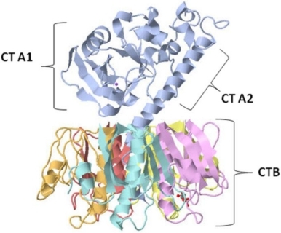
Cholera toxin
CTB → Cholera toxin B subunit
CTA1 and CTA2 → Cholera toxin A subunit

Slide 31
Treatment/Control
Oral Rehydration Therapy
    Fluids supplemented with electrolytes and salts
Antibiotics
  First antibiotic resistant strain – 1970 (Kitaoka et al., 2011)
  Multiple drug resistant Vibrio cholerae (Das et al., 2008; Akoachere., 2013)
Vaccine
Oral vaccine – Not fully effective (WHO Guidelines, 2012)
Safe and Effective alternative strategy needed

Slide 32
Effect of CR, TH and EG on cholera toxin production
Strains of Vibrio cholerae used in this study – VC 11623; BAA-25870 and BAA 2163

Slide 33
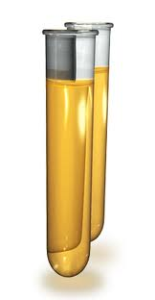

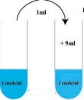


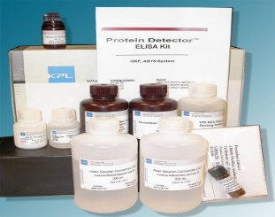
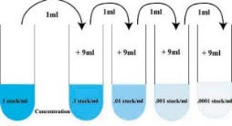
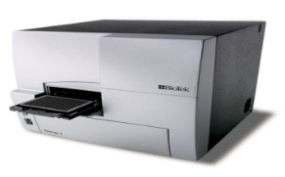

Protocol for quantification of cholera toxin
V. cholerae with
or without PDAS
Culture supernatant collected after 24 hours
Dilution
Cholera toxin custom kit(KPL protein detector kit)
Std curve,
& Quantification by colorimetry
Purified cholera toxin B subunit
Serial dilution
Fleming et al., 1988

Slide 34
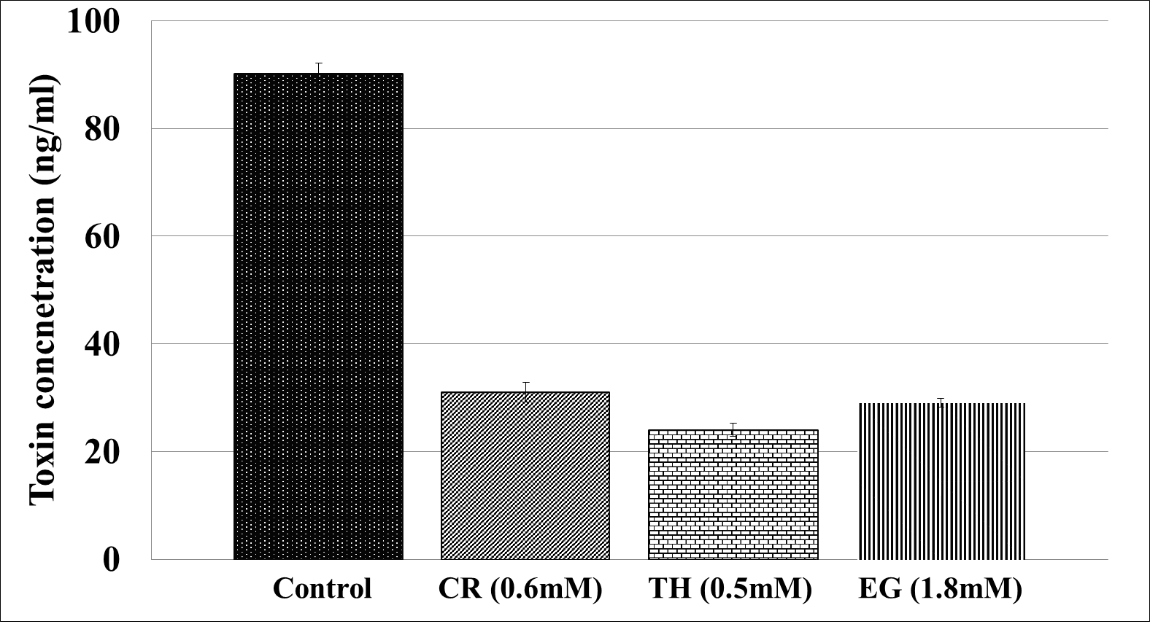
Effect of CR, TH and EG on cholera toxin production (VC 11623)

Slide 35
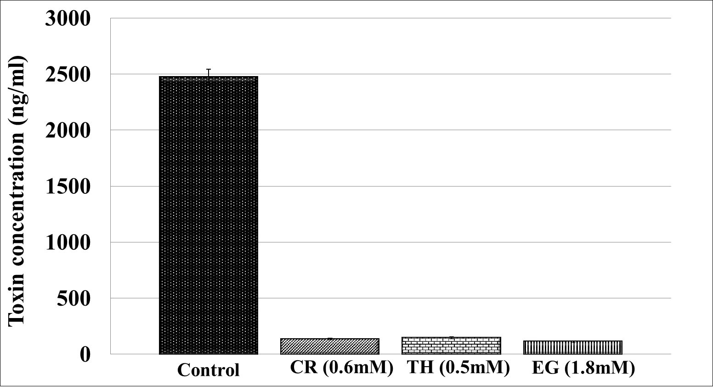
Effect of CR, TH and EG on cholera toxin production (VC 569b)

Slide 36
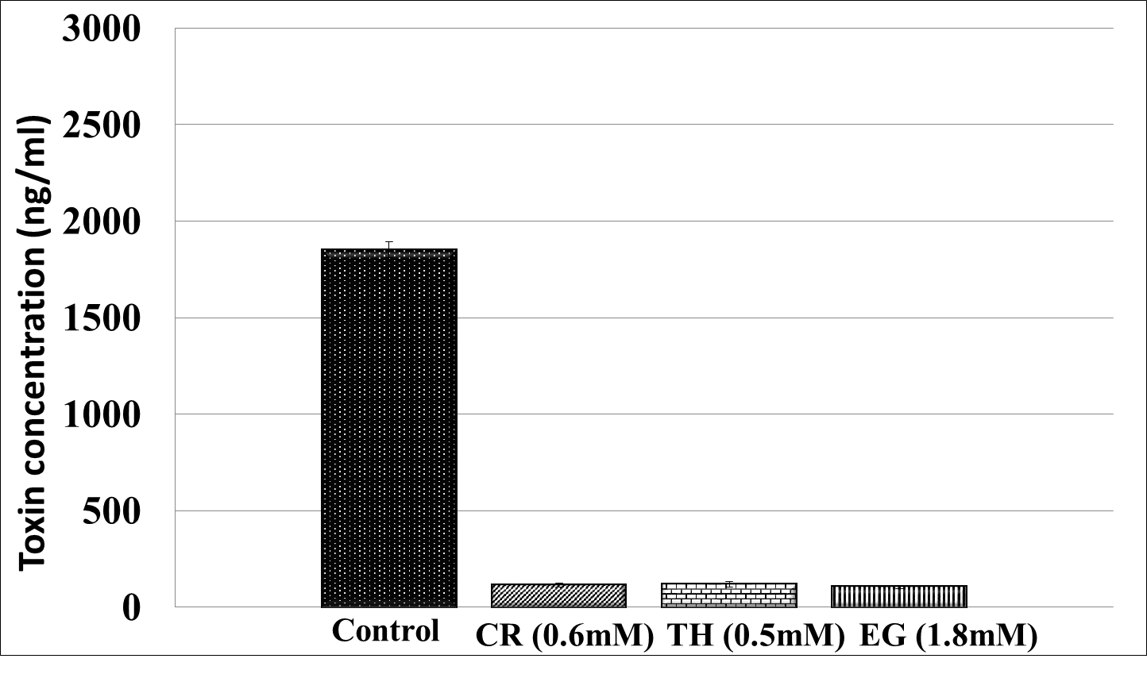
Effect of CR, TH and EG on cholera toxin production (VC 2163)

Slide 37
Summary and Future Studies
PDAs could be potentially added in oral rehydrating solution to control V. cholera infection in humans
Validate the in vitro results in a mammalian in vivo model
Characterize and delineate the mechanism of action CR, TH, and EG

Slide 38
Controlling aflatoxins in chicken feed using carvacrol and trans-cinnamaldehyde as feed additives

Slide 39
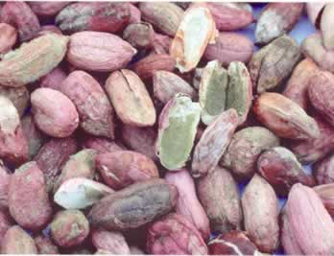
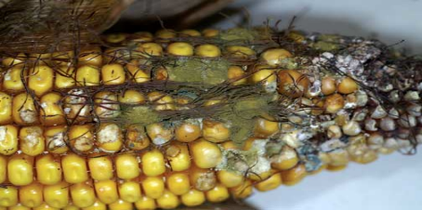
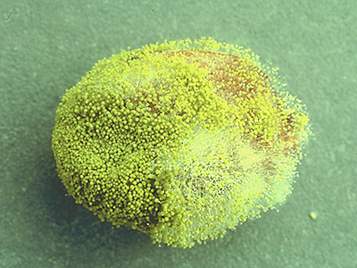
Aflatoxins (AF) in feed
Fungal toxins in feed ingredients
Aspergillus spp. - A. flavus, A. parasiticus
Routes of contamination of grains:
  Pre-harvest, post-harvest, and transportation
  Processing of feed ingredients
  Formulated feed after processing
Notes:
Aflatoxin is a group of mycotoxins produced by fungus A. flavus ans A. parasiticus. These fungus could contaminated the feed ingredients such as peanut, corns, and cottonseed before or after they are havested or during transportation time. Most important is, these fungus could also contaminated the grains even it’s after processing and the fomulated feed ingredient.

Slide 40
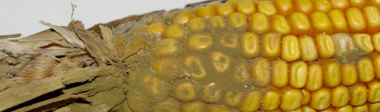
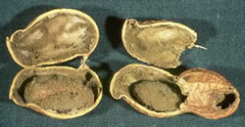
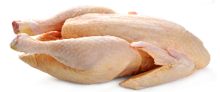


Why study AF?
Aflatoxin-contaminated feed
Consumption by Chickens
Aflatoxin residues in chicken products
Carcinogenic and hepatotoxic effect
Economic losses to producers
Impact on Chicken performance
Impact on Human health
Bbosa et al., 2013; Herzallah et al., 2013
Notes:
Why study aflatoins? High temperature associated high moisture leads to these fungus grow and produce AF in the chicken feed resulted in morn than 225 millions dollar losses per year in poultry industry. AF contaminated feed is the main source of chicken aflatoxicosis. Chickens consume aflatoxin contaminated feed will decrease performance resulted in huge economic loss which I will explain more detail in the following slides. On the other hand, AF residues could be transferred to chicken meat and egg, since AF is a well known carcinogenic and hepatotoxic agent for both human and animals, it’s made AF could be a potential public health hazard.

Slide 41


Aflatoxicosis in chickens
Poor body weight gain
  Acute aflatoxicosis:
    50% mortality within 48 hours
  Chronic aflatoxicosis:
    Decrease egg production
    Decrease hatchability
    Liver necrosis
Fatty liver syndrome
Thrasher, 2012; Hamilton and Garlich, 1971
Notes:
The first outbreak of AF was occurred in England after which caused at least 100,000 turkeys died after consumed AF contaminated feed in 1960s.
Injesting chicken with 100 ppm af comtaminated feed resulted in over 50 percent mortality within 48 h
Ingestion of lower concentration of AF also decrease chicken performances. Such as decreased body weight gain, egg production and hatchability. Chicken consumed with aflaotxin comtaminated feed caused fatty liver and haemorrage syndrome to liver.

Slide 42

Materials and Methods
A. flavus NRRL 3357 or
A. parasiticus NRRL 4123 or NRRL 2999 (5 log₁₀ CFU/g)
200 g chicken feed
CR
0%, 0.4%, 0.8%, 1.0%
TC
0%, 0.4%, 0.8%, 1.0%
Incubated at 25ºC for 3 months
0, 1, 2, 3, 4, 8, 12 weeks
Aflatoxin concentration
Farag et al., 1989; Razzaghi-Abyaneh et al., 2008
Notes:
A similar protocol as in potato dextrose broth study was followed. Instead of using broth, we used 200 grams chicken feed. Inoculated by A. flavus and A. parasiticus. Different concentration of CR and TC was added with the treatments control, .4 .8 and 1 percent.
Celsius
10ml pdb inoculated by A. flavus or A. parasiticus. After inoculation, different concentration of CR and TC was added to each group.

Slide 43

Effect of CR on A. flavus aflatoxin production in chicken feed
*Treatments differed significantly from the control (n = 6) (p<0.05)
Notes:
Likewise, all the TC treatments decreased AF production by A. flavus

Slide 44

Effect of CR on A. parasiticus aflatoxin production in chicken feed
* All treatments differed significantly from the control (n = 6) (p<0.05)

Slide 45

Effect of TC on A. flavus aflatoxin production in chicken feed
*Treatments differed significantly from the control (n = 6) (p<0.05)
Notes:
A similar results was obtained in A. flavus

Slide 46

Effect of TC on A. parasiticus
aflatoxin production in chicken feed
*Treatments differed significantly from the control (n = 6) (p<0.05)

Slide 47

Protective effect of CR and TC on decreasing aflatoxin-induced cytotoxicity in hepatocytes
Notes:
Because aflatoxin is a well known hepatotoxic agent for both animals and chicken. We would like to know if CR and TC has any protective effect on aflatoxin induced cytotoxicity. Therefore, coming to my next objective……

Slide 48


Hepatotoxic effect of aflatoxins
Aflatoxin consumption by chicken
Acute
Aflatoxicosis
Chronic
Aflatoxicosis
Liver hemorrhage
Fatty liver
Liver necrosis
Doerr et al., 1983
Notes:
Because aflatoxin is a well known hepatotoxic agent for both animals and chicken. We would like to know if CR and TC has any protective effect on aflatoxin induced cytotoxicity. Therefore, coming to my next objective……
Generally, chicken feed would be contaminated by AF through post contamination or poor storage condition to allow fungus contaminate and produce aflatoxin. Postharvest contamination can occur if crop drying is delayed or the processing temperature is not enough, and when the conditions during storage of the crop are poor such as with high moisture environment or insect and rodent could easily contact with feed.After chicken consumed with AF contained feed would cause chronic or acute aflatoxicosis. The chronic or acute aflatoxicoses as well as its carcinogenicity depends on the concentration of AF exposed and duration of exposure

Slide 49



Materials and Methods
Human Hepatocytes (ATCC HepG2)
24 hours incubation to form monolayer in 96-wells plate
3 ppm or 10 ppm aflatoxin
Control
0 %
CR
0.05% & 0.1%
TC
0.05% & 0.1%
Incubate for 18 hours at 37ºC
Cytotoxicity % using LDH assay
Reddy et al., 2006; Zhou et al., 2006
Notes:
Instead of using chicken hepatocyte, Human hepatocyte HepG2 cell bought from ATCC was used in this research. Because this cell line has been well established for aflatoxin toxicity studies. And published papers also showed that the pathogenicity of aflatoxin is similar in human and chicken hepatocytes.

Slide 50

Efficacy of CR in reducing aflatoxin-induced cytotoxicity in hepatocytes
10 ppm
3 ppm
* All treatments differed significantly from the control (p < 0.05)
Notes:
0.1 and 0,05% of CR significantly decreased cytotoxocity in hepatocytes when compared to control.

Slide 51

Efficacy of TC in reducing aflatoxin-induced cytotoxicity in hepatocytes
10 ppm
3 ppm
3
* All treatments differed significantly from the control (p < 0.05)
Notes:
Around 60% of reduction in cytotoxicity had been found in 0.05% and 0,1% TC when compare to comtrol

Slide 52
Summary
CR and TC reduced aflatoxins in chicken feed
CR and TC did not change feed composition
CR and TC significantly decreased aflatoxin-induced cytotoxicity in hepatocytes (p < 0.05)
Notes:
To summarize,
Although the mold counts were not as significantly decreased by the lower concentration of plant molecules, CR and TC were very effective in reducing the aflatoxin produced by fungus. We hepothesized that these plant molecules could down-regulated the aflatoxin production genes. Therefore, our last objective was…..

Slide 53
Concluding remarks
Determine the stability of CR and TC in chicken feed during manufacturing process
Field trials in chicken farms

Slide 54

THANK YOU !
QUESTIONS?

