Slide 1
Cost-Sensitive Deep Neural Networks to Address Class Imbalance Problem
Kruy Seng and Man-Leung Wong
Department of Computing and Decision Sciences
Lingnan University
September 07, 2017

Slide 2
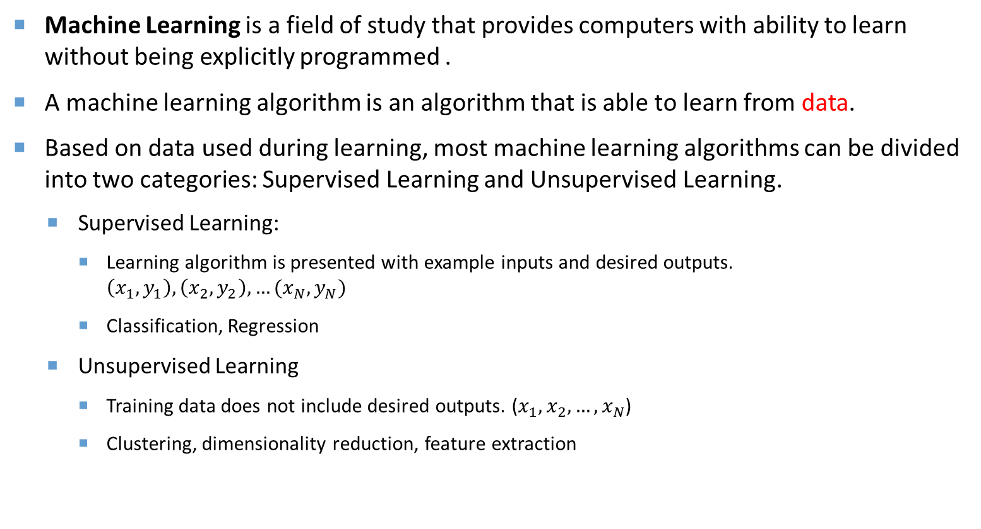
background
Machine Learning is a field of study that provides computers with ability to learn without being explicitly programmed .
A machine learning algorithm is an algorithm that is able to learn from data.
Based on data used during learning, most machine learning algorithms can be divided into two categories: Supervised Learning and Unsupervised Learning.
  Supervised Learning:
    Learning algorithm is presented with example inputs and desired outputs. $\left(x_{1},y_{1}\right),\left(x_{2},y_{2}\right),…(x_{N},y_{N})$
    Classification, Regression
  Unsupervised Learning
    Training data does not include desired outputs. ($x_{1},x_{2},…,x_{N}$)
    Clustering, dimensionality reduction, feature extraction

Slide 3
background
Classification is a task of classifying examples into a given set of categories. ( Supervised learning)
Applications : direct marketing (buyer or non-buyer), fraud detection (Fraud or non-fraud), spam filtering (spam or non-spam), object recognition, speech recognition…
Algorithms for classification task are Decision Tree, Naïve Bayes, Neural Networks, Support Vector Machines, Logistic Regression, Bayesian Networks…
Notes:
For example, given an email content, we classify it into spam or non-spam. Given transaction information of a credit card, we can classify into fraud or non-fraud. Given customer information.
In direct marketing: machine learning algorithm support marketer decision making by classifying consumer into buyer or non-buyer.

Slide 4
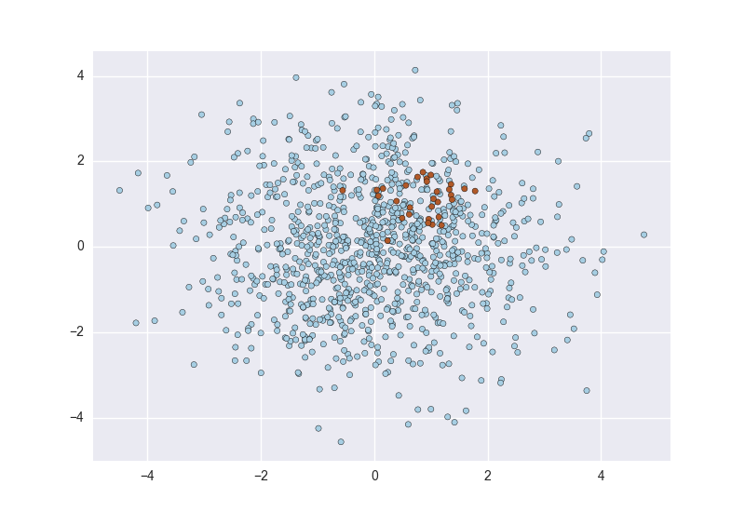
Problem definition
What is class imbalanced problem ?
It is the problem when the number of examples belonged to a class is significantly greater than those of the others.
For example:
  In financial fraud data set, majority of transactions belong to non-fraud class and vice versa.
  In cancer data, the number of patients who have cancer is much smaller than that who don’t.
Majority (Negative) class Minority (Positive) class
Notes:
for example in credit card fraud Data set majorities of a sample legal while there is of the small numbers of transection illegals.
The class which has more number of examples is called majority class; otherwise is called minority class.

Slide 5
Problem definition
The ratio of minority to majority classes can be 1:100, 1:1000, or 1:10000 or even more
There are many other domains that have imbalanced data sets:
  Customer churn
  Credit approval
  Network intrusion detection
  Protein detection
  Oil spill detection etc.
Notes:
Class imbalanced is a very common problem in real life application. There are other various domain that..
Customer churn where the majority of customer stay with company, where minority of customer would leave.

Slide 6
Problem definition
Why is it a problem?
Standard algorithms have poor performance on imbalanced data.
Minimize global error rate without taking data distribution into consideration.
Cause performance bias.
Poor accuracy on minority class and high accuracy on majority class.
Correctly classifying minority class examples are more important than those of majority class.
Cost of misclassifications are different.
E.g. Misclassifying fraud cost > misclassifying non-fraud
Misclassifying buyer cost > misclassifying non-buyer
Therefore, rather than general algorithms, we need a more sophisticated approaches to handle class imbalanced problem.
Notes:
- Most machine learning algorithms and works best when the number of instances of each classes are roughly equal.
Error rate can be influenced by the larger number of examples from the majority class
[switch] Getting poor accuracy on minority isn’t an ideal result because acc on minority is more important
In credit card fraud detection, if a c

Slide 7
Literature reviews:
The solution addressing data imbalanced problem could be classified into three groups:
  Data level
  Algorithmic level
  Cost-sensitive learning approaches.

Slide 8
Literature reviews: Data Level
Data level: modify class distribution in data. The approaches include under-sampling (Kubat and Matwin, 1997; Japkowicz, 2000) and over-sampling (Chawla et al., 2002).
Synthetic Minority Over-sampling TEchnique (Chawla et al., 2002) is the state-of-the-art method. SMOTE generates synthetic examples based on feature spaces. It generates K-nearest neighbors and randomly choose one of the neighbors to create new synthetic examples.
Pros: can be applied to any learning algorithm without modification on algorithm.
Cons:
  Over-sampling could cause the model to be over-fitting.
  Over-sampling increases computational cost.
  Under-sampling could result in losing important information.
After under-sampling
Original data
After over-sampling

Slide 9
Literature reviews: Algorithmic level
Algorithmic level: modify existing algorithms to fit class imbalanced problem. Various approaches include:
Decision Trees (Maloof, 2003), Support Vector Machine (Akbani et al., 2004; Wang and Japkowicz, 2009; Chen et al., 2012)
Neural Networks (Anand et al., 1993; Zhou and Liu, 2006; Jeatrakul et al., 2010; Oh, 2011, Wang et al., 2016 )
Anand et al. (1993) proposed a modified backpropagation algorithm by replacing the gradient vectors with another decent vectors which points the networks in downhill direction for both classes.
Wang et al.(2016) proposed two new loss functions based on concept of false positive rate and false negative rate.
Notes:
Anand 1993 did analysis into the Bp algorithm with imbalance data and found that traditional BP point the network to converge only for majority class.
MFE an MSFE are better than MSE

Slide 10
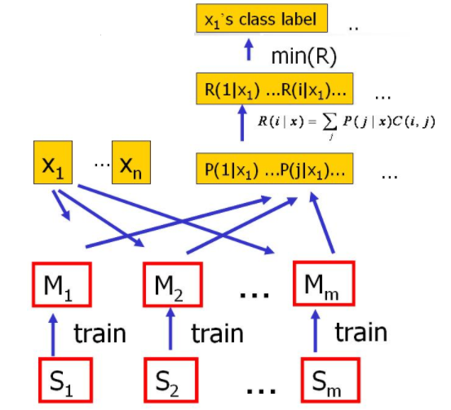
Literature reviews: Cost-sensitive
Cost-sensitive: uses cost information of different misclassification types.
One general approach in cost-sensitive learning is MetaCost (Domingos, 1999) .
Relabel all examples with optimal label
Bayes minimum risk
Training set is replicated into subsets and train with classifiers
MetaCost flowchart

Slide 11



Existing methods : Cost-sensitive
Zadrozny and Elkan (2001) proposed direct cost-sensitive decision-making to address the problem when exact cost of false negative is unknown. Direct cost-sensitive decision-making is a
nonlinear variant of Heckman’s procedure.
Freund and Schapire (1997) proposed AdaCost by incorporate cost information into weight update function of AdaBoost.
Jin et al. proposed the first cost-sensitive genetic programming approach called CGP (Constrained Genetic Programming).
Notes:
Heckman?

Slide 12
Research motivations
The class imbalanced problem has been a significant obstacle for standard learning algorithms to achieve good performance. For the last two decades, continuing research has been conducted to solve this problem. However, this field of study is still a focus of intense research due to shortcoming of existing methods and there are still many directions to be explored.
Efficient methods to train deep architecture of neural networks are proposed by Hinton et al. (2006); Bengio et al. (2007). The potential of deep learning algorithms in class imbalanced problem is of great values to study.
To the best of our knowledge, even though there are a few deep learning approaches to address class imbalanced problem, only one approach focuses on cost-sensitive learning (a method by Chung et al., 2015) .
Notes:
Deep learning become a hot topic and attracted wide-spread attention from many researchers due to its powerful representation learning.

Slide 13
Research objectives
To propose and develop cost-sensitive deep neural networks to address class imbalance problem.
To investigate the capability of Evolutionary Algorithms in hyperparameters tuning in cost-sensitive deep neural networks.
Notes:
In this research, we will proposed two cost-sensitive algorithms based on Stacked Denosing
Autoencoders to address class imbalanced problem.
In the first method, class-based cost will be applied to cost function in fine-tuning stage.
Example-based cost, cost belongs to each example, are applied to cost function in the second method.
We generalize our proposed methods by auto-tuning hyperparameter using Evolutionary
Algorithm.
We will conduct a comprehensive comparison with previous approaches: AdaCost, AdaC2,
and cost-sensitive deep learning proposed by Chung et al. (2015)

Slide 14
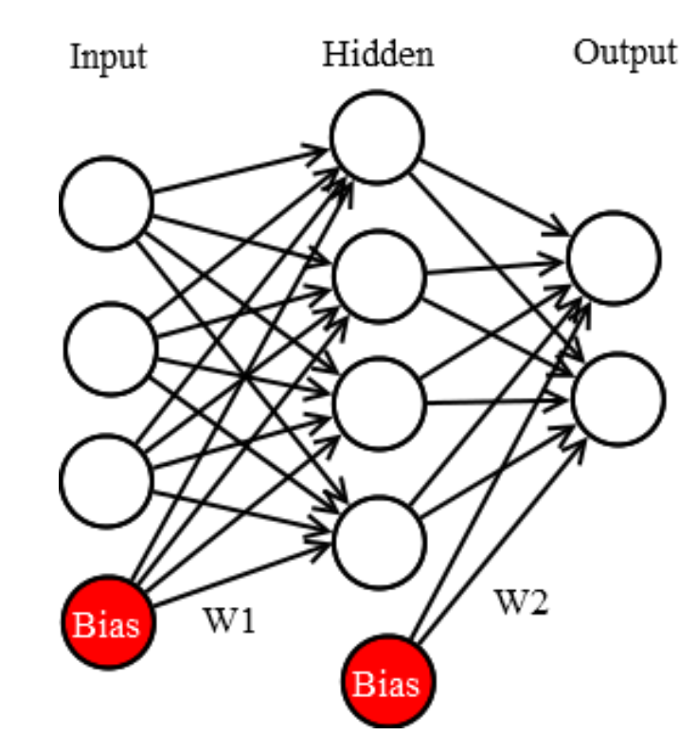
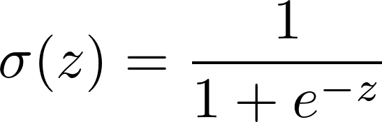
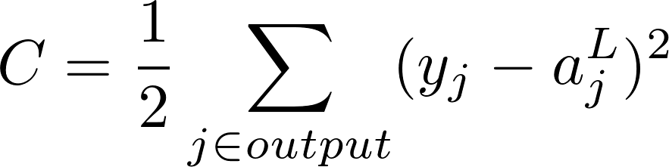



Brief introduction: Neural networks
Feedforward algorithm is used to compute the outputs.
Output =
Sigmoid function:
Minimize Mean Square Error:
$$a_{1}^{3}$$
$$X$$
$$a_{2}^{3}$$
A three-layers Neural networks

Slide 15

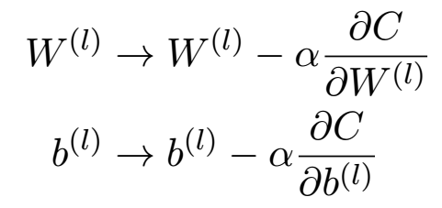
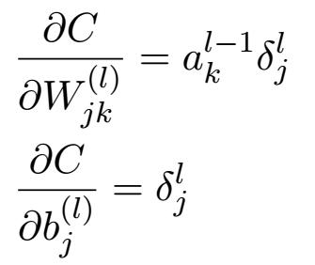
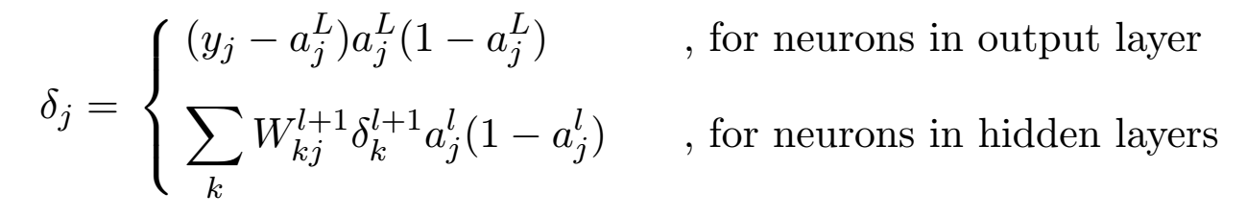
Brief introduction: Neural networks
Adjust weights and bias using gradient decent:
The gradient of cost function computed by backpropagation
Local gradient is computed by delta rule :
$$a_{1}^{3}$$
$$X$$
$$a_{2}^{3}$$
A three-layers Neural networks

Slide 16
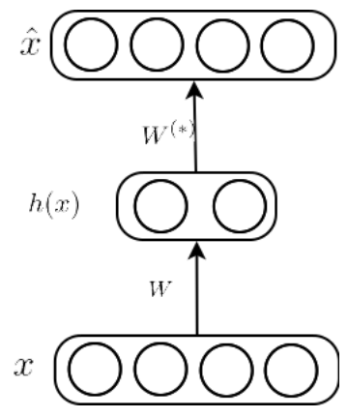
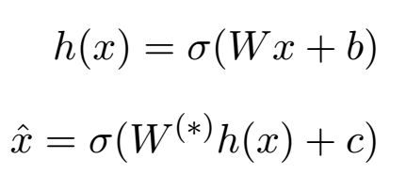

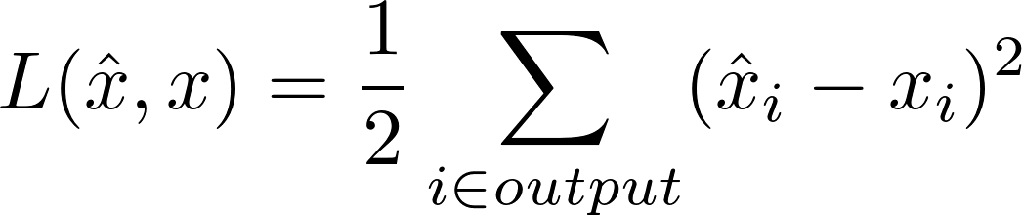
Brief introduction: Autoencoders
Autoencoder is a three-layers artificial feedforward neural network which is trained to reconstruct its input to learning useful representations.
Error measure:
c
Decoder
b
Encoder
Structure of an autoencoder

Slide 17
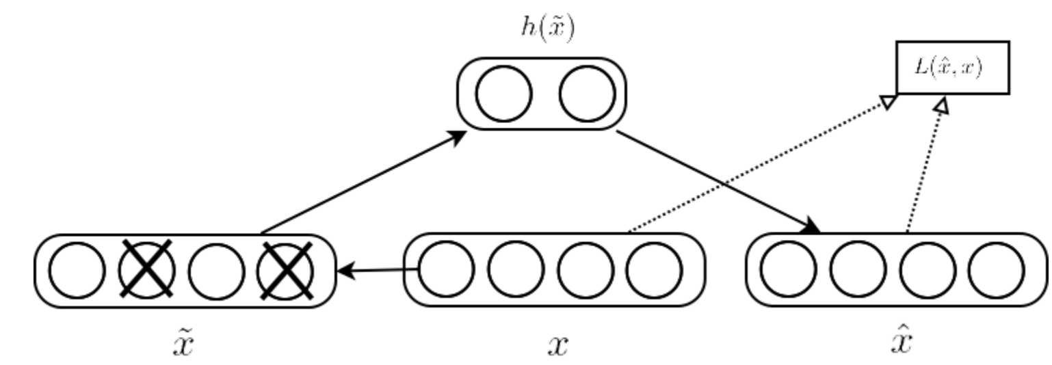
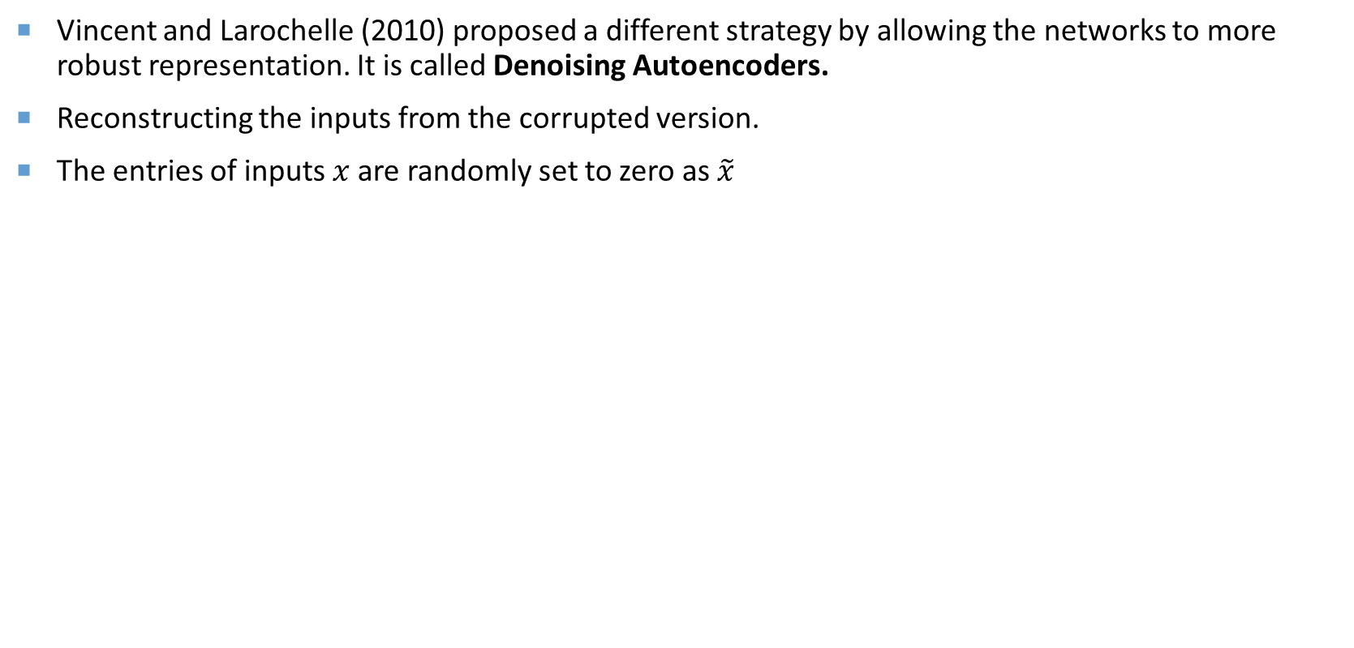
Brief introduction: Denoising Autoencoders
Vincent and Larochelle (2010) proposed a different strategy by allowing the networks to more robust representation. It is called Denoising Autoencoders.
Reconstructing the inputs from the corrupted version.
The entries of inputs $x$ are randomly set to zero as $\tilde{x}$
Structure of an Denoising autoencoder
Notes:
The idea is that we add some noise into input data x and allow the autoencoder decode back a clean version of input x. This way would allow the feature learnt more robust to noise.

Slide 18
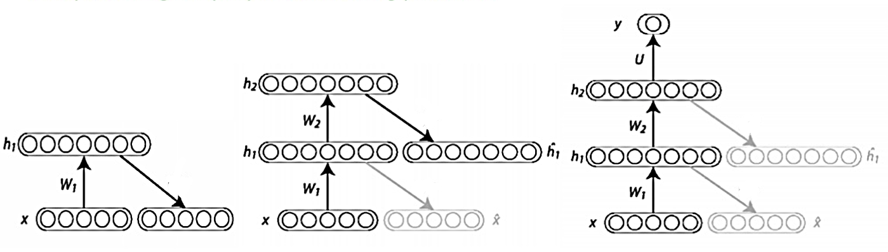
Brief introduction: Stacked Denoising Autoencoders (SDA)
A number of autoencoders can be stacked together to form deep neural networks called Stacked Denoising Autoencoders.
Training process is divided into two stages: pre-training and fine-tuning.
Generate better weight initialization and avoid networks to stuck in local minima.
(1) Training first Autoencoder
(2) Training second Autoencoder
(3) Fine-tuning whole networks using label
Notes:
A number of autoencoder can be used to stacked together to form a deep neural network called SDA.
There are two phases to train an SDA : pretraining and finetuning
In pretraining, each autoencoder is trained layer by layer. The latent representation from previous autoencoder is the input to the next autoencoder.

Slide 19
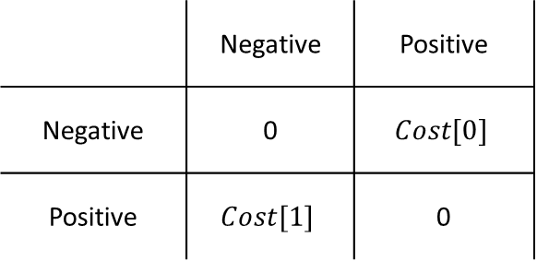
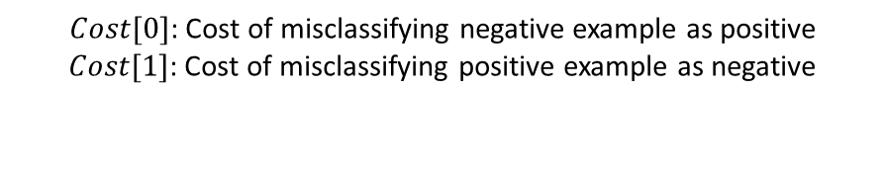
Proposed methods: CB-CSDNN
Standard algorithms assume the cost of misclassification to be equal which is usually failed in practice.
In CB-CSDNN, we incorporate class-based cost into the cost function of Stacked Denoising Autoencoders in fine-tuning stage.
The term Class-Based is refereed to the cost belongs to each misclassification type (i.e. false negative and false positive).
Predicted class
 | Negative | Positive
Negative | 0 | $$Cost[0]$$
Positive | $$Cost[1]$$ | 0
Actual class
$Cost[0]$: Cost of misclassifying negative example as positive
$Cost[1]$: Cost of misclassifying positive example as negative
Notes:
Standard…
In cb-csdnn we define different cost for diff misclass type.
Cost[0] denote
Cost[1] denote

Slide 20
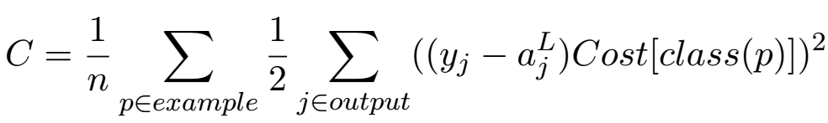
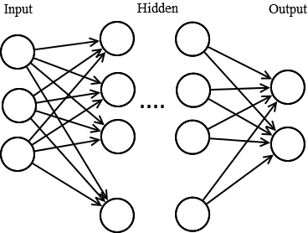
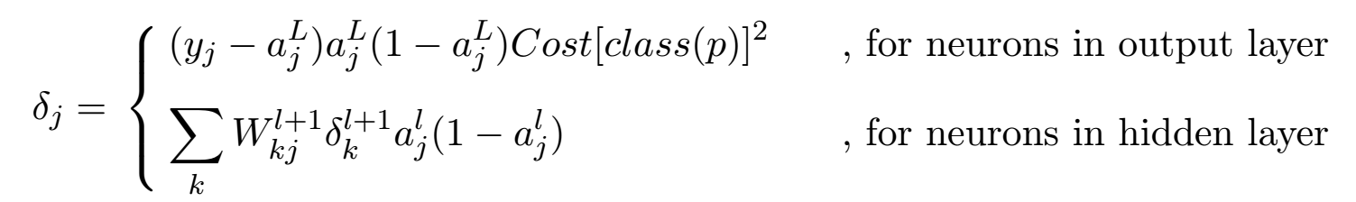

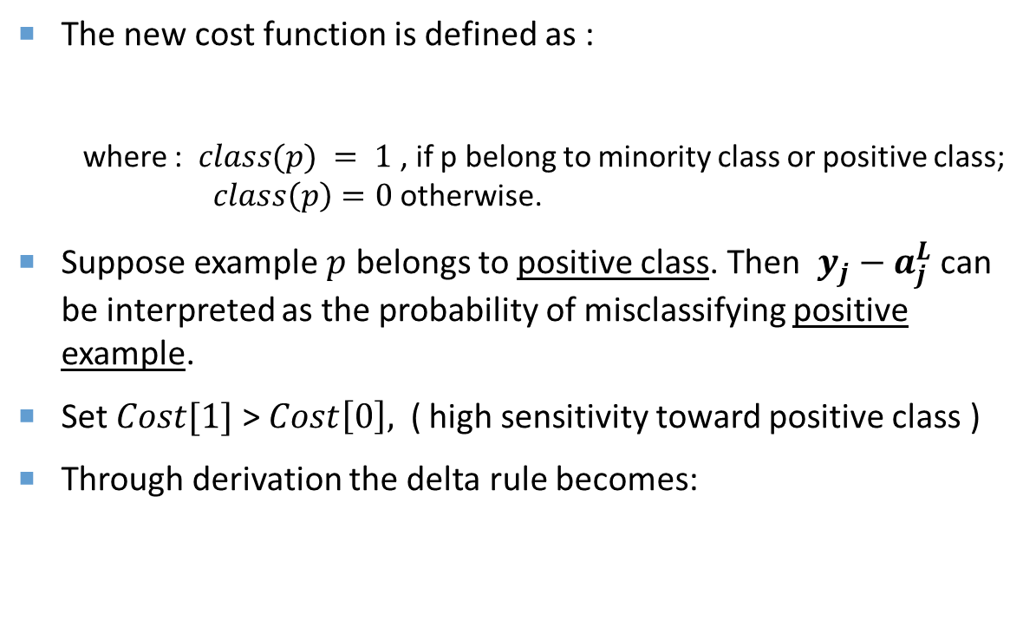



Proposed methods: CB-CSDNN
The new cost function is defined as :
where : $class(p) = 1$, if p belong to minority class or positive class; $class\left(p\right)=0$otherwise.
Suppose example $p$ belongs to positive class. Then $y_{j}−a_{j}^{L}$ can be interpreted as the probability of misclassifying positive example.
Set $Cost[1]$ > $Cost\left[0\right],$ ( high sensitivity toward positive class )
Through derivation the delta rule becomes:
$$a_{1}^{L}$$
$$a_{2}^{L}$$
$$W_{1}$$
$$W_{L}$$
Notes:
To give high sensitivity toward positive class, we could set value of set cost[1] > cost [0]

Slide 21
Hyperparameter Tuning with Evolutionary Algorithm
The hyperparameters such as the Cost, number of iteration, number of neurons, number of layers and learning rate have a significant impact the performance.
We use multi-objective evolutionary algorithm to evolve the parameters.

Slide 22
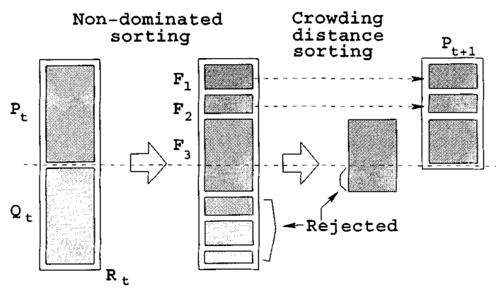
Nsga-ii
Non-Dominated Sorting Genetic Algorithms-II is an effective non-domination based genetic algorithm for multi-objective optimization.
  Population of size N is sorted based on non-domination in to each front ( F1, F2,…)
  Crowding distance is used to maintain diversity.
  Parents are selected by binary tournament selection based on rank and crowding distance
  N offsprings are generated and combine old population, get 2N size.
Notes:
Mutation alters one or more gene values in a chromosome from its initial state.

Slide 23
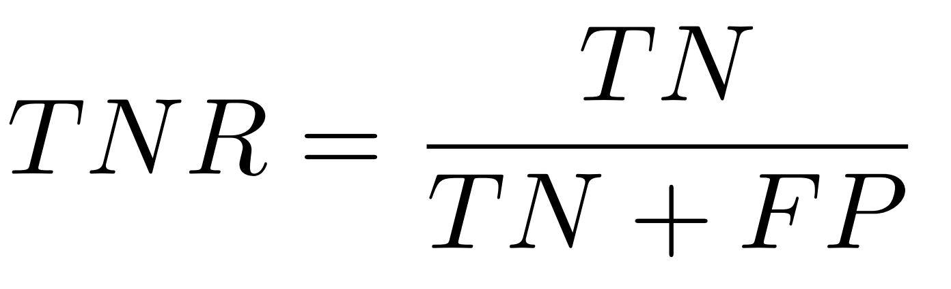
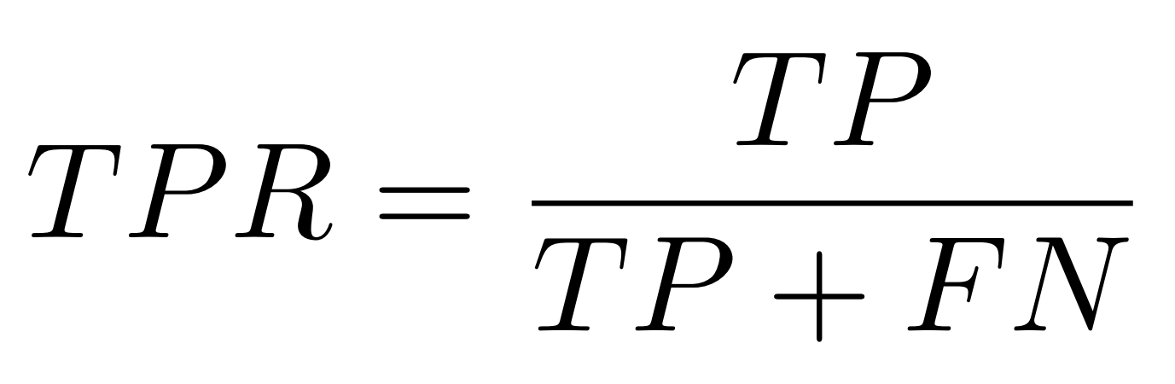
NSGA-II : Fitness function
Predicted class
 | 0 | 1
0 | TN | FP
1 | FN | TP
Actual class

Slide 24
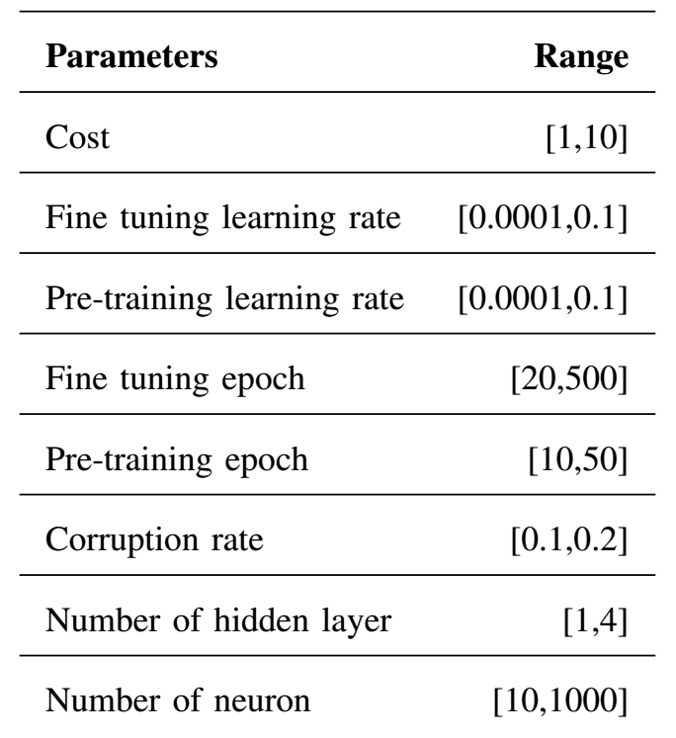
NSGA-II : chromosome
Each gene in chromosome represents one parameter.
The mutation of chromosome is
performed through uniform normal distribution

Slide 25
Preliminary experiment
Some experiments using CB-CSDNN were performed and compared the results with some
traditional algorithms.
We used China Corporate Securities Fraud (CCSF) data containing 18,373 records with 18 attributes. The dataset is imbalanced with 5.8% fraudulent examples.
For CB-CSDNN, original imbalanced dataset is used.
For other methods, dataset is first oversampling with SMOTE before training.

Slide 26
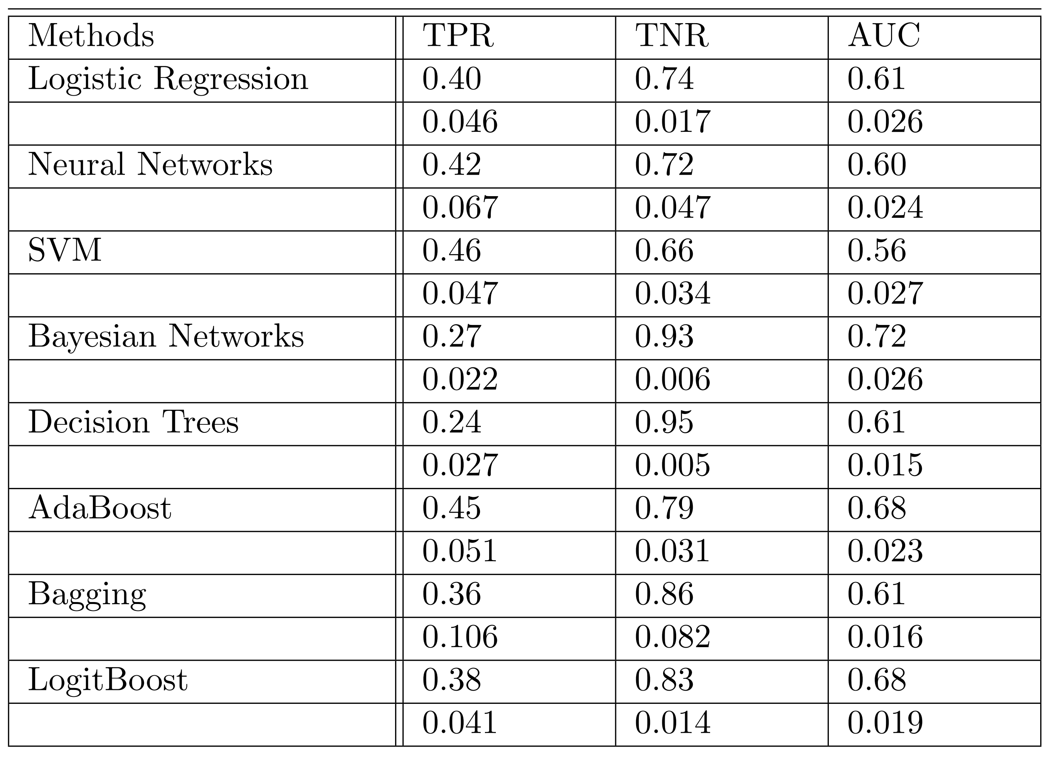
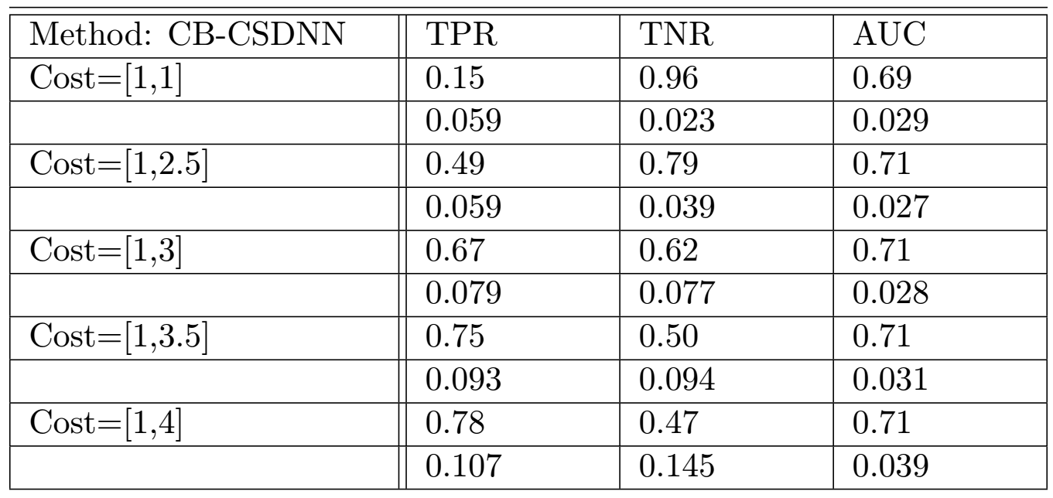
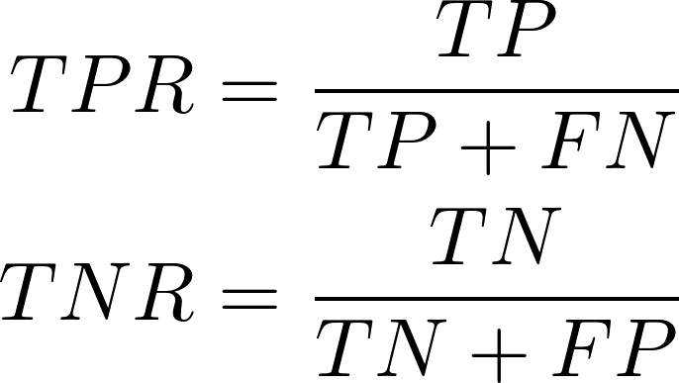
Preliminary experiment

Slide 27
Future works
Implement Evolutionary Algorithms to evolve hyperparameters.
Conduct experiments with AdaCost, AdaC2, and cost-sensitive deep learning proposed by Chung et al. (2015)

Slide 28
References
Akbani, R., Kwek, S., & Japkowicz, N. (2004). Applying Support Vector Machines to Imbalanced Datasets. Lnai, 3201, 39–50. https://doi.org/10.1007/978-3-540-30115-8_7
Anand, R., Mehrotra, K. G., Mohan, C. K., & Ranka, S. (1993). An improved algorithm for neural network classification of imbalanced training sets. IEEE Transactions on Neural Networks / a Publication of the IEEE Neural Networks Council, 4(6), 962–969. https://doi.org/10.1109/72.286891
Bengio, Y., Lamblin, P., Popovici, D., & Larochelle, H. (2007). Greedy Layer-Wise Training of Deep Networks. Advances in Neural Information Processing Systems, 19(1), 153. https://doi.org/citeulike-article-id:4640046
Berry, J., Fasel, I., Fadiga, L., & Archangeli, D. (2012). Training Deep Nets with Imbalanced and Unlabeled Data. Proc. Interspeech, (i), 1756–1759. Retrieved from http://20.210-193-52.unknown.qala.com.sg/archive/archive_papers/interspeech_2012/i12_1756.pdf
Cao, P., Liu, X., Bao, H., Yang, J., & Zhao, D. (2015). Restricted Boltzmann machines based oversampling and semi-supervised learning for false positive reduction in breast CAD. Bio-Medical Materials and Engineering. https://doi.org/10.3233/BME-151453
Cao, P., Zhao, D., & Zaïane, O. R. (2013). A PSO-Based Cost-Sensitive Neural Network. Pakdd, 452–463.
Chawla, N. V., Bowyer, K. W., Hall, L. O., & Kegelmeyer, W. P. (2002). SMOTE: Synthetic minority over-sampling technique. Journal of Artificial Intelligence Research, 16, 321–357. https://doi.org/10.1613/jair.953
Chen, Z., Fan, Z., & Sun, M. (2012). Decision support A hierarchical multiple kernel support vector machine for customer churn prediction using longitudinal behavioral data. European Journal of Operational Research, 223(2), 461–472. https://doi.org/10.1016/j.ejor.2012.06.040
Chung, Y., Lin, H., & Yang, S. (2015). Cost-aware Pre-training for Multiclass Cost-sensitive Deep Learning. Proceedings of the Twenty-Fifth International Joint Conference on Artificial Intelligence, 1411–1417. Retrieved from http://arxiv.org/abs/1511.09337
Cui, G., Wong, M. L., & Wan, X. (2012). Cost-Sensitive Learning via Priority Sampling to Improve the Return on Marketing and CRM Investment. Journal of Management Information Systems, 29(1), 341–374. https://doi.org/10.2753/MIS0742-1222290110
Di Martino, S., Ferrucci, F., Gravino, C., & Sarro, F. (2011). A genetic algorithm to configure support vector machines for predicting fault-prone components. Lecture Notes in Computer Science (Including Subseries Lecture Notes in Artificial Intelligence and Lecture Notes in Bioinformatics), 6759 LNCS, 247–261. https://doi.org/10.1007/978-3-642-21843-9_20
Domingos, P. (1999). MetaCost: A General Method for Making Classifiers Cost-Sensitive. Proceedings of the Fifth ACM SIGKDD International Conference on Knowledge Discovery and Data Mining, 55(10), 155–164. https://doi.org/10.1145/312129.312220
Freund, Y., & Schapire-, R. E. (1997). A Decision-Theoretic Generalization of On-Line Learning and an Application to Boosting*. Journal of Computer and System Sciences SS1504 Journal of Computer and System Sciences, 55. Retrieved from http://www.face-rec.org/algorithms/Boosting-Ensemble/decision-theoretic_generalization.pdf

Slide 29
References
Ghazikhani, A., Monsefi, R., & Sadoghi Yazdi, H. (2014). Online neural network model for non-stationary and imbalanced data stream classification. International Journal of Machine Learning and Cybernetics, 5(1), 51–62. https://doi.org/10.1007/s13042-013-0180-6
Hinton, G. E., Osindero, S., & Teh, Y. W. (2006). A fast learning algorithm for deep belief nets. Neural Computation, 18(7), 1527–54. https://doi.org/10.1162/neco.2006.18.7.1527
Japkowicz, N. (2000). The Class Imbalance Problem: Significance and Strategies. Proceedings of the 2000 International Conference on Artificial Intelligence, 111--117. https://doi.org/10.1.1.35.1693
Kubat, M., & Matwin, S. (1997). Addressing the Curse of Imbalanced Training Sets: One Sided Selection. Icml, 97, 179–186. https://doi.org/10.1007/s13398-014-0173-7.2
Kukar, M., & Kononenko, I. (1998). Cost-sensitive learning with neural networks. 13th European Conference on Artificial Intelligence, 445–449. Retrieved from http://pdf.aminer.org/000/165/499/cost_sensitive_learning_with_neural_networks.pdf
Maloof, M. a. (2003). Learning When Data Sets are Imbalanced and When Costs are Unequal and Unknown. In ICML-2003 Workshop on Learning from Imbalanced Data Sets (Vol. 2, pp. 2–1). Retrieved from http://citeseerx.ist.psu.edu/viewdoc/download?doi=10.1.1.111.5610&amp;rep=rep1&amp;type=pdf
Ng, W. W. Y., Zeng, G., Zhang, J., Yeung, D. S., & Pedrycz, W. (2016). Dual autoencoders features for imbalance classification problem. Pattern Recognition, 60, 875–889. https://doi.org/10.1016/j.patcog.2016.06.013
Sun, Y., Kamel, M. S., Wong, A. K. C., & Wang, Y. (2007). Cost-sensitive boosting for classification of imbalanced data. Pattern Recognition, 40(12), 3358–3378. https://doi.org/10.1016/j.patcog.2007.04.009
Wang, B. X., & Japkowicz, N. (2009). Boosting support vector machines for imbalanced data sets. Knowledge and Information Systems, 25(1), 1–20. https://doi.org/10.1007/s10115-009-0198-y
Wang, S., Liu, W., Wu, J., Cao, L., Meng, Q., & Kennedy, P. J. (2016). Training Deep Neural Networks on Imbalanced Data Sets. 2016 International Joint Conference on Neural Networks (IJCNN), 4368–4374.
Zadrozny, B., & Elkan, C. (2001). Learning and making decisions when costs and probabilities are both unknown. Proceedings of the Seventh International Conference on Knowledge Discovery and Data Mining, (JULY), 204–213. https://doi.org/10.1145/502512.502540
Zhou, Z. H., & Liu, X. Y. (2006). Training cost-sensitive neural networks with methods addressing the class imbalance problem. IEEE Transactions on Knowledge and Data Engineering. https://doi.org/10.1109/TKDE.2006.17

Slide 30
  Thank you

