Slide 1
Breastfeeding: Is Society Catching up with a Miracle of Nature?
Kristen Altdoerffer DNP, CRNP, PNP-PC
Drexel University
Advocare Newborn Network

Slide 2
Objectives
Review the known benefits of breastfeeding
Discuss current recommendations and the barriers to breastfeeding
Examine recent advances in breastfeeding health policy
Present breaking edge breastfeeding research

Slide 3

The Health Benefits
Risk decreases by..
Otitis media 23-50%
URI 63%
Lower Respiratory 72-77%
Asthma 26-40%
RSV bronchiolitis 74%
Atopic dermatitis 27-42%
Gastroenteritis 64%
Popsugar.com
AAP, 2012

Slide 4
The Health Benefits
Risk decreases by..
Obesity 24%
Celiac disease 52%
Type 1 DM 30%
Type 2 DM 40%
Leukemia 15-20%
SIDS 36%
Popsugar.com
AAP, 2012

Slide 5

Is society ready for breastfeeding?

Slide 6
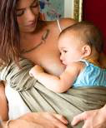
Prevalence in the US
2007 2020 Target
Any breastfeeding
Ever 75.0 81.9
6 mo 43.8 60.5
1 y 22.4 34.1
Exclusive breastfeeding
To 3 mo 33.5 44.3
To 6 mo 13.8 23.7
Worksite lactation support:25 38.0
Formula use in first 2 d 25.6 15.6
www.breastfeeding.com
AAP, 2012
Notes:
↵a 2007 data reported in 2011.10

Slide 7

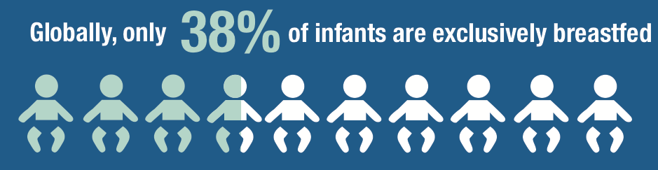
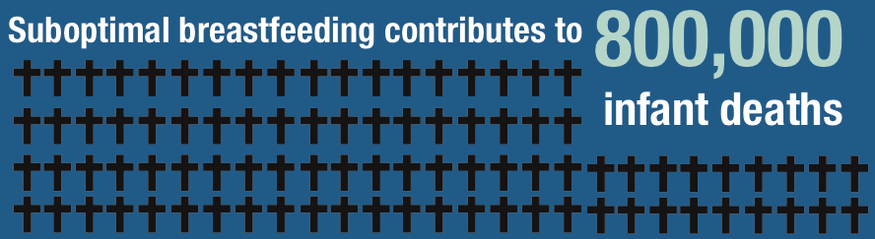

WHO/UNICEF, 2014

Slide 8





Limit formula marketing
Support paid leave
Strengthen health systems
Support mothers
WHO/UNICEF, 2014

Slide 9
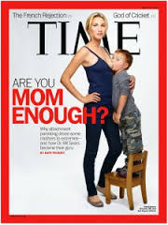
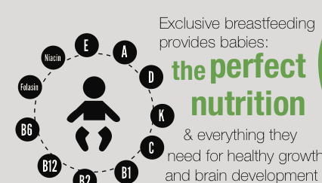
The AAPs recommends
Exclusive breastfeeding for 6 months
Continue at least 1st year and beyond
Peripartum policies supporting breastfeeding
8-12 feeds/day
Vitamin D supplementation drops (400 IU)
Mother and infant sleep close
Pacifier offered after 3-4 weeks
AAP, 2012
WHO/UNICEF, 2014

Slide 10
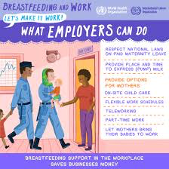
Changes in Policy
1999: Right to Breastfeed on Federal Property
  “A woman may breastfeed her child at any location in a Federal building or on Federal property”
2010: Workplace Support
  Requires employers to provide breaks and non-bathroom locations for pumping for 1 year
  *800% recent increase in breastfeeding-
  related discrimination lawsuits
US Breastfeeding Committee, 2016
Wan Amburg, 2016

Slide 11
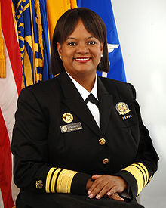
Changes in Policy
2011: The Surgeon General’s Call to Action to Support Breastfeeding
  Call to Action for:
    Mothers and Their Families
    Communities
    Health Care
    Employment
    Research and Surveillance
    Public Health Infrastructure
Surgeongeneral.gov, 2011

Slide 12
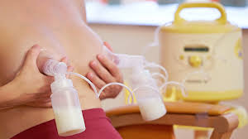
Changes in Policy
2012: The Affordable Care Act
  “breastfeeding support, supplies, and
  counseling”
  “lactation support and counseling”
  “costs for renting breastfeeding equipment”
2013: Model Policy: Payer Coverage of Breastfeeding Support and Counseling Services, Pumps and Supplies
US Breastfeeding Committee, 2016

Slide 13

State Public
Breastfeeding Laws
3 categories of laws:
A. Protect a woman’s right to breastfeed anywhere she or her child have a right to be, regardless of whether the breast is showing
B. Gives the woman the power to bring a legal action against anyone who interferes with her breastfeeding.
Protects a woman’s right to breastfeed in public, but doesn’t provide a way for her to enforce this right.
The act of breastfeeding is not indecent exposure, and prevents a woman from being charged with a sex crime for breastfeeding.
Some States Have No Laws!!!!!!
Breastfeedinglaw.com, 2016

Slide 14
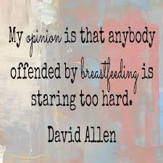

Slide 15
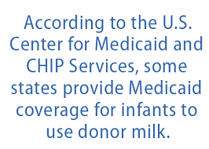

Milk Banks
Risks of breast milk sharing
Do not buy online! Not regulated!
Non-profit milk banks are rigorously screened.
  ~$4/ounce
  Little donated-> majority given to hospitals
CHOP Mother Milk Bank
      BMJ, 2015; Keim et al., 2014;
www.csgmidwest.org

Slide 16

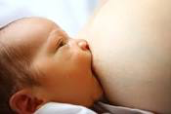
Barriers to Overcome
Tongue tie
Breast refusal
Sore nipples
Poor weight gain
Blocked ducts and mastitis
Thrush
http://www.the-essential-infant-resource-for-moms.com
Americanpregnancy.org
(Syme, Holt, Fell, & Crawley, 2015)

Slide 17

Community Support
Lactation Support-> IBCLC
Primary Care Providers
Breastfeeding Centers
cameronmch.wordpress.com

Slide 18
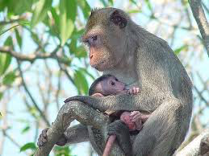
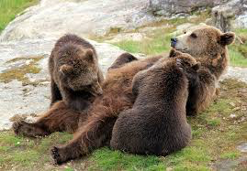
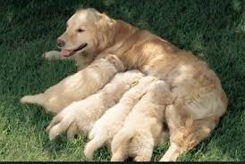
New Research: Most Complex Milk of Mammals
Humans may have the most complex breast milk of all mammals, >200 different sugar molecules (average 30-50)
First feeds: sugar molecules build the bacterial flora.
Slow growth of harmful bacteria and coordinate WBC activity
Thierry Hennet, Lubor Borsig. Breastfed at Tiffany's.
Trends in Biochemical Sciences, 2016; DOI: 10.1016/j.tibs.2016.02.008

Slide 19
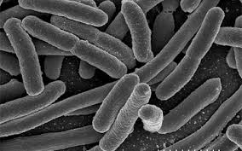
New Research: Hormones
Impact Healthy Gut Bacteria
Insulin and leptin-> increase microbial diversity creating barrier to harmful toxins
Gammaproteobacteria-> cause healthy intestine inflammation and microbiome maturation ( in obese mothers)
Anti-microbial peptides-> kill off bad bacteria, allow good to flourish
D. J. Lemas, et. al., (2016). Alterations in human milk leptin and insulin
are associated with early changes in the infant intestinal microbiome.
American Journal of Clinical Nutrition, 103 (5): 1291 DOI: 10.3945/ajcn.115.126375

Slide 20
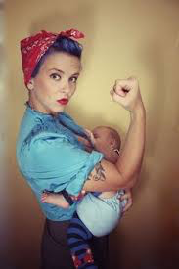
New Research: Breastfed Children have Higher IQ Scores
Longitudinal study which children were assessed annually for 8 waves over 11 years
Neuroimaging between 9.5-14.11 years old
Breastfeeding children
  higher IQ scores
  larger whole brain
  total gray matter
Luby, J.L. et al. (2016). Breastfeeding and Childhood IQ: The Mediating Role of Gray
Matter Volume, Journal of the American Academy of Child & Adolescent Psychiatry ,
Volume 55 , Issue 5 , 367 - 375

Slide 21

So is society supportive of breastfeeding???
Know the benefits of breastfeeding
Discussed current recommendations and the barriers to breastfeeding
Examined recent advances in breastfeeding health policy
Presented new research
Themominmemd.com

Slide 22
References
American Academy of Pediatrics, Section on Breastfeeding. (2012). Breastfeeding and the Use of Human Milk, Pediatrics Mar 2012, 129 (3) e827-e841.
BMJ. (2015, March 24). Concerns over the online market of human breast milk. ScienceDaily. Retrieved July 15, 2016 from www.sciencedaily.com/releases/2015/03/150324210047.htm
Cell Press. (2016, April 19). Unique biology of human breast milk. ScienceDaily. Retrieved July 15, 2016 from www.sciencedaily.com/releases/2016/04/160419130002.htm
Kein, S., A. et al. (2014). Breastmilk Sharing: Awareness and Participation Among Women in the Moms2Moms Study. Breastfeeding Medicine, 9 (8): 398 DOI: 10.1089/bfm.2014.0032
Luby, J.L. et al. (2016). Breastfeeding and Childhood IQ: The Mediating Role of Gray Matter Volume, Journal of the American Academy of Child & Adolescent Psychiatry , Volume 55 , Issue 5 , 367 - 375

Slide 23
References
Marcus, J. (2016). Breastfeeding law: Lactation and the Law. Retrieved from http://breastfeedinglaw.com/articles/lactation-and-the-law/
Surgeon General (2011). The surgeon general’s call to action to support breastfeeding. Retrieved from http://www.surgeongeneral.gov/library/calls/breastfeeding/
Syme, J., Holt, S., Fell, K., & Crawley, L. (2015). Overcoming breastfeeding challenges. Community Practitioner, 88,6:29-31.
United States Breastfeeding Committee (2016). Legislation & Policy, Retrieved from http://www.usbreastfeeding.org/model-payer-policy
University of Colorado Anschutz Medical Campus. (2016, May 4). Breast milk hormones found to impact bacterial development in infants' guts: Intestinal microbiome of children born to obese mothers significantly different from those born to mothers of healthy weight. ScienceDaily. Retrieved July 15, 2016 from www.sciencedaily.com/releases/2016/05/160504174855.htm

Slide 24
References
Van Amburg, J. (2016). Breastfeeding discrimination lawsuits rose 800% in the past decade. Retrieved from http://motto.time.com/4337671/breastfeeding-lawsuits-employee-discrimination/
WHO/UNICEF. (2014). Global nutrition targets 2025: breastfeeding policy brief (WHO/NMH/NHD/14.7). Geneva: World Health Organization.

Slide 25
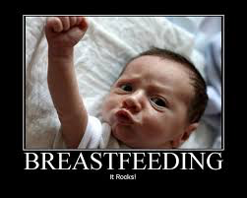
Questions????

