Slide 1
Genomics, Gene Therapy and
Intellectual Property Issues
Krishna Dronamraju
Foundation for Genetic Research,
Houston (kdronamraj@aol.com)

Slide 2
Genome
The genome is the genetic material of an organism. It consists of DNA (or RNA in RNA viruses). The genome includes both the genes and the non-coding sequences of the DNA/RNA.
The term was created in 1920 by Hans Winkler of Hamburg, Germany

Slide 3
Genomics
The term genomics was coined by Tom Roderick, a geneticist at the Jackson Laboratory (Bar Harbor, Maine), over beer at a meeting held in Maryland on the mapping of the human genome in 1986.

Slide 4
Gene Therapy
Safety
Efficacy
Utility

Slide 5
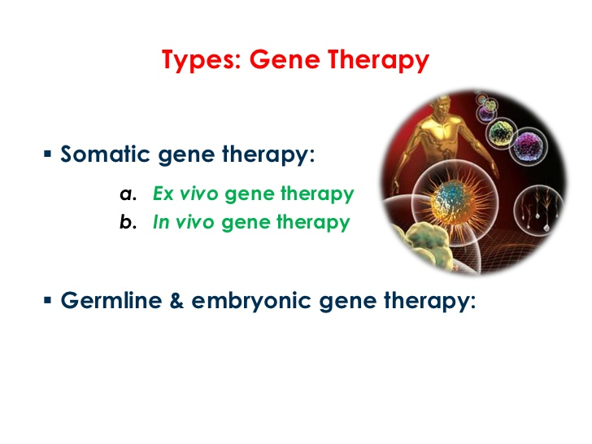

Slide 6
ADA deficiency is one form of SCID (severe combined immunodeficiency), a rare disorder that affects the immune system. A malfunctioning immune system leaves the body open to infection from bacteria and viruses. The disease is caused by a mutation in a gene on chromosome 20.

Slide 7
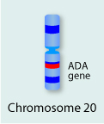

Slide 8
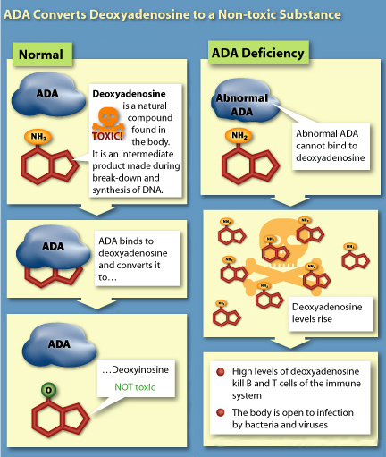
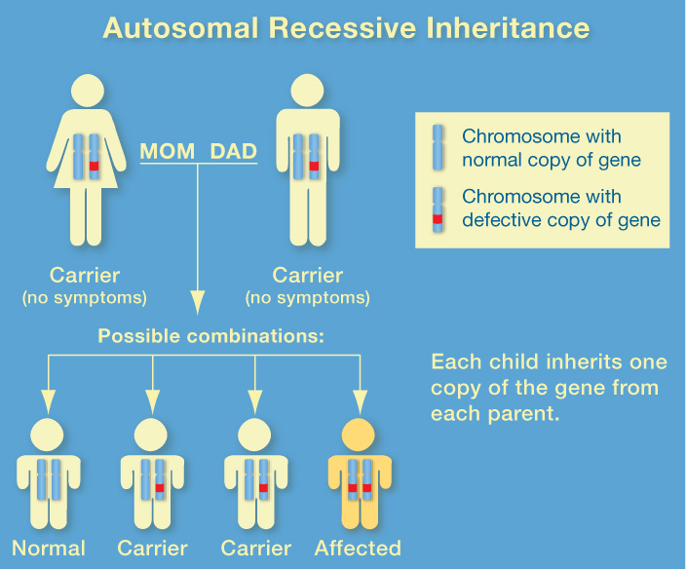

Slide 9
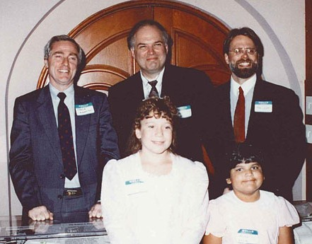

Slide 10
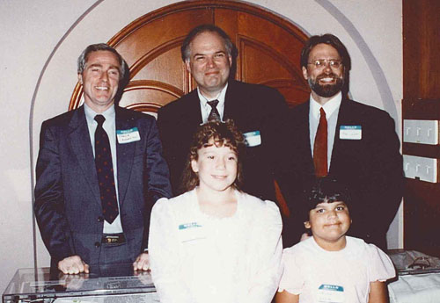
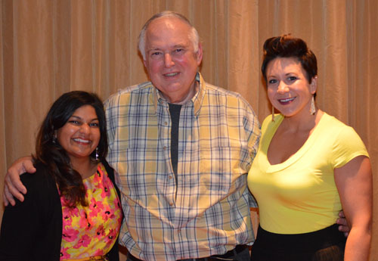
ADA patients today
Cynthia and Ashanthi in 1992 with the pioneer physicians of gene therapy: (from left) French Anderson, MD; Michael Blaese, MD; and Kenneth Culver.
R. Michael Blaese, MD with Ashanthi DeSilva (left) and Cindy Kisik at the IDF 2013 National Conference, June 29.

Slide 11
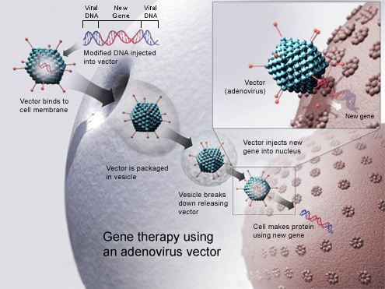
Gene Therapy

Slide 12
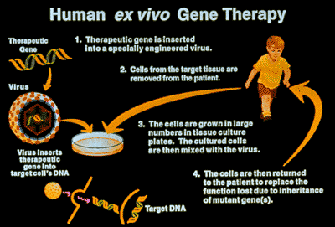

Slide 13
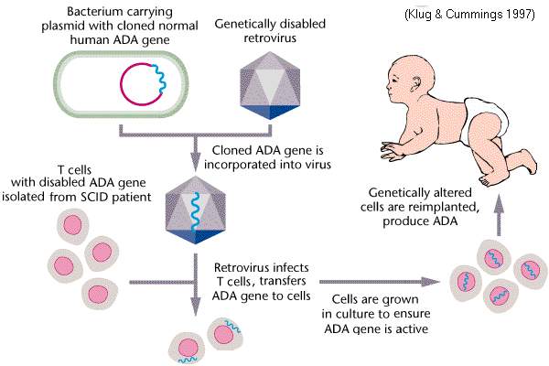
Gene Therapy for ADA

Slide 14
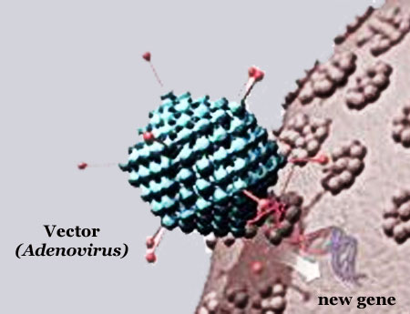

Slide 15
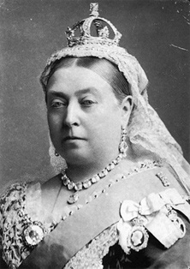
Queen Victoria

Slide 16
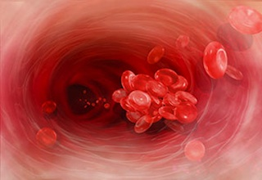

Slide 17
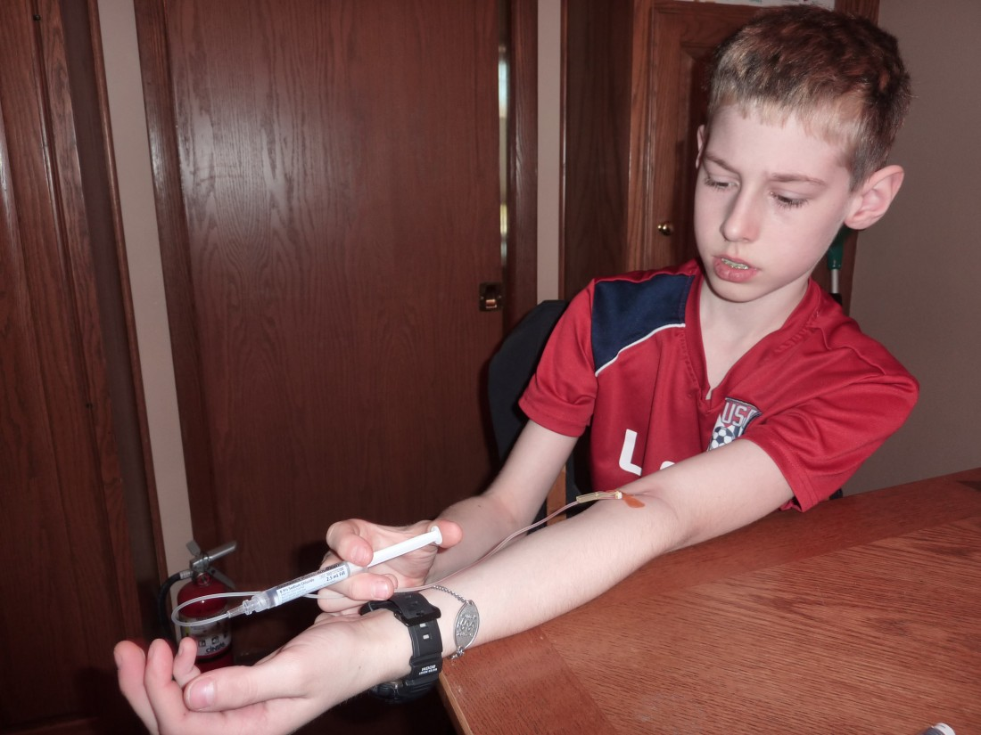

Slide 18
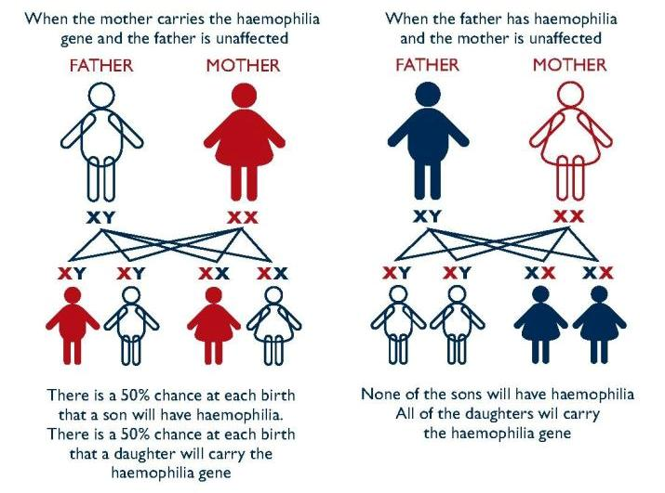
Inheritance of Hemophilia

Slide 19
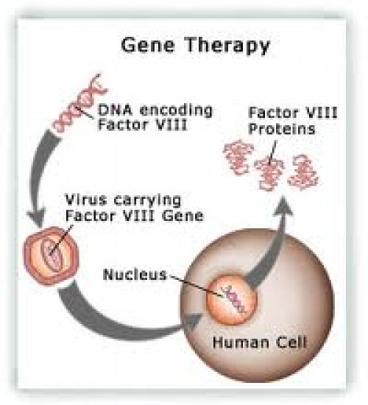

Slide 20
CRISPR
Clustered regularly interspaced short palindromic repeats are segments of prokaryotic DNA containing short repetitions of base sequences.

Slide 21
Each repetition is followed by short segments of "spacer DNA" from previous exposures to a bacterial virus or plasmid. CRISPR spacers recognize these exogenous genetic elements. CRISPRs are found in approximately 40% of sequenced bacteria genomes and 90% of sequenced archaea

Slide 22
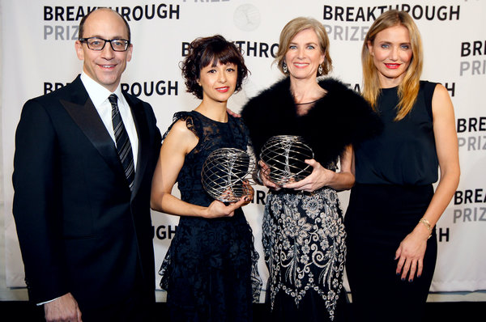

Slide 23
What Applications Are Possible With CRISPR-Cas Systems?
Gene silencing – The Cas9 endonuclease has become a popular tool for directed gene editing in eukaryotic systems. With the use of this technique locations within complex mammalian genomes can be targeted by the Cas9 endonuclease for a double stranded break. Such breaks can result in genomic deletions or insertions that create frame shifts and premature termination to permanently silence target genes.

Slide 24
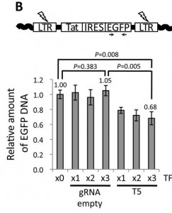
Excision of HIV-1 provirus from host cell genome with CRISPR/Cas9
Figure 4: Excision of HIV-1 provirus from host cell genome with CRISPR/Cas9. From Harnessing the CRISPR/Cas9 system to disrupt latent HIV-1 provirus. Image used under Creative Commons license from (Ebina et al. 2013, Figure 2)

Slide 25
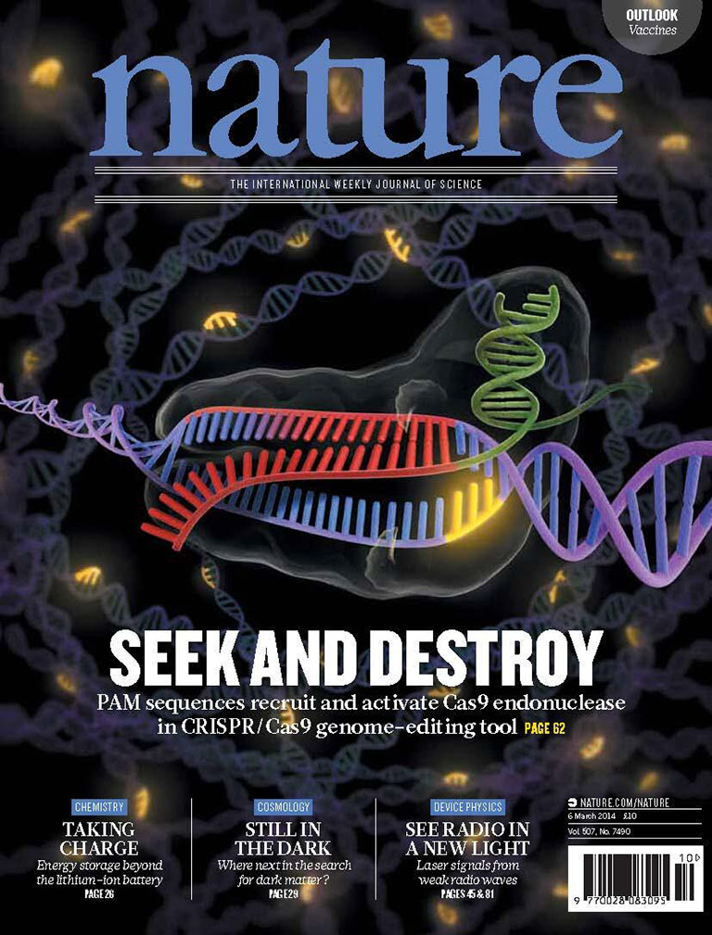

Slide 26
Do the potential benefits of germline gene therapy outweigh the potential risks?
Does germline gene therapy consider an individual's human rights?
Is germline gene therapy affordable?

Slide 27
Is germline gene therapy ethical?
Germline gene therapy targets the reproductive cells, meaning any changes made to the DNA will be passed on to the next generation. Consequently, the practice has dramatically divided opinion.

Slide 28
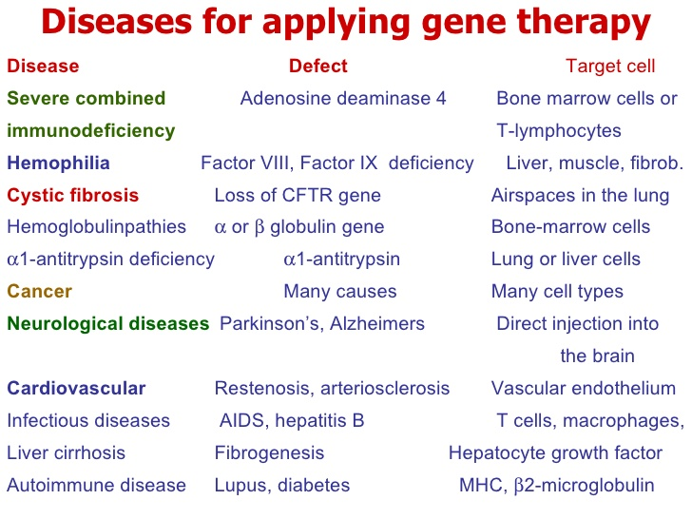

Slide 29
Patent dispute
Feng Zhang and Broad Institute/MIT
Fast Track Patent
vs
Jennifer Doudna and UC Berkeley
Emmanuelle Charpentier and
Helmholtz Center for Infectious
Disease Research, Germany

Slide 30
Patent disputed
The stakes involved are huge. Not only does a Nobel Prize for gene editing seem likely, but several heavily financed startups have been created to start developing gene-therapy treatments. Zhang is involved in Editas Medicine, Doudna’s startup is called Caribou Biosciences, and Charpentier is a founder of CRISPR Therapeutics.

Slide 31
The University of California has asked the U.S. Patent & Trademark Office to decide who was first to invent a powerful gene-editing tool called CRISPR-Cas9. The regents of California’s public university system are challenging ten patents issued last year to the MIT/Harvard/Broad Institute, in Cambridge saying the hugely valuable rights should belong to them.

