Slide 1
Swiprosin – How cardiomyocytes can reorganize their sarcomeres and couple remodeling to β-adrenoceptor desentization
Klaus-Dieter Schlüter
Physiologisches Instuitut, JLU Gießen
Funding and Declaration:
The work presented during this talk was supported by DFG, ECCPS, von Behring-Röntgen-Stiftung, and the Medical Faculty of the JLU Gießen
Berlin; 20.07.2016

Slide 2
Reasons for Heart Failure
Hypertension
Myocardial Infarction
Ageing
Berlin; 20.07.2016

Slide 3
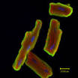
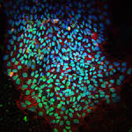



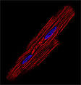
Cardiac Development and Remodeling: Effect of Ageing
Rat heart
n2:n1 4:1
Stem cells fetal cmc neonatal cmc adult 1n adult 2n
Proliferation
Differentiation
Embryogenesis Postnatal Growth Adult
Time
Hypertrophy: α -> β MHC
Berlin; 20.07.2016

Slide 4
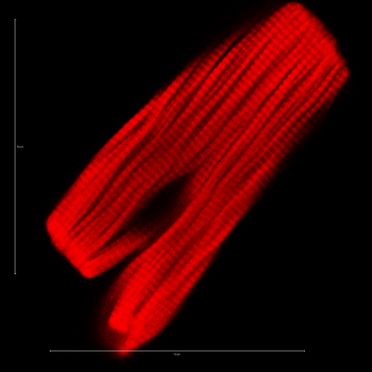
Cardiac Remodelling has many faces
Mitochondria
- ROS
Nucleus
Apoptosis
Transcription
(ANP)
Sarcomer
- MHCβ
Receptors
- AR-β₁
SR
Ca-Transients
Diastole
Systole
Transporters
- GLUT1,4
Ribosomes
- Protein Synthesis
Ion Channels
- I_{k}
Berlin; 20.07.2016

Slide 5
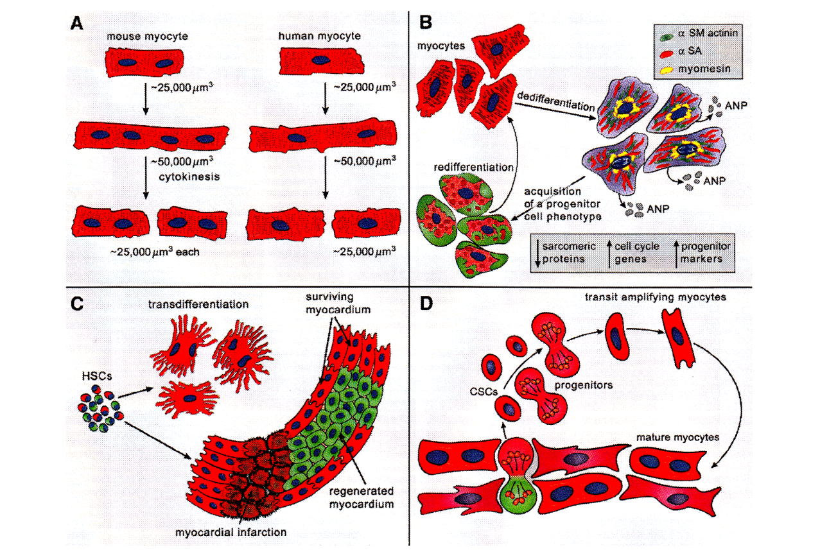
Cardiac Remodeling includes Dedifferentiation
What does the term „terminally differentiated cardiomyocyte“ really mean in the context of cardiac remodeling?
Modified from Leri et al., Circ Res 116:150-166, 2015
Berlin; 20.07.2016

Slide 6
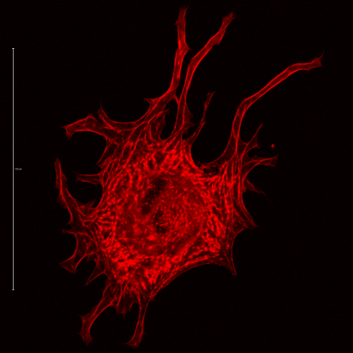
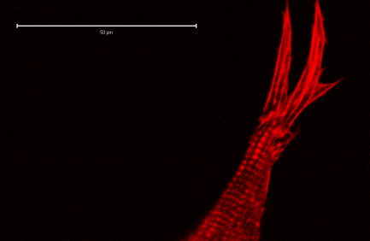
Cardiac Dedifferentiation and Redifferentiation can be studied in vitro
Degradation of existing sarcomeres
2
Stress fibers in perinucelar region
1
3
Formation of new sarcomeres alongside the stress fibres
Day 3-4
Day 1
Day 5-6
Berlin; 20.07.2016

Slide 7
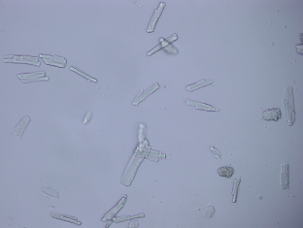
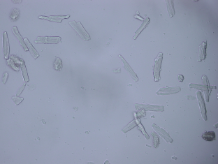
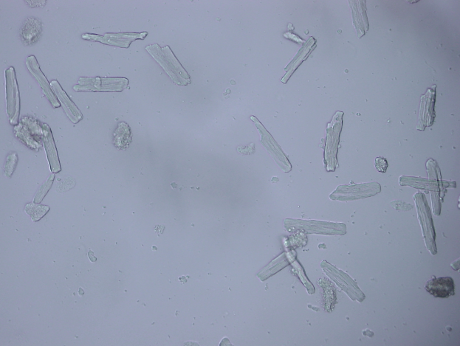
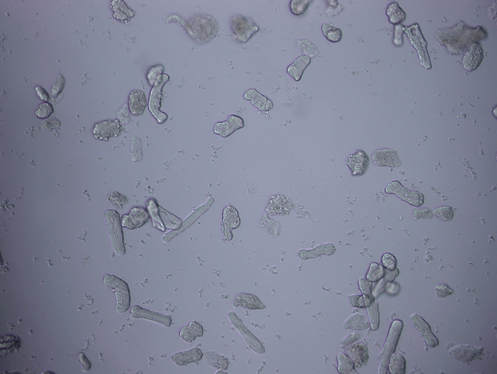
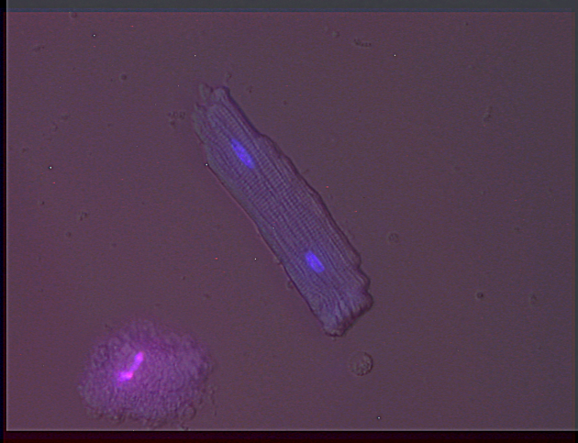
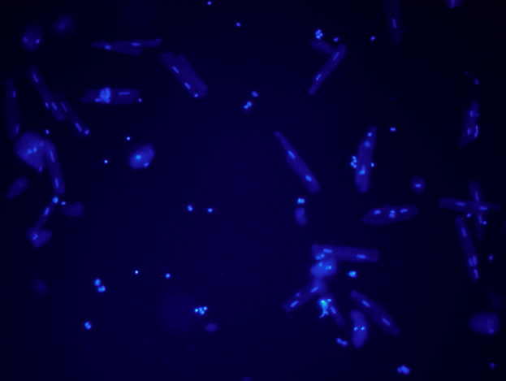
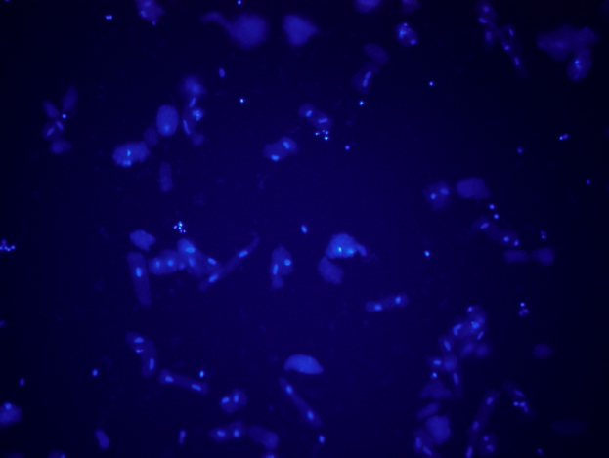
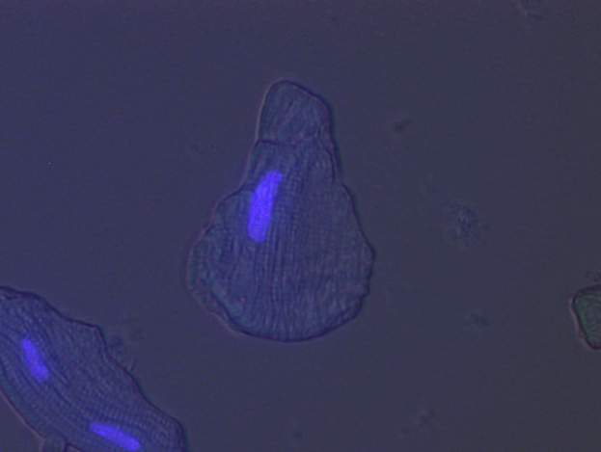
1. Sarcomere degradation in vitro
Day 0 Day 2 Rod vs. Round
Berlin; 20.07.2016

Slide 8
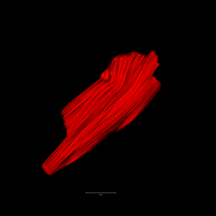

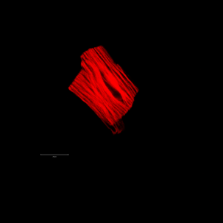
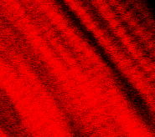
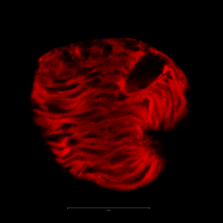
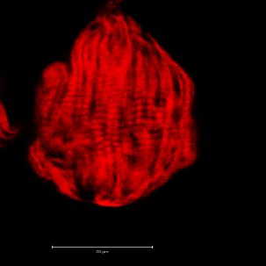
1. Sarcomere degradation in vitro
Day 0
Day 2 – FCS-free
Day 2 – FCS
Berlin; 20.07.2016

Slide 9
1. Sarcomere degradation in vitro: An active process
*
*
n = 1
Round Cells (%)
Round Cells (%)
n ≥ 2
FCS - FCS -
400 cells per preparation / condition
8 different preparations
Berlin; 20.07.2016

Slide 10
1. Sarcomere degradation in vitro: Helps to escape apoptotic damage
n = 1
n ≥ 2
*
Apoptotic Cells (%)
Apoptotic Cells (%)
FCS - FCS -
FCS - FCS -
Berlin; 20.07.2016

Slide 11
1. Sarcomere degradation in vitro: Activates inflammasome at Day 2
Trp C lmp2 β-actin
Transcriptional adaptation of cultured cardiomyocytes:
Degradation of sarcomeric proteins (Trp C)
Induction of proteasome (Lmp2)
Induction of stress fibre proteins (β-actin)
*
*
mRNA (x-fold Day 0)
*
Berlin; 20.07.2016

Slide 12
1. The inflammasome
Proteasome Inflammasome
Pattern recognition site
Proteolytic site
α - subunits
β - subunits
Lmp-2
Berlin; 20.07.2016

Slide 13
1. Induction of Lmp2 for cardiac remodeling
LMP2
GAPDH
Day 0 Day-2 Day-2 / FCS
Round Cells (%)
Lmp2 / GAPDH
*
Apoptotic Cells (%)
Mean ± SEM, n=4
Berlin; 20.07.2016

Slide 14
1. Activation of an inflammasome in vivo
SHR n=6-8
*
LV Lmp2 mRNA (x-fold 1.5 Mo)
*
Berlin; 20.07.2016

Slide 15
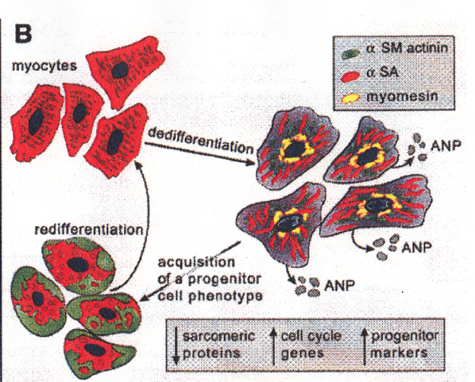
1. Sarcomere degradation in vitro: What we have learned
Terminal differentiated cardiomyocytes are able to degrade their sarcomeres
This is an active process
The process is associated with cellular escape from apoptosis
Mononuclear cells seem to be more sensitive to this process
It requires an increase in proteasome activity by induction of inflammasome structures (lmp2)
It is found in left ventricles from hypertensive rats during the adaptive phase of hypertrophy
Berlin; 20.07.2016

Slide 16
Cardiac Dedifferentiation and Redifferentiation: Spreading
Degradation of existing sarcomeres
2
Stress fibers in perinucelar region
1
3
Formation of new sarcomeres alongside the stress fibres
Day 3-4
Day 1
Day 5-6
Berlin; 20.07.2016

Slide 17
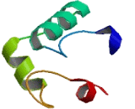
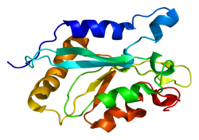

EFHD2; Swip-1; EF-Hand Domain Family, Member D2
Cardiac Redifferentiation (spreading): Swiprosin-1 (=EFhd2)
+ -
Ca²⁺
Swiprosin
Cofilin
Actin
+ -
Berlin; 20.07.2016

Slide 18
Cardiac Redifferentiation (spreading): Swiprosin (=EFhd2)
Swiprosin 1
GAPDH
*
*
*
*
swiprosin 1 / hprt
Swiprosin 1 / GAPDH
0 1 2 3 4 5 6 Day
Berlin; 20.07.2016

Slide 19
Cardiac Redifferentiation (spreading): Swiprosin (=EFhd2)
scRNA siRNA
Swiprosin
*
GAPDH
Swiprosin 1 / GAPDH
≈6 ≈12 ≈18 ≈6 ≈12 ≈18 µg protein
Berlin; 20.07.2016

Slide 20
Cardiac Redifferentiation (spreading): Swiprosin (=EFhd2)
p=0.000
% Spreading
Time (d)
n=6
Berlin; 20.07.2016

Slide 21
Cardiac Redifferentiation (spreading): Influence of Ca_{i}
Swiprosin
GAPDH
Ctr BAP Ctr BAP Ctr BAP
p=0.015
% Spreading
Time (d)
n=5
Berlin; 20.07.2016

Slide 22
Cardiac Redifferentiation (spreading): Swiprosin (=EFhd2) expression in hypertensive heart remodelling
*#
*
*
*
P syst (mmHg)
LVW/TL (mg/mm)
Swiprosin mRNA (x-fold)
n=6-12
Berlin; 20.07.2016

Slide 23
Cardiac Remodeling has many faces: Are they connected?
Mitochondria
- ROS
Nucleus
Apoptosis
Transcription
(ANP)
Sarcomer
- MHCβ
Receptors
- AR-β₁
SR
Ca-Transients
Diastole
Systole
Transporters
- GLUT1,4
Ribosomes
- Protein Synthesis
Ion Channels
- I_{k}
Berlin; 20.07.2016

Slide 24
Cardiac expression of Swiprosin (=EFhd2): Co-Regulation with proteins that desensitize β-adrenoceptors
In vivo
In vitro
GRK-2 mRNA
GRK-2 mRNA
Swiprosin mRNA
Swiprosin mRNA
p=0.000
Berlin; 20.07.2016

Slide 25
Role of GRK2 for β-adrenoceptor responsiveness
NOR
Arrestin
GRK2
PKA
AC
LTCC, PLB, TnI, RyR2
Berlin; 20.07.2016

Slide 26
Cardiac expression of Swiprosin (=EFhd2): Co-Regulation with proteins that desensitize β-adrenoceptors
*#
*
*
scRNA siRNA
GRK-2
Cell Shortening (% of Control)
GAPDH
≈6 ≈12 ≈18 ≈6 ≈12 ≈18 µg protein
Berlin; 20.07.2016

Slide 27
2. Sarcomere remodeling in vitro: What we have learned
Cardiac redifferentiation requires the expression of swiprosin
It requires also a calcium-dependent activation of swiprosin
Swiprosin is induced in a model of cardiac regeneration in vivo
Swiprosin participates in the regulation of β-adrenoceptor desensitization
Berlin; 20.07.2016

Slide 28
Cardiac remodeling: Current view
Agonists
Ca²⁺
Actin-Fibres
Lmp2
Swiprosin
GRK-2
AR-β
Berlin; 20.07.2016

Slide 29

Thank you for your attention!

Slide 30
1. Sarcomere degradation in vitro: Is associated with adaptive hypertrophy
*
Round Cells (%)
Berlin; 20.07.2016

