Slide 1

Parkinsons-2015 Meeting. October 11-13 , Frankfurt , Germany
Nigro-striatal DA neurons in the world of volume transmission and hetero-
receptor complexes . Relevance for Parkinson’s disease and its treatment
K. Fuxe, LF.Agnati and D. Borroto-Escuela
Department of Neuroscience, Karolinska Institutet, Stockholm, Sweden

Slide 2








Karolinska Institutet (Sweden)
Univ of Modena and Palermo
Dasiel Borroto-Escuela
Anders Jansson
Malin Höistad
Börje Bjelke Jan Kehr
Luigi Agnati Diego Guidolin
Susanna Genedani
Giuseppina Leo –
Natale Belluardo, Giuseppa
Mudo
University of Málaga (Spain)
University of Ottawa (Canada)
Adelaida de la Calle Jose Narvaez
Alicia Rivera Zaida Diaz-Cabiale
Kirsten Jacobsen
Barbro Tinner-Staines
William Staines
Univ of Complutense and Barcelona (Spain)
Alberto del Arco Rafael Franco
Francisco Mora Francisco Ciruela
Charles University (Czech Republic)
Eva Syková ,Tomas Mazel
New York University (USA)
Charles Nicholson
Kevin Chen
Margerat Rice
University of Ferrara (Italy)
Sergio Tanganelli, Luca Ferraro

Slide 3
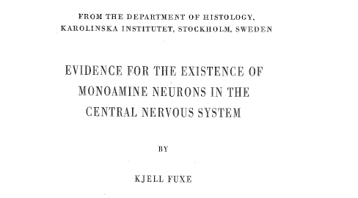
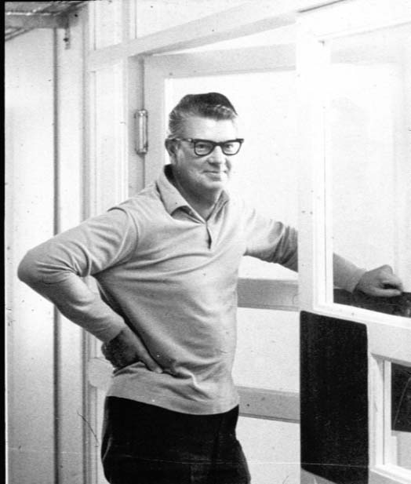
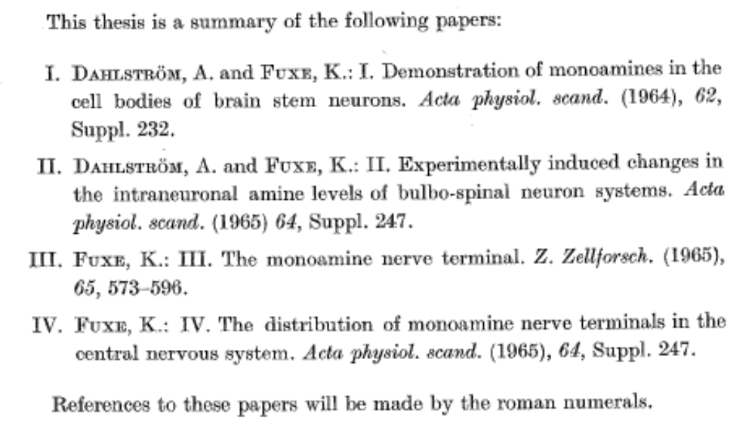
Professor N-Å Hillarp
1965

Slide 4
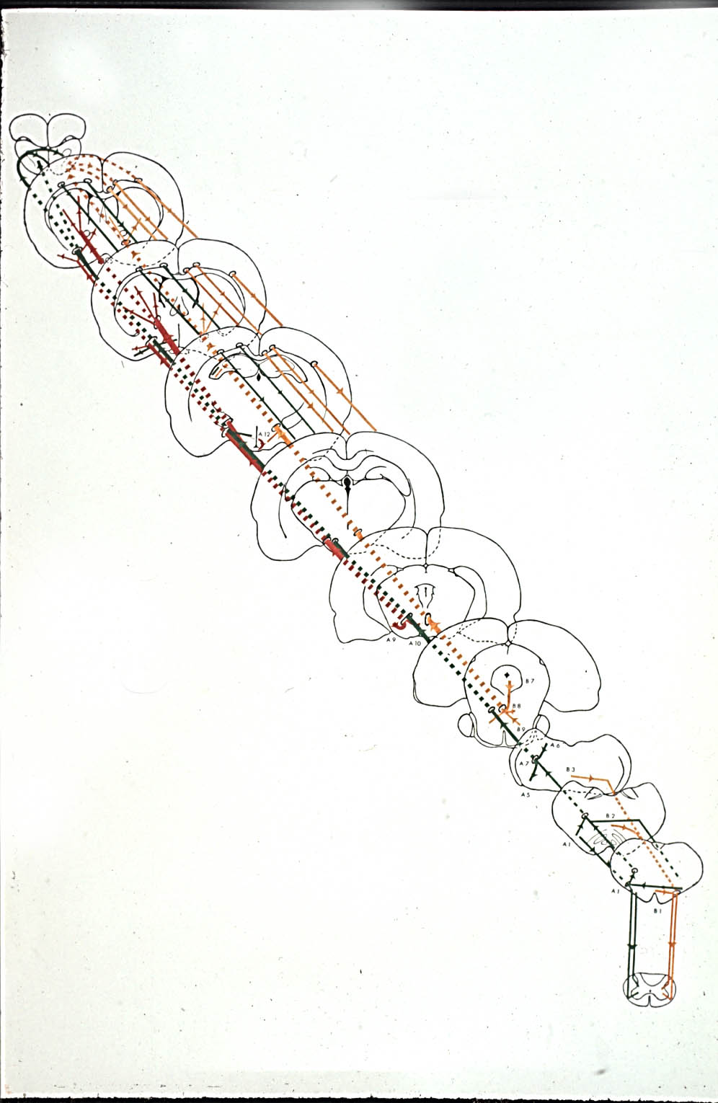
Schematic description of the DA,
NA and 5-HT pathways from 1965
Prepared by Dahlström and Fuxe in 1965
and presented by Fuxe at the second CA
Symposium in Milano in July 4-9,1965
Based on papers in the Fuxe thesis (1965)
Fuxe 1965a,b
Dahlström and Fuxe 1964,1965
and the papers by Fuxe 1963,1964, and
Anden,Carlsson,Dahlström,Fuxe,Hillarp and Larsson 1964
L
Fuxe et al.2007

Slide 5
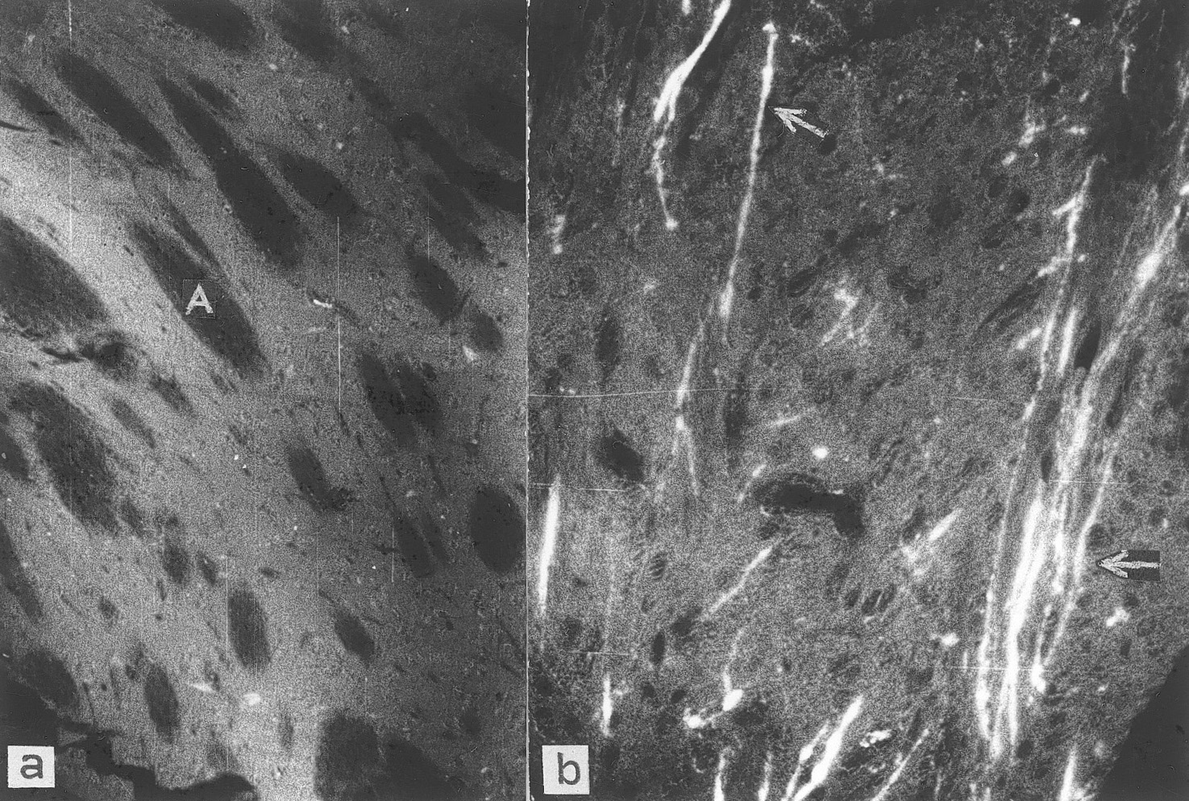
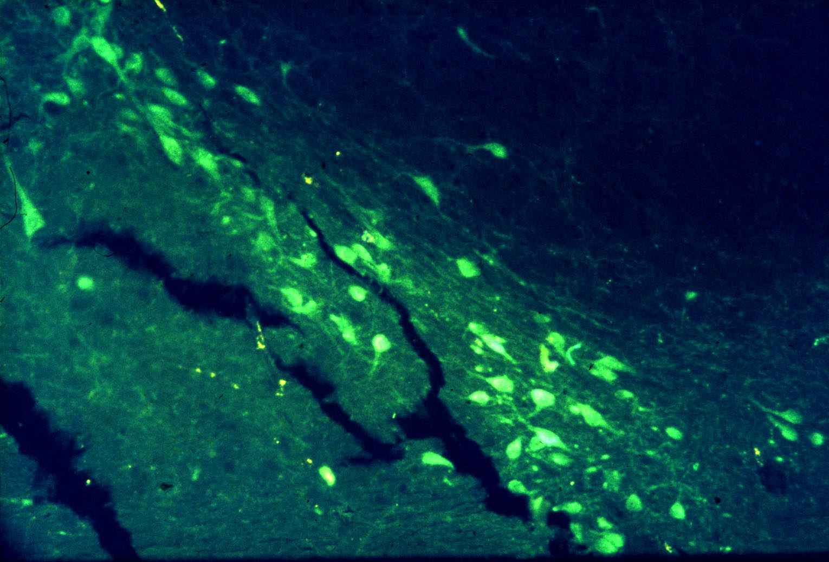
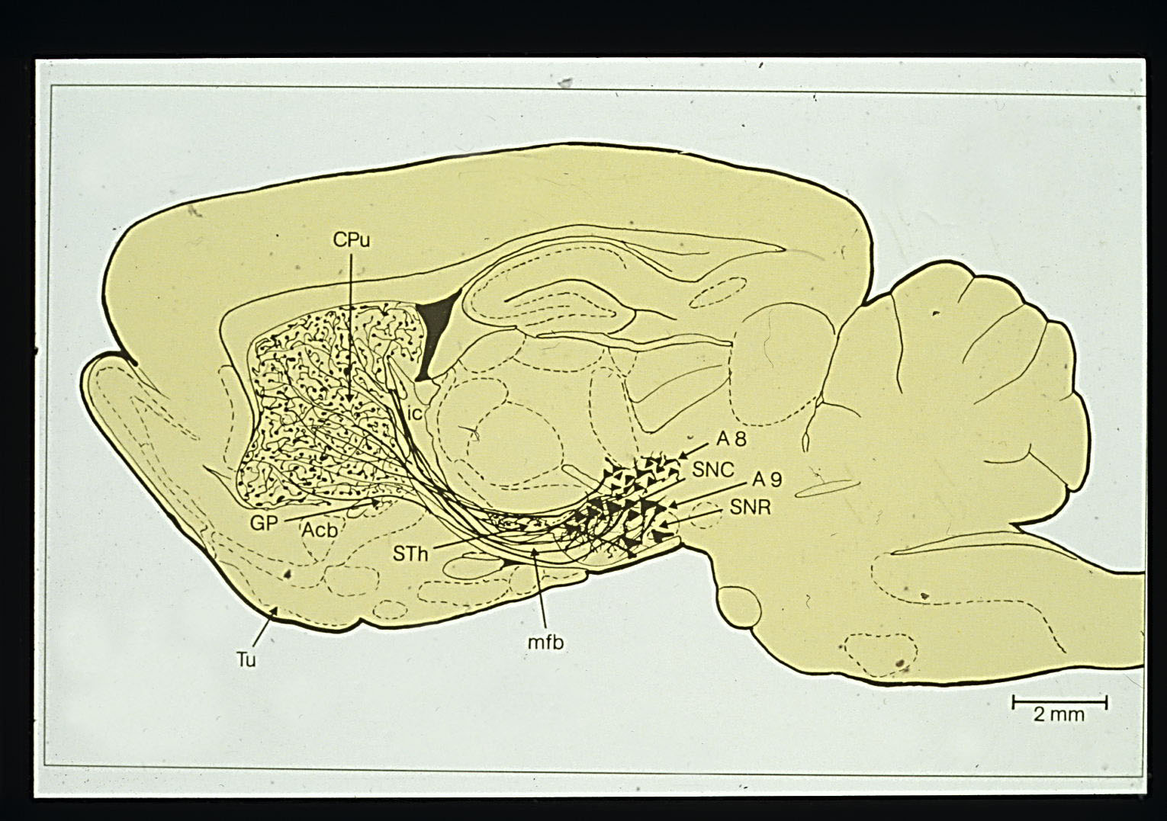
Anden et al.1964; Anden, Dahlström, Fuxe and Larsson 1965
Am J Anat 116:329-334
Fuxe, Agnati, Kalia, Goldstein, Andersson and Härfstrand 1985,
Dahlström and Fuxe 1964

Slide 6
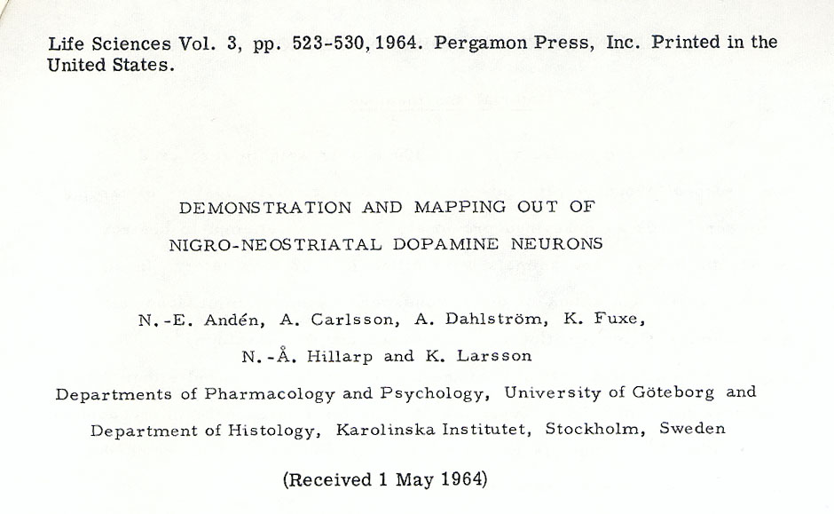
Notes:
Then came the demonstration of the nigro-striatal DA pathway in 1964 with Anden ,Carlsson,Annica Hillarp and Larsson.However,the first DA pathway we discovered were the tubero-infundibular DA neurons as indicated in 1963

Slide 7
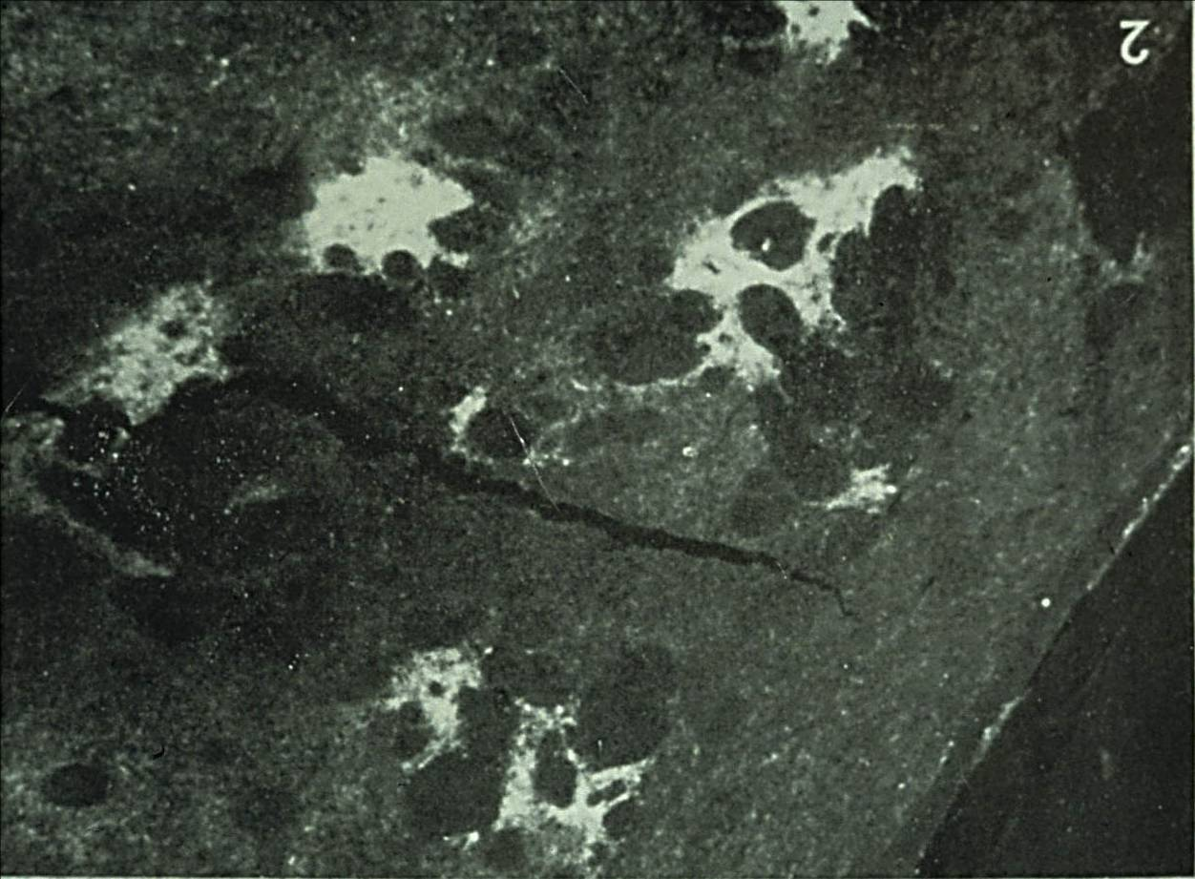
Islands of neostriatal DA nerve terminals (postnatal)
b
Olson, Seiger and Fuxe 1972, Brain Res 44, 283-288, first reported by Fuxe (1970)

Slide 8
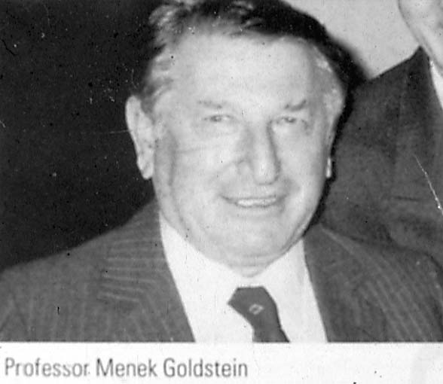
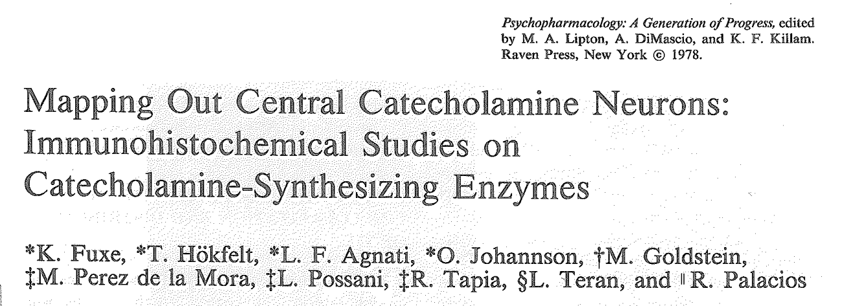

Slide 9
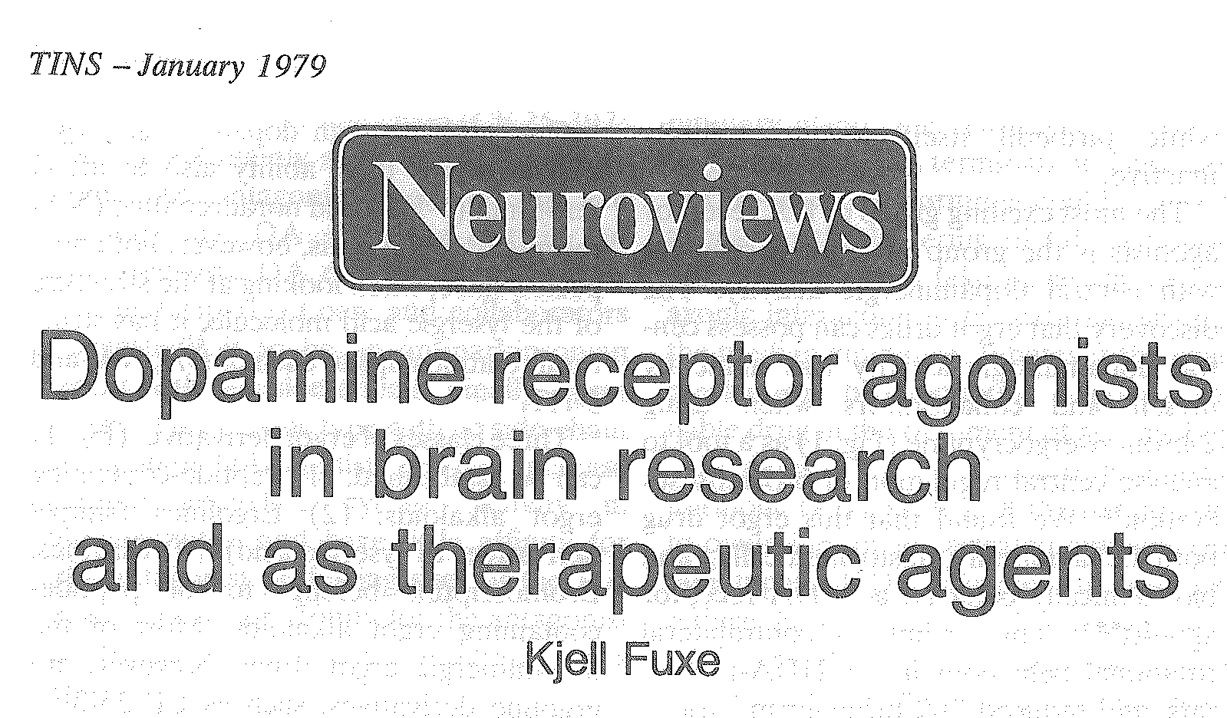
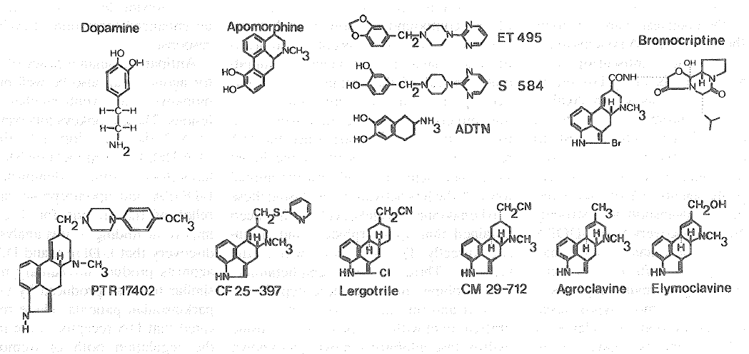
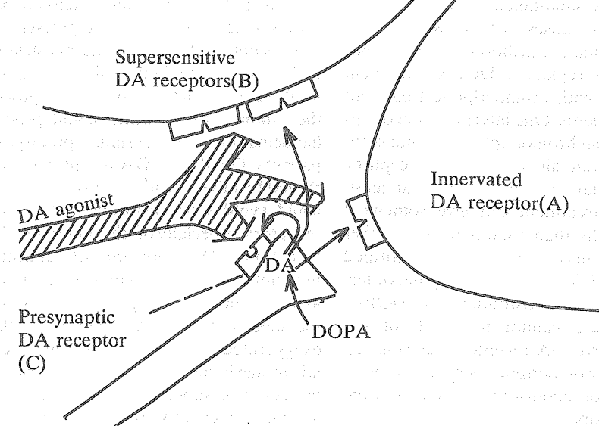
Piripedil

Slide 10
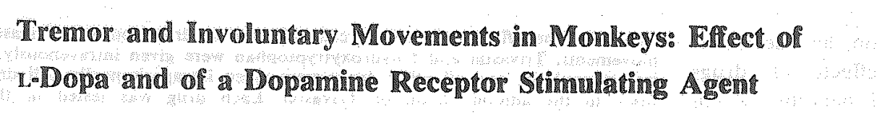
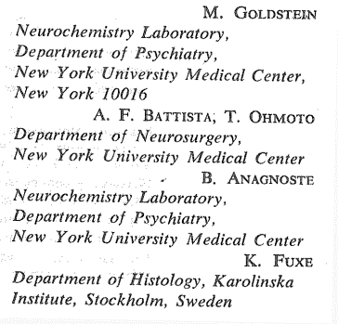
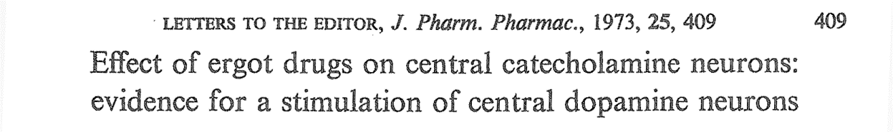
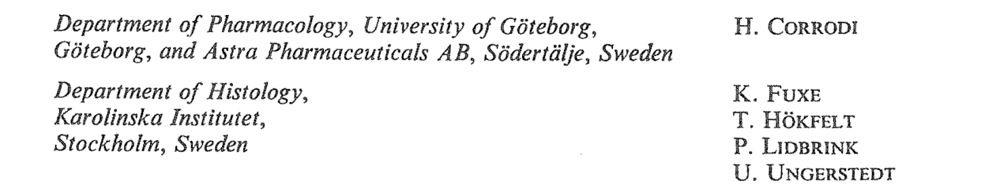
DA receptor agonist actions of ET495 and 2-Br-alpha-ergocryptine
Evidence for a new type of dopamine receptor stimulating agent.
Corrodi H, Fuxe K, Ungerstedt U.
J Pharm Pharmacol. 1971 23 :989-91
ET495 and brain catecholamine mechanisms: evidence for stimulation of dopamine receptors.
Corrodi H, Farnebo LO, Fuxe K, Hamberger B, Ungerstedt U.
Eur J Pharmacol. 1972 20 :195-204
Ergocornine and 2-Br-alpha-ergocryptine. Evidence for prolonged dopamine receptor stimulation.
Fuxe K, Corrodi H, Hökfelt T, Lidbrink P, Ungerstedt U.
Med Biol. 1974 52 :121-32
(Piribedil, Trivastal, ET495,
Piperonyl-piperazine derivative)
Goldstein et al.1973
(Pravidel, Bromocriptine)
cyclic peptide group of ergoline derivatives (ergopeptides).
Notes:
10

Slide 11
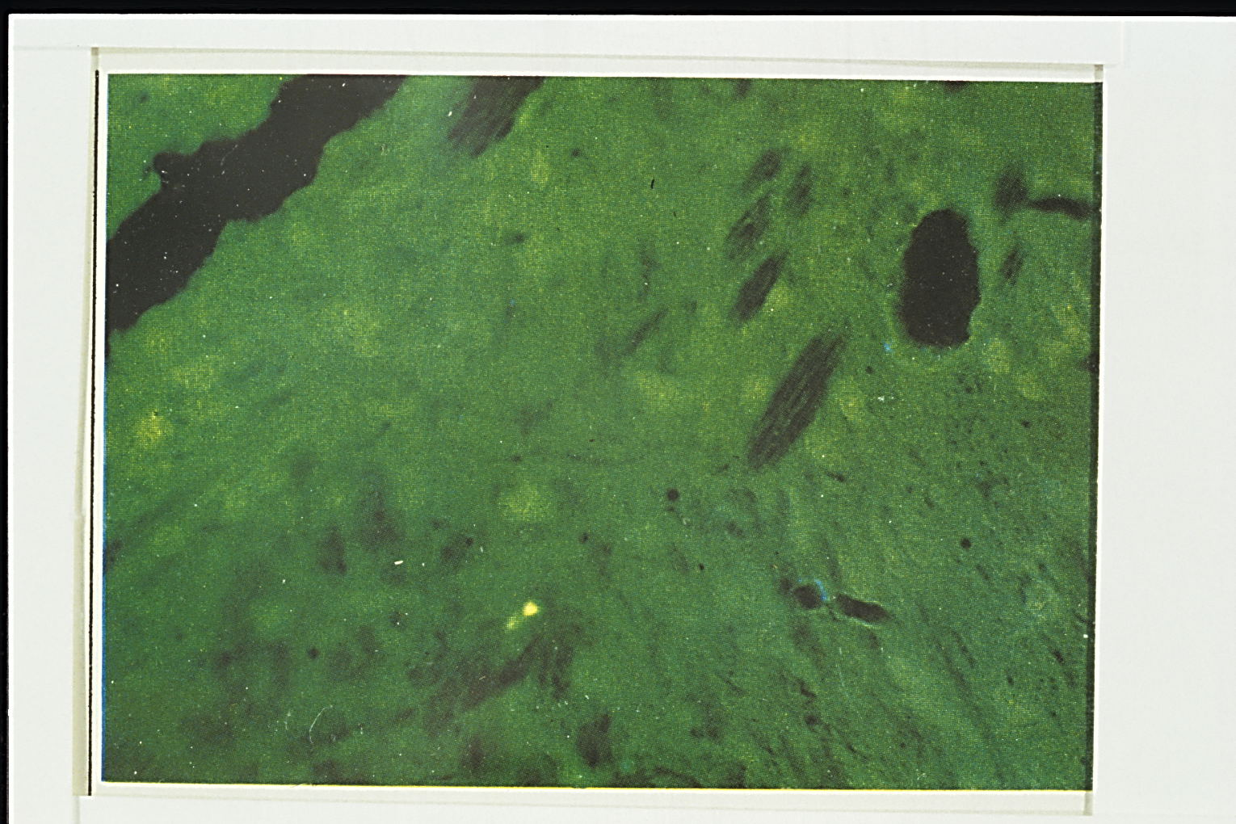
Appearance of extraneuronal greenish DA fluorescence among midbrain DA nerve cells
after amphetamine in reserpine-nialamide-L-dopa treated rats
Amphetamine: enhancement of DA release (Carlsson,Fuxe et al.1966) and reversal of DA uptake
Fuxe and Ungerstedt 1970
Notes:
Now we move into observations that we did not at the beginning understand .There as an appearance of an extraneuronal CA fluorescence after amphetamine in the iral DA cell body area.Did this reflect a communication different from the
Synaptic one ?

Slide 12
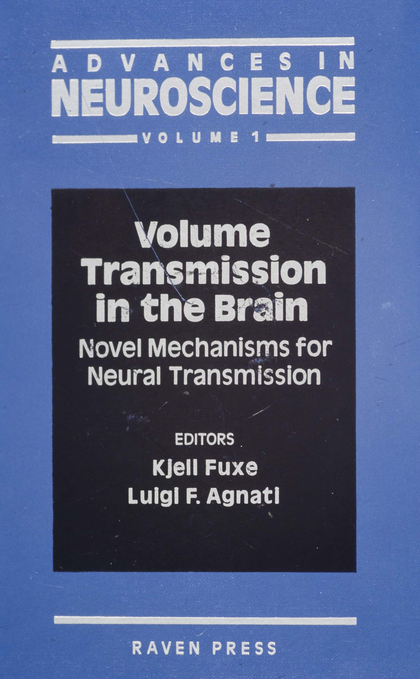
Volume Transmission (VT)
A widespread mode of intercellular communication that occurs in the extracellular fluid and in the cerebrospinal fluid (CSF) of the brain with VT signals moving from source to target cells via energy gradients leading to diffusion and convection (flow). Source: all cells in CNS
channels : diffuse ; privacy : reserved ; safety : low
Connectivity : dynamic .Several forms of VT.
Wiring Transmission
Prototype : synaptic transmission
Channels : private ; privacy : reserved ; safety : high
Connectivity : static and/or dynamic
One subtype : gap junctions
Agnati, Fuxe et al. 1986 ;Fuxe and Agnati 1988, 1991,2009
Notes:
Here you have the essence what we mean by the term volume transmission

Slide 13
Volume Transmission (VT): Extrasynaptic and Widespread (diffuse) Communication in the extracellular space via extracellular channel plexa and in the CSF
Channel | Main Features
Local extracellular channel plexa mainly in the um range (extrasynaptic VT) | Extracellular fluid transmission linked to synaptic transmission. Through extrasynaptic release and synapse spillover involving a role of local field potentials, the ions and transmitters diffuse at the local circuit level to influence nerve cells , glial cells and endothelial cells, mainly via targeting local receptors
Extracellular fluid pathways mainly along paravascular and paraaxonal extracellular channels. Long distance VT, also above 1 mm Transmitter-receptor mismatches | Extracellular fluid transmission; long-distance diffusion and flow of signals in the ECF involving mainly peptides and proteins targeting distant receptors . Flow is generated by temperature and pressure gradients
Cerebrospinal fluid pathways. CSF VT Long distance migration, | CSF transmission; long-distance transmission of signals in the CSF, facilitated by flow generated by the arterial pulse Fuxe et al.2012, Agnati and Fuxe 2014

Slide 14
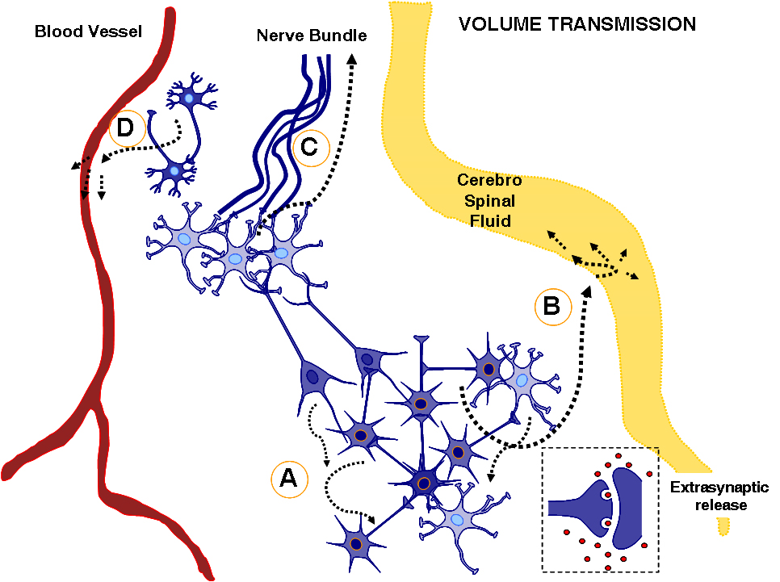
Agnati, Fuxe et al., 1995, Neuroscience 69(3): 711-726.
Fuxe K. et al 2013

Slide 15
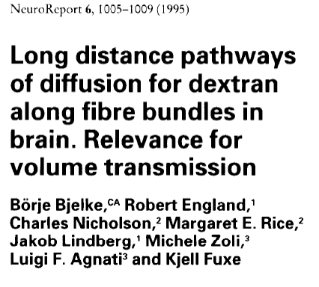
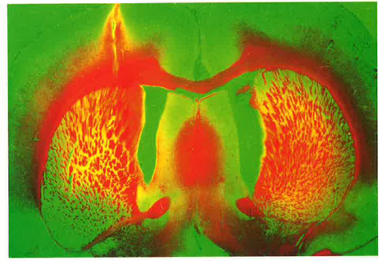
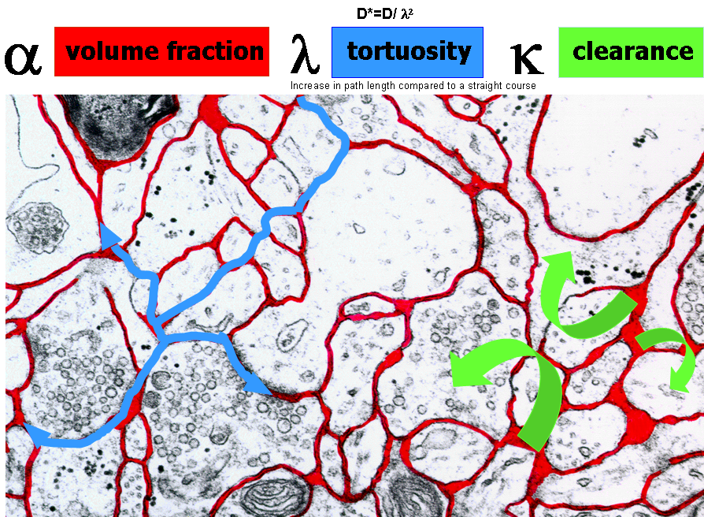
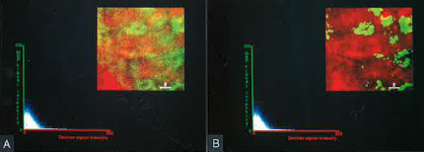
Volume fraction: relative size of ECS compared to brain tissue volume
Tortuosity: increase in path length imposed by cells and extracellular matrix
Clearance: a constant that reflects the removal of a compound from ECS
Modified from Nicholson & Sykova 1998 TINS
Höistad 2004

Slide 16
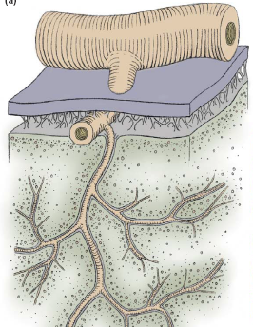
THE “TIDE HYPOTHESIS” OF VT-SIGNAL MIGRATION, CLEARANCE AND OF MODULATORY SIGNAL RELEASE
ARTERY: SYSTOLIC PRESSURE WAVE EXPANDS THE ARTERIAL WALL
VIRCHOW-ROBIN SPACES
CONTINUOUS WITH SAS AND PERICAPILLARY SPACES
ARTERIAL PULSES CAUSE PRESSURE WAVES FROM THE CALVARIUM TOWARDS THE FORAMEN MAGNUM CAUSING CAUDAL MOTION OF THE CSF AND OF THE BRAIN STEM
“PISTON-LIKE” MOVEMENTS OF THE BRAIN
ARTERIAL PULSES CAUSED BY THE SYSTOLIC EJECTION
MEAN VENOUS PRESSURE
TINS 28:202; 2005
SAS
MEAN ARTERIAL PRESSURE
THE “TIDE HYPOTHESIS” OF VT-SIGNAL MIGRATION AND CLEARANCE (AGNATI, FUXE et al., 2004,2005)
• THE ARTERIAL PULSE AS WELL AS THE “PISTON-LIKE” MOVEMENT OF THE BRAIN CAUSE CYCLIC PRESSURE OSCILLATIONS WITHIN ..THE SAS.
• THE CYCLIC PRESSURE OSCILLATIONS WITHIN THE SAS INDUCE “TIDE” MOVEMENTS OF THE FLUID IN THE VIRCHOW-ROBIN SPACES, ...HENCE IN THE PERICAPILLARY SPACES AND, EVENTUALLY, IN THE ECF-CHANNELS.
• THESE FLUID MOVEMENTS CONTRIBUTE TO THE VT-SIGNAL MIGRATION AS WELL AS TO THE HOMEOSTASIS OF THE INTERNAL MILIEU ..OF THE BRAIN (DIFFUSION OF NUTRIENTS AND CLEARANCE OF CATABOLITES e.g., Aß)

Slide 17
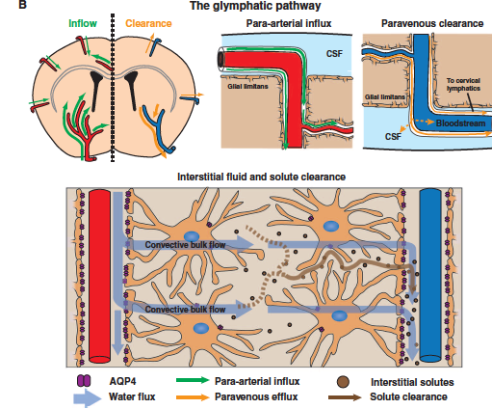
The glymphatic system supports interstitial solute and fluid clearance from the brain.
Schematic depiction of the glymphatic pathway. In this brain-wide pathway, CSF enters the brain
along para-arterial routes, whereas ISF is cleared from the brain along paravenous
routes. Jeffrey J. Iliff et al. 2012

Slide 18
CLEARANCE
THROUGH THE
BRAIN-BLOOD BARRIER
CLEARANCE
THROUGH THE
BRAIN-CEREBROSPINAL
LEAKY BARRIER
CELL SOURCE
CELL TARGET
VT-SIGNAL
CATABOLIC ENZYMES
OF THE ECS
UPTAKE SYSTEMS
IN THE CNS CELLS
Jansson et al.2000
Jansson et al.2000

Slide 19
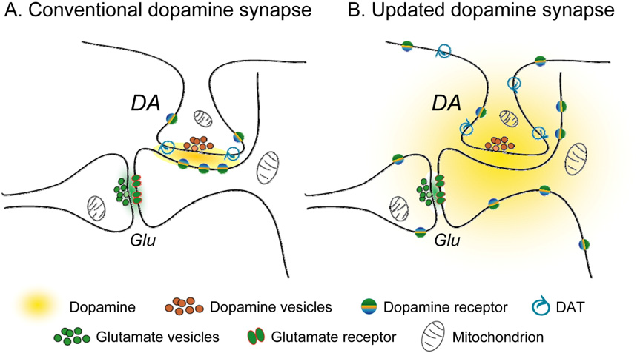
Modeling extrasynaptic DA transmission
Schematic representation of an updated DA synapse that shows ready DA spillover, unconstrained by DATs. The cloud of released DA, diffusing in three dimensions, encounters predominantly extrasynaptic DA autoreceptors on DA axon terminals and heteroreceptors on neighboring dendrites, soma and terminals, including medium spiny neurons .
Rice and Cragg 2008
Notes:
Margret Rice has modeled DA spillover after quantal release based on a large number of experimental data.In the updated DA synapse the DA release is unconstrained by the extrasynapic DAT, the diffusion process being too fast
For the DAT shich mainly increases clearance of DA and thus its half-life.Thus a cloud of DA is formed and can reach the extrasynaptic receptors which are in majority.Thus the primary ode of DA communication is VT.the effective radius
For low afinity DA receptors is 2 um and for high affinity DA receptors is 7-8 um.The spheres obtained would encompass tens to thousands of synapses.

Slide 20
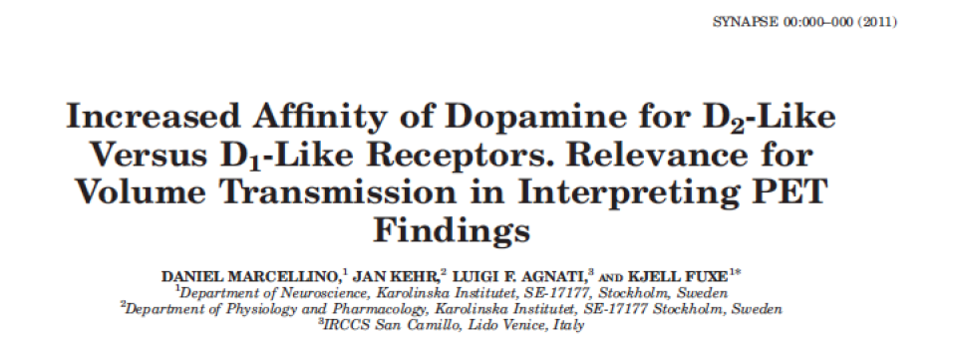
-The IC50 values of DA at D2-like receptors in dorsal striatal membranes and CHO cell membranes were markedly and significantly reduced compared with the IC50 values of DA at D1-like receptors.
-The KiH value for DA at [3H] raclopride-labeled D2-like receptors in dorsal striatum was 12 nM, and this can help explain PET findings that amphetamine-induced increases in DA release can produce an up to 50% decrease of [11C] raclopride binding in the dorsal striatum in vivo.
-These combined results give indications for the existence of striatal D2-like receptor-mediated DA VT at the local circuit level in vivo in the human striatum

Slide 21
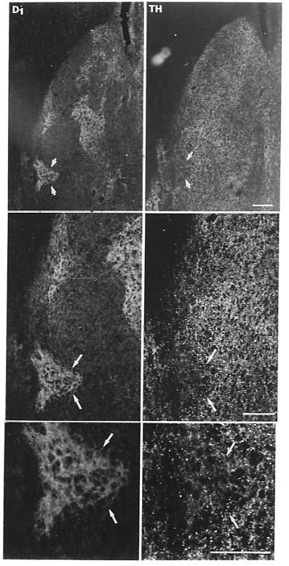
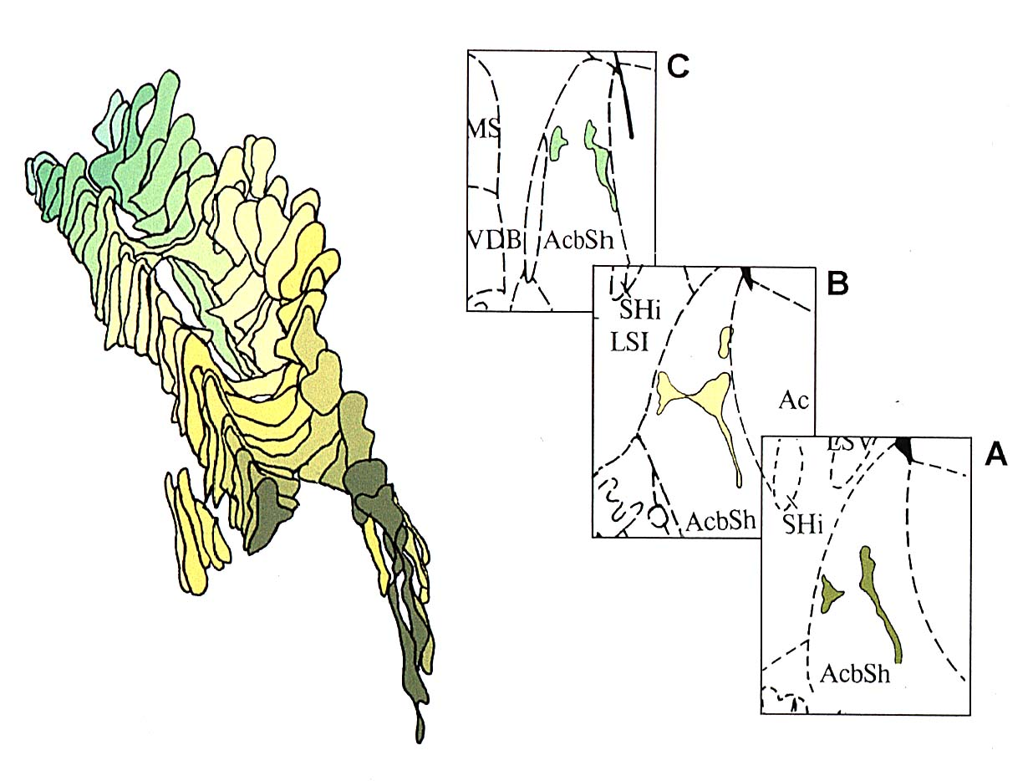
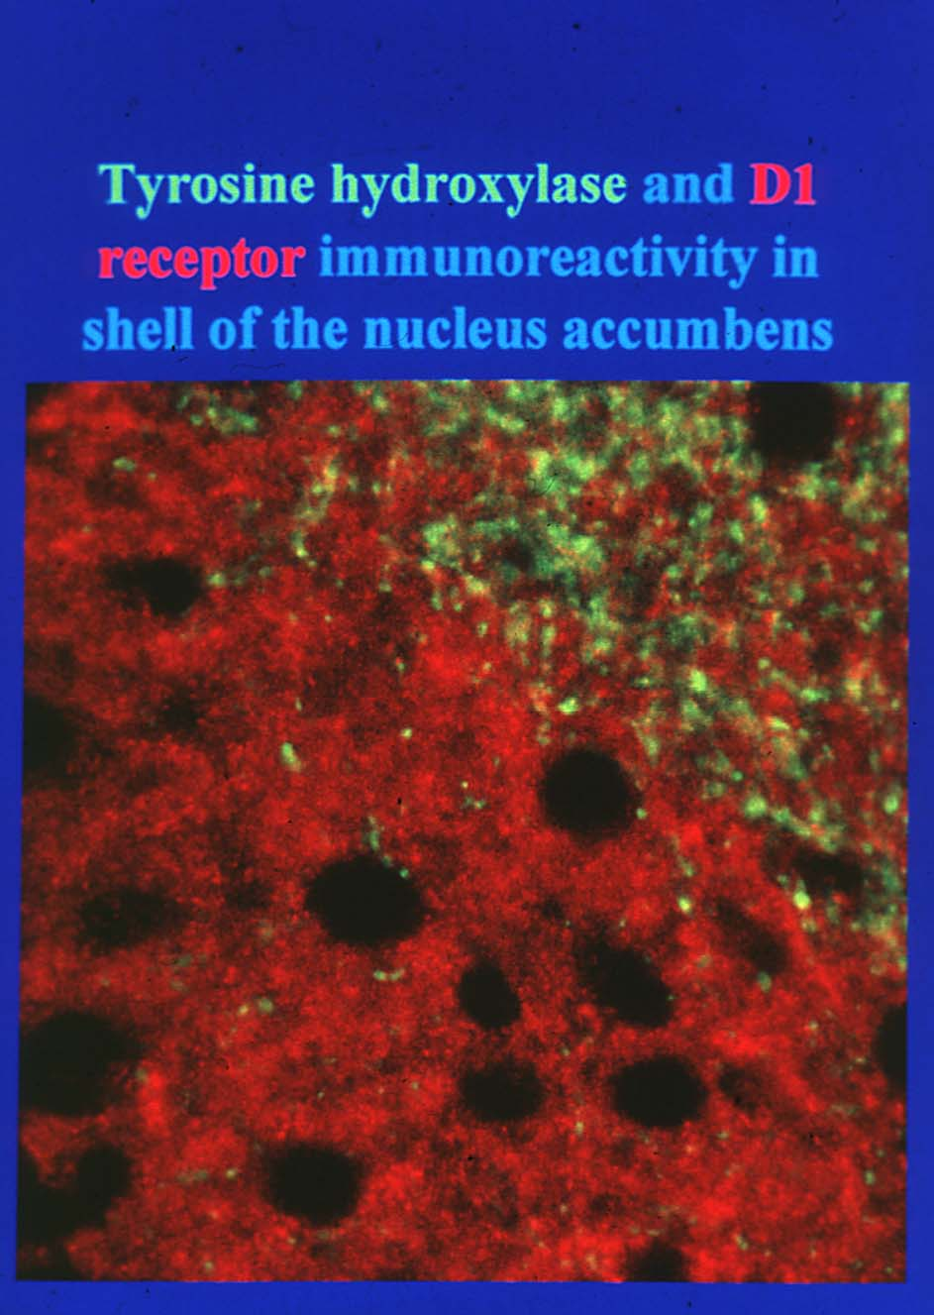
D1 - TH mismatches in the Nucleus accumbens shell
D1 rich islands surrounded by dense TH terminal networks
Function: temporal-difference learning based on VT ?
Due to different velocities of WT and VT , the mismatch VT signal is correlated to the synaptic DA signal at the source at an earlier time step. A prevision of the outcome at the next time step becomes possible. In the beginning DA neuronal activity is high at time of reward. At later trials it is high at the delivery of the sensory cue ( Guidolin et al.2007)
Jansson et al. 1999 Neuroscience

Slide 22
D1 - TH mismatch
in nuc.accumbens shell
Confocal image
Jansson et al. 1999 Neuroscience
Notes:
A confocal image of the mismatch is seen in the accumbens shell which is involved in reward processing .The different speeds of VT and WT may give a time derivative which may make it possible for the output of the DA transmission domain
To act as a prediction error of future rewards and expectations of reward modifying the synaptic weights.

Slide 23
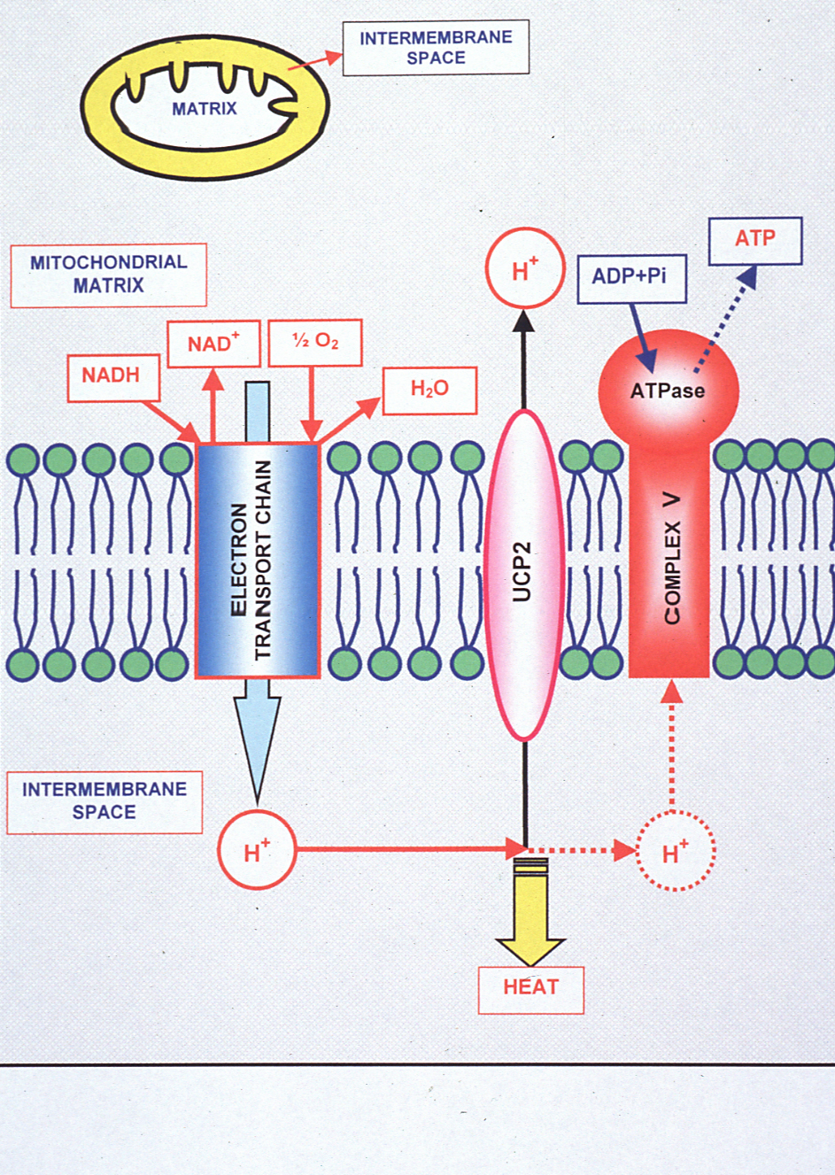
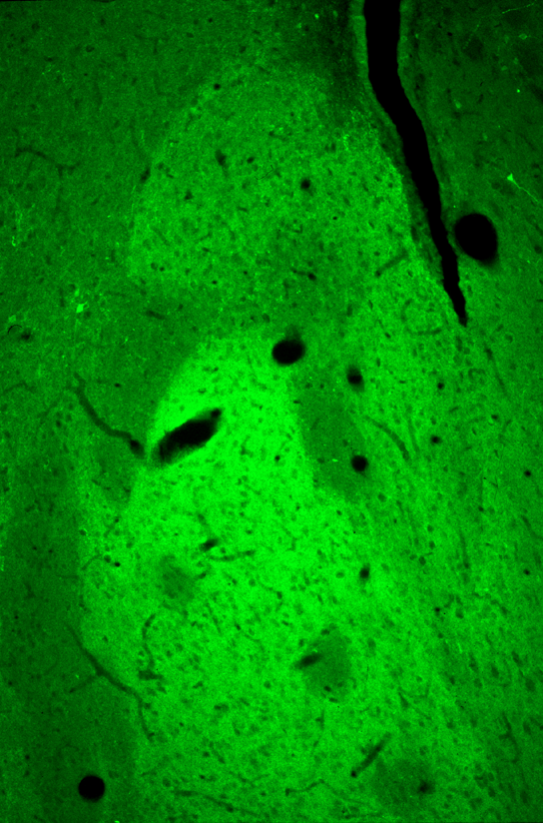
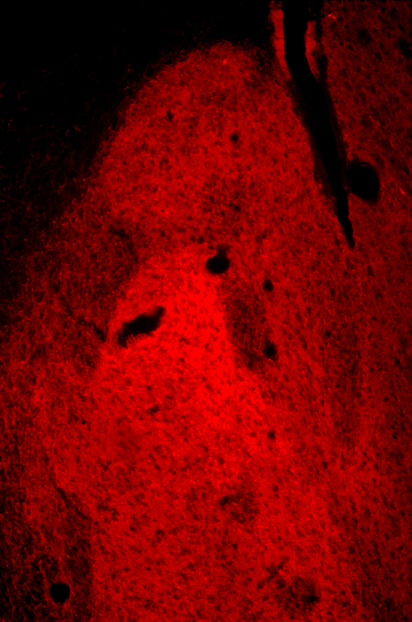
Brain Uncoupling Protein 2 (UCP2)
Uncoupled Neuronal Mitochondria
Predict Thermal Synapses in Homeostatic Centers
UCP2
TH
100 μm
Rivera et al.2005
Agnati,Fuxe et al.2005
Notes:
UCP2 is of interest for VT since it generates heat by producing a disappearance of the proton gradient in the mitochondria.The study was made in collaboration with Tamas Horvath.

Slide 24
Classification of the extracellular vesicle (EV) mediated intercellular communication in the central nervous system into volume transmission
Intercellular communication mode | Channel | Cargo transfer | Mechanism of transport | Origin
EV type of VT (CNS: neurons, glial cells, brain endothelial cells) Simons and Raposo 2009; Schneider and Simons 2013 | Extracellular space and CSF | Exosomes (40 –100nm) containing proteins Including receptors, lipids, mRNA, miRNA, mtDNA Shedding vesicles: Microvesicles (100 – 1000nm) insufficiently known composition; cholesterol, tetraspanin Apoptotic bodies (1 – 4 um) Histones, DNA | Diffusion and flow along energy gradients in the extracellular space | Most cell types: endosomes, fuse with plasma membrane Most cell types: Plasma membrane All cell types: Plasma membrane Agnati and Fuxe 2014

Slide 25
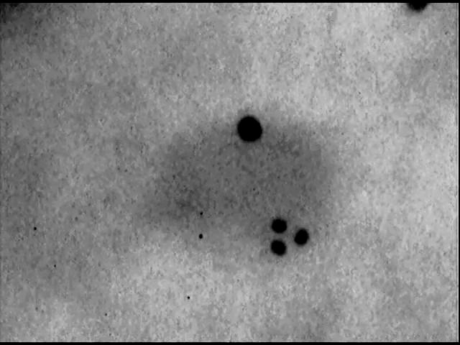
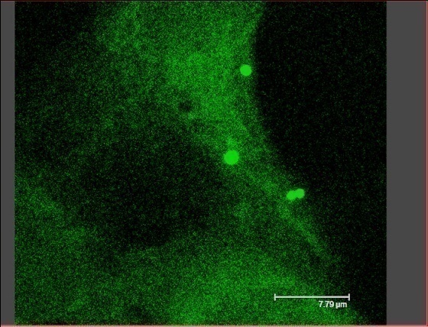
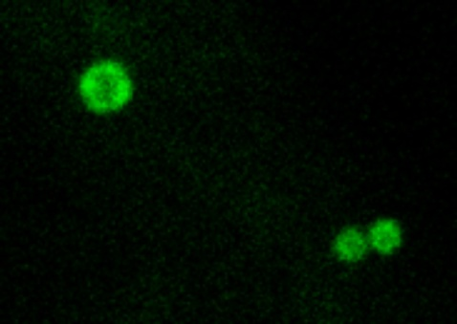
NEW PERSPECTIVES OF THE COOPERATIVE INTERACTIONS BETWEEN COMMUNICATION MODES AND DECODING PROCESSING BASED ON EV TYPE OF VT AND ON REC HETEROMERS
GPCRs ARE PRESENT IN EXOSOMES
ELECTRON MICROSCOPE IMAGE OF EXOSOMES
D2 RECEPTORS were labelled by 15nm gold particles
A2A RECEPTORS were labelled by 10nm gold particles
EXOSOMES ARE INTERNALISED BY CELLS
Glioblastoma cells were incubated with Exosomes prepared by CHO cells and containing A2A and D2 receptor
D2 (15nm)
Exosome
50 nm
1500 nm
1500 nm
A2A (10nm)
Extracellular vesicles internalised by the Glioblastoma cell
D2 – A2A IMMUNOGOLD STAINING SHOWS THE PRESENCE OF THE RECEPTORS IN THE EXOSOME
900 nm
900 nm
IMPLICATIONS OF THE CELL-TO-CELL TRANSFER VIA EXOSOMES OF GPCRs
Cell B, by internalising Exosomes can insert NEW TYPES OF GPCRs in the plasma membrane and hence decode previously undetected signals e.g., an undetected NEUROTRANSMITTER (NT)
and/or can lead to formation of
NEW RECEPTOR HETEROMERS
INTERNALISATION OF EXOSOMES
B
NT
DECODING OF PREVIOUSLY UNDETECTED NEUROTRANSMITTER
B
CELL B IS A TARGET FOR EXOSOMES CONTAINING RECEPTORS THAT CELL B DOES NOT EXPRESS
INSERTION IN THE MEMBRANE OF NEW TYPES OF RECEPTORS
Guescini et al.
2012
Notes:
25

Slide 26
FRET analysis indicates the existence of A2^D2 heteromers in HEK293 cells independently transfected with D2L-CFP and A2a-YFP
CO-CULTURE OF HEK CELLS TRANSFECTED
WITH A_{2A}R-YFP AND D₂R-CFP
FRET ANALYSIS CAN DEMONSTRATE NOT ONLY INTERCELLULAR TRANSFER OF GPCRs BUT ALSO FORMATION OF A2a^D2 HETEROMERS
A_{2A}
D2
YFP
CFP
HEK CELL
HEK CELL
CFP (Donor: cyan); YFP (Acceptor: yellow)
CO-CULTURED HEK CELLS:
ACCEPTOR PHOTOBLEACHING
WORKING HYPOTHESIS: POSITIVE FRET NEEDS LABELLED GPCR EXCHANGE
EXOSOME-MEDIATED ROAMER TYPE VT
514 nm
A_{2A}
D2
bleach
YFP
YFP
CFP
485 nm
CFP
Fret
458 nm
EXOSOMES THAT MAY CONTAIN D2-CFP
Fluorescence 485
EXOSOMES THAT MAY CONTAIN A2A-YFP
Guescini et al.2012
Notes:
26

Slide 27
Table 3 Characterization of the extracellular vesicle mediated volume transmission from the various cell types of the CNS
Cell type | Type of EVs° | Transfer compounds, acceptor cells, function
Neurons | Exosomes and microvesicles | Hsp, Flottilin, miRNA , GLuR2; nerve cells; ECV modulation of exocytosis and ECV internalization leads to neuronal plasticity
Astrocytes | Exosomes and microvesicles | Mitochondria, ATP,Hsp70, synapsin1, functional glutamate transporters, FGF-2,VEGF, matrix metallo-proteinases, microRNA-29; astrocytes and neurons; Potential role in repair,neuroinflammation and neurodegeneration Agnati and Fuxe 2014

Slide 28
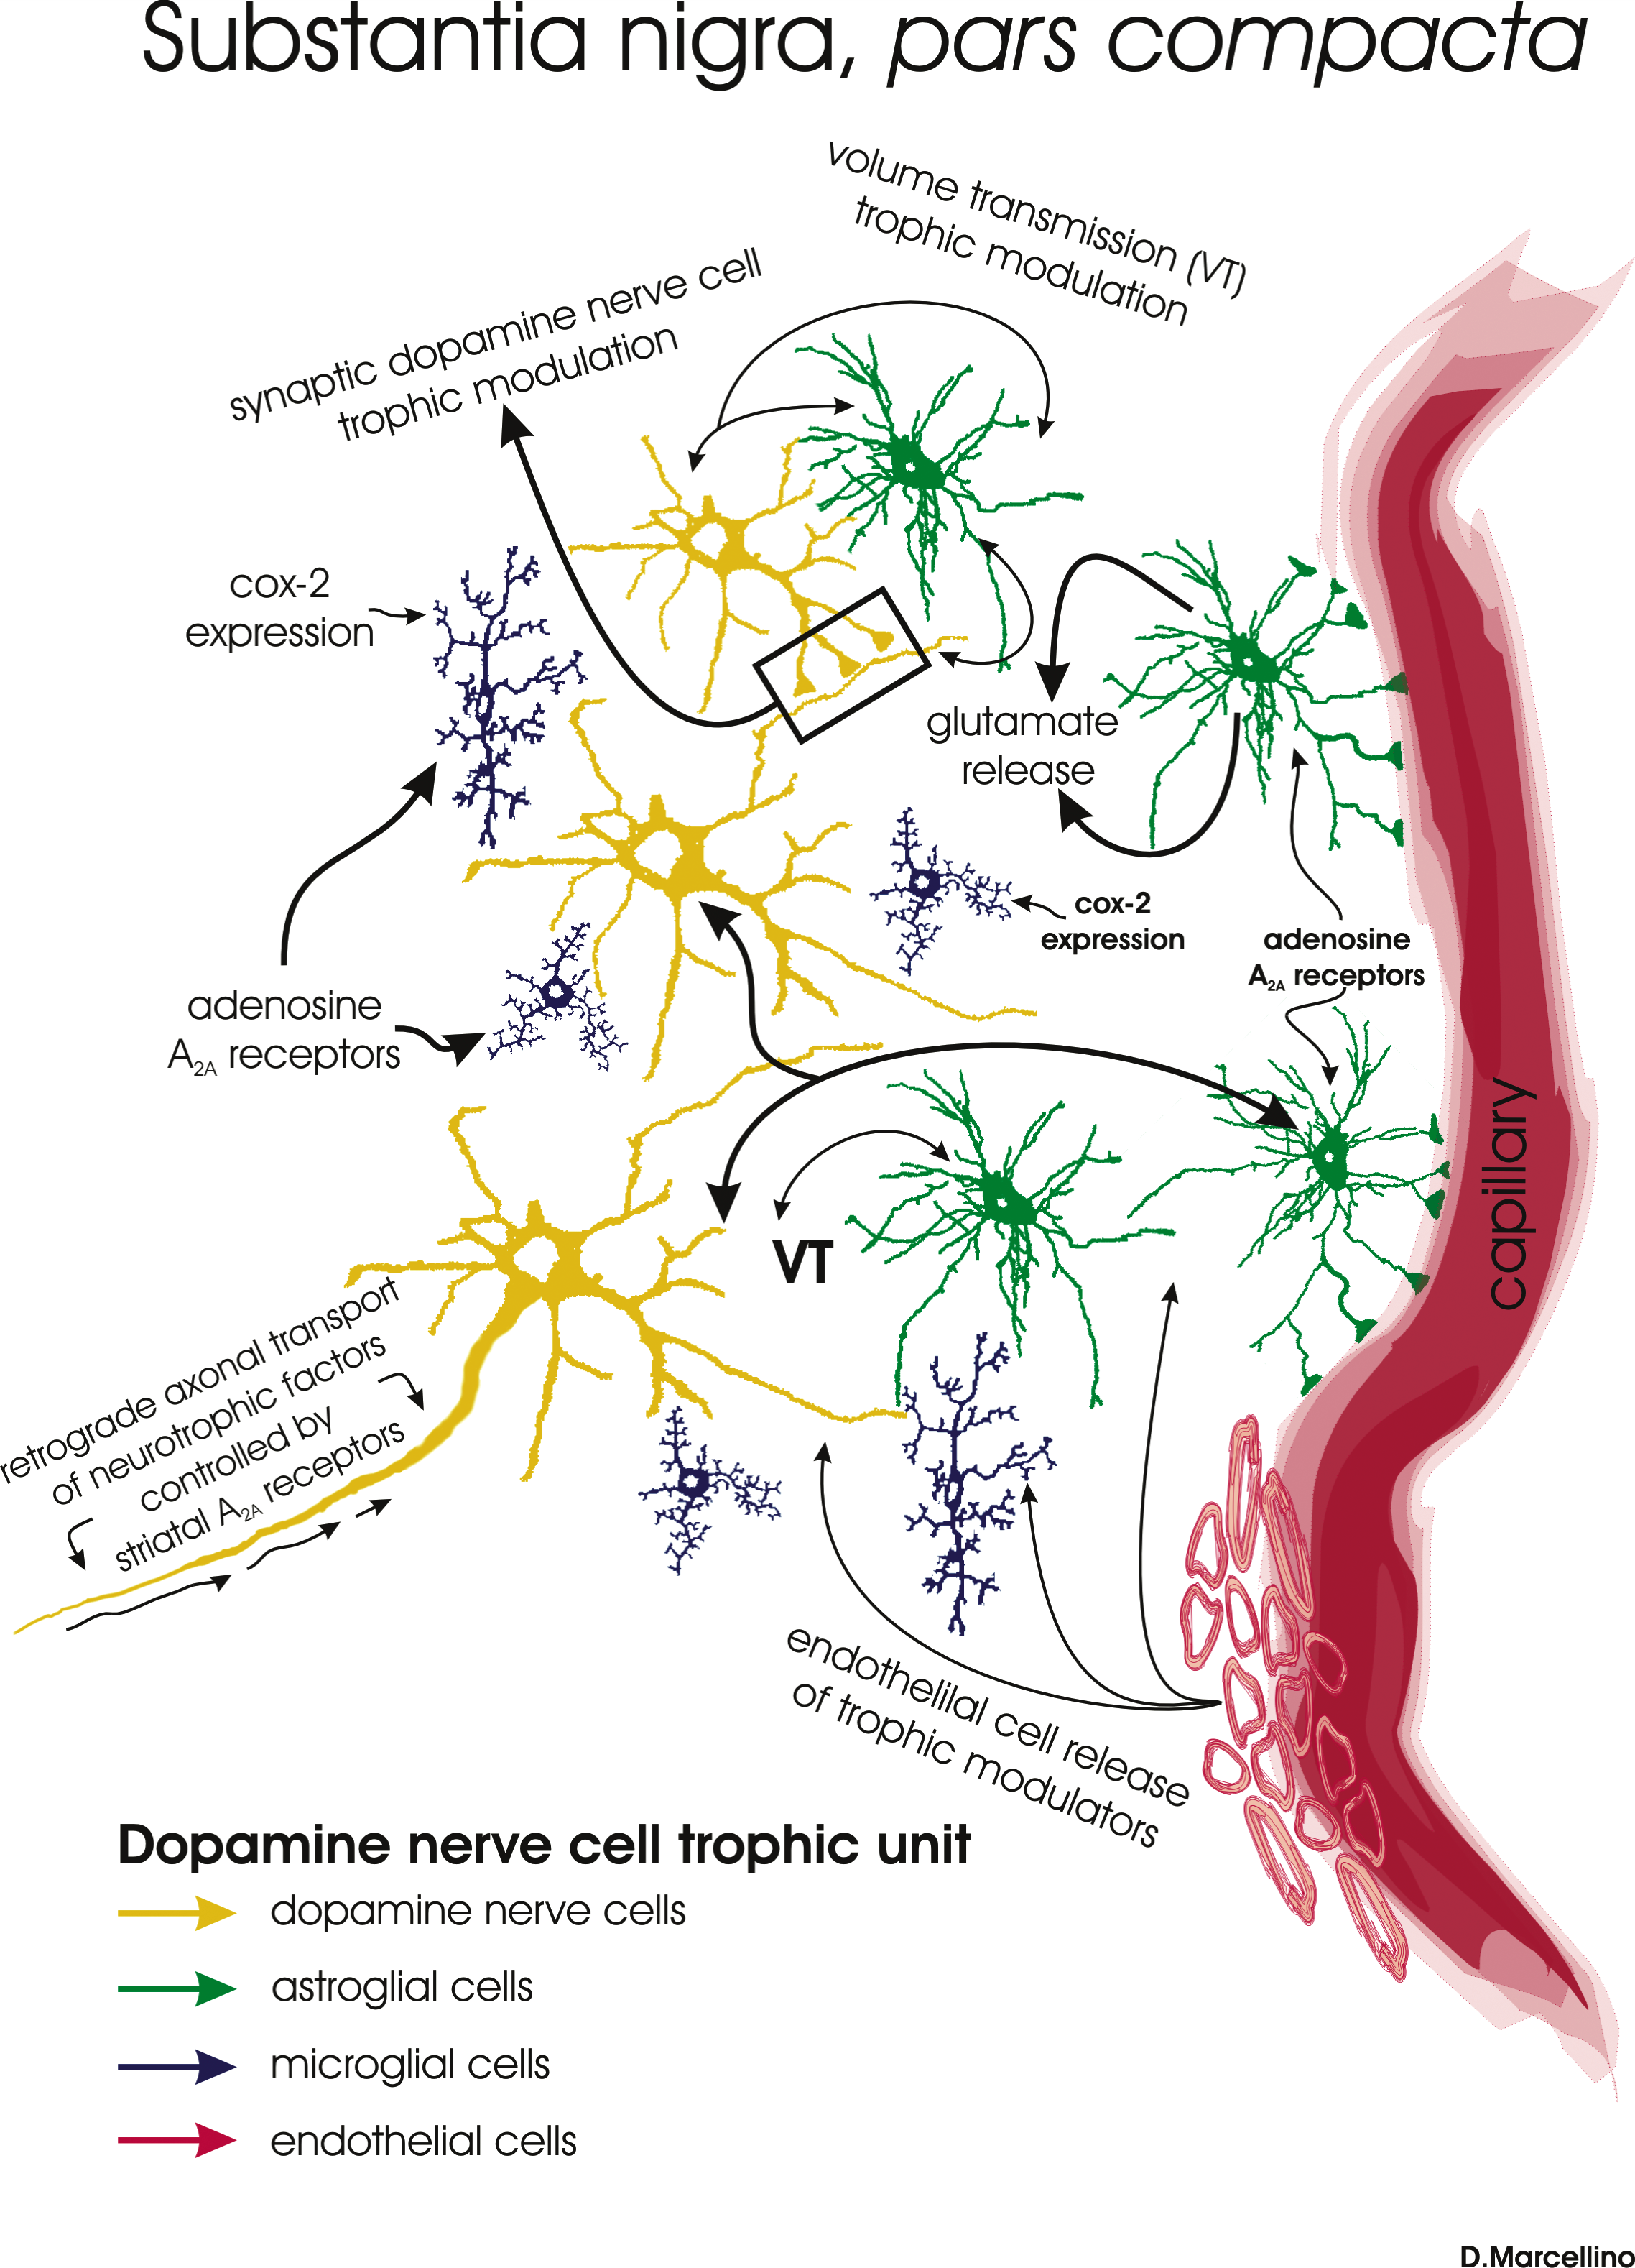
The CNS trophic unit consists of: neurons; glial cells; blood vessels with endothelial cells ; extracellular matrix
This term was used to indicate the smallest set of cells within the CNS which act in a complementary way to support the trophism of one another (Agnati,Cortelli, Pettersson,Fuxe 1995)
Trophic unit linked to the neuro-
vascular unit (BBB) with
Endothelial cells, pericytes,
and astrocytic perivascular endfeet
Fuxe et al.2007

Slide 29
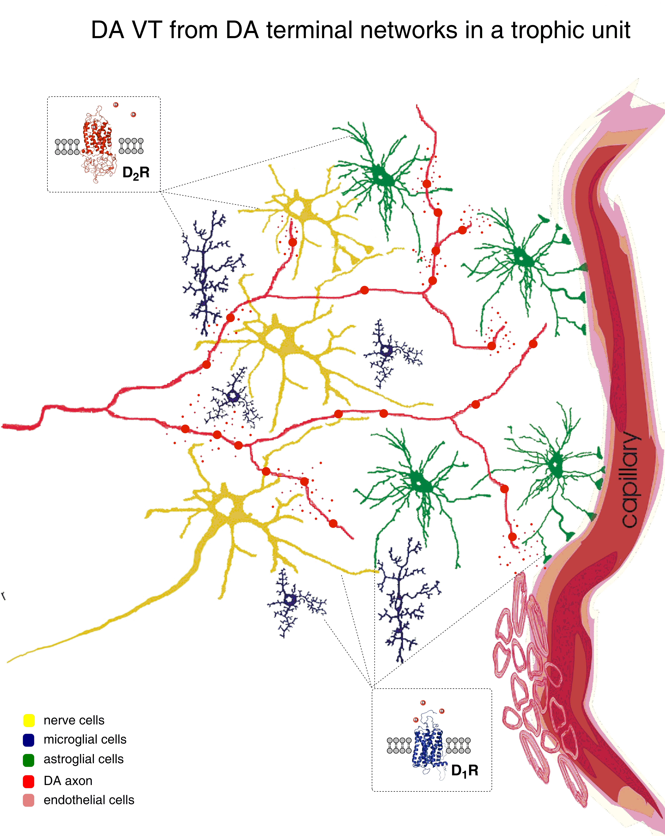
Fuxe, Borroto-Escuela et al. 2015

Slide 30
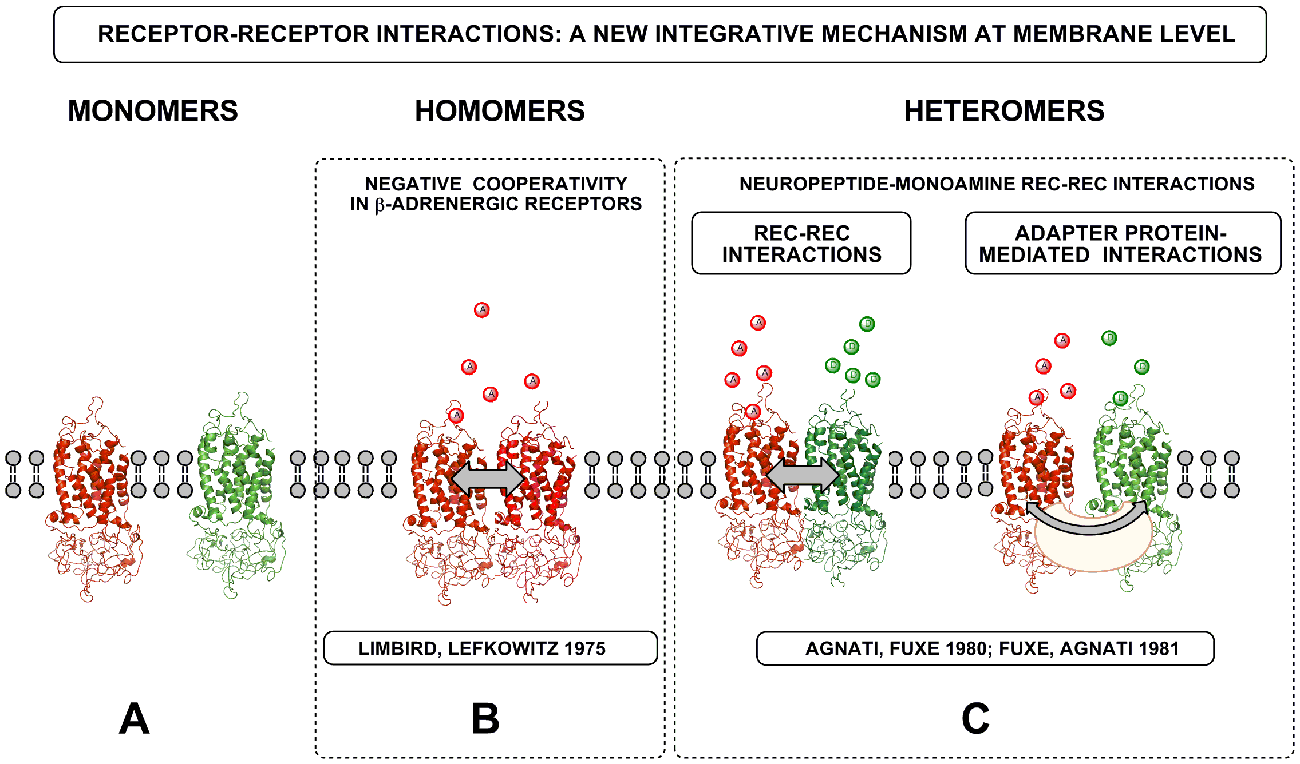
Zoli M, Agnati LF, Hedlund PB, Li XM, Ferré S, Fuxe K.
Mol Neurobiol. 1993 Fall-Winter;7(3-4):293-334. The concept of receptor-receptor interactions in heteromers was introduced
Intramembrane receptor-receptor interactions: a novel principle in molecular medicine.
Fuxe K et al J Neural Transm. 2007 114 :49-75.
Fuxe et al.2010
Notes:
30

Slide 31
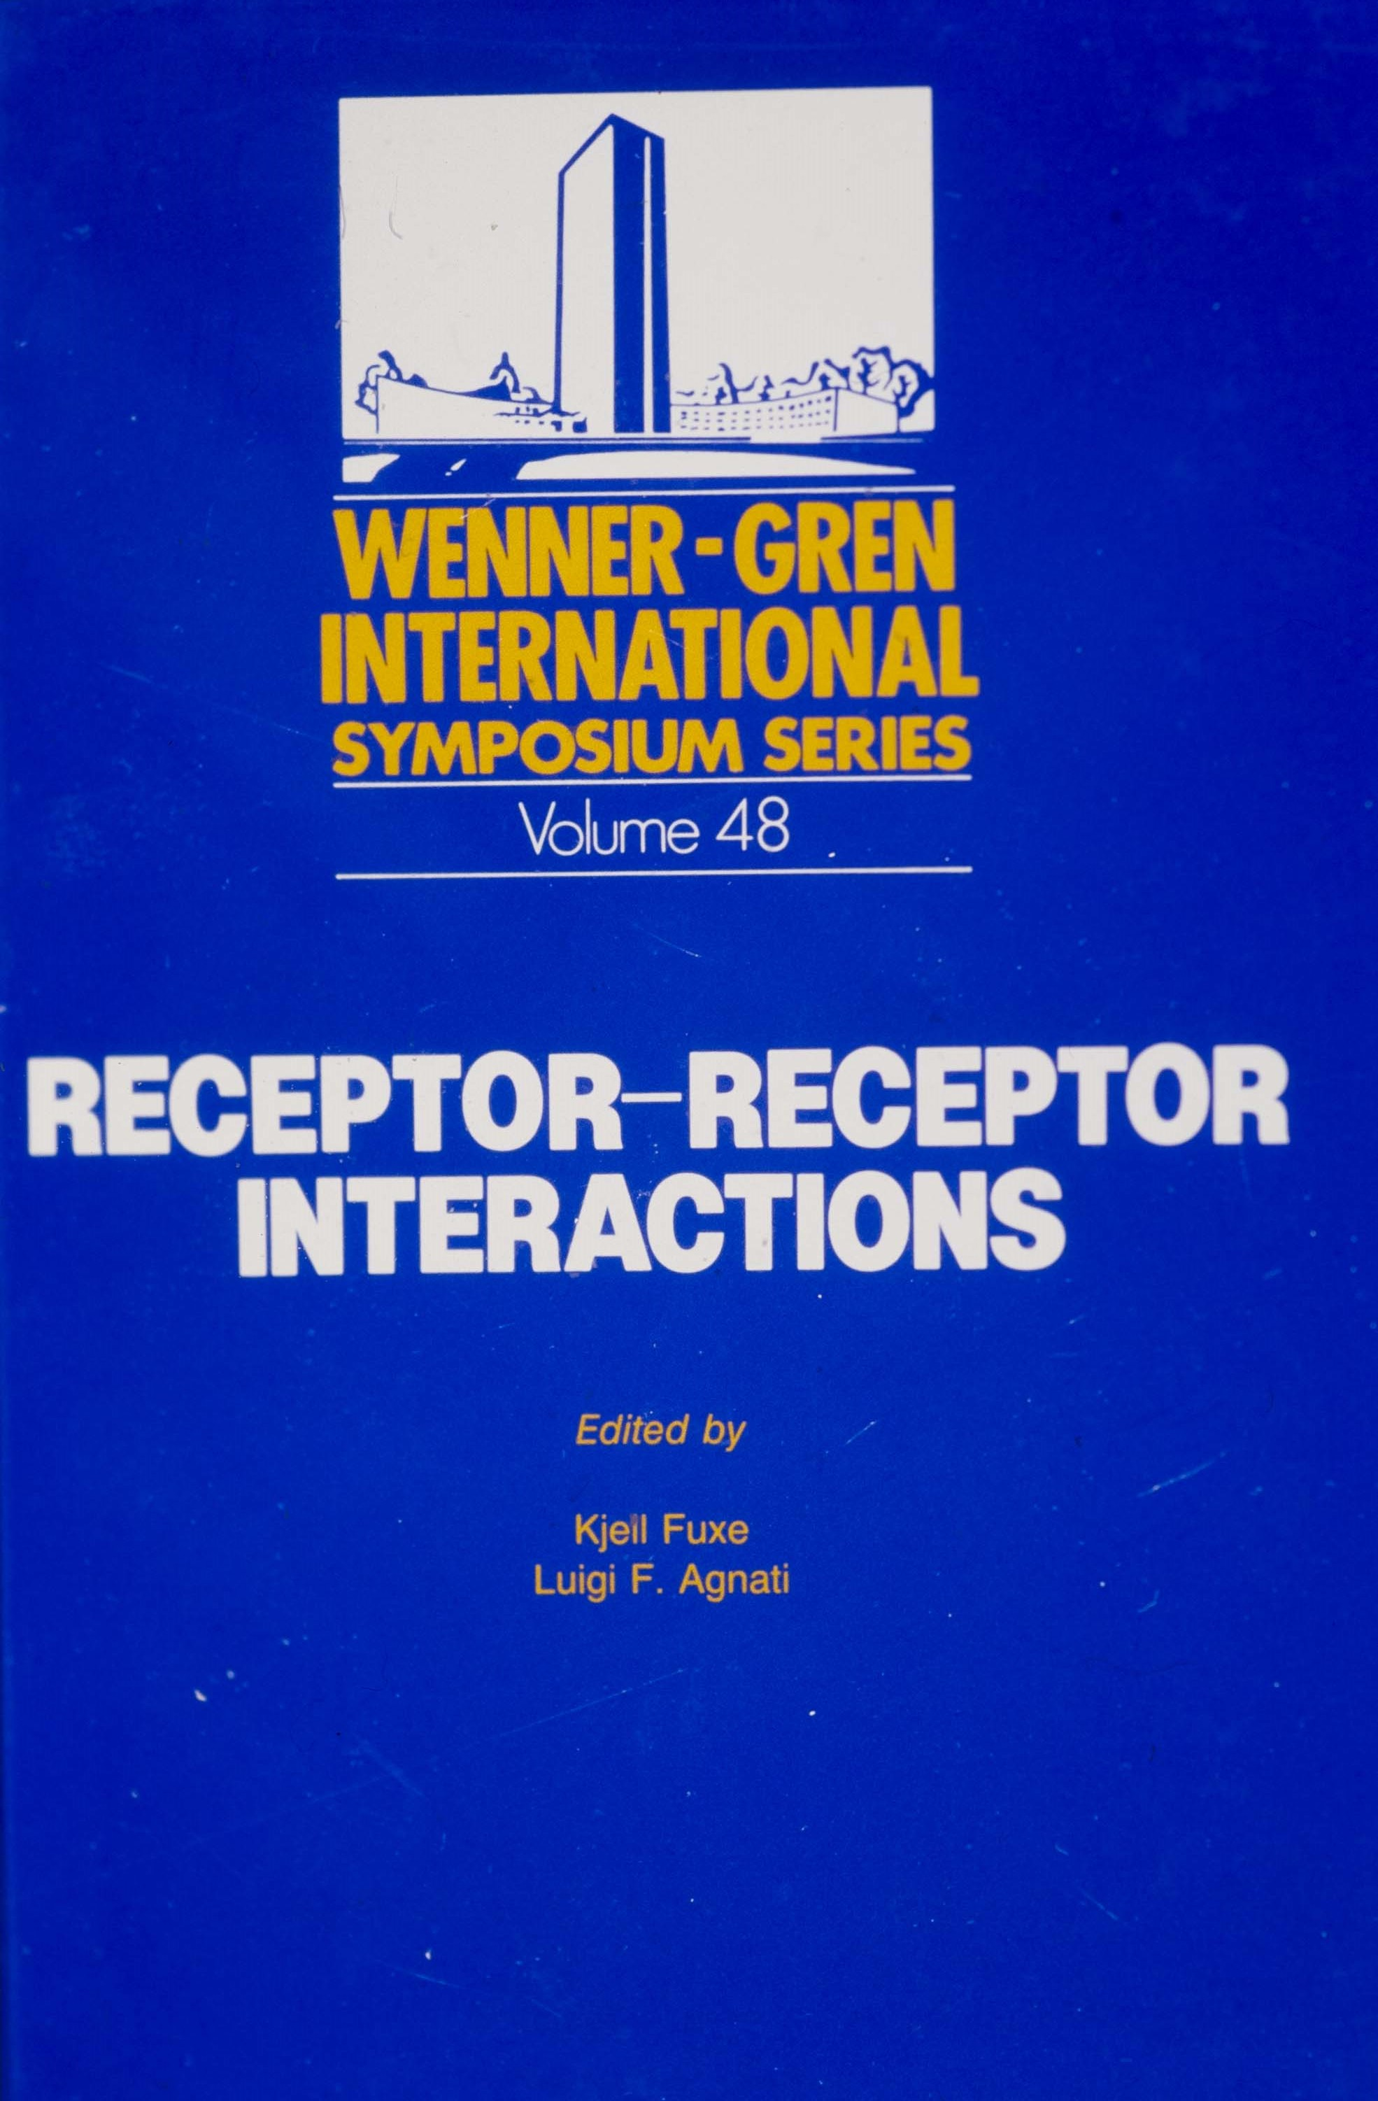
A new integrative mechanism at
membrane level
Stockholm 1986

Slide 32
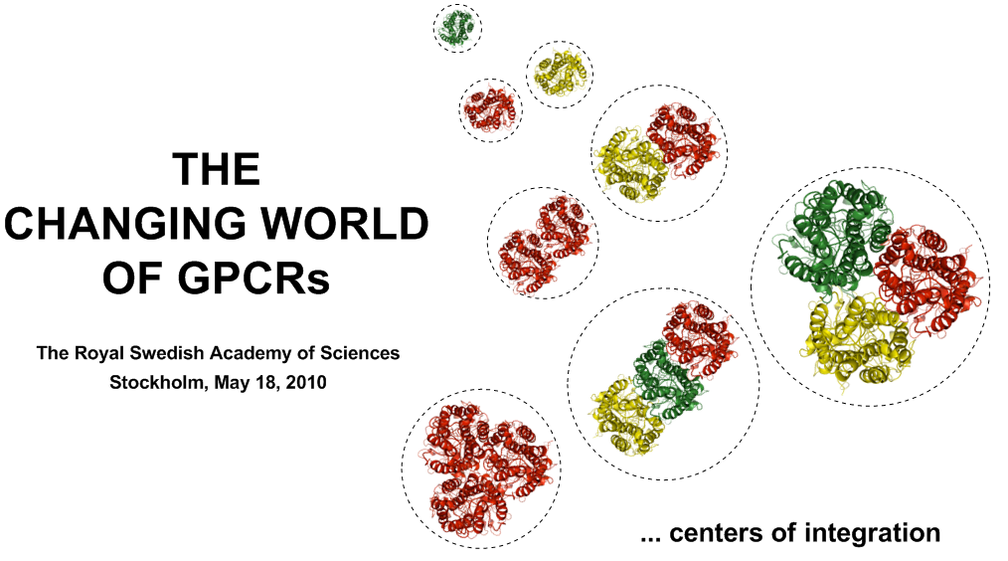
Monomers
heterodimers
homodimers
Higher order homomers
Higher order heteromers
In tissues
heteroreceptor complexes
Organizer. Fuxe
Notes:
32

Slide 33
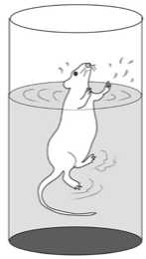
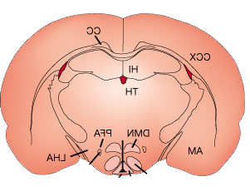
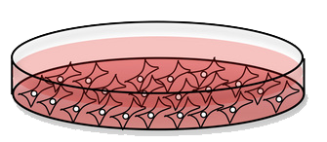
WORKFLOW
Cellular Models
Brain tissue
In vivo
Brain tissue
FRET, RT-FRET,
BRET, BiFC, FCCS,
In situ PLA, CoIP
In situ PLA, CoIP
In situ PLA, CoIP
Heteromer Structure
Receptor interface characterization
Small interface
interfering peptides (SIIP)
Site-direct mutagenesis
Small interface
interfering peptides (SIIP)
Site-direct mutagenesis
Small interface
interfering peptides (SIIP)
Binding assay, GTPγS,
Gene reporter assay,
B-arresting interaction
phosphoproteomics
Binding assay, GTPγS,
Rec autoradiography,
ERK1/2, CREB & c-Fos
Allosteric receptor-receptor interactions
Transgenic rats
A2A knock-in rat line
A2A OE rat line
A2A knock-in rat line
A2A OE rat line
The neuronal level
Neurophysiological
studies
Brain circuit level
Microdialysis,
MRI, fMRI,
in vivo binding PET
Global network level
Behavioral
pharmacology

Slide 34
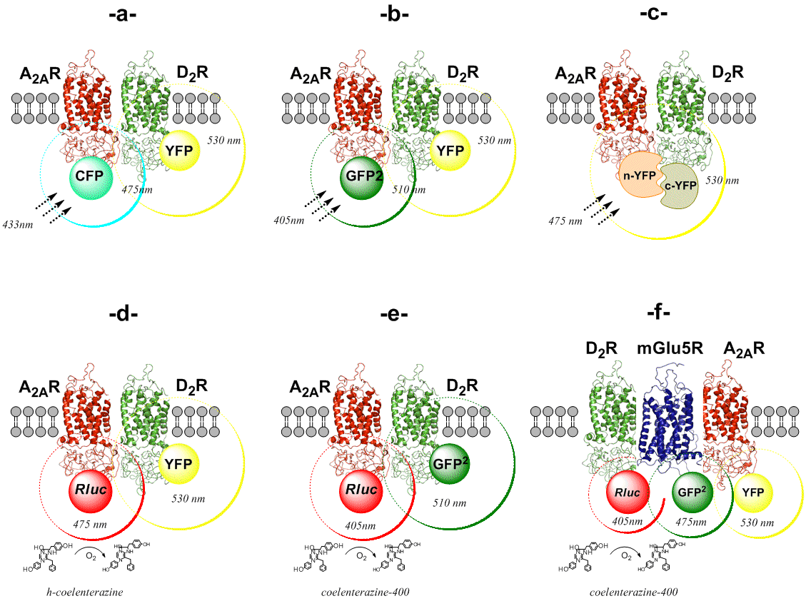
Illustration of the FRET and BRET methods: A_{2A}R-D₂R
Fuxe et al.2012
Notes:
34

Slide 35
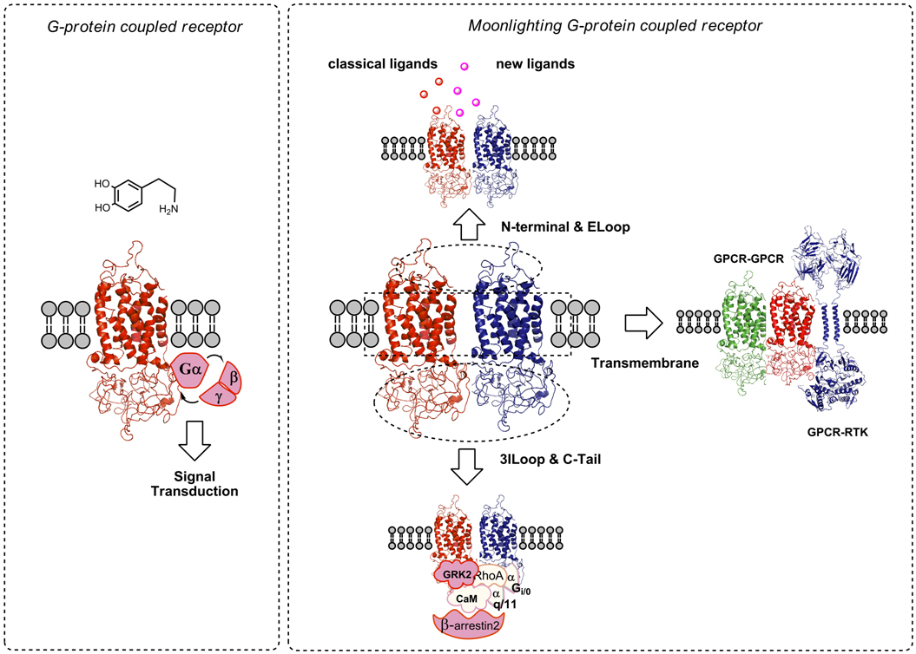
Jeffrey (1999): Moonlighting protein is a multifunctional protein where different
functions are found in single strands of amino acids not linked to splicing etc
GPCR protomers can moonlight through allosteric receptor-receptor interactions
Borroto-Escuela et al.2011
Notes:
35

Slide 36
Heteroreceptor complexes formed between DA receptors and NMDA receptors
Heteroreceptor complex and location | Signaling | Potential relevance PD
D1R-NMDAR ( D1-NR1) Hippocampus, striatum (synapse);Lee et al.2002, Fiorentini et al.2003,Woods et al.2005 | NMDAR increased D1R signaling. D1R activation upregulates NMDA dependent LTP and promotes working memory and NR1-CaMKII coupling | Cognitive dysfunction after uncoupling of the receptor complex ;Nai et al. 2010 Can contribute to improvement of cognitive and motor functions ( direct pathway) with L-DOPA.
Heteroreceptor complex and location | Signaling | Potential relevance PD
D2R-NMDAR (D2-NR2B) ; striatal glutamate synapses Liu et al.2006 | This complex blocks CaMKII-NR2B interaction with reduction of NR2B phosphorylation and NMDAR currents Disruption of the D2R-NR2B receptor complex reduced cocaine induced locomotion. The complex is increased by cocaine | Contributes to increasing motor function by reducing NMDAR drive in the Indirect pathway

Slide 37
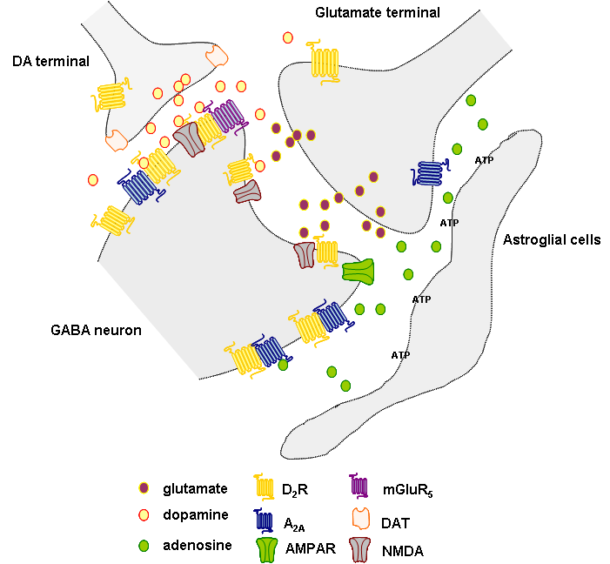
DA VT via D2R modulates glutamate WT via antagonistic receptor-receptor interactions with NMDA receptors in heteroreceptor complexes in the indirect pathway.
D2-NMDA (NR2B) ;indirect pathway (Liu et al.2006).
D1-NMDA (NR1) ; direct pathway (Lee et al.2002)
D2-5-HT2A; dorsal striatum
and nuc accumbens (Borroto-Escuela et al. 2010, 2014 ; Lukasiewicz et al.2010)
mGluR5/D2/A2A RM
Notes:
Thus DA via VT ca reach into glutamate synapses where they modulate the signaling of NMDA receptors since both D1 and D2 receptors form receptor mosaic complexes together with NMDA receptors where e.g. D2 receptors reduce NMDA signaling
in addition to modulating VT signaling of extrasynatic RMs

Slide 38
NEURAL NETWORK
UPREGULATING VT SIGNAL
DOWNREGULATING VT SIGNAL
UPREGULATED SYNAPSE
DOWNREGULATED SYNAPSE
ACTIVE SYNAPSE
INACTIVE SYNAPSE
INFORMATION FLOW
A.
VT
OUTPUT 1.
VT
VT
THREE DIFFERENT OUTPUTS
1. 2. 3.
FROM THE SAME NEURONAL NETWORK THANKS TO THE MODULATORY ACTIONS OF VT SIGNALS
B.
VT
VT
OUTPUT 2.
VT
C.
VT
VT
VT
OUTPUT 3.
Agnati and Fuxe 2000,
Fuxe et al. 2013
Notes:
Fig. 2. Changes in the mix of VT and WT can also give rise to polymorphic networks. Thus, the same neural network (upper Panel) can give different outputs. As shown in this schematic drawing VT signals via modulatory actions on the synaptic contacts of the neuronal network can give rise to three types of outputs (Panel A., B., C.). . Changes in the mix of VT and WT can also give rise to polymorphic networks that is to a neural network (upper Panel), which can give different outputs according to the VT-signals impinging on it. An example of a polymorphic network is illustrated for a neuronal network where the VT-signals by up-regulating or down-regulating synaptic contacts can change the integrative action of the network. Thus, as shown in this schematic drawing VT signals via modulatory actions on the synaptic contacts of the neuronal network can give rise to three types of outputs (Panel A : Output 1., Panel B : Output 2., Panel C : Output 3.). Obviously, the same conceptual scheme can be applied to a Complex Cellular Network.

Slide 39
Direct modulation glutamate excitotoxicity through
Cytokine receptor-ionotropic glutamate receptor
Interactions in heteroreceptor complexes
Cytokine | Receptor heteromer | Source
IFNgamma | IFNGR/GluR1 | Mizuno et al. (2008)
TNFalpha | ? | Pickering et al. (2005)
IL-1beta | ? | Viviani et al. (2003)
IL-6 | ? | Qiu et al. (1998)
IFNgamma directly induces neuronal damage in mouse cortical neurons through a unique neuron-
specific receptor complex (receptor heteromer) containing the IFNgamma receptor (IFNGR) and AMPA
GluR1 receptor.
IFNgamma synergistically enhances glutamate neurotoxicity mediated by AMPA receptors but not
NMDA receptors.
Novel mechanisms of neuronal excitotoxicity based on direct and specific cytokine–glutamate receptor
interactions, which may occur in MS.
A new road to neuroinflammation and neurodegeneration in Parkinson’s disease ( Fuxe et al.2008)
Abnormal allosteric receptor-receptor interactions may also contribute to a microglia-mediated neuroinflammatory
response (Block et al., 2007), found in the SN of individuals with PD.
Tarakanov et al.2009

Slide 40
Summary
The DA, NA and 5-HT neurons served a model neurons for the introduction of the theory of volume transmission (extrasynaptic , long distance and CSF VT)
At the nerve terminal level soluble VT signals dominate, mainly released from synaptic and other vesicles by exocytosis
At the soma-dendritic level not only extrasynaptic exocytosis of soluble VT signals exists but also extracellular vesicle mediated VT ( exosomes and shedding vesicles) containing e.g. proteins incl. receptors, lipids and mRNA ; transport in ECF
The major target for integration of synaptic and VT signals is the trophic unit including the BBB and nerve, glial and endothelial cells (the smallest set of cells to support the trophism of one another)
Extrasynaptic DA,NA and 5-HT VT operates by targeting DA, NA and 5-HT receptor subtypes on the nerve ,astroglial, microglial cells and cells of the BBB of the trophic units. Assemblies of trophic units build up the neural-glial networks of the CNS.
- The molecular targets for the integration of synaptic and volume transmission are the heteroreceptor complexes in the pre-and postjunctional membranes through their allosteric receptor-receptor interactions ( Fuxe et al.2013)

Slide 41
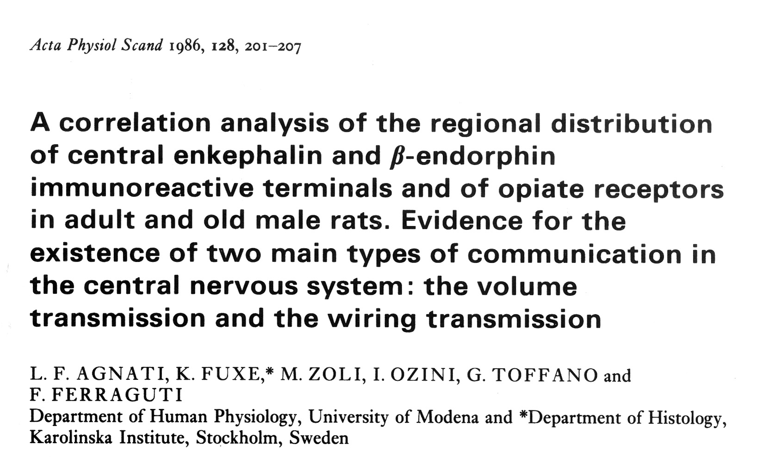
Notes:
Such observations and global monoamine terminal networks together with several other observations in the literature especially the demonstration of nonjunctional monoamine varicosities by Descarries led Luigi and me to propose the existence of volume transmission
Complentory to the wellknown wiring transmission.Of special importance for us was the demonstration of relative transmitter-receptor mismatches in the opioid peptide systems.

Slide 42


Slide 43
Table 2
Classification of the tunneling nanotube (TNT) and extracellular vesicle (EV) mediated intercellular communication in the central nervous system into wiring transmission and volume transmission, respectively
Intercellular communication mode | Channel | Cargo transfer | Mechanism of transport | Origin
TNT type of WT (cultures of neuronal and glial cells) Rustom et al.2004 Gerdes et al.2007 | TNT (15-60 µm long; 50-200nm diameter) transient, membrane continuity between cells | Organelles (especially vesicles), but also mtDNA, proteins, … inside or along the TNT plasma membrane surface | Actin driven | No in vivo data in adult CNS
EV type of VT (CNS: neurons, glial cells, brain endothelial cells) Simons and Raposo 2009; Schneider and Simons 2013 | Extracellular space and CSF | Exosomes (40 –100nm) containing proteins, lipids, mRNA, miRNA, mtDNA Shedding vesicles: Microvesicles (100 – 1000nm) insufficiently known composition Apoptotic bodies (1 – 4 um) Histones, DNA | Diffusion and flow along energy gradients in the extracellular space | Most cell types: endosomes, fuse with plasma membrane Most cell types: Plasma membrane All cell types: Plasma membrane Agnati and Fuxe 2014

Slide 44

AAAAA
THE VOLUME TRANSMISSION CAN BE MEDIATED BY
EXTRACELLULAR VESICLES (ECVs)
EXOSOMES (40-100nm) are ‘SAFE CONTAINERS’ of signals (mtDNA, mRNA, miRNA, Proteins, Lipids, …) released by cells
THE ECV MEDIATED VT
EVs (such as exosomes) allow the transfer of molecules from a source cell to a target cell
EXOSOME
MIGRATION OF EVs
B
Exocytosis Endocytosis
Insertion in the membrane
A
CELL B (TARGET):
INTERNALISATION OF EVs
ENDOSOMES
Insertion in cell organelles
CELL A (SOURCE):
RELEASE OF EVs
NUCLEUS
EVs (e.g., exosomes) can be internalized by Cell B that transiently modifies its biochemical machinery (i.e., the cell neurochemical phenotype)
Agnati and Fuxe 2014:
Borroto-Escuela et al
2015

Slide 45
Table 2
Classification of the tunneling nanotube (TNT) and extracellular vesicle (EV) mediated intercellular communication in the central nervous system into wiring transmission and volume transmission, respectively
Intercellular communication mode | Channel | Cargo transfer | Mechanism of transport | Origin
TNT type of WT (cultures of neuronal and glial cells) Rustom et al.2004 Gerdes et al.2007 | TNT (15-60 µm long; 50-200nm diameter) transient, membrane continuity between cells | Organelles (especially vesicles), but also mtDNA, proteins, … inside or along the TNT plasma membrane surface | Actin driven | No in vivo data in adult CNS
EV type of VT (CNS: neurons, glial cells, brain endothelial cells) Simons and Raposo 2009; Schneider and Simons 2013 | Extracellular space and CSF | Exosomes (40 –100nm) containing proteins, lipids, mRNA, miRNA, mtDNA Shedding vesicles: Microvesicles (100 – 1000nm) insufficiently known composition Apoptotic bodies (1 – 4 um) Histones, DNA | Diffusion and flow along energy gradients in the extracellular space | Most cell types: endosomes, fuse with plasma membrane Most cell types: Plasma membrane All cell types: Plasma membrane Agnati and Fuxe 2014

Slide 46
Table 3 Characterization of the extracellular vesicle mediated volume transmission from the various cell types of the CNS
Cell type | Type of EVs° | Transfer compounds, acceptor cells, function
Neurons | Exosomes and microvesicles | Hsp, Flottilin, miRNA , GLuR2; nerve cells; synaptic and extrasynaptic exocytosis leading to neuronal plasticity
Astrocytes | Exosomes and microvesicles | Mitochondria, ATP,Hsp70, synapsin1, functional glutamate transporters, FGF-2,VEGF, matrix metallo-proteinases, microRNA-29; astrocytes and neurons; Potential role in repair,neuroinflammation and neurodegeneration Agnati and Fuxe 2014

Slide 47
NEW PERSPECTIVES ON ROAMER TYPE OF VT
GPCRs ARE PRESENT IN EXOSOMES
EXOSOMES ARE INTERNALISED BY CELLS
ELECTRON MICROSCOPE IMAGE OF EXOSOMES
D2 RECEPTORS were labelled by 15nm gold particles
A2A RECEPTORS were labelled by 10nm gold particles
Glioblastoma cells were incubated with Exosomes prepared by CHO cells and containing A2A and D2 receptor
D2 (15nm)
Exosome
50 nm
1500 nm
1500 nm
A2A (10nm)
Extracellular vesicles internalised by the Glioblastoma cell
D2 – A2A IMMUNOGOLD STAINING SHOWS THE PRESENCE OF THE RECEPTORS IN THE EXOSOME
900 nm
900 nm
IMPLICATIONS OF THE CELL-TO-CELL TRANSFER VIA EXOSOMES OF GPCRs
Cell B, by internalising Exosomes can insert NEW TYPES OF GPCRs in the plasma membrane and hence decode previously undetected signals e.g., an undetected NEUROTRANSMITTER (NT)
and/or can lead to formation of
NEW RECEPTOR MOSAICS
INTERNALISATION OF EXOSOMES
B
NT
DECODING OF PREVIOUSLY UNDETECTED NEUROTRANSMITTER
B
CELL B IS A TARGET FOR EXOSOMES CONTAINING RECEPTORS THAT CELL B DOES NOT EXPRESS
INSERTION IN THE MEMBRANE OF NEW TYPES OF RECEPTORS
Guescini et al.
2012
Notes:
47

Slide 48
FEATURES OF VOLUME TRANSMISSION
TYPE OF SIGNALS
Chemical : neurotransmitters, neuromodulators,
growth factors, ions, gases (NO, CO, CO₂)
PATHWAYS
ECS preferential pathways
CSF
POTENTIAL ENERGY GRADIENTS FOR SIGNAL MIGRATION
Concentration gradients
Temperature gradients
Pressure gradients
DECODING SYSTEMS Receptors, enzymes, ion channels
Convective forces
Convective forces

Slide 49
Appearance of extraneuronal CA fluorescence in the A9-A10 after
amphetamine treatment in reserpine-nialamide-L-dopa treated rats
Fuxe and Ungerstedt 1970 in Amphetamines and Related Compounds
DA Microinjected into the
striatum can diffuse
Ungerstedt, Butcher,Butcher
Anden and Fuxe 1969

Slide 50

Radio-immunoassay of b-endorphin in the CSF
Intrastriatally administered beta-endorphin can migrate within the brain parenchyma and reach the CSF compartment as an intact peptide.
Beta-endorphin may employ the CSF as an complementary communication pathway, to also reach and activate distant opioid receptors.
The activation of opioid receptors was suggested from the fact that intrastriatally injected beta-endorphin was found on the cell surface of mu-opioid receptor-IR nerve cells on remote cells.
b-endorphin-IRM (nM)
Hoistad et al. 2005
Notes:
The CSF was sampled at different time points up to 2h post-injection and was assayed for
beta-endorphin using radio-immuno-assay.
The obtained beta-endorphin-IRM
showed a typical delay in the peak appearance
in the CSF:
This delay reflects the time it takes to
migrate from the striatum to the CSF compartment.

Slide 51
Summary II
The molecular targets for the integration of synaptic and volume transmission
are the heteroreceptor complexes in the pre-and postjunctional membranes
through allosteric receptor-receptor interactions ( Fuxe et al.2013)
The receptor interface in GPCRs involves helix-helix interactions, electrostatic
interactions in the intracellular loops and C-terminal tail and protriplet amino
acid homologies representing adhesive guides .
The triplet puzzle theory is based on a bioinformatic approach (Tarakanov Fuxe 2010)
5-HT1A autoreceptor-FGFR1 heteroreceptor complexes on serotonin
cell bodies located extrasynaptically are a novel target for antidepressants.
Synergistic allosteric receptor-receptor interactions upon coagonist treatment
recruit 5-HT1A autoreceptors into 5-HT1A-FGFR1 heteroreceptor complexes
(Borroto-Escuela et al.2012)
One proposed role of ECV mediated glial VT in schizophrenia: Based on the
triplet puzzle, CXCR4,CCR2 and ILR2 can in mild neuroinflammation if
internalized into neurons interact with NMDAR and GABAA/BR via distinct triplet
homologies.Pathological allosteric receptor-receptor interactions can develop
contributing to schizophrenia symptoms (Fuxe et al.2013)

Slide 52
Summary II
The molecular targets for the integration of synaptic and volume transmission
are the heteroreceptor complexes in the pre-and postjunctional membranes
through allosteric receptor-receptor interactions ( Fuxe et al.2013)
One proposed role of ECV mediated glial VT in schizophrenia: Based on the
triplet puzzle, CXCR4,CCR2 and ILR2 can in mild neuroinflammation if
internalized into neurons interact with NMDAR and GABAA/BR via distinct triplet
homologies.Pathological allosteric receptor-receptor interactions can develop
contributing to schizophrenia symptoms (Fuxe et al.2013; Bechter 2013)

Slide 53

Illustration of potential chemokine & cytokine receptor transfer via EV-VT from immune and glial cells to neurons in inflammation and formation of putative novel NMDA heteroreceptor complexes
Fuxe et al.2015

Slide 54


Slide 55

The triplet Puzzle: Homologies of amino acid protriplets in Receptor Heteromers
Through a mathematical approach, we have deduced, based on 48 pairs of receptors that form or not form heteromers, sets of triplet amino acid homologies that may participate in receptor interface.
They give a kind of
code that help determine which receptors should or should not form heterodimers .
Illustration of homology protriplets in A2A-D_{2L}R and D_{2L}R-NTS1 heteromers
We propose a 'guide-and clasp’ manner for receptor–receptor interactions where ‘adhesive guides' may be the triplet homologies.
Tarakanov and Fuxe 2010

Slide 56


GPCR heterodimer network
156 protomers
/nodes
260 interactions /edges
Scale- free topology:
Most nodes have few interactions
Nine nodes have ten or more inter actions : e.g. D2, 5-HT1A, A2A, A1
Class A or rhodopsin-like: blue;
Class B or Secretin: red;
Class C or Metabotropic: orange.
Experimental data from the String and Scopus databases and using Cytoscape software
Implemented in Java
http://www.iiia.csic.es/~ismel/GPCR-Nets/index.html
Borroto-Escuela et al. 2014

Slide 57


Slide 58
Heteroreceptor complexes among DA receptor subtypes
Heteroreceptor complex and location | Signaling | Potential relevance PD
D1R-D2R ; subsets of MSNs in accumbens (DYN,ENK,GABA/glutamate) Lee et al.2004, | Gq, Ca release via IP3, recruitment of BDNF via CaMKII and MeCP2, blocked by D1R and D2R antag.;inactivates GSK-3β SKF 83959: D1-D2 heteromer agonist | Hyperdopaminergia increases function of the D1R-D2R heteromer; mental side-effects with L-DOPA and D2 agonist including addiction Perrault et al. 2010-2013; O’Dowd et al.2012
D1R-D3R; certain striato-nigral GABA neurons Bordet et al.1997;Ridray et al.1998; Marcellino et al.2008 Fiorentini et al.2008 | D3R enhancement of D1R affinity and postsynaptic signaling | D3R enhances D1R induced locomotion. Marcellino et al.2008, Fiorentini et al.2008
D2R-D3R; ventral striatum Scarcelli et al. 2001; Pou et al.2012 | Partial D2R agonists turn into D2R antagonists at the D2-D3 heteromer | Partial D2R agonists in PD treatment have reduced mental side-effects Maggio and Millan 2010

Slide 59
Heteroreceptor complexes among DA receptor subtypes
Heteroreceptor complex and location | Signaling | Potential relevance PD
D2R-D4R: D2LR–D4.2R , D2LR–D4.4R but not D2LR-D4.7R heteromers; short form of D2R also form hetromers with D4.2 and D4.4; colocalization in striatum Borroto-Escuela et al.2011, Gonzalez et al.2012 | Combined D2 and D4 agonist treatment resulted in potentiating effects on ERK1/2 phosphorylation for D4.2R, D4.4R but not for D4.7R containing heteromers | The synergistic effects on ERK signaling may increase plasticity responses to L-DOPA treatment.The D4.7 variant may be linked to ADHD. Borroto-Escuela et al.2011, Gonzalez et al.2012
D2R-D5R: colocalization cortex and ventral pallidum So et al.2009, O’Dowd et al 2013 | Gq-PLC signaling upon combined agonist treatment leads to small intracellular calcium release and then to large extracellular influx of calcium | Possible activation of CaMKII , linked to involvement in drug addiction. Possible side-effect of L-DOPA treatment in PD. So et al.2009, O’Dowd et al 2013

