Slide 1
Integrated consulting services for rich gas production plan from mature fields
Kjeld Bokstijn, Lan Ji, María Rey
6th International Conference on Petroleum Engineering
June 29, 2017

Slide 2
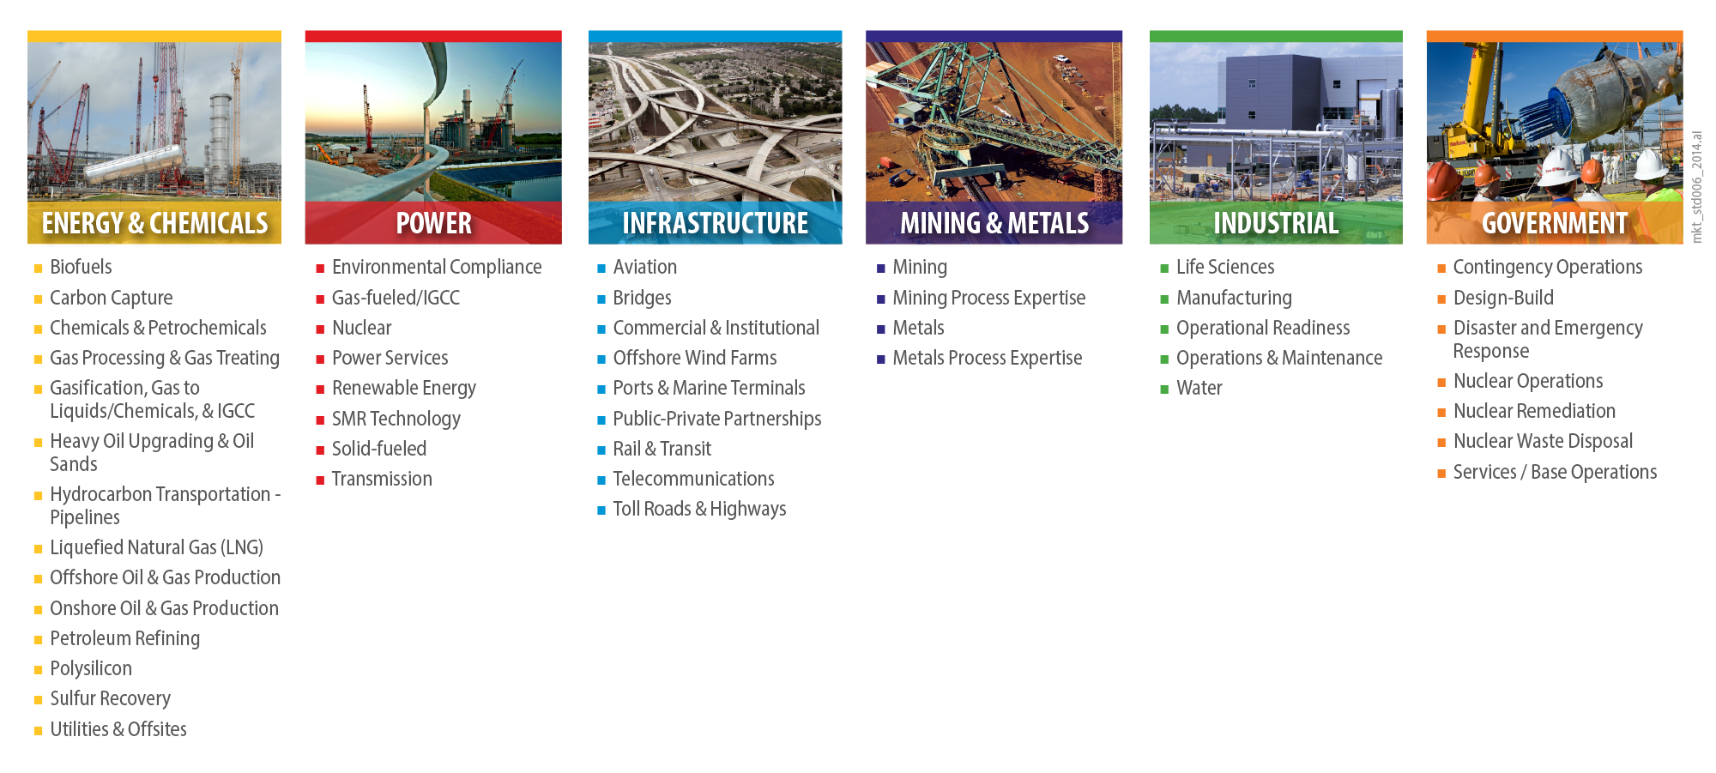
SacyrFluor – Who we are
SacyrFluor, S.A. is formed 50% Fluor & 50% Sacyr and based in Spain.
Sacyr = long experience in construction and procurement areas in large investments and worldwide projects.
Fluor Corporation = excellence technical capabilities and global resources as well as a technology expert.
SacyrFluor counts with the spirit of excellence that originates in each of the two founding companies.
SacyrFluor purpose: be a leading company for integral services, specialized in EPC projects.
EXCLUSIVE BUSSINES LINE

Slide 3
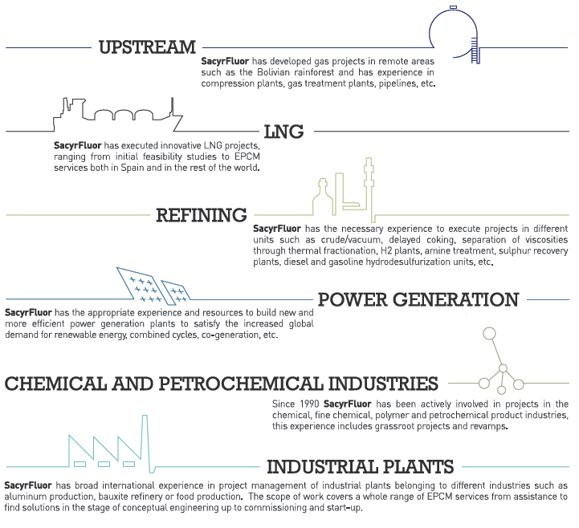
SacyrFluor – Business Areas
SacyrFluor has developed gas projects in remote areas such as the Bolivian rainforest and has experience in compression plants, gas treatment plants, pipelines, etc
SacyrFluor has executed innovative LNG projects, ranging from initial feasibility studies to EPCM services both in Spain and in the rest of the world.
SacyrFluor has the necessary experience to execute projects in different units such as crude/vacuum, delayed coking, separation of viscosities though thermal fractionation, H2 plants, amine treatment, sulphur recovery plants, diesel and gasoline hydrodesulfurization units, etc.
SacyrFluor has the appropriate experience and resources to build new and more efficient power generation plants to satisfy the increased global demand for renewable energy, combined cycles, co-generation, etc.
Since 1990 SacyrFluor has been actively involved in projects in the chemical, fine chemical, polymer and petrochemical product industries. This experience includes grassroot projects and revamps.
SacyrFluor has broad international experience in project management of industrial plants belonging to different industries such as aluminum production, bauxite refinery or food production. The scope of work covers a whole range of EPCM services from assistance to find solutions in the stage of conceptual engineering up to commissioning and start-up.

Slide 4
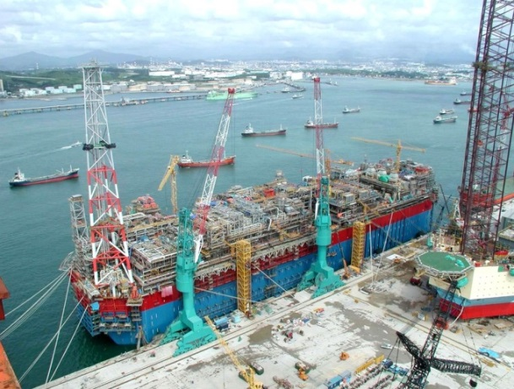
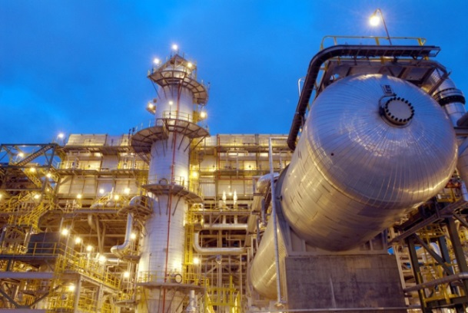
Fluor – Energy & Chemicals
The Energy & Chemicals business line serves the global oil and gas production/processing, chemicals, and petrochemicals industries.
Ranks No. 1 on ENR (Engineering News-Record) magazine’s list of Top Design Firms in the Petroleum sector
Full range of services including design, engineering, fabrication, procurement, construction, and project management
Consulting services for feasibility studies and project financing
Global office platform optimizes execution of all sized projects including mega-projects in remote locations with challenging environments
Services from upstream, midstream, downstream and petro-chemical derivatives.

Slide 5
Fluor: what we do
Operating facility producing the right product in a cost competitive and sustainable way
Client with an idea and a business plan
Fluor
Turning ideas into reality
… a passion to design and build!

Slide 6
A project with special expertise requirements
A SacyrFluor international client requested SacyrFluor to perform consulting services for rich gas production plan from mature fields with the goal of feeding downstream petrochemical industry.
Resources were identified from within the SacyrFluor and Fluor organizations to support the project.
Formed an overall project team consisting of:
    SacyrFluor process engineering and project management
    Fluor upstream experts
    Fluor NGL separation experts
Guaranteeing expertise made available to the project from the optimal location.

Slide 7
Client with an idea and a business plan
Client requests a feasibility study for a rich gas field development and debottlenecking the offshore and downstream NGL facilities.
The business plan included:
  Produce gas from depleted oil reservoirs to be procured by Client
  Transmit the gas to a petrochemical complex at 80 km from the fields
  Separate the NGLs from the gas
    Dry gas → Ammonia & Urea feedstock
    NGLs → Steam Cracker feedstock

Slide 8
Client with an idea and a business plan – cont´d
To the Client available reservoir information:
  Reserve books → 4.3 TCF in place (2014)
  Previous studies →2.3 TCF in place (2011-2013)
  Business Case:
    High case: 20 year 345 MMSCFD needs 2.5 TCF recoverable reserves
    Low case: 20 year 180 MMSCFD needs 1.3 TCF recoverable
Client interpretation:
  Sufficient gas in place for low case and maybe for high case
  High case might need Enhanced Gas Recovery to meet gas reqm´t

Slide 9
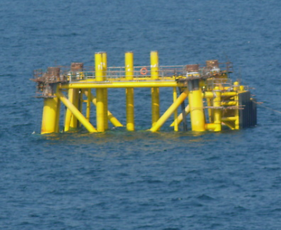
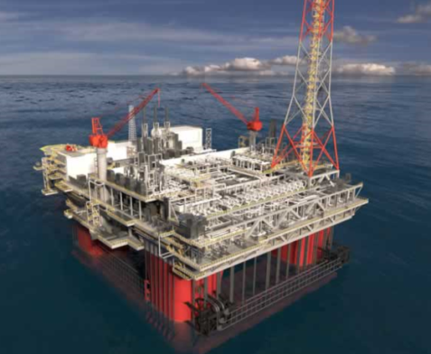
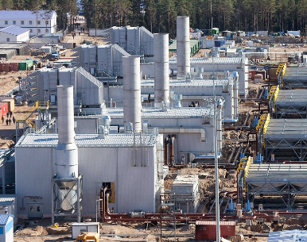
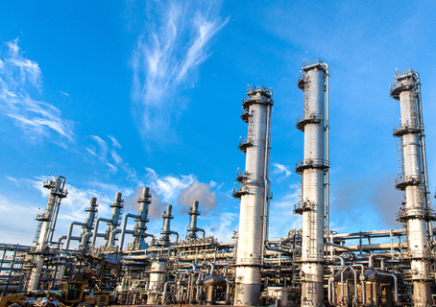
Client with an idea and a business plan – cont´d
Client requests support in confirming the viability of the business plan:
  Confirm current gas in place estimates
  Test Enhanced Gas Recovery schemes for implementation
  Conceptualize required gas production & transmission facilities
  Study feasibility of debottlenecking existing NGL separation train

Slide 10
Turning ideas into reality
Project approach:
  Understand Client business plan and Client needs
  Align on project requirements and relationship to SacyrFluor & Fluor capabilities and limitations in scope that can be provided in-house and that needs to be outsourced
  Prepare an integrated solution for the overall consulting services required as part of the scope to support the Client´s needs

Slide 11
Understand Client business plan
A workshop was held for the client to explain their business plan:
  Reservoirs selected by Client
    Depleted oil production reservoirs
    Status, history, previous current in place volume studies
  Existing production facility availability
    Wells, gathering system, trunk lines, Central Processing Facilities
  Existing rich gas transmission facility availability
    Compressor stations, main lines
  NGL separation facility specifics

Slide 12
Understand Client needs
Client has done significant pre-work:
  Pre-assessment of provided reservoir and production data
  Pre-assessment of existing production & transmission facilities available
  Developed business plan from available current in place volume estimates
Client wants:
  SacyrFluor to help assess the viability of the business plan and provide input for generation of a bankable business plan
  Perform dynamic reservoir modeling to make a detailed characterization of the reservoirs

Slide 13
Align on study requirements and scope split
Reservoir assessment is not performed in-house by Fluor / SacyrFluor
From the wellhead all services can be provided in-house:
  Oil / Gas production facility
  Transmission
  NGL separation
Third party specialist consulting is required for reservoir assessment and well opening plan development
→ Integrated solution

Slide 14
Preliminary reservoir assessment
Possible mismatch:
  Reserve books → 4.3 TCF in place (2014)
  Previous studies →2.3 TCF in place (2011-2013)
  Business Case: 20 year 345 MMSCFD needs 2.5 TCF recoverable reserves
Client interpretation:
  Should have sufficient gas in place, but might need Enhanced Gas Recovery to enable producing the required gas volumes
  Need to update in place volume estimates to current to confirm business plan is feasible
  Need to define the production facilities required to support the plan

Slide 15
Develop the integrated solution
SacyrFluor / Fluor to provide a cost effective integrated solution contacted reservoir assessment consultants to jointly define the optimal approach that will:
  Reduce the reservoir modeling work required
  Provide the data required for the study
    Current in-place hydrocarbon volumes
    Contingent resources for 20 year plan
    Average reservoir conditions
    Number of wells required for 20 year production plan
    Well head flowing conditions to conceptualize topsides
Conventional reservoir assessment is selected

Slide 16
Reservoir assessment
Conventional reservoir assessment no detailed modeling
  Low effort and cost
  Quick results
  Sufficient details for other parts of feasibility study
Method
  Reinterpret available reservoir data to confirm Net Rock Volume, porosity, water saturation, formation factors and gas-to-oil ratio → Original Oil In Place & Original Gas In Place
  Perform material balances for the reservoirs using historical production data → Current In-Place Volumes

Slide 17
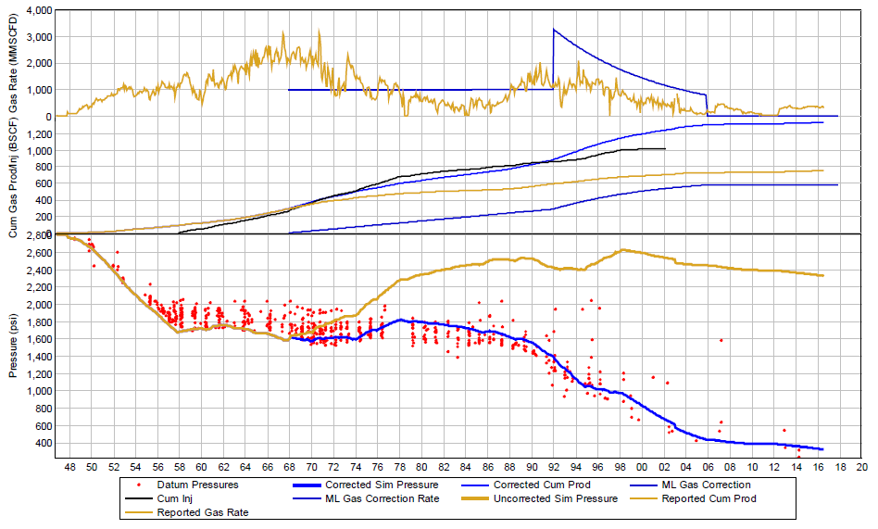
Reservoir assessment – cont´d
Material Balance results (one reservoir)
Pressure from MBAL
Pressure mismatch
Actual Pressure

Slide 18
Reservoir assessment – cont´d
Preliminary Material Balance Results:
Reservoir pressure obtained from material balance using reported oil, gas and water production and re-injection data is much higher than observed:
  MBAL: 2400 psi
  Observed: 400 psi
Gas re-injection reported too high or gas leaked into adjacent reservoirs
Implemented a gas injection correction term to match pressure

Slide 19
Reservoir assessment – cont´d
Material balance correction assumptions:
Liquid volumes accurately measured
Reservoir pressure should match
→Gas re-injection adjusted downwards via correction term to match observed reservoir pressure

Slide 20
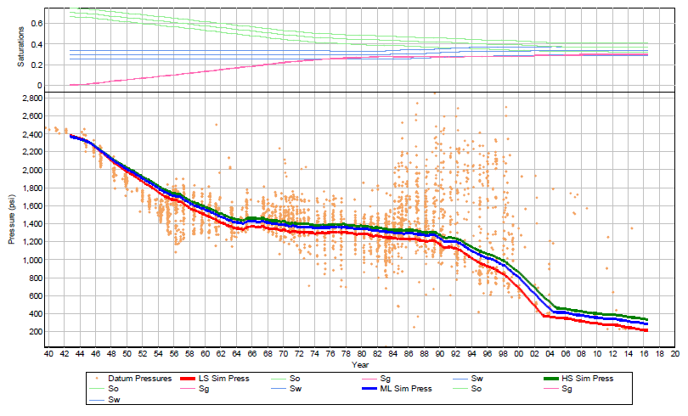
Reservoir assessment – cont´d
A: Solution Gas Drive
B: Gas injection
C: Water injection
D: Natural Decline
A
B
C
D

Slide 21
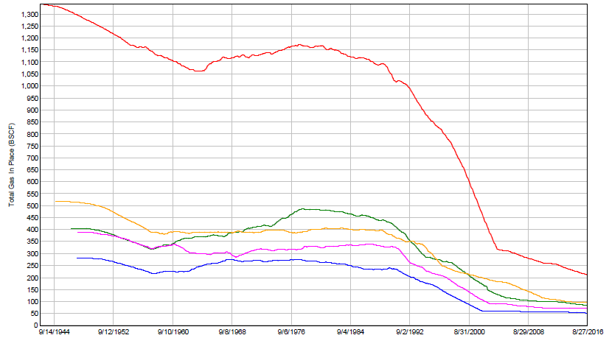
Reservoir assessment – cont´d
Total Gas in Place vs. Time (all 5 reservoirs)

Slide 22
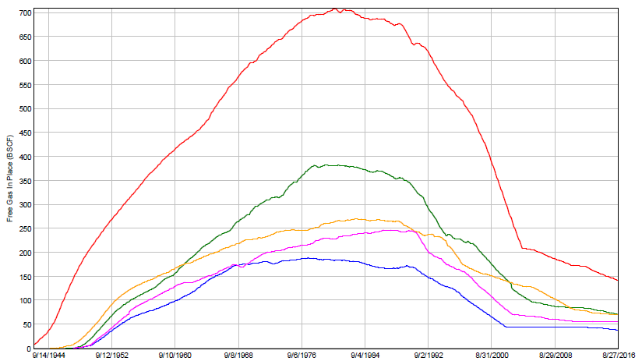
Reservoir assessment – cont´d
Free Gas In-Place vs. Time (all 5 reservoirs)

Slide 23
Reservoir assessment – cont´d
Current In-Place Gas Volumes estimated at:
Total: 0.5 TCF (0.4 Free & 0.1 Solution)
Business Plan requires: 1.3-2.5 TCF recoverable gas
Current gas-in-place does not support the business plan
Understanding of the material balance key to achieving acceptance of the results by stakeholders.

Slide 24
Roll-up into the overall study
Client has been provided with a quick assessment of the viability of his business case:
  Reservoir assessment indicates current in-place volumes selected reservoirs do not support business plan
  No other studies were performed as the conventional reservoir assessment could be performed upfront and no parallel execution of study work was required to meet the overall study plan
Overall study cost was minimized while providing the required information to Client

Slide 25
Overall study results
SacyrFluor has successfully coordinated the overall study between the different stakeholders:
  Client management
  Client gas production specialists
  Third party reservoir consultant
  Fluor upstream specialists
A cost effective method was derived to obtain the minimum required reservoir information
Client money has been saved and remains available to study other opportunities

Slide 26
Lessons learned
Zero base approach, i.e. going back to the basics, helps set the basis and shift the paradigm.
Bringing required expertise together from various sources:
  Client
  Contractor
  Subcontractor
→ Helps limit the scope to the minimum required.
Ensuring agreement on the basis is required to obtain acceptance of the outcome.

Slide 27
Contact Details
Kjeld Bokstijn – Process Director
Ph +34 91 536 5904
Email: Kjeld.Bokstijn@sacyrfluor.com
Lan Ji – Process Director
Ph +1 949 349 3356
Email: Lan.Ji@fluor.com
María Rey – Project Director
Ph +34 91 536 6402
Email: Maria.Rey@sacyrfluor.com

Slide 28
Disclaimer
This presentation has been prepared by and remains the sole property of SacyrFluor S.A.
Client agrees, by its acceptance or use of this document, to return it upon SacyrFluor’s request, and not to reproduce, copy, lend, or otherwise disclose or dispose of the contents, directly or indirectly, and not to use them for any purpose other than that for which it was specifically furnished.

