Slide 1

Impairment of diabetic wound healing: Key genetic players
DEPARTMENT OF MOLECULAR AND HUMAN GENETICS
BANARAS HINDU UNIVERSITY
Kiran Singh
Assistant Professor

Slide 2

Defining the problem ?
Diabetes mellitus (T2DM): complex metabolic disorder associated with an array of secondary complications
Wound healing impairment: 25% of total T2DM patients (Boulton et al., 2005)
Every 30 seconds a lower limb is lost throughout the world due to diabetic foot ulcer (DFU)

Slide 3
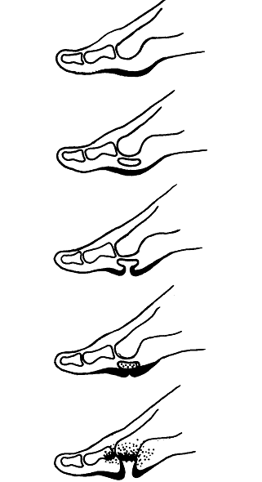
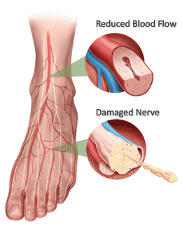
Mechanism of wound occurrence in case of diabetes
non enzymatic glycation of collagen
stiffing and rupturing of skin
wound infection and osteomyelitis
Delbridge et al., 1985

Slide 4
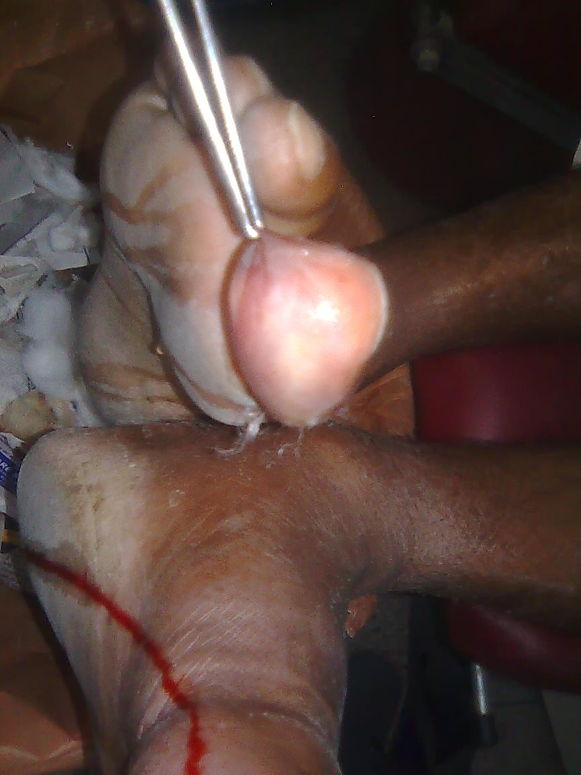
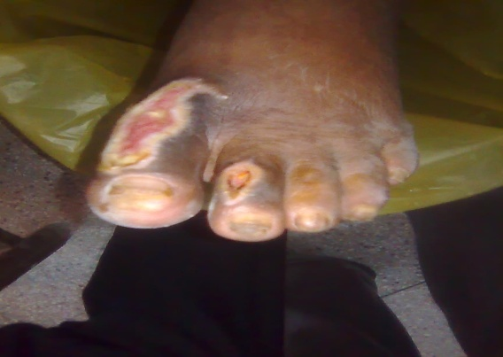
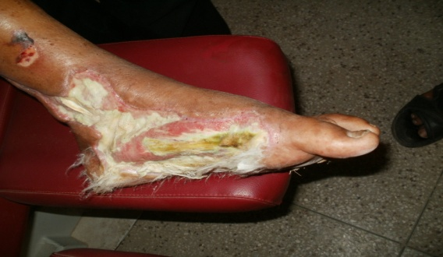
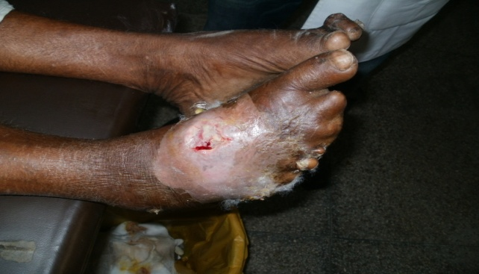
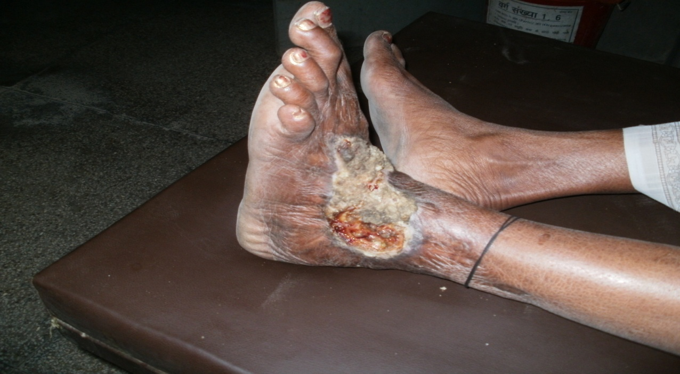
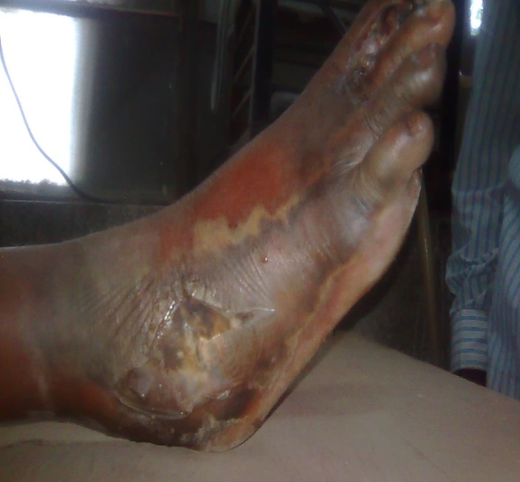
Wound Grading on the basis of severity
Grade | Description
0 | No ulcer, but high-risk foot (e.g., deformities, callus, insensitivity)
I | Superficial, full-thickness ulcer
II | Deeper ulcer, penetrating tendons, without bone involvement
III | Deeper ulcer with bone involvement
IV | Partial gangrene (e.g., toes, forefoot)
B | Presence of Infection
D | Ischemic ulcer
0
I
II
III
II-B
IV-D
Armstrong et al., 1998; Lavery et al., 1996
Notes:
4

Slide 5
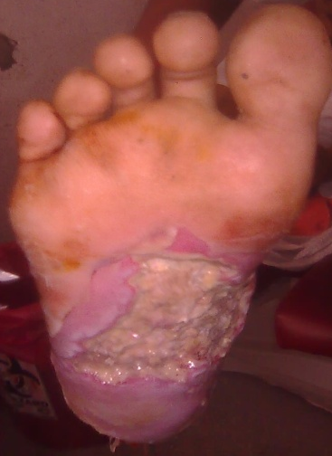
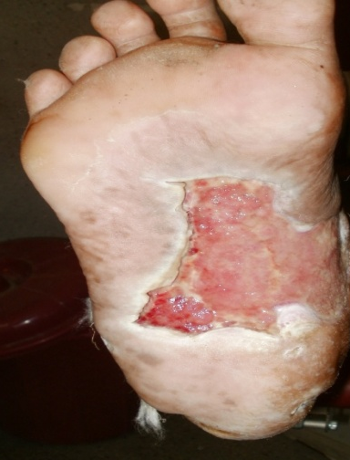
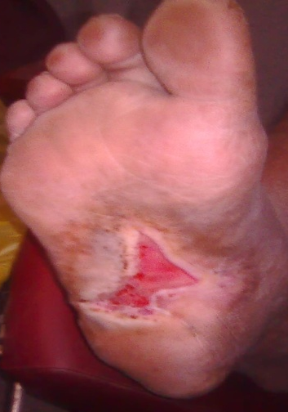
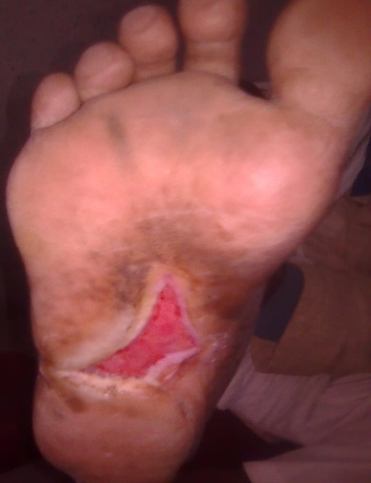

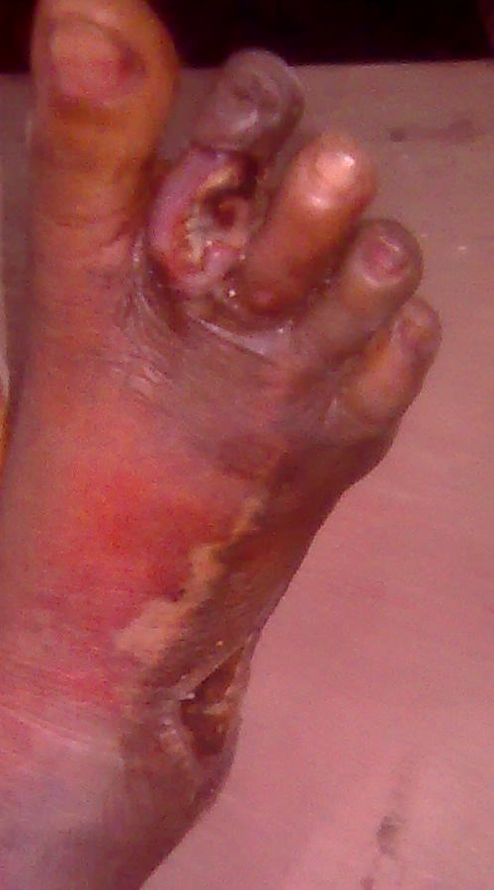
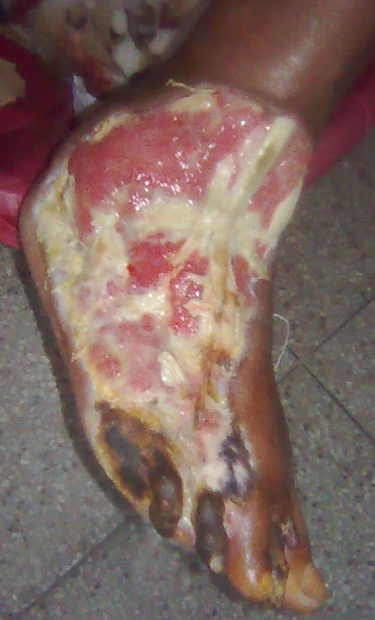
Some diabetic wounds heal, others do not
DFU patient 66
DFU patient 72

Slide 6
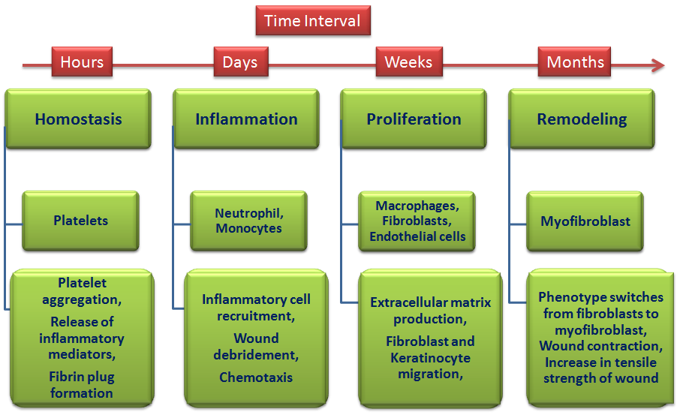
Wound Healing Cascade
Stages
Cells involved
Specific Events

Slide 7
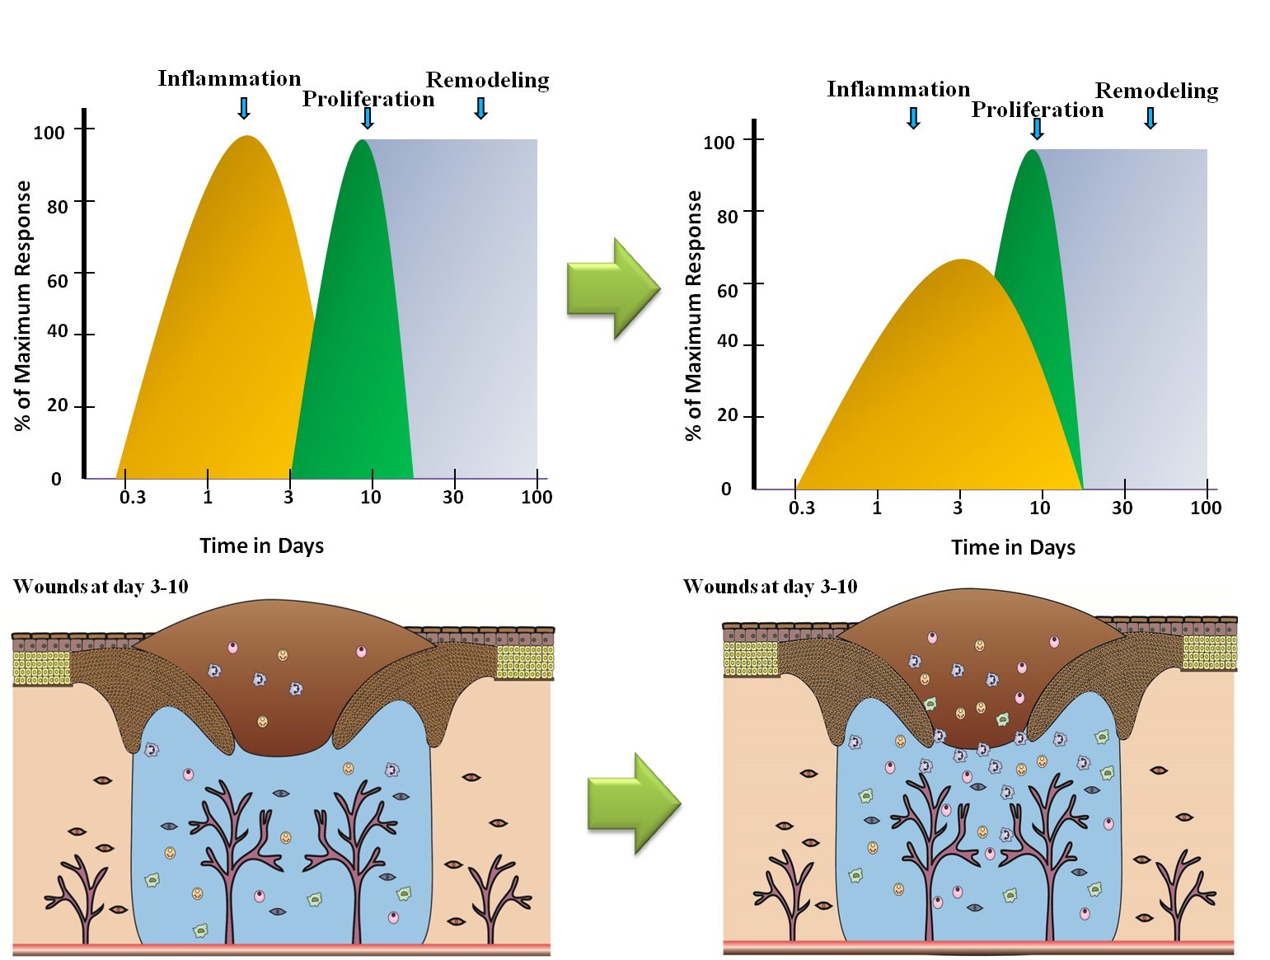
Wound Inflammation: The master process deciding the fate of wound
Singh and Singh, Current Diabetes Reviews, 2015

Slide 8
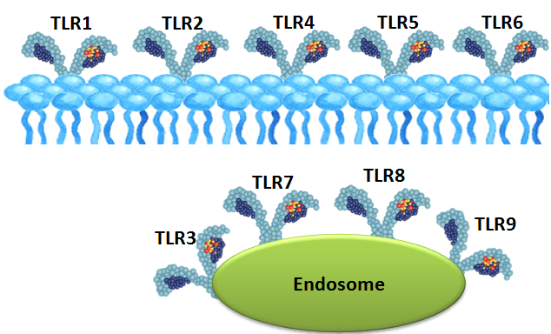
Wound Inflammation: Challenges the innate immune system
Limit the spread of infection, Initiate adaptive immune response, Set in the tissue repair process
Toll like receptors
Play a key role in the innate immune system.
Recognize structurally conserved molecules derived from microbes (pathogen-associated molecular patterns)
TLR2 and TLR4: promote angiogenesis and growth factor secretion in mice (Xu et al., 2012)
TLR7 and TLR9: induce tissue necrosis and neurotoxicity in mice (Iliev et al., 2004)

Slide 9
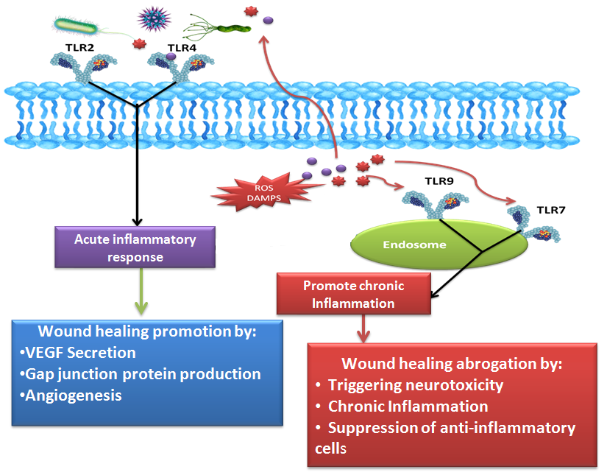
TLRs in wound healing

Slide 10

Questions we asked….
Are the TLRs expression altered in human diabetic wounds compared to control wounds?
Whether TLRs downstream signalling also affected by this deregulation?
Whether epigenetic changes like promoter DNA methylation are implicated in the altered expression of TLRs?
Expression analysis of TLRs and their mediators in Diabetic and Control wounds
DNA methylation analysis of the promoters of down-regulated genes

Slide 11
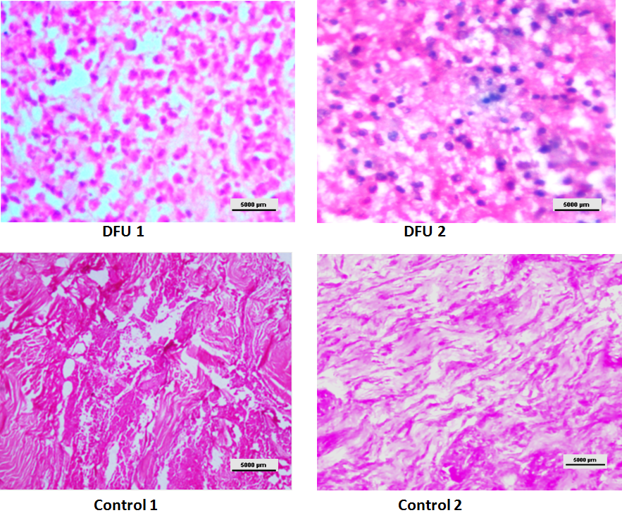
Histological difference between diabetic & Non diabetic wounds
Hematoxylin and eosin staining for determining cell types in wound biopsies
Inflammatory cells were more abundant in diabetic wounds compared to control wounds

Slide 12
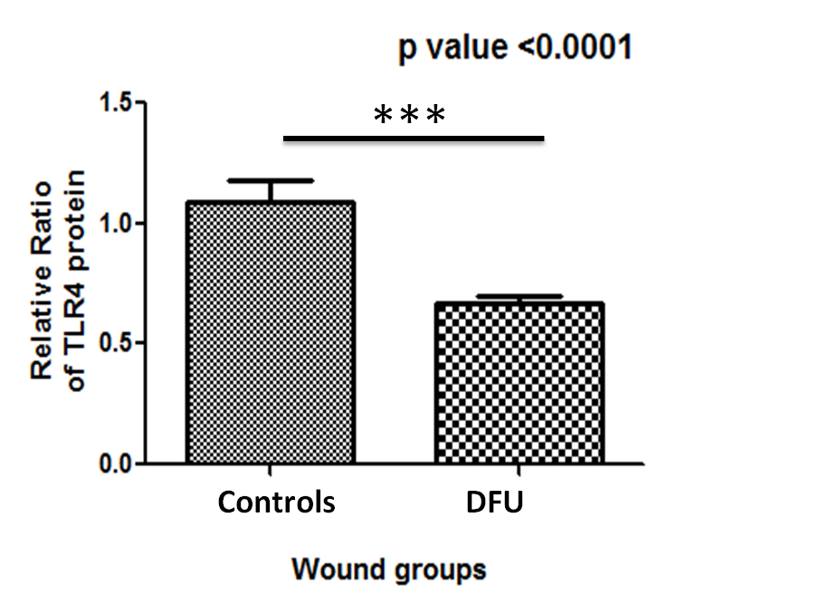
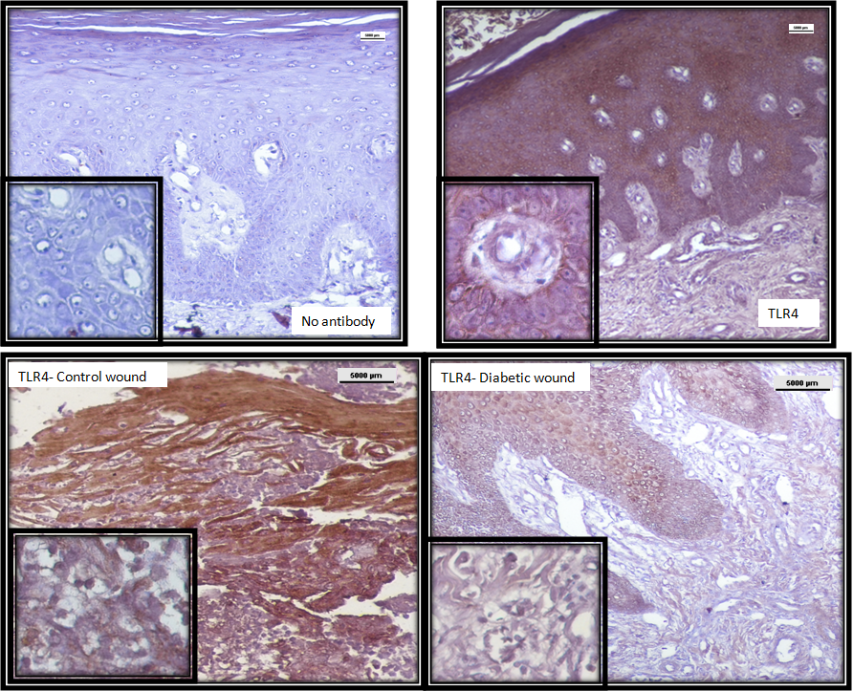

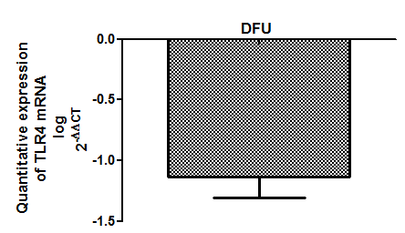
Status of TLR4 in diabetic and control wounds
Immunohistochemistry and Western blot using anti TLR4 antibody
RT-PCR using primer specific to TLR4
**
p value = < 0.001
Fold change = 14
TLR4 was significantly down regulated in diabetic wounds compared to control wounds
Singh et al., J Diabetes & Metabolism, 2013

Slide 13
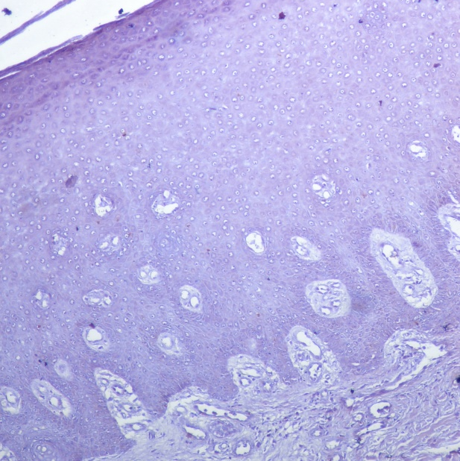
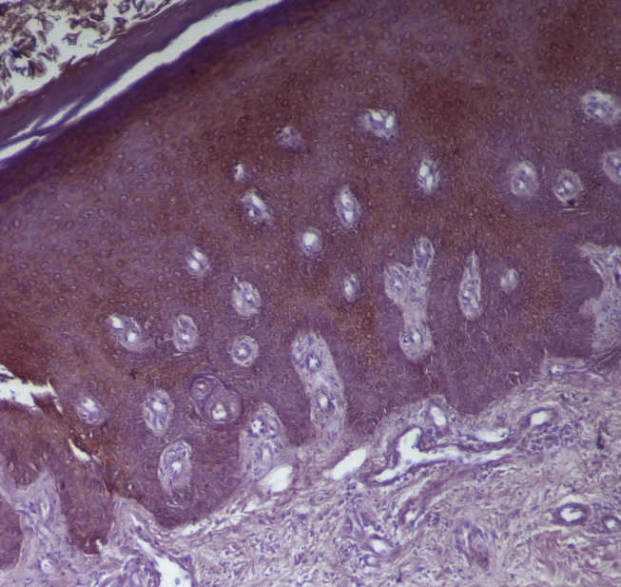
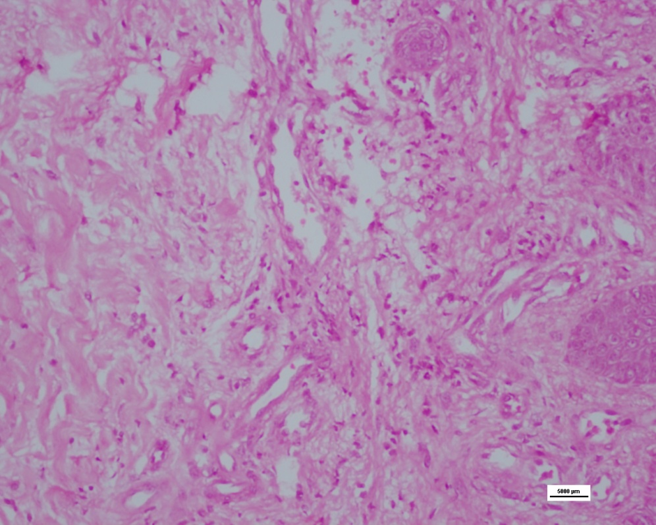
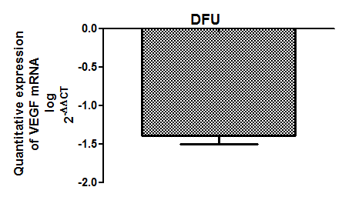
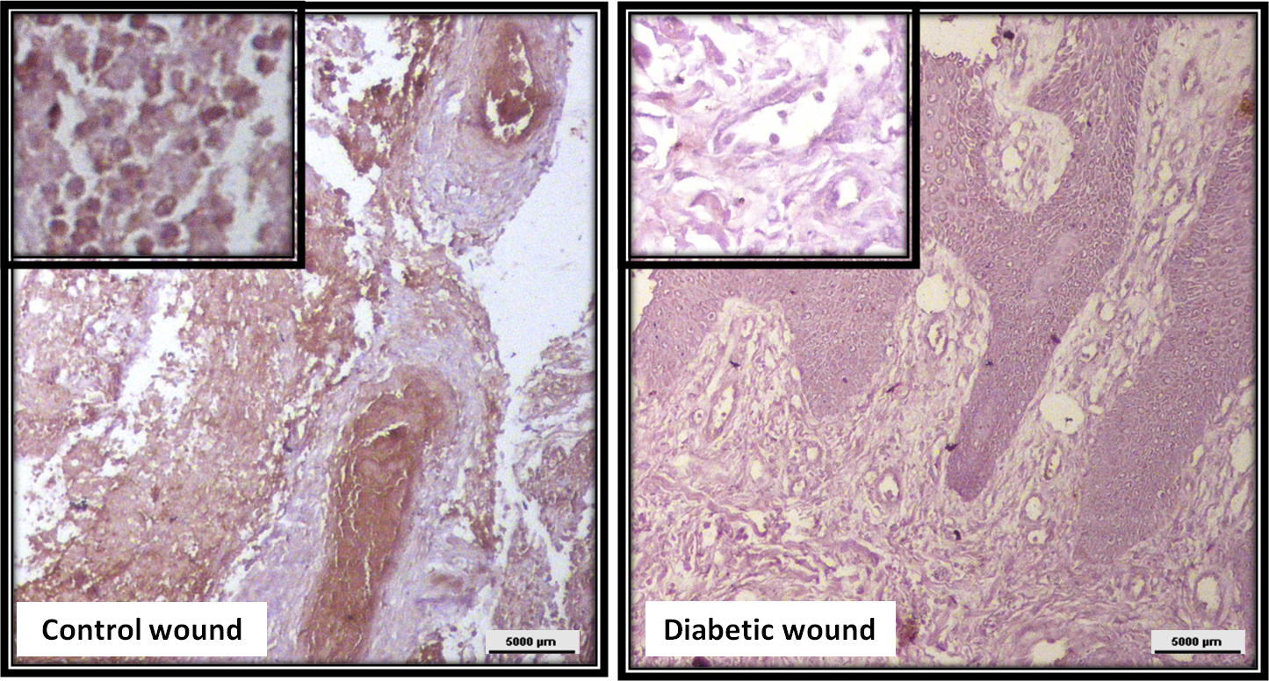
Levels of VEGF, a downstream effector of TLR4 signalling
Immunohistochemistry using anti VEGF antibody
RT-PCR using primer specific to TLR4
No antibody
VEGF
***
p value = < 0.0001
Fold change = 25
VEGF levels followed similar pattern as TLR4 protein and were down regulated in DFU
Singh et al., J Diabetes & Metabolism, 2013

Slide 14
Methylation analysis of the TLR4 gene promoter
Specific methylation-sensitive restriction enzyme application followed by PCR
DNA un-methylated
DNA methylated
Methylation sensitive Restriction
enzyme application
Semi quantitative Approach
Promoter status | Band Intensity
Methylated | Above 75 % of the undigested DNA
Partial Methylated | Between 25 to 75 % of undigested DNA
Unmethylated | Below 25 % of undigested DNA
No DNA Cleavage
DNA cleavage
PCR amplification is abrogated
PCR amplification is achieved
Singh et al., J Diabetes & Metabolism, 2013

Slide 15
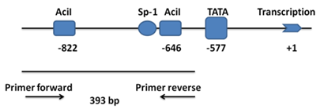
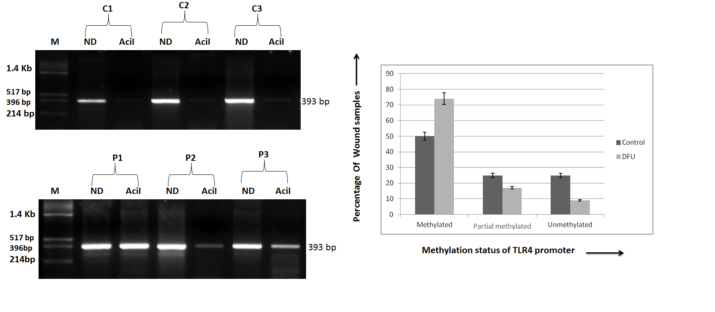
Methylation analysis of the TLR4 gene promoter
AciI (C^CGC)
74 % of DFU cases contained methylated CpG at –822 and –646 positions near a TATA box located close to the Sp-1 sites in the promoter of TLR4 compared to non diabetic control wounds containing only 50% methylated CpG.
Singh et al., J Diabetes & Metabolism, 2013

Slide 16
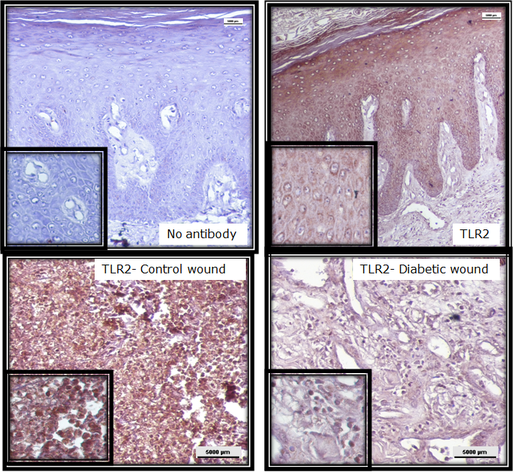
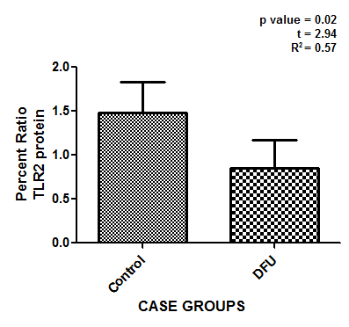

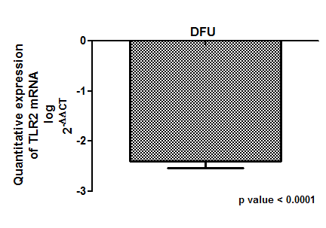
Status of TLR2 in diabetic and control wounds
Immunohistochemistry and Western blot using anti TLR2 antibody
RT-PCR using primer specific to TLR2
p value = 0.02
C = Control; P = DFU
***
p value = < 0.0001
Fold change = 250
TLR2 was significantly down regulated in diabetic wounds compared to control wounds
Singh et al., J Diabetes & Complications, 2014

Slide 17
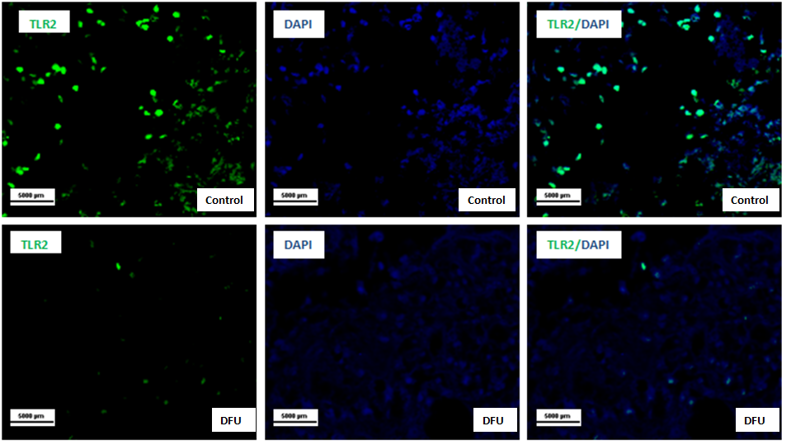
Status of TLR2 in diabetic and control wounds
Immunofluorescence using anti TLR2 antibody to validate the results
TLR2 was down regulated in diabetic wounds compared to control wounds
Singh et al., J Diabetes & Complications, 2014

Slide 18
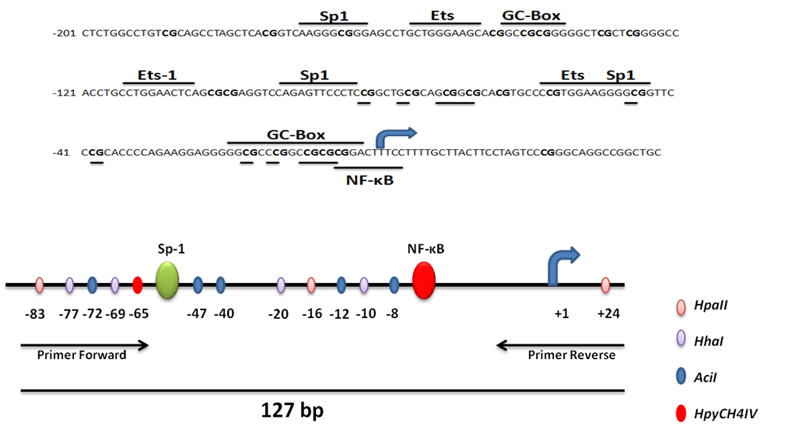
Methylation status of TLR2 promoter in DFU cases
Specific methylation-sensitive restriction enzyme application followed by PCR
HpaII (C^CGG), HhaI (GCG^C), AciI (C^CGC) and HPyCH4IV (A^CGT)
Representative diagram of the promoter of human TLR2 gene with the potential sites for binding of transcription factors and CpG involved in methylation
Singh et al., J Diabetes & Complications, 2014

Slide 19
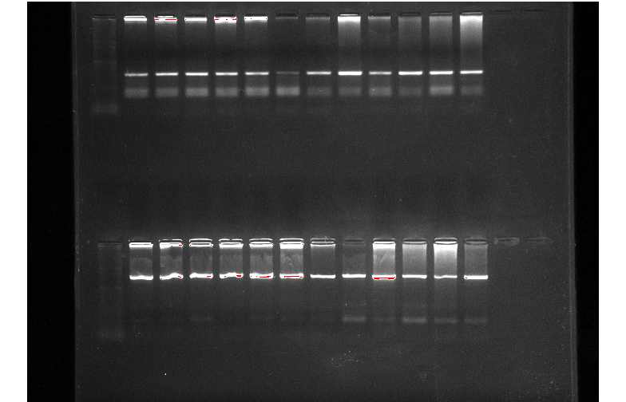
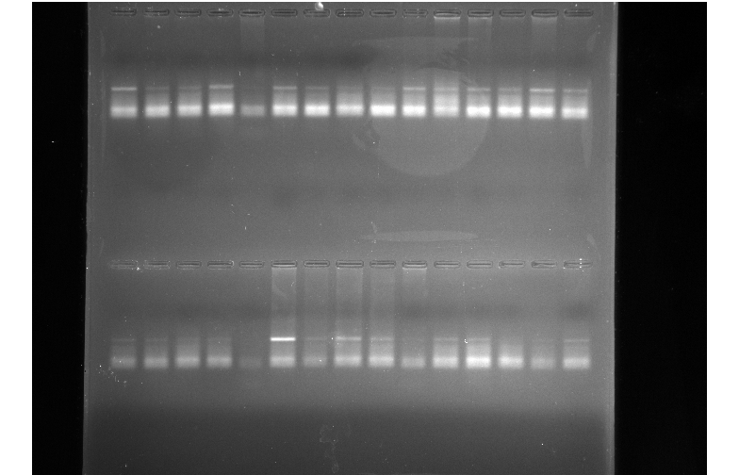
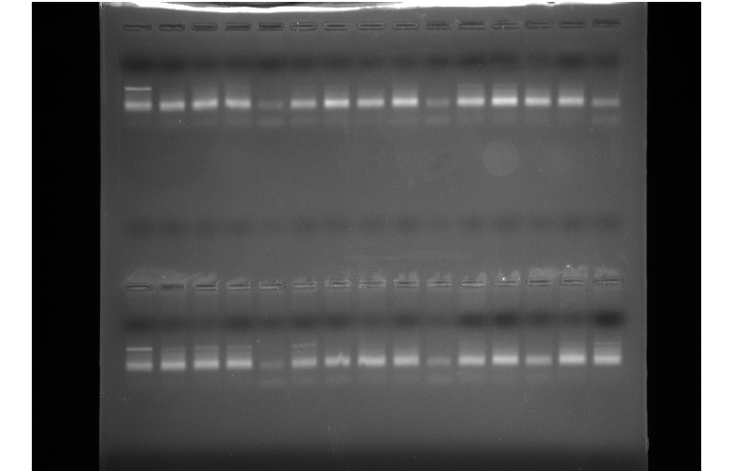
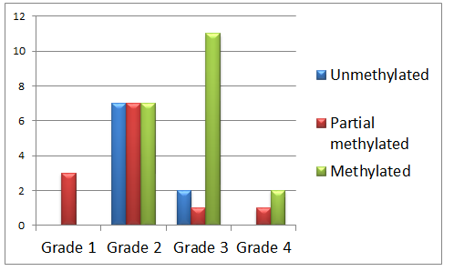
Methylation status of TLR2 promoter in DFU cases
Specific methylation-sensitive restriction enzyme application followed by PCR
ND AciI HhaI HpaII HpyChIV
Methylated
Partial methylated
Unmethylated
Representative agarose gel picture showing Methylated, Partialmethylated and Unmethylated TLR2 promoter based on the intensity of the bands
Number of DFU cases
Wound grades on Wagner’s Scale
Methylation status of TLR2 gene promoter was not significantly different among different grades of wounds in T2DM subjects.
Singh et al., J Diabetes & Complications, 2014

Slide 20
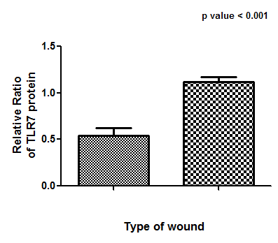
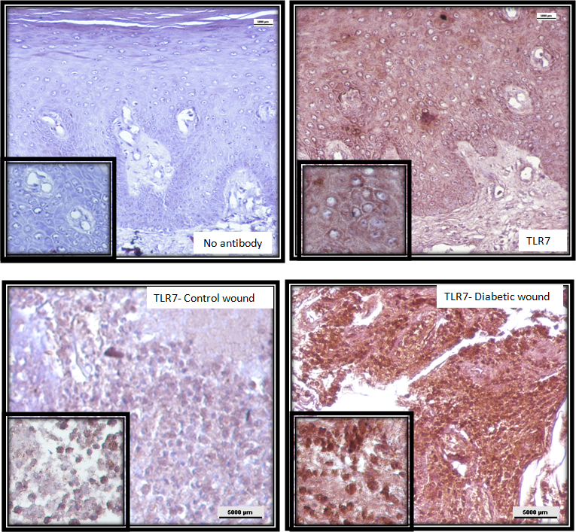

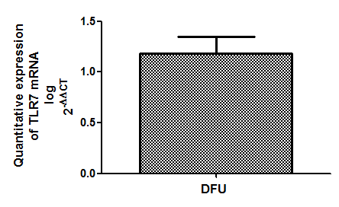
Status of TLR7 in diabetic and control wounds
Immunohistochemistry and Western blot using anti TLR7 antibody
RT-PCR using primer specific to TLR7
Control DFU
TLR7 (110kDa)
GAPDH (36 kDa)
p value = 0.01
Fold change = 15
TLR7 was significantly up regulated in diabetic wounds compared to control wounds
Singh et al., Int. Wound Journal, 2015

Slide 21
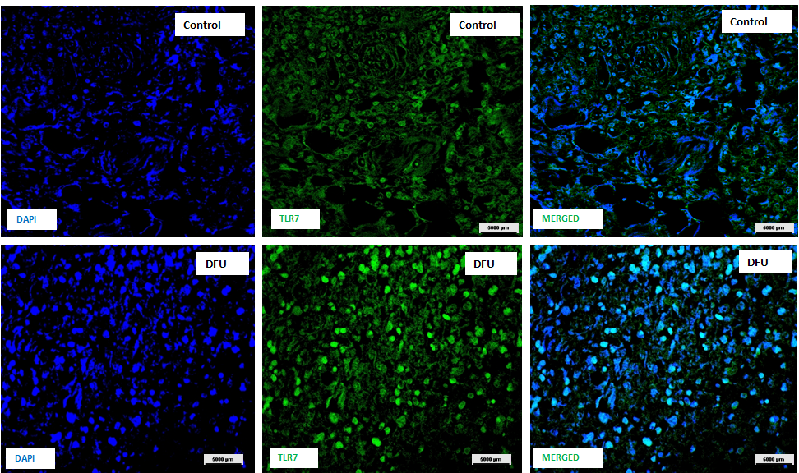
Status of TLR7 in diabetic and control wounds
Immunofluorescence using anti TLR7 antibody to validate the results
TLR7 was up regulated in diabetic wounds compared to control wounds
Singh et al., Int. Wound Journal, 2015

Slide 22
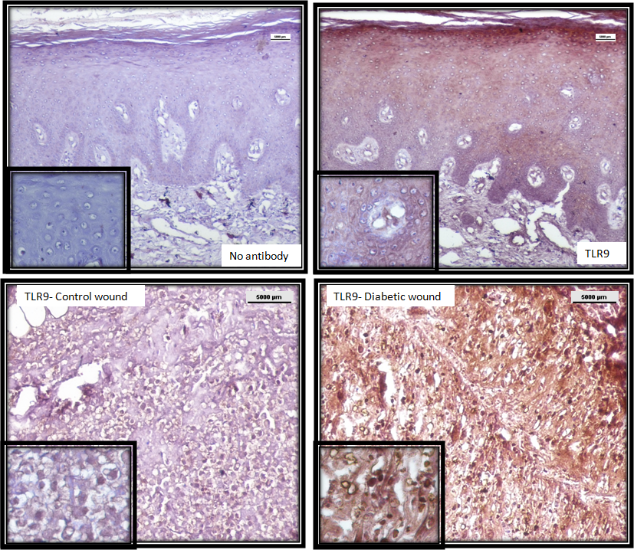
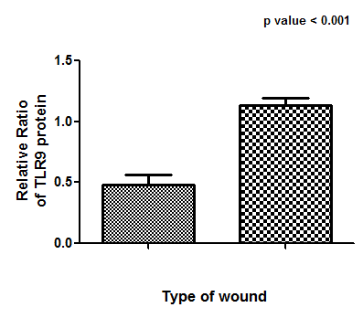
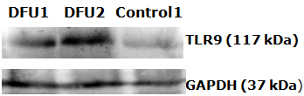
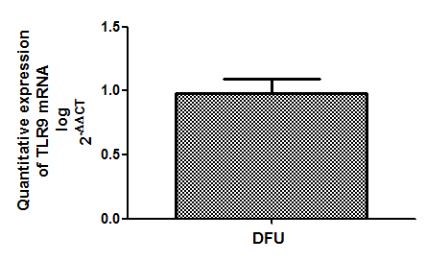
Status of TLR9 in diabetic and control wounds
Immunohistochemistry and Western blot using anti TLR9 antibody
RT-PCR using primer specific to TLR9
Control DFU
TLR9 (117kDa)
GAPDH (36 kDa)
p value = 0.03
Fold change = 9
TLR9 was significantly up regulated in diabetic wounds compared to control wounds
Singh et al., Int. Wound Journal, 2015

Slide 23
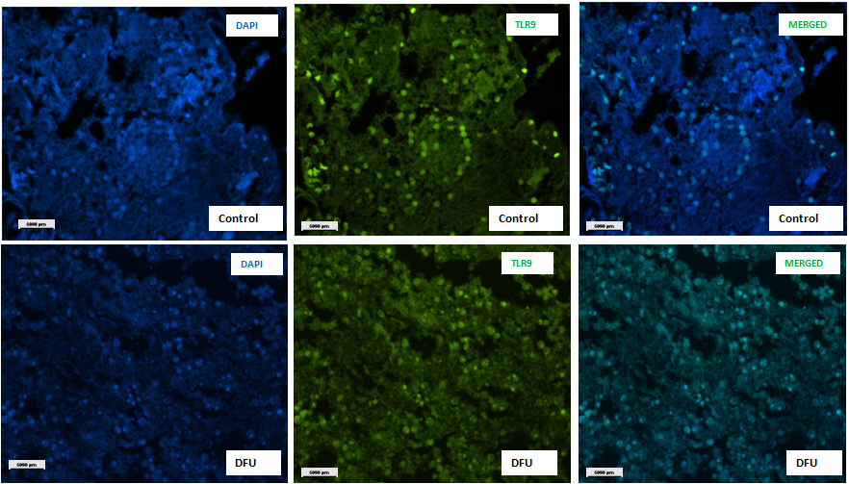
Status of TLR9 in diabetic and control wounds
Immunofluorescence using anti TLR9 antibody
TLR9 was up regulated in diabetic wounds compared to control wounds
Singh et al., Int. Wound Journal, 2015

Slide 24
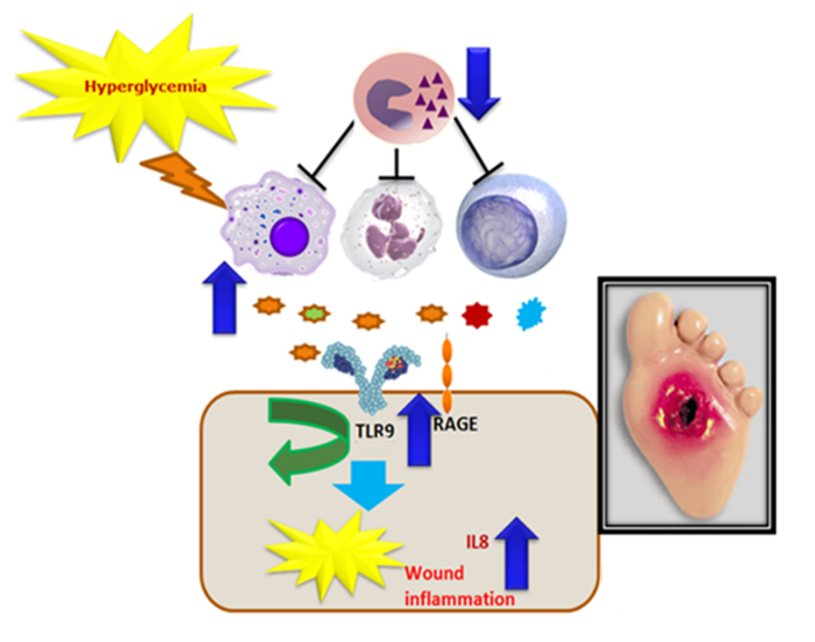
Potential mediators of endosomal TLR signalling in wound healing
Hyperglycemia
and/or CpG DNA
TLR9
Macrophage
Neutrophil
DC
MO-MDSC
PMN-MDSC
Myeloid cells in DFU microenvironment
S100A8
IL-8
Persistent wound inflammation
Diabetic foot ulcer

Slide 25

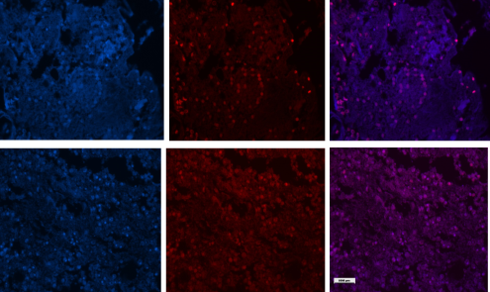
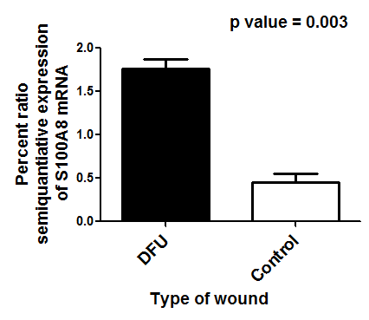




Status of S100A8 in diabetic and control wounds
A
F
C4 C3 C2 C1 M P1 P2 P3 P4 P5
DAPI
S100A8
Merged
S100A8 (93 bp)
GAPDH (113 bp)
B
C
Non-diabetic
control
2
p=0.003
2
S100A8 / GAPDH mRNA
Average ± SEM log (fold change)
1
1
DFU
0
0
Non-diabetic
control
DFU
S100A8
D
E
DAPI
TLR9
p=0.03
C1 C2 P1 P2 P3
1
S100A8 / GAPDH protein
S100A8 (10 kDa)
GAPDH (37 kDa)
0
Non-diabetic
control
DFU
S100A8
Merged
G
S100A8 was up regulated in diabetic wounds compared to control wounds

Slide 26



Status of IL8 in diabetic and control wounds
Reverse Transcription Polymerase Chain Reaction using primers specific for IL8
C5 C4 C3 C2 C1 Marker P1 P2 P3 P4 P5 P6 P7
IL8 (151 bp)
GAPDH (113 bp)
C = Control; P = DFU
Fold change = 40
Log (relative average fold change)
IL8 was up regulated in diabetic wounds compared to control wounds

Slide 27


S100A8, IL8 expression in PBMCs
Reverse Transcription Polymerase Chain Reaction using primers specific for S100A8, IL8
NS
NS
*
NS
*
*
S100A8 and IL8 were up regulated in diabetic wounds compared to control wounds

Slide 28





Wound Grade dependency of the studied genes
The levels of TLR2, 4, 7, 9, S100A8 and IL8 were compared between grades using ANOVA
Levels of the studied genes showed a increasing trend along with the wound severity

Slide 29


Levels of anti inflammatory MDSCs in diabetic and control individuals
Determination of cd11b/cd33 double positive MDSCs through flow cytometry
CD11b/ CD33
17.2
10.4
11.8
Anti inflammatory cells were significantly reduced in diabetic individuals

Slide 30

MDSCs levels DFU patients with and without infected wounds
Comparing levels of MDSCs in blood of sterile and infected patients
Number of cases
Infected = 5
Non infected = 5
9.2
16.8
MDSCs levels shoot up significantly upon wound infection

Slide 31






Summary
Hyperglycemia
TLR2
TLR4
Growth factors
TLR7
IL8
Impaired inflammatory phase

Slide 32



THANK
YOU

