Slide 1

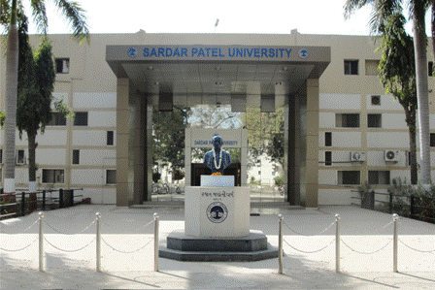
Sardar Patel University

Slide 2

Efficacy of Urinary N-Acetyl β- D- Glucosaminidase in Detecting Renal Tubular Damage: A Early Consequence in Type 2 Diabetes Mellitus leading to Diabetic Nephropathy
Kiran Kalia & Dhara Patel
B R D School of Biosciences, Saradar Patel University,
Vallabh Vidyanagar – 388 120
Gujarat, India
kirankalia@gmail.com

Slide 3
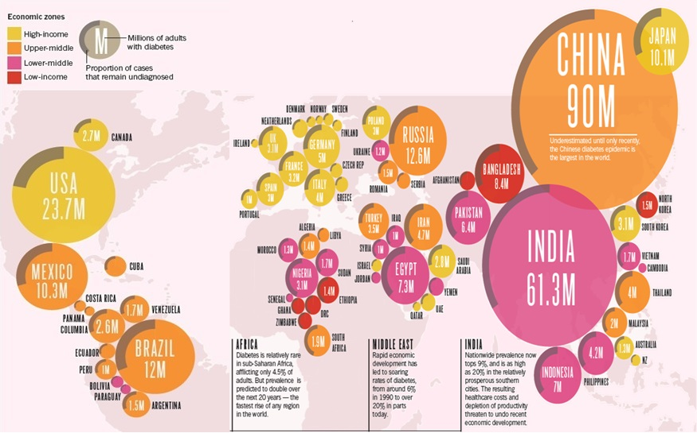
Global Epidemic of Diabetes
Tony Scully, Diabetes in Numbers. 2012; Nature, 485: S2-S3

Slide 4
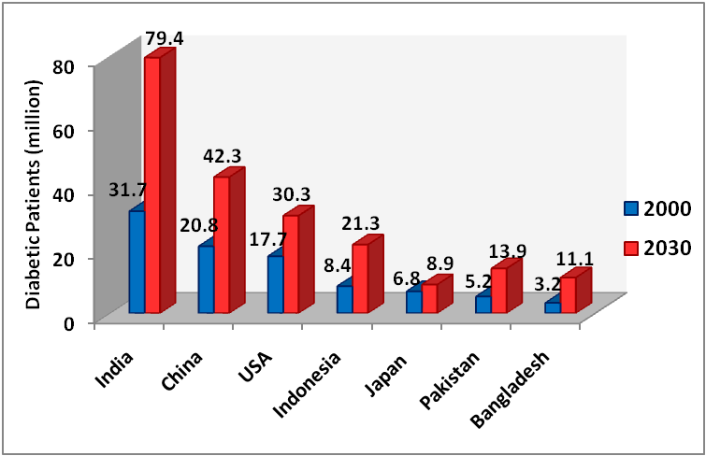
Introduction
Worldwide, 350 million people are suffering from diabetes and the number is expected to reach 366 million by 2030.
Country | % Increase (2000 to 2030)
World | 110.5
India | 150.5
China | 103.3
USA | 71.2
Indonesia | 153
Japan | 30.9
Pakistan | 167.3
Bangladesh | 246.8
India has fifth portion of the diabetic population of world.
Data obtained from references quoted in AMJ 2014, 7, 1, 45-48

Slide 5
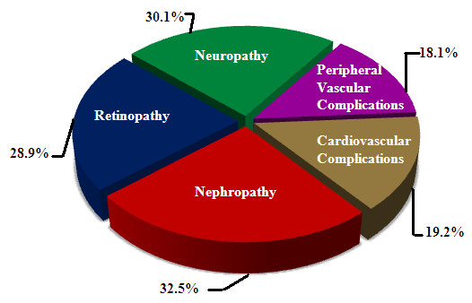
Major Secondary Complications of Diabetes

Slide 6
Factors Leading to Diabetic Nephropathy & its Progression
Non manageable Manageable on Therapeutic Unknown Complex
Factors Interventions relations
Blood Pressure
Unknown
Tubulosclerosis
Genes
Lipid peroxidation
Hyperglycemia
AGEs
Proteinuria
Unknown
Duration of DM
GAGs Deterioration
Blood Pressure
Podocytouria
Unknown
Glomerulosclerosis
Metabolic factors
Progression of Diabetic nephropathy

Slide 7
Diabetic Nephropathy
Diabetic nephropathy (DN) is a major secondary microvascular complication leading to ESRD (end-stage renal disease) and finally to mortality.
It is characterized by persistent microalbuminuria >30mg/g creatinine.
Hyperglycemia induce following mechanisms which play a crucial role in development and progression of DN:
Increased Polyol pathway flux
Increased Advanced Glycation End-products (AGE) formation
Activation of various isoforms of protein kinase C (PKC)
Increased oxidative stress

Slide 8
Mechanism of Diabetic Nephropathy
Exposure of renal cells to prolonged hyperglycemia leads to structural and functional alterations
Initial structural changes are noticed in proximal tubular cells which are reversible
Proteins involved in tubular basement membrane repair are excreted
Alterations in Glomeruli are noticed in later stages
Microalbumin starts excreting in urine
Further hypertension, AGE, lipid peroxidation and PKC isoforms extravagate complication to irreversible stage
Ultimately leading to Diabetic Nephropathy

Slide 9
Significance of Urinary Enzymes in Early Detection of Diabetic Nephropathy (DN)
Due to renal cell insult, physiological activity of certain tubular enzymes increases significantly
Measurement of such enzymes has been proven useful as non-invasive biomarker for evaluating onset of DN
N-acetyl β-D-glucosaminidase is one of the example and other enzymes are γ-Glutamyl Transpeptidase and α-Aminotranspeptidase

Slide 10
N-Acetyl β- D- Glucosaminidase (NAG)
NAG (EC: 3.2.1.30) is a hydrolytic lysosomal tubular enzyme with low physiological activity
It is distributed along the nephrons with highest activity in proximal tubules
Due to its high molecular weight (150 Kda) it cannot pass through glomerular filtration
It is involved in basement membrane repair
It degrades intracellular macromolecules rich in carbohydrate

Slide 11
Mechanism of NAG Excretion in Urine
Glucose is reabsorbed at proximal tubules (PT) only
Long standing hyperglycemia leads to oxidative insult to basement membrane of proximal tubule
NAG - increased physiological activity & extensive participation in PT basement membrane repair
Direct excretion in urine due to its high molecular weight and inability to cross glomerular barrier
Measurement of Urinary NAG will serve as non-invasive test to detect diabetic nephropathy in earliest stage

Slide 12
Objectives
To validate urinary N-acetyl β D- glucosaminidase (NAG) excretion as site specific early diagnostic biomarker
To measure the diagnostic accuracy of cutoff value of urinary NAG inT2DM patients with susceptibility to develop diabetic nephropathy

Slide 13
Sample Collection
The study was ethically approved by the Ethics Committee of the Muljibhai Patel Urological Hospital, Nadiad, Gujarat, India.
Total 491 patients attending the OPD of hospital from December 2009 to September 2013 were divided in eight groups as follow:
1.) Healthy controls (N=76) | 2.) Normoalbuminuria with T2DM duration of 0-5 Yrs (N=81)
3.) Normoalbuminuria with T2DM duration of 5-10 Yrs (N=38) | 4.) Normoalbuminuria with T2DM duration of 10-15 Yrs (N=45)
5.) Normoalbuminuria with T2DM duration of 15-20 Yrs (N=30) | 6.) T2DM with Microalbuminuria (N=71)
7.) T2DM with Diabetic Nephropathy (DN) (N=100) | 8.) Non Diabetic Nephropathy (N=50)

Slide 14
Sample Collection
Informed consent and detailed history were obtained from the
subjects.
Serum (from plain vaccutainers) was separated from whole blood at 4ºC at 3000 rpm
Fresh urine samples no more than delay of 4 hrs were used for enzyme assay and
Aliquots of urine samples (with 0.05% sodium azide as preservative to avoid bacterial growth) were stored at -20ºC for further analysis.

Slide 15
Anthropometric Data
Anthropometric Data |  | Control | Type 2 Diabetes (T2DM) with Normoalbuminuria |  |  |  | Type 2 Diabetes with Micro albuminuria | Diabetic Nephropathy | Non Diabetic Nephropathy
 |  |  | 0-5 Yrs | 5-10 Yrs | 10-15 Yrs | 15-20 Yrs
Number of Patients |  | 76 | 81 | 38 | 45 | 30 | 71 | 100 | 50
Age |  | 58.42+1.2 | 56.94+ 1.3 | 59.13+1.8 | 56.84+1.8 | 57.60+1.8 | 57.96+1.1 | 57.49 + 1.1 | 60.02 + 1.4
Gender (F/M) |  | 36/40 | 35/46 | 20/18 | 13/32 | 12/18 | 38/33 | 42/58 | 29/21
BMI (Kg/m²) |  | 21.29+0.3 | 27.83+0.5 a ^{NS} | 26.52+0.7 a ^{NS} b ^{NS} | 25.77+0.5 a ^{NS} b ^{NS} c ^{NS} | 26.31+0.9 a ^{NS} b ^{NS} c ^{NS} d ^{NS} | 24.92+0.5 a ^{NS} b ^{NS} c ^{NS}d ^{NS}e ^{NS} | 24.91 + 0.3 a ^{NS}b ^{NS} c ^{NS}d ^{NS}e ^{NS} f ^{NS} | 23.62 + 0.8 a ^{NS} a ^{NS}b ^{NS} c ^{NS}d ^{NS}e ^{Ns} f ^{NS}g^{NS}
Therapeutic Modules in Percentage of Studied Patients | Oral Hypo glycemic agents (%) | Nil | 19.2 | 14.38 | 12.21 | 19.59 | 22.5 | 29.1 | Nil
 | Insulin + Oral Hypo glycemic agents (%) | Nil | 62.34 | 68.29 | 66.57 | 49.61 | 41.9 | 32.4 | Nil
 | Insulin (%) | Nil | 18.46 | 17.33 | 21.22 | 30.8 | 35.6 | 38.5 | Nil
The results are expressed as Mean+SE and p<0.05 is considered significant
a-Compared with control b- Compared with 0-5 yrs T2DM c- Compared with 5-10 yrs T2DM
d- Compared with 10-15 yrs T2DM e- Compared with 15-20 yrs T2DM f- Compared with Microalbuminuria
g-Compared with Diabetic Nephropathy NS-Non Significant

Slide 16
Biochemical Parameters

Slide 17
Renal Function Assessment Parameters

Slide 18
Urinary/Serum NAG Assessment

Slide 19
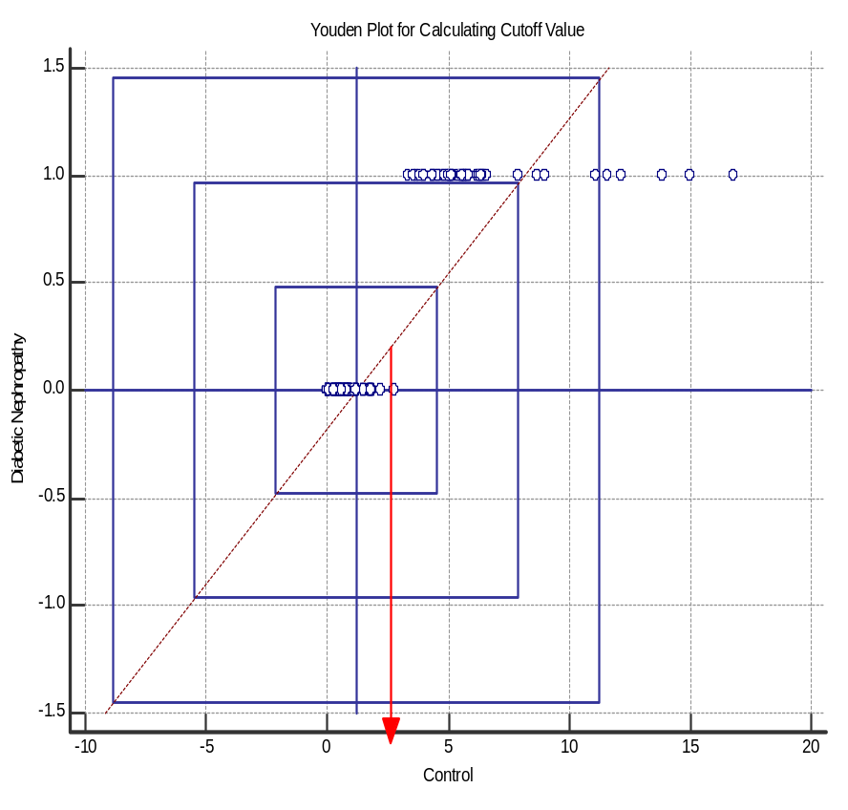
Urinary N-Acetyl β-D-Glucosaminidase Activity in Control and Test Groups
Youden Plot for Calculating Cutoff Value of
Urinary N-Acetyl β-D-Glucosaminidase Activity for Discriminating Various Groups of Patients
a b c
d e f
a b c
d e
a b c d
a b c
a b c d e f g
a- Compared with control
b- Compared with 0-5 yrs Type 2 Diabetes Mellitus
c- Compared with 5-10 yrs Type 2 Diabetes Mellitus
d- Compared with 10-15 yrs Type 2 Diabetes Mellitus
e- Compared with 15-20 yrs Type 2 Diabetes Mellitus
f- Compared with Microalbuminuria
g-Compared with Diabetic Nephropathy
Significance at p<0.0001
Cutoff Value was calculated 3 U/L was calculated with ROC curve analysis and Mean±3SD was plotted on Youden Graph for discriminating patients having diabetic nephropathy and control group

Slide 20
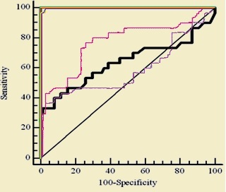
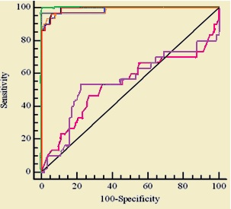
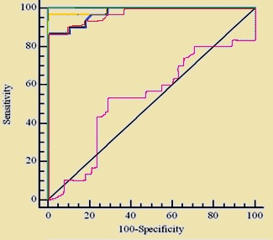
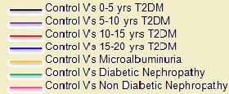
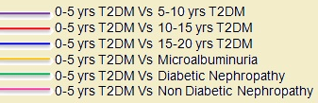

ROC Curve Analysis to Determine Cutoff Value, Specificity and Sensitivity of
Urinary N-Acetyl β-D-Glucosaminidase Activity in Different Study Groups
[A] Control Vs
Other Study Groups
[B] 0-5 yrs T2DM Vs
Other Study Groups
[C] 5-10 yrs T2DM Vs
Other Study Groups
ROC curves of urinary NAG for assessment of diabetic nephropathy. With 3 U/L cutoff value control group discriminated T2DM patients with 10-15 yrs, 15-20 yrs, microalbuminuria and diabetic nephropathy with a likelihood ratio of 25.6, 96.1 %specificity and 100% sensitivity. The AUC were 1.000,0.999, 0.999 and 1.000 respectively.

Slide 21
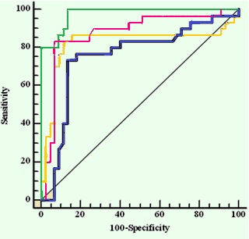
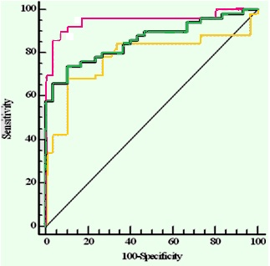
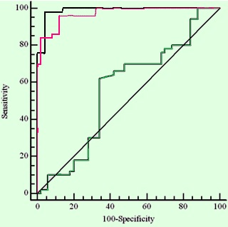



ROC Curve Analysis to Determine Cutoff Value, Specificity and Sensitivity
of Urinary N-Acetyl β-D-Glucosaminidase Activity in Different Study Groups
[D] 10-15 yrs T2DM Vs
Other Study Groups
[E] 15-20 yrs T2DM Vs
Other Study Groups
[F] Microalbuminuria Vs
Diabetic Nephropathy &
Non Diabetic Nephropathy
ROC curves of urinary NAG for assessment of diabetic nephropathy. With 3 U/L cutoff value control group discriminated T2DM patients with 10-15 yrs, 15-20 yrs, microalbuminuria and diabetic nephropathy with a likelihood ratio of 25.6, 96.1 %specificity and 100% sensitivity. The AUC were 1.000,0.999, 0.999 and 1.000 respectively.

Slide 22
Multiple Regression Analysis of Urinary Urinary N-Acetyl β-D-Glucosaminidase ( NAG) as Dependent Variable Against Independent Variables
Independent Variable | Regression Coefficient | Standard Error | p Value
Duration of Diabetes | 0.843 | 0.03 | <0.0001
Urinary Microalbumin | 0.742 | 0.001 | <0.0001
Age | 0.006 | 0.012 | NS
Fasting Blood Glucose | 0.291 | 0.003 | NS
Serum Creatinine | 0.335 | 0.08 | NS
eGFR | 0.016 | 0.004 | NS
Urinary NAG excretion is dependent on independent variables like duration of diabetes and degree of renal damage (microalbuminuria)
p<0.05 is considered significant

Slide 23
Conclusion
From our data it can be suggested that increased excretion of
urinary NAG indicates the site specific early tubular damage due
to long standing hyperglycemia
Urinary cutoff value of 3 U/L in T2DM patients can be predictive
of early stages of diabetic nephropathy

Slide 24
Acknowledgements
Dr. Shishir Gang, HOD, Nephrology Department, Muljibhai Patel Urological Hospital, Nadiad.
Dr. Kalpesh Gohel, Nephrologist, Muljibhai Patel Urological Hospital, Nadiad.
All the patients and healthy individuals participated in the study.
University Grant Commission, New Delhi for meritorious fellowship provided to student.

Slide 25
References
Abhijeet S, Kaveeshwar, The current state of diabetes mellitus in India Cornwall J . AMJ, 2014: 7, 1, 45-48
Scully T, Diabetes in Numbers. Nature, 2012: 485, S2-S3
Dronavalli S, Duka I, Bakris G L. The pathogenesis of diabetic nephropathy. Nat. Clin Pract Endorinol Metab., 2008; 4: 444-452.
Hong C Y, Chia K S. Markers of diabetic nephropathy. J Diab Comp., 1998; 12: 43-60.
Magri C J, Fava S. The role of tubular injury in diabetic nephropathy. Eur J Int Med., 2009; 20: 551-555.
Moriya T, Tanaka K, Moriya R. Glomerular structural changes and structural functional relationships at early stage of diabetic nephropathy in Japanese type 2 diabetic patients. Med Electron Microsc., 2000; 33(3): 115-122.
Myjak B L. Serum and urinary biomarkers of acute kidney injury. Blood Purif., 2010; 29: 357-365.
Jerums G, Premarante E, Panagiotopoulos S,Clarke S, Power D A, MacIssac R J. New and old markers of progression of diabetic nephropathy. Diabetes Res Clin Pract., 2008; 82 (Suppl 1): S30-S37.
Yaqoob M, Mc Clelland P, Patrick A W, Stevenson A, Mason H, Bell G M. Tubular damage in microalbuminuric patients with primary glomerulonephritis and diabetic nephropathy. Ren Fail., 1995; 17: 43–49.
Mogensen C E, Christensen CK. Predicting diabetic nephropathy in insulin dependent patients. N Engl J Med., 1984; 311: 89–93.
Nauta F L, Boertien W E., Bakker S J L, Goor H V, Oeveren W V, Jong P E, Bilo H, Gansevoort R T. Glomerular and tubular damage markers are elevated in patients with diabetes. Diabetes Care, 2011; 34: 975-981.
Turecky L, Uhlikova E. Diagnostic significance of urinary enzymes in nephrology. Bratisl Lek Listy., 2003; 104 (1): 27-31.
Lary S A. Urinary NAG, AAP and Microalbuminuria as indicators of hypertensive disease. JKAU:Sci., 2008; 20 (1), 123-144.
Mocan Z, Erem C, Yildirim M, Telatar M, Deger O. Urinary beta 2-microglobulin levels and urinary N-acetyl B-D-glucosaminidaseenzyme activities in early diagnosis of non insulin dependent diabetes mellitus nephropathy. Diabetes Res., 1994; 26:101-107.
Moresco R N, Sangoi M B, De Carvalho J A M, Tatsch E, Bochi G V. Diabetic nephropathy: traditional to proteomic markers. Clin Chim Acta., 2013; 421: 17-30.
Kroll M H, Chesler R, Hagengruber C, Blank D W, Kestner J, Rawe M. Automated determination of urinary creatinine without sample dilution: Theory and Practice. Clin Chem., 1986; 32 (3): 446-452.
Cockroft D W, Gault M H. Prediction of creatinine clearance from serum creatinine. Nephron., 1976; 16: 31-41.
Parker K M, England J D, Da Costa J, Hess R L, Gloldstein D E. Improved colorimetric assay for glycated hemoglobin. Clin Chem., 1981; 27 (5): 669-672.
Horak E, Hopfer S M, Sunderman, Jr. W F. Spectrophotometric assay for urinary n-acetyl-b-d-glucosaminidase. Clin. Chem., 1981; 27(7): 1180-1185.
Lehmann R and Schleicher E D. Molecular mechanism of diabetic nephropathy Clin Chim Acta, 2000; 297: 135–144.

Slide 26


Slide 27
Prevention is Always Better Than Cure

