Slide 1
Engaging Patients with your Website
Kimberlee Snyder, PhD; Lynne Ornes, PhD; Patrick Paulson, J.D.
Presented at
Healthcare & Fitness Summit
July 20-22, 2015
San Francisco, Calf.

Slide 2
Internet and Healthcare Information
PewResearchCenter, June 20, 2013, http://pewinternet.org
Family Caregivers are Wired for Health

Slide 3
Website Assessment Model
LEVEL 1: Informing Website
LEVEL 2: Advanced Informing Website
All functions of the previous levels plus:
LEVEL 3: Collaborative Website
LEVEL 4: Empowered/Engaged Website
1-way communication: “Brochure-Style” information
2-way communication:
Incorporates functions in two prior levels plus:
Includes functions in prior level plus:
Working directly with groups for feedback & information sharing
Limited online services
Increased online services available
More opportunities to manage patient’s own health information and feedback to health team
Fully developed mobile connection
Interactive and real-time knowledge exchange

Slide 4

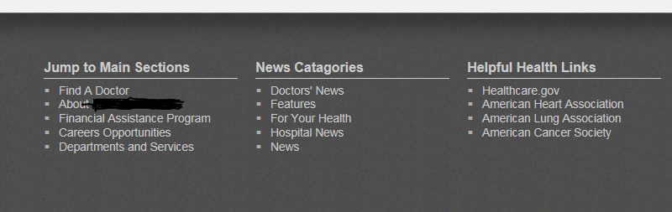
Level 1: Informing Website
One-way flow of information
  What the hospital can do for the customer
  Stresses key departments or areas
  Address maybe at bottom of page
  “Contact us” optional
  No online services available

Slide 5
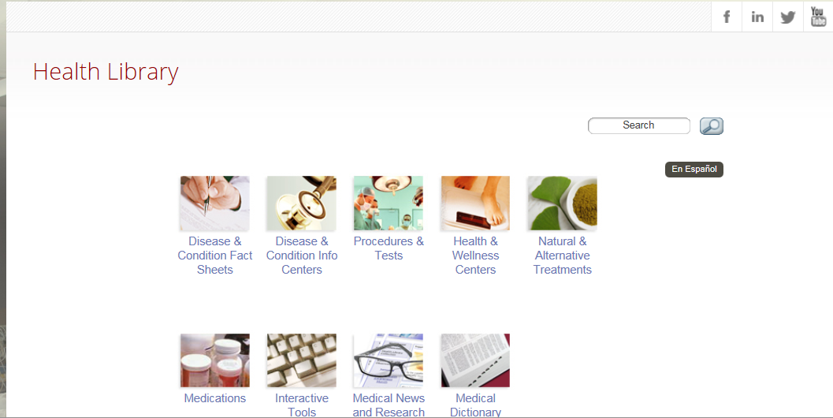
Level 2: Advance Informing Website
Links to Social Media
Includes all of Level 1
  Hospital events
  Hospital news
Interactive Health Library
Online paying

Slide 6
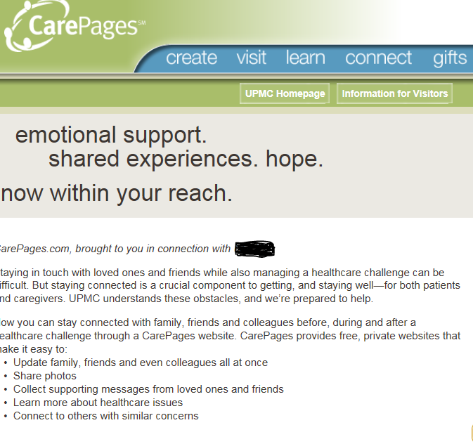
Level 3: Collaborative Website
Includes all of level 1 and 2 and
  On-line appointment scheduling
  Prescription renew online
  Call center
  Able to request medical tests on-line
  Email doctor
  Patient health blog and/or journal (third party)
  More……

Slide 7
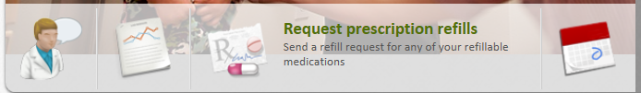

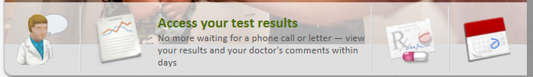
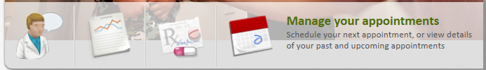
Level 4: Empowered/Engaged Website
Includes level 1, 2, and 3 and
  Doctor referral request on-line
  Patient portal thru website
  Close captioning

Slide 8
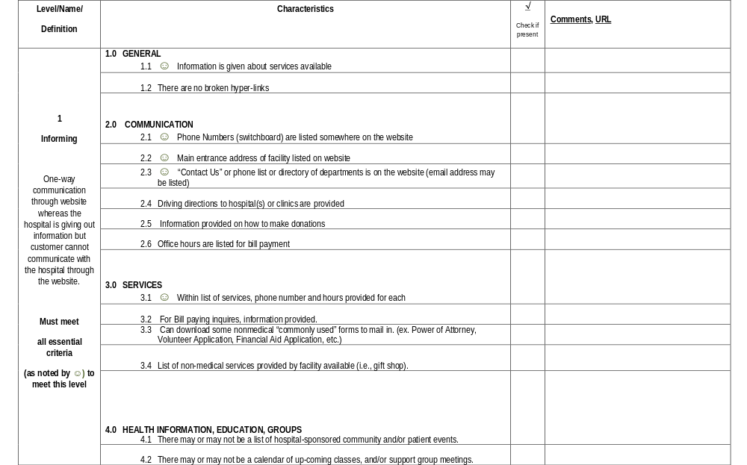
Assessment
tool

Slide 9
Conclusion
Start evaluating your website, create an assessment team --
  Include customers (community)
  Include technical people
  Include medical
  Include young and old
Assess periodically not just one time
Take some steps for improvement (improve at existing level then one or two items for next level)
This is a journey not a destination.

