Slide 1
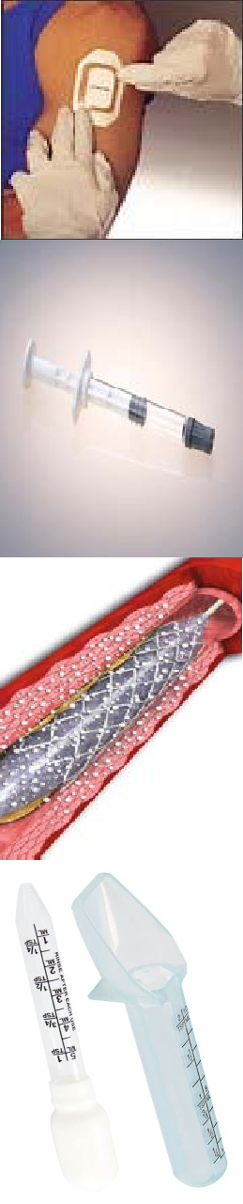

Combination products The paradigm shift
(US / Japan / EU / Australia)
Global impact
Khaudeja Bano MD 5th Global Pharmacovigilance Summit Medical devices Pharmacovigilance
April 28-29, 2016 Dubai, UAE

Slide 2
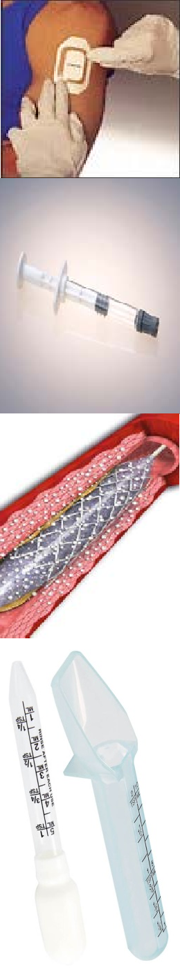
Combination Products
Two or more Components; Two Quality Systems;
Two or more Databases;
One or more Postmarketing Safety Report(s)
What Is An Organization To Do?

Slide 3
Agenda
Combination Product Regulations – FDA / Japan
Expectations /Interpretation(s) and Challenges
Quality and Regulatory Strategy
The Right Culture
Best Practices

Slide 4
Industry cares
Safety (Patient and User)
Benefit vs. Risk - Efficacy (drugs)/Effectiveness (devices)
  Patients
  Clinicians
  Pharmacists
  Regulators
  Payors
  Other users

Slide 5
Regulations - FDA
The cGMP Final Rule for combination product addresses how to comply with CGMP requirements for co-packaged and single-entity combination products.
It recognizes the multiple quality systems and addresses how to maintain them for combination products
[21 CFR 4.4(b)(1) and (b)(2)].
Rule was effective 22 July 2013

Slide 6



(Device) QS
Combination product compliance
(Drug) cGMP
(Drug) cGMP +
Sec. 820.20. Management responsibility.
Sec. 820.30. Design controls.
Sec. 820.50. Purchasing controls.
Sec. 820.100. Corrective and preventive action.
Sec. 820.170. Installation.
Sec. 820.200. Servicing
(Device) QS +
Sec. 211.84. Testing and approval or rejection components, drug product containers, closures
Sec. 211.103. Calculation of yield.
Sec. 211.132. Tamper-evident packaging requirements for (OTC) drug products
Sec. 211.137. Expiration dating.
Sec. 211.165. Testing and release for distribution.
Sec. 211.166. Stability testing.
Sec. 211.167. Special testing requirements.
Sec. 211.170. Reserve samples.

Slide 7
History - FDA
1970s - first sign of combination products
November 2002 public hearing
December 2002, Office of Combination Products created.
July 2003 public workshop held
2005 - OCP Concept paper published
2009 - OCP proposed rule post-marketing safety reporting requirements
•
2013 - a working group chaired by OCP to prepare a final rule and associated guidance.

Slide 8
Types of combination products
A combination product as defined in 21 CFR § 3.2(e), as a product comprised of any combination of a drug and a device; a biological product and a device; a drug and a biological product; or a drug, device, and a biological product.
(1) Single entity combination product
(2) Co-packaged / Kits
(3) Cross-Labeled Products
(4) Cross-Labeled Investigational Products

Slide 9










Paradigm shift => Combination
Tissue
Pharma Products
Devices
Clinical Studies / Pre-market
Software & Apps
Biologics
Biosimilar
Generics
Combination Products

Slide 10
What is expected
Combine applicable rules for the constituent parts (CP)
Follows a single set of adverse event reporting rules
– marketing application under which the product was cleared / approved
Apply sections of other CP rules (missing / different)
Reports submitted to the lead Center
Field alert reports submitted to field offices

Slide 11



Similarities
Death
SAE
Periodic / Follow-up Reports
Safety Signal and
Expedited reporting
Risk Based
Drugs
21 CFR parts
(310 & 314)
Biologics
21 CFR parts
(600 & 606)
Devices
21 CFR part
(803)

Slide 12



Differences
Malfunctions
Timelines
Caused or Contributed
Codes
Investigation
User requirements
Design controls
Devices lifecycle management
Drugs
21 CFR parts
(310 & 314)
Biologics
21 CFR parts
(600 & 606)
Devices
21 CFR part
(803)

Slide 13
Reporting Timelines Differences
3-Day field alert report for drugs
5-Day report for devices (“remedial action”)
7-Day expedited blood fatality report
15-Day “alert report” for drugs and biological product
30-Day device malfunction report

Slide 14
Challenges
Reportability criteria for drug and device
Determining which constituent part is associated with the adverse event
Possible relationship (temporal, causal, none)
Follow-up information
Coding
Multiple manufacturers / Multiple applications
Inspections

Slide 15
Challenges
Technology
  Infrastructure
  Gateway
Component versus Constituent part
Cross-labeled versus concomitant
Global aspects
Legacy data & new regulation?
Clinical trials

Slide 16
It takes an entire organization to make combination product happen
Multiple functions – Team work / collaboration
Decision making body & Rapid response team
Communication
Broader Impact assessment of changes
Staff education & development
Culture
Management support & prioritization

Slide 17
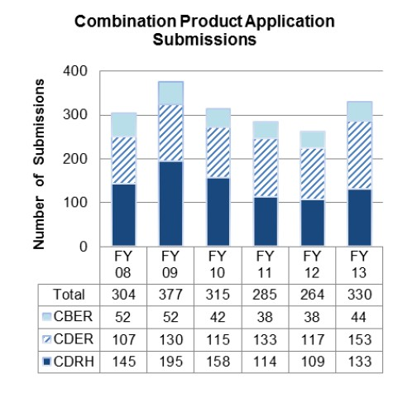
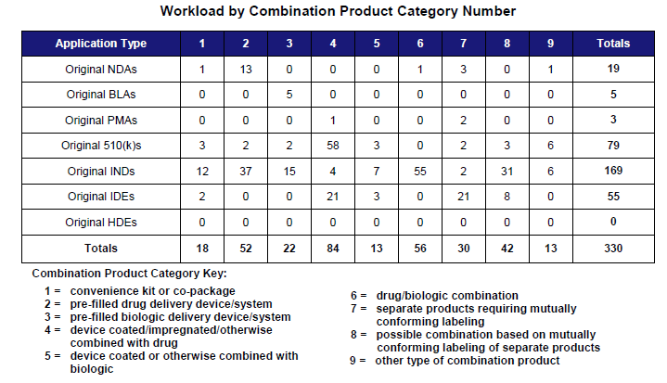
Combination Product Review. FDA received 330 original premarket applications for combination products in FY 2013. This is a 25 percent increase from 264 in FY 2012.
http://www.fda.gov/downloads/AboutFDA/ReportsManualsForms/Reports/PerformanceReports/CombinationProducts/UCM439389.pdf

Slide 18
Best Practices
Product as a whole
Risk-based approach
Categorize by severity
Standardize
Share the burden (component based)
Overlap is good
Build talent / Define processes

Slide 19
“THE PRODUCT”
Whole or as a system
Risk based review, prioritization and reporting
One report with all the relevant information
One integrated set of reporting timelines
Reported to one system
Too much !!! Too little !!!
Perfect balance

Slide 20
Worldwide Impact
Japan
Europe
Other Geographies

Slide 21
Relevant Standards/Regulations
ISO 14971 Application of Risk Management to Medical Devices
21 CFR 4 Subpart B: Proposed Rule Postmarketing Safety Reporting for Combination Products
21 CFR 7.41 Health Hazard Evaluation and Recall Classification
21 CFR 803 Medical Device Reporting
21 CFR 820.30 Design Controls
Medical Device Directive (MDD) 93/42/EEC

Slide 22
Key Definitions
Adverse Event (AE) (Source: ICH E2A)
Any untoward medical occurrence in a patient or clinical investigation subject administered a pharmaceutical product and which does not necessarily have to have a causal relationship with this treatment
Complaint (Source: 21 CFR 820.3)
Any written, electronic, or oral communication that alleges deficiencies related to the identity, quality, durability, reliability, safety, effectiveness, or performance of a device after it is released for distribution

Slide 23
QUESTIONS ????

