Slide 1



MicroRNA—a small non-coding RNA: An efficient biomarker for prostate cancer
Khanmi Kasomva,
Ph.D. Research Scholar,
Biotechnology & Molecular Biology Unit,
ERI, Loyola College
Chennai, Inida.

Slide 2
What we will be discussing about
Prostate Cancer
Detection of prostate cancer at Early
Detection of prostate Cancer
What is MicroRNA? And functions
Potential of microRNA as a biomarker for detecting Prostate Cancer
Summary

Slide 3
Prostate cancer (PCa) is primarily a disease of the elderly -cases occurring in men above 55-74 years of age
prostate cancer is the second most frequently diagnosed cancer in men worldwide and the fifth most common cancer overall.
Leading cause of cancer in men estimated 280,890 new cases of PCa and
26,120 deaths in 2016
prostate cancer is projected to have the largest proportionate increase in cancer cases in men by 2020
Khanmi K et al., 2015, Krishnamoorthy Hariharan et al 2016

Slide 4
The mortality of the prostate cancer is differ from country to country region to region
Due to the different ethnicity, diet and other lifestyle
Some of the countries like Australia, New Zealand, Western and Northern Europe, and North America are highest in prostate cancer
Due to regular prostate‑specific antigen (PSA) screening
Krishnamoorthy Hariharan et al 2016

Slide 5
In India Oral and esophageal cancers have the highest incidence
Rectal, prostate, and lung cancers have the lowest
Increase in life expectancy and changes in lifestyles increase the rates of prostate cancers in India
One of the projected cases of prostate cancer all over India for the periods 2010, 2015, and 2020 were estimated as 26,120, 28,079, and 30,185.
Krishnamoorthy Hariharan et al 2016

Slide 6
Prostate Cancer is elevating in India population but there is no proper registration
Lack of community base study/ good number of population study-India is a mixtures of ethnicity, diet and lifestyle
Specially North-east states of India
Krishnamoorthy Hariharan et al 2016

Slide 7
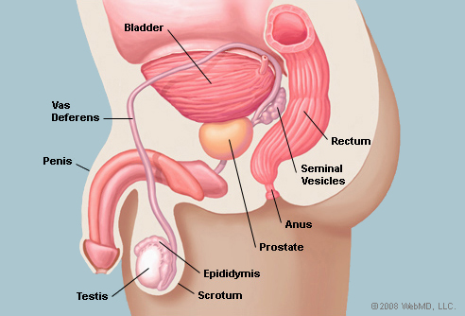
Prostate Anatomy
http://tvmouse.ucdavis.edu/prostate/

Slide 8
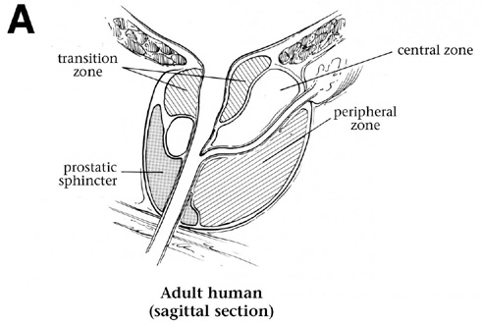

Slide 9
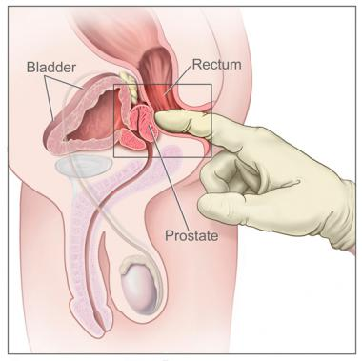
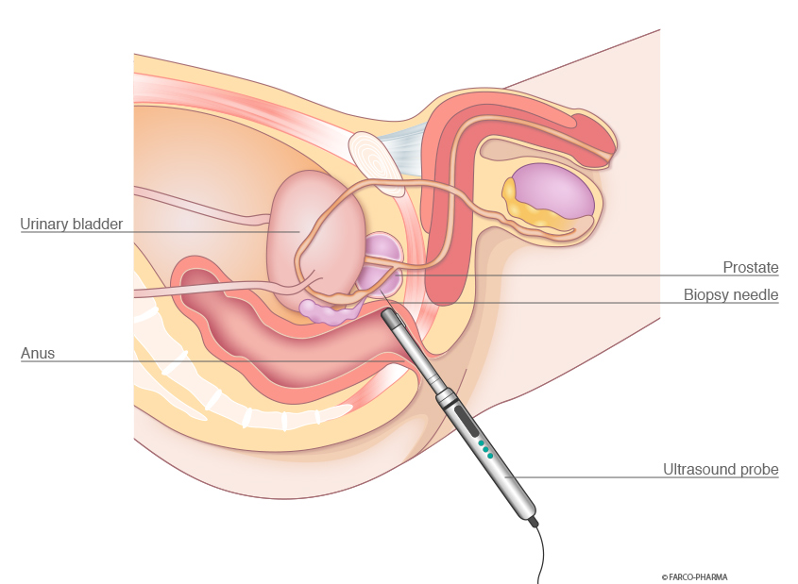
Detection of prostate Cancer
Digital rectal exam (DRE)-
Prostate- Specific Antigen(PSA
Biopsy via transrectal ultrasound (TRUS)

Slide 10
Digital rectal exam (DRE)-
- Lubricated finger into the rectum to feel for any bumps or hard areas on the prostate that might be cancer
- Uncomfortable, cause no pain and short time
Prostate- Specific Antigen(PSA) -
-Blood test -serum
-Most of the healthy men have less amount of PSA in their blood (less than 4ng/mL)
-above 10ng/mL 70% chances of prostate cancer
Biopsy via transrectal ultrasound (TRUS)
- Gleason Score- overall ranges from 2- 10
- Score of less than 6 considered as low risk
- Score of greater than 8 considered as aggressive cancer

Slide 11
Limitation With PSA Screening
In most of the cases PSA testing may give wrong results and clinicians may misdiagnose the disease
Low specificity as the PSA levels are elevated even in benign prostatic hyperplasia (BPH), chronic inflammation and infection.
DRE has low sensitivity at diagnostic level
Due to these shortcomings early detection of prostate cancer is not effective
Srivastava et al.,2011, Shariat et al., 2011

Slide 12
Other biomarkers have been proposed such as
Total PSA velocity (total PSAV),
human glandular kallikrein 2 (hk2),
Urokinase plasmonogen activator (uPA),
Urokinase plasmonogen receptor (uPAR),
Transforming growth factor-beta 1 (TGF-β 1),
Interleukin-6 (IL-6),
Interleukin-6 receptor (IL-2R)
For diagnosis
Srivastava et al.,2011, Shariat et al., 2011

Slide 13
We Need a novel marker for diagnosis prostate cancer
To over come all the short coming of current available markers
MicroRNA is the right candidatures to be proof as potential biomarker

Slide 14
Biology of microRNA
MicroRNAs(miRNAs) are a class of endogenously expressed small, non-coding, single-stranded RNA
Which have post-transcriptional function as regulators of gene expression
Negatively miRNA genes can regulate gene expression at the post-transcriptional level inhibiting translation of messenger RNA (mRNA) by mainly binding to 3ʹ untranslated region (3ʹ-UTR) and cause translational repression or induce mRNA degradation to enhance the pathways in the progression of cancer
The miRNA target recognition is mediated through the sequence complementarity between the 2–8 nt at the 5ʹ end of miRNA (seed sequence) and the 3ʹ-UTR of targetmRNA
Khanmi k et al., 2015

Slide 15
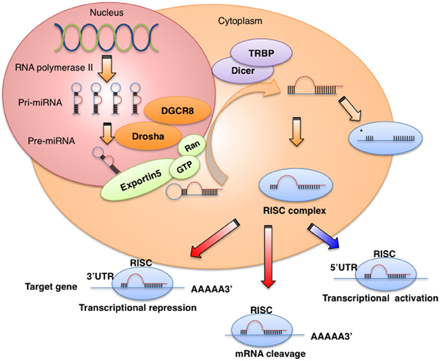
Takahashi et al., 2014

Slide 16
MicroRNA and Prostate Cancer
miRNAs expression could help determine a tumor’s origin
Expression of miRNAs in cancer is dysregulated
Over-expression or limit/no expression of specific miRNA could signify aggressive or metastatic tumor’s

Slide 17
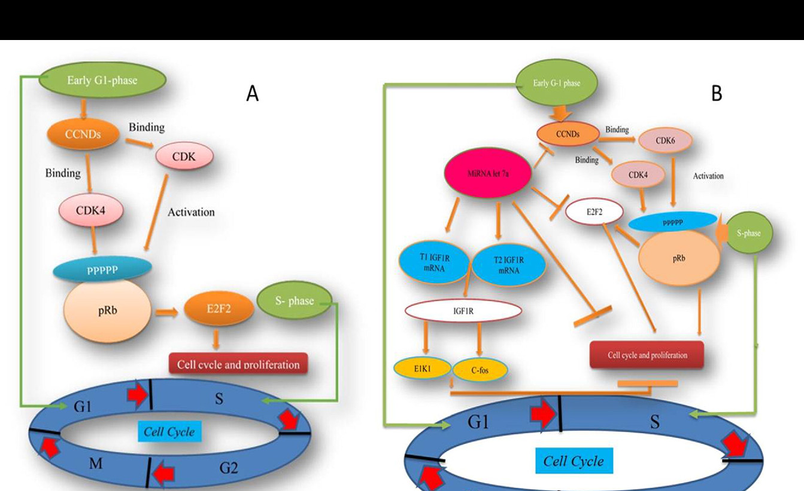

Slide 18

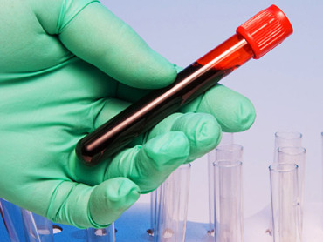
Categories of microRNAs
Urine Based Blood Based

Slide 19
Urine MiRNAs
MiRNAs that are identified in urine could play an important role as molecular diagnostic markers having non-invasive diagnostic potential.
MiR-205 and miR-214
MiRNAs expression study from 40 formalin-fixed, paraffin-embedded (FFPE) tissue specimen blocks from radical prostatectomy {15 Caucasian American (CA) and 25 African American (AA)} (Srivastava et al, Plos one, 2013)
Validated by qRT-PCR

Slide 20
Deregulated miRNAs were also analyzed in urine samples from 36 PCa patients (18 CA and 18 AA)
Ethnicity matched healthy donors (6 CA and 6 AA)
Found out that miR-205 and miR-214 were significantly downregulated in PCa patients
Discriminate PCa patients from healthy individuals with 89% sensitivity and 80% specificity
Potential non-invasive molecular biomarker for Pca

Slide 21
miR-1825/484
miRNA expression profiling of 8 PCa patients, 12 BPH patients and 10 healthy
The sensitivity and specificity of miR-1825 for detecting PCa was 60% and 69%
The sensitivity and specificity of miR-484 were 80% and 19%
Combination of miR-1825/484 sensitivity and specificity was 45% and 75%
Validated by RT-qPCR

Slide 22
Diagnostic Utility of miR-1825 and miR-484 for Diagnosing PCa
Candidate Biomarker(s) | Sensitivity (%) | Specificity (%)
miR-1825 | 60 | 69
miR-484 | 80 | 19
miR-1825 and miR-484 | 45 | 75
miR-1825/miR-484/PSA | 40 | 81
PSA (Experimental/Literature) | 90/86 | 25/33
Khanmi et al, Cancer 2015

Slide 23
Blood microRNAs
Most of the blood based biomarkers are useful for prognosis, diagnosis and effective treatments.
miR-141
6 miRNAs expression was study from 25 metastatic prostate cancer patients and 25 healthy men.
Study of 667 miRNAs expression on serum from advanced PCa patients
miR-141 showed the greatest differential expression among the other miRNAs

Slide 24
Their release into the blood was associated with advanced PCa as compared to the other miRNAs
miR-141 had a sensitivity of 78.9% and specificity of 68.8% in predicting clinical progression
Khanmi K et al, J Cancer, 2015

Slide 25
In other study
71 patients with Pca, 20 with PBH and 60 healthy
miR-141 was analyzed by qRT-PCR
80% sensitivity and 87.1 specificity
Zhuo Li et al,OncoTargets and Therapy,2015

Slide 26
VIRUS MICRORNAS AS BIOMARKER
Virus miRNAs are used to control the expression of either the host's genes and/ or their own
The first virus miRNAs were found in cells infected with EBV.
About 95 % of virus miRNAs known today are of herpes virus origin

Slide 27
hsv1-miR-H18 and hsv2- miR-H9-5p
In study of 1052 urine, 150 serum, and 150 prostate tissue samples of PCa patients (Yun et al, 2015)
Virus miRNAs was overexpression in urine samples compared to control subjects
hsv1-miR-H18 and hsv2- miR-H9-5p was abled to detected in urine samples
Better diagnostic biomarker performance than tPSA levels in prostate cancer patient

Slide 28
Summary
MicroRNAs shown the potential biomarker in prostate cancer
MiRNAs are testable/detectable in the urine, blood
Further validation of these miRNAs based biomarkers and research into potential therapeutic targets is needed

Slide 29
Acknowledgement
Rev. Dr. S. Ignacimuthu S. J
ERI, Loyola College, Chennai, India
Dr. G. Pailraj
ERI, Loyola College, Chennai, India
Dr. Arnab Sen
ICAR Research complex for NEH Region, Shillong, India
Dr. Stephen Sailo
NEIGRIHMS, Shillong, India

Slide 30
THANK YOU

