Slide 1


Evaluation of Filler/Binder Properties of Modified Starches Derived from Plectranthus esculentus by Direct Compression in Metronidazole Tablet Formulations
8th International Conference and Exhibition on Pharmaceutics and Novel Drug Delivery Systems, Pharmaceutica 2016
March 07-09, 2016 Madrid, Spain
Khalid Garba Mohammed
Department of Pharmaceutics and Pharmaceutical Technology
Bayero University, Kano-Nigeria.

Slide 2
Synopsis
Introduction
Justification of the research
Aim of the study
Materials and Methods
Results and discussion
Summary and conclusion
References
Acknowledgement

Slide 3
Introduction
Plectranthus esculentus N.E. Brown/Livingstone potato
It is among the non-popular African tubers
It is a yellow-flowered member of the mint family (Lamiaceae) with elongated tubers.
It is cultivated for its edible tubers which contains carbohydrates as source of energy especially in the rural areas (Olojede et al, 2005).

Slide 4
Origin and Geographical Distribution
Plectranthus esculentus is indigenous to tropical Africa.
It was first cultivated in the upper Niger valley of the Hausaland in Nigeria and in the Central African Republic (Kyesmu, 1994).
Popular amongst the middle belt region of Nigeria as energy source particularly in states like Niger, Nassarawa, Plateau and some parts of Kaduna and Katsina states (Olojede et al, 2005).

Slide 5
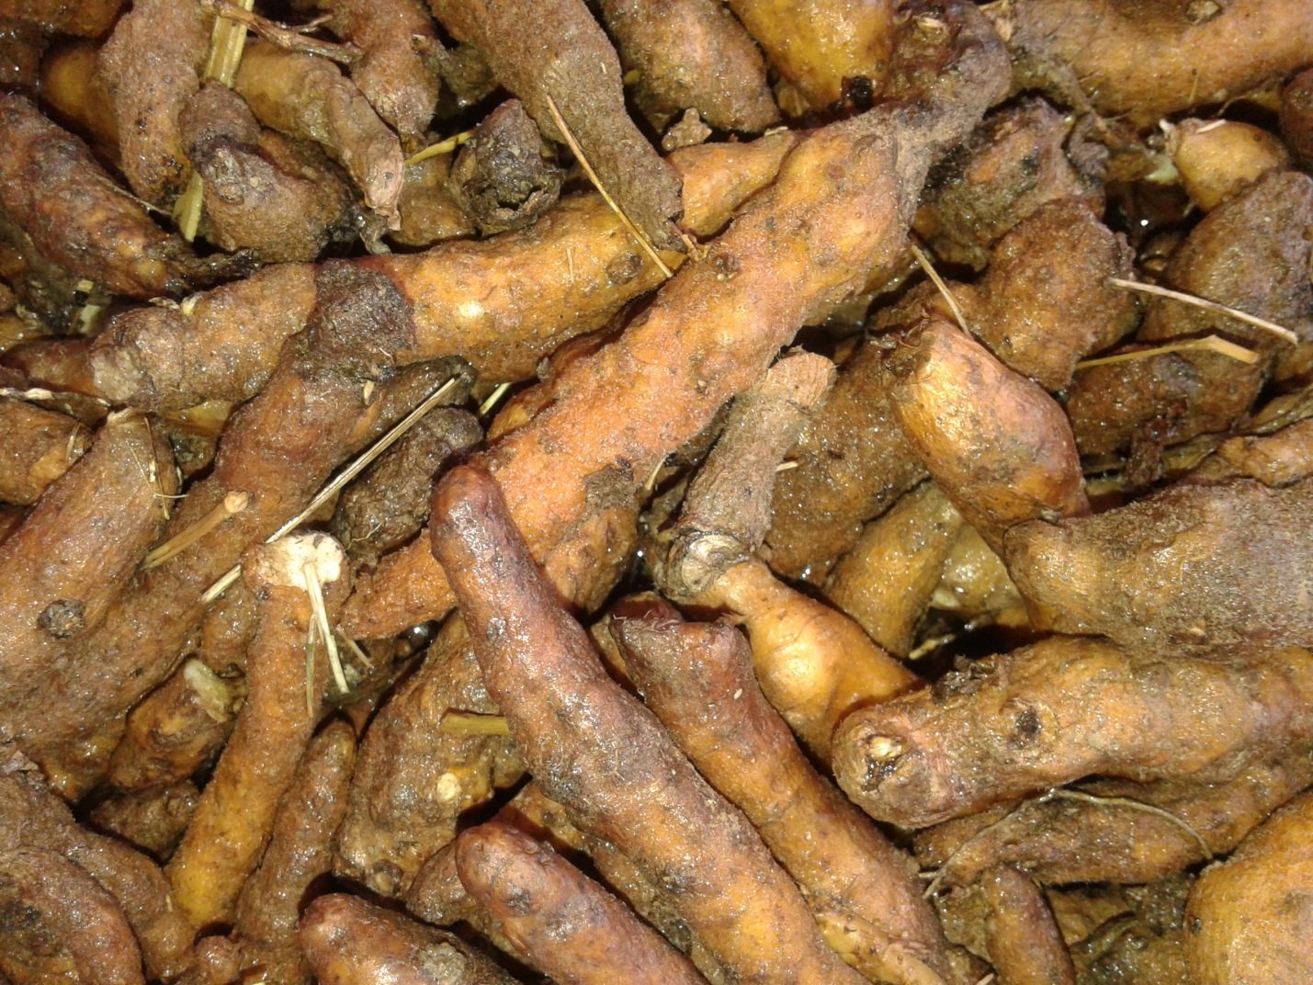
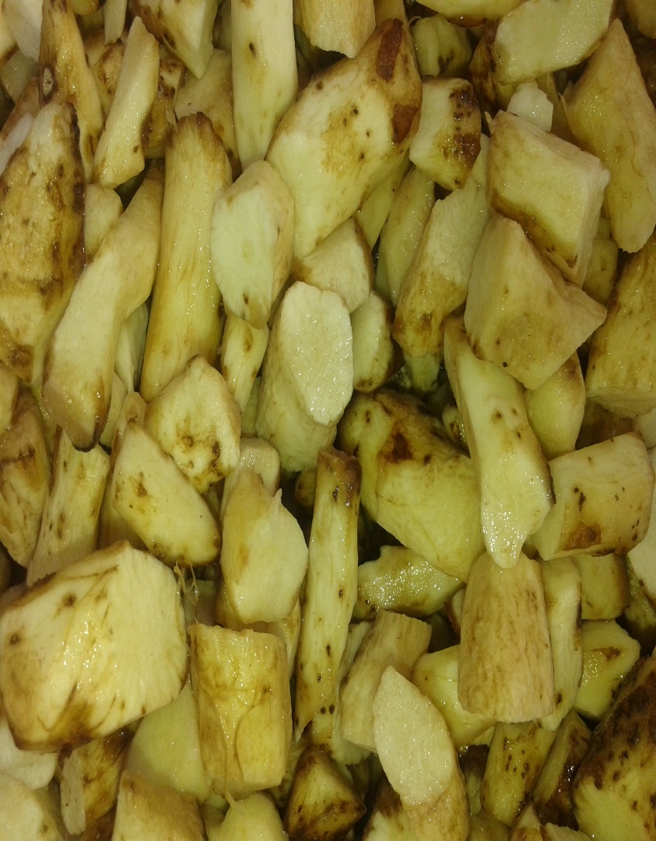
Before peeling After peeling
Figure 1. Typical tubers of Plectranthus esculentus (Source: Khalid)

Slide 6
Justification of the Research
Oral route of drug administration is the most straightforward for majority of patients. It remains the largest slice of the overall drug market with over 52 % share, presently valued at $49 billion (Pharmaceutica, 2016).
Starch is receiving attention as Pharmaceutical excipient due to its usefulness, cheapness and inertness, especially its modified form.
Direct compression (DC), few excipients are available for use in DC, and also few literatures on P. esculentus for use as Pharmaceutical excipient.

Slide 7
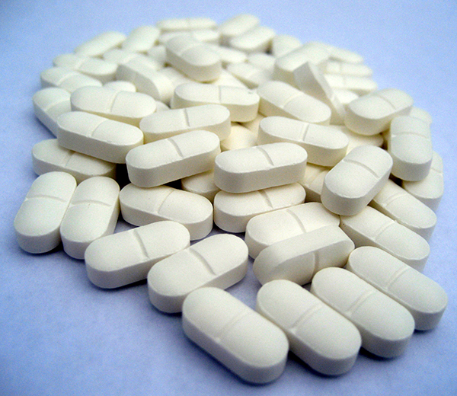
Aim of the Study
To evaluate the tableting properties of modified starches derived from Plectranthus esculentus, as filler/binder by direct compression using metronidazole as a model drug.
To provide alternative sources for directly compressible excipients.

Slide 8
Materials and Methods
Experimental samples:
Plectranthus esculentus (Vom area of Plateau State, Nigeria)
Metronidazole powder (BDH Chemicals Ltd Poole, England)
Microcrystalline cellulose PH 101 (ATOZ Pharmaceuticals Ltd, Ambaltur, India)
Equipment
HH-S Digital thermostatic water bath
Gallenkamp BS size 3 hot air oven (England)
Single punch tableting machine (G.m.b.H Germany)
General laboratory centrifuge (Sorvall 7506180)
Electronic digital scale (MSI-A Electronic balance)
Grinding machine, among others.

Slide 9
Methods
Sample collection, from Plateau state in Nigeria.
Extraction of starch (wet milling)
Modification of the native starch
Acid hydrolysis (300 g/800mL H20:28 mL 6N HCl/24 hours)
Pregelatinization (150 g/1L H20/ 90⁰ C thermostatic water bath)
Ethanol dehydrated pregelatinization

Slide 10
Methods
Physicochemical evaluation of the native and modified starches for percentage yield, pH, solubility, swelling power, moisture content, according to official and standard procedures.
Physicomechanical evaluation of the modified starches for flow properties, angle of repose, Carr’s index, Hausner’s ration, bulk and tapped densities, based on official and standard procedures.
Compressibility studies (tablet compact density vs log compaction pressure)

Slide 11
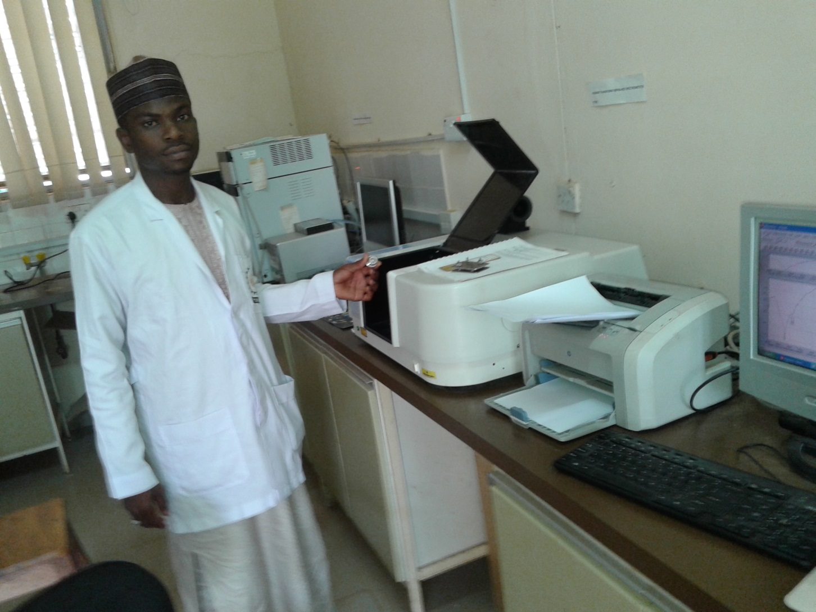
Methods
Drug-Excipient compatibility studies using FTIR analysis.

Slide 12
Tablet Formulation
Table 1. Tablet Formula for studying the filler/binder properties of modified starches from P. esculentus compared with MCC PH101 in metronidazole tablet 200 mg
______________________________________________________________________________
Ingredients Quantity/Tablet Quantity/Tablet (mg) Quantity/Batch of 200
tablets (g)
______________________________________________________________________________
Metronidazole 200 mg 200.00 40.00
Filler/binder: MCC PH 101/ q.s 344.50 68.90
PPS/APS/PPE
Lubricant: Stearic acid 0.25 %w/w 1.38 0.28
Glidant: Talc 0.75 %w/w 4.13 0.83
Target Tablet weight 550 mg Total 550 Total 110 ______________________________________________________________________________
*Key:
MCC PH101=Microcrystalline cellulose
APS= Acid hydrolyzed P. esculentus Starch
PPS= Pregelatinized P. esculentus Starch
PPE=Ethanol dehydrated Pregelatinized P. esculentus Starch

Slide 13
Evaluation of Tablet Properties
Dissolution
Disintegration
Content uniformity
Weight uniformity
Friability, thickness and diameter, crushing strength and tablet tensile strength were all determined base on the official and standard procedures.

Slide 14
Statistical Analysis and Data Presentation
Statistical analysis of the data was done using SPSS V-20
Differences between means were analyzed using one way analysis of variance (ANOVA) followed by Dunett’s test for multiple comparison.
Significant differences among means were considered at 95 % confidence level and p ≤ 0.05.

Slide 15
RESULTS AND DISCUSSION

Slide 16
Table 2. Organoleptic and Physical Test on Native Starch of Plectranthus esculentus
__________________________________________________
Properties Result
__________________________________________________
Taste Tasteless
Odor Odorless
Color White
Texture Smooth
Gelatinization temperature ⁰ C 66
Percentage yield (% w/w) 31.67
Iodine test Positive
__________________________________________________

Slide 17
Table 3. Physical Tests of Modified Starches of P. esculentus
_____________________________________________
Properties PPE PPS APS
_____________________________________________
Color Off white Light brown Off white
Texture Brittle Brittle Smooth
Perc. yield (% w/w) 89.54 90.61 76.74
_____________________________________________

Slide 18
Table 4. Physicochemical Properties of Modified Starches of Plectranthus esculentus and MCC PH101 (Mean ±SEM)
___________________________________________________________________________________
Parameter MCC PH101 PPE PPS APS
___________________________________________________________________________________
Bulk Density (g/cm³) 0.34 ± 0.00 0.66 ± 0.01 0.73 ± 0.02 0.64 ± 0.01
Tapped Density (g/cm³) 0.53 ± 0.01 0.78 ± 0.03 0.88 ± 0.03 0.78 ± 0.01
True Density (g/cm³) 1.82 1.42 1.71 1.91
Angle of repose (⁰) 46.22 ± 0.25 15.65 ± 0.91 25.43 ± 1.33 30.05 ± 1.2
Flow Rate (g/s) 0.80 ± 0.02 8.13 ± 0.09 8.25 ± 0.19 2.85 ± 0.17
Carr’s Index (%) 35.38 ± 1.01 15.63 ± 2.26 17.03 ± 1.96 18.69 ± 2.03
Hausner’s Ratio 1.54 ± 0.03 1.18 ± 0.03 1.2 ± 0.03 1.23 ± 0.03
Hydration Capacity 3.02 6.02 4.18 2.18
Swelling capacity 2.00 8.00 5.50 1.68
Moisture sorption capacity (%) 20.50 30.00 26.50 25.00
Moisture Content (%) 7.00 13.40 11.00 8.80
pH 6.89 7.40 7.05 6.81
Mean Particle Size (µm) 118.67 ± 8.11 68.20 ± 3.02 102.53 ± 3.98 13.53 ± 11.45
____________________________________________________________________________________

Slide 19
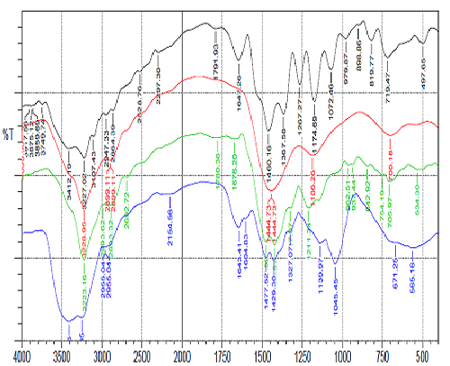
MET+PPE
1/cm
Figure 2. Comparative FTIR spectra of pure drug and physical mixture of drug and excipients
Key: MET – Metronidazole
MET+PPS
METRONIDAZOLE
MET+APS

Slide 20
Figure 3. Plots of tablet compact densities against log compaction pressure of MCC PH101, and modified starches of P. esculentus

Slide 21
Table 5. Compressibility index of MCC PH101 and modified starches of P. esculentus
________________________________________
Excipient Slope (compressibility)
________________________________________
MCC PH101 0.992
PPE 0.478
PPS 0.503
APS 0.601
_________________________________________

Slide 22
Figure 4. In-vitro Dissolution profile of metronidazole 200 mg tablet formulations in MCC PH101 and modified starches of P. esculentus

Slide 23
Table 6. Physicochemical Properties of Tablets from Modified Starches of P. esculentus and MCC PH101 (Mean ±SEM)
_______________________________________________________________________________
Parameter MCC PH101 PPE PPS APS
_______________________________________________________________________________
Mean tablet weight (mg) 553±3.65 553.5±1.86 532.5±1.80 553.5±3.18
Thickness (mm) 4.67±0.01 4.44±0.02 4.41±0.03 4.46±0.03
Diameter (mm) 12.09±0.01 12.04±0.01 12.17±0.02 12.09±0.01
Friability (%) 0.72 0.54 8.74 0.90
Crushing strength (N) 64.3±0.41 79.43±0.32 28.44±0.10 70.41±0.55
Tensile strength (MNm⁻²) 0.73 0.95 0.03 0.83
Disintegration time (min) 35.34±4.33 45.53±3.11 1.42±0.19 * ** 2.83±2.11***
T_{50%} (min) - 38.00 2.30* 3.40*
T_{90%} (min) - 58.00 3.40* 5.15*
Content uniformity (%) 95.33±3.04 102.12±2.11 96.81±3.12 104.05±4.01
_______________________________________________________________________________
* Significant at p<0.05
*** Significant at p<0.001

Slide 24
Summary
Modified starches of P. esculentus produced excipients of good physico-chemical properties such as flowability, swelling capacity and hydration capacity.
FTIR analysis indicates that there was no chemical interaction between the drug and modified starches of P. esculentus.
Metronidazole tablets produced from these modified starches exhibited good quality control properties.

Slide 25
Conclusion
APS produced the best metronidazole tablets of better quality compared to MCC PH101 and other two modifications.
Therefore, APS is a good directly compressible filler/binder in conventional tablet formulation.

Slide 26
Recommendations
Pregelatinized starch of P. esculentus should be evaluated for use as tablet disintegrant, or in formulations of orally dispersible tablets.
Ethanol dehydrated pregelatinized modification of P. esculentus should be explore in sustained release or modified release tablet formulations.

Slide 27
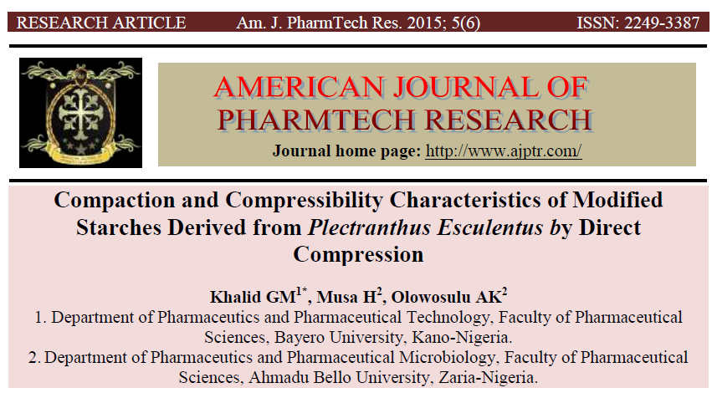
Publications

Slide 28
References
Adebayo, S.A., Myrie E.B., and Itiola, O.A. (2008). Comparative Disintegrant Activities of Breadfruit Starch and Official Corn Starch. Powder Technology, 181: 98-103.
Alderborn G (2002). Tablets and compaction In: Aulton, M.E. (Ed.). Pharmaceutics: The Science of Dosage form design, (2nd Ed). Churchill Livingstone, New York, pp. 397-440.
Alderborn, G. (2007). Tablets and Compaction. In: Aulton, M.E. Editor. Aulton’s Pharmaceutics-The Design and Manufacture of Medicines ed. Churchill Livingstone Elsevier, London. Third edition; pp 441- 482.
Alebiowu G. and Itiola, O.A. (2002), Compressional Characteristics of Native and Pregelatinized Forms of Sorghum, Plantain and Corn Starches and the Mechanical Properties of their Tablets. Drug Dev. Ind. Pharm. 28(6): 663-672.
Allen, L.V, Popovich, N.G.,Ansel, H.C.(2004).Ansel's pharmaceutical dosage forms and drug delivery systems, 8th Edition edn, Lippincott Williams and Wilkins, Philadelphia.pp 236-238.
Antikainen, O. and Yliruusi, J. (2003). Determining the compression behaviour of pharmaceutical powders from the force-distance compression profile. International Journal of Pharmaceutics, 252(1-2): p. 253.
Apeji, Y.E., Avosuahi, O., Musa, H., and Olowosulu, A.K. (2010). Investigation of the direct compression properties of microcrystalline starch (MCS) as a filler/binder/disintegrant in metronidazole tablet formulation. International Journal of Pharmaceutical Research and Innovation.(1) 8-14
Pharmaceutica 2016, available at: http://novel-drugdelivery-systems.pharmaceuticalconferences.com (Accessed on 24th January, 2016)

Slide 29
Acknowledgement
I acknowledged the support received from Bayero University, Kano-Nigeria.

