Slide 1
Predictive Parameters of Arteriovenous Fistula Functional Maturation in a Population of Patients with End-Stage Renal Disease
Khalid Bashar, Adeel Zafar, Sawsan Elsheikh, PE Burke, EG Kavanagh, Stewart Walsh

Slide 2
Introduction
Increased number of patients with ESRD
Vascular access required for HD
Well functioning AVF is the best modality of access
AVF maturation is a complex process of remodelling

Slide 3
Introduction
AVF maturation:
  Intimal hyperplasia
  Arterial remodelling
  Venous remodelling

Slide 4
Introduction
Haemodynamics of fistula maturation
  Mean arterial blood flow needs to be increased several fold
  Increased cardiac output
  Arterial dilatation in response to wall shear stress
  Medial thickening in response to increased tensile stress
  Effects mediated by Nitric Oxide (NO), Matrix Metalloproteinases (MMPs), Endothelin and Haemoxygenase 1 (HO-1)

Slide 5
Introduction
Defining a mature AVF:
  Low resistance conduit
  Ease of cannulation
  Rule of 6
  Lack of a universal definition

Slide 6
Introduction
AVF advantages (Compared to grafts and Catheters):
  Last longer
  Reduced rates of infection and sepsis
  Fewer secondary interventions
  The least modality associated with hospitalisation and death
Main disadvantage is higher rate of primary failure

Slide 7
Introduction
Timing of initial cannulation:
  Previous access
  Patients already on HD
    Baldrati et al showed that AVF created prior to starting HD had 94.6% patency rate immediately and 72.2% in 2 years, compared to 86.5% immediately and 54.8% in 2 years in patients with AVF created after starting HD
  Time to mature : 2- 4 weeks

Slide 8
Introduction
The order of preference for creating an AVF:
  Distal Radio-Cephalic
  Proximal Radio-Cephalic
  Brachio-Cephalic
  Brachio-Basilic (transposed Basilic vein)
Notes:
(NKF KDOQI) guidelines

Slide 9
Introduction
Basilic vein transposition:
  First described by Dagher (1976): the use of basilic vein to create an AVF in the upper arm between the end of basilic vein and the side of the brachial artery to act as access for long term haemodialysis
  Dagher F, Gelber R, Ramos E, Sadler J (1976) The use of basilic vein and brachial artery as an A-V fistula for long term hemodialysis. J Surg Res 20: 373-376

Slide 10
Introduction
One-stage vs Two-stage techniques:
One stage:
  One procedure
  Faster cannulation for HD
  More cost-effective
  Longer incision
  Technically more demanding and longer

Slide 11
Introduction
One-stage vs Two-stage techniques:
Anaya-Ayala et al studied the anatomy of basilic vein:
  Only 66% of patients are expected to have a “normal” basilic vein entering one of two paired brachial veins close to the axilla, while up to 34% will have an “abnormal” variant that would negatively influence the maturation of the newly created fistula
  Anaya-Ayala JE, Younes HK, Kaiser CL, Syed O, Ismail N, et al. (2011) Prevalence of variant brachial-basilic vein anatomy and implications for vascular access planning. J Vasc Surg 53: 720-724.

Slide 12
Introduction
One-stage vs Two-stage techniques:
Two stage:
  Vein more resistant to torque
  Easier to mobilise
  Aim is to reduce complications and improve patency rates
  Requires two procedures with added costs and increased burden on theatre waiting lists and staff

Slide 13


Slide 14
Aims
Audit our own practice in terms of AVF maturation
Test the association between certain characteristics (age, gender and medical co-morbidities - diabetes in particular) and AVF maturation
Test the association between specific inflammatory markers (Neutrophils and Lymphocytes) obtained preoperatively and AVF maturation.

Slide 15
Methods
A retrospective chart review:
  All patients with ESRD referred for a vascular access
  Three surgeons performed the procedures.
  The data-analysis was performed according to a predefined set of outcomes based on extensive search of the literature.

Slide 16
Methods
Inclusion Criteria:
  All patients aged 18 years or older who underwent formation of AVF in the upper limb between 2006 and 2013
  In patients with multiple episodes of newly constructed AVFs, each episode was considered separately
Exclusion Criteria:
  Patients that underwent salvage procedures to improve maturation
  Patients who had prosthetic graft and/or tunnelled catheters as the only means for HD
Notes:
, i.e. secondary maturation, as we analysed data related to primary functional maturation rates only

Slide 17
Methods
Primary Endpoints:
  The association between AVF maturation and:
    Age, gender, diabetes, smoking, hypertension, hyperlipidaemia, history of steroids use, history of Calcium channel blockers at the time of the access formation and the history of previous dialysis access

Slide 18
Methods
Secondary Endpoints:
  The association between AVF maturation and perioperative blood investigations:
    Haemoglobin, White cells count, Neutrophils count and Lymphocytes
    Calculated the NLR as a potential predictor tool for AVF maturation

Slide 19
Definitions
Functional Maturation:
  Successful use of the arteriovenous fistula for ≥ 6 consecutive sessions of HD
Primary Patency Rate:
  Time from access creation to the first surgical intervention required to restore adequate fistula flow
Notes:
, i.e. secondary maturation, as we analysed data related to primary functional maturation rates only

Slide 20
Data Collection
Ethical approval obtained
Data extracted from medical records
Blood investigations results: Electronic systems
Functional maturation from HD records
Notes:
research ethics committee and the risk management department of the regional Health Service Executive (HSE West)

Slide 21
Statistical analysis
IBM SPSS version 22.0
  Normality tests: Histograms, Q-Q plots and Box Plots
  Categorical data: Pearson Chi-Square (X²) test
  Continuous data were reported as mean ± SD / Median:
    Normal Distribution: Independent sample t-test
    Skewed data: Mann-Whitney U

Slide 22
Statistical analysis
Logistic Regression
  An overall logistic regression test
  Variables with a p value of < 0.1 in bivariate analysis
  Functional maturation as the dependent (outcome) measure
Notes:
Finally, a prediction model was calculated by logistic regression analysis using data from variables that have been suggested to correlate to fistula in the literature, as well as variables from our study with a p value of < 0.1 in bivariate analysis with functional maturation being the dependent (outcome) measure of analysis. We also performed an overall logistic regression test with all of the included variables in our study without restrictions in terms of the p value.

Slide 23
Results
97 AVFs in 86 patients
Aetiology of ESRD:
  Diabetes (38.1%)
  Congenital renal agenesis (8.2%)
  Hypertension (7.2%)
  Ischaemic injury (6.2%).

Slide 24
Results
Age of all patients was (mean ± SD) 60.9 ± 16.9:
  Men aged 63.7 ± 14.8 with a median of 67 (22 – 86)
  Women aged 54.5 ± 19.6 with a median of 55 (21 – 81)
  The difference was statistically significant (P = 0.012)

Slide 25
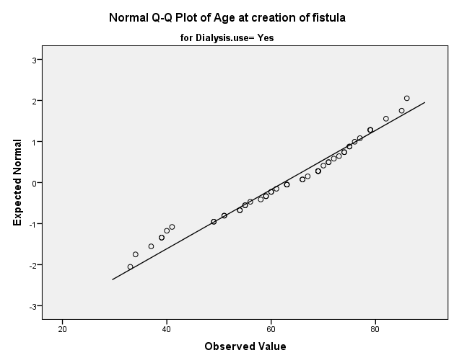

Slide 26
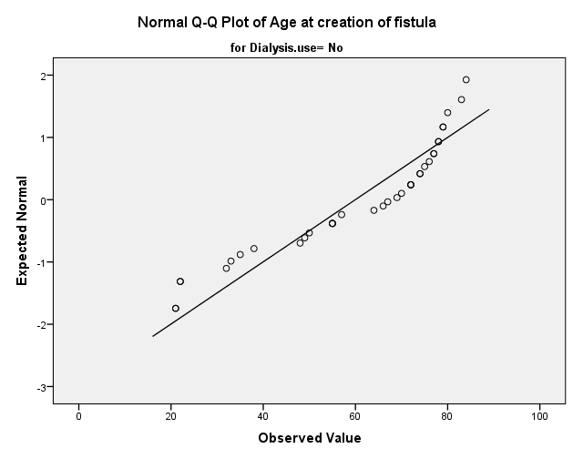

Slide 27
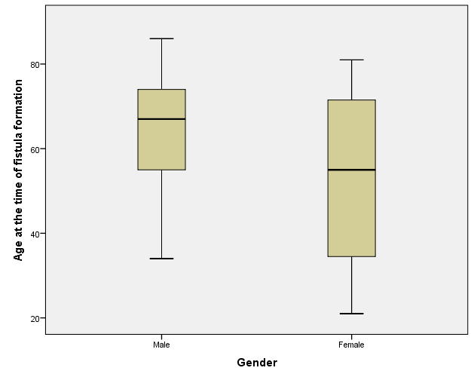

Slide 28
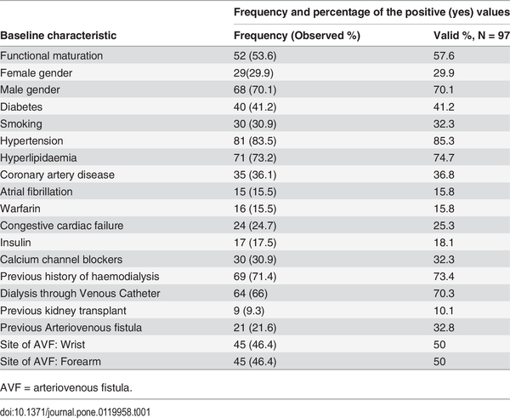
Characteristics of Patients

Slide 29
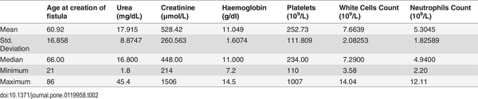
Characteristics of continuous variables

Slide 30
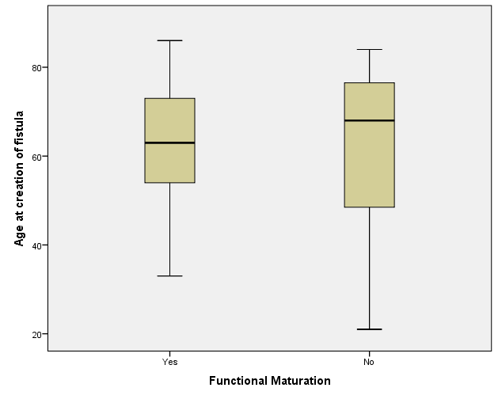
(P = 0.926; Mann-Whitney U test)

Slide 31
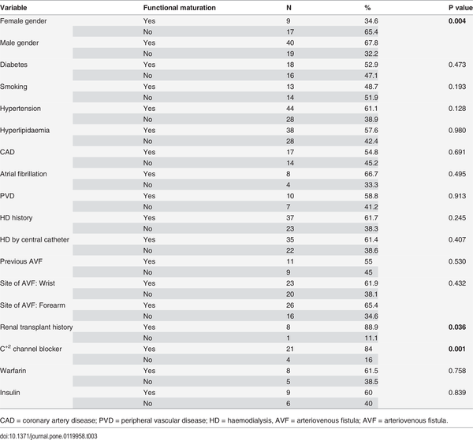
Categorical variables and Maturation

Slide 32
Categorical variables and Maturation

Slide 33
Categorical variables and Maturation

Slide 34
Categorical variables and Maturation

Slide 35
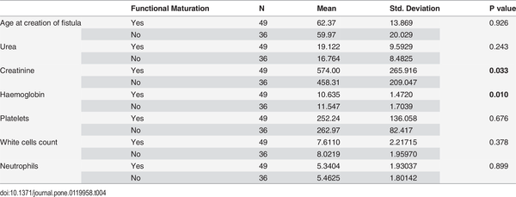
Continuous variables and maturation

Slide 36
Results
Logistic Regression (All Variables):
  The overall prediction accuracy of the model was 77.8%
  Independent predictor for AVF outcomes:
    Female gender (P = 0.04)
    History of calcium channel blockers (P = 0.034).

Slide 37
Results
Logistic Regression (Based on the literature):
  The overall prediction accuracy of the model was 71.7%,
  The independent predictor for functional nonmaturation was a female gender (P = 0.011).
Notes:
age, history of diabetes, smoking, hypertension, hyperlipidaemia, warfarin, congestive cardiac failure, history of starting HD prior to AVF placement, history of dialysing through CVC, and history of an attempted AVF.

Slide 38
Results
Predictive value of the NLR:
  Statistical test: Mann-Whitney U
  NLR of mature AVFs ----> 4.850 (1.8 – 15.7)
  NLR of failed AVFs ----> 3.554 (1.7 – 15.0);
  The difference was significant (P = 0.024).

Slide 39
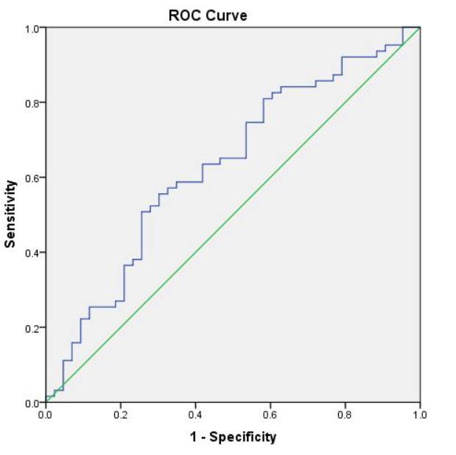
The utility of the NLR in predicting AVF maturation outcomes
Area Under The Curve
0.629

Slide 40
Discussion
Functional maturation was associated with:
  Previous history of a kidney transplant (P = 0.036)
  Low Haemoglobin levels (P = 0.01)
  Patient on a calcium channel blocker (P = 0.001)
Functional non-maturation was associated with:
  Female gender (P = 0.004)

Slide 41
Discussion
Conflicting evidence with regards to:
  Female gender
  Diabetes
  Age

Slide 42
Limitations
Retrospective Study
Small number
The use of “functional maturation” to determine outcomes
Lack of preoperative US scans
  Differentiate failure from mis-cannulation
  Stratify findings by vein diameter

Slide 43
Conclusion
Age should not be a limiting factor
Female gender can independently predict functional non-maturation in multiple regression analysis
Calcium channel blockers might improve maturation rates
Large multi-centre registry-based studies needed
Biomechanical factors that influence intimal hyperplasia should be considered
Notes:
Logistic regression analysis showed that the only independent predictor of functional non-maturation was a female gender. In view of the conflicting evidence in the literature, large multi-centre registry-based studies with well-defined outcomes are required; however, other biomechanical factors that influence intimal hyperplasia should be considered as playing a leading role in AVF maturation.

Slide 44
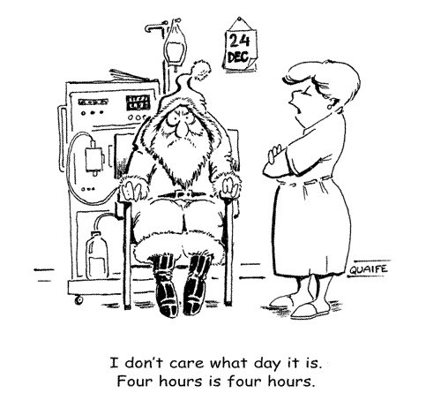
Thank You

Slide 45
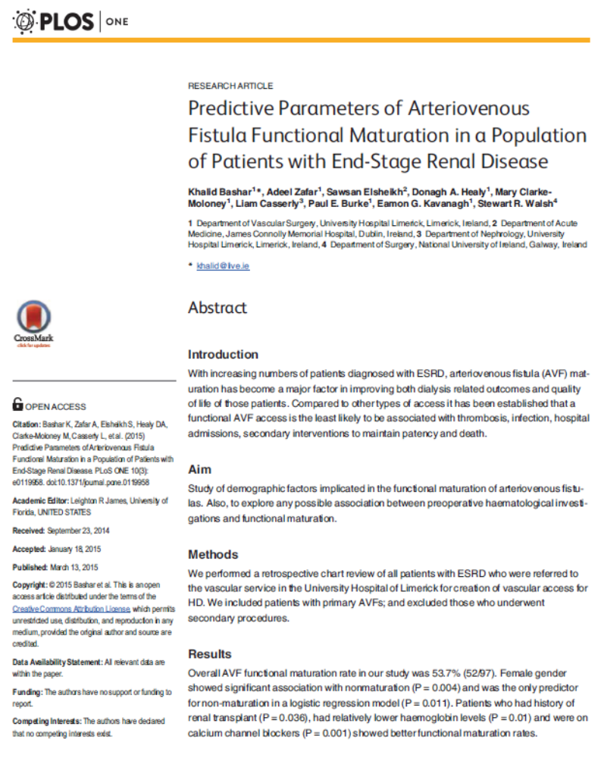

Slide 46
Predictive Parameters of Arteriovenous Fistula Functional Maturation in a Population of Patients with End-Stage Renal Disease
Khalid Bashar, Adeel Zafar, Sawsan Elsheikh, PE Burke, EG Kavanagh, Stewart Walsh

