Slide 1


Molecular characterization of Trichoderma isolates as biological control agent
Khalid Abdel-lateif
Menoufia University, Egypt

Slide 2
Why we need biological control?
Chemical pesticides
  Implicated in environmental and human health problems
  Require yearly treatments and expensive
  Toxic to both beneficial and pathogenic species
Biological control agents
  Non-toxic to human and animal
  Not polluted
  Host specific
    Only effect one or few species

Slide 3
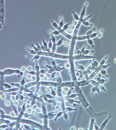
Trichoderma spp.
Trichoderma spp. are present in nearly all agricultural soils
Agriculturally used as biocontrol agent and as a plant growth promoter
Trichoderma species exhibited effective antagonism of different degrees against wide range of soilborne plant-pathogenic fungi such as Pythium,
Rhizoctonia, Fusarium and Sclerotina

Slide 4
Mechanisms of Trichoderma as biological control agent
Mycoparasitism
Trichoderma penetrates into pathogen mycelium by degradation of its cell wall
Antibiosis
By secretion of antibiotics
Competition for nutrients or space
Induced resistance
Inactivation of the pathogen’s enzymes

Slide 5
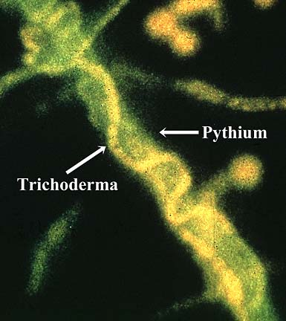
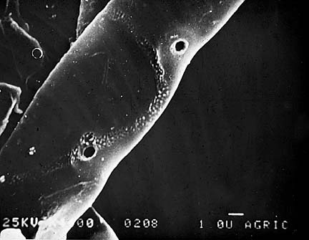
Action of Trichoderma against pathogenic fungi
2- Penetrate the host cell walls by secreting lytic enzymes: Chitinases, Proteases, Cellulases
1- Attachment to the host hyphae by coiling
(Hubbard et al., 1983. Phytopathology 73:655-659).
(Ilan Chet, Hebrew University of Jerusalem).

Slide 6
Isolation and identification of Trichoderma isolates
Trichoderma isolates | Code | Isolation source
T. koningii | TK | Ismailia governorate
T. hamatum1 | TM1 | Menoufia governorate
T. hamatum2 | TM2 | Menoufia governorate
T. hamatum3 | TM3 | Gharbia governorate
T. hamatum4 | TM4 | Sharkya governorate
T. viride 1 | TV1 | Gharbia governorate
T. viride 2 | TV2 | Kafer El-shikh governorate
T. viride 3 | TV3 | Sharkya governorate
T. viride 4 | TV4 | Menoufia governorate
T. harzianum 1 | TZ1 | Sharkya governorate
T. harzianum 2 | TZ2 | Ismailia governorate
T. harizianum 3 | TZ3 | Menoufia governorate
Isolation according to Elad et al., 1981
identification according to Barnett (1998) and Bissett (1991a,b,c)

Slide 7
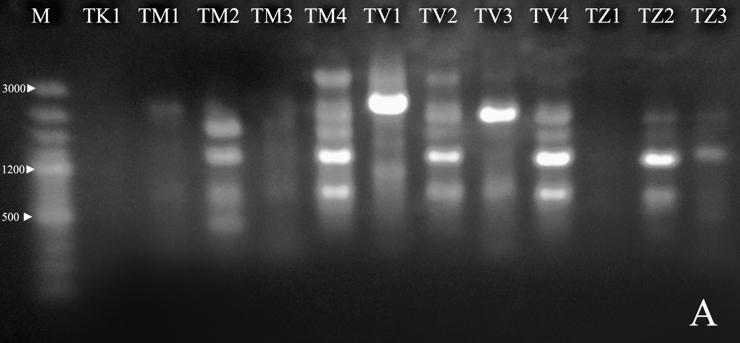
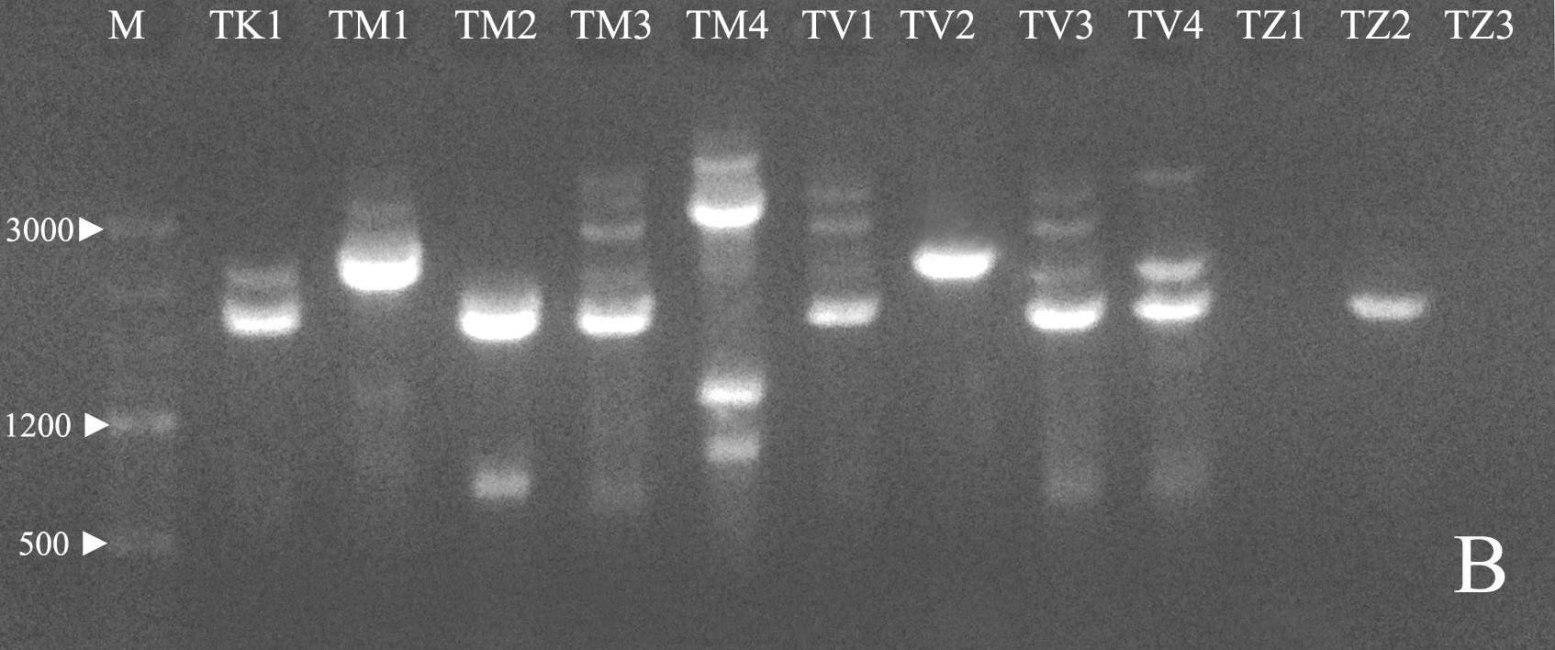
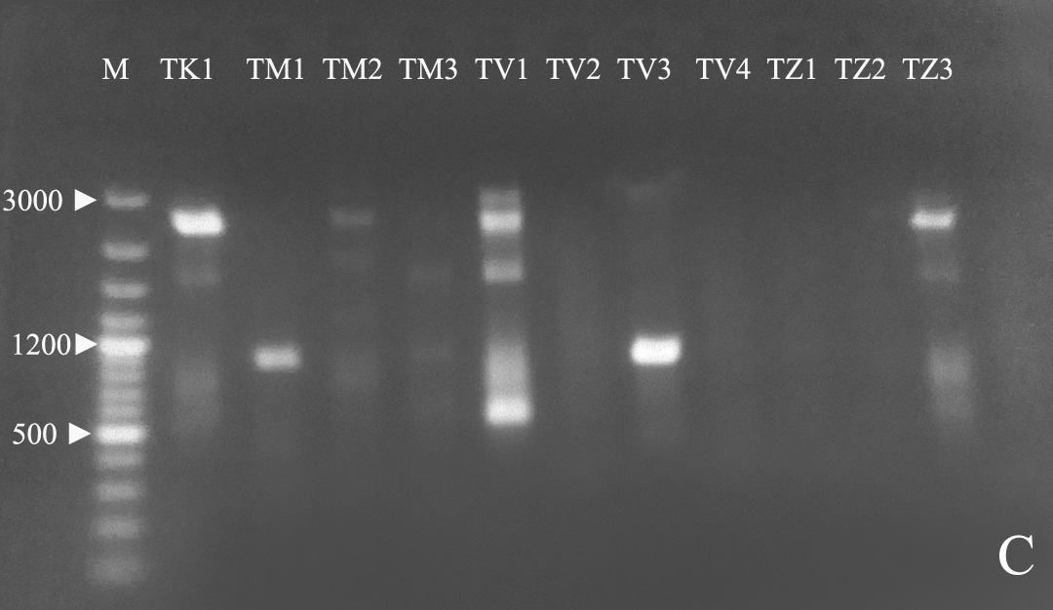
Genetic diversity based PCR-RAPD
Primer | Sequence
OPA-02 OPB-07 OPB-08 | 5ʹ- TGCCGAGCTG-3ʹ 5ʹ- GGTGACGCAG-3ʹ 5ʹ- GTCCACACGG-3ʹ
OPB-09 | 5ʹ-TGGGGGACTC-3ʹ
OPB-18 | 5ʹ-CCACAGCAGT-3ʹ
OPB-19 | 5ʹ-ACCCCCGAAG-3ʹ
OPG-04 OPG-07 OPE-04 OPF-06 | 5ʹ-AGCGTGTCTG-3ʹ 5ʹ-GAACCTGCCC3-3ʹ 5ʹ- GTGACATGCC-3ʹ 5ʹ-GGGAATTCCC-3ʹ

Slide 8
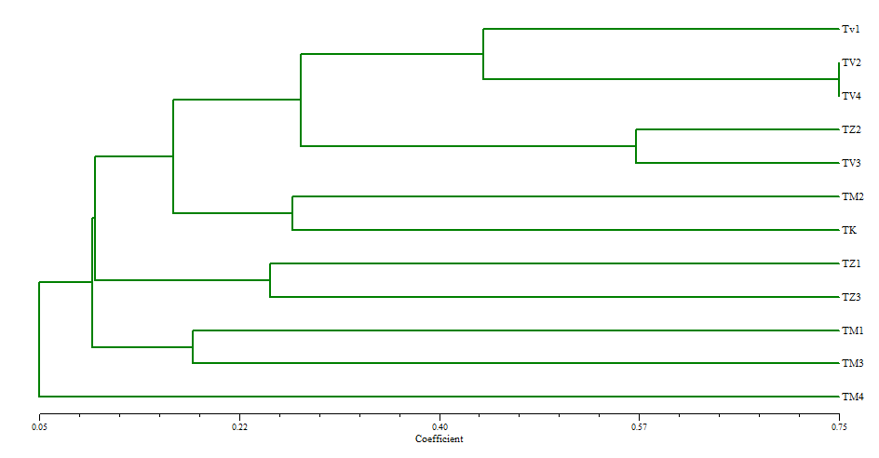
The similarity matrix
Isol | TK1 | TM1 | TM2 | TM3 | TM4 | TV1 | TV2 | TV3 | TV4 | TZ1 | TZ2 | TZ3
TK | 1.00
TM1 | 0.08 | 1.00
TM2 | 0.26 | 0.16 | 1.00
TM3 | 0.12 | 0.18 | 0.17 | 1.00
TM4 | 0.10 | 0.00 | 0.04 | 0.00 | 1.00
TV1 | 0.09 | 0.18 | 0.08 | 0.09 | 0.00 | 1.00
TV2 | 0.30 | 0.00 | 0.18 | 0.06 | 0.26 | 0.37 | 1.00
TV3 | 0.11 | 0.10 | 0.19 | 0.14 | 0.12 | 0.11 | 0.50 | 1.00
TV4 | 0.25 | 0.00 | 0.15 | 0. 07 | 0.14 | 0.50 | 0.75 | 0.30 | 1.00
TZ1 | 0.06 | 0.10 | 0.24 | 0.23 | 0.00 | 0.11 | 0.07 | 0.27 | 0.08 | 1.00
TZ2 | 0.08 | 0. 14 | 0.07 | 0.18 | 0.00 | 0.16 | 0.33 | 0.57 | 0.25 | 0.22 | 1.00
TZ3 | 0.20 | 0.00 | 0.08 | 0.00 | 0.00 | 0.00 | 0.00 | 0.00 | 0.00 | 0.25 | 0.00 | 1.00

Slide 9
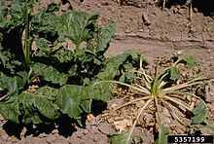
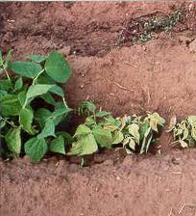
Evaluation of Trichoderma Antagonism against some soil porne pathogens
Pythium aphanidermatum:
- Cellulose is the main cell wall component
- a wide host range and cause damping off (kill seeds or seedlings before or after they germinate)
Rhizoctonia solani:
- Chitin is the main cell wall component
- Cause various plant diseases such as collar rot and damping off .

Slide 10
Evaluation of Trichoderma Antagonism against
P. aphanidermatum and R. solani
The antagonism of Trichoderma was evaluated by determined three criteria:
Radial growth inhibition by comparing radial growth of Trichoderma against growth of pathogen (R1 - R2)/ R1 × 100
Over growth ability was calculated as mycelial growth of Trichoderma over the pathogen
Inhibition zone was measured by observation the clear zones formed between Trichoderma and pathogen as result of antibiotic secretion

Slide 11
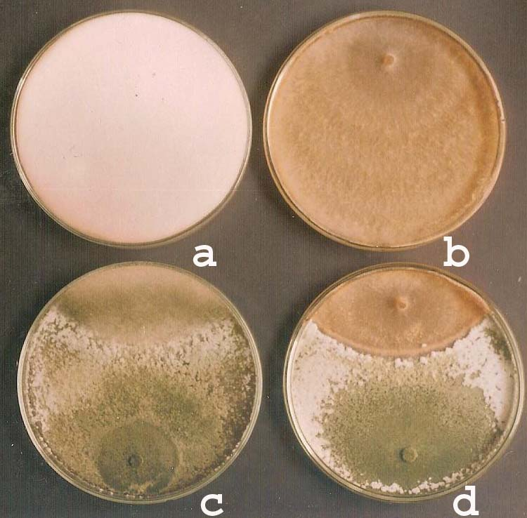
a; Pythium aphanidermatum, b; Rhizoctonia Solani, c; Trichoderma against Pythium aphanidermatum, d; Trichoderma against Rhizoctonia Solani
Inhibition of P. aphanidermatum and R. solani growth in presence of Trichoderma

Slide 12
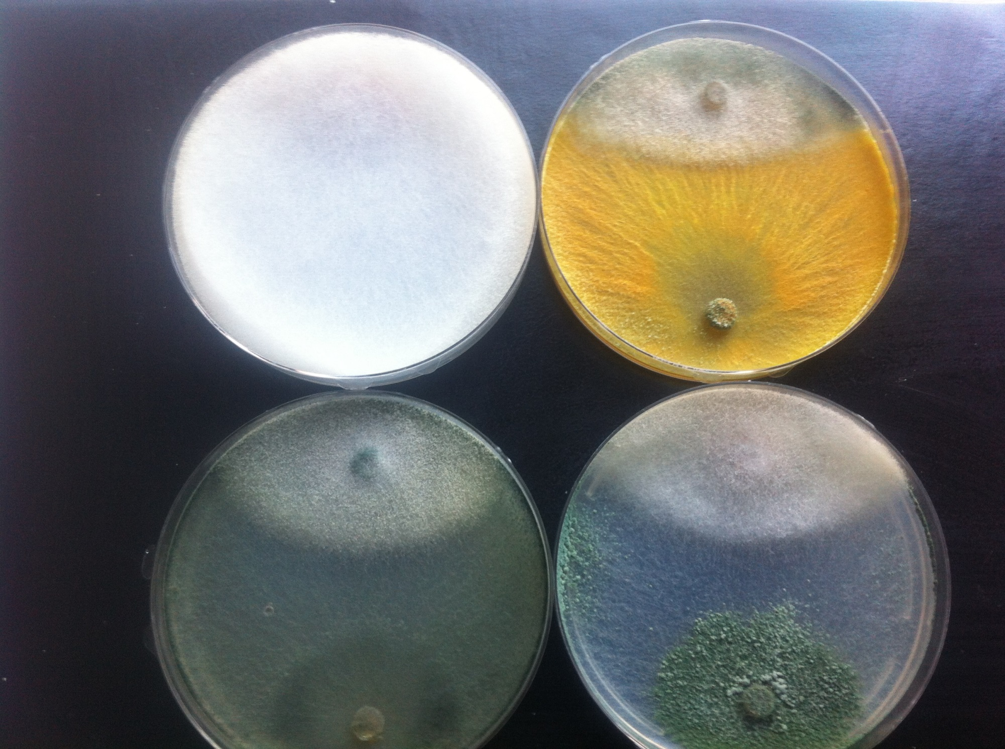

Slide 13
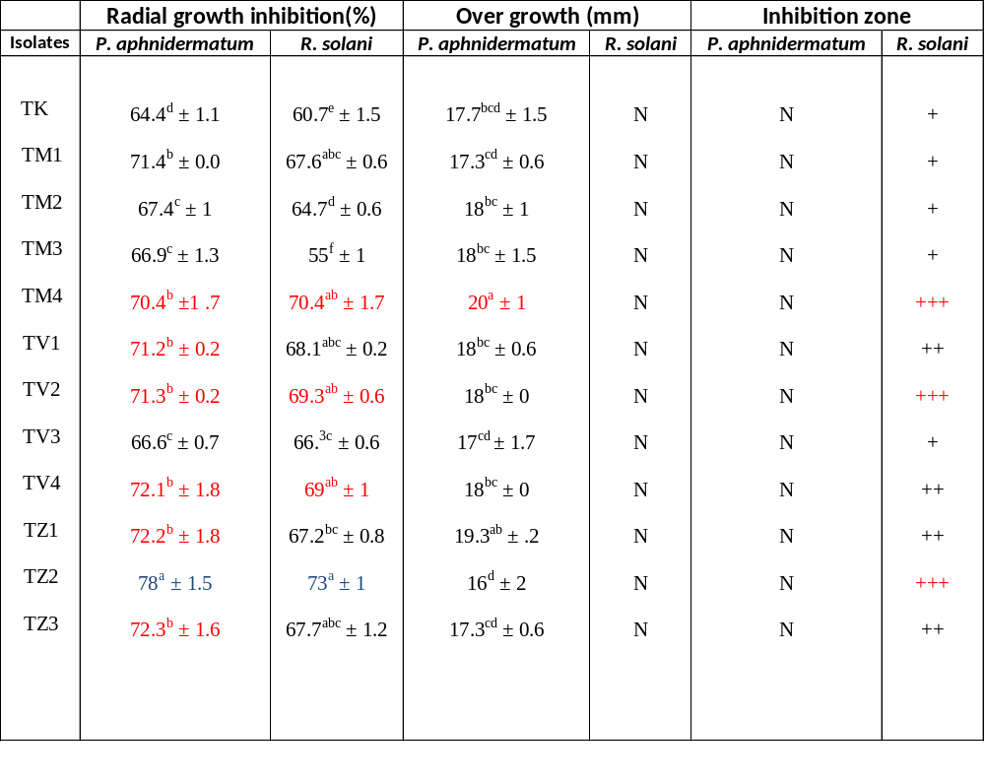
No over growth of trichoderma on R. Solani
No inhibition zones were observed between trichoderma and P. aphnidermatum

Slide 14
Conclusion
PCR-based RAPD techniques are useful tool to cluster, verify, and prove taxonomy morphology-based data
The isolates of Trichoderma harizianum and Trichoderma viride were the most active against R.Solani and P. aphnidermatum

Slide 15
Future working
    Trichoderma contain a large number of genes which allow biocontrol to occur
    Trying cloning certain genes from Trichoderma and introduce them into plants to obtain crops resistant to plant diseases

Slide 16
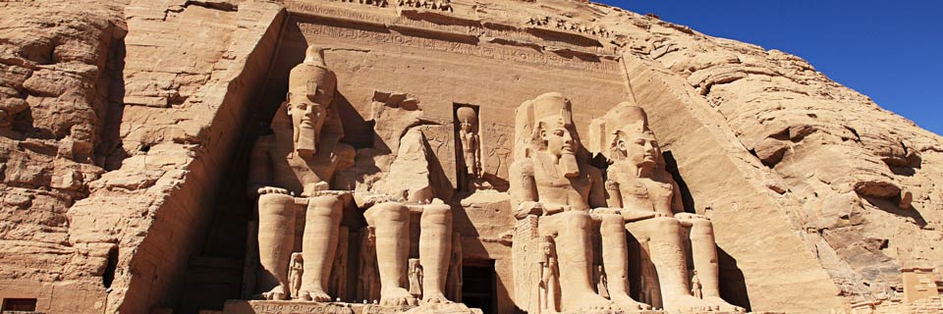
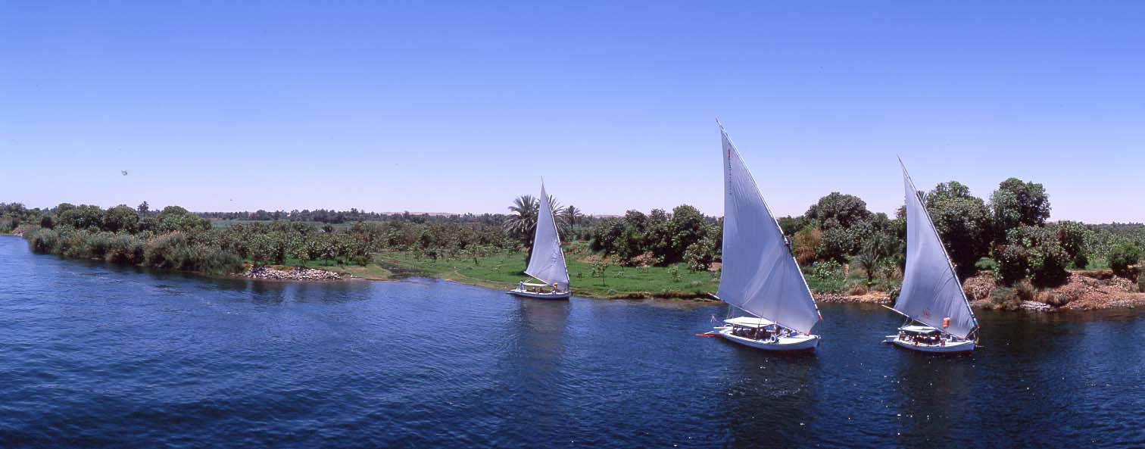
THANK YOU

