Slide 1
Rational Design Of Small Molecule Immune Checkpoints’ Inhibitors
Khaled Barakat, PhD
Faculty of Pharmacy & Li Ka Shing Institute of Virology
University of Alberta

Slide 2
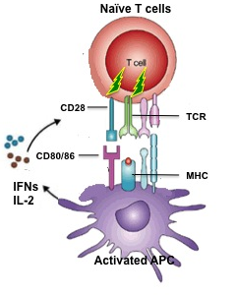
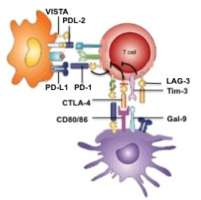
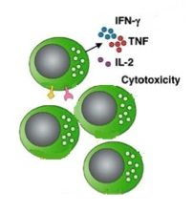
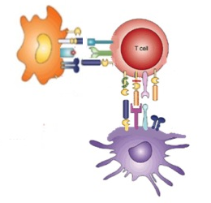


Tumors Induce T Cell Dysfunction
Naïve T Cell
Normally
Chronic Infection Or Tumor
Exhausted T Cell
Exhausted T cells
Activated effector T cells
PDL-1
PD-1
CTLA-4
Tim-3
CD80/CD86
Gal-9
Blocking The Inhibitory Receptor Reactivates T cells
Notes:
Red cross

Slide 3
Immune Checkpoint Blockers Revolutionized The Landscape Of Oncology
Blocking the immune inhibitory checkpoint pathways recently emerged as ‘game changing’ in cancer immunotherapy.
They reactivate the immune system to recognize and kill tumor cells.
Blocking multiple checkpoints has synergistic effects.
These blockers have very broad potential and tremendous clinical impact on many solid tumors.

Slide 4
Current Checkpoints Blockers Are Limited
Currently, they are limited to antibodies.
these antibodies have numerous disadvantages including cost and side effects.
They are very expensive, making them financially inaccessible to many patients.
They require bolus intravenous injections every 3 weeks leading to problems in controlling the side effects.
  These side effects include autoimmunity as well as many immune-related adverse effects, which include rash (47-68%), diarrhea, colitis (31-46%), hepatotoxicity (3-9%) among others.
J Clin Oncol. 2012 Jul 20;30(21):2691-7
Notes:
We need to have percentage of side effects.
Side effects can be delayed even if you stop the treatment.

Slide 5
These limitations suggest that the full potential of the immune checkpoint blockade has yet to be fulfilled.
PATIENTS NEED SAFER, MORE AFFORDABLE AND CLINICALLY CONTROLLED ALTERNATIVES.

Slide 6
Small Molecules Can Provide A Safer And Affordable Alternative
Small molecules can overcome current MABs’ limitations and reduce the treatment cost.
They can provide increased oral bioavailability and shortened half-life activity for a more controllable treatment, particularly, in the case of autoimmune or other adverse events.
They can also offer greater distribution within the tumor tissue and access the blood-brain-barrier better than MABs to treat brain tumors.

Slide 7
Modelling PPI And Identify Binding sites
Fragment-based design Of Novel Inhibitors
In Silico Screening of ≈2,000,000 Small Molecules
Chemical Synthesis
300 - 500 Hits
Direct Binding assays
10-20 novel Compounds
~30 Hits
Lead Translation
Lead Identification
&Optimization
~5 Hits
In Vitro Assays
~2 leads

Slide 8
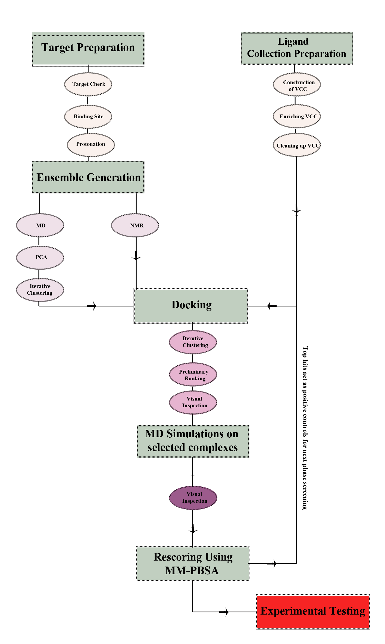
Barakat K, et al. J Mol Graph Model. 2009 Sep;28(2):113-30
Barakat K, et al. “Virtual Screening: An Overview on Methods and Applications”. Handbook of Research on Computational and Systems Biology: Interdisciplinary Applications. IGI Publishing. (Published, January 2010)
-Barakat K, et al. J Mol Graph Model. 2010 Feb 26;28(6):555-68.
-Barakat K. et al. “Virtual Screening for
DNA repair proteins. DNA Repair / Book 1.
InTech open access publisher. Published
September, 2011.
-Barakat K. et al. J Mol Graph Model.
2011 Feb;29(5):702-16.
-Barakat K. et al. PLoS One. 2012;7(12)
:e51329.
-Barakat K. et al. Mol Pharmacol. 2013 Jul;
84(1):12-24.
-Barakat K. et al. J Chem Inf Model. 2013
Nov 25;53(11):3031-43.
-Barakat K. et al. Mol Pharm. 2013 Dec 2;
10(12):4572-89.
-Barakat K. et al. IJCMAM. 2014; 1(4): 127
-Barakat K. et al. J Chem Inf Model. 2014;
Apr 14. [Epub ahead of print].
-Viricel et al JMGM 57, 131-142
On Local Machines
On Supercomputers
Notes:
The overall flow used in virtual screening can be divided into two major steps. The initial step run on local machines involves the preliminary preparation of both the target protein (target check, binding site identification and protonation) and the used virtual screening collection (VCC). This step is not computationally expensive and can be run on a single computer machine for one day. The most computationally demanding step is the construction of a reliable ensemble of protein structures which involves a long molecular dynamics (MD) simulations. Without using the Blue Gene/Q machine, a typical MD simulation of length 10 nano seconds would take 3 weeks on a 64 computer cluster. On the other hand, using the Blue Gene machine we have reached exceptional simulation time for over 100ns and for only 2 weeks of computational time. This step is crucial in introducing realistic accountability of the target protein flexibility in the subsequent molecular docking simulations. Principal component analysis (PCA) is used to detect the degree of sampling in the MD trajectory. This is followed by clustering analysis of this trajectory to select the dominant conformations of the binding site. Each conformation is then used for molecular docking against the whole collection of small molecules (VCC). This usually involves millions of docking experiments. Top hits are then prepared within the binding site of the target for an additional set of MD simulations (an additional 1000 MD simulations for the top 1000 hits). The most stable structures are then visually inspected and run through binding energy analysis for final scoring prior to experimental testing. In a nutshell, without using the Blue Gene/Q supercomputer, a typical application of this workflow would take 1 year of continuous calculations on computer resources that was previously available to our group. Using blue gene directly reduced the time to complete this workflow and raised the quality of our work.

Slide 9
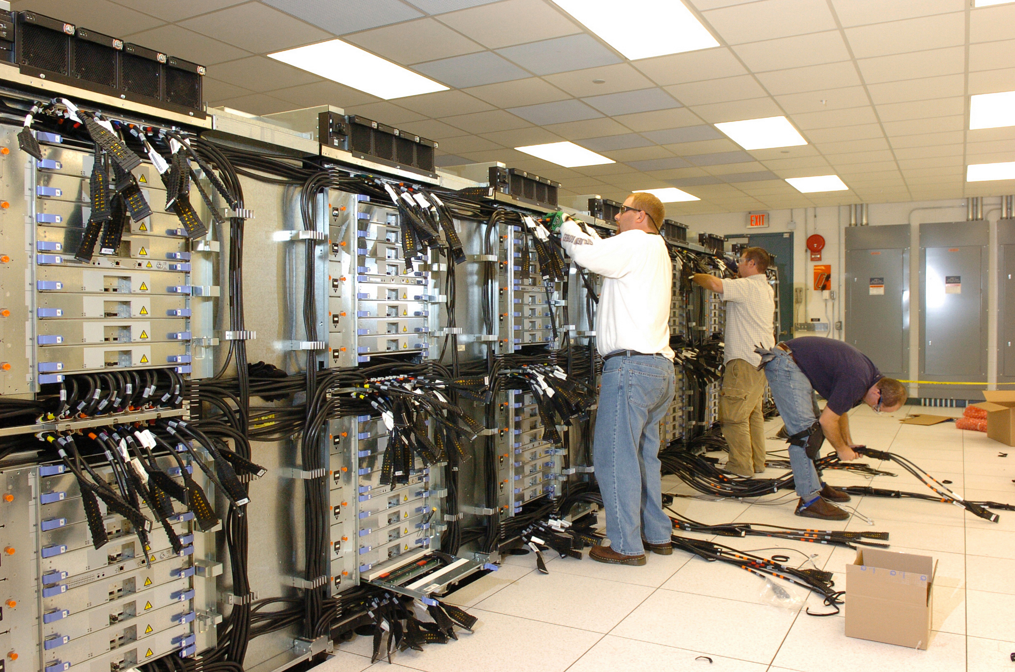

Slide 10
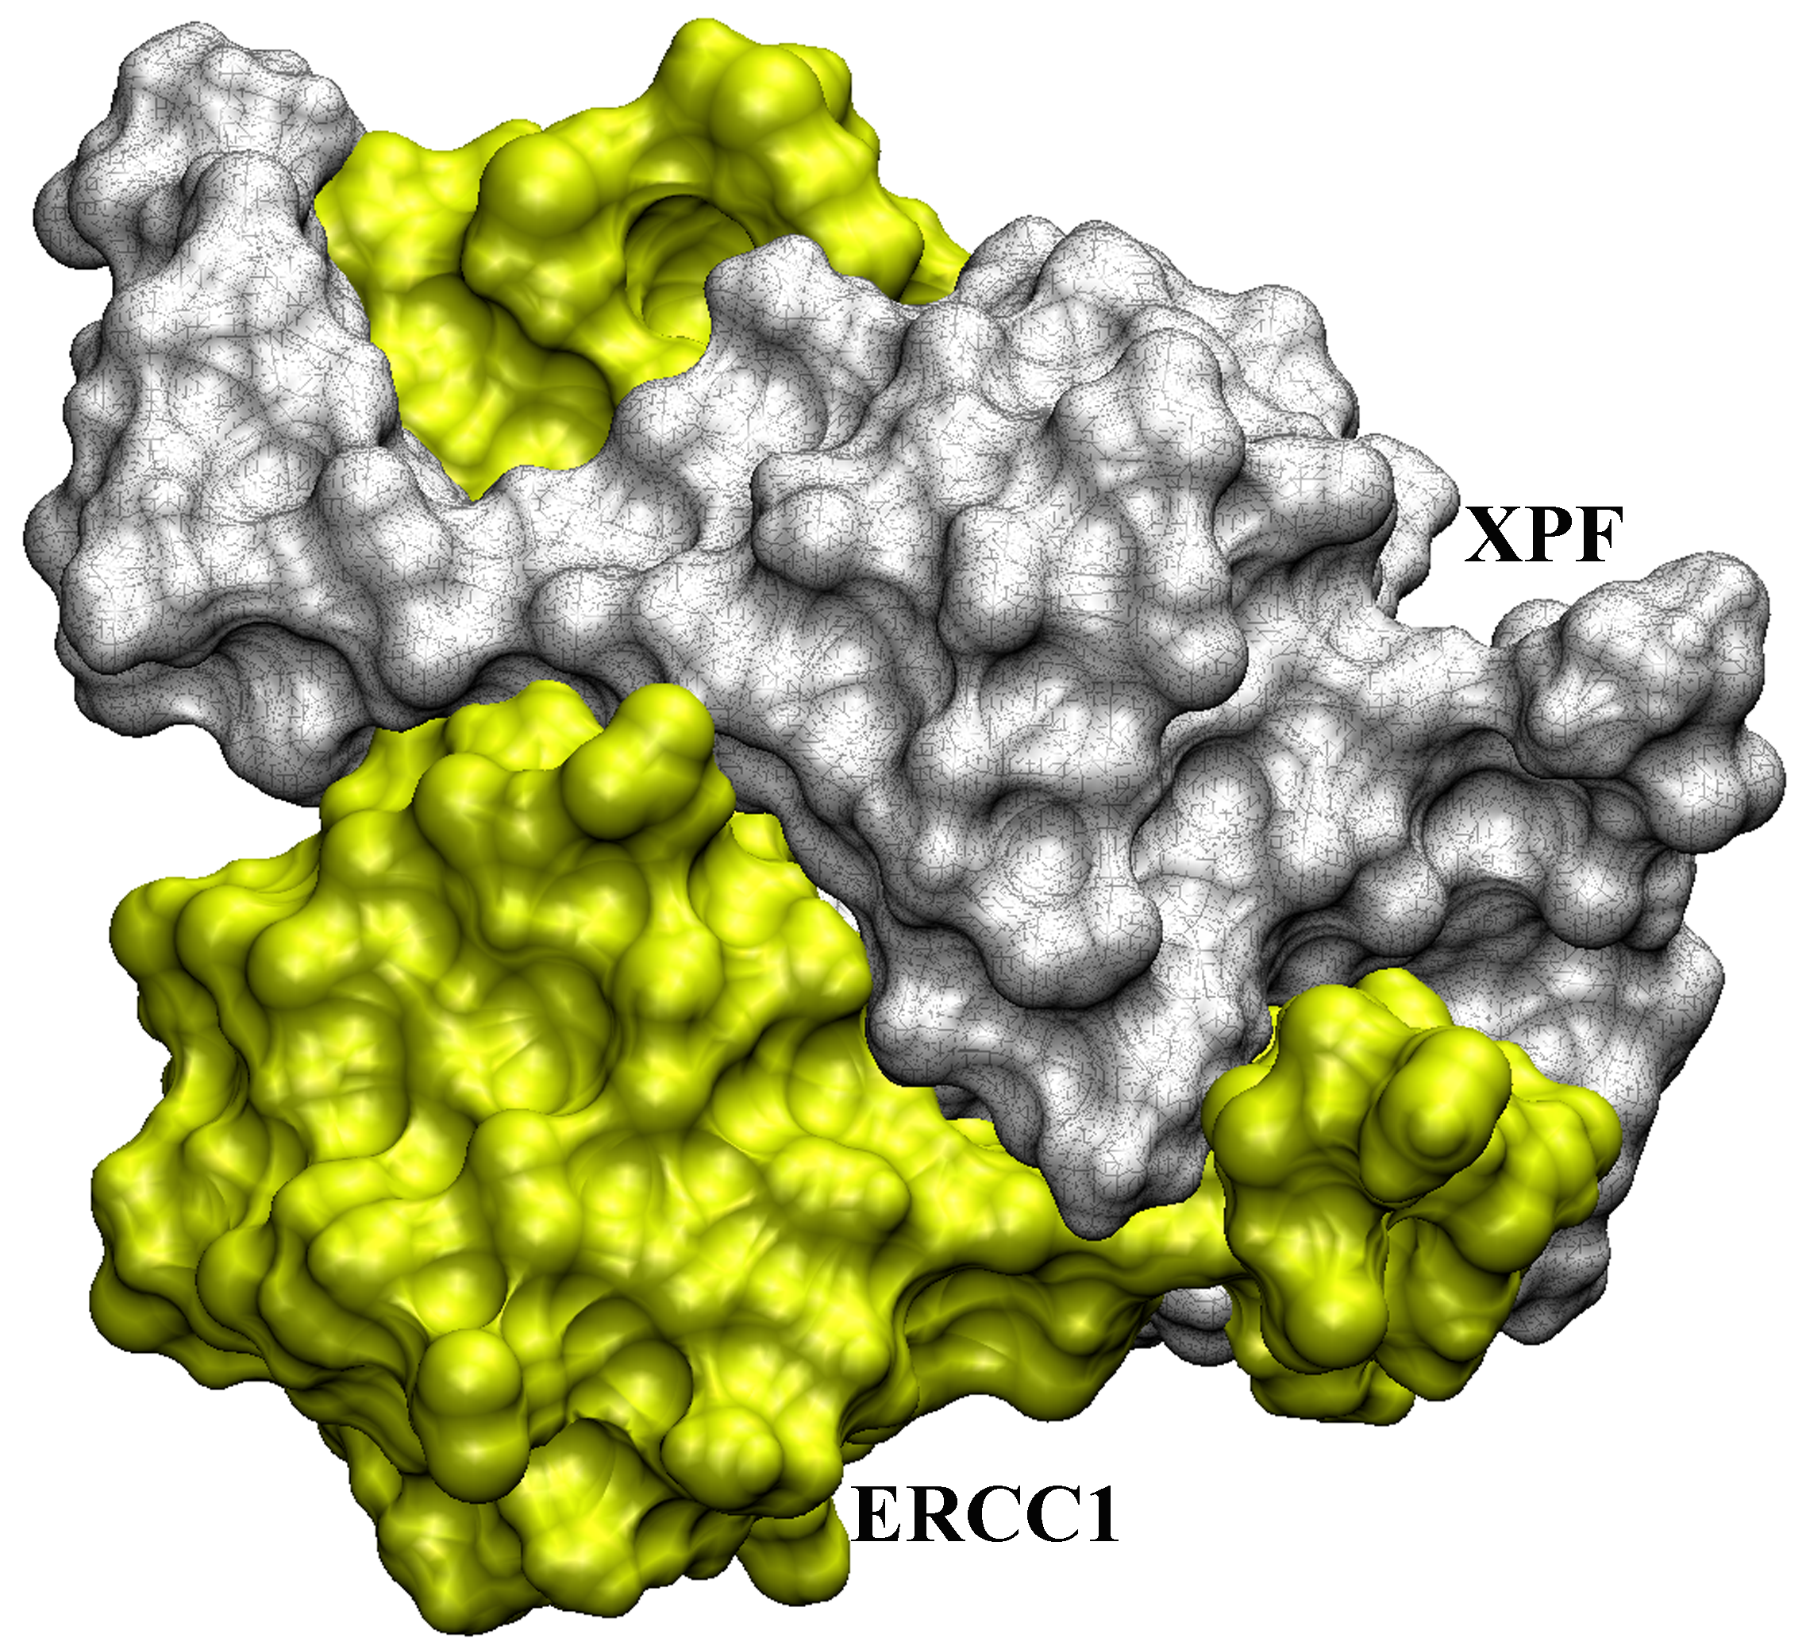
Example: Targeting Nucleotide Excision DNA Repair. XPF-ERCC1

Slide 11
NERI02
Mol Pharmacol. 2013 Jul;84(1):12-24

Slide 12
PD-1 INHIBITORS
Viricel et al JMGM 57, 131-142

Slide 15
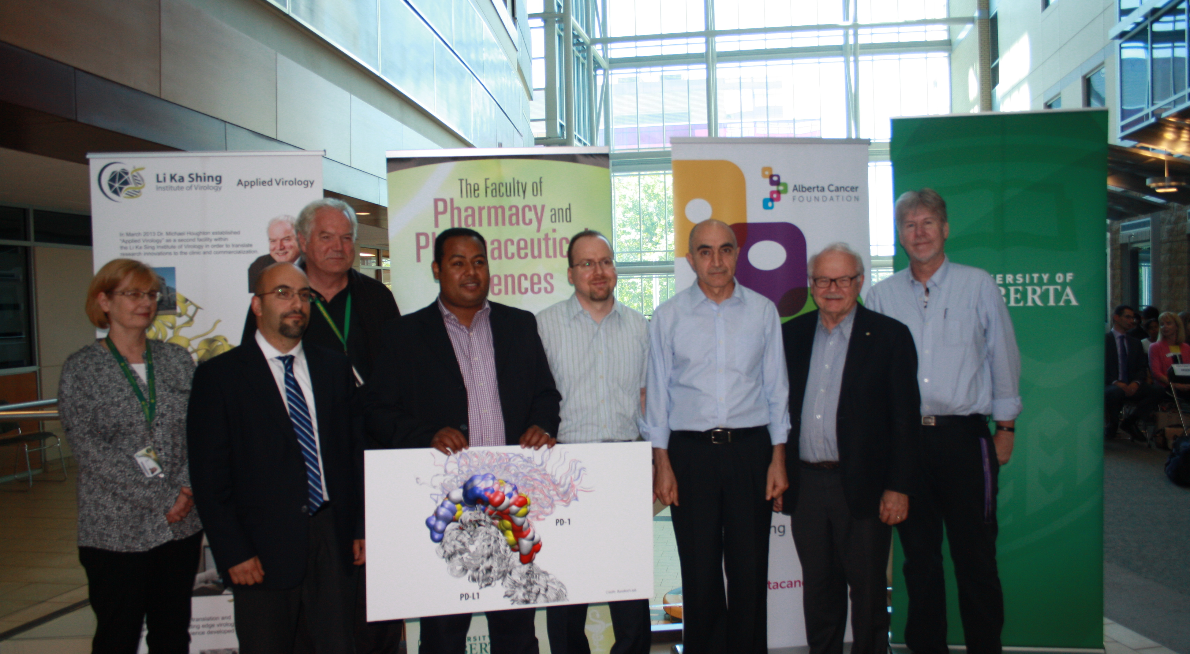
Recently, we received a $5.4M team grant to develop these small molecules through a joint partnership between the Alberta Cancer Foundation (ACF) and the Applied Virology Institute (AVI).

Slide 16
CD8 T Cell Proliferation

Slide 17
CD4 T Cell Proliferation

Slide 18
CONCLUSION
Immune Checkpoints Blockers Are Revolutionizing The Landscape Of Oncology.
They are limited to MABs, which have numerous disadvantages including cost and side effects.
PATIENTS NEED A SAFER, MORE AFFORDABLE AND CLINICALLY CONTROLLED ALTERNATIVES.
Small molecules can overcome current MABs’ limitations and reduce the treatment cost.
We already established the necessary tools to rationally design these molecules in human.
Notes:
We have been able to use . . . Hit rate

Slide 19




ACKNOWLEDGMENTS
Barakat’s Lab
Houghton’s Lab
Tyrrell’s Lab
Dr. Aviad Levin
Elahi’s Lab
Hitt’s Lab
West’s Lab
Siraki’s Lab
Smylie’s Lab
Walker’s Lab
Applied Virology Institute
Dr. James Nieman

Slide 20
Thank You !

