Slide 1
About OMICS Group
OMICS Group International is an amalgamation of Open Access publications and worldwide international science conferences and events. Established in the year 2007 with the sole aim of making the information on Sciences and technology ‘Open Access’, OMICS Group publishes 400 online open access scholarly journals in all aspects of Science, Engineering, Management and Technology journals. OMICS Group has been instrumental in taking the knowledge on Science & technology to the doorsteps of ordinary men and women. Research Scholars, Students, Libraries, Educational Institutions, Research centers and the industry are main stakeholders that benefitted greatly from this knowledge dissemination. OMICS Group also organizes 300 International conferences annually across the globe, where knowledge transfer takes place through debates, round table discussions, poster presentations, workshops, symposia and exhibitions.

Slide 2
About OMICS Group Conferences
OMICS Group International is a pioneer and leading science event organizer, which publishes around 400 open access journals and conducts over 300 Medical, Clinical, Engineering, Life Sciences, Phrama scientific conferences all over the globe annually with the support of more than 1000 scientific associations and 30,000 editorial board members and 3.5 million followers to its credit.
OMICS Group has organized 500 conferences, workshops and national symposiums across the major cities including San Francisco, Las Vegas, San Antonio, Omaha, Orlando, Raleigh, Santa Clara, Chicago, Philadelphia, Baltimore, United Kingdom, Valencia, Dubai, Beijing, Hyderabad, Bengaluru and Mumbai.

Slide 3

Impact of metal-loaded industrial dust on the physiology of a model experimental animal
Khadiga G. Adham*¹
Ghada M.S. Alfuhaid²
Nadia A. Al- Eisa¹
Maha H. Daghestani¹
¹King Saud University, Riyadh, Saudi Arabia
²Hail University, Saudi Arabia
*presenting author

Slide 4
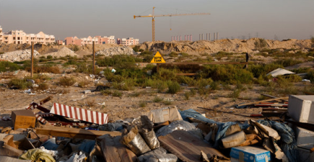
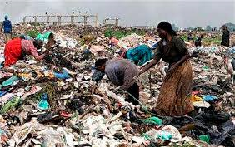


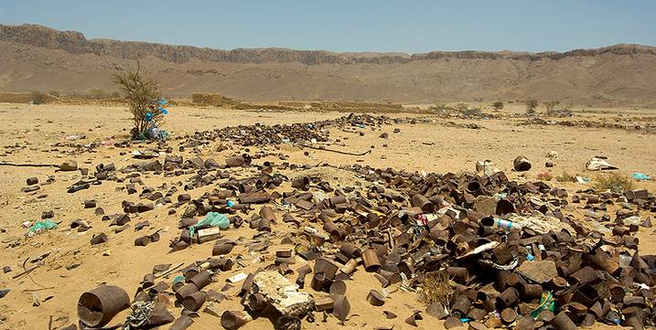
2
Environmental pollution is a major global concern that poses a serious threat to the health of man and animal.

Slide 5

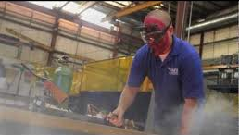


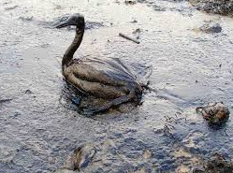

3
The development of modern technology and the rapid progress in industrialization are among the foremost factors contributing to environmental pollution.
#2

Slide 6


One of the most fast growing industries in Hail City is the construction industry.
4
Expanding industrial areas are acknowledged for distributing toxic heavy metals into the environment.

Slide 7
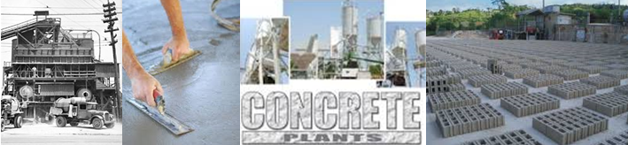
5
Concrete is the second most used product in the world, after water, and the concrete industry is a key component of both commercial and residential construction.
#2

Slide 8
6
Comparison of trace element concentrations (mg/Kg) in different brands of Portland cement
Brand | Cr | Ni | Cd | Cu | Co | Zn
Askari | 38 | 20 | 1 | 10 | 12 | 34
Cherat | 24 | 27 | >1 | 20 | 9 | 85
D.G. Khan | 53 | 38 | 1 | 16 | 15 | 29
Lucky | 58 | 35 | 3 | 11 | 13 | 25
Best way | 48 | 31 | 3 | 11 | 18 | 25
Kohat | 48 | 55 | 3 | 14 | 13 | 29
Pak Cem | 67 | 45 | 4 | 18 | 27 | 38
After Wali et al. (2012)
This table shows concentrations of trace elements in Portland cement used in concrete industry. Trace elements include Cr, Ni, Cd, Cu, Co and Zn. Therefore this study dealt with two essential and two non essential elements of the referred to roster.

Slide 9


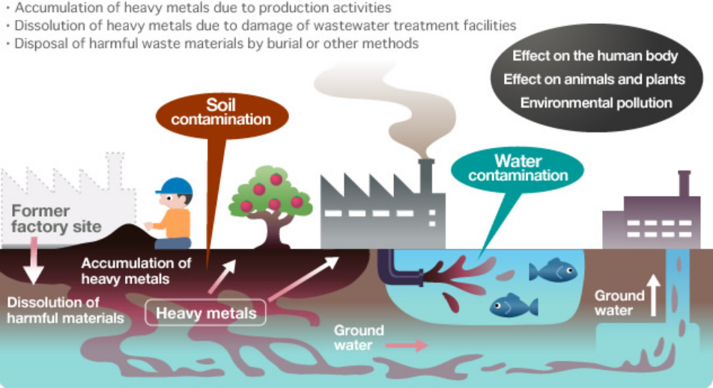

7
Metals and metalloids are persistent pollutants that neither biodegrade, nor are they eliminated by incineration processes.
Industrial polymetal dust is a widespread urban pollutant of great concern to human and animal health
Terrestrial vertebrates have long been reported to bi-oaccumulate heavy metals in different tissues.

Slide 10
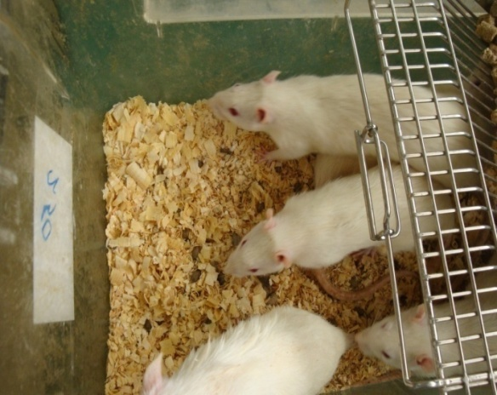
8
Rattus norvegicus
  a 2 mL daily dose for 60 days
  C group H₂O
  D1 group 0.001 Kg⁻¹ body weight
  D2 group 0.002 Kg⁻¹ body weight
  All groups were allowed free access to water and food
  D1 and D2 doses are water suspension of concrete dust
Notes:
0

Slide 11
9
liver
Varian Atomic Absorption Spectrometer
Cd, Pb, Cu and Zn
accumulation
kidney
Red blood cell indices
Hemogram
Beckman Coulter Hematology Analyzer
leukogram
ALT
Liver function
AST
cobas c 311 analyzer
ALP
DNA damage
Liver DNA concentration
QIAamp DNA Mini Kit

Slide 12
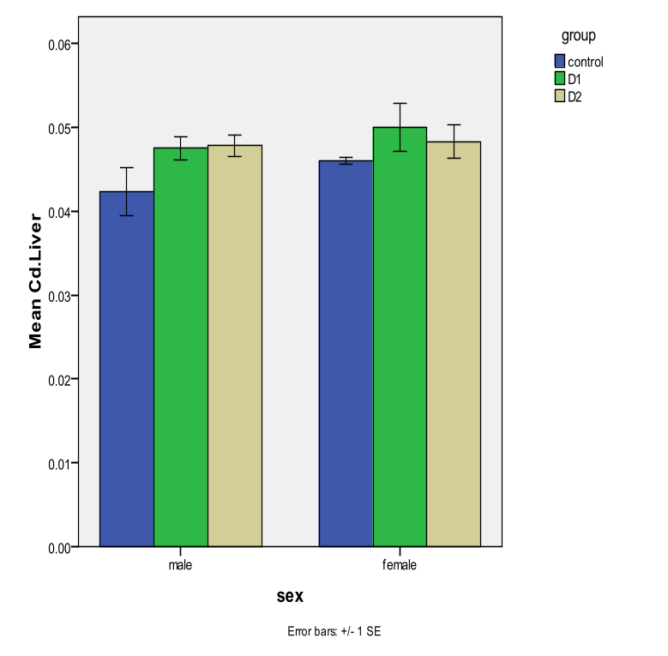
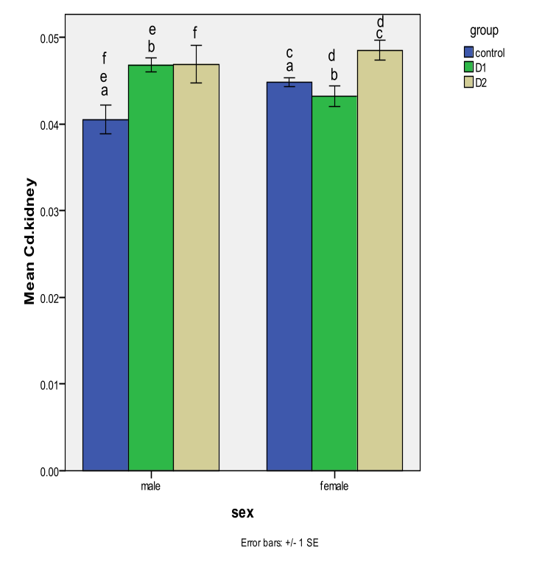
10
Cd accumulation in the liver and kidneys of both sexes of Rattus norvegicus
Mean ± SE Cd concentrations (µg g¯¹) in the liver and kidney of male and female rats (R. norvegicus).

Slide 13
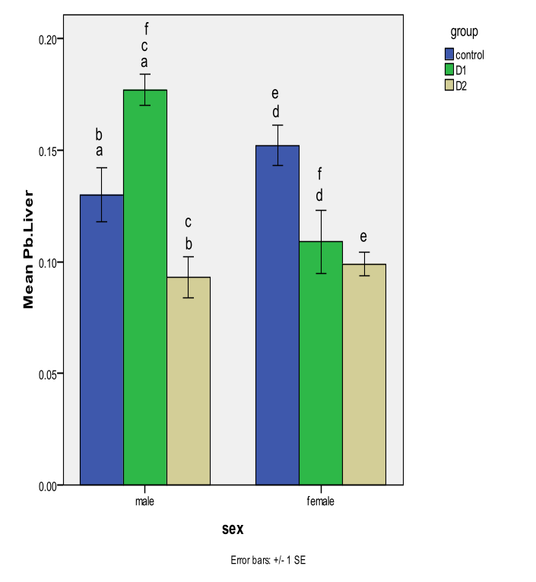
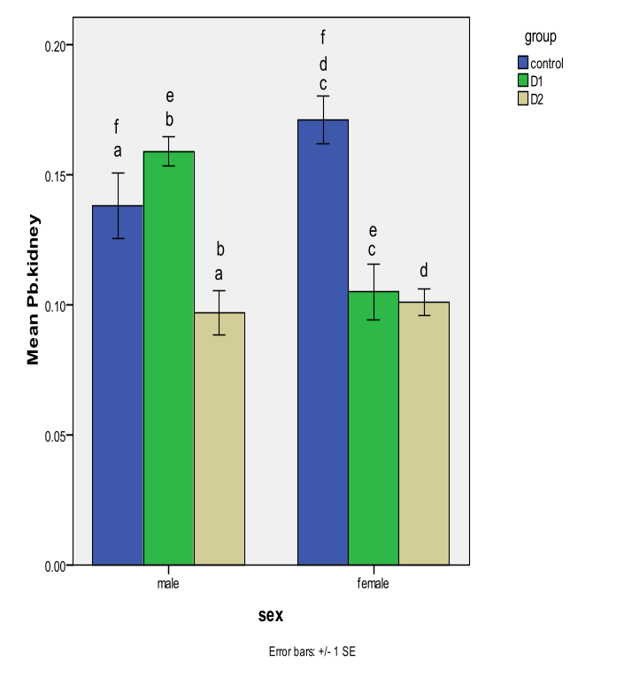
Pb accumulation in the liver and kidneys of both sexes of Rattus norvegicus
11
Mean ± SE Pb concentrations (µg g¯¹) in the liver and kidney of male and female rats (R. norvegicus).

Slide 14
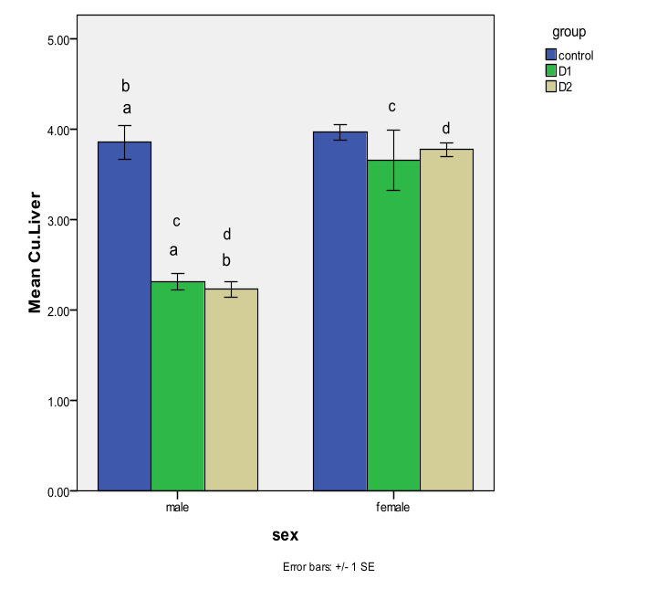
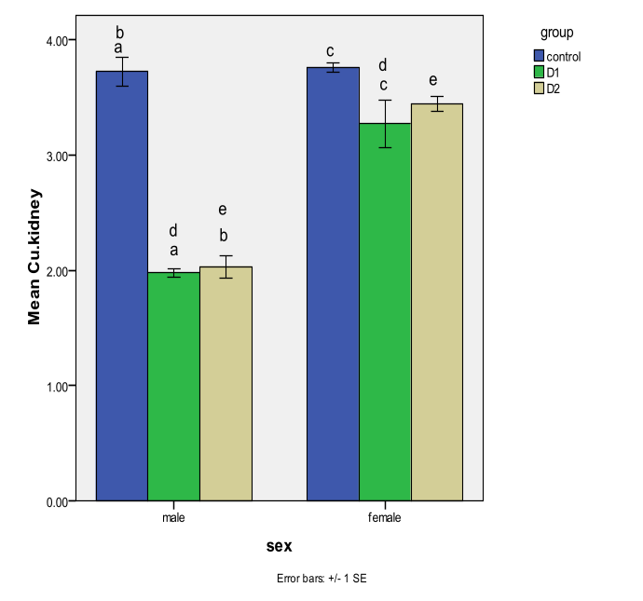
12
Cu accumulation in the liver and kidneys of both sexes of Rattus norvegicus
Mean ± SE Cu concentrations (µg g¯¹) in the liver and kidney of male and female rats (R. norvegicus).

Slide 15
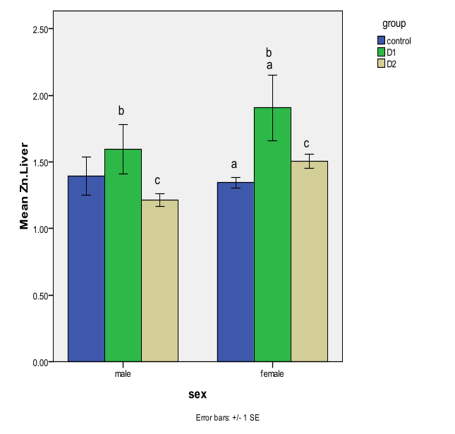
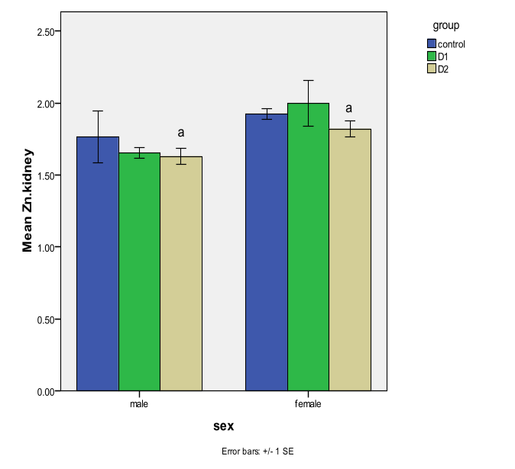
13
Zn accumulation in the liver and kidneys of both sexes of Rattus norvegicus
Mean ± SE Cu concentrations (µg g¯¹) in the liver and kidneys of male and female rats (R. norvegicus).

Slide 16
14
  Essential and non essential metal accumulation in the liver and kidneys
higher bioavailability of toxic versus essential metals.

Slide 17
RBCs indices in male rats given doses D1 and D2 of industrial dust compared to control
15
D2 | D1 | C
7.2940 ± 0.82 | 7.81 ± 0.89 | 8.12 ± 0.20 | RBC
802.20 ± 104.14 | 859.10 ± 46.62 | 986.20 ± 41.18 | PLT
13.2300 ± 1.48 | 15.6700 ± 0.52 | 14.49 ± 0.18 | Hb
47.3000 ± 5.31 | 45.8000 ± 5.11 | 51.90 ± 0.46 | MCV
16.3700 ± 1.83 | 15.8500 ± 1.78 | 17.83 ± 0.16 | MCH
31.1700 ± 3.47 | 31.1100 ± 3.46 | 34.39± 0.14 | MCHC
38.2500 ± 4.30 | 45.4700 ± 1.71 | 42.10± 0.44 | PCV/HCT
12.8500 ± 0.93 | 10.7100 ± 1.23 | 12.15 ± 0.22 | RDW
WBCs differential count in male rats given doses D1 and D2 of industrial dust compared to control
D2 | D1 | C
12.99 ± 1.83 | 16.33 ± 1.01 | 12.14 ± 1.09 | WBC
1.79 ± 0.44 | 1.88 ± 0.43 | 2.31 ±0.34 | Neutrophils
8.44 ± 1.26 | 10.79 ± 0.75 | 7.93 ± 0.57 | Lymphocytes
1.04 ±0.26 | 1.25 ±0.28 | 1.40 ±0.18 | Monocytes
0.46 ± 0.08 | 0.55 ± 0.09 | 0.45 ± 0.07 | Eosinophils
RBC, Hb, MCV, MCH, MCHC, PCV-HCT, RDW and WBC (red blood cell, hemoglobin, mean corpuscular volume, Mean Corpuscular Hemoglobin , mean corpuscular hemoglobin concentration, packed cell volume-hematocrit, Red cell distribution width and white blood cell)

Slide 18
RBCs indices in female rats given doses D1 and D2 of industrial dust compared to control
16
D2 | D1 | C
7.59 ± 0.15 | 7.84 ± 0.17 | 7.5290 ± 0.09 | RBC
954.10 ± 39.60 | 819.60 ± 85.00 | 803.00 ± 35.09 | PLT
14.0700 ± 0.21 | 14.84 ± 0.39 | 13.98 ± 0.42 | Hb
52.4000 ± 0 .50 | 53.3000 ± 0.63 | 51.90 ± 1.59 | MCV
18.5700 ± 0.22 | 18.91 ± 0.22 | 18.56 ± 0.57 | MCH
35.5200 ± 0.25 | 35.41 ± 0.12 | 35.62 ± 0.27 | MCHC
39.6200 ± o.61 | 41.88 ± 1.06 | 39.17 ± 1.11 | PCV/HCT
10.7900 ± 0.22 | 10.40 ± 0.13 | 10.74 ± 0.31 | RDW
WBCs differential count in female rats given doses D1 and D2 of industrial dust compared to control
D2 | D1 | C
6.84 ± 0.71 | 5.69 ± 0.90 | 8.71 ± 0.810 | WBC
1.5570 ± 0.22 | 1.01 ± 0.19 | 1.73 ± 0.33 | Neutrophils
4.2690 ± 0.45 | 3.42 ± 0.54 | 5.22 ± 0.46 | Lymphocytes
0.7270 ± 0.07 | 0.62 ± 0.11 | 0.97 ± 0.18 | Monocytes
0.2620 ± 0.08 | 0.23 ± 0.07 | 0.43 ± .08 | Eosinophils
RBC, Hb, MCV, MCH, MCHC, PCV-HCT, RDW and WBC (red blood cell, hemoglobin, mean corpuscular volume, Mean Corpuscular Hemoglobin , mean corpuscular hemoglobin concentration, packed cell volume-hematocrit, Red cell distribution width and white blood cell)

Slide 19
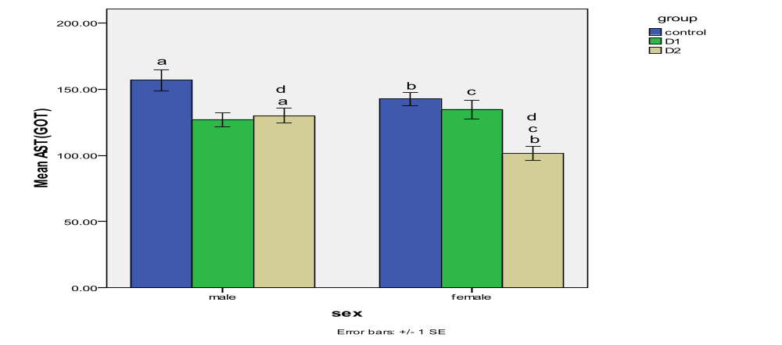
Serum AST activities in both sexes of Rattus norvegicus
17
Mean ± SE Serum AST activities (UL⁻¹) in male and female rats (R. norvegicus).

Slide 20
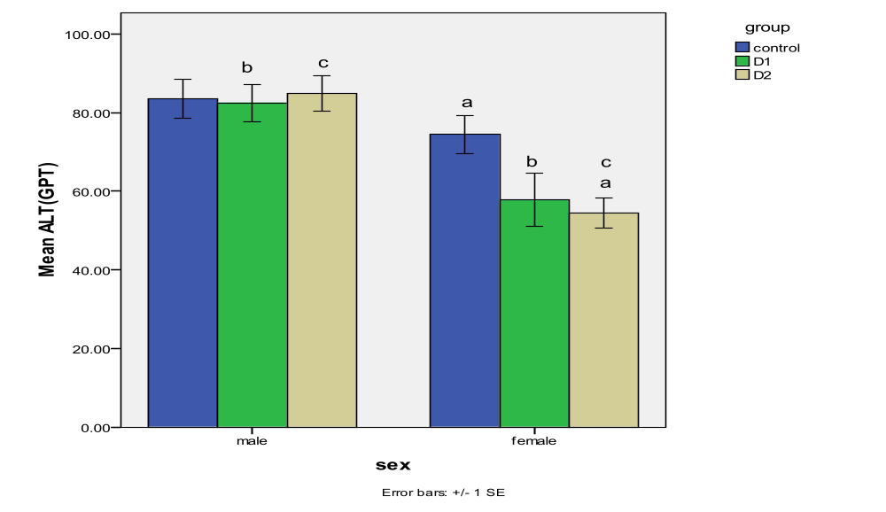
Serum ALT activities in both sexes of Rattus norvegicus
18
Mean ± SE Serum ALT activities (UL⁻¹) in male and female rats (R. norvegicus).

Slide 21
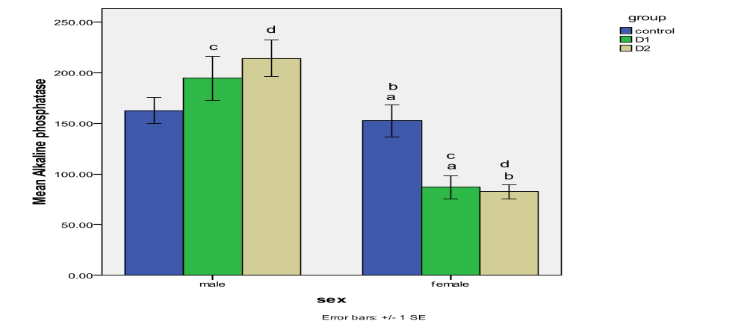
Serum ALP activities in both sexes of Rattus norvegicus
19
Mean ± SE Serum ALP activities (UL⁻¹) in male and female rats (R. norvegicus).

Slide 22
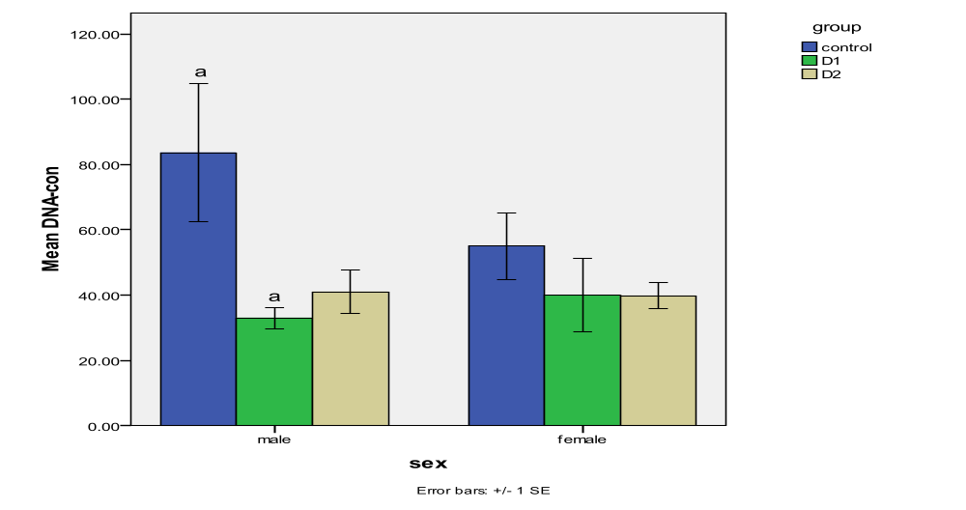
Liver DNA content in both sexes of Rattus norvegicus
20
Mean ± SE Liver DNA concentrations (ng µL⁻¹) in male and female rats (R. norvegicus).

Slide 23
21
conclusions
Sex factor effect is negligible
Tissue specific metal accumulation
Higher bioavailability of non essential versus essential elements

Slide 24
conclusions
22
Adverse physiological and health effects including:
Disturbances in blood coagulation activities
Stress-based leukocyte mobilization
Challenge of the immune system
DNA damage
Compensation of the deleterious effects of polymetal dust by detoxification pathways

Slide 25

Thank You
Khadiga Adham, M.Sc., Ph.D.
Professor of Physiology
King Saud University
Alexandria University
kadham@ksu.edu.sa
kadham_100@yahoo.com

Slide 26
Let Us Meet Again
We welcome you all to our future conferences of OMICS Group International
Please Visit:
www.omicsgroup.com
www.conferenceseries.com
www.pharmaceuticalconferences.com

