Slide 1

Est. 2001
Kevin Murray
VP Global Sales

Slide 2
Cytocentric Platform
Total Quality Approach for Cells Outside the Body

Slide 3
CELLS ex vivo
TRANSPORT
Incubator to hood
Hood to machine
INCUBATION
HANDLING
MACHINES
CO2 incubator
O2/CO2 incubator
Thermal incubator
BSL2 Hood
Etc.
Laminar clean hood
Glove box
Lab bench
Etc.
Microscope
Sorter
Separator
Reader
Hood to incubator
Machine to incubator
Etc.
Etc.
Centrifuge
Mixer
Analyzer
Robot
Etc.
Etc.
Notes:
If you define the path

Slide 4
CYTOCENTRIC
Beyond the needs of people to meet the needs of cells.
Notes:
So what is Cytocentic? In essence, it is a new and better way to culture and handle cells when they are outside the body. It goes beyond the apparent and perceived needs of most people to actually address and meet the underlying real needs of the cells. Conventional equipment is more oriented towards the needs of people, so we call it people centric. Conventional incubators and hoods are good products and well designed to do the job they were meant to do, but only as appliances for people. Cytocentric takes cell incubation and processing equipment to a higher level, or maybe a deeper level, for the sake of the cells. Of course it is people who benefit.

Slide 5
CYTOCENTRIC PRINCIPLES
Cells Need Full Time Protection
Cells Need Full Time Optimization
Cells Need Physiologic Simulation
Cells Need Dynamics
Cells Need Protocol
Cells Need to Fit
Cells Need Accountability
Cells Need Technician Protection
Notes:
The Cytocentic approach to cell incubation and handling is based on 8 principles. The first 5 are core cell principles. Cells need full time protection from microbial contamination, not part time like conventional people centric equipment provides. Cells need full time, not part time, optimization of all critical parameters during their entire existence outside the body, during incubation, during handling, during manipulation, during manual processing, during machine processing, during examination, and during the transport back and forth and waiting between all these. Conventional equipment can only optimize part time. Cells need physiologic simulation, not air. Conventional equipment mostly provides air. Cells need dynamic conditions. After all they are dynamic entities not static entities. Conventional equipment only provides static, limiting conditions. Cells need their own specific protocols, and not be forced into the same, routine, lowest common denominator protocol as every other cell, like done in conventional equipment. The last 3 principles are not core cell principles like the first 5, but are still primary guiding principles in cytocentric equipment design in keeping with a higher level approach. More about all these later.

Slide 6
Full Time Protection

Slide 7
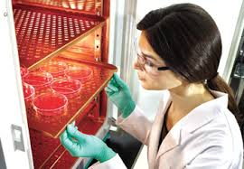
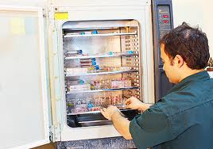
People Centric Incubators
OPEN
Notes:
Conventional incubators designed for people make it easy for people to move cells in and out. The direct exposure to microbial contamination from people and room air

Slide 8
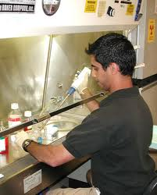
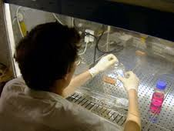
People Centric Hoods
OPEN

Slide 9
Cytocentric Incubators
CLOSED
X3 attaches to closed cytocentric hoods.
Never opens into room.
Opens only into aseptic closed hood workspace.
Conventional incubator made cytocentric.
Inside closed hood, never opens into room.
Opens only into aseptic closed hood workspace.
Subchambers in remote open incubators.
Closed incubation and transport, never opens into room.
Opens only into aseptic closed hood workspace.

Slide 10
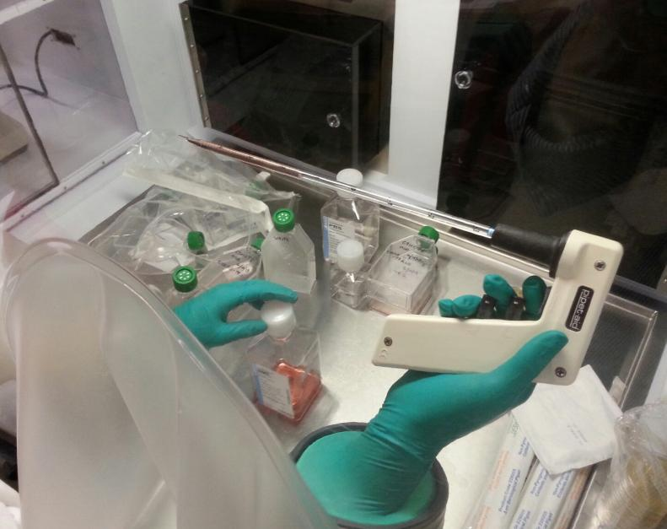

Slide 11
Full Time Optimization

Slide 12

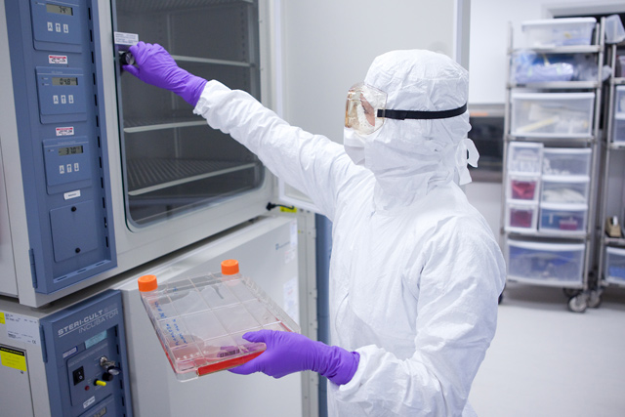
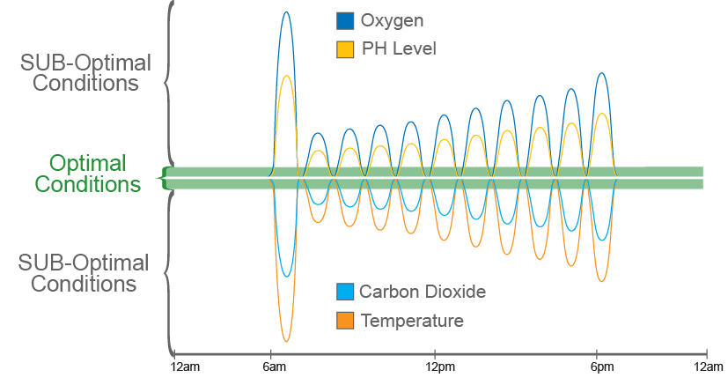
Traditional Cleanroom
12 hours of incubator access (open and closing door) – 1 culture

Slide 13
Traditional Cleanroom
Variability
12 hours of incubator access (open and closing door) – 1 culture

Slide 14

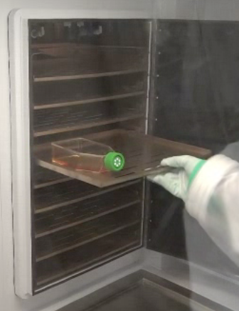
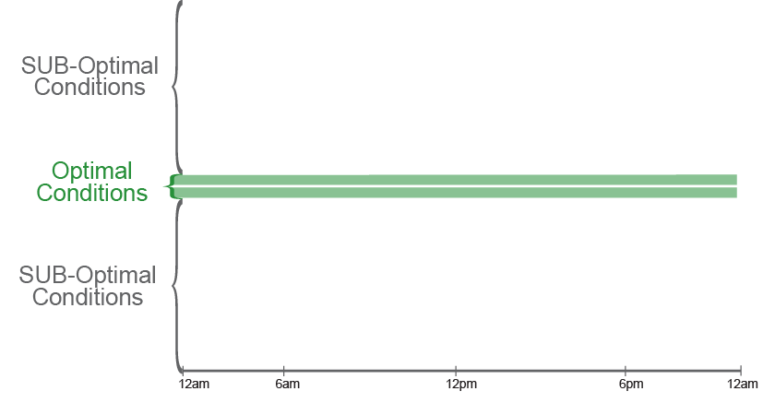
BioSpherix GMP System
12 AM
6 AM
12 PM
6 PM

Slide 15
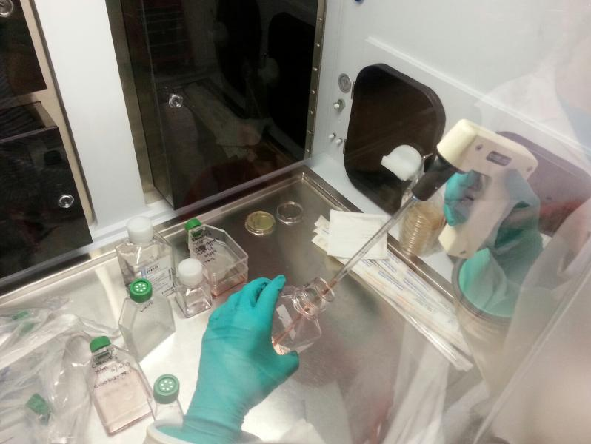
Optimal Conditions:
CO2 levels (5%)
Temp (37C)
Oxygen

Slide 16
CELLS ex vivo
TRANSPORT
Incubator to hood
Hood to machine
INCUBATION
HANDLING
MACHINES
CO2 incubator
O2/CO2 incubator
Thermal incubator
BSL2 Hood
Bioreactor
Laminar clean hood
Glove box
Lab bench
Etc.
Microscope
Sorter
Separator
Reader
Hood to incubator
Machine to incubator
Etc.
Etc.
Centrifuge
Mixer
Analyzer
Robot
Etc.
Etc.
Etc.
Notes:
If you define the path

Slide 17
FULL TIME OPTIMIZATION
INCUBATOR
HOOD
MACHINES
TRANSPORT
XVIVO SYSTEM
INCUBATOR
HOOD
MACHINES
TRANSPORT
OPEN LABS
KEY: Optimal Suboptimal

Slide 18
Physiologic Simulation

Slide 19
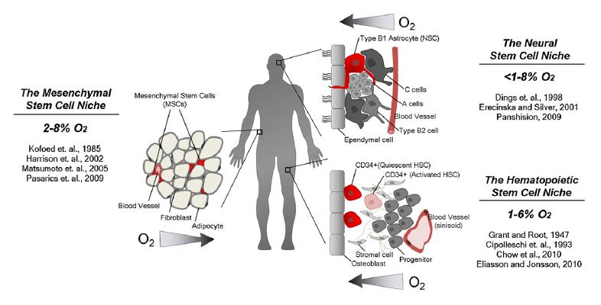
What is Physiologic?
Mohyeldin et al, CELL STEM CELL (2010) 7(2), p.151.

Slide 20
Conventional Incubator
Cytocentric Incubator
Temperature
Carbon Dioxide
Oxygen
Temperature
Programmable Temperature
Uninterruptible Temperature
Carbon Dioxide
Programmable Carbon Dioxide
Uninterruptible Carbon Dioxide
Oxygen
Programmable Oxygen
Uninterruptible Oxygen
pH
Programmable pH
Uninterruptible pH
Carbon Monoxide
Programmable Carbon Monoxide
Uninterruptible Carbon Monoxide
Nitric Oxide
Programmable Nitric Oxide
Uninterruptible Nitric Oxide
Ozone
Programmable Ozone
Uninterruptible Ozone

Slide 21
Conventional Hood
Cytocentric Hood
Temperature
Programmable Temperature
Uninterruptible Temperature
Carbon Dioxide
Programmable Carbon Dioxide
Uninterruptible Carbon Dioxide
Oxygen
Programmable Oxygen
Uninterruptible Oxygen
pH
Programmable pH
Uninterruptible pH
Carbon Monoxide
Programmable Carbon Monoxide
Uninterruptible Carbon Monoxide
Nitric Oxide
Programmable Nitric Oxide
Uninterruptible Nitric Oxide
Ozone
Programmable Ozone
Uninterruptible Ozone

Slide 22
Optimal Conditions:
CO2 levels (5%)
Temp (37C)
Oxygen

Slide 23
Dynamics

Slide 24
CELLS ARE DYNAMIC
NOT STATIC
Metabolize
Differentiate
Produce molecules
Proliferate
Etc.

Slide 25
Conventional Incubator
CELL EXPANSION PROTOCOL
Gas is controlled. Liquid is not
O₂
Gas
Culture Media
DAYS IN CULTURE

Slide 26
GMP XVIVO Barrier Isolator
XVIVO DYNAMIC OXYGEN
CELL EXPANSION PROTOCOL
Gas is controlled. Liquid is controlled.
Gas
O₂
Culture Media
DAYS IN CULTURE

Slide 27
Hypoxia preconditioning Ischemia preconditioning
Implant preconditioning
GMP XVIVO Barrier Isolator
XVIVO DYNAMIC OXYGEN
O
2
DAYS IN CULTURE

Slide 28
Benefits of Preconditioning Cells
Cells cultured and processed in room air conditions adjust to a 21% O2 environment
Injecting these cells into a low O2 environment (<5%) causes cell shock and death
Preconditioning cells prior to injection into this low O2 environment will enhance engraftment and viability

Slide 29
Protocol

Slide 30
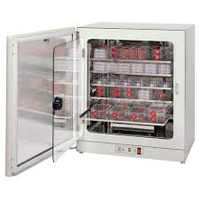
CONVENTIONAL PEOPLE CENTRIC INCUBATION
PROTOCOL 1
PROTOCOL 2
PROTOCOL 3
PROTOCOL 4

Slide 31
Xvivo System
Up to 15 independent protocols simultaneously.

Slide 32
Fit

Slide 33
CELLS NEED TO FIT
RESEARCH NOW
Modular
Many choices
BUDGET
$3,000 - $90,000
Affordable options
LAB SPACE
Efficient
Conformable
RESEARCH LATER
Modular upgrade path
No dead-ends

Slide 34
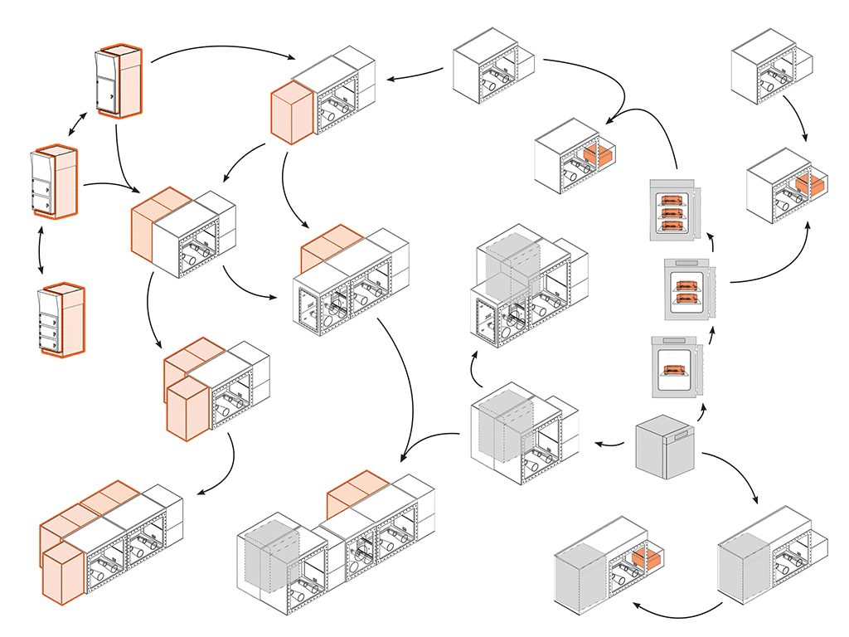

Slide 35
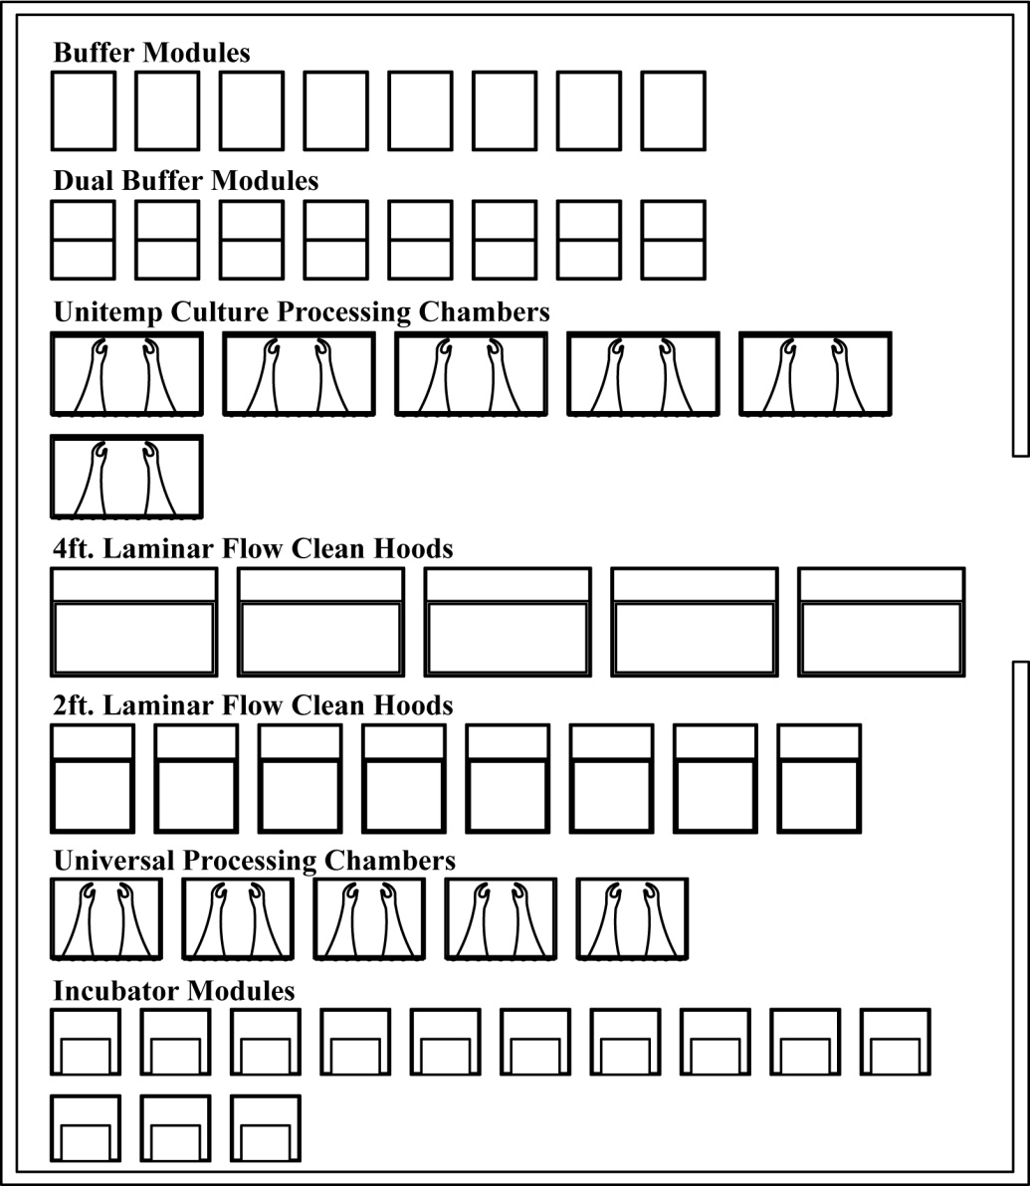
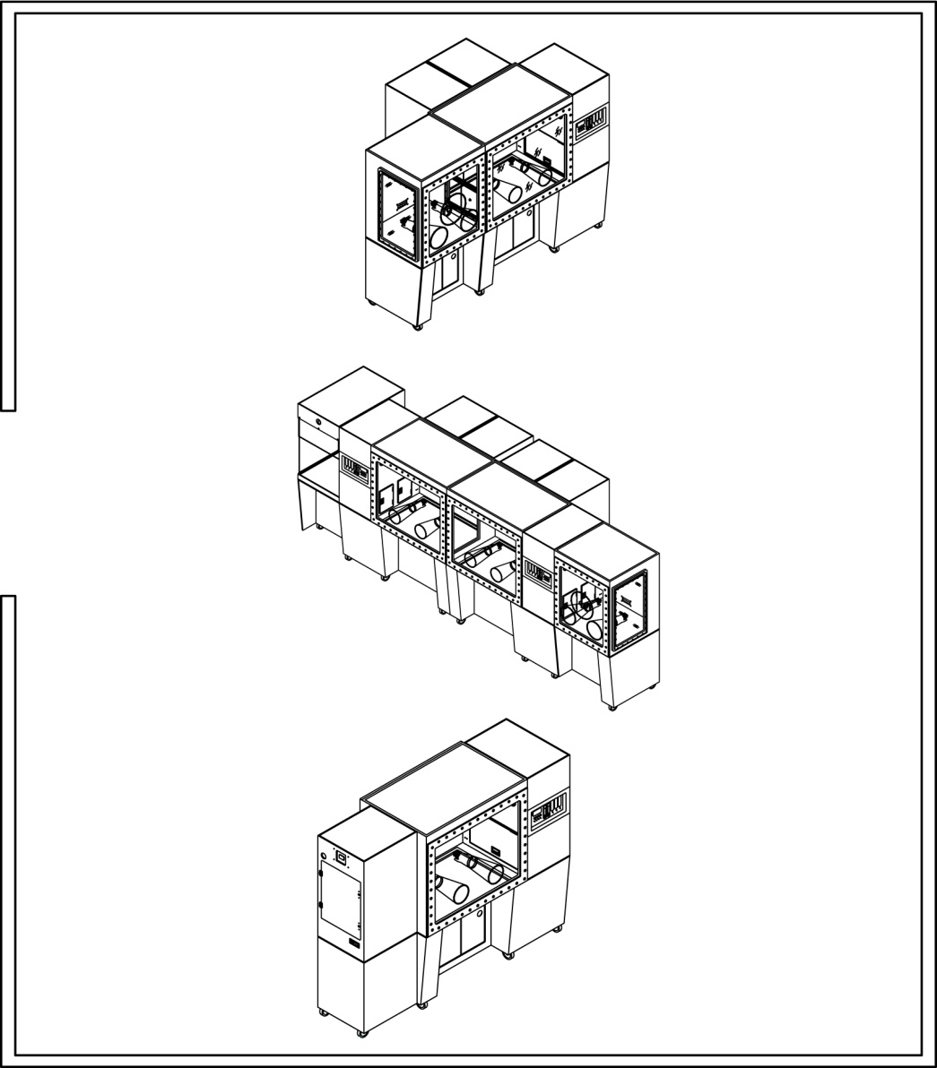
CYTOCENTRIC HOODS

Slide 36
MODULES CAN BE CONFIGURED TO ACCOMMODATE ANY PRODUCTION PROCESS

Slide 37
Accountability

Slide 38
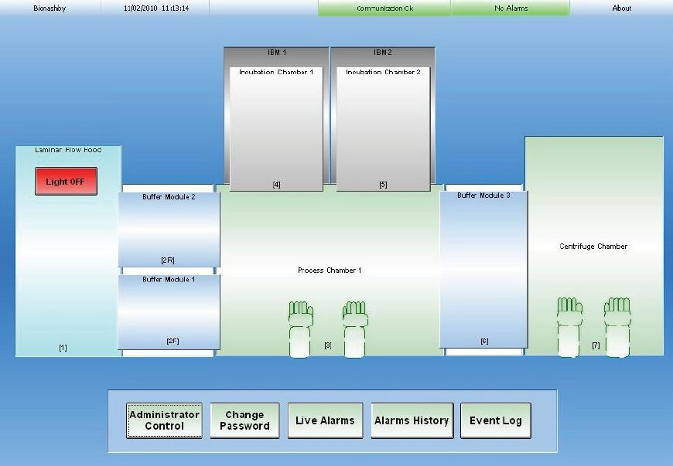

Slide 39
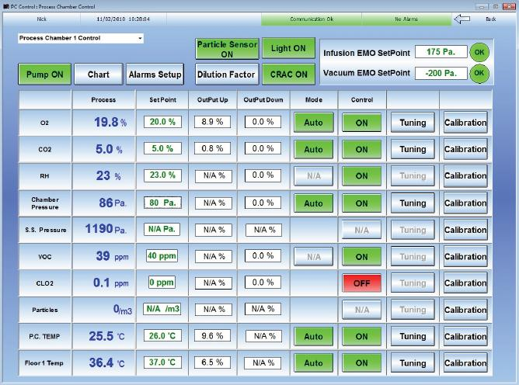

Slide 40
Quality by Design

Slide 41
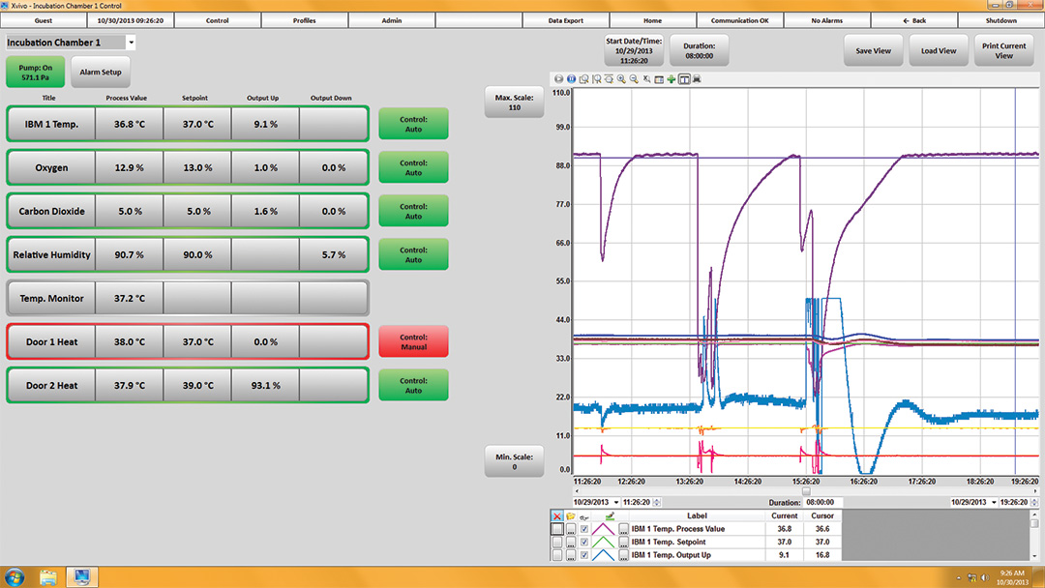
CELLS NEED ACCOUNTABILITY

Slide 42
Technician Protection

Slide 43
TECHNICIAN INFECTION RISK open > closed
Cell Protection
Technician Protection

Slide 44
CYTOCENTRIC
BSL1
BSL2
BSL3
BSL4

Slide 45
DESIGN REQUIREMENTS
 | CYTOCENTRIC ISOLATOR | TRADITIONAL ISOLATOR
PROTECT CELLS | + | +
PROTECT PEOPLE | + | -
OPTIMIZED CELL ENVIRONMENT | + | -
P.A.T. READY | + | -

Slide 46
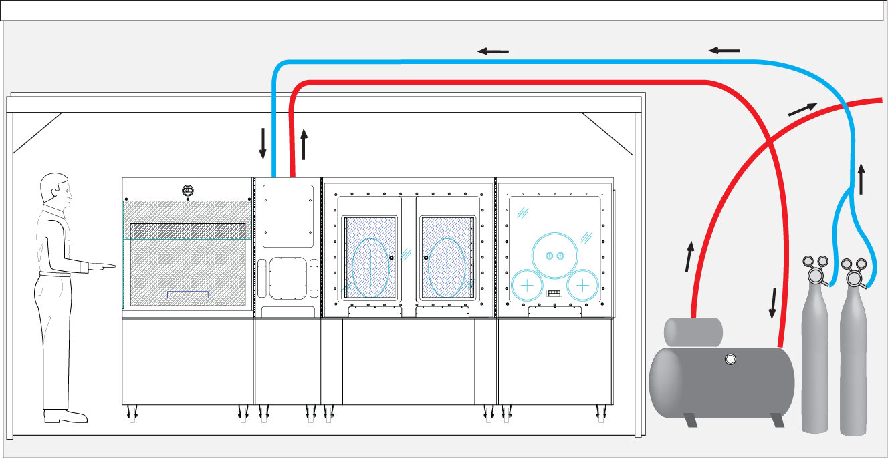
UNCLASSIFIED
CLASSIFIED

Slide 47
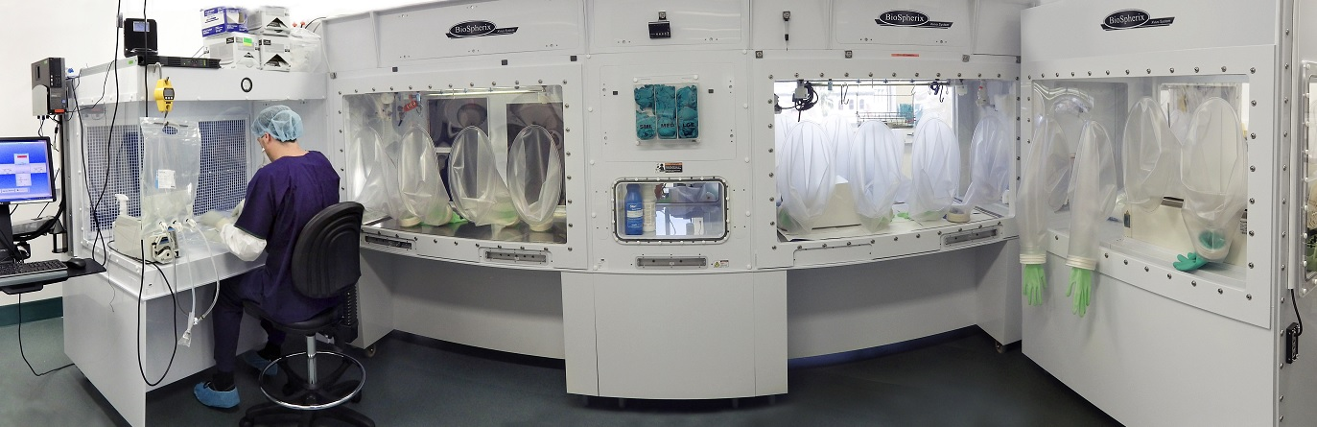
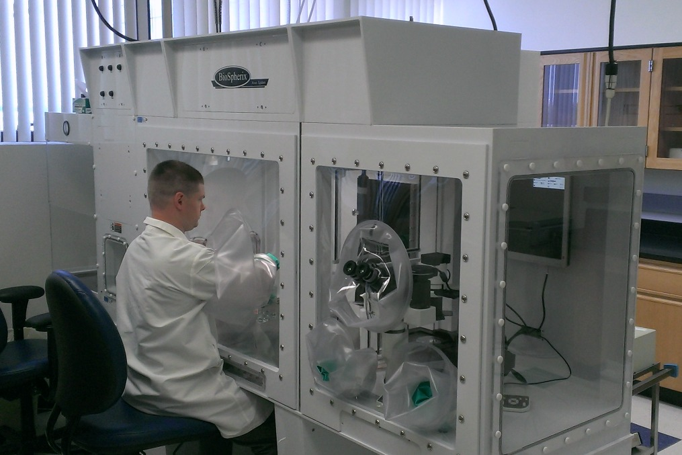
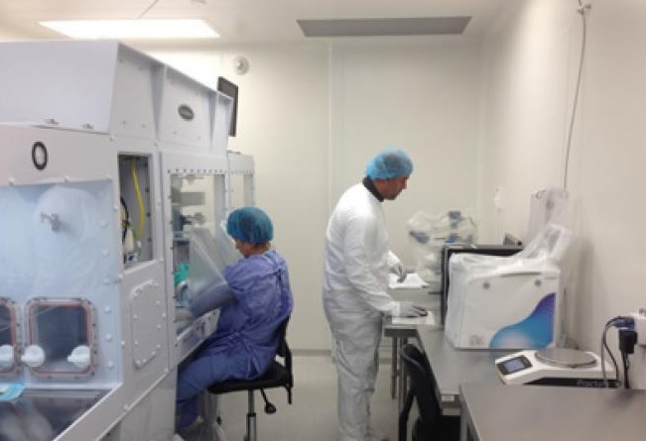
“What does it look like?”

Slide 48
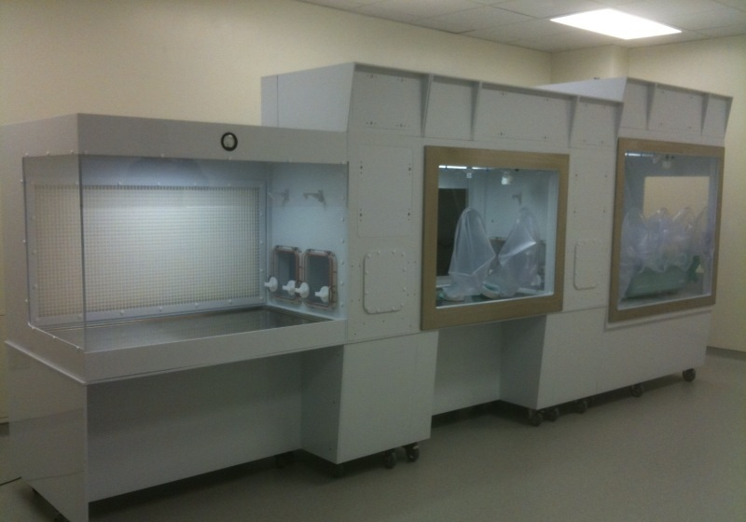
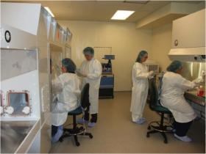
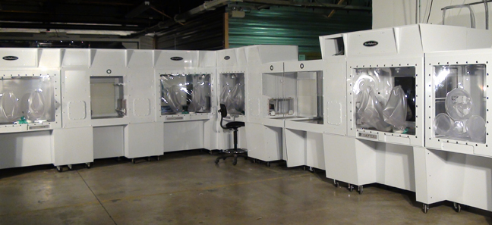
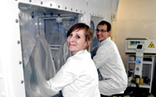

Slide 49
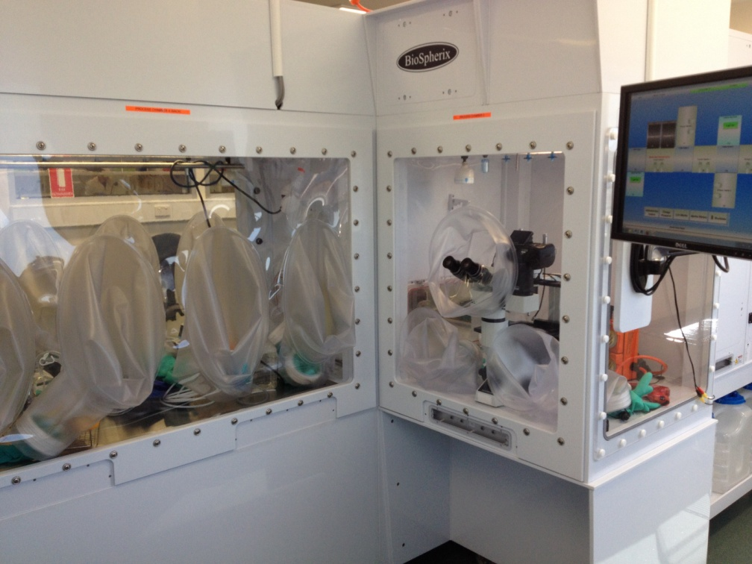
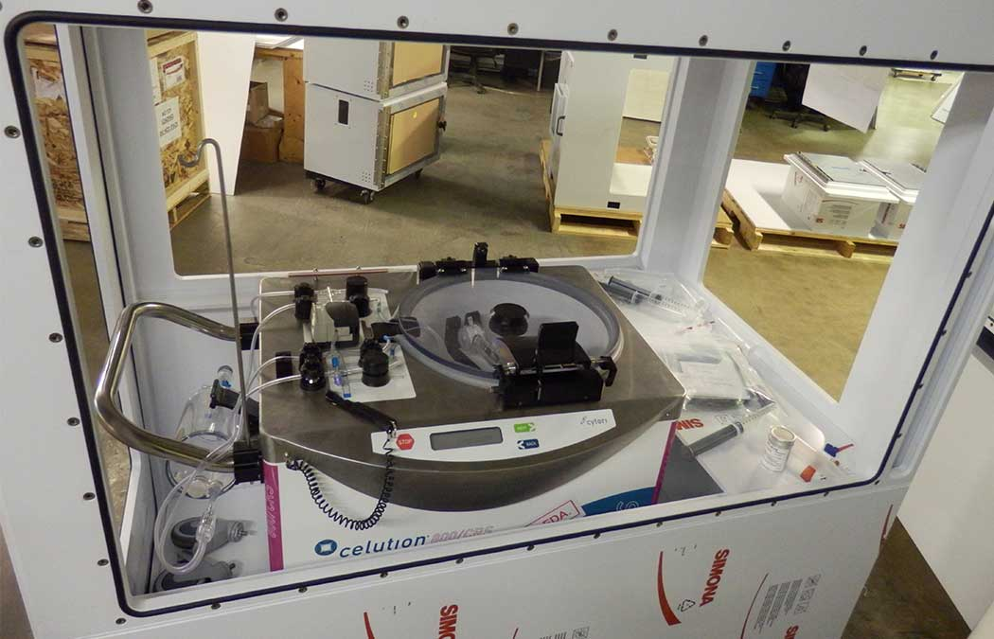
Incorporate ANY third party equipment:
Microscopes
Centrifuges
Clinimacs
Robotics
Filling Machines
Bio-reactors

Slide 50
CYTOCENTRIC =
Total QUALITY Approach to
INCUBATION AND
PROCESSING
[GMP, GLP, GCCP]

Slide 51
Benefits of a Total Quality Approach
Better Cell Potency
Better Reproducibility
Better Safety
Better Process Control
Better GMP
Notes:
The Cytocentic approach to cell incubation and handling is based on 8 principles. The first 5 are core cell principles. Cells need full time protection from microbial contamination, not part time like conventional people centric equipment provides. Cells need full time, not part time, optimization of all critical parameters during their entire existence outside the body, during incubation, during handling, during manipulation, during manual processing, during machine processing, during examination, and during the transport back and forth and waiting between all these. Conventional equipment can only optimize part time. Cells need physiologic simulation, not air. Conventional equipment mostly provides air. Cells need dynamic conditions. After all they are dynamic entities not static entities. Conventional equipment only provides static, limiting conditions. Cells need their own specific protocols, and not be forced into the same, routine, lowest common denominator protocol as every other cell, like done in conventional equipment. The last 3 principles are not core cell principles like the first 5, but are still primary guiding principles in cytocentric equipment design in keeping with a higher level approach. More about all these later.

Slide 52
Est. 2001
Thank you
kmurray@biospherix.com
www.biospherixmedical.com

