Slide 1

OMICS GROUP 3rd International Conference and Exhibition OHS Valencia Spain
24 June 2014
An assessment of exposure to respirable crystalline silica and the impact upon lung function among Quarry workers in
Queensland, Australia?
Kevin Hedges, BSc,. DipEd,. MAppSc,. CIH, COH
University of Western Sydney

Slide 2
What is the risk?
Study in Scottish coal miners.
15 years exposure to RCS in mg/m³ | Predicted risks of developing silicosis within 15 years following exposure
0.02 | 0.25%
0.04 | 0.5%
0.1 | 2.5%
0.3 | 20%
Study in Scottish Coal Miners Source: HSE EH75/4 2002 p. 73.

Slide 3
According to this study:
15 years exposure at 0.1mg/m³ followed by 15 years of non exposure, equals:
1 in 40 chance of being diagnosed with silicosis
(ILO Category 2/1)

Slide 4
“The quality of the exposure data for this study is more detailed and better documented compared to other studies”
HSE 2002 EH75/4 p.67

Slide 5
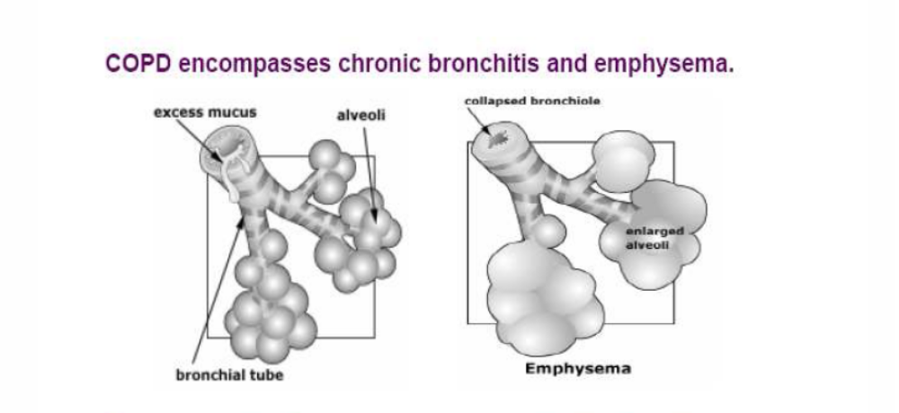
Chronic obstructive pulmonary disease (COPD)

Slide 6
Potency matrix
Factors | Comment | Situations
Particle size | Enhances potency | Grinding and abrasive process.
Dry and freshly cut | Reference point to compare potency | Drilling, crushing.
Wetting | From dust suppression | Wet extraction processes
Aged | Reduces potency | No abrasion, grinding.
Presence of clay | Aluminium reduces potency | Mines extracting low rank coal
Adapted from HSE EH 75/4 page 7

Slide 7
Intensity of exposure.
Freshly cut crystalline silica has a higher degree of potency to crystalline silica that has aged.
This may mean that if you breath in a relatively high concentration for a short duration of time this may be more hazardous than breathing in a lower concentration over a longer period of time.
Even though the average exposure over a day is the same!

Slide 8
What about long periods of low exposure with short periods of high exposure?

Slide 9
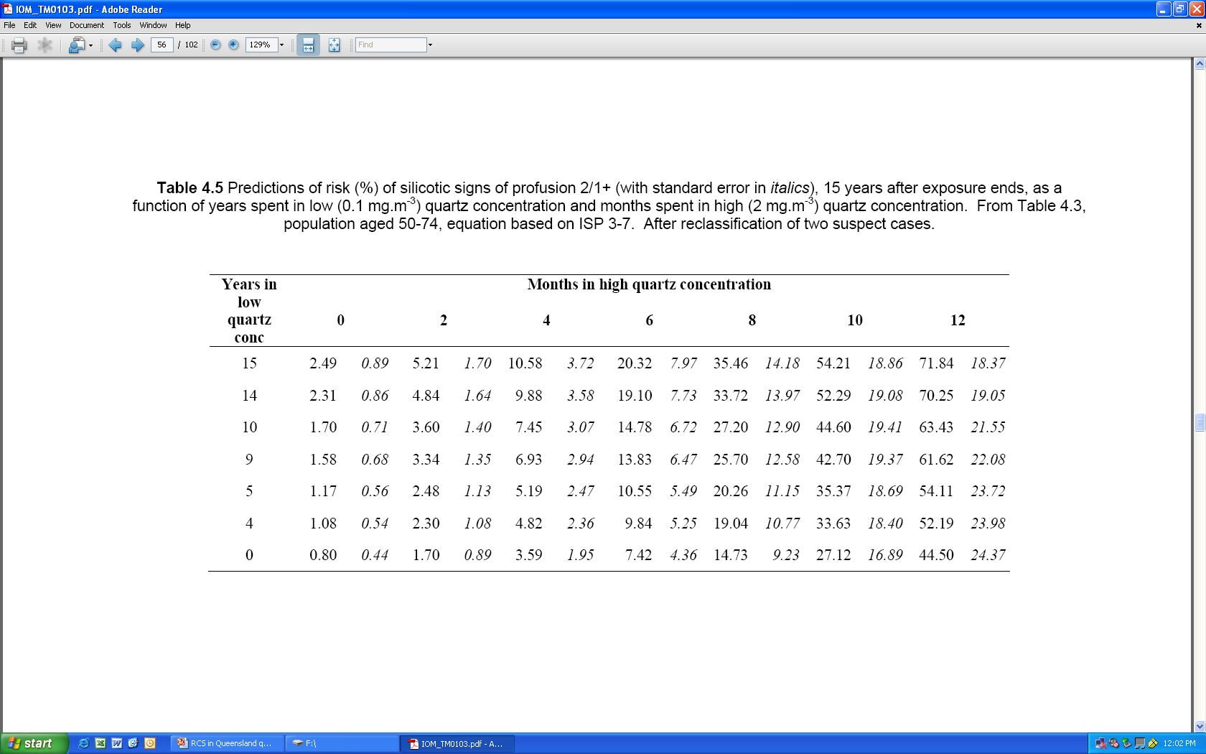
0.1 mg m-3
Low + high
IOM Research Report TM/01/03 February 2001
IOM Research Report TM/01/03 February 2001

Slide 10
Smoking?

Slide 11
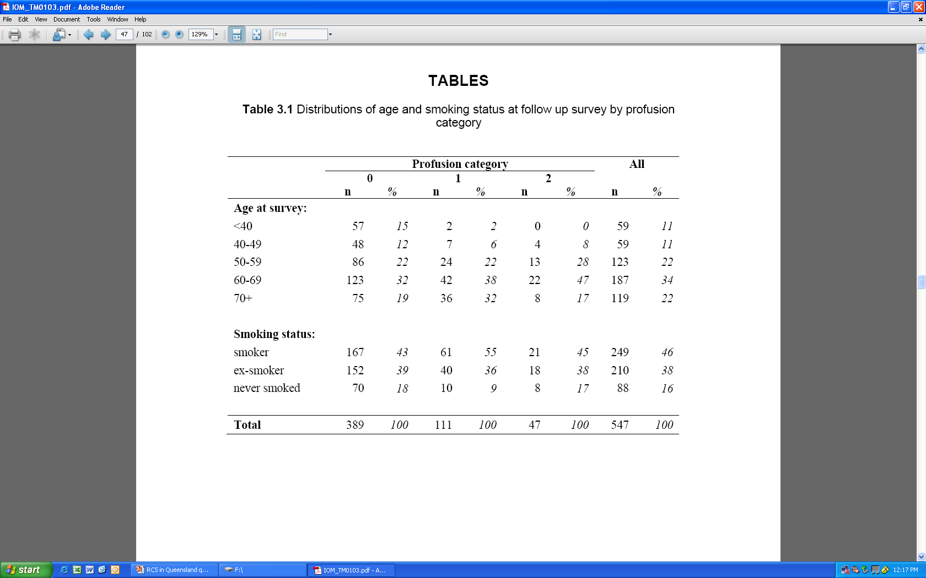
IOM Research Report TM/01/03 February 2001

Slide 12
What about morphology?

Slide 13
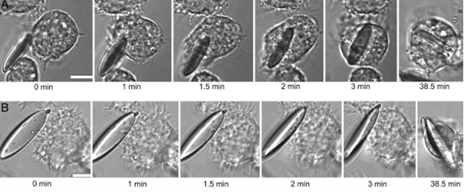
Source: Champion et al,.2005 p. 4931

Slide 14
What about particle size?

Slide 15
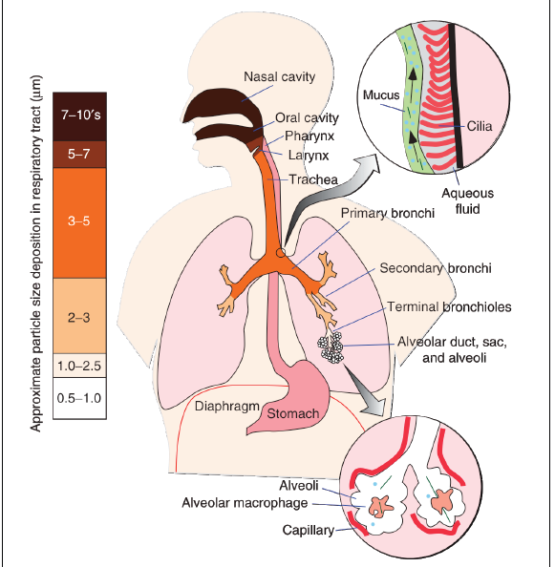
(Plumlee and Ziegler, 2006).
Notes:
A schematic representation of the respiratory tract. The two inset show details of the alveolus and of the muco-ciliary clearance. The colours from brown to pink show the particle size distribution in the respiratory tract
(Plumlee and Ziegler, 2006).

Slide 16
A recent development discussed in ISO 13138 (2012), is that the conventional design of a cyclone is based on particle penetration and does not incorporate deposition.

Slide 17
An assessment of exposure to respirable crystalline silica and the impact on lung function among quarry workers in Queensland
Hedges, K., Reed, S., (2013), What parameters adversely impact lung
function of workers exposed to Respirable Crystalline Silica?, J Health & Safety Research & Practice

Slide 18
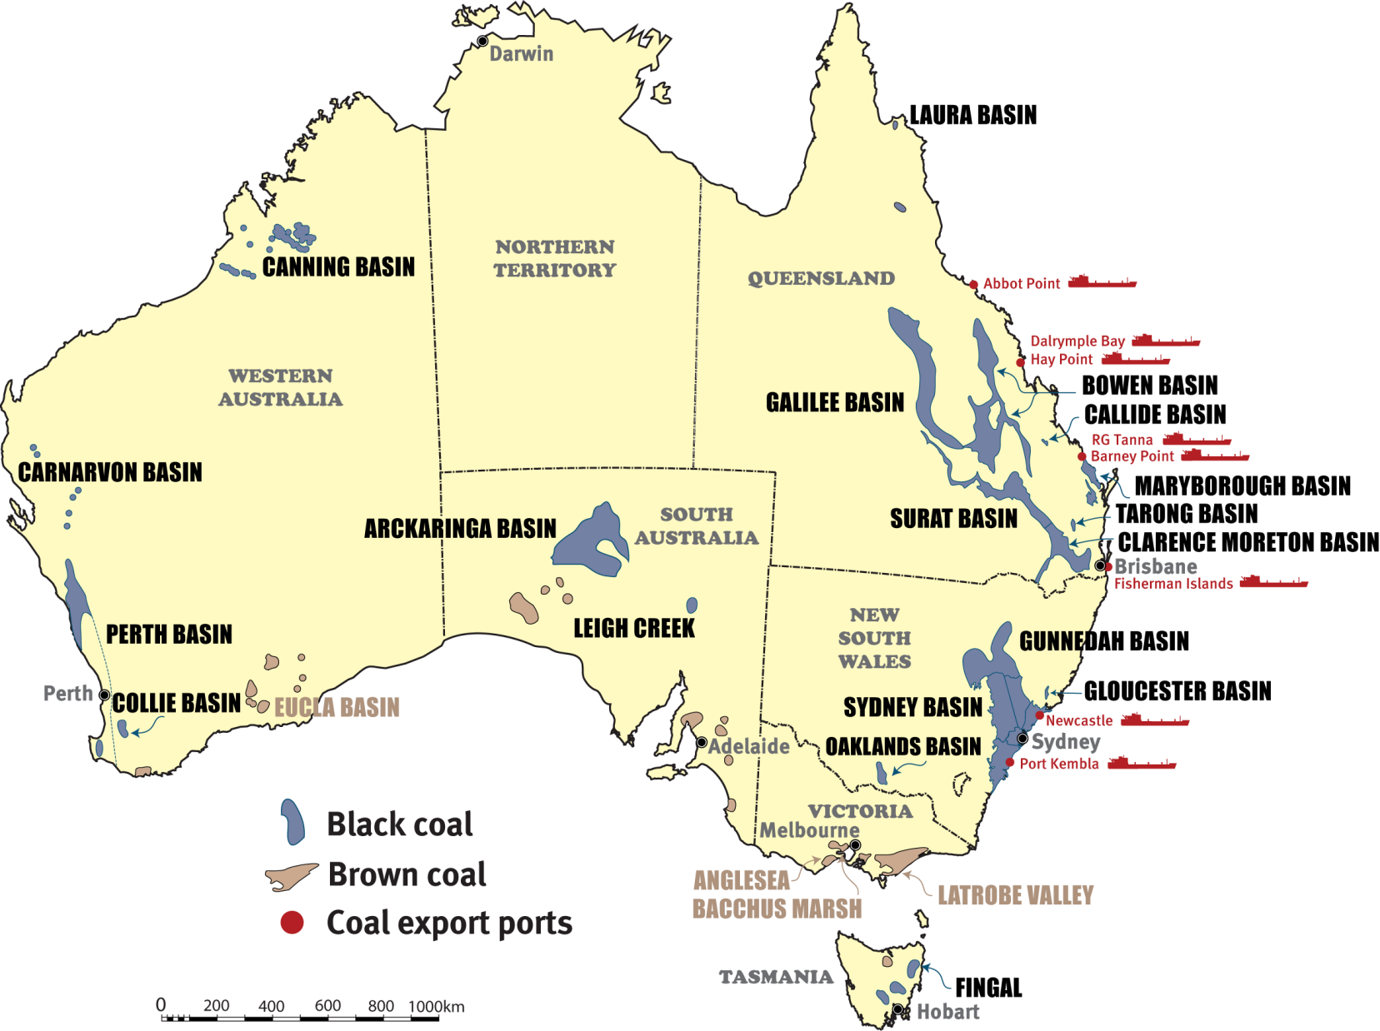
Data supplied by Geoscience Australia

Slide 19
Occupational Exposure to Respirable Crystalline Silica
HSE
Mines
Quarries
Granite Flint Slate
Sand Clays Gravel
Sandstone
Shale
Steel/Iron foundries Bricks Tiles
Glass making Ceramics Potteries
Construction-stone/concrete/plaster
Silica flour; paints, filtration, specialist products
Approximately 33,000 employees
in Queensland Mining

Slide 20
The aim of this study was to reassess previous exposures in conjunction with more recent monitoring data and lung function testing.

Slide 21
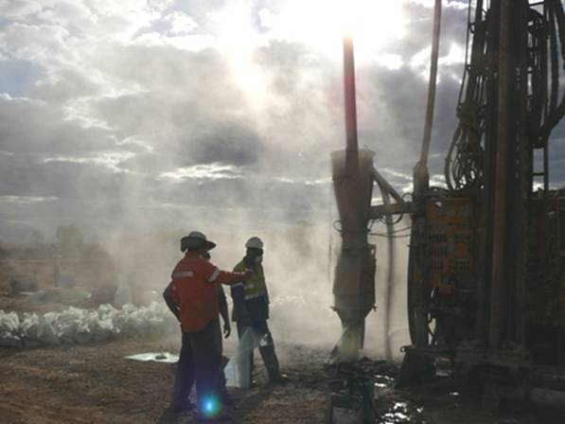
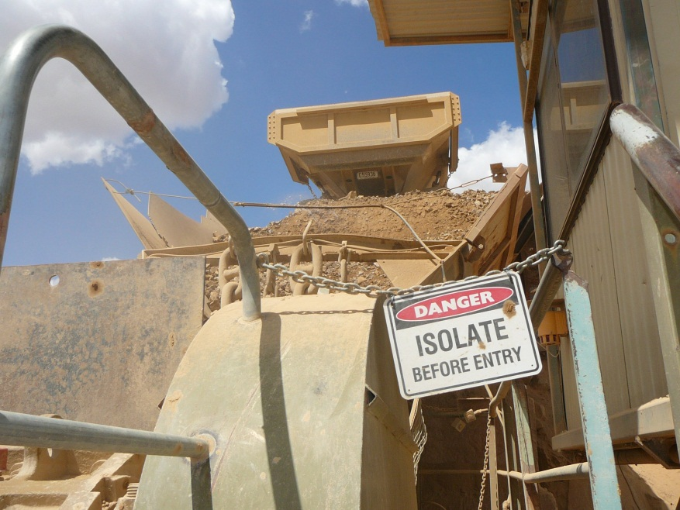
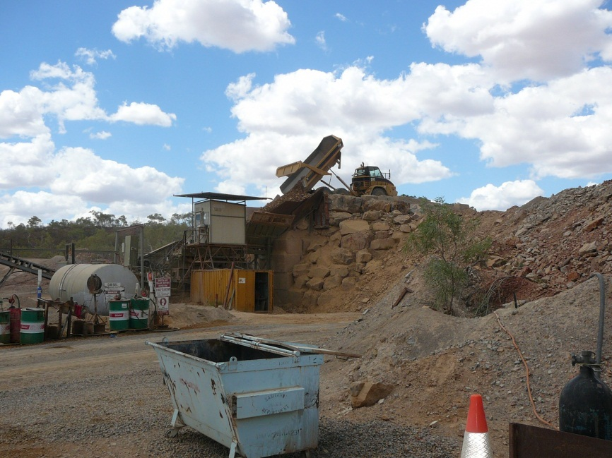
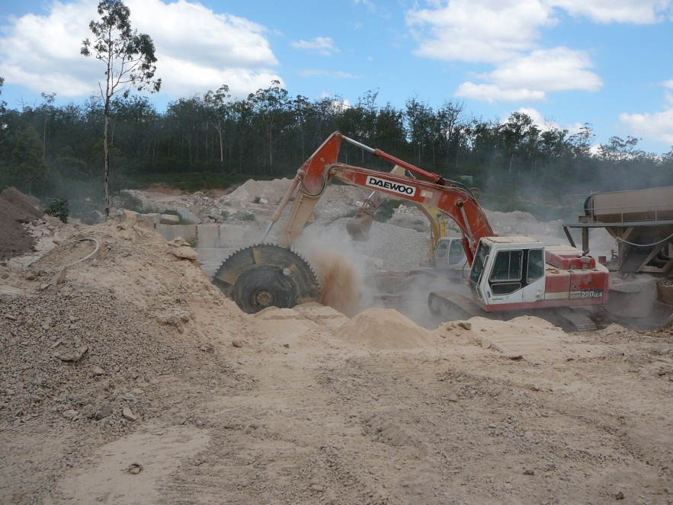

Slide 22
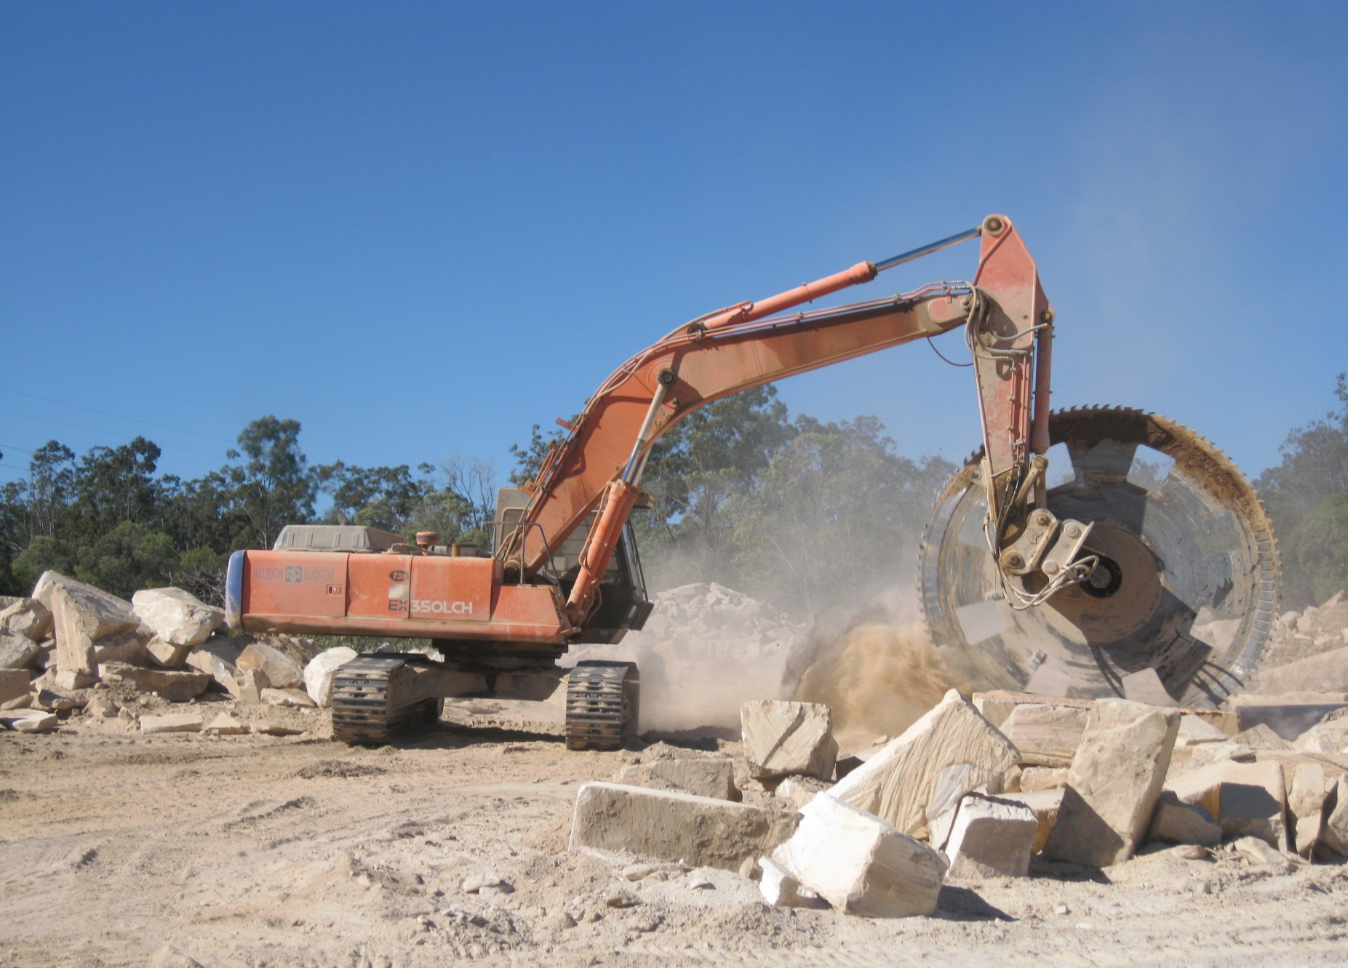

Slide 23
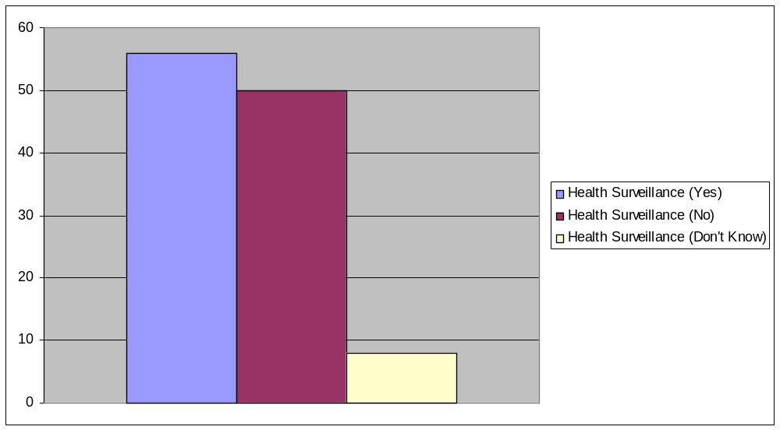
Health Surveillance
Use of an appropriate doctor?

Slide 24
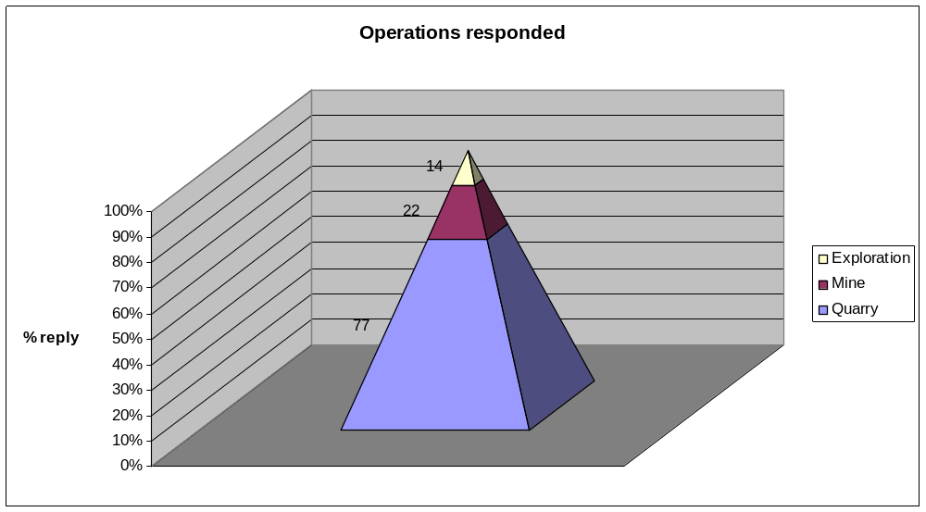
Report provided back to the metal mining and quarrying industry in response to a questionnaire sent in March 2008

Slide 25
To better understand the correlation between RCS exposure and loss of lung around 0.1 mg/m³ which is the Safe Work Australia 8-hr exposure standard.

Slide 26
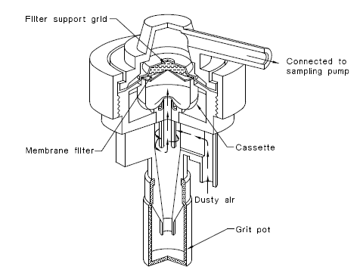
Source: AS 2985 – 2009, p.6

Slide 27
Particle Aerodynamic Diameter (µm) | Respirable Dust Fraction (ISO7708) (%)
0 | 100
1 | 100
2 | 97
3 | 80
4 | 56
5 | 34
6 | 20
7 | 11
8 | 6
10 | 2
12 | 0.5
14 | 0.2
16 | 0.1
18 | 0
AS 2985-2009, p.6

Slide 28
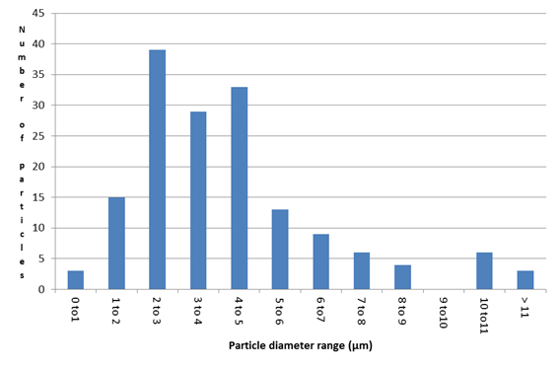
Graphical distribution of particles

Slide 29
As the sampling and analysis using a cyclone is mass based and the median cut is 4.25 µm, sampling the larger particles may not provide an accurate estimate of risk where particles less that 2 µm are considered to be much more hazardous.

Slide 30
PM_{2.5} may provide a better indication of the risk when attempting to identify a dose response relationship.

Slide 31
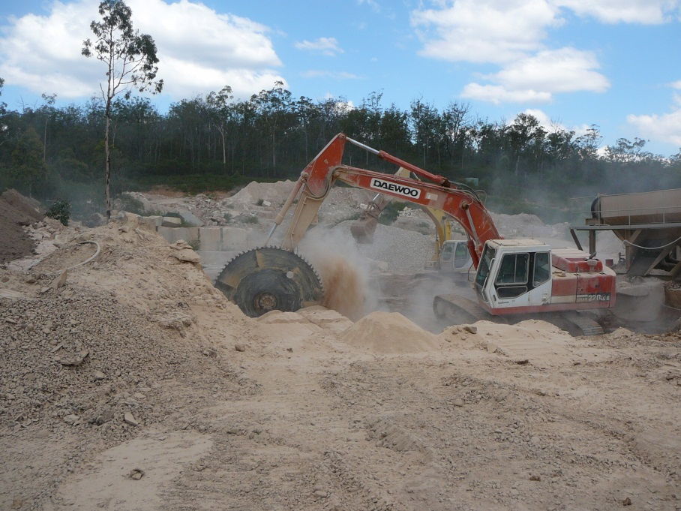
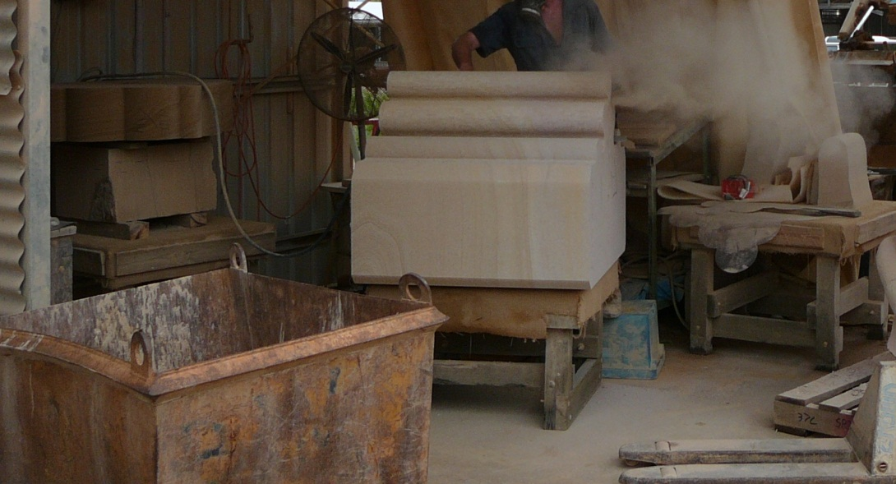

Slide 32
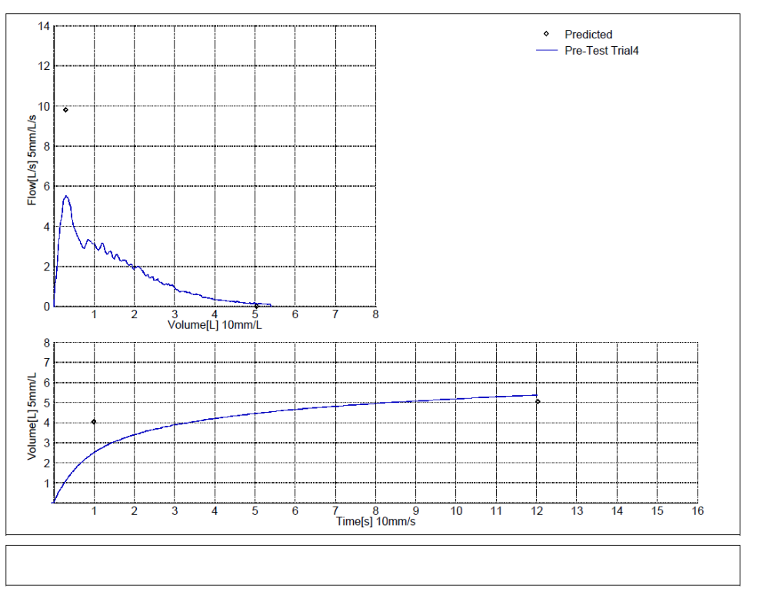
Health effects
Notes:
Lung function tests were carried out, though 80% of the quarry workers tested were either current smokers or had smoked previously.

Slide 33
FEV1 (Forced Expired Volume in 1 Second) measured in Litres, which is the volume of air exhaled in the 1st second.

Slide 34
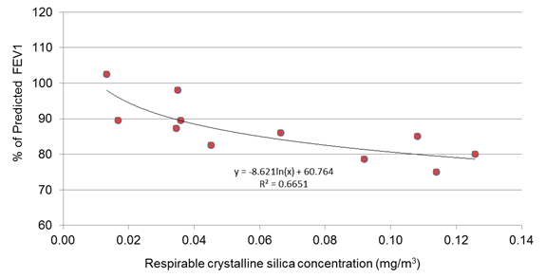

Slide 35
Degree of severity | FEV1 % of predicted
Mild | > 70#
Moderate | 60 - 69
Moderately severe | 50 - 59
Severe | 35 - 49
Very severe | < 35
(From Pellegrino et al, 2005, p.957)
7 of the 45 (16%) of workers - moderate severity

Slide 36
A correlation between loss of lung function even at exposures near or at the current exposure standard for RCS.
The results of this study show the importance of the use of lung function measurement (spirometry).

Slide 37
Morphology?

Slide 38
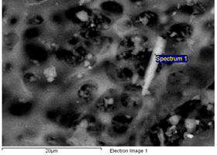
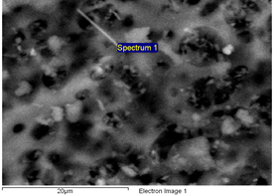
Electron microscopy by Microanalysis Australia (2 of 9 filters showed fibre-type morphology)

Slide 39


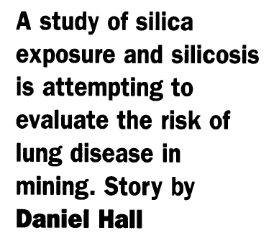
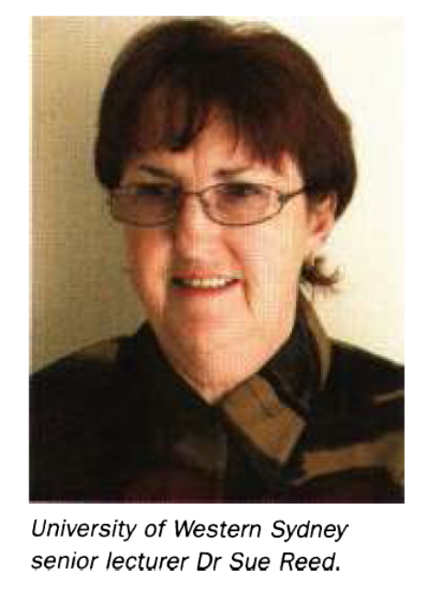

Slide 40

Taking care of our future

Slide 41
Or are we?

