Slide 1

Luminescent Periodic Microstructures for Medical Applications
Materials Science 2016
September 13, 2016
Atlanta, USA
Kenta Miura
Division of Electronics and Informatics,
Graduate School of Science and Technology,
Gunma University, JAPAN

Slide 2
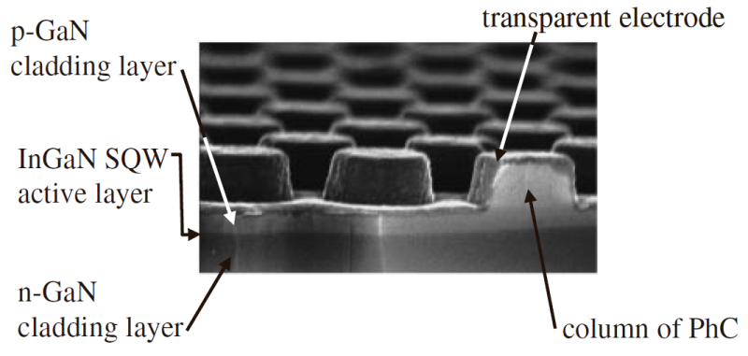
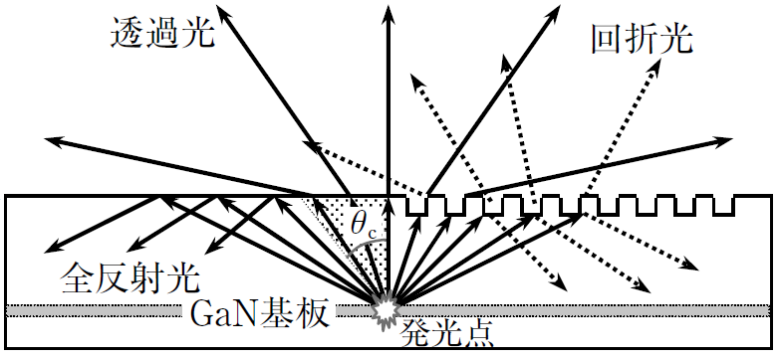
Background
1
Integration of periodic structures and light-emitting diodes (LEDs) was reported as one solution for achieving high light-extraction efficiencies of LEDs.
It was reported that two-dimensional (2-D) periodic structures can effectively extract light emitted from active layers of LEDs according to diffraction laws.
K. Orita, et al., Jpn. J. Appl. Phys. 43 (2004) 5809.
Diffraction
Transmission
(Refraction)
Periodic
Structure
Interface
Total Reflection
GaN etc.
Emission

Slide 3
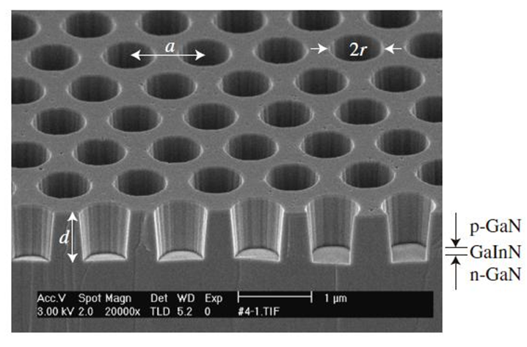
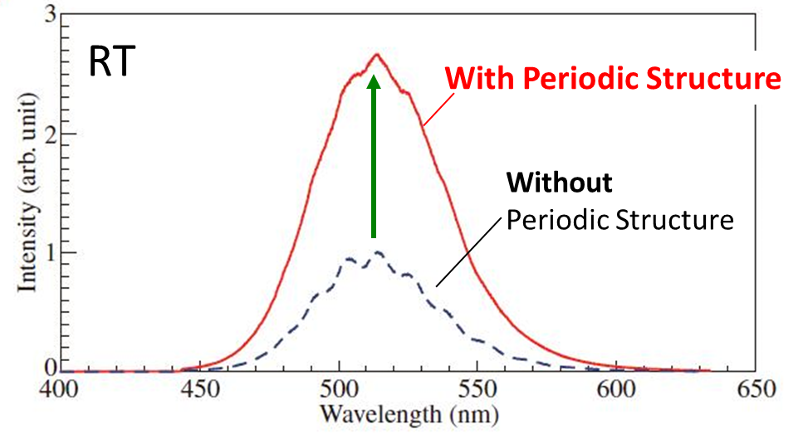
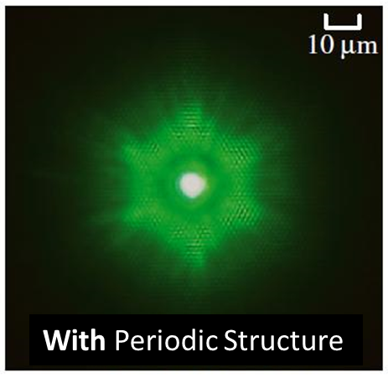
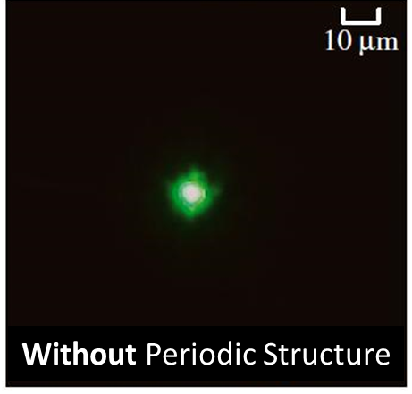
Improvement of light-extraction efficiency by periodic structure
2
H. Kitagawa et al., APEX. 1 (2008) 032004.
SEM image of a 2-D periodic structure with air holes (bird’s-eye view)
PL spectra of samples
- A green-emitting GaInN 2-D periodic structure with air holes has been investigated.
- The photoluminescence (PL) intensity from the sample with the air holes was approximately three-times stronger than that of a sample without air holes.
- These air holes have been processed using electron-beam (EB) lithography and plasma etching.
Emission patterns of the samples

Slide 4
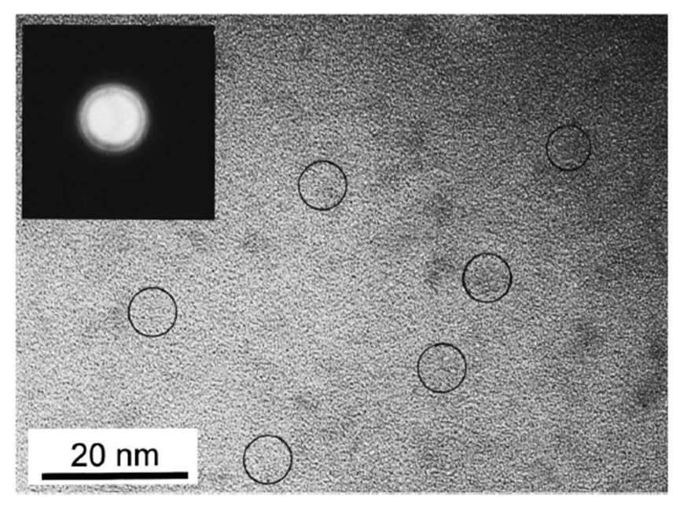
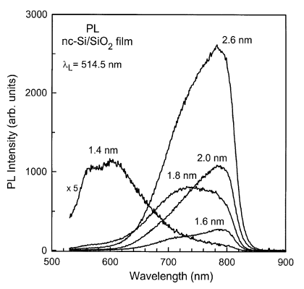
Si nanocrystals (Si-ncs) produced by using sputtering
3
H. Seifarth et al., Thin Solid Films 330 (1998) 202.
R.K. Soni et al., J. Lum. 83-84 (1999) 187.
Average size of Si-nc
(calculated from T)
HRTEM image of Si-ncs embedded in SiO2
Size dependent PL spectra from Si-ncs embedded in SiO2
Si-ncs exhibit a quasi-direct band gap as a result of the quantum-size effect.
→ They can show visible photoluminescence (PL) depending on their size.

Slide 5
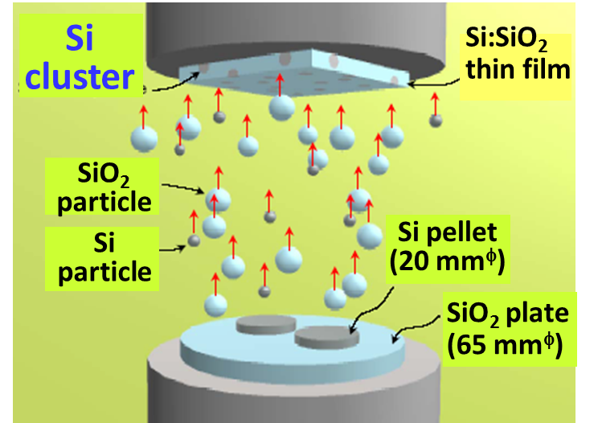
Preparation of a Si:SiO₂ co-sputtered thin film
4
An Si:SiO₂ co-sputtered film was deposited on a fused SiO₂ substrate by using radio-frequency (RF) magnetron sputtering method.
We used an SiO₂ plate (65 mm^{φ}) on which four Si pellets (20 mm^{φ}) were placed as a co-sputtering target.
Sputtering conditions:
- Base pressure: 2.7 ×10⁻⁴ Pa
- Ar pressure: 1.3 Pa
- RF power: 200 W
- Unheated substrate
The film was annealed in ambient air for 20 min at 1000ºC using an electric furnace.
SiO₂ plate
(65 mm^{φ})
Si tablet
(20 mm^{φ})
Schematic of the co-sputtering target (top view)
O. Hanaizumi et al., Appl. Phys. Lett. 82 (2003) 538.
O. Hanaizumi et al., Jpn. J. Appl. Phys. 41 (2002) L1084.

Slide 6
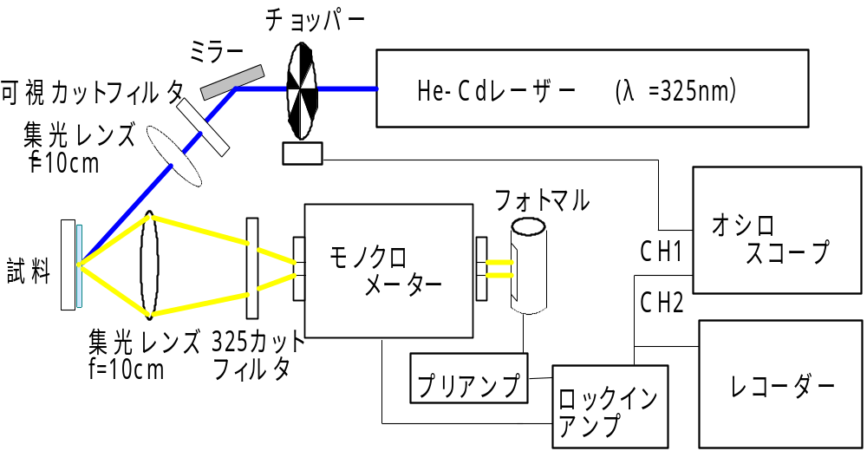
Measurement of photoluminescence (PL) spectra
5
Experimental set-up
Chopper
Mirror
Filter
He-Cd laser (λ=325 nm)
Lens
Sample
Photomultiplier
Oscilloscope
Monochro-
mator
Lens
Filter
Amplifier
Recorder
Lock-in
amplifier
Photoluminescence (PL) spectra were measured at room temperature.
A monochromator, a photomultiplier, and a lock-in amplifier were used.
The intensities of PL spectra were calibrated by using a white-light spectrum measured with an optical spectrum analyzer.

Slide 7
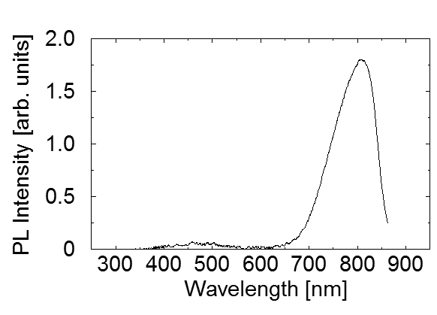
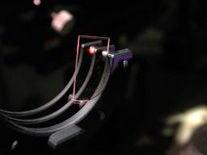
Measured PL spectrum of the Si:SiO₂ co-sputtered film
6
◆ Red-light emission was observed from the Si:SiO₂ co-sputtered film.
◆ The PL peak is located around a wavelength of 800 nm.
Red-light emission

Slide 8
Design using wave vector and grating vector
7
Transmission (Refraction)
→ Snell’s Law
Transmission (Diffraction)
→ Diffraction Laws
Total Reflection
k₀=2π/λ
k₀=2π/λ
k₀=2π/λ
Air
(n=1)
k_{1//}
k₀
k₀
k_{2//}
(=k_{1//}=k_{0//})
k_{1//}
k_{2//} (=k_{1//})
k_{1//}
G
θ₁
θ₂
θ₁
θ₂
Si:SiO₂
(n=n₁)
θ₁
θ₂
k₁
k₂
k₁
k₂
k₁
k₂
k₁=2πn₁/λ
k₁=2πn₁/λ
k₁=2πn₁/λ
G : Grating Vector
Λ : Period of Grating
k_{2//} ≧ |G| = 2π / Λ ）
Λ_{min} = 2π / k_{2//} = 2π / k_{1//} = λ / (n₁ sinθ₁) ~ 800 nm
@ λ=800 nm, n₁=1.75, θ₁ = 35º (total reflection angle)

Slide 9
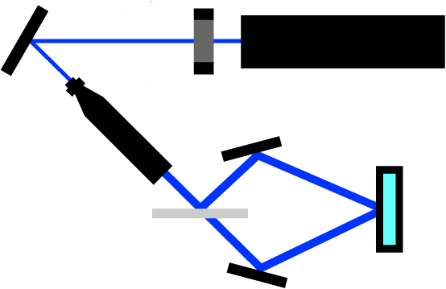
Fabrication Process of Periodic Structures
8
1. Spin coating of photoresist on the Si:SiO₂ co-sputtered film.
2. Double photolithography using two-beam interference method.
3. After development, reactive ion etching of the surface of the film using the patterned resist as a mask.
Mirror
Shutter
He-Cd laser
（λ=325 nm）
Mirror
Sample
Beam expander
(X 40)
2θ
Half mirror
Mirror
Experimental setup of two-beam interference lithography

Slide 10
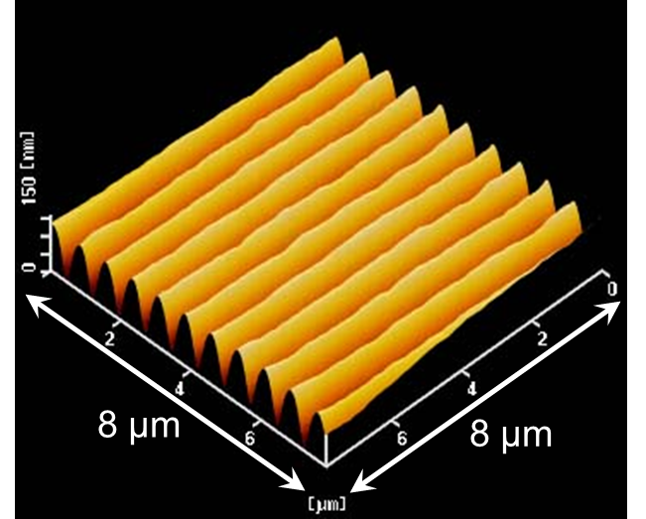
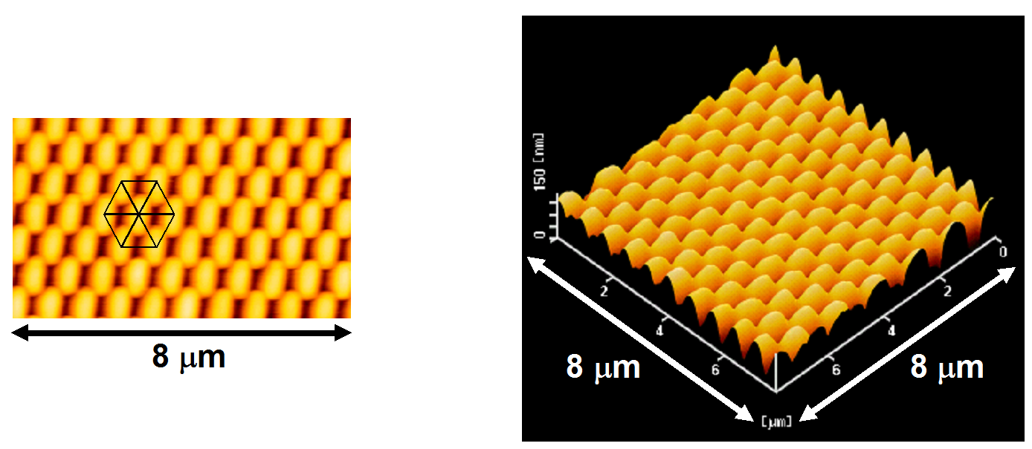
Double-interference exposure
9
(1) A 1-D periodic pattern was formed by the first exposure.
→ The periodicity of the 1-D pattern D is expressed as
D = λ/(2sinθ )
(λ=325 nm, 2θ is the angle between the two beams)
(2) A 2-D periodic pattern was formed by the second exposure
after rotating the sample.
→ Rotation of the sample by 60º produces a hexagonal lattice.
→ The lattice constant of the hexagonal lattice L is expressed as
L = 2D/3^{1/2}
(1)
D
(2)
L
1-D periodic pattern
2-D periodic pattern

Slide 11
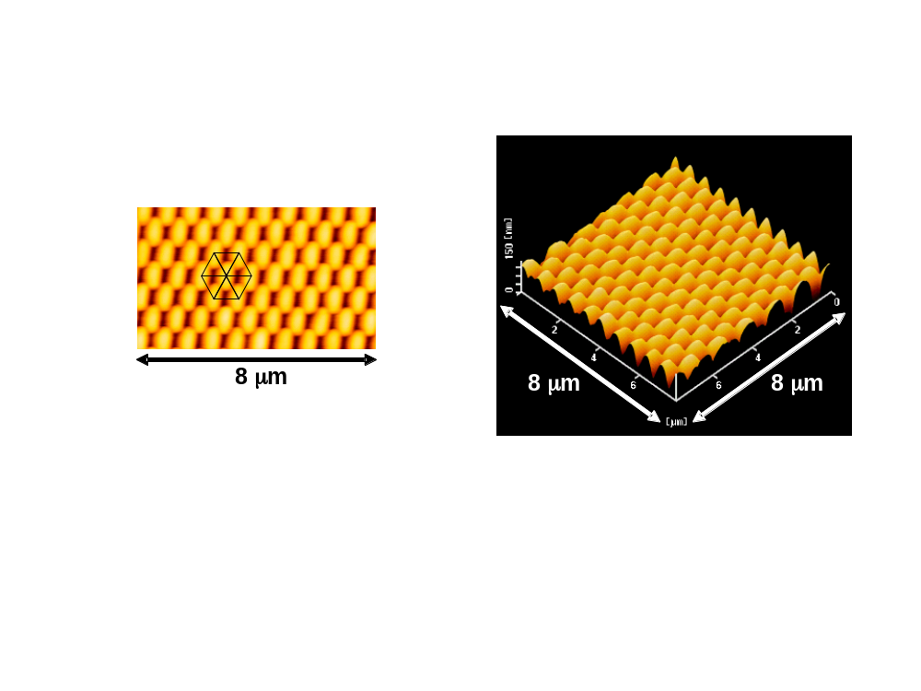
AFM images of the 2-D periodic structure
10
◆ A 2-D periodic structure with a hexagonal lattice was obtained.
◆ Lattice constant L (measured) : ~810 nm (average)
◆ Depth of processed patterns： ~50 nm (average)
150 nm
Top view
Bird’s-eye view

Slide 12
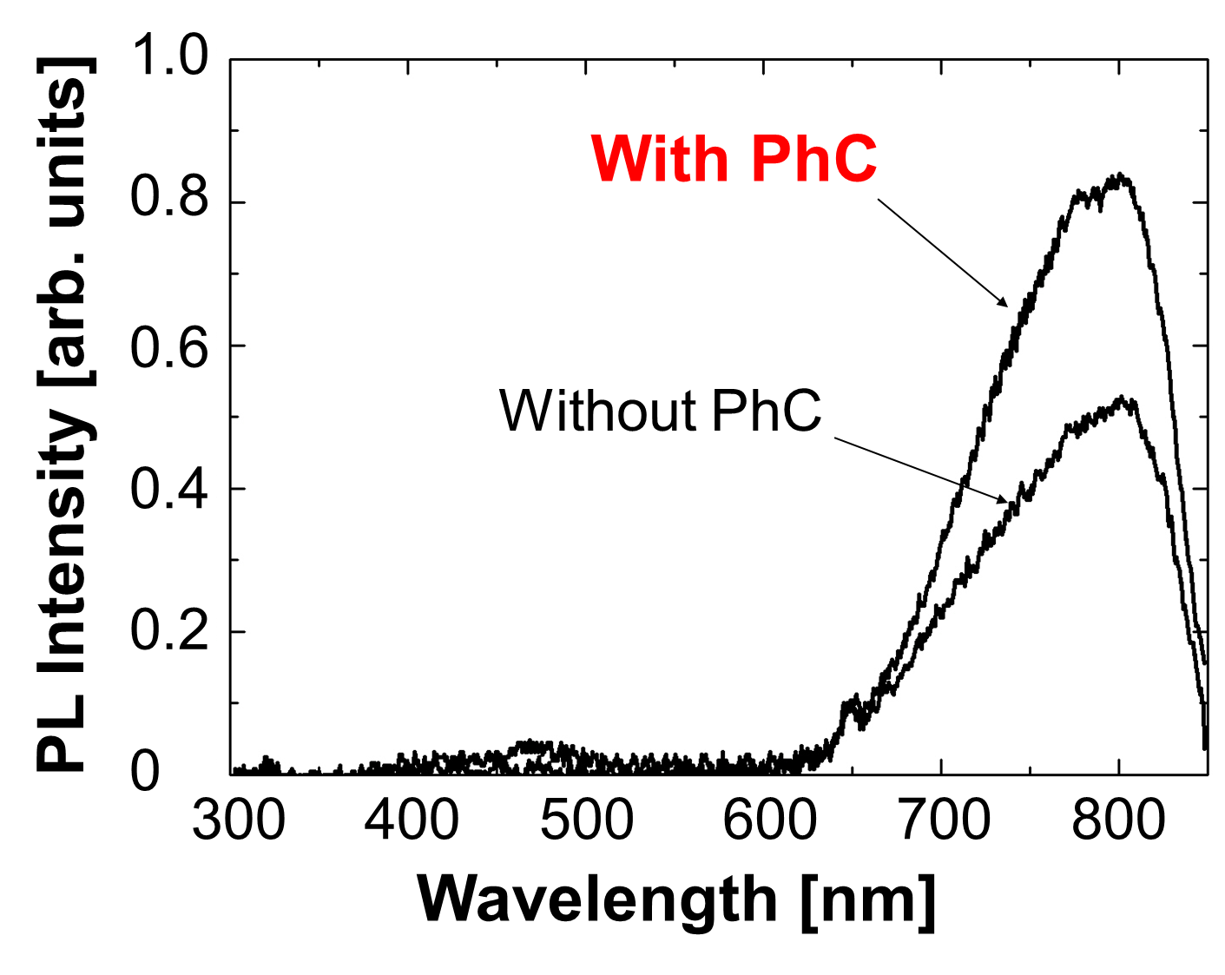
Measured PL spectra
11
With Periodic Structure
Without Periodic Structure
◆ Si-based materials have biocompatibility.
◆ The emission wavelength of 800 nm penetrate a human body.
→ Light-emitting devices for medical applications will be realized.

