Slide 1

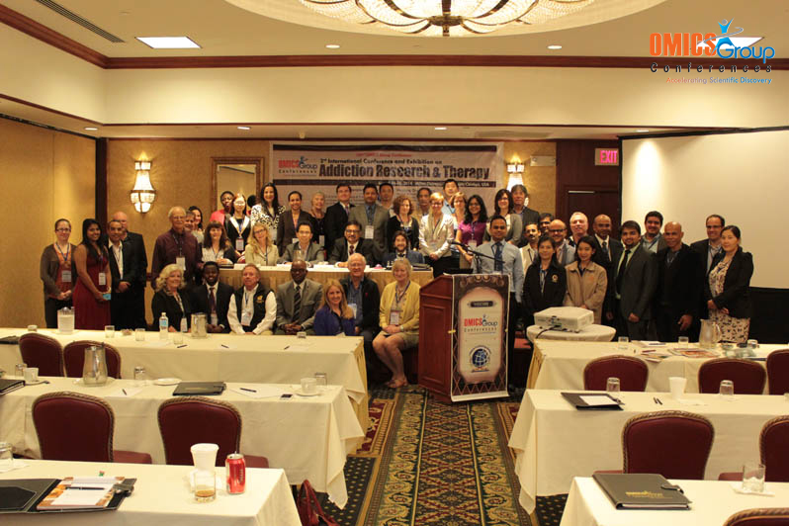
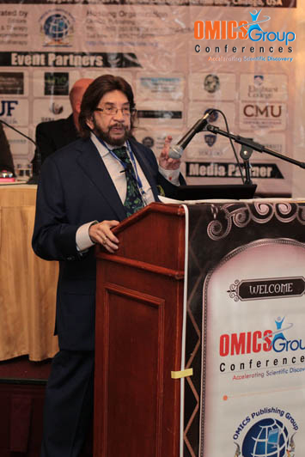
Addiction Therapy-2014
Chicago, USA
August 4 - 6, 2014
Kenneth Blum

Slide 2

Reward Deficiency Solution System: Translational Research
Kenneth Blum, Ph.D.
Departments of Psychiatry
Brain McNight Institute

Slide 3
Reward Deficiency Solution System
Over the last 50 years our laboratory has been engaged in developing a number of important tools to accurately diagnose, evaluate compliance to treatment medications, abstinence and enhance the quality of life of the “recovering” addict.

Slide 4
ASAM New Definition of Addiction
Addiction is a primary, chronic disease of brain reward, motivation, memory, and related circuitry. Dysfunction in these circuits leads to characteristic biological psychological social and spiritual manifestations. This is reflected in an individual pathologically pursuing reward and/or relief by substance use and other behaviors.
August 15,2011

Slide 5
Reward Deficiency Syndrome (RDS) Behaviors:
A Function of the Reward Genes
ADDICTIVE BEHAVIORS |  | IMPULSIVE BEHAVIORS |  | OBSESSIVE COMPULSIVE BEHAVIORS | PERSONALITY DISORDERS
Substance Related | Non Substance Related | Spectrum Disorders | Disruptive Impulsive
Alcohol | Thrill seeking (novelty) | Attention-deficit Hyperactivity | Anti-social | Body Dysmorphic | Paranoid
Cannabis | Sexual Sadism | Tourette and Tic Syndrome | Conduct | Hoarding | Schizoid
Opioids | Sexual Masochism | Autism | Intermittent Explosive | Trichotillo-mania (hair pulling) | Borderline
Sedatives/ Hypnotics | Hypersexual |  | Oppositional Defiant | Excoriation (skin picking) | Schizotypal
Stimulants | Gambling |  | Exhibitionistic | Non-suicidal Self-Injury | Histrionic
Tobacco | Internet Gaming |  |  |  | Narcissistic
Glucose |  |  |  |  | Avoidant
Food |  |  |  |  | Dependant
Modified according to DSM-5 from Blum et al. 1996

Slide 6
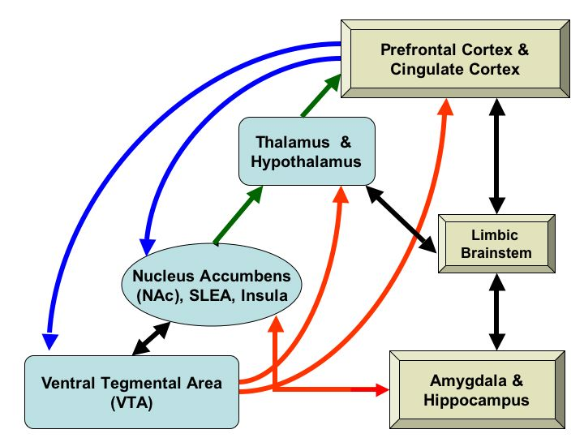
BRAIN REWARD CIRCUITRY

Slide 7
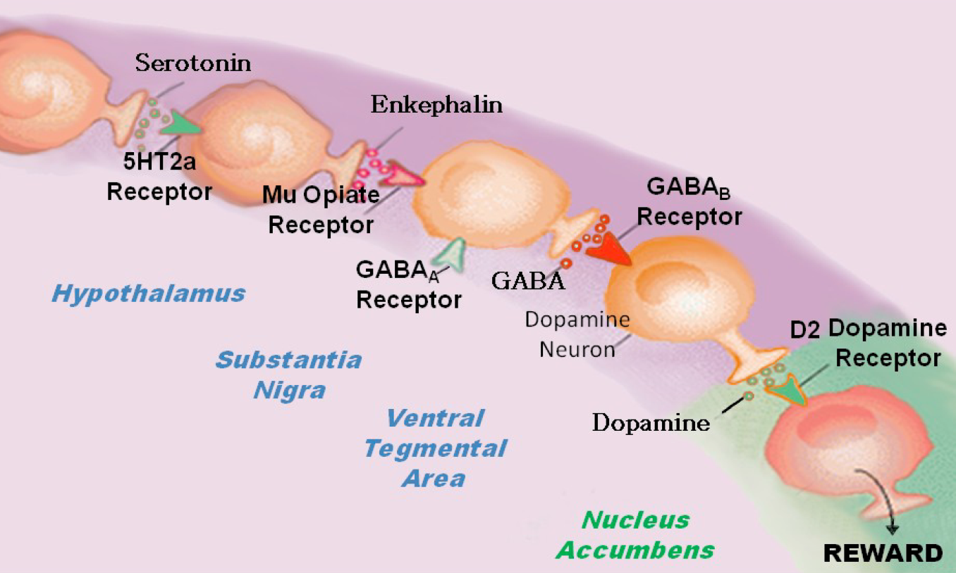
BRAIN REWARD CASCADE

Slide 8
Addiction Medications
FDA Approved
Acamprosate (Campral)
Disulfiram (Antabuse)
Naltrexone (ReVia, Vivitrol, Depade)
Topiramate (Topamax)
Methadone
Buprenorphine
Suboxone
Off Label
Nefazodone (Serzone)
Ondansetron (Zofran)
Gabapentin

Slide 9
CARD Summary Reports
The Clinic receives a summary quarterly and annually that shows the following:
  Overall Summary of the Clinic
  Summary of NO treatment related medication prescribed and NO self reported use
  Adherence to Treatment Related Medication
  Self-Reported Misuse for Both Detected and Non-Detected
  Self-Reported Drug Misuse When Adherent to Medication both detected and non-detected
  A Summary as to why a CARD™ Analysis could not be completed

Slide 10
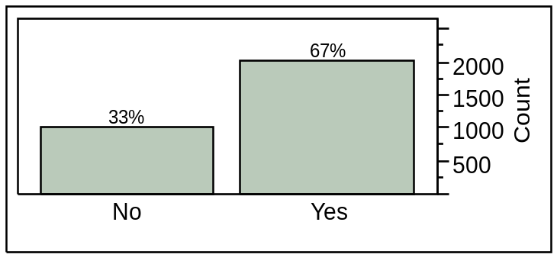
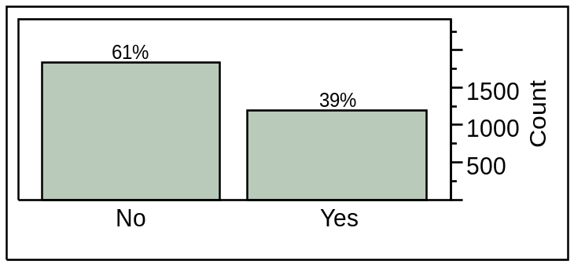
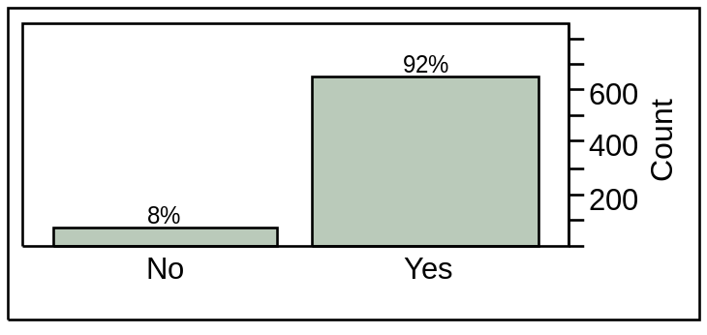
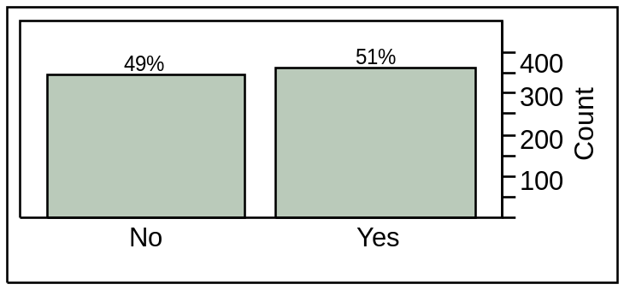
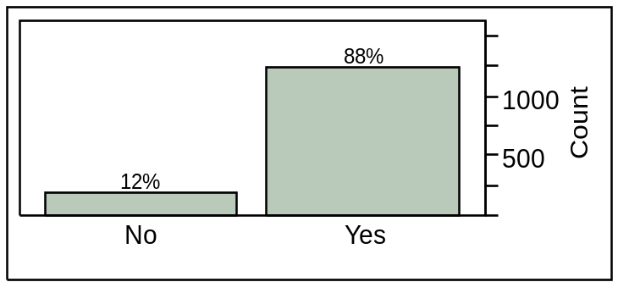
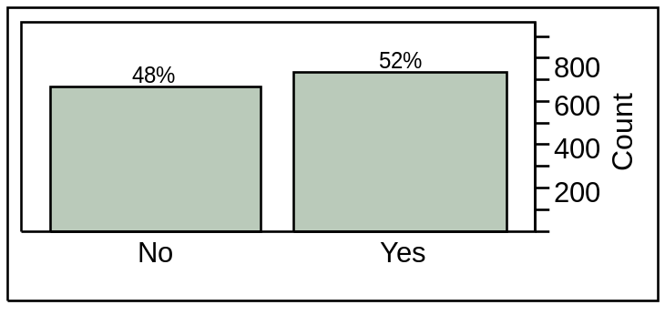
Comprehensive Analysis of Reported Drugs (CARD)
Compliance
Abstinence
Methadone
Methadone
Suboxone
Suboxone

Slide 11
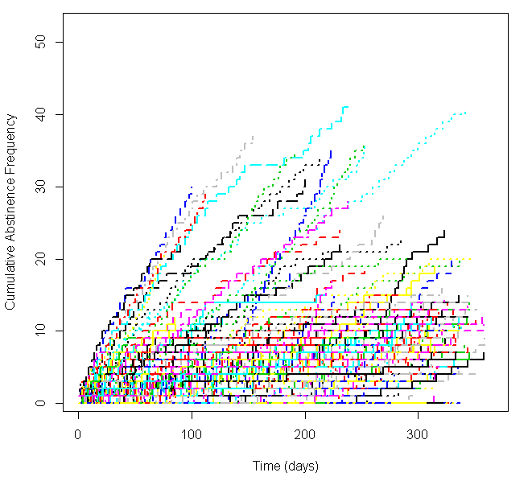
Cumulative Abstinence Frequency
p=2.353×10⁻⁸

Slide 12
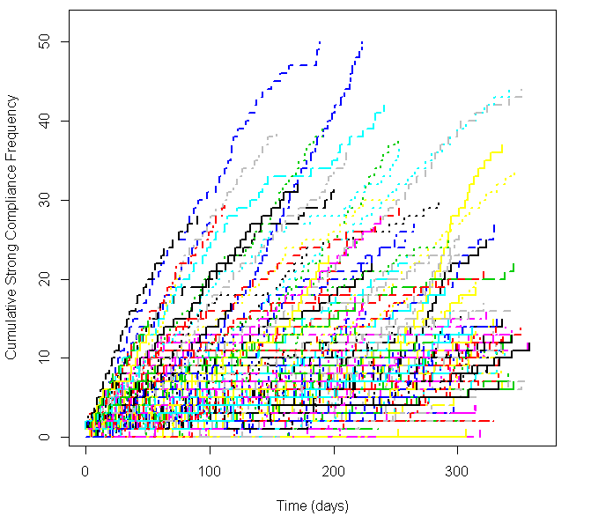
Cumulative Compliance Frequency
p=2.200×10⁻¹⁶

Slide 13
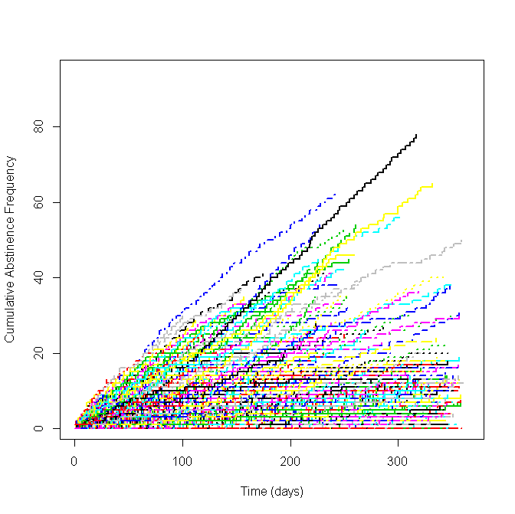
Suboxone: cumulative abstinence frequency 365 days 2011

Slide 14
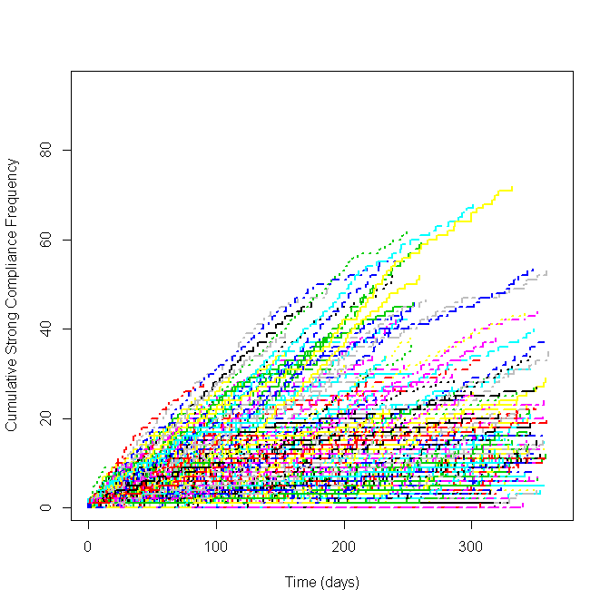
Suboxone: cumulative compliance frequency 365 days 2011

Slide 15
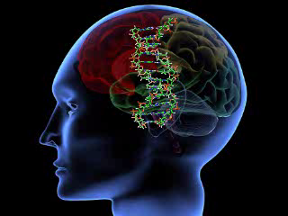
Targeting Brain DNA

Slide 16

I can’t Help It; its in my Genes
Epigenetics
Notes:
You Can Change how your Genes Express themselves. Your DNA code is not the final say on who or what you become….

Slide 17
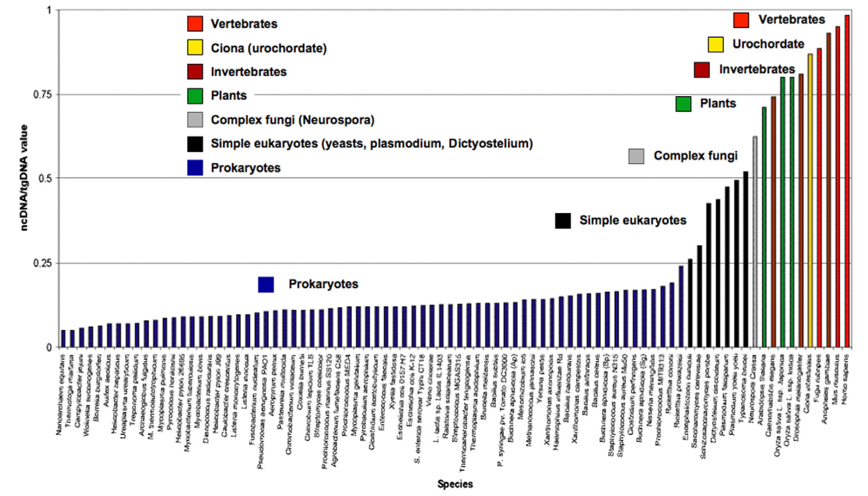
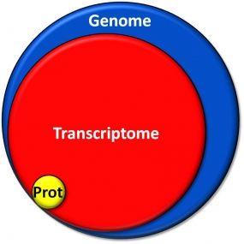
The genome is more complicated than we thought
DNA → RNA → PROTEIN
Mattick 2011

Slide 18
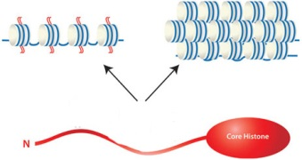
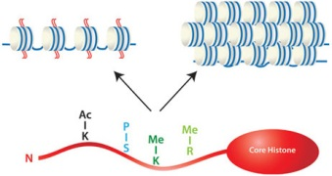
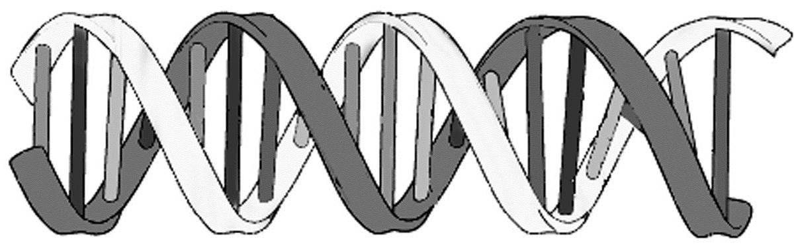
How much more complicated?
Chromatin Regulation
Transcriptional Regulation
TBPi
TF
TBP
lincRNA
M
M
M
CpG
Island
M
M
Promoter
GENE
3’ UTR
Post-translational Regulation
Antisense RNA
Antisense RNA
miR
mRNA
RISC
miR
miR
miR
miR
miR
miR
miR

Slide 19
Genetic Addiction Risk Score (GARS) ™
Evaluated eleven genes and 22 Risk Alleles from
Nine Addiction Treatment Centers in
The United States (N= 393)

Slide 20
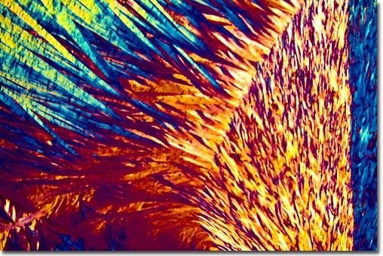
DNA COLLECTION PROCESS.
Collection Process
Patient spit into tube
Tube Sent for Genotyping
Laboratory Tests for poly-genes
Risk assessment sent to clinician/patient

Slide 21
Genetic Addiction Risk Score (GARS).
Gene | Allele | Prime Function
Dopamine D1 Receptor | 48G | Regulation of Dopamine Release in Accumbens
Dopamine D2 Receptor (ANKKI/DRD2 ) | Taq I A1 | Controls Synthesis of Dopamine D2 Receptors
Dopamine D3 Receptor (DRD3) | C | Carriers sensitive to cocaine; opioids, alcohol and nicotine
Dopamine D4 Receptor (DRD4) | 7R | Pre-disposed to Novelty Seeking and ADHD
Dopamine Transporter (DAT1) | 9R | Fast transport of synaptic Dopamine back into pre-neuron leading to Hypodopaminergic trait.
Serotonin Transporter (HTTLPR ) | S | Fast transport of serotonin back into neuron
Mu-opiate Receptor (OPRM1) | G | Predisposes to heroin addiction and pain sensitivity
GABA –B₃ Receptor (GABAR3) | 181. | Predisposes to anxiety disorders
Mono-Amine –Oxidase A (MAO-uVNTR) | 3R | Fast catabolism of mitochondria Dopamine
Catecholamine –Methyl-Transferase (COMT-vall58met) | G | Val substitution leads to fast catabolism of synaptic Dopamine leading to RDS

Slide 22
Reward gene publications as of 3/16/2014

Slide 23
GARS Risk Stratification
 | Caspi MAOA uVNTR | Caspi MAOA uVNTR | DRD4 | DRD4 | DAT | DAT | 5HTTLR diallelic | COMT val/met G=val A=met | DRD2 TaqIA rs1800497
XY | 3R | 3R | 4R | 5R | 9R | 10R | S/S | A/A | A2/A2
XY | 3R | 3R | 4R | 4R | 10R | 10R | S/S | A/G | A1/A1
XX | 4R | 5R | 0 | 4R | 9R | 10R | L/L | A/G | A2/A2
DRD3 rs6280 C=Gly T=Ser | OPRM1 Rs179971 A=Asn G=Asp | GAB RA3 | GAB RA3 | # of ALLELES | SCORE | SEVERETY
C/T | A/A | 181 | 181 | 8 | 0.44 | Medium
C/C | A/A | 181 | 181 | 12 | 0.7 | High
T/T | A/A | 181 | 193 | 5 | 0.29 | L0w

Slide 24
Association Study Compared GARS & ASI
Evaluated a Subset of 220 Subjects who had also responded to the Addiction Severity Index -Media Version (ASI-MV) –Alcohol Severity Risk Score

Slide 25
Genes and Risk Alleles Tested
DRD1=G
DRD2=AI
DRD3=C
DRD4=C
DAT1=9R
DRD4=7-11R;
HTTLPR=
S or Lg
MAOA=3.5-5R
COMT=G
OPRM1=G and
GABRB3=181

Slide 26
Demographics.
 |  | N | Mean | S.D. | Range
School | Males | 129 | 13.4 years | +/- 2.24 | 8 - 20
 | Females | 94 | 14.6 years | +/- 2.22 | 9 - 20
Age | Males | 129 | 34.46 years | +/- 12.21 | 18 - 67
 | Females | 94 | 38.00 years | +/- 13.96 | 18 - 70
Alcohol Risk Score | Males | 129 | 4.47 | +/- 2.66 | 1 - 9
 | Females | 94 | 4.91 | +/- 2.64 | 1 - 9
Notes:
This sample is overwhelmingly White (220 of the available sample size and to have some college education).

Slide 27
6 or less Risk Alleles= 28.7%
7 or 8 Alleles =30.9%
9 or higher Alleles =40.4%
GARS Score
100% Carried at least one risk allele

Slide 28
Chi Sq Analysis of Association to Predict Severity
Mixed Gender with 7 Risk Alleles
Significantly Predicts ASI –Alcohol Severity Score
χ2 =8.38, df=1, P <0.003

Slide 29
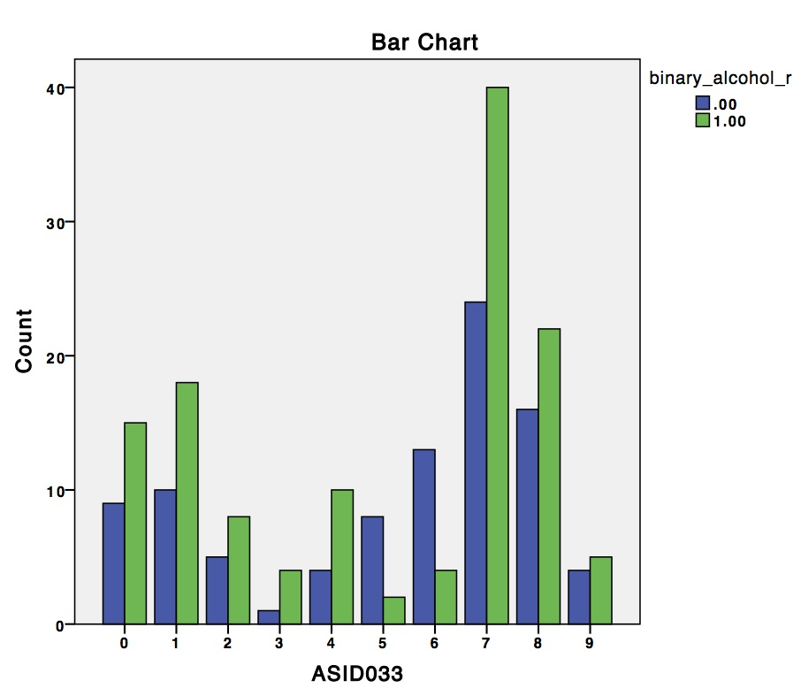
Significant Association with ASI-Drug Severity
Illicit drug use as a function of alcohol risk severity score (0/1).
Higher severity risk scores for alcohol
also have
higher severity risk score for illicit drug use
compared with those with a lower alcohol risk
severity score (chi-square = 17.48, df = 9, p = 0.042)

Slide 30
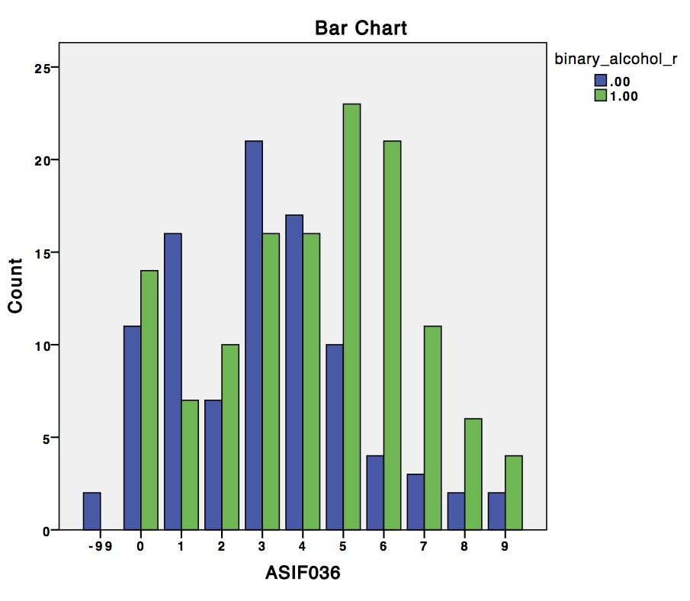
FAMILY PROBLEMS
Higher alcohol risk severity scores have
significantly higher number of family problems
as compared with those with lower alcohol severity risk scores.
(Chi-square = 26.73. df = 1-, p = 0.003).

Slide 31
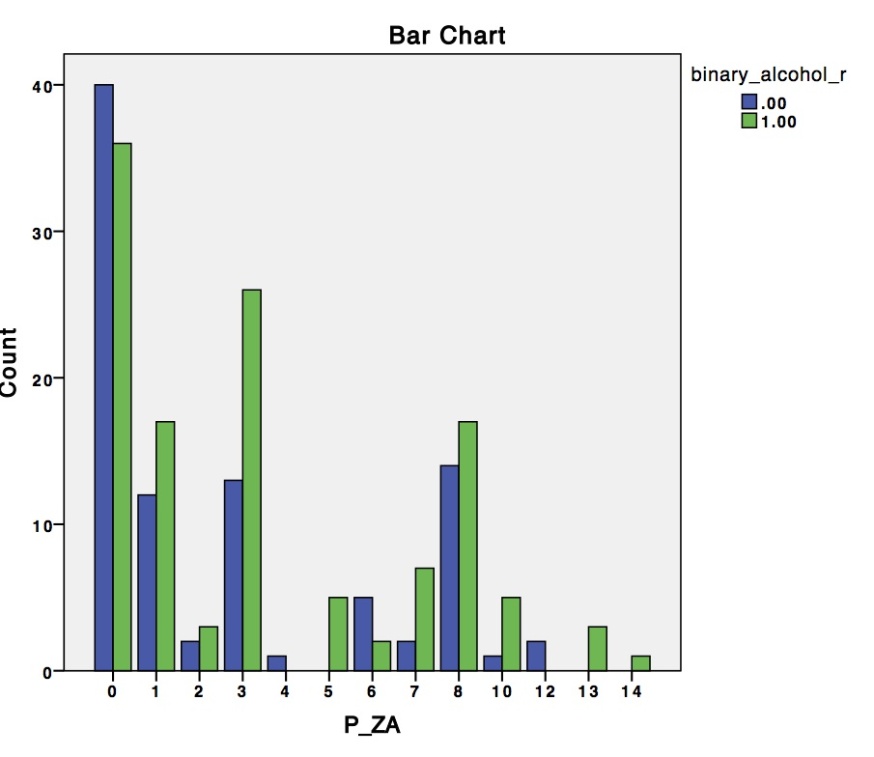
RDS Risk Behaviors
High (score = 1) alcohol severity risk scores
more frequently report mood-related disorders such as
-DEPRESSION (#1 P< 0.05),
-ANXIETY (#3 P<0.05) and
-PTSD (8 P<0.05).
Although the sample size is small, there appears to be a trend for
-HIGHER RATES OF EATING disorders (#7 P<0.06).

Slide 32
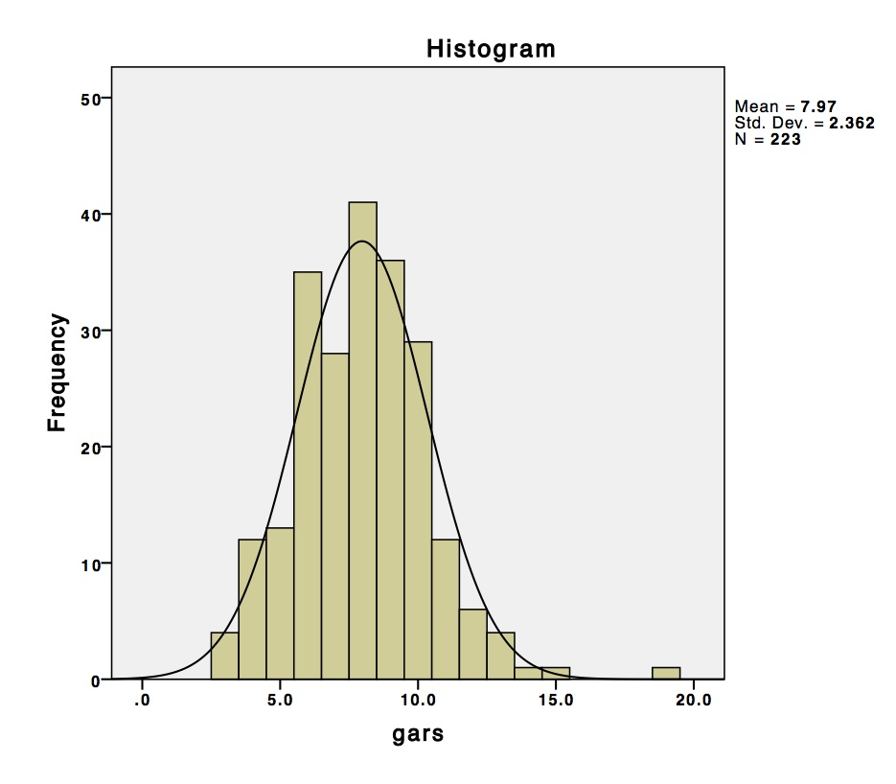
Hardy-Weinberg Distribution
Genetic risk is normally distributed
in the population,
with the average individual carrying roughly 8 risk alleles.

Slide 33
Logistic regression results.
Alcohol risk severity score has a cut off
at 5 or fewer symptoms = 0; Binary genetic risk score has a cut off
at 7 or fewer risk alleles = 0.
 | B | S.E. | Wald χ² | df | P-value
Constant | -1.23 | 0.60 | 4.28 | 1 | 0.039
Gender | -0.34 | 0.30 | 1.38 | 1 | 0.240
Age | 0.03 | 0.01 | 8.45 | 1 | 0.004
Race | 0.16 | 0.27 | 0.32 | 1 | 0.571
Genetic Risk Score | 0.70 | 0.60 | 4.28 | 1 | 0.015
Notes:
Alcohol risk severity score has a cut of at 5 or fewer symptoms = 0; Binary genetic risk score has a cut off of 7 or fewer risk alleles = 0.

Slide 34
Genetic Addiction Risk Score (GARS)
GENE
DRD1
DRD2
DRD3
DRD4
DAT
COMT
MAOA
5HTTLLR
OPRM1
GABRA3
GARS results of a total of 393 subjects | GARS Predicts ASI
Number of Subjects | 223
Low Risk | 28.7%
Moderate Risk | 30.9%
High Risk | 40..4%
ASI –Alcohol Severity Risk Score | GARS Predicts at P<.0.003 Age adjusted P<0.012
Nine Treatment centers | 393

Slide 35
GARS Predicts ASI –Drug Severity Risk Score
Linear Regression using 223 Patients from Nine Diverse Addiction Treatment Centers
Hypothesis Higher GARS Predicts Higher ASI-033 Drug Score .
Log Transformation (10) .
P<0.028 Unadjusted—Indicting significant association.
Log Transformation (10).
P<0.044 adjusted for age -Indicting significant association.

Slide 36
Proposed Clinical Tree For GARS
Reduce patient guilt
Reduce patient denial of disease
Reduce overall stigma
Stratify genetic risk for “reward deficiency” (Addiction)
Provide information of “relapse chance” (e.g. DRD2 A1 allele increases risk for relapse)
DNA-directed therapeutic targets based on gene polymorphisms

Slide 37
Proposed Clinical Tree For GARS cont’
Provide medical monitoring based on pharmacogenetics (differential genotypes and pharmaceutical outcomes – Vivatrol, Antidepressants etc.)
Provide medical necessity for insurance payments in terms of days required for treatment based on risk
Provide medical necessity for level of care (e.g. Detox, Intensive Out Patient, Residential etc.)

Slide 38
Reward Deficiency Syndrome is the true phenotype
The necessity for SUPER CONTROLS

Slide 39
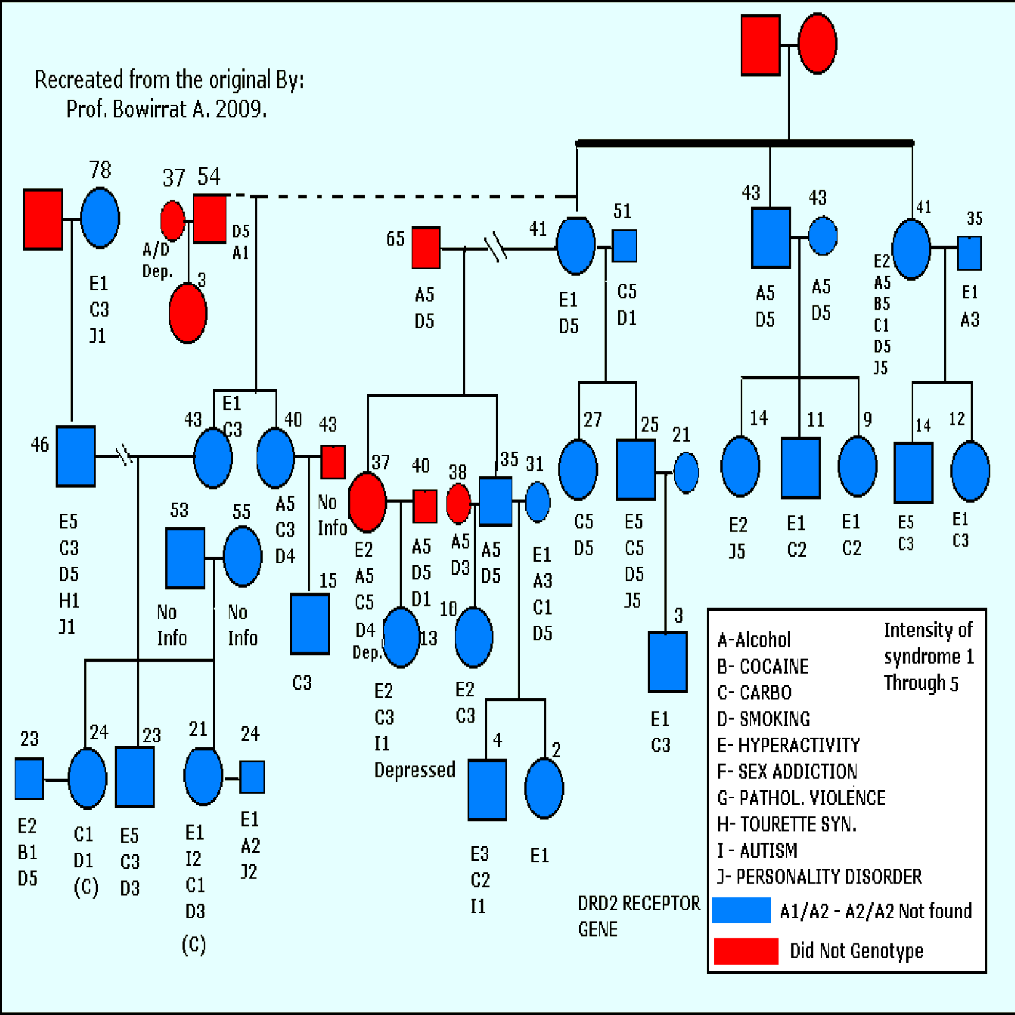
Reward Deficiency Syndrome in the Generational

Slide 40
D₂ Dopamine Receptor Gene Association Studies
n=3329
n=748
n=30
Noble, E.P. (2003). D₂ dopamine receptor gene in psychiatric and neurologic disorders and its phenotypes. American Journal of Medical Genetics, 116B, 103-125.
Chen, et al. Gene Therapy & Mol Biology, 11A: 93-112

Slide 41
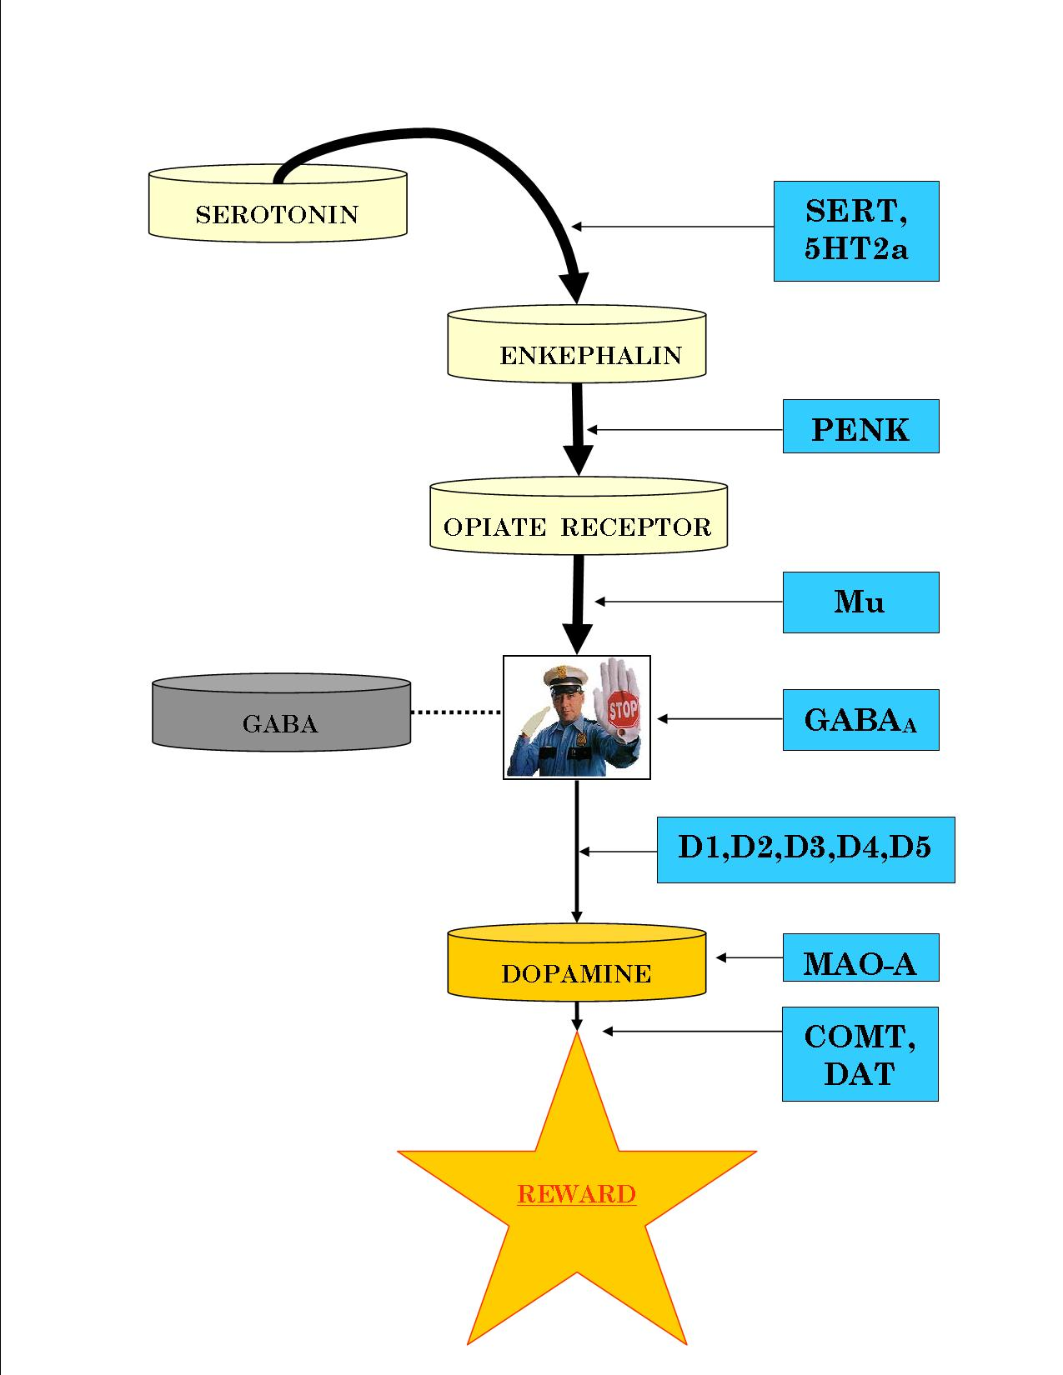
The Brain Reward Cascade
Gene Targets in the
Brain Reward Cascade
Notes:
REWARD, COMFORT, AND PLEASURE from ordinary activities; and a degree of calming to fight off unwanted stress. However, your genetics and environment greatly affect this cascade; and unfortunately, some of our genes come with variations called polymorphisms. Polymorphisms change the way the gene expresses itself. Most people will call this a predisposition. These polymorphism’s can alter their intended genetic function.

Slide 42
Neuroadaptagen Amino-Acid Therapy (NAAT)
GRAS N U T R I E N T | P A T H W A Y
D-Phenylalanine | Opioid peptides
L-Phenylalanine | Dopamine
L-Tryptophane | Serotonin
L-Tyrosine | Dopamine
L-Glutamine | GABA
Chromium | Serotonin
Rhodiola rosea | COMT
Pyridoxine | Enzyme catalyst
Glycoside | Immune
27 Published Clinical Trials of KB220 Variants

Slide 43
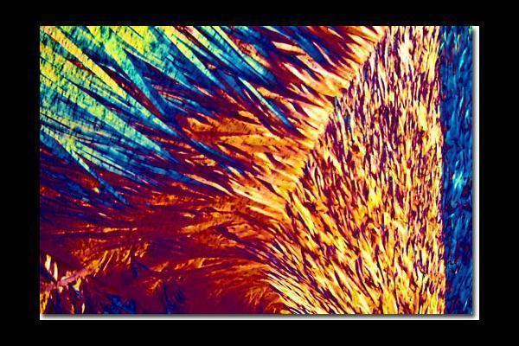
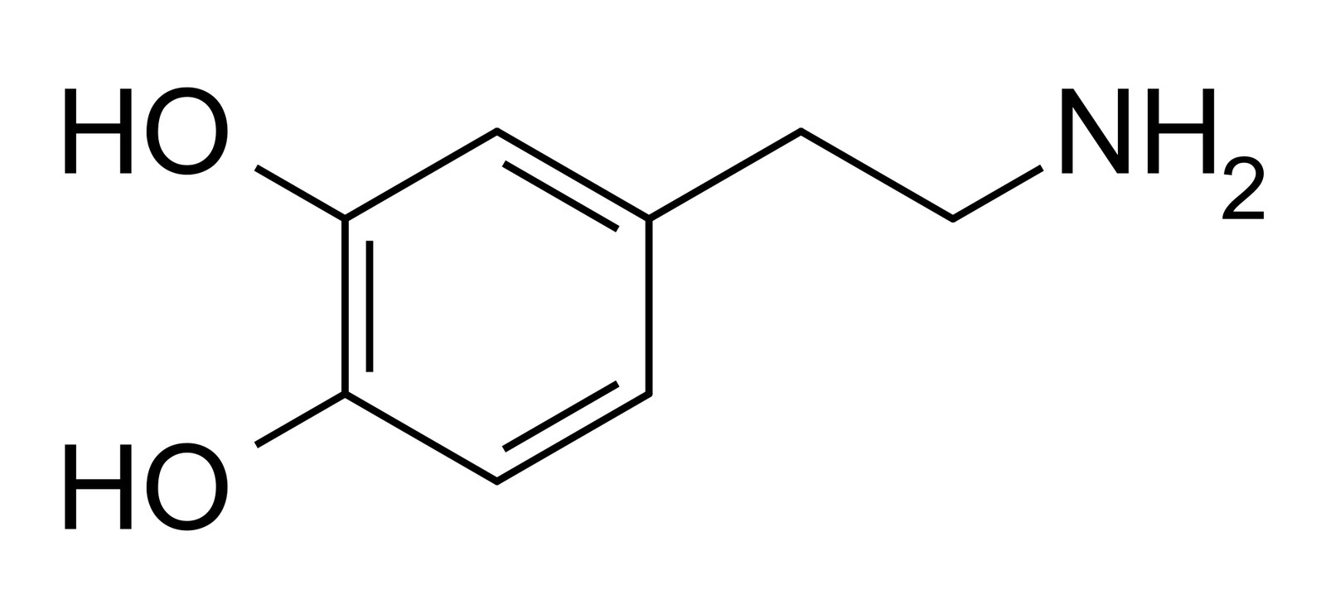
Dopamine

Slide 44
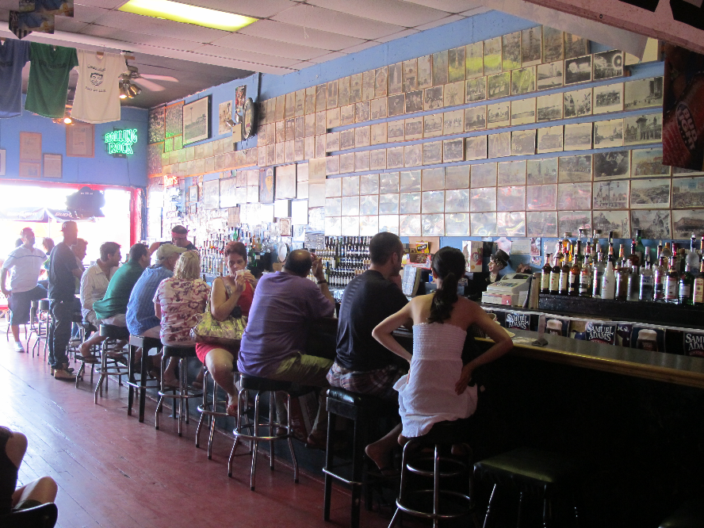
SELF MEDICATION

Slide 45
fMRI of Caudate Region of Brain following food, Music & Cocaine

Slide 46
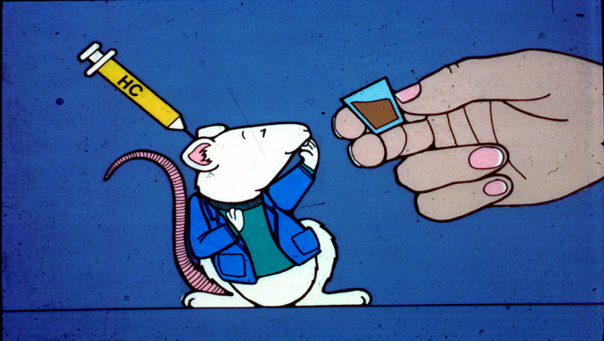
D-Phenylalanine raises brain endorphins and stops cravings

Slide 47
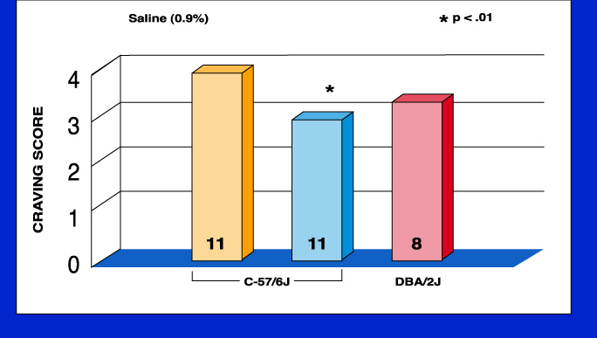
Pharmacogenetic conversion of high craving to low craving mice
DPA

Slide 48
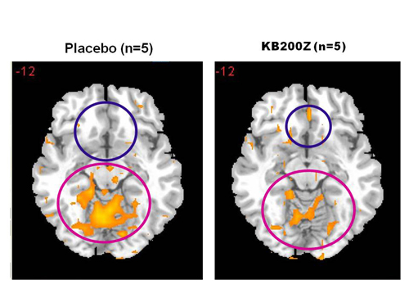
KB220Z Neuroadaptogen Complex
KB220Z compared to Placebo in five abstinent heroin dependent patients using fMRI
KB220Z normalizes qEEG Dysregulation
fMRI and qEEG results one-hour post administration compared placebo to KB220Z

Slide 49
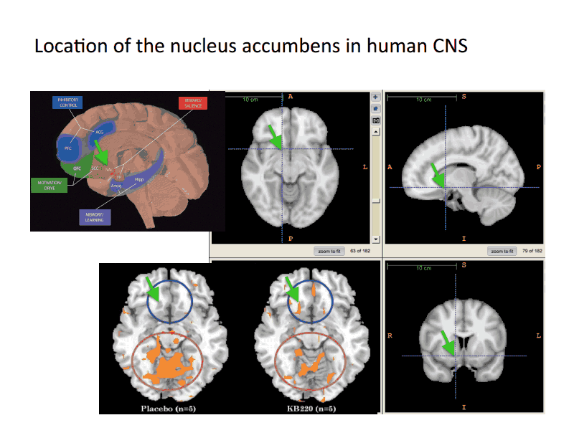
Human brain map

Slide 50
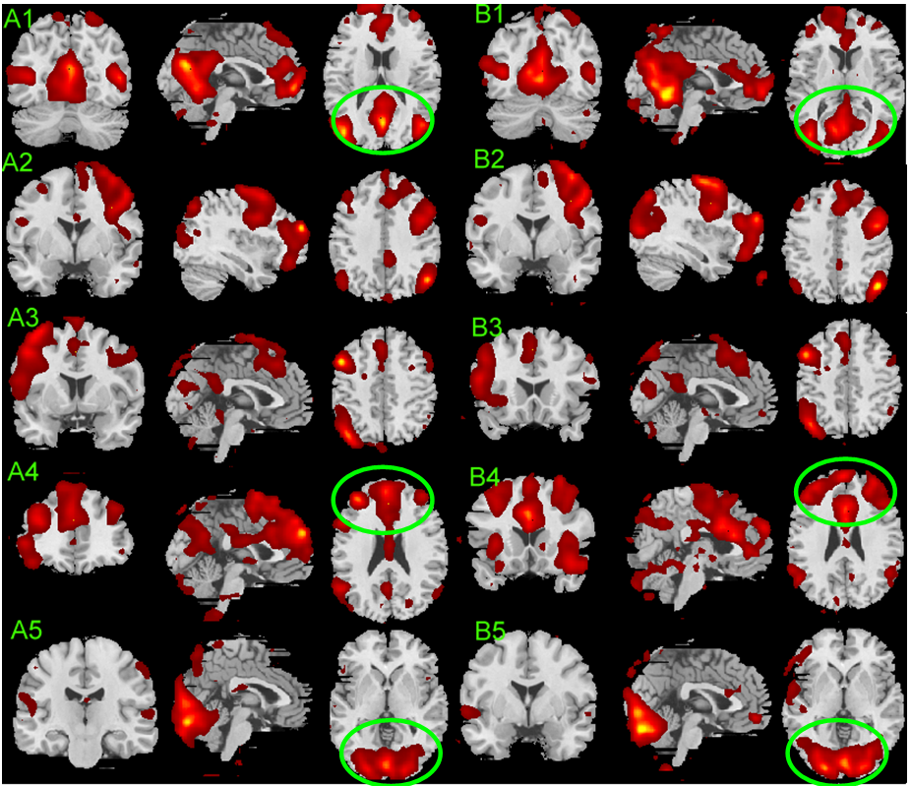
Placebo VS KB220Z

Slide 51
Areas of Significance
Dorsal Anterior Cingulate
Medial Frontal Gyrus
Nucleus Accumbens
Posterior Cingulate
Occipital Cortical
Cerebellum

Slide 52
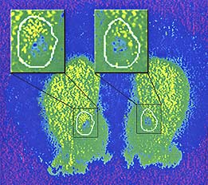
GENE THERAPY
The insets in this image of a rat's brain show increased expression of dopamine D2 receptors in the nucleus accumbens on the left side, which was injected with the D2 gene, compared with the right side, which was not injected with the receptor gene.
Thanos et al. Neurochemistry, 2004

Slide 53
DRD2 Repletion Therapy is one key to unlocking the cause of RDS
DRD2 receptors
Alcohol drinking
Cocaine intake

Slide 54
Reward Deficiency Solution System
To this end we have:
utilized the CARD [urine screen] to determine treatment outcomes
developed Genetic Addiction Risk Score (GARS), a DNA based panel of candidate genes to stratify risk for all reward dependent behaviors;
evaluated the first ever natural dopamine D2 receptor activator (KB220Z) to provide enhancement of “dopamine sensitivity” using neuroimaging in animals and humans;
propose using mRNA to determine reward gene expression pre and post treatment.

Slide 55
RDS and Co-morbid Psychiatric Disorders
PENK
5HTTLR
e
DRD4
Major Depression
Schizophrenia
e
DAT1
e
e
e
DRD2
Spectrum Disorders ADHD Tourette Autism
e
Reward Deficiency Syndrome
e
Personality Disorders
e
DRD3
GABA-B3
e
e
Bipolar Depression
DRD1
5HT2A
Anxiety Disorders
e
MOR1
COMT
e
e

Slide 56

Meet the eminent gathering once again at
Addiction Therapy-2015
Florida, USA
August 3 - 5, 2015
Addiction Therapy – 2015 Website:
addictiontherapy.conferenceseries.com

