Slide 1


AML & MDS:
Genomics to therapies
Ken Mills
5th World Hematologist Congress
18th August 2016

Slide 2
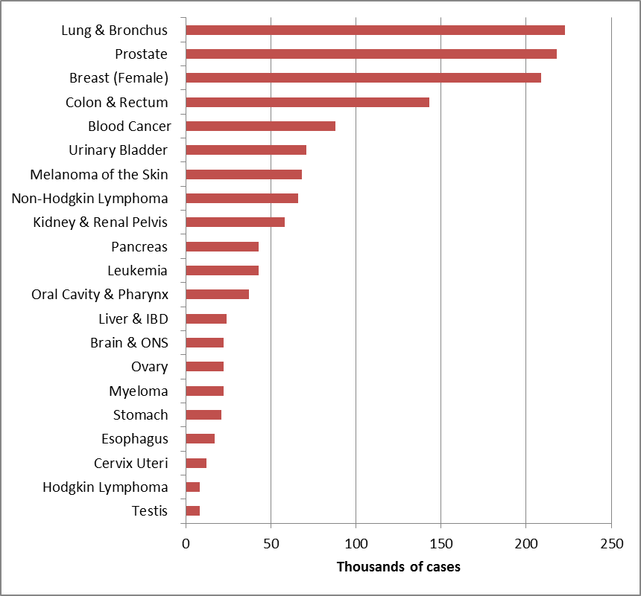
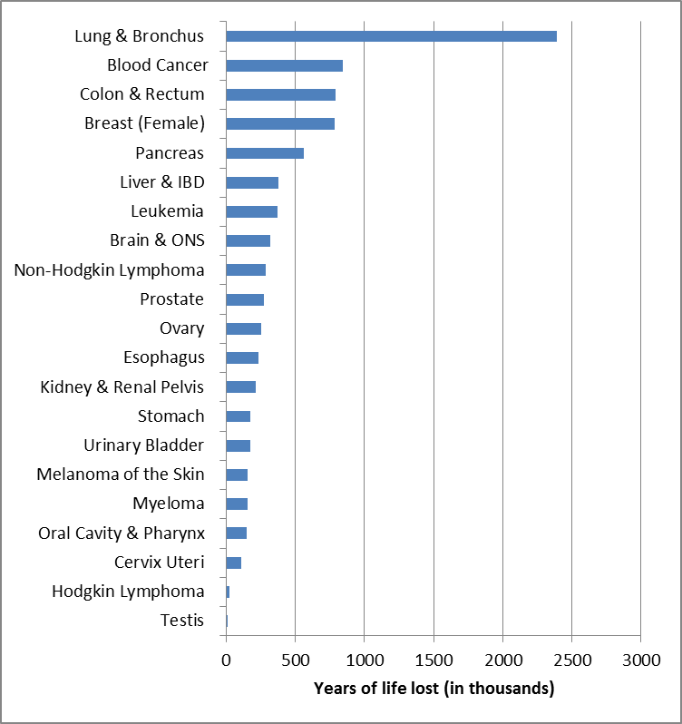
Blood Cancers
Blood Cancers are the 5th most common type of cancer
  >25,000 people each year in the UK
Blood Cancer is the 3rd leading cause of cancer death
Blood Cancer is the 2nd highest “years of life lost”

Slide 3
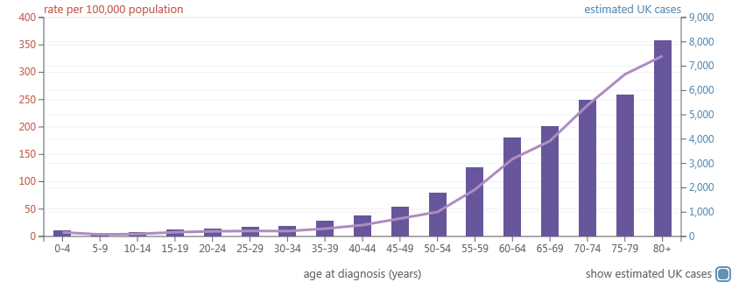
Incidence of blood cancers
0nly 1% of cases in patients under 15 years old
75% of all blood cancers occur in people older than 60 years old at diagnosis

Slide 4

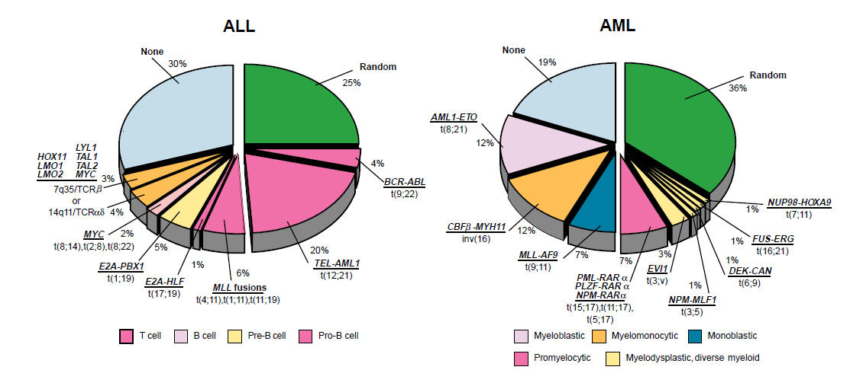
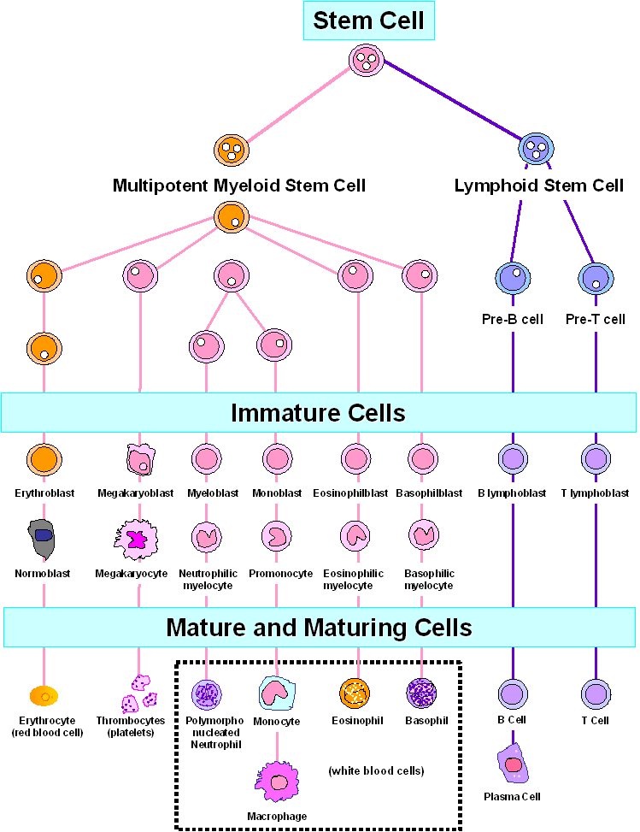
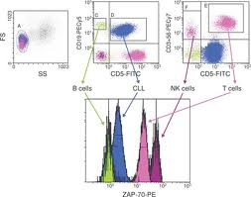
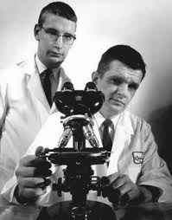
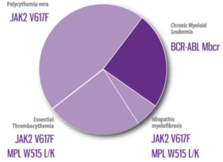
Acute
Lymphocytic
Leukaemia
(ALL)
Acute Myeloid
Leukaemia
(AML)
&
Myelodysplastic
syndromes
(MDS)
T-ALL
Haematopoiesis
Chronic
Lymphoid
Leukaemia
(CLL)
IgH / TCR
ZAP70
CD38
1960
Myeloproliferative
Neoplasms (MPN)
&
Chronic Myeloid
Leukaemia (CML)
Myeloma

Slide 5

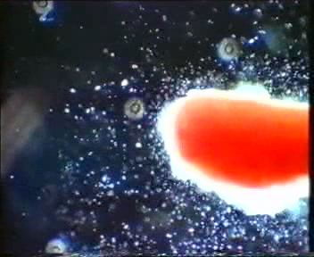
Bone Marrow
Peripheral
Blood

Slide 6
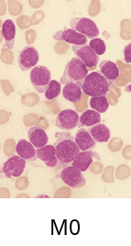
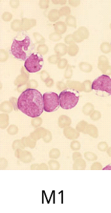
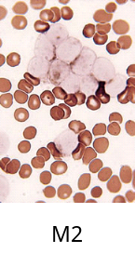
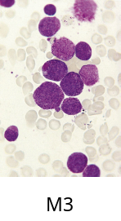
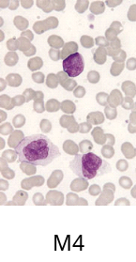
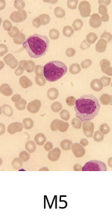
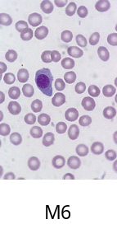
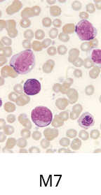
FAB classification of AML
M0
Acute myeloid leukaemia, minimally differentiated
M0
M1
Acute myeloid leukaemia without maturation
M1
M2
Acute myeloid leukaemia with maturation
M2
M3
Acute
promyelocytic
leukaemia
M3
M4
Acute
myelomonocytic
leukaemia
M4
FAB Classification
Acute
Acute
myelomonocytic
myelomonocytic
leukaemia with increased marrow
leukaemia with increased marrow
eosinophils
eosinophils
(M4EO)
(M4EO)
M5
Acute
Monocytic
leukaemia
M5
Acute
Acute
monoblastic
monoblastic
leukemia
leukemia
(M5a)
(M5a)
Acute
Acute
monocytic
monocytic
leukemia
leukemia
with maturation (M5b)
with maturation (M5b)
M6
Erythroleukaemia
M6
Erythroid
Erythroid
/myeloid) (M6a)
/myeloid) (M6a)
Pure
Pure
erythroid
erythroid
malignancy (M6b)
malignancy (M6b)
M7
Acute
megakaryoblastic
leukaemia
M7
Bennett et al, Br J Haematol 1976

Slide 7
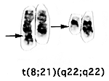


Cytogenetics
t(15;17)(q22;q12)
PML-RARa
t(8;21)(q22;q22)
AML-ETO
(RUNX1-RUNXT1)
Cytogenetics in AML
inv(16)
CBFβ-MYH11

Slide 8
WHO classification of AML (2002)
AML with {t(8;21)(q22;q22)}
AML with
AML with {t(8;21)(q22;q22)}
AML with
·
·
Acute
Acute
promyelocytic
promyelocytic
leukemia
leukemia
with
with
t(15;17) and variants,
recurrent
t(15;17) and variants,
recurrent
·
·
{PML/RAR
{PML/RAR
-
-
alpha}
cytogenetic
alpha}
cytogenetic
AML with{inv(16)(p13q22)} or t(16;16)(p13;q11)},
translocations
AML with{inv(16)(p13q22)} or t(16;16)(p13;q11)},
translocations
·
·
{CBFb/MYH11}
{CBFb/MYH11}
AML with 11q23 abnormalities {MLL}
·
AML with 11q23 abnormalities {MLL}
·
With prior
With prior
myelodysplasic
myelodysplasic
syndrome
AML with multi
syndrome
AML with multi
-
-
·
·
Without prior myelodysplastic syndrome
lineage
Without prior myelodysplastic syndrome
lineage
dysplasia
dysplasia
·
WHO 2002
·
AML minimally differentiated
AML not
AML minimally differentiated
AML not
·
·
AML without maturation
otherwise
AML without maturation
otherwise
·
·
AML with maturation
categorised
AML with maturation
categorised
·
·
(lineage and
(lineage and
Acute
Acute
myelomonocytic
myelomonocytic
leukemia
maturation
leukemia
maturation
·
·
Acute
Acute
monocytic
monocytic
leukemia
categories)
leukemia
categories)
·
·
Acute
Acute
erythroid
erythroid
leukemia
·
leukemia
·
Acute megakaryocytic
Acute megakaryocytic
leukemia
·
leukemia
·
Acute basophilic
Acute basophilic
leukemia
·
leukemia
·
Acute
Acute
panmyelosis
panmyelosis
with
with
myelofibrosis
·
myelofibrosis
·

Slide 9
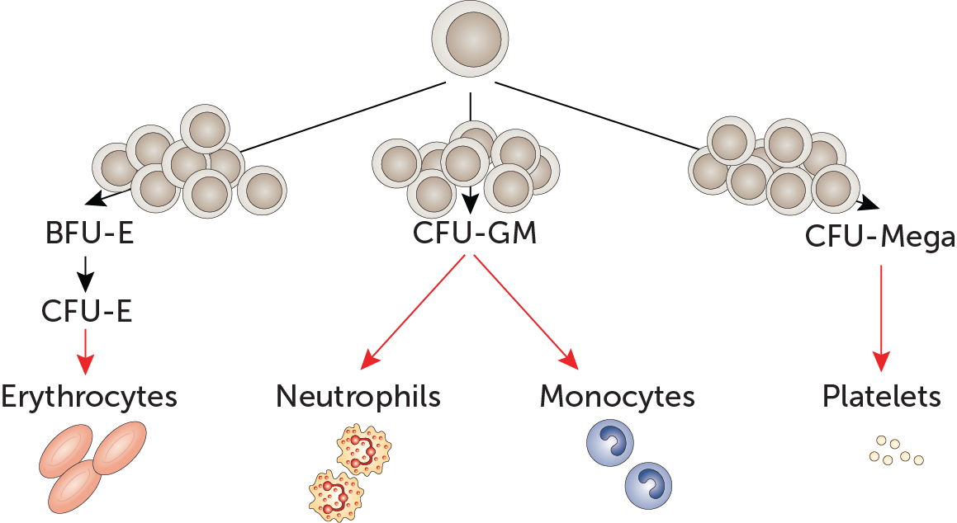
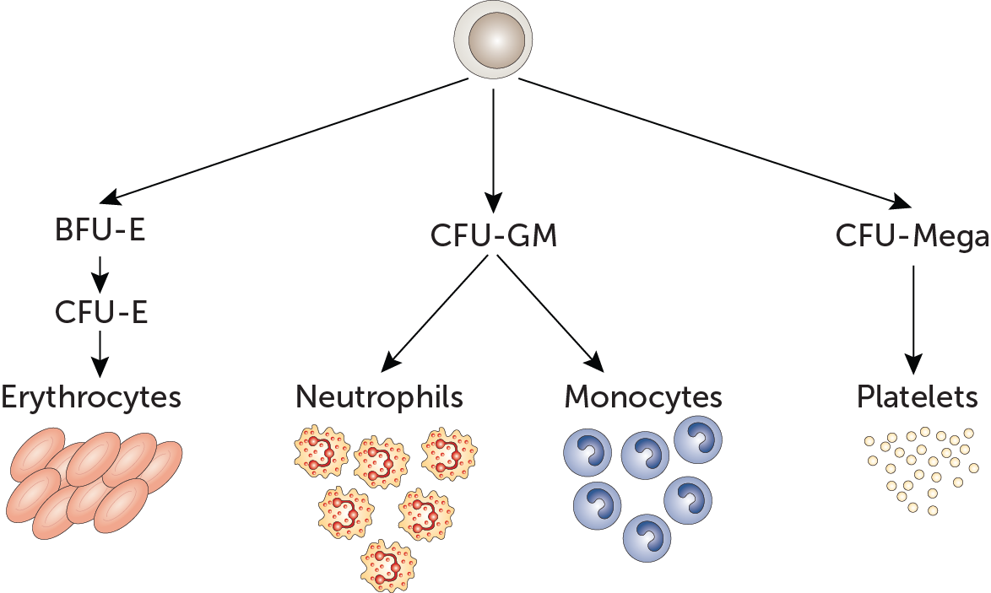
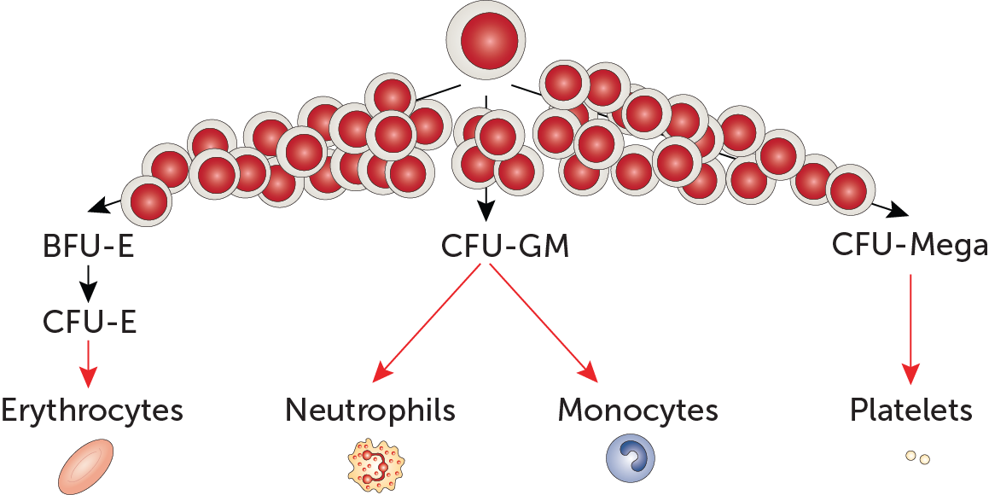
NBM → MDS → AML
Acute Myeloid Leukaemia (AML)
Normal Bone Marrow (NBM)
Myelodysplastic Syndrome (MDS)
~¹/₃ transform

Slide 10
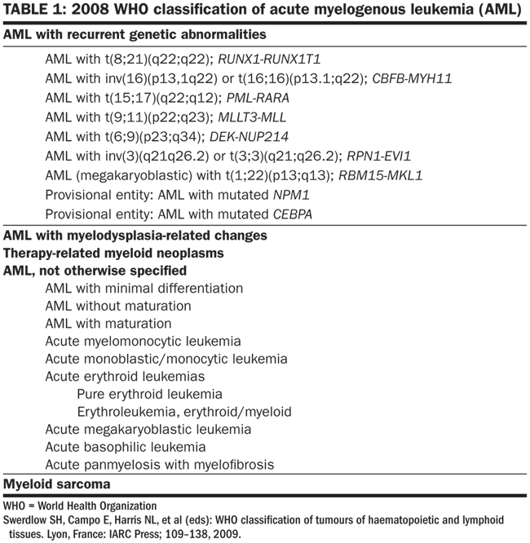
WHO 2008
7 cytogenetically defined entities
2 provisional entities
WHO 2008

Slide 11
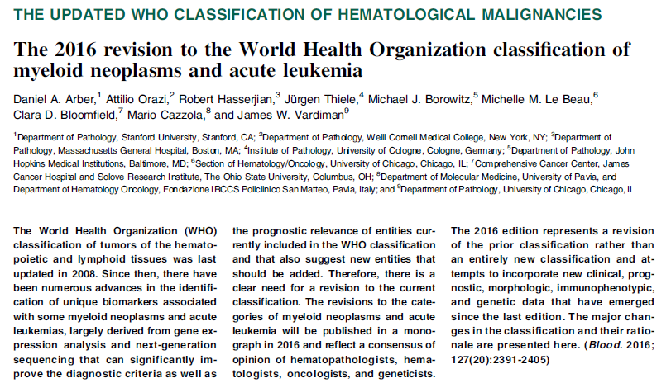
WHO 2016 Revision

Slide 12
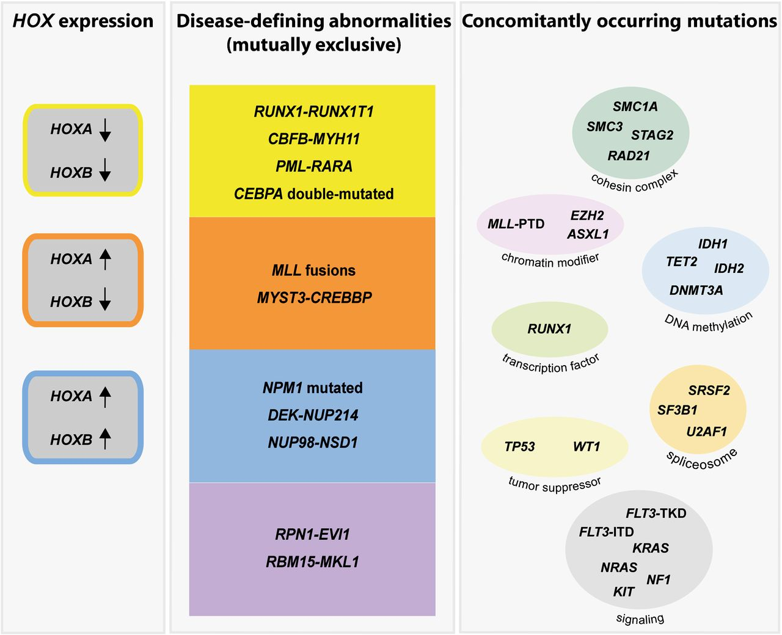
Genetic abnormalities in AML as disease-defining abnormalities
WHO 2008 Plus
Haferlach C , and Haferlach T Blood 2013;122:2532-2534
Notes:
Genetic abnormalities in AML can be classified as disease-defining abnormalities that are mutually exclusive. So far, they encompass the 7 genetically defined WHO entities, 2 provisional WHO entities (NPM1 mutated, CEBPA double-mutated), and 2 suggested new WHO entities (MYST3-CREBBP, NUP98-NSD1). These are associated with a distinct cytomorphology and gene expression pattern. In addition, a specific pattern of HOXA and HOXB genes is recognized with MYST3-CREBBP being related to an elevated expression of HOXA, but not of HOXB genes. A further class comprises mutations that concomitantly occur and alter different cellular processes, such as signaling, chromatin modification, DNA methylation, RNA splicing, cohesion of sister chromatids, transcription, and tumor suppression.

Slide 13
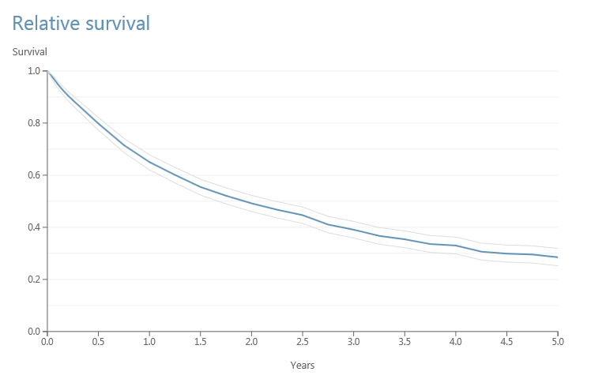
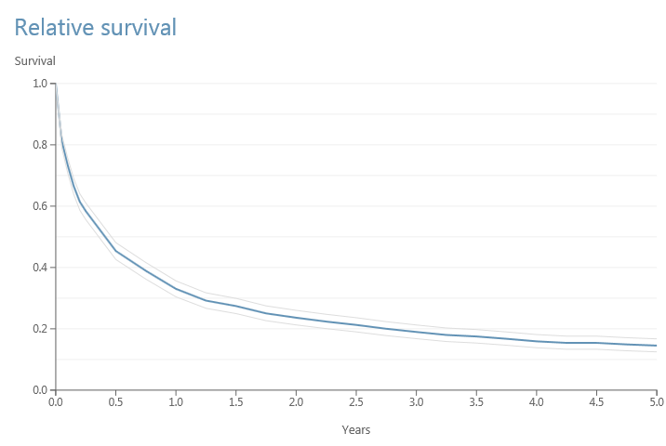
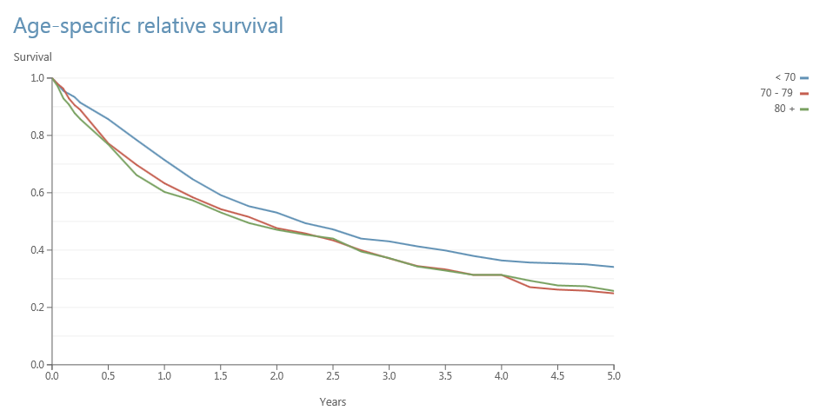
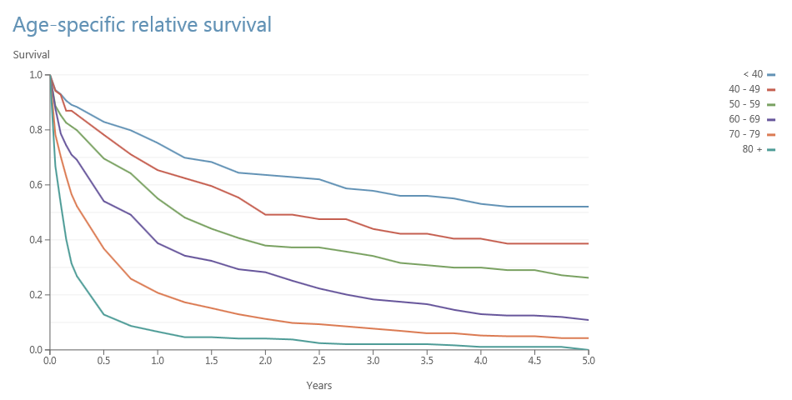
Overall and Age-Specific
Relative Survival
MDS
AML
HMRN 2016

Slide 14
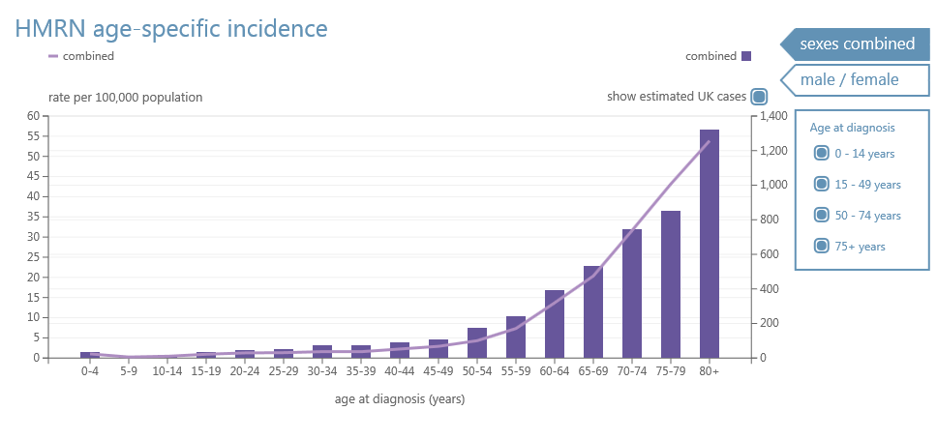
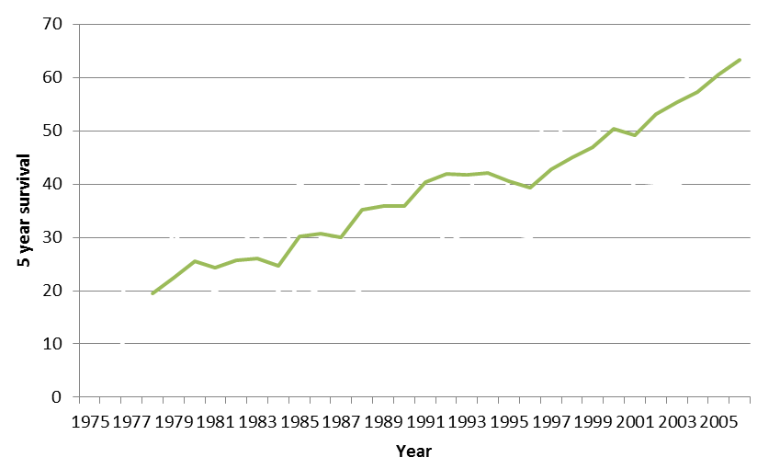
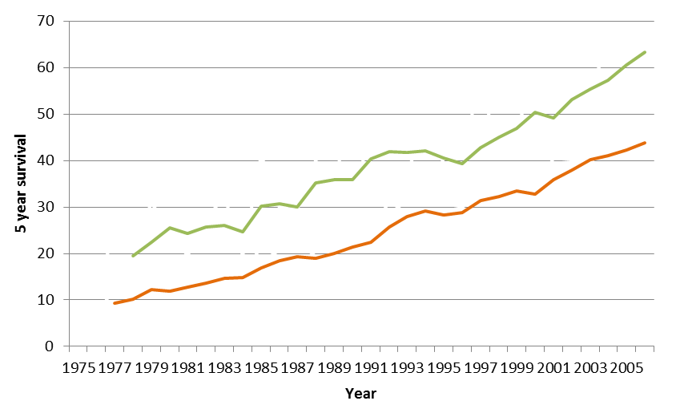
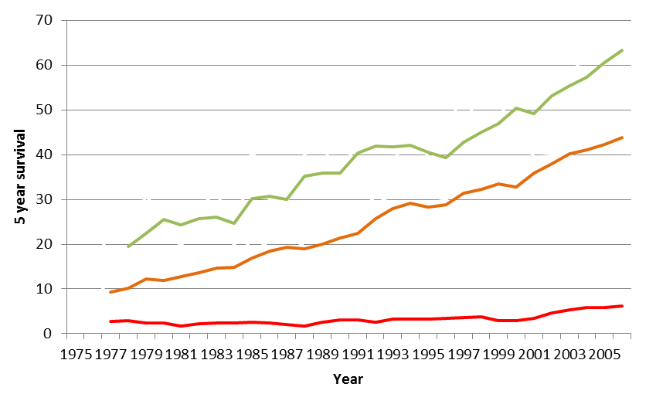

Novel therapies are needed for elderly AML / MDS
  Leukaemia is the most common cancer in children less than 20 years old
    The survival rate for children 0-14 years old has increased from ~10% at 1 year in the 1960’s to >90% at 10 years now
  Over 95% of cases of leukaemia occur in people over the age of 20 years old
    BUT survival rates for some types of leukaemia in patients over the age of 65 years old still remain poor
HMRN 2016
Elderly patients are unable to withstand harsh standard chemotherapy
Bleak outlook
Novel therapies required
<20 yrs
<65 yrs
Why has this person developed this disease?
How can I treat this more successfully?
How can I treat this patient without so much damage?
How can I treat the elderly?
>65 yrs
SEER, August 2014

Slide 15
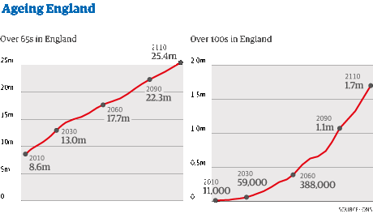
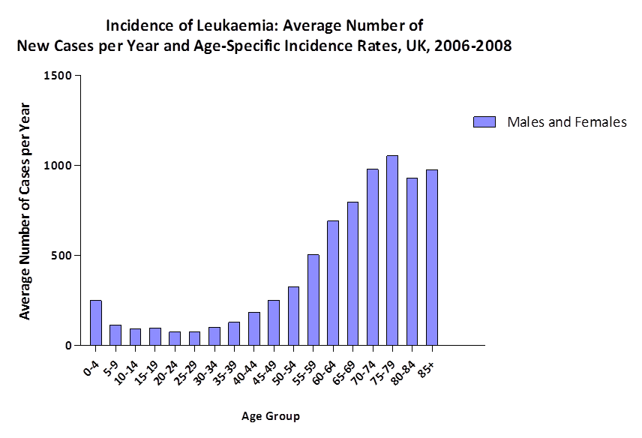
  LEUKAEMIA
  Leukaemia is the most common cancer in children less than 20 years old
    The survival rate for children 0-14 years old has increased from ~10% at 1 year in the 1960’s to >90% at 10 years now
  Over 98% of cases of AML occur in people over the age of 20 years old
    Survival rates for AML patients under 65 yr old at diagnosis has also significantly increased
    BUT survival rates for some types of leukaemia in patients over the age of 65 years old still remain poor
<20 yrs
<65 yrs
>65 yrs
*SEER, August 2014

Slide 16
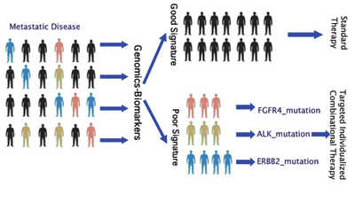
Personalised medicine
Favourable outcome
Standard Therapy
Molecular Analysis
Personalised Therapy
Adverse outcome
Mutation A: Therapy A
Mutation B: Therapy B
Mutation C: Therapy C

Slide 17
    Genes mutated in MDS & AML
BIRC3
BRAF
CDKN2A
CEBPA
CSF3R
ETV6
FBXW7
GATA2
GNAS
KDM6A
KRAS
MAP2K1
MLL
PTPN11
RAD21
RHOA
RUNX1
SETBP1
SMC1A
SMC3
SRSF2
U2AF1
XPO1
ZRSR2
ASXL1
PHF6
WT1
IDH2
NPM1
TET2
SF3B1
TP53
FLT3-ITD
FLT3-TKD
EZH2
JAK2
STAG2
MLL-PTD
CEBPA
RUNX1
IDH1
DNMT3A
NRAS
KIT
CBL
BCOR/BCORL1
1990
1992
1994
1996
1998
2000
2002
2004
2006
2008
2010
2012
NGS

Slide 18
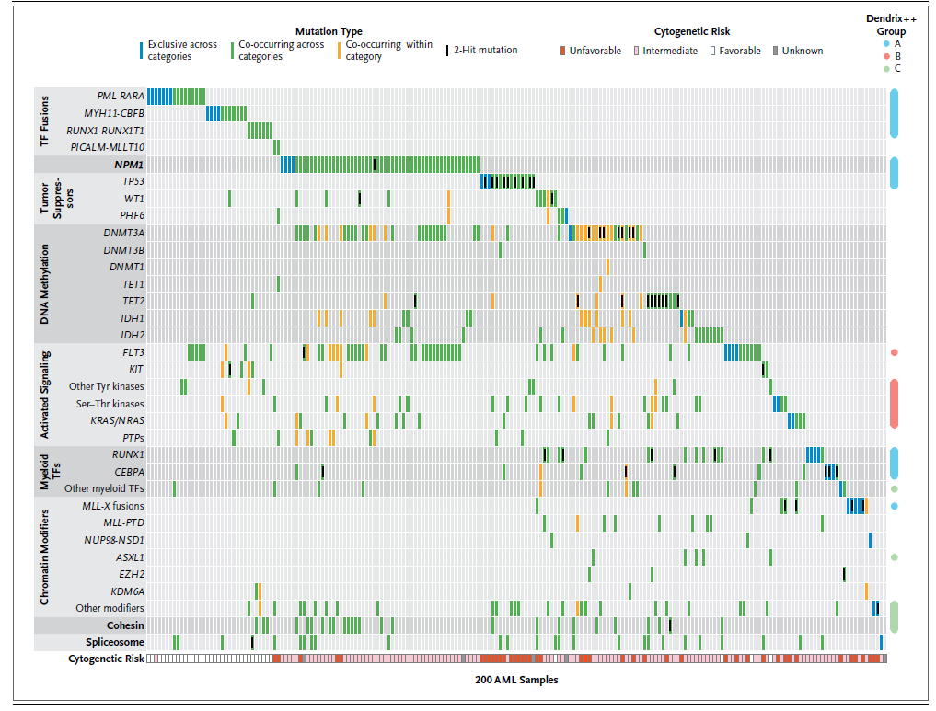
200 Patients
Mutated Genes
Genomic and epigenomic landscapes of adult de novo acute myeloid leukemia.
The New England Journal of Medicine 368(22), 2059-2074. 30-5-2013

Slide 19
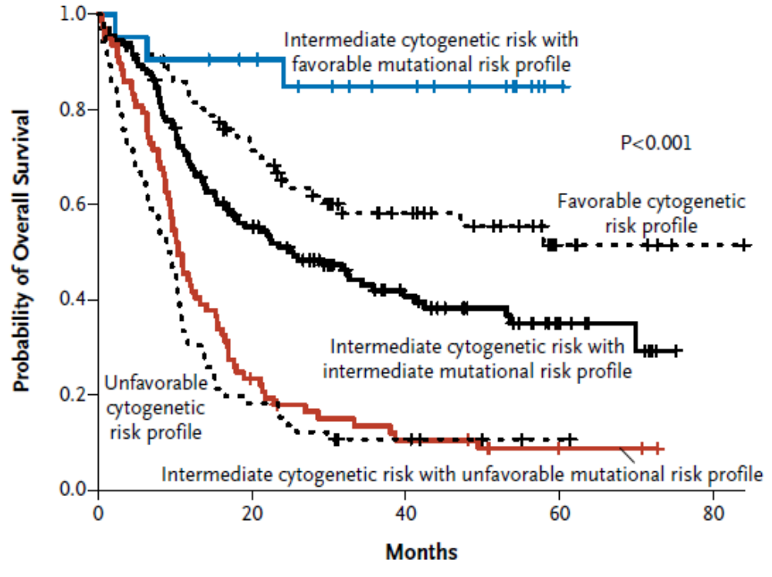
Molecular profiling distinguishes subgroups of
cytogenetically intermediate risk AML with differing outcome
Mutation screen (n=398):
FLT3 37%
NPM1 29%
CEBPA 9%
DNMT3A 23%
TET2 8%
IDH1 7%
IDH2 8%
WT1 8%
RUNX1 5%
AXL1 3%
TP53 2%
MLL-PTD 5%
HRAS 0%
KRAS 2%
NRAS 10%
KIT 6%
EZH2 0%
PHF6 3%
PTEN 2%
At least 1 mutation in 97%
FLT3-ITD neg, NPM1 & IDH1/2 mutation
CBF leukaemia
Molecular & cytogenetic sub-groups
Intermediate-risk cytogenetics
Intermediate risk mutational profile
Intermediate-risk cytogenetics
Adverse risk mutational profile:
FLT3-ITD, MLL-PTD,
Mutant DNMT3A, TET2, ASXL1, PHF6
Adverse
cytogenetics
Patel JP et al, New Engl J Med 2012; 366: 1079-89.

Slide 20
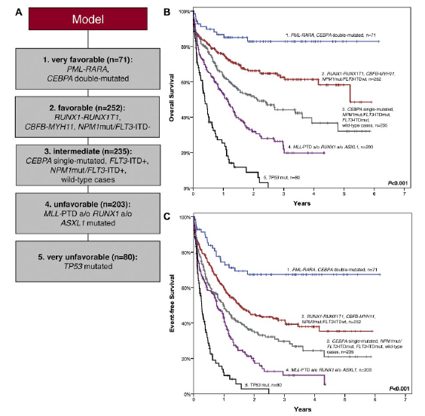
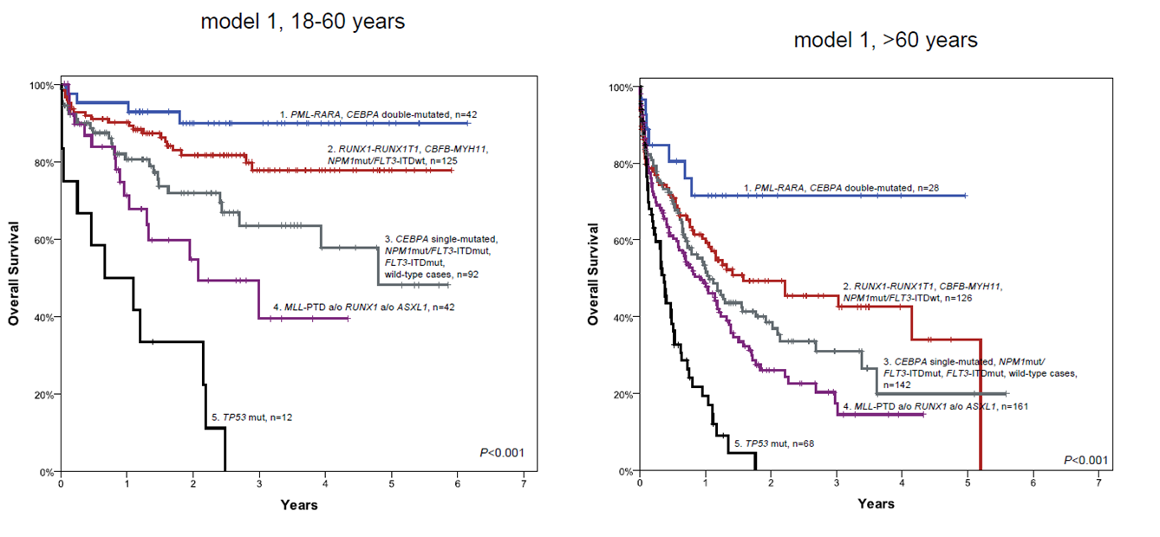
AML stratification model based on molecular mutations
<60 yr
>60 yr

Slide 21
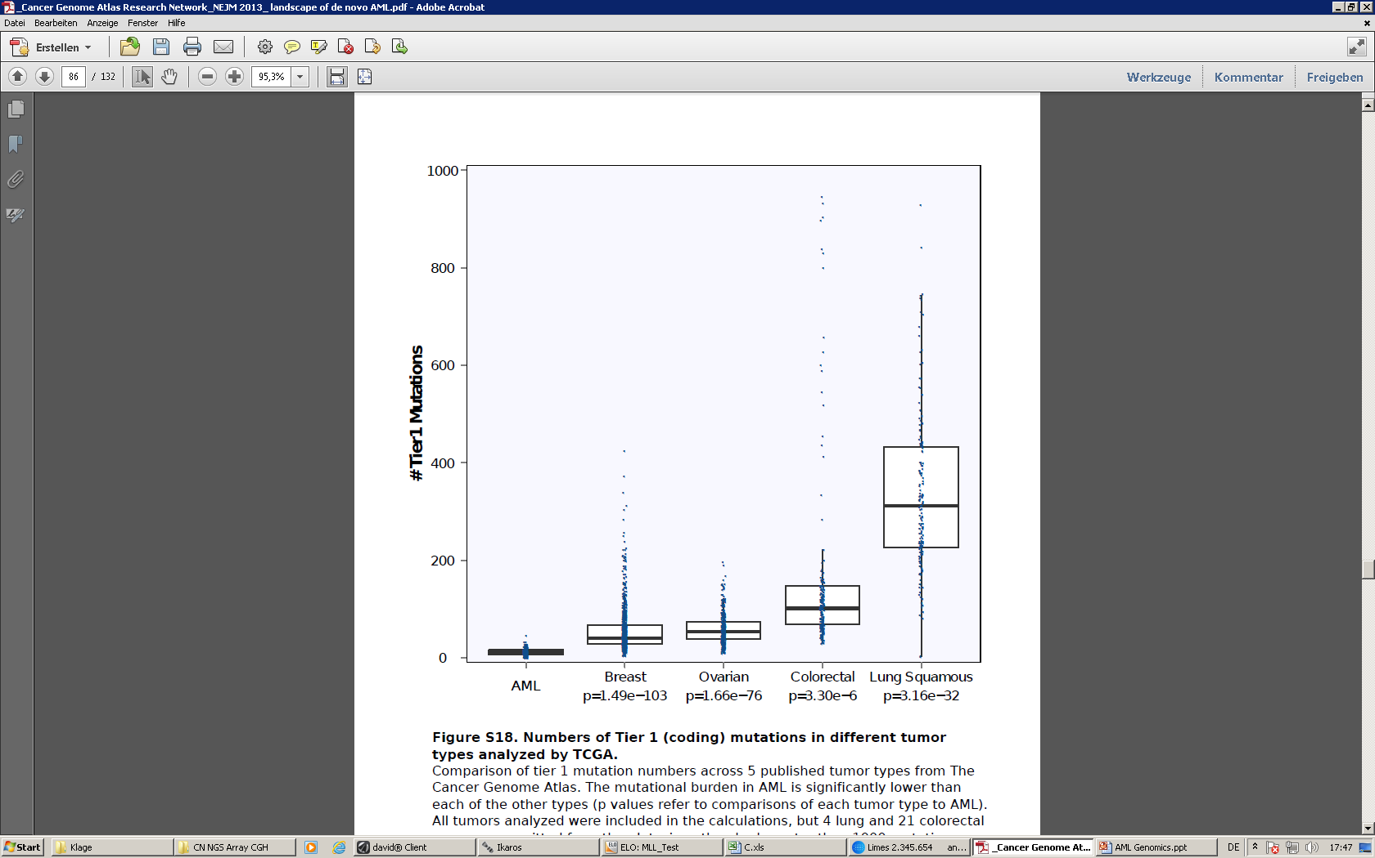
Numbers of mutations in
different tumor types
Mutations in different tumours
T. J. Ley et al., NEJM, 368, 2059-2074, 2013

Slide 22
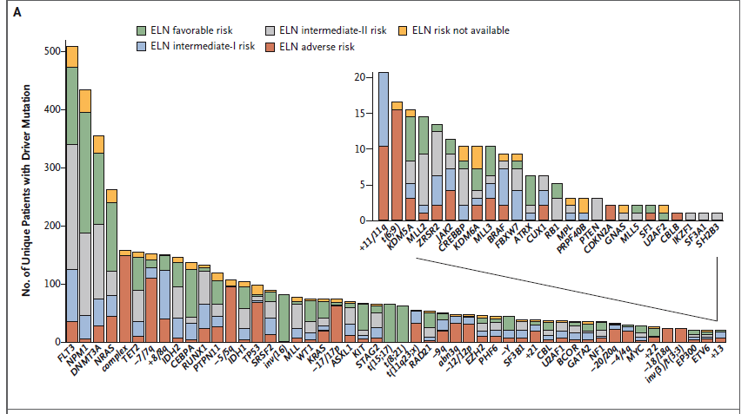
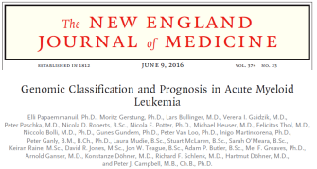
Landscape of driver mutations in AML

Slide 23
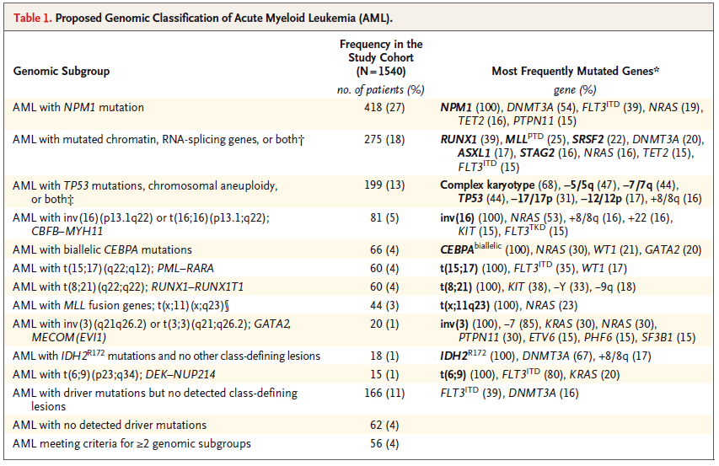
Proposed genomic classification of AML

Slide 24
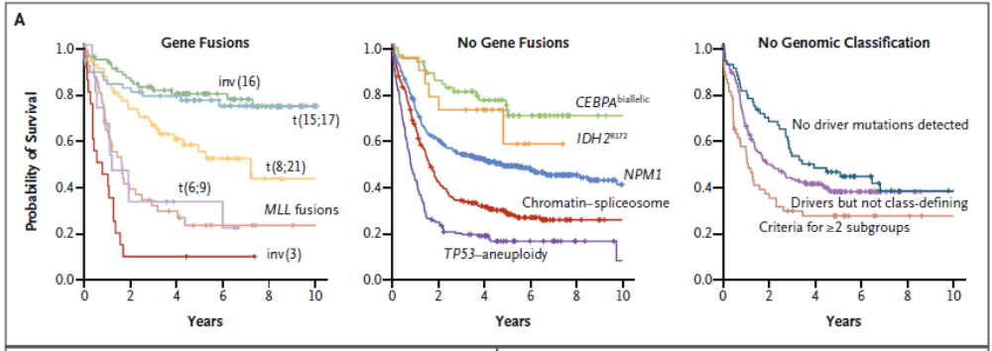
Survival curves for the 11 genomically defined sub-groups

Slide 25
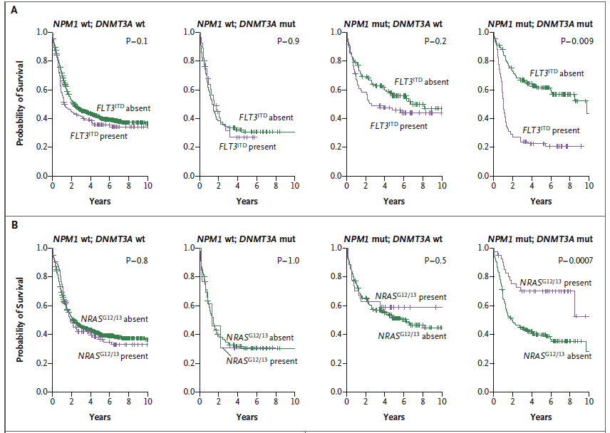
Influence of gene-gene interactions on survival

Slide 26
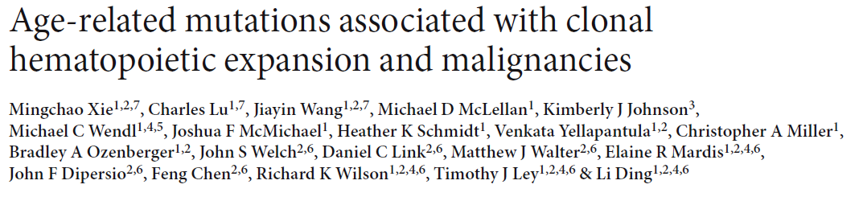
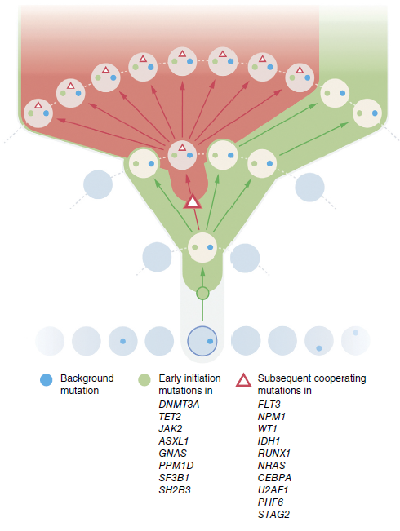
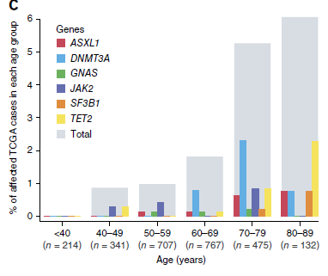
Nature Medicine: Online 19th Oct 2014

Slide 27
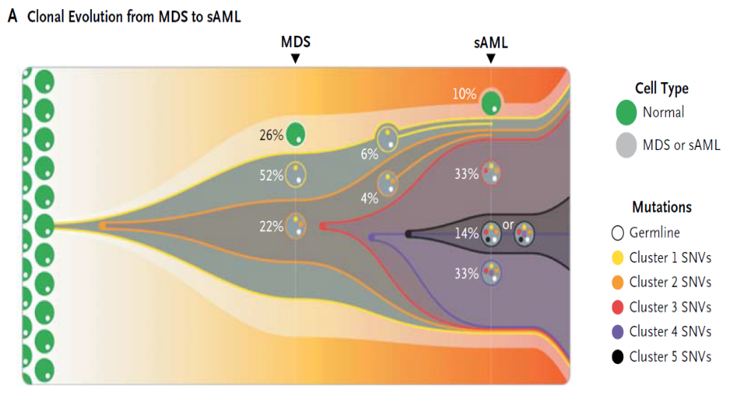
Evolution from diagnosis to relapse
NBM
Diagnosis
Relapse
```
Mutation evolution
3 mutations in two combinations
5 mutations in
six combinations
Walter et al., NEJM, 366, 1090-1098, 2012

Slide 28
Proposed genomic classification of AML

Slide 29
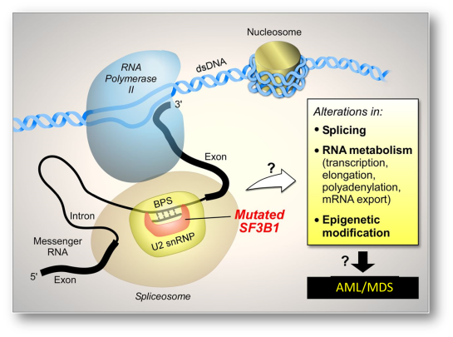


Genomic Sub-Group 2
AML with mutation chromatin, RNA splicing genes or both
RUNX1
MLL^{PTD}
Splicesome
  SRSF2
  SF3B1
Epigenetic modifiers
  DNMT3A
  TET2
  ASXL1
Cohesin complex
  STAG2
NRAS
FLT3

Slide 30

Cohesin
Multimeric protein complex containing STAG1/2, RAD21, SMC1A and SMC3.
Highly conserved across species.
Involved in Sister Chromatid Cohesion.
Post-replicative DNA Repair.
Transcriptional Regulation

Slide 31




Cohesin complex
Multimeric protein complex containing STAG1/2, RAD21, SMC1A and SMC3.
Highly conserved across species.
Involved in Sister Chromatid Cohesion.
Post-replicative DNA Repair.
Transcriptional Regulation
ChIP-seq
RNA-seq
Clone 1: premature stop codon
Clones 2 & 3: 2/3 codon deletion
Altered proliferation
CRISPR-CAS9 induced STAG2 mutation
Nuclear export defect

Slide 32
Genomic Sub-Group 2
AML with mutation chromatin, RNA splicing genes or both
RUNX1
MLL^{PTD}
Splicesome
  SRSF2
  SF3B1
Epigenetic modifiers
  DNMT3A
  TET2
  ASXL1
Cohesin complex
  STAG2
NRAS
FLT3

Slide 33



Components of the spliceosome are frequently mutated
50% of mutations
Murati et al. 2012

Slide 34





RNA-seq analysis
Deregulation of DNA damage genes
SF3B1 MT vs Healthy
SF3B1 WT vs Healthy

Slide 35








Defect in RNA export
Oligo dT probe
Merge
DAPI
K562
K-562-K700E
(V3)
1.18
1

Slide 36


RNA-seq
Identification of novel therapies

Slide 37
Genomic Sub-Group 2
AML with mutation chromatin, RNA splicing genes or both
RUNX1
MLL^{PTD}
Splicesome
  SRSF2
  SF3B1
Epigenetic modifiers
  DNMT3A
  TET2
  ASXL1
Cohesin complex
  STAG2
NRAS
FLT3

Slide 38


AML/ MDS
An epigenetic disease
Issa, Jean-Pierre J, Blood (2013)
Rodríguez-Paredes & Esteller, Nature (2011)

Slide 39


A need to identify rationally defined epigenetic therapeutic combinations
Estey, 2013. Leukaemia

Slide 40


Limited clinical response of AML patients to demethylation agents
Epigenetic therapies
0 12 24 36
Months

Slide 41




  An epi-sensitised therapeutic approach
Less toxic for unfit patients
Epigenetic therapy sensitises cells to combination therapies
Kathryn Christine Jodie Hilary
Clarke Young Hay Colyer

Slide 42

HDACi
DNMTi
HDMi
NGS mutation detection
DNA sequencing
Methylation profiling
Epigenetic Therapy
2nd Combination Therapy
Chemo-resistant
leukaemia
cells
Primed
leukaemia
cells

Slide 43

Re-purposed agents
Novel targets
Novel agents
2nd Combination Therapy
Primed
Leukaemia
cells
Cell death!

Slide 44

AXL
AXL
AXL
Notes:
So to summarise this chapter of work, I have shown that the combined action of Decitabine and vorinostat in oci-aml3 cells leading to the inhibition and dna methylation and increased histone acetylation produces a unique gene expression signature within these cells. Specific functions that were found to be enriched included those such as the immune and inf response and cell death and upon further investigation some of the genes altered were found to play a role in the induction if caspase activity which may provide a possible reason for the increase in caspase and apoptosis seen in the first chapter. Differentiation was also enriched and although this was not investigated directly in the human aml cell lines, treatments on murine cell lines suggested a role for these agents in the induction of differentiation. And finally, the cell cycle and dna replication related genes both of which were down regulated following combination treatment.

Slide 45





72 h
0 h
24 h
48 h
72 h
Decitabine / Vorinostat combination
AXL inhibitor
AXLi
Control
Decitabine
Vorinostat
Combination
AXL inhibitor

Slide 46
Triple combination:
Decitabine/Vorinostat/AXLi
0 h
24 h
48 h
72 h
AXL inhibitor
AXL inhibitor
Performed using OCI-AML3_Luciferase expressing cells
Transplanted into NSG mice
Mice imaged using Burker bioimager
Notes:
So cells were treated as beofore wit the double combination and then treated with AXL inhibitor 8 hours post vorinostat addition as this is where I had previously shown axl to start to increase. So some preliminary viabilty assays again support the idea that axl may be signalling within these cells. So axl alone does not induce much of a change in cell viability even at 0.5 um however once axl is induced with the combination treatment we see a further 15% reducition in the viabilty of the cells when also treatmed with the axl inhibitor.

Slide 47


Triple combination:
Decitabine/Vorinostat/AXLi

Slide 48
The future
AML and MDS has benefited from numerous molecular classification studies
The focus has to shift to study clinical applicability
Translational success of cancer research is judged by improved survival for cancer patients
Now need to utilise the power of omics to transform medicines and improve patient outcomes

Slide 49


Thank you!

