Slide 1
About OMICS Group
OMICS Group is an amalgamation of Open Access Publications and worldwide international science conferences and events. Established in the year 2007 with the sole aim of making the information on Sciences and technology ‘Open Access’, OMICS Group publishes 500 online open access scholarly journals in all aspects of Science, Engineering, Management and Technology journals. OMICS Group has been instrumental in taking the knowledge on Science & technology to the doorsteps of ordinary men and women. Research Scholars, Students, Libraries, Educational Institutions, Research centers and the industry are main stakeholders that benefitted greatly from this knowledge dissemination. OMICS Group also organizes 500 International conferences annually across the globe, where knowledge transfer takes place through debates, round table discussions, poster presentations, workshops, symposia and exhibitions.

Slide 2
OMICS International
OMICS International is a pioneer and leading science event organizer, which publishes around 500 open access journals and conducts over 500 Medical, Clinical, Engineering, Life Sciences, Pharma scientific conferences all over the globe annually with the support of more than 1000 scientific associations and 30,000 editorial board members and 3.5 million followers to its credit.
OMICS Group has organized 500 conferences, workshops and national symposiums across the major cities including San Francisco, Las Vegas, San Antonio, Omaha, Orlando, Raleigh, Santa Clara, Chicago, Philadelphia, Baltimore, United Kingdom, Valencia, Dubai, Beijing, Hyderabad, Bengaluru and Mumbai.

Slide 3
Bioequivalence of Topical Corticosteroids: Design and Data Analysis Challenges with the Vasoconstrictor Assay
6th World Congress on BA/BE
Keith Gallicano, Ph.D.
August 17, 2015

Slide 4
Topics
Operational Procedures and Challenges
Types of Studies
Data Analysis and Sample Size
Design and Analysis Challenges and Issues
BE Study Example
Summary and Conclusions

Slide 5
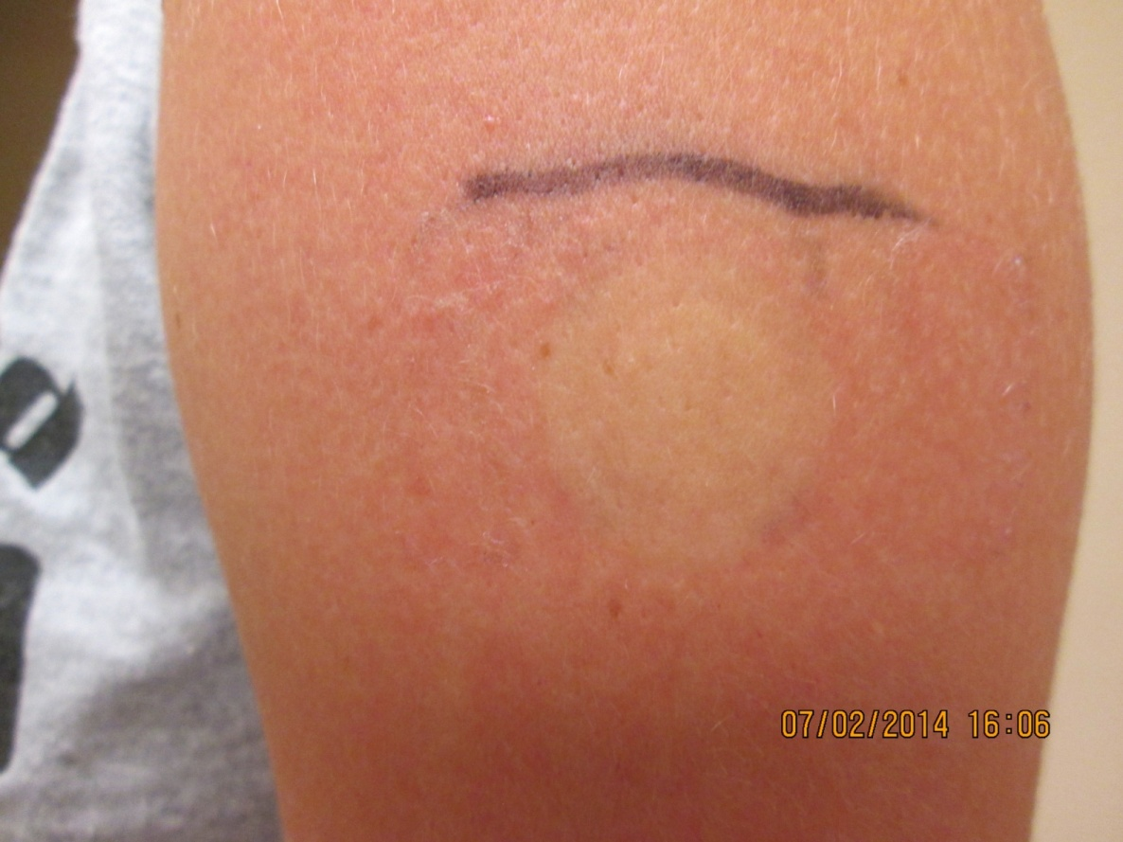
Skin Blanching from Corticosteroids

Slide 6
Potency
In 1985, Stoughton and Cornell classified corticosteroid potency according to their vasoconstrictive properties (vasoconstrictor assay)
Determined by chemical structure, strength and formulation
Higher potency more effective but higher rate of side effects; can be very significant in pediatrics
USA
Seven potency groups:
Super potent (Class I)
.
Least Potent (Class VII = OTC)
UK
Four potency groups:
Very Potent (Class I)
Potent (Class II),
Moderately potent (Class III),
Mild (Class IV)

Slide 7
Corticosteroid Activity
Magnitude and duration of topical corticosteroid skin blanching in human skin is influenced by vehicle, treatment duration, and time of day of application
Time of maximal decreased skin color generally occurs at midnight, independent of vehicle, treatment duration, or time of day of application
  Coincides with lowest circulating cortisol concentrations
In general, the higher the potency of the topical corticosteroid, the earlier the maximal effect is observed
  This finding suggests that short application of highly potent agents might minimize systemic absorption without sacrificing efficacy
Pershing et al. J Invest Dermatol 1994;102:734-9

Slide 8
Potency by Formulation
Typically, potency of gels and ointments are the greatest, followed by creams and lotions
Lotions and solutions (sprays) cause a rapid and greater early response (a much quicker ED₅₀ in the E_{max} dose duration-response curve)
A shorter ED₅₀ does not mean a more potent product
  Faster absorption
Occlusion (covering the site of application) significantly increases potency

Slide 9
Use of Vasoconstrictor Response in Generic Evaluation
When applied topically, corticosteroids are not systemically measurable (they are absorbed)
The vasoconstrictor response is a “validated” pharmacodynamic measure of potency
In 1992, OGD/FDA published an Interim Guidance on the use of the vasoconstrictor response to evaluate the bioequivalence of generic topical corticosteroids
In 1995, OGD finalized the Guidance
Only PD method currently “approved” by OGD for demonstrating BE
Estimate ~ 100 generic topical steroid formulations approved by FDA using this method

Slide 10
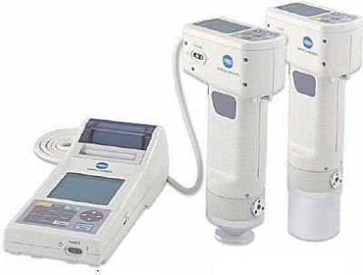
Vasoconstrictor Assay Operational Procedures
Primary objective is to measure the blanching response of the skin over time following a set dose
Both the drug application, removal and the method of evaluation must be standardized and validated
Important to try to reduce variability (noise) caused by the methodology
  Chromameter is the equivalent of an LC/MS analyzer used in standard PK/BE studies

Slide 11
Vasoconstrictor Assay Operational Procedures
Standardized application “dosing” is achieved using:
  A standardized area of application
  A standardized unit measure of dose
  A standardized method of application and removal
Inspect products to ensure they are homogenous
  No separation of components

Slide 12
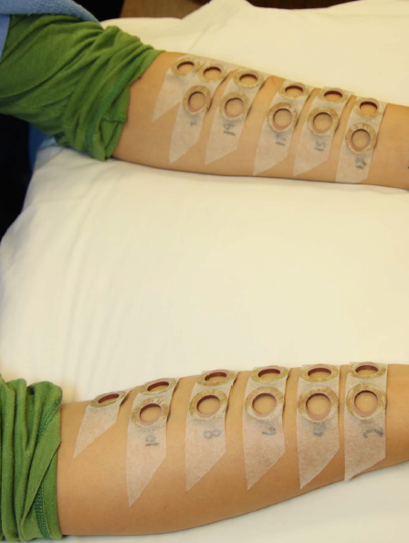
Standardized Area of Application

Slide 13
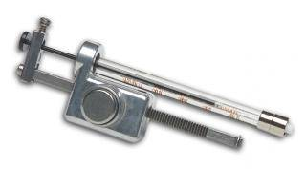
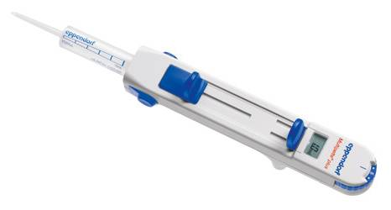
Standardized Unit Measure of Dose

Slide 14
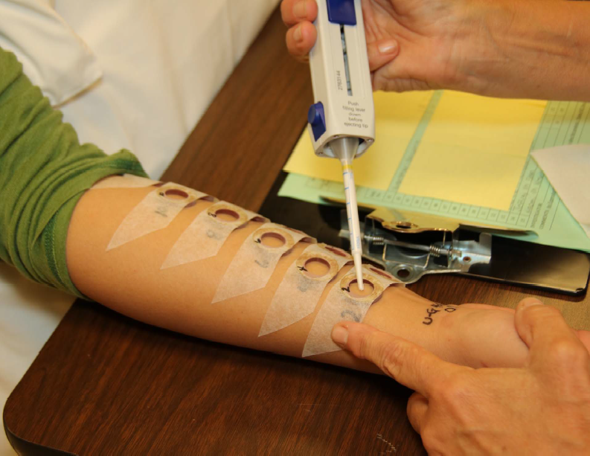
Standardized Application

Slide 15
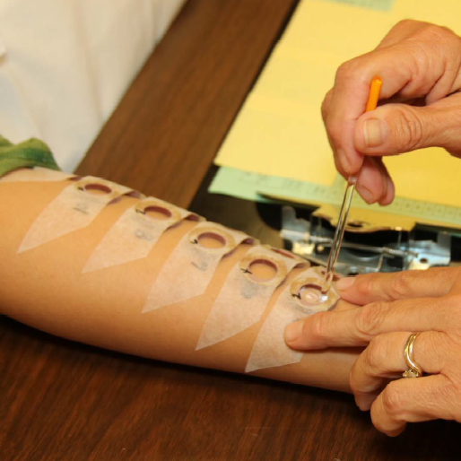
Standardized Application

Slide 16
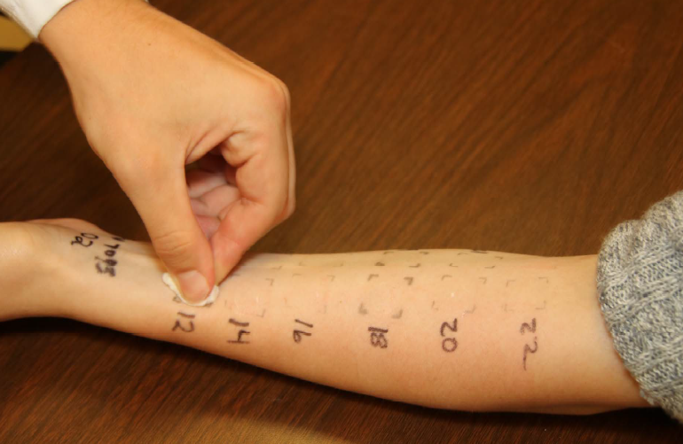
Standardized Removal

Slide 17
Vasoconstrictor Assay Operational Procedures
Standardized assessment/evaluation is achieved using:
  An objective measuring device (Chromameter)
  Pre-reading calibration / baseline correction
  Validated operators
  All Chromameters and operators must be cross validated for each study to ensure “within” and “between” reproducibility

Slide 18
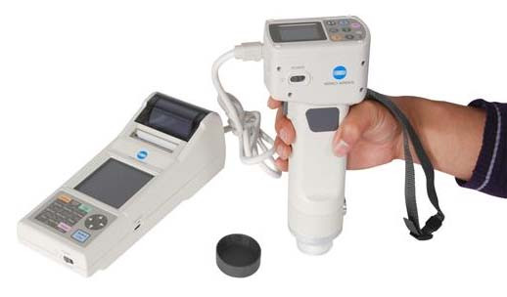
Chromameter

Slide 19
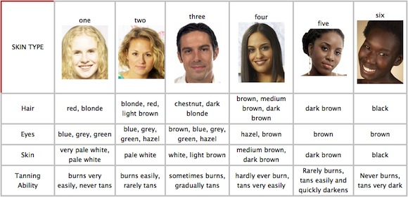
Fitzpatrick Skin Types

Slide 20
Basic Inclusion Criteria:
Blanchers (Responders/Detectors)
Only “subjects who have the capacity to vasoconstrict when dosed with the RLD”
Inclusion of “nonresponders” would decrease the ability to detect differences between Test and RLD
About 90% of the population will blanch
10-15% are super blanchers!
Need to determine blanching status to every product (blanching depends on potency)
Performed at screening on upper arm
2 hr duration or at estimated ED₅₀ duration, whichever is longer
Blanching (responder) status assessed visually 6-9 hr after removal

Slide 21
Four-Point Ordinal Visual Scale
Assessments performed under standard fluorescent lighting and at room temperature.
0 = No pallor; no change from surrounding area.
1 = Mild pallor; slight or indistinct outline of application site.
2 = Moderate pallor; discernible outline of application site.
3 = Intense pallor; clean, distinct outline of application site.

Slide 22
During Study Procedures: Limit Variability
Avoid extremes of temperature/humidity
No caffeine/alcohol, etc. (flushing)
No showers/washing arms at all during study
Avoid activity
No lying on arms during dosing or before readings
Arms out straight for 5 minutes before readings
Subjects must be under facility control throughout study

Slide 23
During Study Procedures: Challenges
Summer months (suntans/availability)
Too many sites/short arms (9-10 max)
Very short duration periods (super potent products)
Very long duration periods
Drug “creeping” especially lotions

Slide 24
Types of Studies
Dose duration-response study (ED₅₀ or pilot study)
Bioequivalence study
Formulation screening study (more than one TEST lot)
Potency-ranking study (NCEs or new formulations only)

Slide 25
FDA Guidance Quote
“…Because dose duration-response characteristics may vary with the particular drug of interest, as well as with study conditions, the Guidance encourages the performance of a pilot study to define appropriate parameters for the pivotal study…”
Guidance for Industry. Topical Dermatologic Corticosteroids: In Vivo Bioequivalence. U.S. Department of Health and Human Services, Food and Drug Administration, Center for Drug Evaluation and Research (CDER), 2 June 1995, Page 6.

Slide 26
Major Differences between ED₅₀ and Bioequivalence Studies
ED₅₀
Reference product only
Apply for 7-8 durations
Smaller subject #’s (20-24)
Analysis on all subjects
Bioequivalence Study
Reference and test
Apply for 3 durations only
Large number of subjects (100-200)
Analysis on sub group of participants (qualifiers)

Slide 27
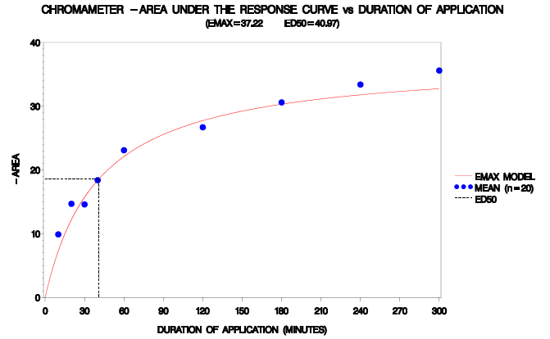
ED₅₀ Study: Objective
Objective is to calculate a duration of application (time) where 50% of maximal blanching occurs (i.e., the ED₅₀)
  This is the duration used to compare the test and reference product in the bioequivalence study because the responses are in the most sensitive (linear) part of the E_{max} dose duration-response curve to optimize discrimination of formulation differences

Slide 28
ED₅₀ Study: Design
Apply reference product for 7 to 8 different durations (range depends on potency of product)
Class III/IV products: 5, 15, 30, 45, 60, 120, 180, 240 minutes
Generally shorter for Super Potent; longer for Low Potency but ED₅₀ time can easily be manipulated
Two untreated sites per arm
Evaluate area of blanching over 24 hours (AUEC_{0.5-24hr}) after removal for each duration (some exceptions)

Slide 29
ED₅₀ Study: Application Schemes
Two approaches for application of reference product
  Staggered application with synchronized removal
  Synchronized application with staggered removal

Slide 30
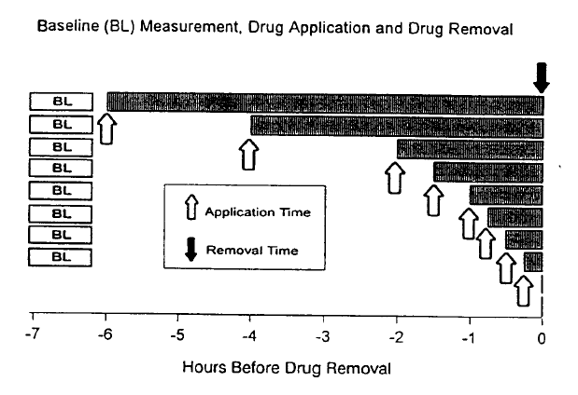
Staggered Application
Synchronized Removal

Slide 31
Post-Removal Evaluation Scheme
Skin Blanching Measurements
Allow equilibration time (0.5 hr) before first measurement
Removal Time
Measurement Time
0 1 2 4 6 8 10 12 14 16 18 20 22 24
Hours After Drug Removal

Slide 32
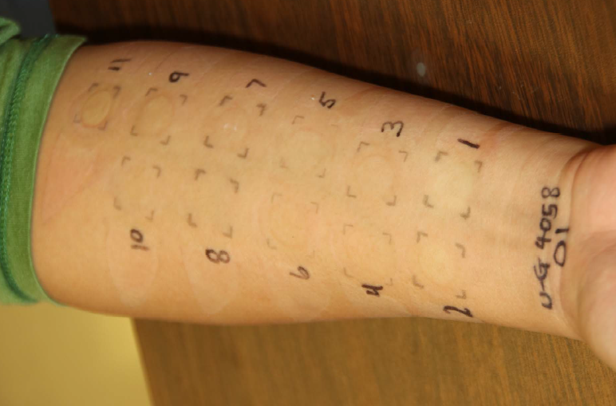
Post-Removal Evaluation Sites

Slide 33
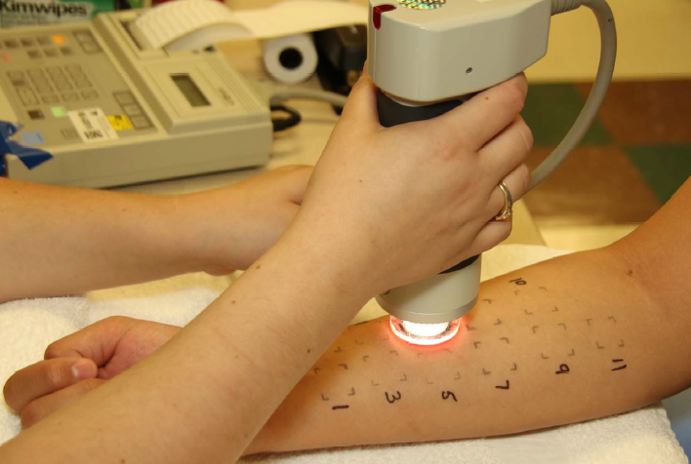
Chromameter Evaluation

Slide 34
ED₅₀ Study: Calculation of AUEC_{0.5-24hr}
The post-dose Chromameter a-scale readings at each treated site are first corrected for the average of duplicate pre-dose (baseline) reading and then corrected for the average baseline-adjusted reading for the two untreated sites (on the same arm) at the corresponding post-dose reading time
These "corrected" baseline-adjusted Chromameter values are used to calculate the area under the effect (response/time curve) (AUEC_{0.5-24hr}) for each site by the linear trapezoidal method
Individual AUECs for each dose duration (single site on each ventral forearm (left/right)) are pooled across subjects
A population model of the areas from all subjects is used to estimate the population dose duration-response (E_{max}) relationship

Slide 35
ED₅₀ Study: Statistical Analysis
Use population modeling approach to develop simple E_{max} model
E = (D*E_{max})/(ED₅₀ + D) = AUEC_{0.5-24hr}
  E is the response (area) at D, the duration of application, and ED₅₀ is the duration at which half-maximal response occurs
PPharm software has been used by FDA (no longer available)
E_{max} model is often not best fit
Data becomes increasingly noisy (above baseline) as potency drops

Slide 36
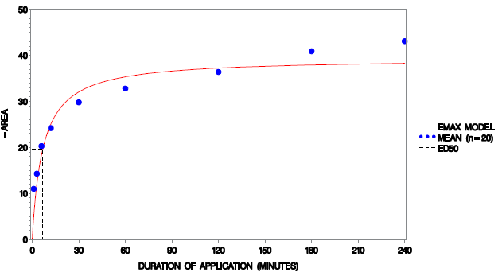
ED₅₀ Example: (Super Potent Cream)

Slide 37
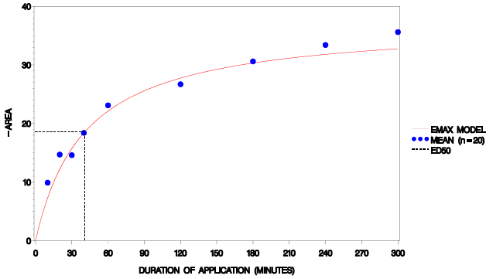
ED₅₀ Example: Upper Mid-Strength Cream

Slide 38
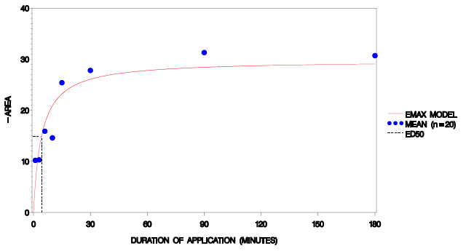
ED₅₀ Example: Lower Mid-Strength Lotion

Slide 39
ED₅₀ Study: Design Challenges
“Published” potency can be misleading
Very long or very low ED₅₀ durations are unworkable
Low potency products may require site occlusion
Data can be very noisy
Have to use all subjects, whereas pivotal studies only require analysis of the “detectors”
  Know qualitative blanching response from individual screening data, but don’t know quantitative blanching response (population)

Slide 40
ED₅₀ Study: Analysis Challenges
Simple E_{max} model is not always best fit
Some products show a sigmoidal E_{max} response
Very short ED₅₀ can drop below the first time of application (below the LLOQ!)
  Short ED₅₀ (≤ 1 min can be impractical for pivotal study)
  Short ED₅₀ can lead to high variability in pivotal study because of steep dose response
Low E_{max}
  Should be > 10
Biphasic dose response
Truncation of vasoconstrictor response at 24 hr post removal
Data can be very noisy
Reference lot variability

Slide 41
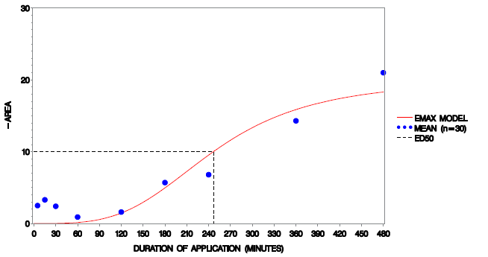
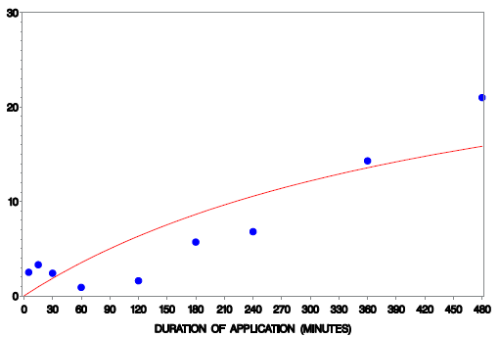
E_{max} Model Fit: Simple or Sigmoid?
Sigmoid Simple

Slide 42
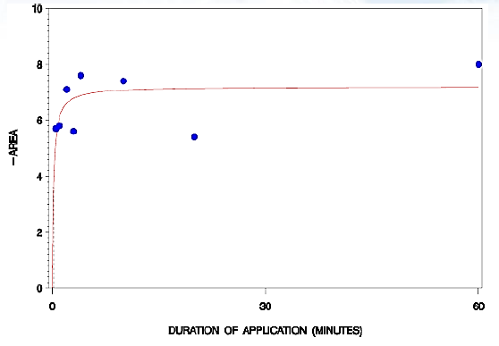
ED₅₀ Analysis: Challenges
Low E_{max}

Slide 43
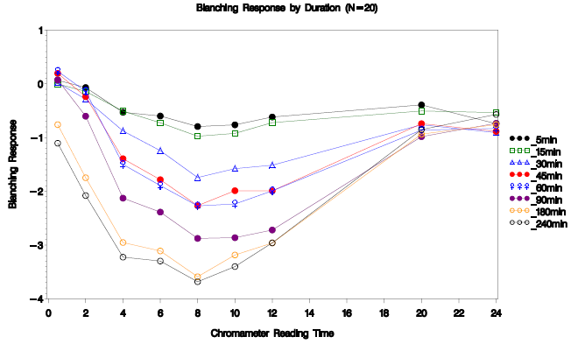
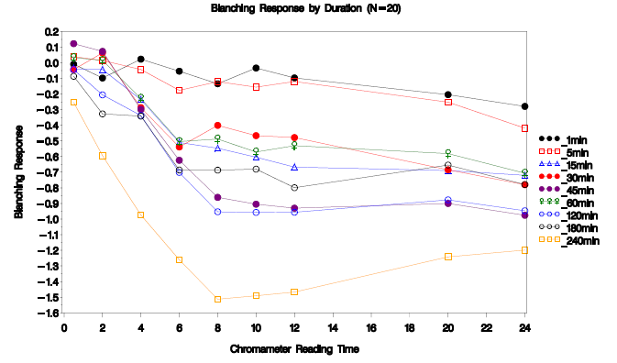
ED₅₀ Analysis: Challenges
Truncation of vasoconstrictor response
Class 3 (Upper Mid-Strength) Cream
Class 6 (Mild) Gel

Slide 44
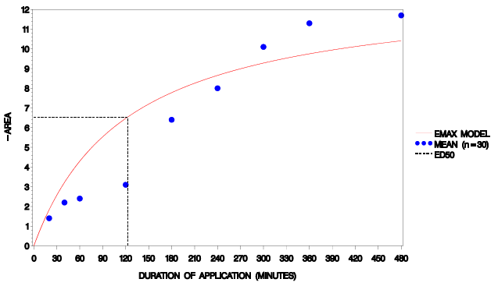
ED₅₀ Analysis: Challenges
Bi-phasic dose response for an ointment

Slide 45
Bioequivalence Study: Objective
Objective is to demonstrate bioequivalence of the test to reference product
Formulation screening study has similar objective with one or more test lots

Slide 46
Bioequivalence Study: Sample Size
FDA Guidance says 40-60 qualifiers
  What is the basis for this?
# of qualifiers depends on CV% and T/R (may be < 40 or > 60)
Estimate sample size using Fieller’s (Locke’s) method
  N-Query software application for Equivalence: “Crossover design TOST for ratio of means (using original scale)”
Need estimates of both within-subject and between-subject variability because Fieller’s equation requires both between-subject variance and covariance estimates
Fieller’s method accounts for reference variability and treats reference mean as a variable and not as a constant when converting T- R to T/R
Consider group sequential design with Pocock adjustment

Slide 47
Sample Size Estimations for 80% Power
T/R = 95%
ISCV (%) | BSCV (%) | N
25 | 60 | 36
 | 100 | 42
30 | 60 | 48
 | 100 | 56
32 | 60 | 54
 | 100 | 60
35 | 60 | 64
 | 100 | 70
40 | 60 | 80
 | 100 | 88

Slide 48
Bioequivalence Study: Design
Apply reference product for 3 different durations (D₁, ED₅₀ and D₂)
  D₁ = ½ x ED₅₀ = ⅓ x E_{max}
  ED₅₀ = ½ x E_{max}
  D₂ = 2 x ED₅₀ = ⅔ x E_{max}
Apply test product for ED₅₀ duration only
Evaluate area of blanching over 24 hours (AUEC_{0.5-24hr}) after removal for each duration
Use D₂/D₁ area ratio to qualify subjects for testing bioequivalence of test to reference

Slide 49
BE study: Calculation of AUEC_{0.5-24hr}
The post-dose Chromameter a-scale readings at each treated site are first corrected for the average of duplicate pre-dose (baseline) reading and then corrected for the average baseline-adjusted reading for the untreated sites (on the same arm) at the corresponding post-dose reading time
These "corrected" baseline-adjusted Chromameter values are used to calculate the area under the effect (response/time curve) (AUEC_{0.5-24hr}) for each site by the linear trapezoidal method
Individual AUECs for each treatment (triplicate sites for each ED₅₀ test and reference and single site for each D₁ and D₂ on each ventral forearm (left/right)) are pooled and averaged
The mean AUEC value (n = 6 per ED₅₀ treatment and n = 2 for each D₁ and D₂) is used as the response variable for each subject

Slide 50
Bioequivalence Study: Statistical Analysis
Only subjects whose D₂/D₁ area ratio ≥ 1.25 included in analysis
These subjects are considered detectors or qualifiers
Compare Test AUEC_{0.5-24hr} with RLD AUEC_{0.5-24hr}
Locke’s 90% CI (80-125% criterion)
  Pocock adjustment if use two-group sequential design (94.12% CI at each stage)
Ideally want to see Test and Reference AUEC values between those of D₁and D₂

Slide 51
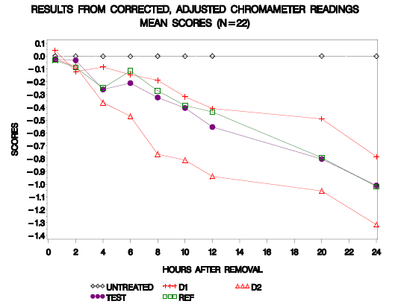
BE Example: Mean Blanching Profiles

Slide 52
BE Example: Interim Results
Number Enrolled | Number and % Qualified (N) | D₁ Mean AUEC_{0.5-24} | D₂ Mean AUEC_{0.5-24} | Test Mean AUEC_{0.5-24} | Ref. Mean AUEC_{0.5-24} | Test-to-Reference Ratio (%) | 90% Conf. Interval* Lower (%) Upper (%) |  | Intra-subject CV relative to LSMean(ref) (%) | Total N needed for 80% Power with T/R Ratio of: 100% * 95-106.3%*
58 | 22 (38%) | 8.20 | 18.62 | 12.08 | 11.19 | 107.94 | 88.28 | 131.93 | 37.8 | 62 | 80
*Use observed BSCV and ISCV relative to reference of 102% and 37.8%, respectively
Study fails at interim analysis (~ 50% of protocol-specified 40 qualifiers)
Advised client to continue study because of acceptable T/R and study was predicted to pass assuming same T/R , BSCV and ISCV, and 40 qualifiers, despite predicted low study power of 43%

Slide 53
BE Example: Final Results
Number Enrolled | Number and % Qualified (N) | D₁ Mean AUEC_{0.5-24} | D₂ Mean AUEC_{0.5-24} | Test Mean AUEC_{0.5-24} | Ref. Mean AUEC_{0.5-24} | Test-to-Reference Ratio (%) | 90% Conf. Interval* Lower (%) Upper (%) |  | Intra-subject CV relative to LSMean(ref) (%) | Total N needed for 80% Power with T/R Ratio of: 100% * 95-106.3%*
118 | 45 (38%) | 8.93 | 20.28 | 11.57 | 11.26 | 102.83 | 89.10 | 119.72 | 41.0 | 70 | 90
*Use observed BSCV and ISCV relative to reference of 95.8% and 41.0%, respectively
Study passes with 45 qualifiers (post-hoc power ~ 52%)

Slide 54
Summary and Conclusions
Most important to control within-subject variability (ISCV) via consistent Chromameter technique
Even with good Chromameter technique , some products’ data do not fit well to a simple E_{max} model or they have inherent high ISCV that requires sample sizes > 60 (upper limit in FDA Guidance)
Works best with medium to high potency formulations and simpler formulations such as gels and ointments
Problematic for lower potency products and newer formulations (e.g., sprays, tapes, foam)
Works best with fair-skinned subjects who show good blanching response
Current alternative method to a pharmacodynamic study is not attractive (clinical trial, microdialysis)
Need to make best use of current requirements

Slide 56
Let us meet again..
We welcome you all to our future conferences of
OMICS International
7th World Congress on
Bioavailability & Bioequivalence: BA/BE Studies Summit
On
August 29 - 31, 2016 at Atlanta, USA
http://bioavailability-bioequivalence.pharmaceuticalconferences.com/

