Slide 1
About OMICS Group
OMICS Group International is an amalgamation of Open Access publications and worldwide international science conferences and events. Established in the year 2007 with the sole aim of making the information on Sciences and technology ‘Open Access’, OMICS Group publishes 400 online open access scholarly journals in all aspects of Science, Engineering, Management and Technology journals. OMICS Group has been instrumental in taking the knowledge on Science & technology to the doorsteps of ordinary men and women. Research Scholars, Students, Libraries, Educational Institutions, Research centers and the industry are main stakeholders that benefitted greatly from this knowledge dissemination. OMICS Group also organizes 300 International conferences annually across the globe, where knowledge transfer takes place through debates, round table discussions, poster presentations, workshops, symposia and exhibitions.

Slide 2
About OMICS Group Conferences
OMICS Group International is a pioneer and leading science event organizer, which publishes around 400 open access journals and conducts over 300 Medical, Clinical, Engineering, Life Sciences, Phrama scientific conferences all over the globe annually with the support of more than 1000 scientific associations and 30,000 editorial board members and 3.5 million followers to its credit.
OMICS Group has organized 500 conferences, workshops and national symposiums across the major cities including San Francisco, Las Vegas, San Antonio, Omaha, Orlando, Raleigh, Santa Clara, Chicago, Philadelphia, Baltimore, United Kingdom, Valencia, Dubai, Beijing, Hyderabad, Bengaluru and Mumbai.

Slide 3




Structures and Physical Properties of Ferromagnetic Crystals with Supramolecular Cations
Kazuya Kubo
Research Institute for Electronic Science, Hokkaido University
3rd International Conference and Exhibition on Materials Science & Engineering
San Antonio, USA
6 October 2014
Notes:
Thank you Mr. chairman. Good afternoon, Ladies and Gentlemen. I’d like to thank the organized committee of the conference for giving me an opportunity of my presentation. Today, I am going to talk about Structures and Physical Properties of Ferromagnetic Crystals with Supramolecular Cations

Slide 4
Table of Contents
Chapter 1
Motivation of development of multifunctional materials based on [Mn^{II}Cr^{III}(oxalate)₃]⁻ complexes including supramolecular cations
Hybridized complexes including the supramolecular cations and
[Mn^{II}Cr^{III}(oxalate)₃]⁻ complex
• (3-fluoro-4-methoxyanilinium⁺)([18]crown-6)[Mn^{II}Cr^{III}(oxalate)₃]⁻ (acetone) (1)
• (anilinium⁺)(benzo[18]crown)[Mn^{II}Cr^{III}(oxalate)₃]⁻ (2)
• (m-fluoroanilinium⁺)(dicyclohexano[18]crown-6) [Mn^{II}Cr^{III}(oxalate)₃]⁻ (3)
Chapter 2
2-1. Synthesis of (anilinium)(benzo[18]crown-6) [Mn^{II}Cr^{III}(oxalate)₃]⁻ (2)
2-2. Crystal structure of 2
2-3. Magnetic susceptibility of 2
2-4. Solid state ²H-NMR of 2
2-5. Potential energy calculation for molecular motions in 2
2-6. Dielectric property of 2
Chapter 3
Summary and future plans
Notes:
This is table of contents of my talk. In this talk, I suggest new strategy to develop multifunctional materials based on [Mn^{II}Cr^{III}(oxalate)₃]⁻ complexes including supramolecular cations. First, I am going to talk about the motivation and strategy of our work, reviewing some of the early studies. Then, I will show you some crystals synthesized by our strategy. Among them, I will share with you some of highlight data of (anilinium)(benzo[18]crown-6) supramolecular csystal with [manganese chromium oxalates] complex. Finally, I will make a brief summary and talk about future plans.

Slide 5
Chapter 1
Motivation of development of multifunctional materials based on [Mn^{II}Cr^{III}(oxalate)₃]⁻ complexes including supramolecular cations
Notes:
At first, I will show you the motivation and strategy of our work.

Slide 6
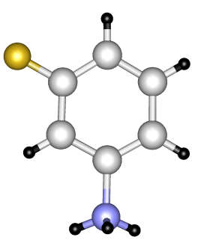
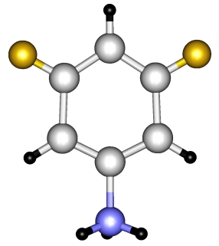
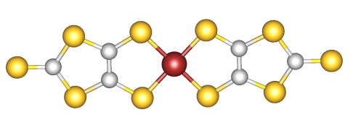
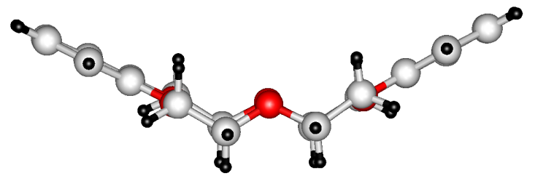
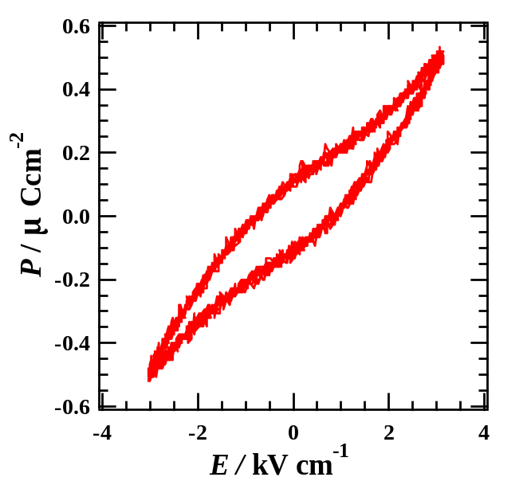
Introduction: Ferroelectricity based on the supramolecular cation
(m-fluoroanilinium)(dibenzo[18]crown-6)[Ni(dmit)₂]
E
(m-fluoroanilinium⁺)(dibenzo[18]crown-6)
[Ni(dmit)₂]⁻
Weak antiferromagnetic interaction between S = ½ spins on the anion
Ferroelectricity
T_{c} = 345 K
Advantage of the supramolecular cations
Various salts of the cation including functional anions can be obtained.
T. Akutagawa et al. Nature Materials., 2009 8, 342
Notes:
Previously, we reported a ferroelectric compound formed by meta-fluoroanilinium, dibenzo eighteen crown 6 and Ni(dmit)2. In this crystal, we can observe a supramolecular inclusion between the ammonium group in meta-fluoroanilinium and dibenzo-eighteen crown six through a hydrogen bond. This aryl group can rotate in the crystal. The supramolecular cation has a dipole moment for the rotation axis direction because of the fluorine atom.
So, we can control the flip-flop motion between the double minimum potentials with the application of an external field. And this compound exhibits the ferroelectric transition at 345 K by the flip-flop motion.
We can also observe an antiferromagnetic behavior with Curie-Weiss law due to the Ni(dmit)2 with one half spins.
This type supramolecule has an advantage for development of multifunctional materials. These type supramolecles is cationic. So we can obtain various salts of the supramolecuar cations with functional anions.

Slide 7
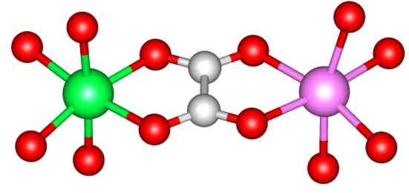
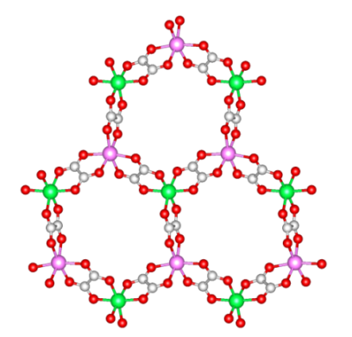
Strategy: Combinations of the Supramolecular cations and ferromagnets
ferromagnet
[Mn^{II}Cr^{III}(ox)₃]
Coexistence?
o-fluoroanilinium
m-fluoroanilinium
H₂PPD²⁺
Supramolecular cation
ferroelectricity
cis-syn-cis-DCH[18]Crown-6
Trans-syn-trans-DCH[18]Crown-6
benzo[18]Crown-6
dibenzo[18]Crown-6
Notes:
By using the advantages of the supramolecular cations, we applied ferromagnetic metal complexes to synthesis new crystals with coexistence of ferromagnetism and ferroelectricity. For this purpose, we focused Manganese chromium oxalates complexes. This complex generally forms a two dimensional honeycomb structure exhibiting ferromagnetic behavior.

Slide 8
This work: Three crystals were synthesized.
• (3-fluoro-4-methoxyanilinium⁺)([18]crown-6)[Mn^{II}Cr^{III}(oxalate)₃]⁻ (acetone) (1)
• (anilinium⁺)(benzo[18]crown)[Mn^{II}Cr^{III}(oxalate)₃]⁻ (2)
• (m-fluoroanilinium⁺)(dicyclohexano[18]crown-6)[Mn^{II}Cr^{III}(oxalate)₃]⁻ (3)
Crystal 1
Crystal 2
Crystal 3
Space group: Cc
Magnetic behavior:
Ferromagnetic
Dielectric response:
Not observed
(Chem. Lett. 2013, 42, 137)
Space group: P2₁
Magnetic behavior:
Ferromagnetic
Dielectric response:
Observed
Space group: P2₁2₁2₁
Magnetic behavior:
Ferromagnetic
Dielectric response:
Not observed
Notes:
In this work, we synthesized three crystals including the supramolecular cations and manganese chromium oxalates. Similar layer structures were formed in all crystals. All crystals exhibited ferromagnetic behavior due to the manganese chromium oxalate complex. No dielectric responses for crystals 1 and 3 was observed because of no molecular motions of the cationic molecules. However, crystal 2 exhibited both ferromagnetic transition and dielectric response. From this point forward, I focus discussion of structural and physical property data of crystal 2. Discussions about crystals 1 and 3 are beyond the scope of my talk.

Slide 9
Chapter 2
2-1. Synthesis of (anilinium)(benzo[18]crown-6)[Mn^{II}Cr^{III}(oxalate)₃]⁻ (2)
2-2. Crystal structure of 2
2-3. Magnetic susceptibility of 2
2-4. Solid state ²H-NMR of 2
2-5. Potential energy calculation for molecular motions in 2
2-6. Dielectric property of 2
Notes:
In this section, I will show you synthesis and physical properties of the crystal 2.

Slide 10
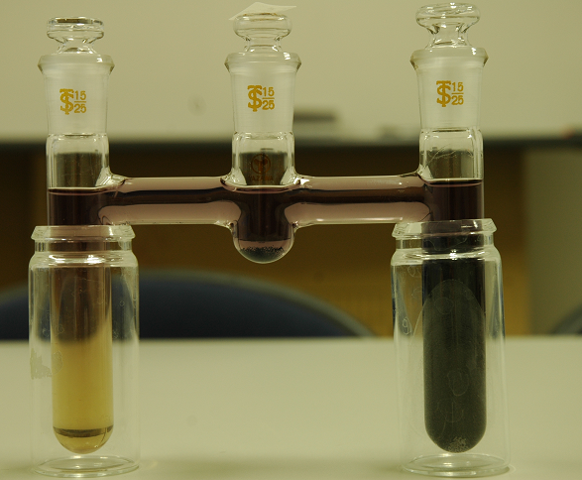
2-1. Preparation of (anilinium)(benzo[18]crown-6) [Mn^{II}Cr^{III}(oxalate)₃]⁻ (1)
Precursors of
Supramolecles
Precursors of
[Mn^{II}Cr^{III}(oxalate)]⁻
Conditions
Diffusion method; Temperature: 25 ºC; Period: 1 week; solvents: CH₃OH and CH₃CN mixtures
Confirmation of the formula: X-ray crystallographic, elemental, and Thirmogramometric analyses
Notes:
We can prepare the crystal by using of the diffusion method at room temperature for a week in methanol and acetonitrile mixtures. We put precursors of the supramolecular cations on the one side of the H type cell, and on the another side, precursors of the MOFs. We can see the formula of the complex in the top of the slide. We confirmed the formulas of the complexes by using of X-ray crystallographic, elemental, and thirmogramometric analyses.

Slide 11
2-2. Crystal structure of (anilinium)(benzo[18]crown-6)[Mn^{II}Cr^{III}(oxalate)₃]⁻
The two dimensional honeycomb structure Diameter of the ring ca. 10 Å
Distance between the layers ca. 11 Å
Crystal data of 2
Monoclinic; P2₁ (#4); a = 8.7986(8) Å; b = 23.315(3) Å; c = 9.4749(13) Å; β = 115.483(3)°;V = 1754.6(3) Å^{3;} T = -100 °C; R₁ = 0.0725; R_{w} = 0.1706
Hydrogen bonds between N and O atoms: 2.782-2.957 Å
Formation of the supramolecular cation
Notes:
This is the crystal structure of complex 2. You can see the crystal structure of complex 2 along the a and the c axes. Crystal system of 2 is monoclinic. And Space group is P two one. This crystal includes one crystallographic independent supramolecular cation and one manganese and chromium oxalates unit. We can observe alternate stackings of the supramolecular cation and the two dimensional anionic layers along the b axis. In this anionic layers, we can observe the typical two dimensional honeycomb structure. Diameter of the ring was about 10 angstrom. This is almost the same value of the other oxalate network complexes. The distance between the nitrogen and oxygen atoms is almost the same value for the typical hydrogen bond. The distances indicates supramolecular inclusion between ammonium moiety of anilinium and oxygen atoms of the crown ether through the hydrogen bond.

Slide 12
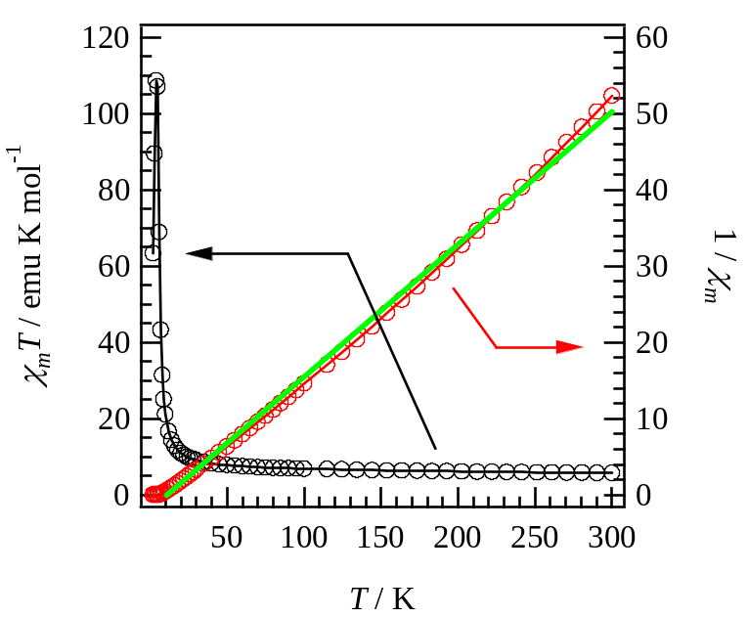
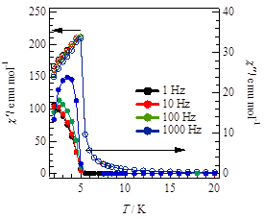
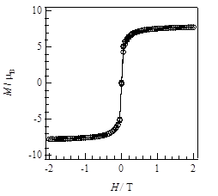
Magnetic susceptibility of (anilinium)(benzo[18]crown-6) [Mn^{II}Cr^{III}(oxalate)₃]⁻ (2)
Ferromagnetic transition at 5.0 K
(1) Crystal 2 exhibits ferromagnetic behavior.
(2) Crystal 2 is a good candidate of a multifunctional material with coexistence of a ferromagnetism and a ferroelectricity.
Notes:
These are results of the magnetic measurements of complex 2. The complex exhibits ferromagnetic behavior with Weiss temperature of thirteen point seven kelvins. We can observe ferromagnetic transition at five point zero kelvins. Saturated magnetization of the complex is about eight myu bee. This value is good agreement with that of high spin states of the manganese two and the chromium three ions. Thus, these results suggest the complex is a good candidate of multifunctional material with coexistence of the ferromagnetism and the ferroelectricity.

Slide 13
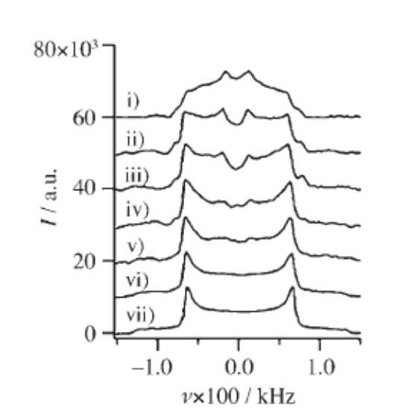
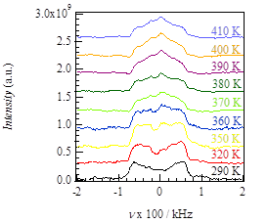
Solid state ²H-NMR of (anilinium-d5)(benzo[18]crown-6) [Mn^{II}Cr^{III}(oxalate)₃]⁻ (2)
Previous work
D
Nuclear spin of ²H: I = 1
large
flip-flop motion
small
293 K
C
245 K
electrical field gradient of anilinium-d5: C-D direction
230 K
215 K
200 K
185 K
Anilinium-d5
170 K
²H-NMR of (anilinium-d5)([18]crown-6) [Ni(dmit)₂]⁻
S. Nishihara et al., Chem. Asian J. 2007, 2, 1083
Another peak is observed.
Another molecular motion ?
large flip-flop motion
Weak flip-flop motion
Notes:
In order to investigate the molecular motion of the supramolecular cation, we measured a solid state deuterium NMR spectrum of the complex by using a deuterium complex of 2. Nuclear spin of deuterium is one. And, electrical field gradient of the molecule is C-D direction. Previously, we measured the deuterium NMR spectrum for similar supramolecular crystal anilinium d5 and [18]crown-6. At one hundred seventy kelvin, we can observe the two separate peaks in the spectra indicating no flip-flop motion in the solid state. The flip-flop motion was beginning, the two peaks were gradually united around room temperature. In the case of complex 2, the NMR spectra exhibited broadened signals. However, two separate peaks were observed below three hundred twenty kelvin, indicating the weak flip-flop motion of the aniliniun cation. The two peaks were gradually united around three hundred seventy kelvin as shown in the crystal of anilinium and 18 crown 6. In higher temperature regions, another peak appeared around 0 kHz. Now, origin of the peak is not attributed. The peak would indicate another molecular motion.

Slide 14
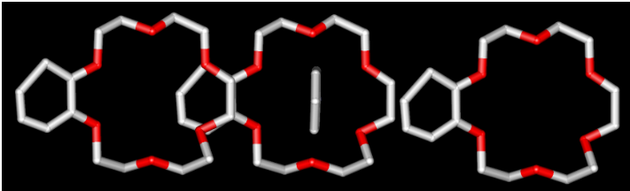
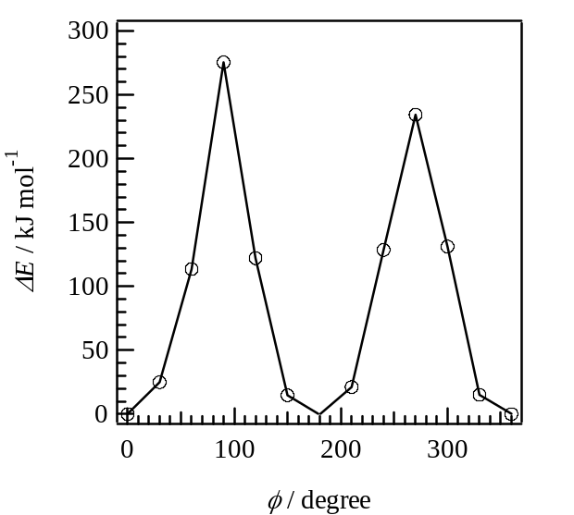
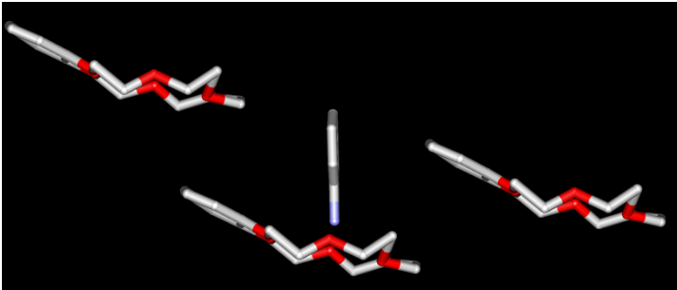
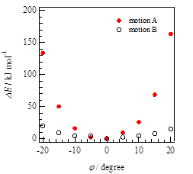
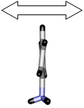
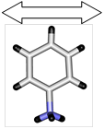
Potential energy calculations of (anilinium)(benzo[18]crown-6) [Mn^{II}Cr^{III}(oxalate)₃]⁻ (2)
flip-flop motion
cf. Energy barrier for the flip-flop motion in the ferroelectric salt,
(m-fluoroanilinium)(dibenzo[18]crown-6)(Ni(dmit)₂): ca. 250 kJ mol⁻¹
Pendulum motions
Small energy barrier for the pendulum motion B
motion A
motion B
Notes:
In order to confirm the NMR spectrum, we calculated the potential energy curve for the flip-flop motion of the supramolecular cation. These are model structures of the calculation at zero degree based on the crystal structural analysis. We selected three crown ether molecules with steric hindrances around the anilinium molecule. The black line show the potential energy curve of 2. Energy barrier for the flip-flop motion is about two hundred fifty kilo joule per mol. This value is almost same value for the ferroelectric compound, indicating the flip-flop motion of the anilinium in crystal 2. Now, this model structure suggests another chance for the molecular motions such as the pendulum motions. So, we also calculated the potential energy curve for the pendulum motions A and B. You can see the result of the calculations in the bottom of the slide. Red and black points indicate energy barriers for motion A and B, respectively. Energy barrier for Pendulum motion A is larger than that of pendulum motion B. These small energy barrier can generate molecular fluctuation such as the pendulum motion B easily in the solid state of complex 2. The pendulum motions cannot cause dipole inversion of the crystal. However, dielectric response measurement provide some information about the molecular fluctuations.

Slide 15
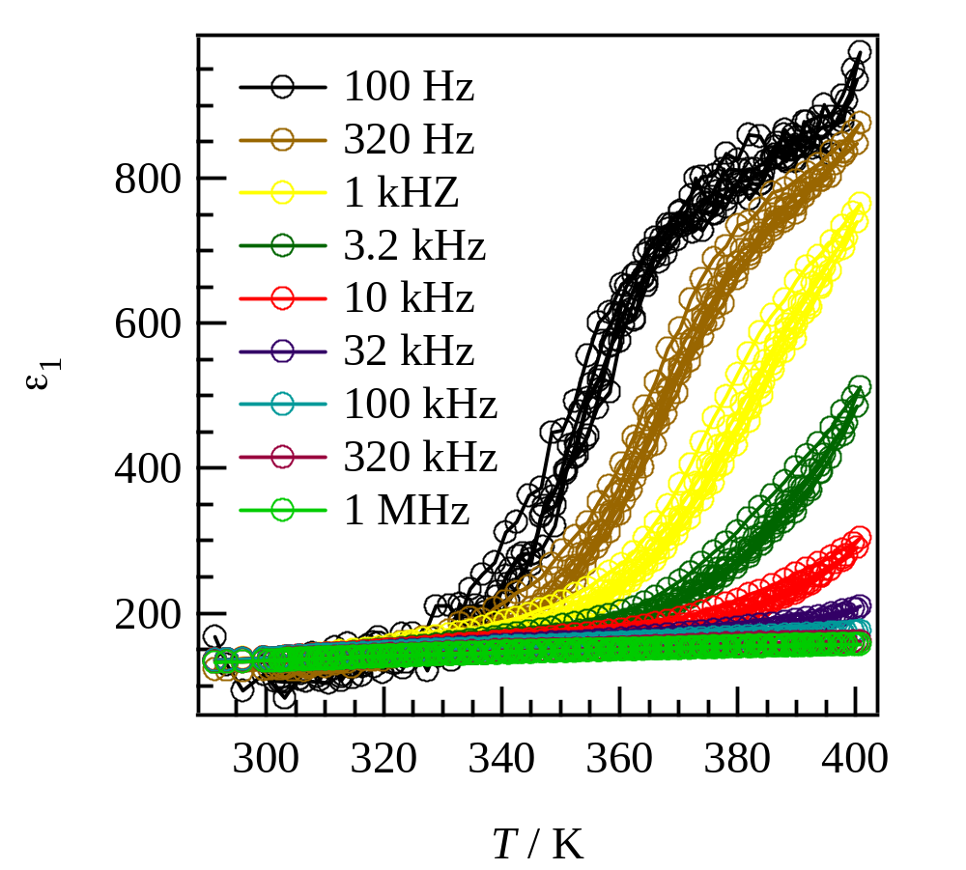
Temperature and field dependence dielectric constants of
(anilinium)(benzo[18]crown-6) [Mn^{II}Cr^{III}(oxalate)₃]⁻ (2)
The flip-flop motion of anilinium⁺ dose not cause an inversion of the dipole-moment.
These large dielectric responses would correspond to the pendulum motions.
Notes:
Dielectric response of complex 2 agrees with the results of the deuterium NMR and potential energy calculations. This spectra are temperature and field dependence dielectric constants of crystal 2. Large dielectric responses were observed at low frequency regions above three handred forty kelvins. The flip flop motion of anilinium cation dose not cause an inversion of the dipole moment because of no substituent on the cation. So the dielectric responses should correspond to the another molecular motion, such as the pendulum motion. This compound exhibits no ferroelectric transition. However, Our result proposes new synthetic strategy to develop the molecular molecular multifunctional materials with coexistence of ferromagnetism and ferroelectricity.

Slide 16
Section 3: Summary and future works
Development of multifunctional materials based on the MOF system with the supramolecular cations.
·(organic ammonium)([18]crown-6 derivative)[MnCr(oxalate)₃] were synthesized.
· Salt 2 exhibits a ferromagnetic transition at 5.0 K.
· Dielectric responses were observed due to the pendulum motion of anilinium in the solid state of 2.
· Crystal 2 is a model compound for the molecular multifunctional materials.
Future Plan
(anilinium)(bebzo[18]crown-6)[MnCr(oxalate)₃] (2)
A good candidate for the multifunctional materials with coexistence of ferromagnetism and ferroelectricity such as multiferroic materials.
Future plans:
·Development of the multifunctional materials such as multiferroic compounds based on the molecular system.
Notes:
Finally, I summarize my talk. We synthesized three crystals based on supramolecular cations and ferromagnetic oxalate complexes in order to develop the multifunctional materials with both ferromagnetism and ferroelectricity. Complex 2 exhibits a ferromagnetic transition at 5.0 K due to the typical two dimensional honeycomb structure of the manganese chromium oxalates. Furthermore, large dielectric response was observed due to the pendulum motion of the anilinium cation. The ferroelectric transition was not observed in the crystal. However, our result provides new synthetic strategy to develop the molecular ferroelectric materials with ferromagnetic properties. As the next step, we will try to develop the multifunctional materials such as multiferroic compounds based on the molecular system.

Slide 17
Acknowledgement
Professor Takayoshi Nakamura (Hokkaido University)
Professor Tomoyuki Akutagawa (Tohoku University)
Professor Shin-ichiro Noro (Hokkaido University)
Professor Sadamu Takeda (Hokkaido University)
Dr. Toru Endo (Chisso Cooperation, Hokkaido University)
Mr. Masashi Yoshitake (Hokkaido University)
Professor Kunio Awaga (Nagoya University)
Dr. Hirofumi Yoshikawa (Nagoya University)
Professor Jun Kawamata (Yamaguchi University)
Professor Sadafumi Nishihara (Hiroshima University)
Dr. Yasutaka Suzuki (Yamaguchi University)
Dr. Ryo Tsunashima (Yamaguchi University)
Notes:
They are my collaborators for this work. Thank you for your kind attention.

Slide 18
Crystal structure of (3-fluoro-4-methoxy-anilinium)([18]crown-6) [Mn^{II}Cr^{III}(oxalate)₃]⁻ (CH₃OH)₂ (1)
Shortest N···O distance of 2.810 Å
A mean plane of the six oxygen atoms of the crown ether was close to right angle (89.32°)
Hydrogen bonds between N and O atoms
Formation of the supramolecular cation
The two dimensional honeycomb structure
Diameter of the ring ca. 10 Å
Distance between the layers ca. 13 Å
Crystal data of 1
Monoclinic; Space group, C_{c}; a = 16.1878(10) Å; b = 9.4716(5) Å; c = 22.6967(13) Å; b = 97.847(2)°; V = 3447.4(3) Å³; Z = 4.
·Space group without inversion center
·No disorder of F and MeO groups
Notes:
This is the crystal structure of complex 1. You can see the crystal structure of complex 1 along the a and the c axes directions. Crystal system of 1 is monoclinic. And Space group is P two one. This crystal includes one crystallographic independent supramolecular cation and one manganese and chromium oxalates unit. We can observe alternate stackings of the supramolecular cation and the anionic MOF layers along the b axis. In this anionic layers, we can observe the typical two dimensional honeycomb structure. Diameter of the ring was about 10 angstrom. This is almost the same value of the other oxalate network complexes. Distance between the layers was about 11 angstrom. In the cationic layer, we can observe supramolecular inclusion between anilinium and the crown ether through the hydrogen bond between the nitrogen and the oxygen atoms. The distance between the nitrogen and oxygen atoms is almost the same value for the typical hydrogen bond.

Slide 19
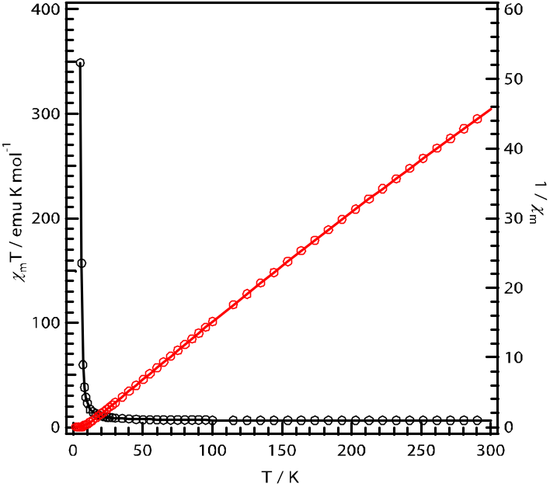
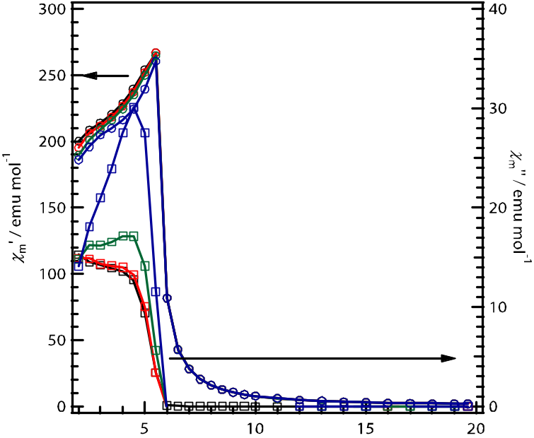
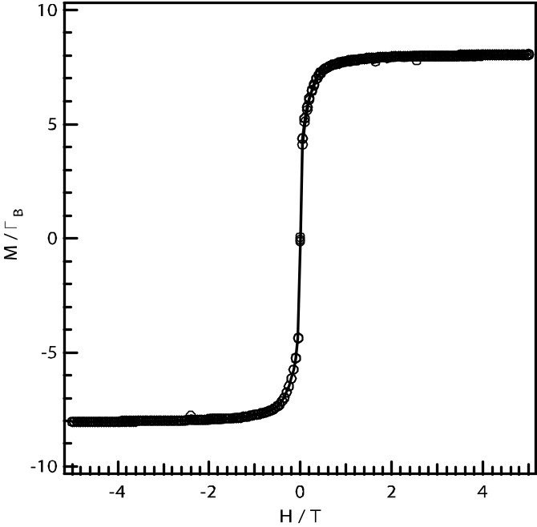
Magnetic susceptibility of (3-fluoro-4-methoxy-anilinium)([18]crown-6) [Mn^{II}Cr^{III}(oxalate)₃]⁻ (CH₃OH)₂ (1)
Ferromagnetic transition at 5.5 K
(1) Crystal 1 exhibits ferromagnetic behavior.
(2) Salt 1 is a good candidate of a multifunctional material with coexistence of a ferromagnetism and a ferroelectricity.
Notes:
These are results of the magnetic measurements of complex 1. The complex exhibits ferromagnetic behavior with Weiss temperature of thirteen point seven kelvins. We can observe ferromagnetic transition at five point zero kelvins. Saturated magnetization of the complex is about eight myu bee. This value is good agreement with that of high spin states of the dicationic manganese and the tricationic chromium. Thus, we believe that the complex is a good candidate of multifunctional material with coexistence of the ferromagnetism and the ferroelectricity.

Slide 20
Crystal structure of (m-fluoroanilinium)(trans-syn-trans-DCH[18]crown-6)[MnCr(oxalate)₃] at 25 ºC
Crystal data of
orthorhombic
P2₁2₁2₁
a = 9.1025(5)Å
b = 25.0202(12) Å
c = 33.5384(15) Å
V = 7638.2(7) Å³
T = 25 °C
Two dimensional honeycomb structure including the supramolecular cations
Two dimensional honeycomb structure
Pores of the anion layers are filled with cyclohexane moieties of the crown ethers
Ferromagnetic behaviour
No solvent molecule in the salt
Air stable compound
Notes:
This is the crystal structure of the complex at room temprature. This crystal has orthorhombic crystal system and P212121 space group. We can see the alternate stacking of the anionic and the cationic layers. In the anionic layers, the two dimensional honeycomb structure is formed. The pores of the honeycomb structure are filled with cyclohexsane moieties of the crown ethers. So the solvent molecules were removed from the complex. We succeeded in preparation of the air stable crystal of the MOF system.

Slide 21
Molecular arrangements of supramolecular cations of (m-fluoroanilinium)(trans-syn-trans-DCH[18]crown-6)[MnCr(oxalate)₃]
Column A
Column B
Column A
Column B
c
C-F:1.043 Å
C-F:1.273 Å
C-F:1.335 Å
Highly steric hindrances
Flat conformations
This complex is a good candidate for the multifunctional material coexisting a ferromagnetism and a ferroelectricity.
Debatable points
The C-F Bond lengths in column A are shorter than the typical bond length.
The cyclohexane moieties in column A are not trans-syn-trans conformation.
Two crystallographically independent supramolecular cations in this crystal
Disordered fluorine atoms on the cations
Notes:
You can see the molecular arrangement of the spramolecular cation viewed along the b and c axes. Large spaces for the molecular rotation were formed around the cations in column A. And we can observe the disorder of the fluorine atoms based on the flip-flop motion of the cations in this column. So, we believe this complex is a good candidate for the multifunctional material coexisting ferromagnetic and ferroelectricity. However, we have some debatable points about the structure. The C-F bond lengths in column A are shorter than the typical C-F bond length. And the cyclohexane moieties in column A are almost flat. The moieties are not trans-syn-trans conformation. We need further consideration about the crystal structure.

Slide 22
Magnetic susceptibility of the salt
inflection point
Ferromagnetic transition at 5.5 K
(1) The exhibits a ferromagnetic behavior.
(2) Ferromagnetic transition at 5.5 K
(3) Saturated magnetization of the salt is about 8 μ_{B}.
(4) In 1/χ vs. T plot, inflection point was observed at 110 K.
→Interaction between the supramoleculer cation and the oxalete complex?
Notes:
These are results of the magnetic measurements. The crystal shows ferromagnetic behavior. We can observe ferromagnetic transition at five point five kelvins by the AC susceptibility measurement. Saturated magnetization of the complex is about eight myu bee. This value is good agreement with that of high spin states of the manganese two and chromium three cations. Interestingly, we can observe an inflection points in the chi invers versus T plot at one hundred ten kelvin. The inflection point may suggest the interaction between the supramolecular cation and the oxalate complex.

Slide 23
Organic ammonium and crown ether derivatives
Anilinium derivatives
拡散法
[18]crown-6 derivatives

Slide 24
Let Us Meet Again
We welcome you all to our future conferences of OMICS Group International
Please Visit:
http://materialsscience.conferenceseries.com/
Contact us at
materialsscience.conference@omicsgroup.us
materialsscience@omicsgroup.com

