Slide 1

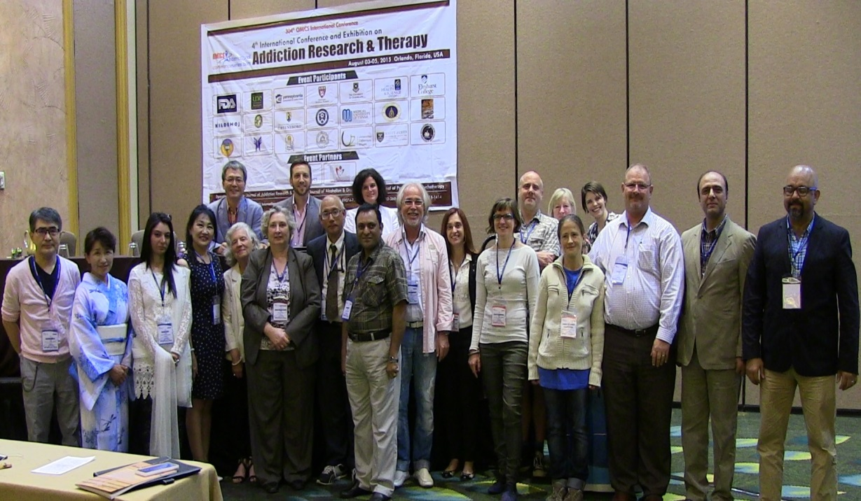
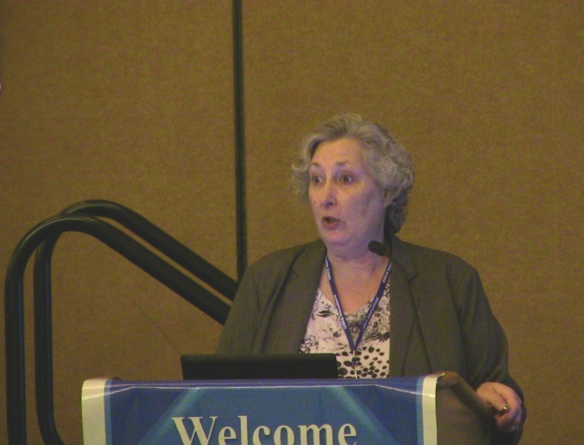
Addiction Therapy 2015
Florida, USA
August 03-08, 2015
Kathy Sexton Radek

Slide 2
What are the commonly used Sleep medicines and are they always necessary?
Kathy Sexton-Radek,PhD., C.BSM
Elmhurst College/Suburban Pulmonary & Sleep Associates
Presentation for OMICS AddictionTherapy Conference, Orlando, Florida, USA, August, 2015
Resources: Basics of Sleep, Principles & Practices of Sleep Medicine

Slide 3
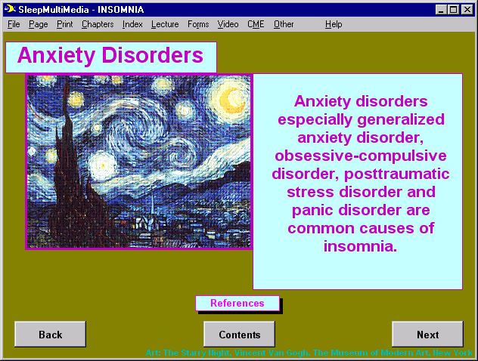

Slide 4
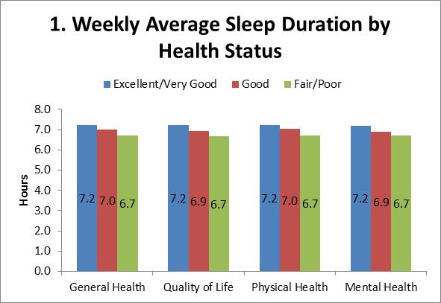
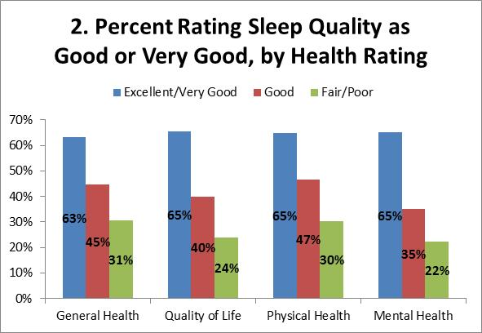
Key Findings: Good health was related to good sleep
Americans were asked to rate their general health, quality of life, physical health and mental health. Almost half (48%) rated their general health highly, as very good or excellent, and just over half (54%) also rated their quality of life highly. In addition, 44% rated their physical health highly and 60% rated their mental health highly.
As seen in Figure 1, those who rated their health or quality of life more highly (very good or excellent) reported getting approximately 30 minutes more sleep on average in the past 7 days than those who rated their health or quality of life as poor or fair. Those who rate their general health more highly were approximately twice as likely to rate their sleep quality as very good or excellent (63% vs. 31% in Figure 2).

Slide 5
Accidents and sleep loss
A large number of transportation accident are due to sleep loss and inadequate sleep
Lapses in attention are common to sleepiness
A 2 sec lapse can result in a driver moving out of lane on the highway and a drowsy driving crash
There is a high likelihood of drowsy driving crashes in sleep deprived people, especially those who drive at night
Truck traveling
At 60 mph
4º angle of drift
Within 2 sec truck has traveled 190ft and is completely out of lane
Notes:
Motor vehicle accidents related to fatigue, drowsy driving and falling asleep at the wheel are particularly common but often underestimated. Increased time awake, nocturnal circadian phase, reduced sleep duration, prolonged driving duration, and use of soporific medications, all have been found to contribute to the occurrence of drowsy-driving and fatigue-related motor vehicle crashes. Studies of shift-workers, truck drivers, medical residents, and airline pilots show an increased risk of crashes or near misses due to sleep deprivation. Sleepiness related motor vehicle crashes have a fatality rate and injury severity level similar to alcohol-related crashes.
Slide by: David F. Dinges, PhD and Siobhan Banks, PhD

Slide 6
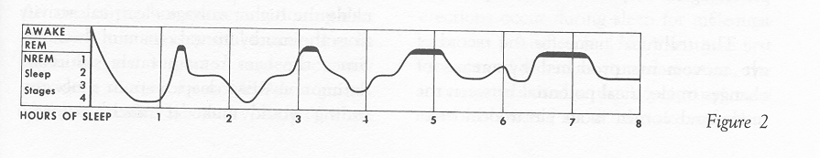
Figure 2

Slide 7
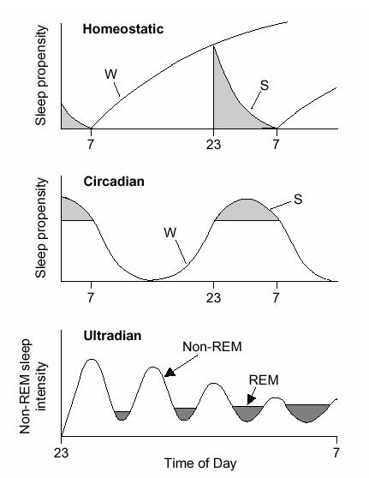

Slide 8
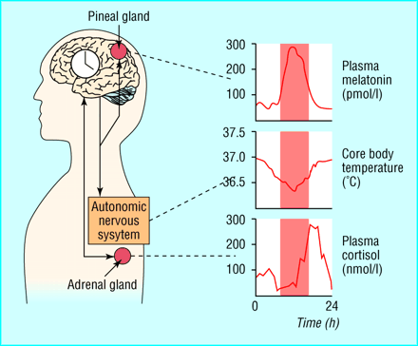
Outputs of the circadian timing system
Night
Hastings, British Med J, 1998
Notes:
The output of the circadian timing system (CTS) is accessible through monitoring a variety of systems. Three such systems often used in human studies of the CTS are displayed in this figure partially redrawing from Hastings (1998).
The pink area represents nighttime or usual sleeping hours. The analogue clock embedded in the brain is a metaphorical representation of the suprachiasmatic nuclei (SCN) of the hypothalamus, the master circadian oscillator in mammals. The clock signals the timing for countless physiological processes. Melatonin levels are constrained in the presence of light (due to inhibition of components of the chemical pathway in the presence of light); nevertheless, even in constant darkness or low levels of light, melatonin expresses a nocturnal rise that roughly spans the usual sleeping phase for humans. Core body temperature falls during the biological night, even if one does not sleep. Cortisol levels are lowest in the latter half of the day and first half of the night, rising in the latter portion of the night to an early morning peak. These occurs whether the person is asleep or awake. This late night steep rise of cortisol has been pointed out as a good example of anticipatory homeostasis, one of the major putative roles of the CTS.
Hastings M. The brain, circadian rhythms, and clock genes. BMJ 1998, 317 (7174), 1704-7.
Slide by: Mary A. Carskadon, PhD

Slide 9
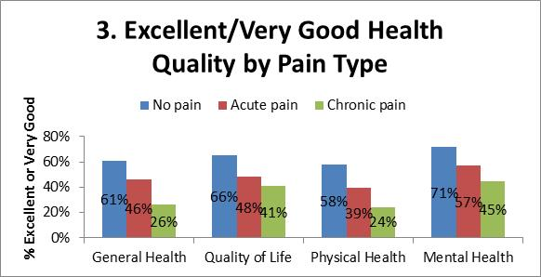
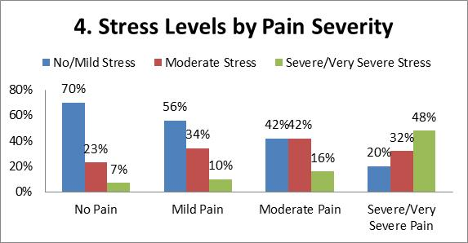
Key Findings: Pain was associated with worse health and more stress
When asked about any physical pain experienced in the past 7 days, the majority of Americans (57%) indicated they had experienced at least mild pain. Those experiencing pain were asked if the pain was chronic and long-lasting or only fleeting and minor, which we have termed “acute” pain. Both chronic pain and acute pain were associated with worse health and greater stress. As seen in Figure 3, those with either chronic or acute pain were less likely to report excellent or very good general health, quality of life, physical health and mental health compared with those with no pain in the previous 7 days. People with pain were more likely to report severe to very severe stress levels. Among those with chronic pain, 23% reported severe/very severe stress levels in the previous 7 days compared with 12% of those with acute pain and 7% of those with no pain.
Average pain severity was described as severe/very severe for 5% of people, moderate for 24% of people and mild for 30% of people. Pain severity is also associated with higher stress levels (Figure 4). Among those with no pain in the past 7 days, 70% had mild or no stress and just 7% were severely stressed. In contrast, among those with severe or very severe average pain in the past 7 days, only 20% reported mild or no stress and 48% reported their stress levels as severe or very severe.
Not surprisingly, those with chronic pain experienced greater pain severity in the last week. 40% of those with acute pain reported at least moderate pain compared to 69% of those with chronic pain.

Slide 10
Sleep and Psychiatric disorders
Insomnia may predict new onset or recurrence of psychiatric disorders
Adolescent Insomnia associated with Depression and Substance Abuse
Insomnia symptoms associated with increased risk for new onset depression
Chronic Insomnia associated with incidence of Depression
Insomnia associated with clinically significant depression and anxiety
Obstructive Sleep Apnea comorbid with depression
Treatments of insomnia improves psychiatric outcomes
Hypersomnia and Narcolepsey (moderate sleepiness in general population 10-15%,5% extreme sleepiness)
Fatigue more common than EDS in Bipolar I
EDS in Major Depressive Disorder
Rates of RLS/PLMs elevated in MDD,Schizophrenia
REM parasomnias in PTSD

Slide 11
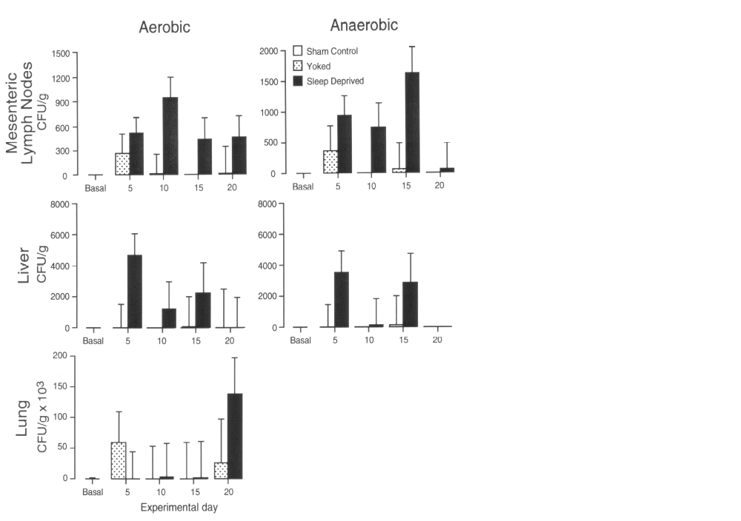
Physiological effects of prolonged SD
Decreased resistance to infectious disease
  Early infection
  Chronic septic state
  Eventual lethal bloodstream infection
    A proximal cause of death
Modified from Everson and Toth, Am J Physiol Regul Integr Comp Physiol, 2000
Notes:
Not much is known about the immunological consequences of sleep deprivation; although a large role of sleep restriction in producing immunopathology has long been suspected. The data presented here show that bacteria that the body normally controls are not normally controlled during sleep deprivation. Live bacteria were cultured from the mesenteric lymph nodes and from other major organs that should remain sterile. The bacteria presumably translocated from the intestine and migrated to extraintestinal sites. Presence of pathogenic microorganisms and their toxins in tissues constitutes a septic burden and chronic antigenic challenge of the host. Eventually host defense fails, as indicated by eventual bloodstream infection and signs consistent with death by septicemia.
Modified with permission from Everson CA, Toth LA, and The American Physiological Society. Am J Physiol Regul Integr Comp Physiol 278: 905-916, 2000.
Slide by: Carol A. Everson, PhD

Slide 12
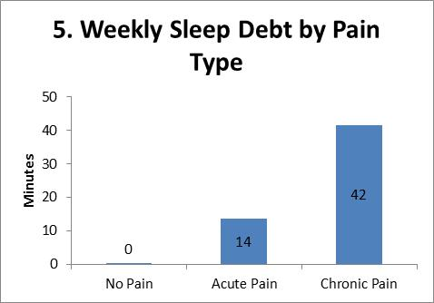
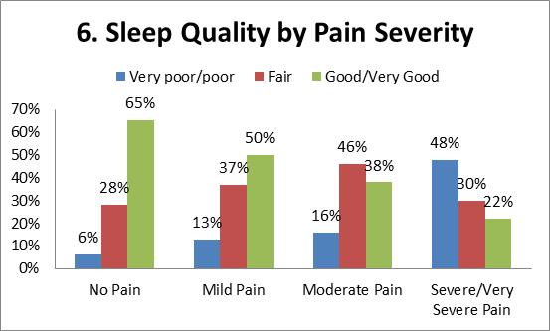
Key Findings: Pain was also associated with lower sleep quality, more sleep problems, and greater sleep debt
Those experiencing pain in the past 7 days slept less and had worse sleep quality than those without pain. On average, those with no pain slept 7.3 hours in the past week, while those with acute pain slept 7.0 hours and those with chronic pain slept 6.7 hours. Those with an average pain severity that was mild got an average of 7.0 hours of sleep, compared to 6.5 hours for those with severe or very severe pain (and 6.9 hours for those with moderate pain).
More important, pain was related to greater sleep debt – the gap between how much people say they need and the amount they’re actually getting. The sleep debt averaged 42-minute for those with chronic pain and 14 minutes for those who’ve suffered from acute pain in the past week (see Figure 5). There was no gap for those who did not have pain in the last week. Likewise, those who reported greater average pain severity in the past week also experienced greater sleep debt. The sleep debt for those with mild pain was 15 minutes, 24 minutes for those with moderate pain, and 60 minutes for those with severe pain.
Pain is also associated with sleep quality. While 65% of those with no pain reported good or very good sleep quality, just 45% of those with acute pain did the same. Just 37% of those with chronic pain reported good or very good sleep, 25% reported poor or very poor sleep quality, and 38% reported fair sleep quality. Average pain severity is also related to sleep quality, as seen in Figure 6. 50% of those with mild pain in the past 7 days reported good or very good sleep, compared to just 22% of those with severe pain.

Slide 13
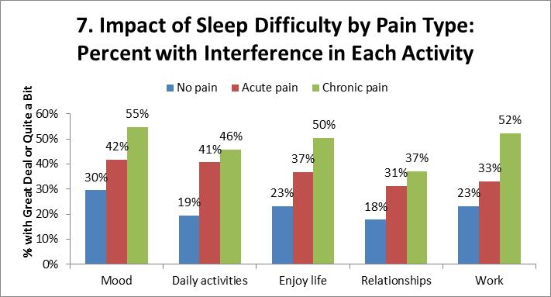
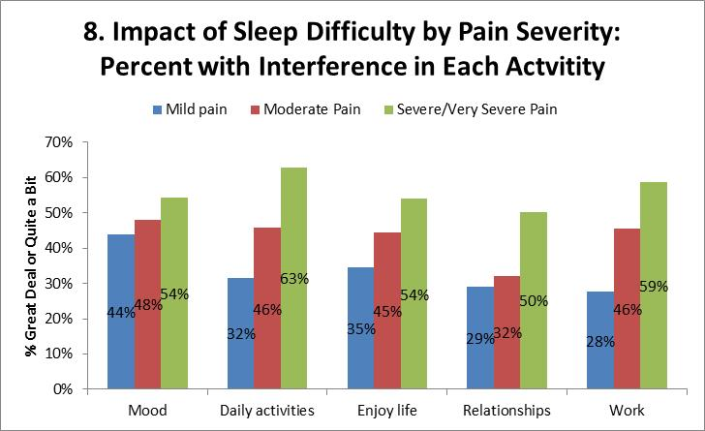
Key Findings: Difficulty sleeping interferes with life more among people with either acute or chronic pain
48% reported sleep problems in the last week according to the NIH PROMIS scale (see appendix for details: URL). They people were asked how the sleeping difficulties interfered with 5 domains of life: their mood, daily activities, enjoyment of life, relationships with other people and ability to do work, chores, child care, or other duties. As seen below, people who have chronic or acute pain are more likely to have sleeping difficulties interfere with their life. For example, 52% of those with chronic pain indicate that sleeping difficulties interfere with their work, compared to 23% of those without pain. Thus, sleep difficulties appear to have a greater impact on the lives of those in pain.

Slide 14
Medical illness and Sleep disorder
Foley et al (2004)
Odds ratio greater than 2 for Depression, Lung conditions and obesity with breathing symptom;
Odds ratio greater than 2 for Stroke, Depression and Body Pain with excessive daytime sleepiness

Slide 15
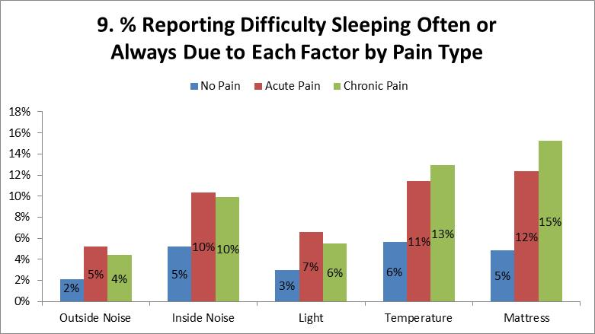
Key Findings: Environmental factors disturb sleep more among those with either acute or chronic pain
Everyone was asked the degree to which specific environmental factors made it more difficult to get a good night’s sleep. People with pain, either acute or chronic, were significantly more likely to have environmental factors such as noise, light, temperature and their mattresses interfere with their sleep. After adjustment for sociodemographic factors, people with acute and chronic pain were still more likely to have sleep difficulties due to inside noise, light, temperature and their mattresses. Similar associations were observed for average pain intensity: those with severe pain were more likely to report that their sleep was disturbed by these environmental factors. For example, 21% of those with the most severe pain report having sleep disturbed by inside noise, compared to 8% of those with mild pain.

Slide 16
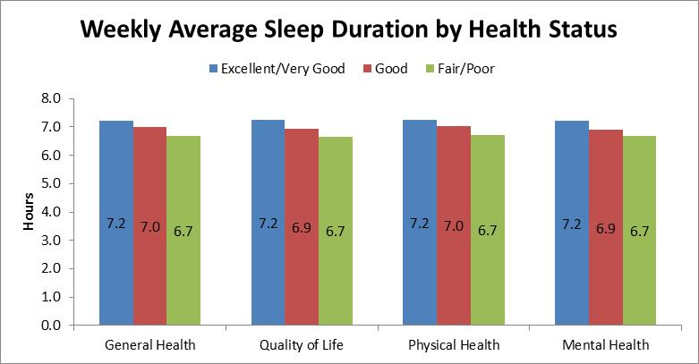
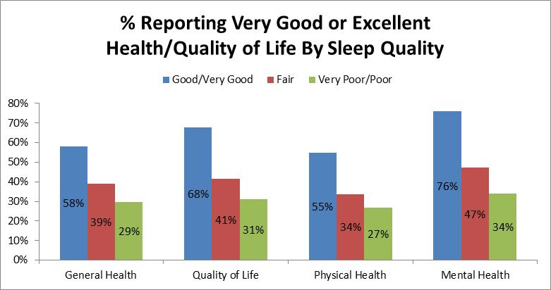
Detailed Findings: Sleep and Health (continued)
Longer sleep duration and better sleep quality were associated with better health:
  As seen in graph below, those who rate their sleep quality more highly were also more likely to rate their health and quality of life as very good or excellent, while those who indicated they had difficulty sleeping in the previous 7 days were less likely to rate their health and quality of life as very good or excellent (all p<0001). Similarly, those with better health had lower scores on the sleep disturbance scale.
  Likewise, those who rated their health and quality of life highly (very good or excellent) reported getting more sleep -- getting approximately 30-34 minutes more sleep (depending on which health/quality of life question is used) across the week on average than those who reported their health as fair or poor (all p<.001).
  In the overall relationship between health and sleep, pain plays a prominent role – a point explored in the next section.

Slide 17
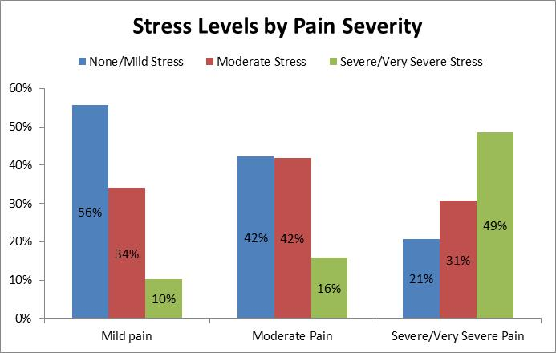
Detailed Findings: Pain, Health, and Sleep (continued)
People with pain were more likely to report severe or very severe stress levels. Among those with chronic pain, 23% reported higher stress levels and 12% of those with acute pain as compared with 7% of those with no pain (p<.0001). As seen in the graph below, greater pain severity was also associated with more severe stress levels: 49% of those with severe/very severe pain reported severe/very severe stress compared with 10% of those with mild pain (p<.0001).

Slide 18


: Napping: Good or Bad?

Slide 19
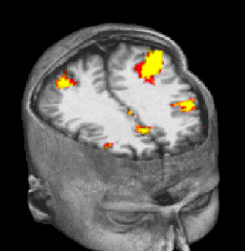
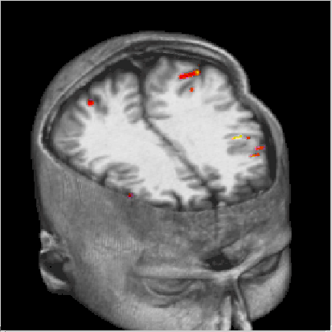
Arithmetic
Normal Sleep Sleep Deprivation
Modified from Drummond et al., Neuroreport, 1999
Notes:
This is an example of an impaired brain response during sleep deprivation. Subjects in this study were scanned with functional magnetic resonance imaging while performing an arithmetic working memory task (serial subtraction of 6, 7, 8, or 9). The gray-scale anatomical image is a single individual with a slice removed from the skull in the axial plane (parallel with the floor) and another in the coronal plane (perpendicular to the floor and to the midline of the brain) to expose the brain. The color is the average group activation. On the left, we see the brain regions responsive to task demands after a normal night of sleep. These are the brain regions one would expect based on the literature (bilateral inferior parietal lobes, bilateral dorsolateral prefrontal cortex, & anterior cingulate.) On the right, those regions that are normally responsive to arithmetic working memory demands all show significantly less responsiveness to the same task demands following 35 hours total sleep deprivation. In fact, the only one of these regions that showed significant activation after sleep deprivation was the left inferior parietal lobe. So, clearly there is an impaired response within the brain regions responsible for performing this task. Not surprisingly, subjects performed worse on this task following sleep deprivation. NOTE: Later studies reported that one mechanism underlying this impaired brain response may be an impaired ability to appropriately allocate resources (e.g., oxygen, glucose, or some other cellular need) to regions of the brain where they are needed.
See Drummond, S. P. A., Bischoff-Grethe, A., Dinges, D. F., Ayalon, L., Mednick, S. C., & Meloy, M. J. (2005). The neural basis of the psychomotor vigilance task. Sleep, 28(9), 1059-1068.
Modified from: Drummond, S.P.A., G.G. Brown, J.L. Stricker, R.B. Buxton, E.C. Wong, and J.C. Gillin, Sleep deprivation-induced reduction in cortical functional response to serial subtraction. Neuroreport, 1999. 10(18): p. 3745-3748
Slide by: Sean P. A. Drummond, PhD

Slide 20
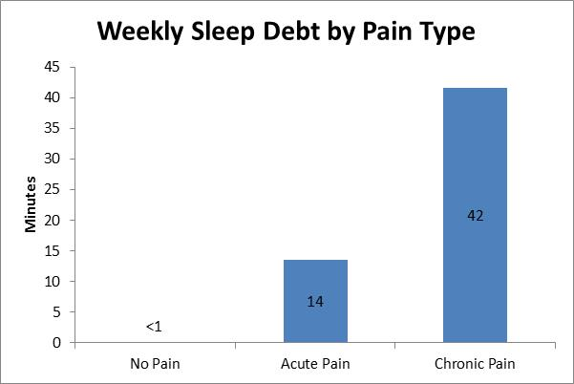
Detailed Findings: Pain, Health, and Sleep
Pain and Sleep (continued)
Pain was also related to greater sleep debt, the difference between preferred sleep and actual sleep. As seen in figure below, the sleep debt averaged 42 minutes for those with chronic pain and 14 minutes for those with acute pain in the past week while those with no pain did not report a sleep debt. Those with more severe pain in the past week also experienced greater sleep debt. The sleep debt for those with mild pain was 15 minutes, 24 minutes for those with moderate pain, and 60 minutes for those with severe or very severe pain.
People with chronic pain were more likely to have been diagnosed with sleep disorder (23%) compared with those with no pain (5%) and acute pain (6%).
The presence of pain was associated with greater concern that poor sleep may have serious consequences for physical health. The proportion who indicated that they were very or extremely concerned was 24% among those with no pain, 32% among those with acute pain and 39% among those with chronic pain (p=.0001).
People with chronic pain also worry about getting a good night’s sleep more often; 24% of those with chronic pain indicated they often or always worried while only 12% of those with acute pain worried and 11% of those with no pain worried (p<.0001).
The presence of pain was also associated with feeling less in control of sleep. The proportion who said they often or always have control over when and how much they sleep was 63% in the group without pain and 45% in the acute pain group and 47% in the chronic pain group (p=.0001).
People with pain more often reported being overwhelmed by thoughts when trying to sleep. 27% of those with chronic pain, 17% of those with acute pain and 14% of those with no pain indicated they were often or always overwhelmed by thoughts (p<.0001).

Slide 21
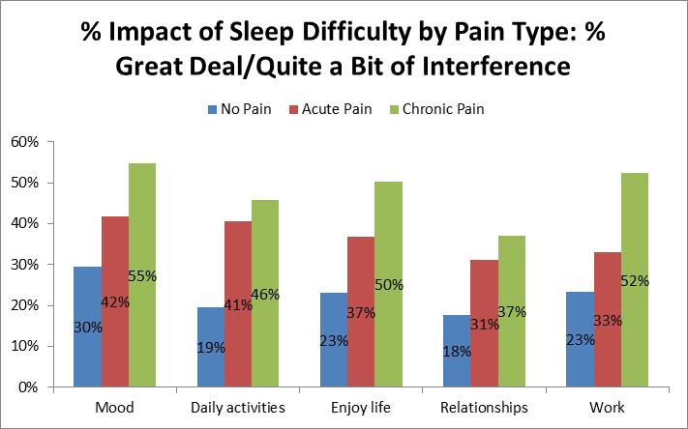
Detailed Findings: Interference of Difficulty Sleeping (continued)

Slide 22
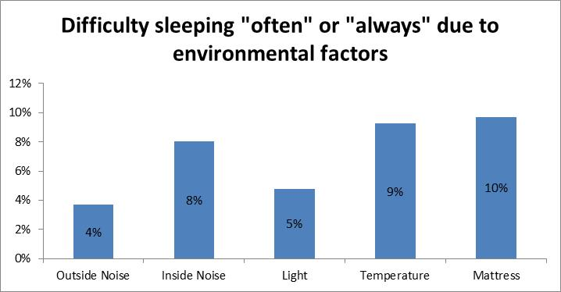
Detailed Findings: Environmental Factors Disturbing Sleep
Of factors disturbing sleep often or always: an uncomfortable mattress was the most commonly reported problem (10% of people), followed by temperature (9%), inside noise (8%), light (5%) and outside noise (4%).
  Women’s sleep was disturbed more often by inside noise (11% vs 4%) and temperature (11% vs 7%, p=.04) than men’s sleep. There were no differences between men and women for the other environmental factors.
  There was no difference in sleep duration between those with 0 to 1 of these environmental factors frequently (sometimes, often or always) making sleep difficult and those with 2-5 of these factors frequently making sleep difficult. However, sleep quality was significantly lower in those with 2-5 perturbations: 64% of them reported poorer sleep quality (very poor, poor or fair) compared with 39% of those with 0-1 perturbations (p<.0001). A greater proportion of people with 2-5 perturbations reported difficulty sleeping in the past 7 days (60% compared with 41% of those with 0-1 perturbations, p<.0001). Mean sleep disturbance score was also higher (23 vs 19 points, p<.0001). Perceived sleep debt was higher among those with 2-5 perturbations: 40 vs 18 minutes on work days (p=.0003), -6 vs -24 on free days (p=.008) and 27 vs 5 minutes per night across the week on average (p=.0002).

Slide 23
Withdrawal syndrome: Untreated Insomnia/Sleep disturbance theatens recovery
Brower (2007) reported increased number of arousals, sleep fragmentation, decreased REM episodes, breathing disorders
Cocaine withdrawal effect: hypersomnia, excessive wakefulness
Marijuana withdrawal effect: REM suppression, Insomnia

Slide 24
Gersa et al (2007)
Neurobiological vulnerability
Adrenocorticaotrophic hormone and cortisol plasma levels directly correlate with childhood neglect and depression measures in addicted patients
Reported to be involved in vulnerability to alcohol and drug dependence in humans
Possible underlying both addictive behavior and depression susceptibility
Heroin/cocaine dependent addicts completed SCL-90 and blood samples (ATCH) and cortisol basal plasma levels as compared to controls

Slide 25
Behavioral (Non-pharmacological)Treatment Works
Cognitive Behavior Therapy, multicomponent package of empirically validated behavioral and cognitive treatments to reduce Insomnia symptoms, composed of:
Stimulus Control
Sleep Restriction
Relaxation Training/Mindfulness Training
Cognitive Therapy
Sleep Education
Sleep Hygiene

Slide 26
Alcohol dependent disorder
4.4/10 nights on average report Insomnia (Watanabe et al. 2001)
Hatzinger (1995) PSG of Patients with Addiction diagnosis (alcohol/opoid)/MDD versus controls
R-OH: decrease in SWS,TST
Opoid: REM suppressed
Controls: -
Depressed: Increased onset REM, increased WASOs

Slide 27
Pharmacologic treatments
FDA-approved drugs
  Benzodiazepine receptor agonists
  Melatonin receptor agonist
Drugs used off-label (not FDA approved for insomnia)
  Sedating antidepressants
  Antipsychotics
Self medication
  Alcohol
  H1 antihistamines (OTC sleep aids)
  Herbal remedies
Notes:
There are two different approaches to the pharmacological management of insomnia. First there is self medication with either alcohol or OTC medication. Second there is the use of prescription medications. Prescription medications can be dichotomized into those indicated for the treatment of insomnia by the FDA, and the other is off label used of a variety of sedating medication; primarily sedating antidepressants.
Slide by: Thomas Roth, PhD

Slide 28
Self-medications
Ethanol—22% report using, results in tolerance with chronic used and diminished sleep efficiency and quality
Over the counter sleeping pills contain sedating antihistamines, usually diphenhydramine, results in daytime sleepiness, cognitive impairment, anticholinergic effects that persist days after use and driving performance decrements
Herbal agents including melatonin, chronic use associated with sever eosinophilia –toxicity
Tryptophan supplement-also in bedtime snack foods such as bananas, milk and turkey
Kava-abused in some cultures, associated with hepatic toxicity
Some evidence to support herbal agents such as chamomile, passion flower and skullcap

Slide 29
Drugs commonly used for insomnia¹ in 2002
Drug | Occurrences (millions) | Drug (cont) | Occurrences (millions
trazodone | 2.730 | hydroxyzine | 0.293
zolpidem | 2.074 | alprazolam | 0.287
amitriptyline | 0.774 | lorazepam | 0.277
mirtazepine | 0.662 | olanzepine | 0.216
temazepam | 0.558 | flurazepam | 0.205
quetiapine | 0.459 | doxepin | 0.199
zaleplon | 0.405 | cyclobenzaprine | 0.195
clonazepam | 0.394 | diphenhydramine | 0.192
¹ Verispan PDDA; desired action of “hypnotic”, “promote sleep” or “sedate night”
Walsh, Sleep, 2004
Notes:
Walsh JK. Drugs used to treat insomnia in 2002: regulatory-based rather than evidence-based medicine, Sleep, 2004;27:1441-2.
Slide by: Thomas Roth, PhD

Slide 30
Medications known to cause insomnia
Antibiotics-quinolones
Anticonvulsants
Antihypertensives
Caffeine
Decongestants
Diuretics
Lipid and cholesterol lowering agents
Niacin
Theophylline
Thyroid preparations

Slide 31
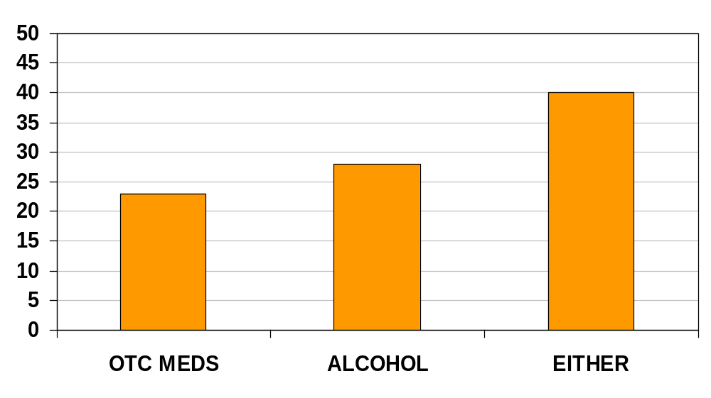
% of patients using OTCs, alcohol, or both
N = 320
Modified from Ancoli-Israel and Roth, Sleep, 1999
Notes:
A variety of different medications are used to treat insomnia.
In this study of a data base looking at what physicians used to treat insomnia it is very clear that off label use sedating mediations for the treatment of insomnia is common. Among the medications used are hypnotics, sedating antidepressants (3 of the top 4 atypical antipsychotic and anilities. It is hypothesized that the off label use of these medications is driven by cost and concern over abuse liability. In terms of self medication 40% of the insomniacs have self medicated with either alcohol or an over the counter sleep agent. In fact about 10% have used both. Generally there is concern about the sleep disruptive effects of alcohol and the safety of OTC sleep medications.
Ancoli-Israel S, Roth T. Characteristics of insomnia in the United States: results of the 1991 National Sleep Foundation Survey. I, Sleep, 1999;22 Suppl 2:S347-53.
Slide by: Thomas Roth, PhD

Slide 32
Duration of hypnotic use
70
<6 months
6-12 months
60
1-5 years
50
>5 years
40
% of Participants
30
20
10
0
Ohayon, 1996
European Union
Balter et al., 1992
United States
Modified from Ohayon, Sleep, 1996
Modified from Balter and Uhlenhuth, J Clin Psych, 1992
Notes:
Duration of hypnotic use in Europe and US:
Similar to previous slide, this slide present data on the pattern of use of hypnotic use specifically in provides the data from The US as well as Europe. The data clearly reflect that on both continent nights long term use of sleep agents is not uncommon. Clearly data on the nature of this use is needed.
Ohayon M. Epidemiological study on insomnia in the general population, Sleep, 1996;19(3 suppl):S7-S15.
Balter MB, Uhlenhuth EH. New epidemiologic findings about insomnia and its treatment, J Clin Psychiatry, 1992;53:34-39
Slide by: Thomas Roth, PhD

Slide 33
Neurochemical Targets for
Pharmacologic Development:
Sleep/Wake Neurotransmitters and Modulators
Wake
Norepinephrine
Serotonin
Acetylcholine
Histamine
Orexin/hypocretin
Sleep
Adenosine
γ-aminobutyric acid (GABA)
Galanin
Melatonin
Notes:
Multiple Transmitters are involved in controlling sleep and wake.
Like most biological systems, Sleep-Wake is controlled by multiple transmitter systems. Interestingly, with one exception, all approved sleep medication s have a single therapeutic target GABAa. As will be seen later, off label use of medications for sleep as well drugs under development are aimed at new target including H1 Orexin, serotonin and melatonin.
Slide by: Thomas Roth, PhD

Slide 34
GABA: Principal inhibitory neuronal transmitter
GABA: gamma-aminobutyric acid
30% of all brain synapses use GABA as transmitter¹
Binds to and activates GABA_{A} receptors¹
Controls flow of chloride ions across neuronal membrane through receptor channels¹
Resulting ion flux causes membrane hyperpolarization and neuronal inhibition²
GABA
OH
O
NH₂
Sieghart and Sperk, Curr Top Med Chem, 2002;
Krogsgaard-Larsen et al., Chem Rec, 2002
Notes:
Sieghart W, Sperk G. Subunit composition, distribution and function of GABA(A) receptor subtypes, Curr Top Med Chem. 2002;2:795-816.
Krogsgaard-Larsen P, Frolund B, Liljefors T. Specific GABA(A) agonists and partial agonists. Chem Rec. 2002;2:419-430.
Slide by: Thomas Roth, PhD

Slide 35
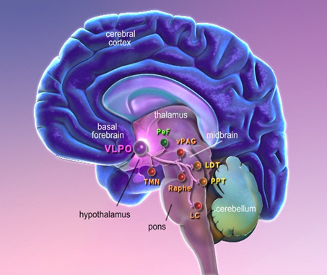
BzRAs Target GABA_{A} receptors
Notes:
GABA is the primary inhibitory neurotransmitter in the human brain and 60-80% of neurons respond to this neurotransmitter. In the spinal cord, glycine is the primary inhibitory neurotransmitter. In most areas of the brain, GABA is involved in local inhibitory circuits. The ventrolateral preoptic nucleus (VLPO) is a hypothalamic nucleus involved in the promotion of sleep. It uses GABA as its main neurotransmitter and projects to several sleep active targets. Thus, increased activity of the VLPO during sleep will inhibit the wake-promoting histaminergic tuberomammillary nucleus (TMN), hypocretinergic perifornical area (PeF), the serotonergic raphe, the cholinergic laterodorsal tegmentum/pedunculopontine tegmentum (LDT/PPT), the dopaminergic ventral periaqueductal grey (vPAG) and noradrenergic locus coeruleus (LC).
For review: Saper CB, Cano G, Scammell TE (2005) Homeostatic, circadian, and emotional regulation of sleep. J Comp Neurol 493:92-98.
Slide by: Jamie Zeitzer, PhD
Notes below by Thomas Roth, PhD:
The hypnotic and sedative effects of both selective and nonselective BzRAs result from their binding to benzodiazepine recognition sites on the GABA_{A} complex and are mediated by the allosteric modulation of GABA_{A1a} receptors.^{1,2} GABA_{A} receptors are distinguished by the presence of the α₁ subunit throughout the brain. It is thus not surprising that nonselective and selective BzRAs can be associated with amnesic, ataxic, and sedative effects, given the broad distribution of the α₁ subunit³ and the results of animal studies implicating the α₁ subunit with sedative, amnesic,² and ataxic effects.¹
1. Mendelson WB, Roth T, Casella J, et al. The treatment of chronic insomnia: drug indications, chronic use and abuse liability. Summary of a 2001 New Clinical Drug Evaluation Unit meeting symposium. Sleep Med Rev. 2004;8:7-17.
2. Landolt HP, Gillin JC. GABA_{A1a} receptors. Involvement in sleep regulation and potential of selective agonists in the treatment of insomnia. CNS Drugs. 2000;13:185-199.
3. Sieghart W, Sperk G. Subunit composition, distribution and function of GABA_{A} receptor subtypes. Curr Top Med Chem. 2002;2:795-816.

Slide 36
Benzodiazepine Receptor Agonists
FDA-approved hypnotics
Drug | Dose (mg) | t_{1/2} (h) | Active metabolite | Metabolism
Triazolam | 0.25 | 2–4 | N | Oxidation
Temazepam | 15–30 | 8–20 | N | Conjugation
Estazolam | 1–2 | 10–24 | N | Oxidation
Quazepam | 15 | 25–41 | Y | Oxidation
Flurazepam | 15-30 | 24-100 | Y | Oxidation
Zaleplon | 10 | 1 | N | Oxidation
Zolpidem | 5–10 | 1.5–2.5 | N | Oxidation
Eszopiclone | 1-3 | 5-7 | N | Oxidation
Notes:
BzRAs approved by FDA as Hypnotics:
This table provides the pharmacokinetic and other information for each of the BzRAs approved for insomnia. The three “non benzodiazepines” (zolpidem, zaleplon and eszopiclone) generally have shorter half lives than the. It is important to recognize that for the drugs with long half lives, the extended duration of action is primarily due to an active metabolite. Finally as a general rule Tmax should be 1-2 hours for an induction effects and half life should be less than 6-7 hours to avoid residual effects.
Slide by: Thomas Roth, PhD

Slide 37
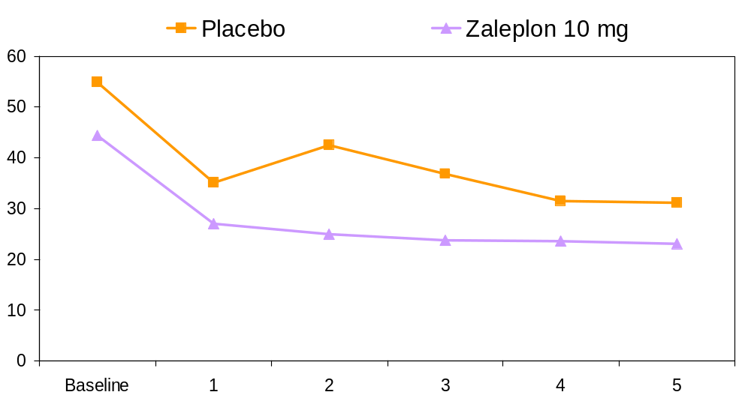
Sleep onset (Latency to persistent sleep)
*
*
*
*
*
Minutes
Week
* P<.031 or better vs Placebo
Modified from Walsh et al., Sleep Med, 2000
Notes:
Sleep induction measure:
This slide provides an example of the effect of a hypnotic (zaleplon 10mg) on sleep induction. In the sleep laboratory efficacy in sleep induction is defined by Latency to Persistent Sleep (LPS). LPS is defined as the first ten minutes of uninterrupted sleep. This measure is used in insomnia as sometimes insomniac might fall asleep for a few minutes and they stay awake for a long time. Thus LPS seems to correlate better with a patient’s response to the therapy.
Walsh JK, Vogel GW, Scharf M, et al. A five week, polysomnographic assessment of zaleplon 10 mg for the treatment of primary insomnia, Sleep Med. 2000;1:41-49.
Slide by: Thomas Roth, PhD

Slide 38
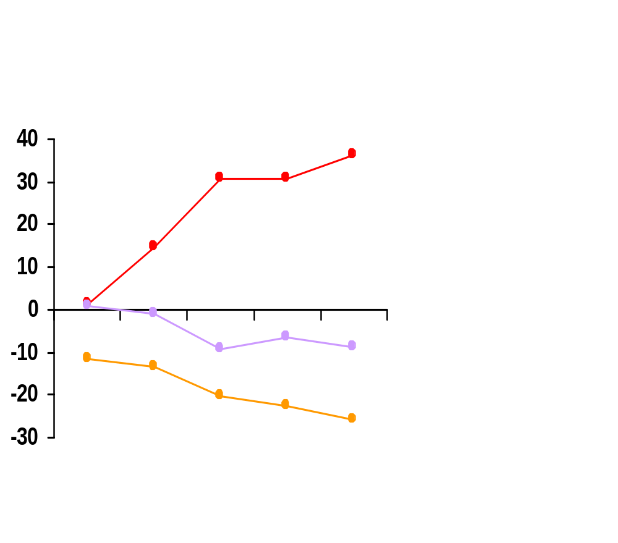
Dose response effects on PSG efficacy variables
***
TST
**
***
*
Mean Change From Baseline (min)
SL
*
WASO
**
Pbo 0.25 0.5 1.0 2.0
*p <.05, **p<.01, ***p<.001
Estazolam Dose (mg)
Modified from Roehrs et al., J Clin Psychopharmacol, 1983
Notes:
PSG = Polysomnography
TST = total sleep time
WASO = wake after sleep onset
Dose response effects of BzRAs:
This slide depicts the dose response effects of a hypnotic (estazolam) on tree measures of hypnotic efficacy: sleep induction (SL- sleep latency) sleep maintenance (WASO wake time after sleep onset) and sell duration (TST total sleep time). As might be expected the rapidity of sleep onset is defined by a Cmax. As most doses of hypnotics have adequate blood levels to initiate sleep, sleep latency is a flat dose response curve. In contrast sleep maintenance is determined by how long those blood levels are maintained and that increase with dose, given a nice dose response curve for both WASO and TST.
Roehrs T, Zorick F, Lord N, et al. Dose-related effects of estazolam on sleep of patients with insomnia. J Clin Psychopharmacol. 1983;3:152-6.
Slide by: Thomas Roth, PhD

Slide 39
BzRA adverse events (BZD and non-BZD)
Adverse Events
  Somnolence Dizziness
Determinants
  C_{max}, T_{1/2}
  Ataxia Taste
  Amnesia Nausea
Discontinuation effects
  Rebound insomnia, withdrawal syndrome
Dependence liability
  Dose escalation, self-administration outside therapeutic context
BzRA = Benzodiazepine Receptor Agonist.
Notes:
The primary side effects of BZRAs are somnolence ,ataxia, dizziness., amnesia and nausea. These all related to the Cmax (i.e. they are dose related) as well as duration of action of the drug (Half life and dose). In addition discontinuation effects are of concern. Finally in at risk populations abuse liability needs to be considered.
Slide by: Thomas Roth, PhD

Slide 40
Discontinuation effects of hypnotics on sleep
Rebound Insomnia
  Single symptom
  Exacerbation relative to baseline
  1-2 night duration
Withdrawal Syndrome Recrudescence
  Return of original symptom(s)
  At basal level of severity
  Complex of symptoms
  Longer duration
Notes:
An important clinical issue with hypnotic use is an understanding of what happens when the medication is stopped. The most benign result is a return to pre treatment levels of insomnia (recrudescence). However there are data that short and intermediate acting BzRAs produce a worsening of the insomnia upon discontinuation (rebound insomnia). This generally lasts only 1-2 days. The worst possibility is the development of a withdrawal syndrome. This generally has multiple symptoms including some which were not present before starting medication. Generally this lasts longer than rebound insomnia.
Slide by: Thomas Roth, PhD

Slide 41
Sedating antidepressants
Common but not well studied for the treatment of insomnia in patients without depression^{1,2}
  Not FDA approved for insomnia
Sedating antidepressants commonly used¹
  Desyrel® (trazodone)
  Elavil® (amitriptyline HCl)
  Sinequan®, Adapin® (doxepin)
  Remeron® (mirtazapine)
® All brand names are the property of their respective owners.
Lippmann et al., South Med J, 2001;
Mendelson et al., Sleep Med Rev, 2004
Notes:
As the data presented in slide 7 points out sedating antidepressants are commonly used of label for the treatment of insomnia .This slides presents the 4 most commonly used drugs in this category. Interestingly these drugs were developed for the treatment of depression but are rarely used for that indication. Their widespread clinical use suggests they must have some efficacy. However for how long at what dose and at what risk needs to be determined.
Although physicians often prescribe sedating antidepressants for patients with insomnia who are not depressed, there is little published evidence to support such use.^{1,2} Sedating antidepressants are not habituating. Thus, they may be useful in patients who are at risk of substance abuse and in known and former substance abusers.¹
Commonly used sedating antidepressants include trazodone, amitriptyline, doxepin, and mirtazapine.¹
1. Lippmann S, Mazour I, Shahab H. Insomnia: therapeutic approach. South Med J. 2001;94:866-873.
2. Mendelson WB, Roth T, Cassella J, et al. The treatment of chronic insomnia: drug indications, chronic use and abuse liability. Summary of a 2001 New Clinical Drug Evaluation Unit Meeting Symposium. Sleep Med Rev. 2004;8:7-17.
Slide by Thomas Roth, Phd.

Slide 42
Trazodone vs. Zolpidem in primary insomnia
90
Subjective sleep latency
* p < 0.01 ** p < 0.001
400
Subjective sleep duration
* p < 0.01
380
*
80
*
70
360
Sleep Latency (min)
Sleep Duration (min)
60
*
340
50
*
*
*
320
40
300
Baseline
Week 1
Week 2
Baseline
Week 1
Week 2
Placebo n=103 Trazodone 50mg, n=98 Zolpidem 10mg, n=100
Modified from Walsh et al., Hum Psychopharmacol: Clin & Exp, 1998
Notes:
As was pointed out previously many different types of drugs other than BzRAs are used to treat insomnia.. The most commonly used of these medications is trazedone . Unfortunately ,as the NIH State of the science reports, we do not know the risk benefit ratio associated with these ( sedating antidepressants) drugs. This slide presents a patient report study of zolpidem 10mg versus placebo and trazedone 50mg, versus placebo. Zolpidem separated from placebo on both weeks of the study while trazedone separated only in week one. Is this tolerance to trazedone? Does this happen with other doses? What is the minimally effective dose? What happens to daytime function? Clearly given how commonly these medications are used we need to know more about their efficacy and safety. There are few studies on the hypnotic efficacy of antidepressants in non-depressed persons with insomnia. In this study both trazodone 50 mg and zolpidem 10 mg improved subjective sleep latency and duration during the first week of use. However, by the second week only zolpidem showed a difference from placebo.¹
Walsh JK, Erman M, Erwin CW, et al. Subjective hypnotic efficacy of trazodone and zolpidem in DSMIII-R primary insomnia. Human Psychopharmacology: Clinical and Experimental, 1998;13:191-98.
Slide by Thomas Roth, Phd.

Slide 43
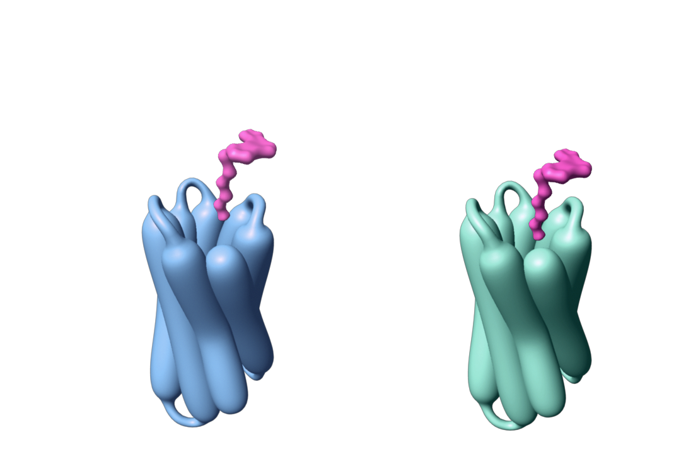
Receptors in the SCN
Sleep-promoting
Phase-shifting
MT₁
MT₂
MT₁ agonism
Attenuates SCN alerting signal
MT₂ agonism
Synchronizes circadian clock
Modified from Dubocovich et al., Front Biosci, 2003
Notes:
MT₁ and MT₂ receptors are heavily concentrated in the SCN. Given the key role of the SCN in sleep regulation, agents with high affinity and selectivity for MT₁ and MT₂ receptors are rational targets in the treatment of insomnia.
Specifically, binding to MT₁ receptors could decrease SCN stimulatory output (alerting signal), with selective MT₁ receptor agonists potentially facilitating or augmenting the effects of endogenous melatonin in sleep promotion. Agonism of the MT₂ receptors may help to entrain the circadian clock via phase shifting, which could help adjust the timing of sleep.
MT₃ binding sites have been studied in vitro and in non-human mammals and, based on these studies, appear to be widely distributed in the kidneys, liver, brain, intestine, lungs, heart, and skeletal muscle. The exact role and function of MT₃ binding sites remain unknown.
Dubocovich MI, Rivera-Bermudez MA, Gerdin MJ, et al. Molecular pharmacology, regulation and function of mammalian melatonin receptors, Front Biosci. 2003; 8:d1093-1108.
Liu C, Weaver DR, Jin X, et al. Molecular dissection of two distinct actions of melatonin on the suprachiasmatic circadian clock, Neuron. 1997;19:91-102.
Nosjean O, Ferro M, Coge F, et al. Identification of the melatonin-binding site MT3 as the quinone reductase 2. J Biol Chem. 2000;275:31311-31317.
Nosjean O, Nicolas J-P, Klupsch F, etal. Comparative pharmacological studies of melatonin receptors: MT1, MT2 and MT3/QR2. Tissue distribution of MT3/QR2, Biochem Pharmacol. 2001;61:1369-1379.
Slide by: Thomas Roth, PhD

Slide 44
Novel mechanism of action (onset)
Placebo
Ramelteon 8 mg
90
P=.008
80
P<.001
P=.003
70
Sleep Latency (Min.)
60
50
40
30
1
3
5
Week
Modified from Roth et al., Sleep Med, 2006
Notes:
Ramelteon is the first ,and currently the only, melatonin agonist approved by the FDA for the treatment of sleep onset insomnia.. This slide presents the efficacy or ramelteon on inducing sleep , relative to placebo, across five weeks of nightly administration.
Roth T, Seiden D, Sainati S, et al. Effects of ramelteon on patient-reported sleep latency in older adults with chronic insomnia, Sleep Med. 2006;7:312-8.
Slide by: Thomas Roth, PhD

Slide 45
General effects of drugs of abuse
Nature of sleep effects
  Sleep efficiency – TST, LPS, WASO
  Sleep staging – NREM (SWS, SWA), REM (lat, %, EM density)
Acute sleep effects of various drugs of abuse
Relation of sleep effects to disease process
Relation of sleep effects to MOA of drugs
Notes:
Sleep effects of drugs, whether abused drugs or therapeutic drugs, can be described based on their effects on the sleep wake process, that is the extent to which sleep onset is delayed, its continuity interrupted, and its duration shortened. Additionally, drug effects on the usual percentages of the various sleep stages and the distribution of those sleep stages across the sleep period can be characterized. Attention to the acute versus the chronic effects of a given drug is important because often adaptations to the drug’ effects on sleep occur with chronic administration. Finally, understanding the drug’s mechanism of action (MOA) relative to its sleep effects and relative to the disease process is important to an understanding of its therapeutic effects or its adverse effects.
Slide by: Timothy Roehrs, PhD

Slide 46
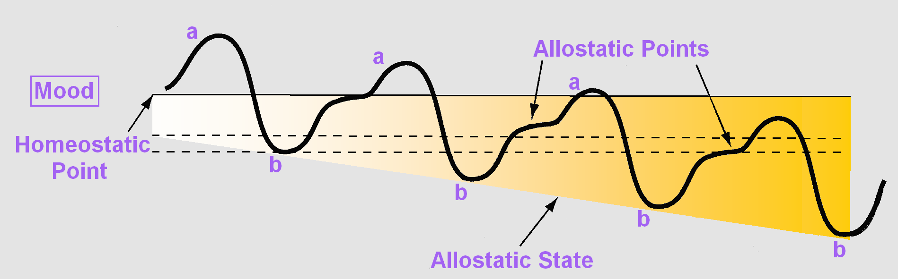
Model of adaptation in chronic drug use
Redrawn from Koob and Le Moal, Neuropsychopharm, 2001
Notes:
Koob and LeMoal have hypothesized that with chronic drug or alcohol use there is an adaptation in mood regulation. The mood set points (a and b) drift outside of the normal homeostatic range such that even the positive mood state set point (a) is close to the original negative (b) mood set point. They have labeled this an allostatic state. Adaptations in HPA axis neurobiology underlie this allostatic state. This allostatic state is likely the “aversive” state that promotes the negative reinforcing effects of drug and alcohol use. Sleep and wake changes seen in chronic drug and alcohol use most likely are associated with this adaptation. They may represent the “aversive” state, the reversal of which is negatively reinforcing.
Koob GF, Le Moal M. Drug addiction, dysregulation of reward, and allostasis, Neuropsychopharmacology, 24:97-129, 2001.
Slide by: Timothy Roehrs, PhD

Slide 47
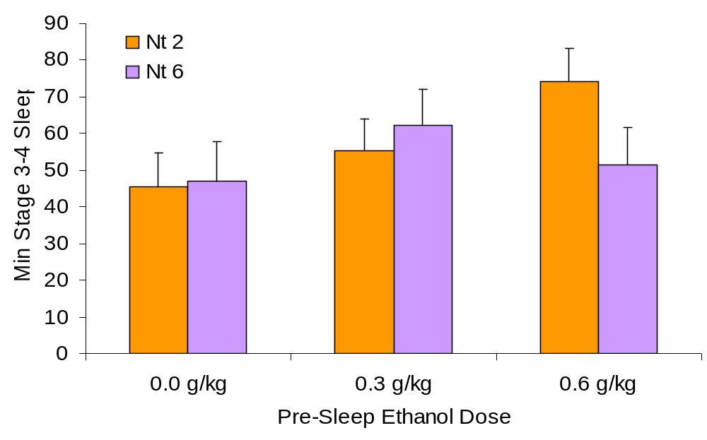
Tolerance to ethanol develops rapidly
Nt x Dose p<.04
Modified from Roehrs et al., Neuropsychopharmacology, 1999
Notes:
The minutes of stage 3-4 sleep are increased on night two with increasing doses of ethanol administered before sleep. However, by night six tolerance to the stage 3-4 sleep enhancement has developed with the high ethanol dose. This illustrates how an adaptation to the sleep effects of alcohol can lead to the need of increasing doses to achieve the stage 3-4 enhancement. It is consistent with the Koob and LeMoal model of allostatis.
Roehrs T, Papineau K, Rosenthal L, et al. Ethanol as a hypnotic in insomniacs: self administration and effects on sleep and mood, Neuropsychopharmacology, 20:279-86, 1999.
Slide by: Timothy Roehrs, PhD

Slide 48
These systems impact sleep/wake function
 | Sleep Continuity | SWS | REM Sleep | REM Latency
Anti-Histaminergic | ↑ | ↔ | ↔ | ↔
Anti-Cholinergic | ↔ | ↔ | ↓ | ↑
5HT1A Binding | ↓ | ↔ | ↓ | ↑
5HT2 Blockade | ↑ | ↑ | ↔ | ↔
5HT2 Binding | ↓ | ↓ | ↔ | ↔
Alpha-1 NE Blockade | ↑ | ↔ | ↑ | ↓
DA and NE Binding | ↓ | ↔ | ↓ | ↑
SWS; slow-wave sleep (stage 3 + stage 4), REM; rapid eye movement, ↑; increased, ↓; decreased, ↔; little or no effects
Espana, Sleep, 2004
Notes:
All of these neurotransmitter systems can have significant effects on sleep, sleep-wake dynamics, sleep stages, and on motor control during sleep. Antihistaminergic agents tend to lead to sedation which can increase the continuity and duration of sleep or lead to daytime sleepiness. Agents with anti-cholinergic effects can suppress REM sleep and shorten the latency to REM sleep. Agents which enhance 5HT1A activation can disrupt sleep and also suppress REM and shorten REM latency. 5HT2 agonists have sedating, sleep continuity enhancing effects and increase the amount of slow-wave sleep (SWS), while 5HT2 antagonists have the opposite effect. Alpha-1 adrenergic blockers may have sedating effects and suppress REM, while agents which are adrenergic and dopaminergic agonists can have stimulant-like effects including decreasing sleep continuity, while agents which enhance binding to NE receptors may suppress REM sleep and increase REM latency.
Espana RA, Scammell TE. Sleep neurobiology for the clinician. Sleep. 27(4):811-20, 2004.
Slide by: Andrew Krystal, MD, MS

Slide 49

Some Sleep issues to consider
Consider…..

Slide 50
Discontinuation effects
Disturbance of sleep may occur in the days following acute discontinuation of antidepressant and antipsychotic medications.
This can include not only insomnia but also alterations in dream-related function such as vivid dreams.
Notes:
Discontinuation of antidepressant and antipsychotic medications can be associated with a variety of effects. Insomnia commonly occurs in this setting. Among the antidepressants, this is best described with selective serotonin reuptake inhibitors. Alterations in REM sleep and dreams have also been reported. Such changes can also occur when initiating these medications and include vivid dreams and failure to inhibit motor activity during dreams resulting in individuals “acting out” their dreams.
Zajecka J, Tracy KA, Mitchell S. Discontinuation symptoms after treatment with serotonin reuptake inhibitors: a literature review. J Clin Psychiatry, 58(7):291-7, 1997.
Rosenbaum JF, Fava M, Hoog SL, Ascroft RC, Krebs WB. Selective serotonin reuptake inhibitor discontinuation syndrome: a randomized clinical trial. Biol Psychiatry, 15;44(2):77-87, 1998.
Dilsaver SC. Withdrawal phenomena associated with antidepressant and antipsychotic agents. Drug Saf. 1994 Feb;10(2):103-14.
Slide by: Andrew Krystal, MD, MS

Slide 51
Sleep and Medical Conditions
COPD –often associated with OSA “overlap syndrome” and is treated with nocturnal supplemental oxygen and medical management
Gastric reflux and disrupted sleep is a common condition-sometimes associated with asthma and is treated with behavioral and pharmacological interventions
Sleep and renal disease—common complaint of reduced, fragmented sleep, also a large number of cases have OSA-dialysis and pharmacologically treated
Cardiovascular disease and sleep—commonly associated with OSA. CPAP improves BP/oxygen level

Slide 52
Cognitive Impairment & Sleep
Difficulty sleeping, little circadian rhythm regulation with declining cognitive control
Sundowning in late afternoon, early evening
Mood changes –particularly the disregulation of bipolar disorder or neurochemical changes associated with depression deregulate sleep, low cognitive output or erratic

Slide 53
Clinical Impressions
Global survey on facebook findings: widespread use of alternative medicine and OTC as well as non-pharmacological approaches
BZ titrations have to be individualized and monitored carefully for compliance
6months -1 year typical regime

Slide 54
ksrsleep@aol.com
Thank you for your attention!
for further information, go to the National Sleep Foundation website at www.nationalsleepfoundation.org

Slide 55

Meet the eminent gathering once again at
Addiction Therapy 2016
Miami, USA
October 06-08, 2016
Addiction Therapy 2016
Website: addictiontherapy.conferenceseries.com

